Slide 1
Swing App: PCSpace at the upstart NCGC in 2006
Basic concepts
Screenshots
Use case

Slide 2
Purpose of PCSpace
Calculate and visualize descriptors for molecules to explore Chemistry Space
Manage and share molecular descriptors
A molecular descriptor value is a real number that describes how the molecular receptor is “perceiving” the molecule
A list of N molecular descriptor values will embed the molecule in N-dimemsional space (“chemspace”)

Slide 3
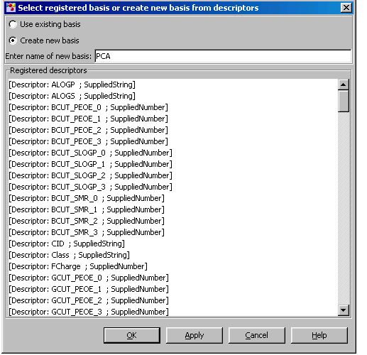
Field of descriptor research

Slide 4
PCSpace/NCGC
“business” entities
Molecule
Molecular descriptor
Assay (biological activity)
Libraries – millions of compounds
Datasources and pointsets
Assay plates
Users help define entity. JPA/XML

Slide 5
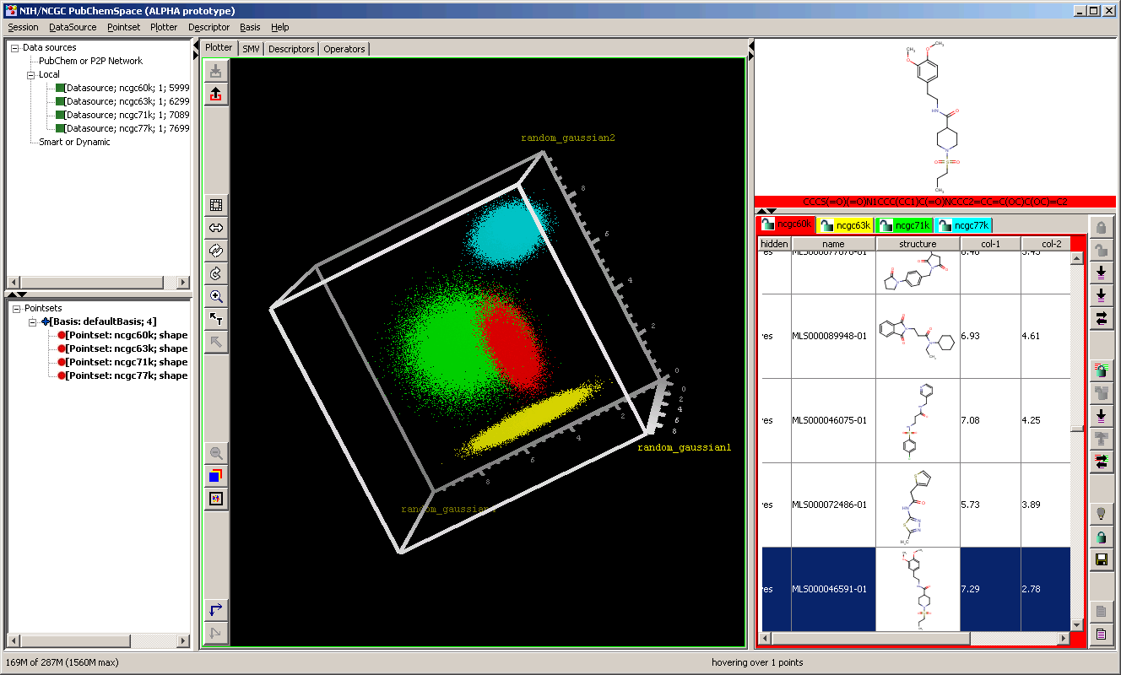

Slide 6
Data Source entity
A potentially very large table
Each row is a molecule
Each column is a molecular descriptor
As new molecules and descriptors are introduced, table grows

Slide 7
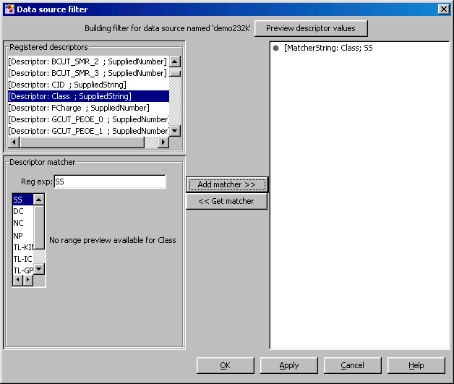

Slide 8
Pointset entity
Data source can get too large, must select a subset to view.

Slide 9
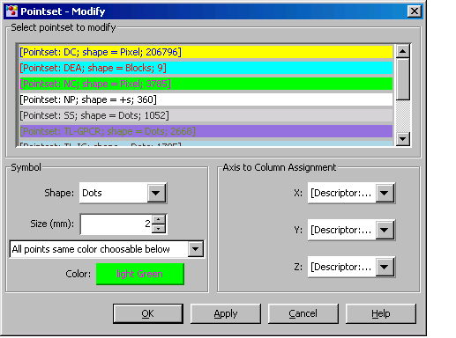

Slide 10
Basis entity
A collection of N distinct descriptors
Pointsets may be a member of a given basis

Slide 11
Working prototypes
JBoss entity server. (Serviced other apps.) Descriptor calculation.
Dimensionality reduction - Plot in 2D or 3D
User extensibility – descriptor calc “plugins”
User sharing – plugins, pointsets, datasources, screenshots,
PCSpace could be used in other fields, not just pharma drug discovery

Slide 12
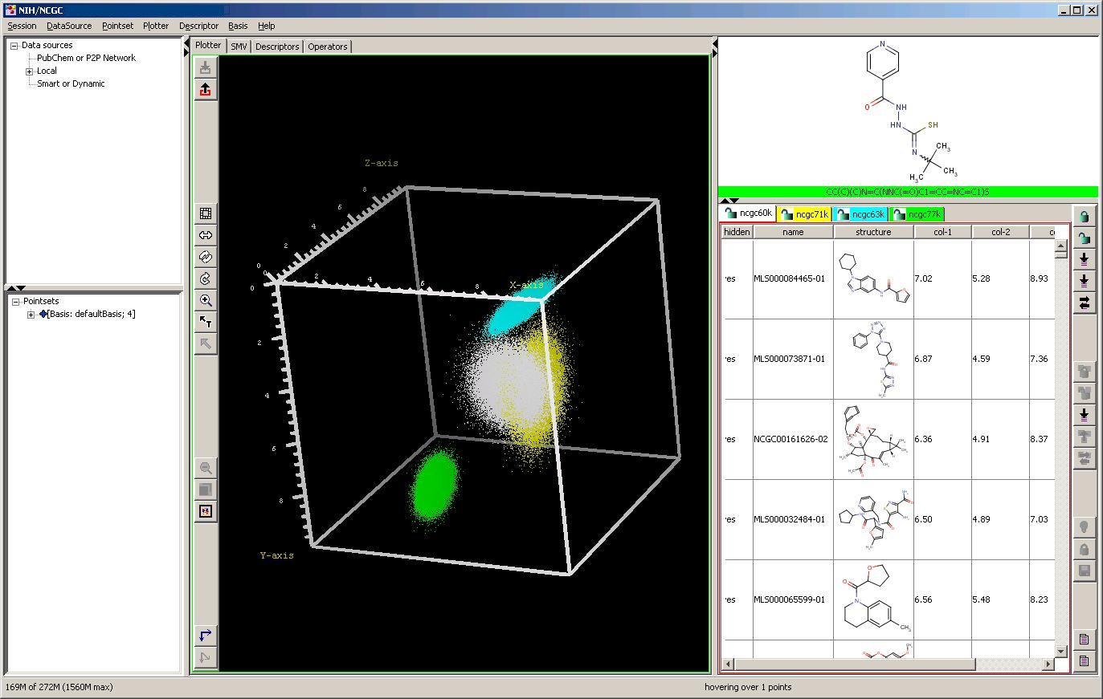

Slide 13
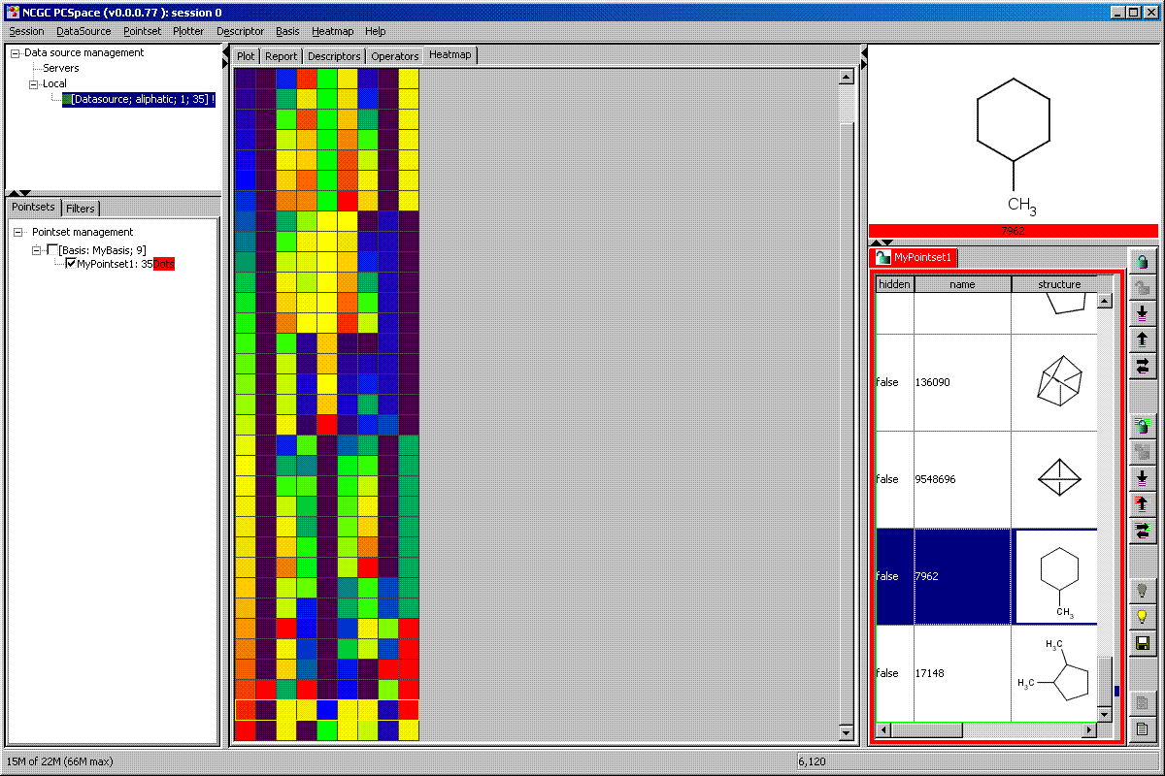

Slide 14
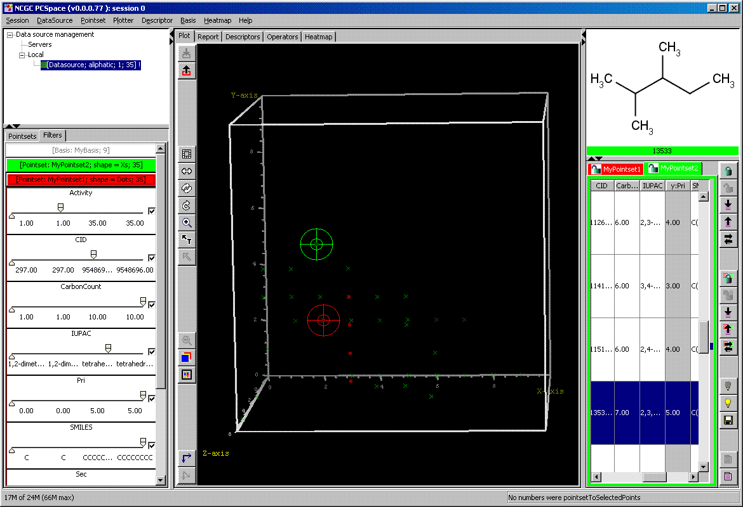

Slide 15
