Slide 1
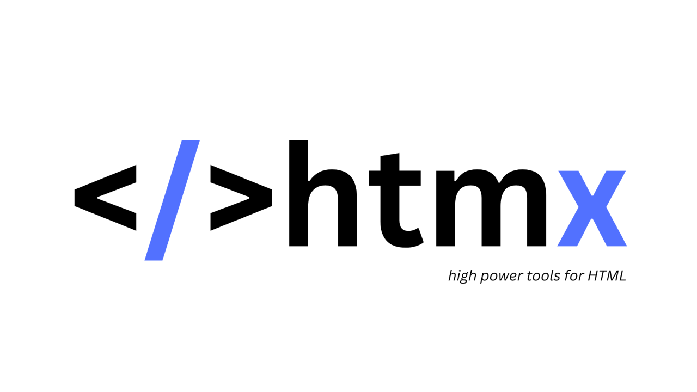
By Jacob Tanner and Mike Kadoshnikov

Slide 2

The man who started it all!

Slide 3
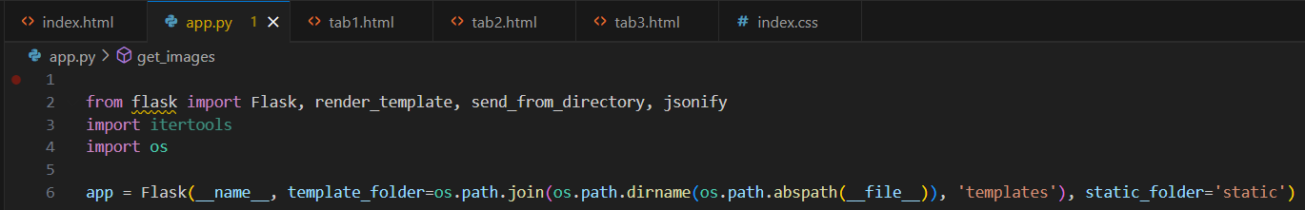
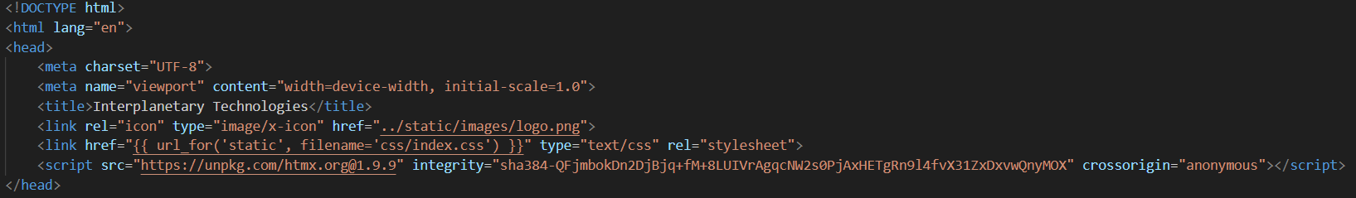
HTMX w/ Python
Our framework of choice is Flask Python Backend, with HTMX.
How do I use HTMX with Python? (to answer the question nobody asked)

Slide 4
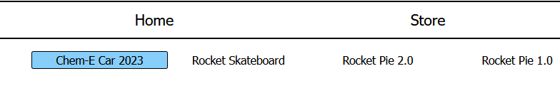
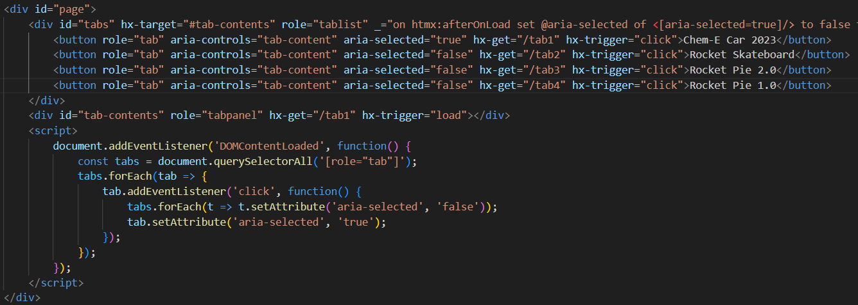
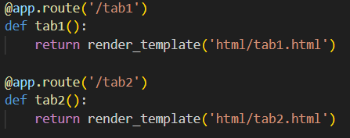
Tabs
Used to change page content without reloading webpage.
HTMX handles the get request
Flask loads content

Slide 5
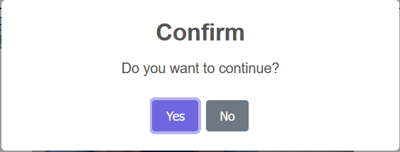
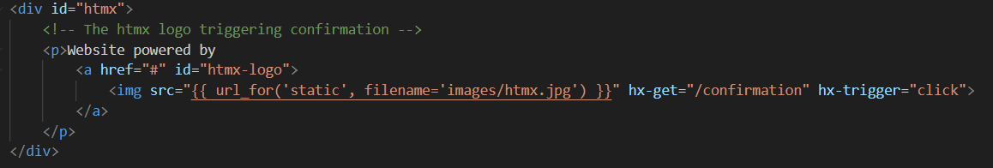
Confirmation
Uses the hx-trigger to trigger a JavaScript confirmation pop-up

Slide 6
What it do tho?

