Slide 1
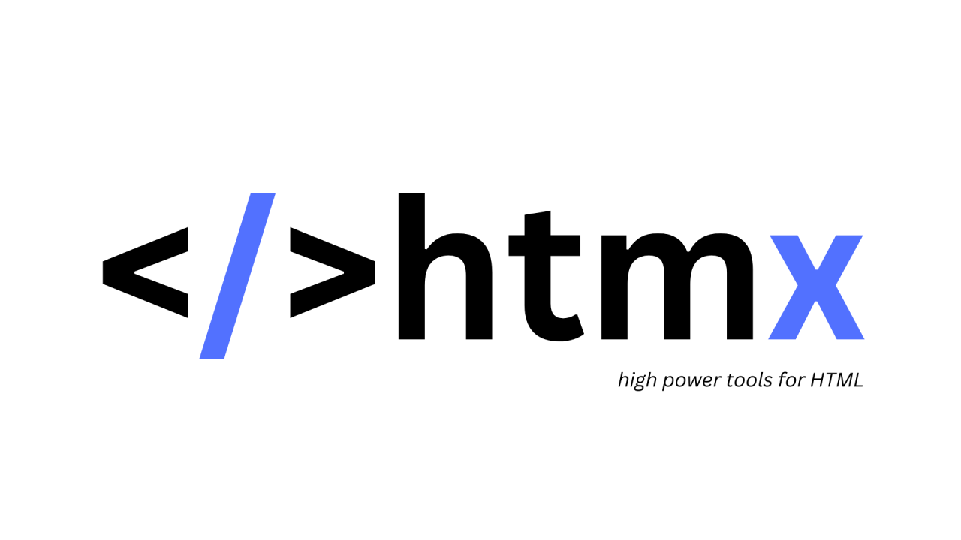
By Jacob Tanner and Mike Kadoshnikov

Slide 2

The man who started it all!

Slide 3
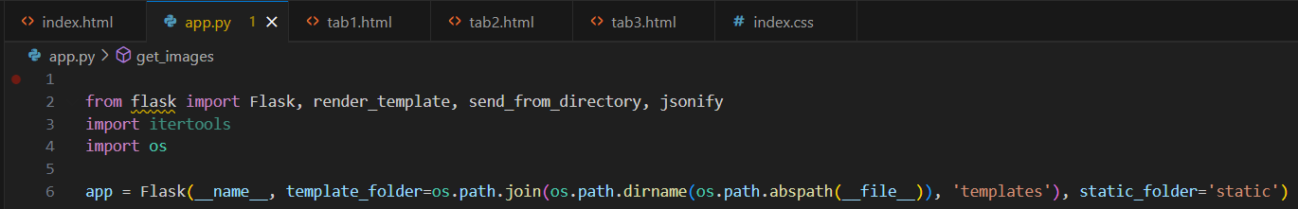
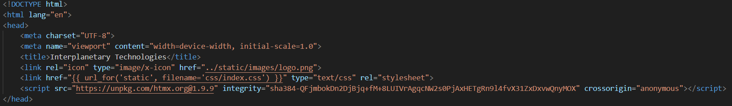
HTMX w/ Python
Our framework of choice is Flask Python Backend, with HTMX frontend.
How do I use HTMX with Python? (to answer the question nobody asked)

Slide 4
What it do tho?

