Slide 1

By Jacob Tanner and Mike Kadoshnikov

Slide 2

The man who started it all!

Slide 3

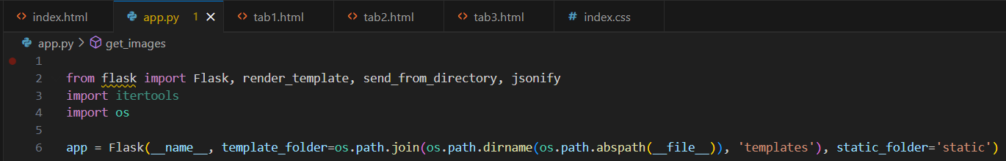
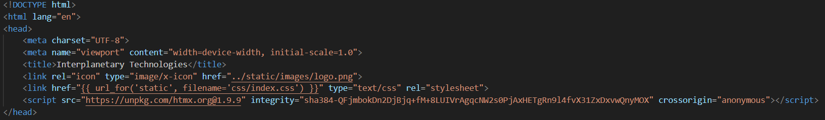
HTMX w/ Python
Our framework of choice is Flask Python Backend, with HTMX.
How do I use HTMX with Python?

Slide 4
Reusing prebuilt elements
One of the benefits of NodeJS was that you could build an element once and reuse it as many times as you needed
HTMX offers a way to do that, but with HyperMedia
You create an element in HTML and then use a div with hx-get to retrieve your element
Use hx-trigger=“load” to issue the GET request when the page loads
Use hx-swap=“outerHTML” to replace the existing div with the response
”?page=home” is how we specified what page should be active in top nav

Slide 5
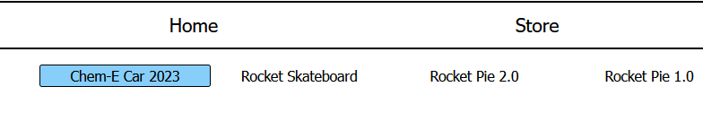
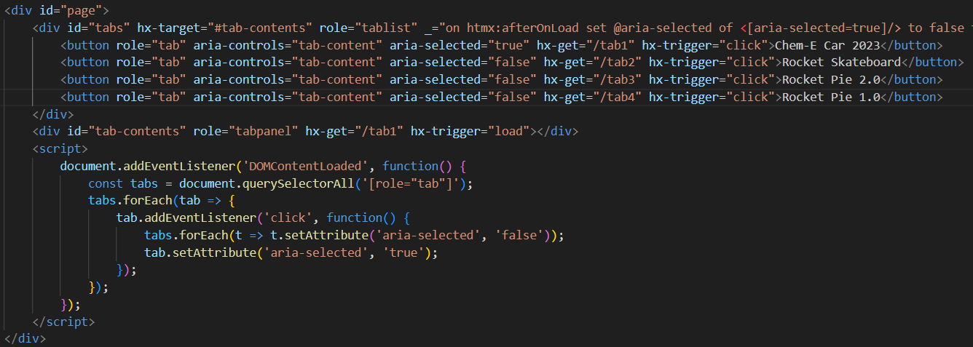
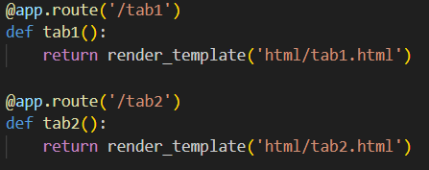
Tabs
Used to change page content without reloading webpage.
HTMX handles the get request
Flask loads content

Slide 6
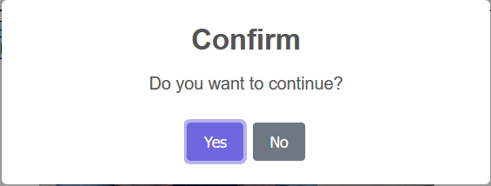
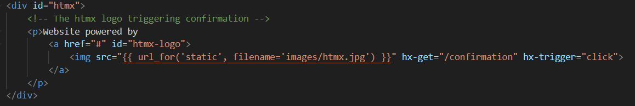
Confirmation
Uses the hx-trigger to trigger a JavaScript confirmation pop-up
The hx-get isn't in use but if we wanted the backend to perform an action after it was pressed we would create the get route in the app.py file.

Slide 7

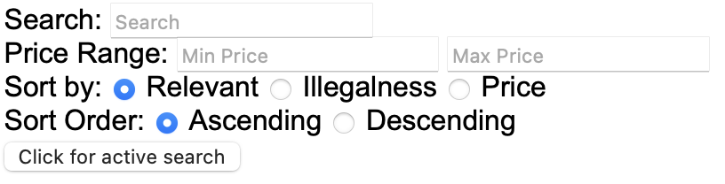
Search with HTMX
Search issues a GET request to the flask server with the search parameters
hx-target=“#results” specifies where to put the response
Our active search uses a simple <input> tag and returns the value in the input field
Our filtered search uses a <form> tag and the parameters to return are specified with hx-parms and pulled from input fields within the form

Slide 8
The Store Page (/store)
Uses same store template and URL for all pages
HTMX uses a GET request to retrieve a sub-page that is specified by our flask server
That sub-page depends on if there is a product id in the URL and if that id is valid
The sub-pages available: Active search, filtered search, product page, product not found page
Active search has a button that retrieves and replaces itself with filtered search and vice versa

Slide 9
Demo

