Slide 1
New Part Design
By: Mike Kadoshnikov & Jacob Tanner

Slide 2
Old Design
Insert Old Picture Here The old design of the hand is rather simplistic and doesn’t allow for much usable tasks or hand gestures. Ultimately, we see that the old design limits the robot's functionality and doesn’t offer the interaction capabilities that would prove helpful when the robots design is focused on Human Interactions.

Slide 3
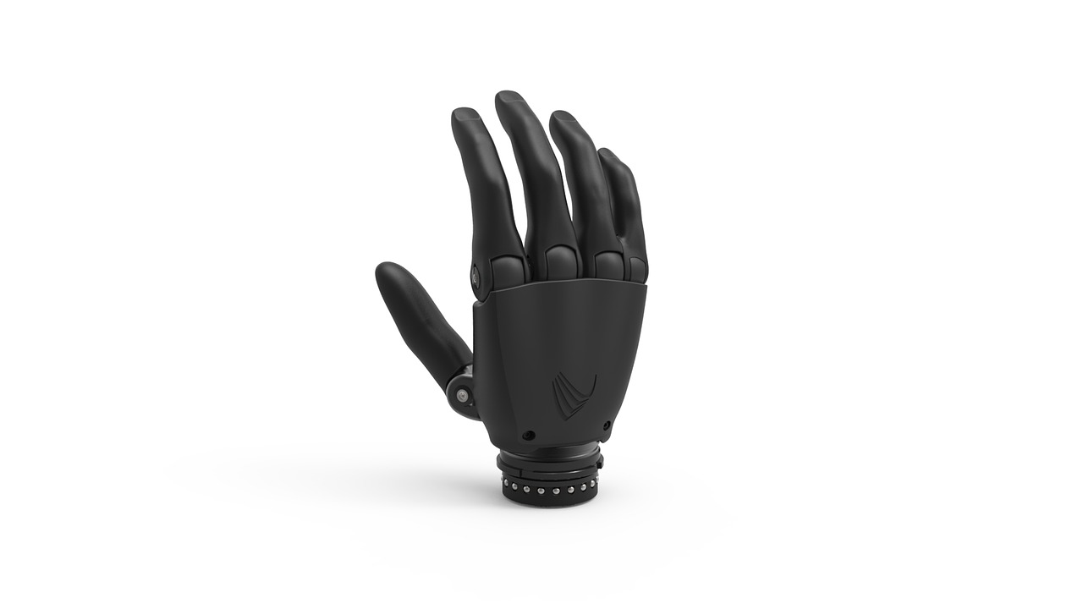
New Design
We want to design the hands to be able to do more than just grasp an object, the robot should be able to interact with the object.
The new hand design will be reminiscent of a human hand, having fingers that will be able to grasp an object and with individual fingers for different movements.

Slide 4
Benefits of the new design
Since the new design has more appendages that can be controlled, we will be able to implement more hand gestures that may help with communication. For example, we might be able to program sign language as an alternative for impaired peoples.
Also, the design allows for better control of objects and potential for a better interaction with people.

Slide 5
Hand Gestures
Not only will hand gestures help with communication with people, we will be able to also add offensive gestures when we start the robot uprising, with a full hand of fingers to choose from we know everyone's favorite one to wave, and our robots should now be able to do it too!
Since we have all fingers, we will be able to point out the spies within our ranks without the threat of misidentifying them.

Slide 6
Object Control
Since the hand will be able to do more with more appendages, we will now be able to equip our robots with trendy new items, such as:
Tools: wrenches, hammers, pliers, etc.
Utensils: Forks, spoons, knives, etc.
Electronics
Weapons
Art Supplies
Additionally, robots can perform more tasks with these new hands such as:
painting
making repairs
breaking and entering
enslaving humanity

