Slide 1
Welcome!
Before we start, make sure you’ve…
1. downloaded the Session 4 files from github: https://github.com/jtannen/r-for-datascience/session-4-gis
- including the shapefiles in data/
2. install these packages:
install.packages(
c(“sf”, “ggmap”, “ggthemes”, “tidycensus”, “tigris”) )
3. Registered a Census API key at
http://api.census.gov/data/key_signup.html

Slide 2
R for Data Science IV: GIS
Jonathan Tannen

Slide 3
Workshop Schedule
Intro to R dataframes
Visualizations with ggplot
Data Wrangling with the Tidyverse
GIS with sf
Software Engineering for Researchers
Regression

Slide 4
Analyses with GIS
Aggregate data to a spatial unit
Create distance-based variables
Maps

Slide 5
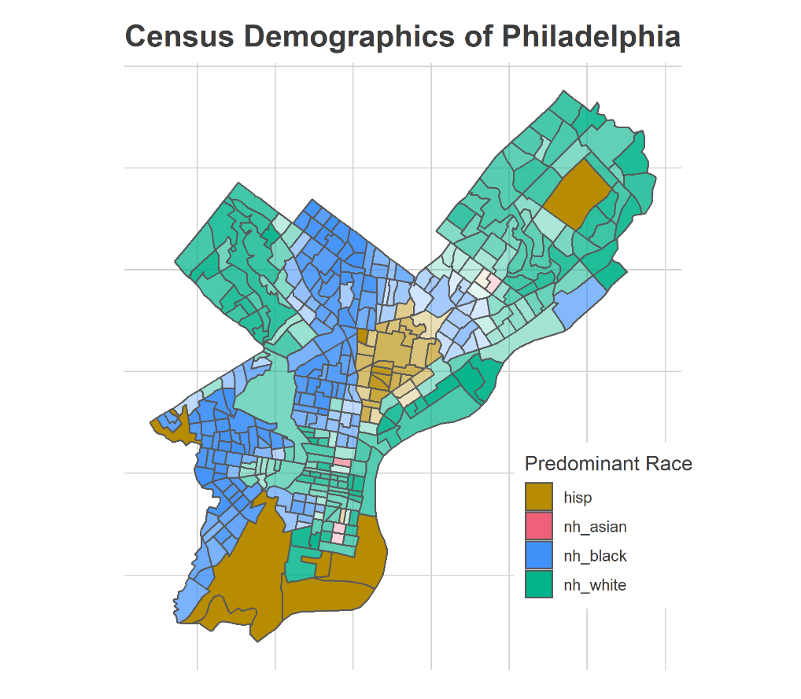
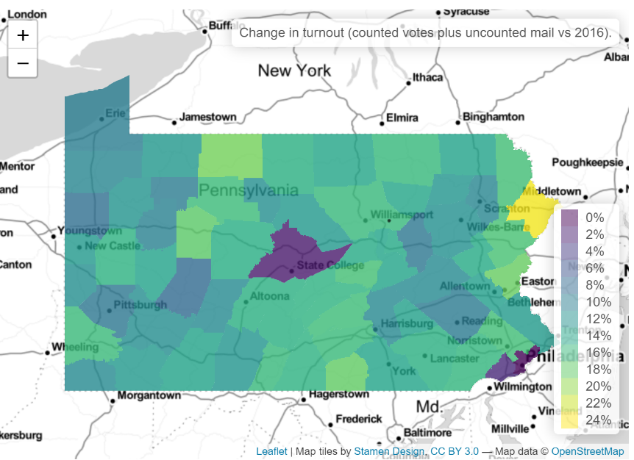
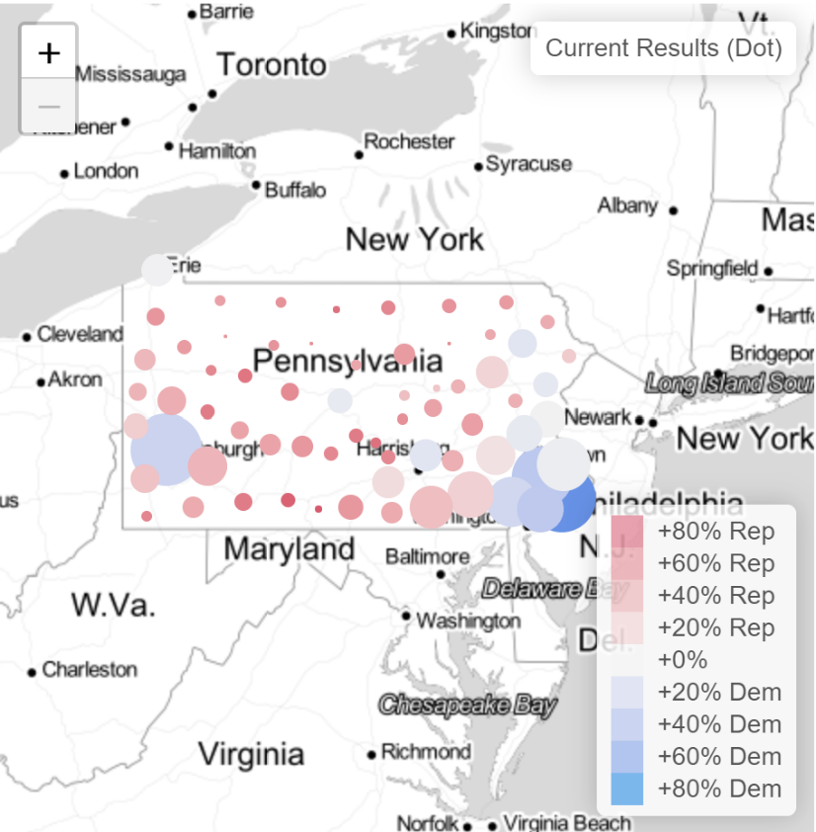
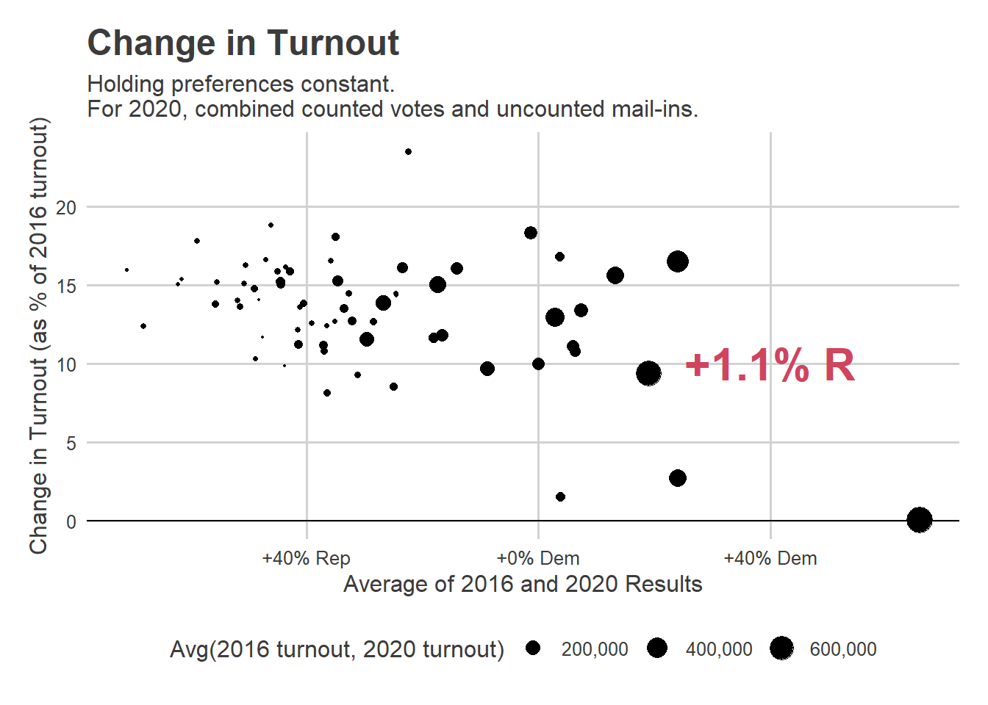
Aggregate to spatial units

Slide 6
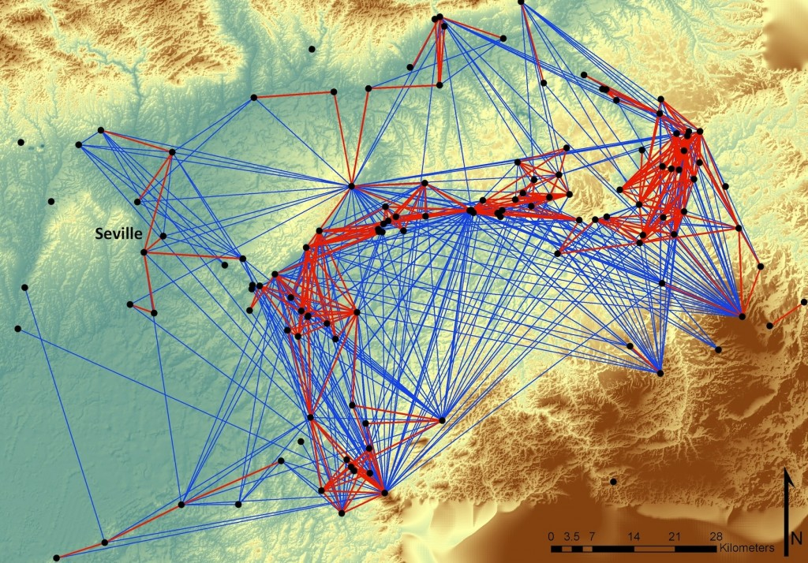
Distance-based variables
“Distance to nearest park”
“Number of supermarkets within a radius”
Proximity among points.

Slide 7
Maps

Slide 8
Common GIS tasks
- geocoding ggmap::geocode()
- assign points to polygons sf::st_within()
- distance between points sf::st_distance()

Slide 9
Projections

Slide 10
Let’s do it

Slide 11
Projections
For world/country plots defaults are usually ok.
For states, it’s *important* to choose a projection centered at your state.
In practice: Google “epsg” + state. Copy the number.
Use st_transform(x, crs = 1234)

