Slide 1
Welcome!

Slide 2
R for Data Science V: Software Engineering for Researchers
Jonathan Tannen

Slide 3
Workshop Schedule
Intro to R dataframes
Visualizations with ggplot
Data Wrangling with the Tidyverse
GIS with sf
Software Engineering for Researchers
Regression

Slide 4
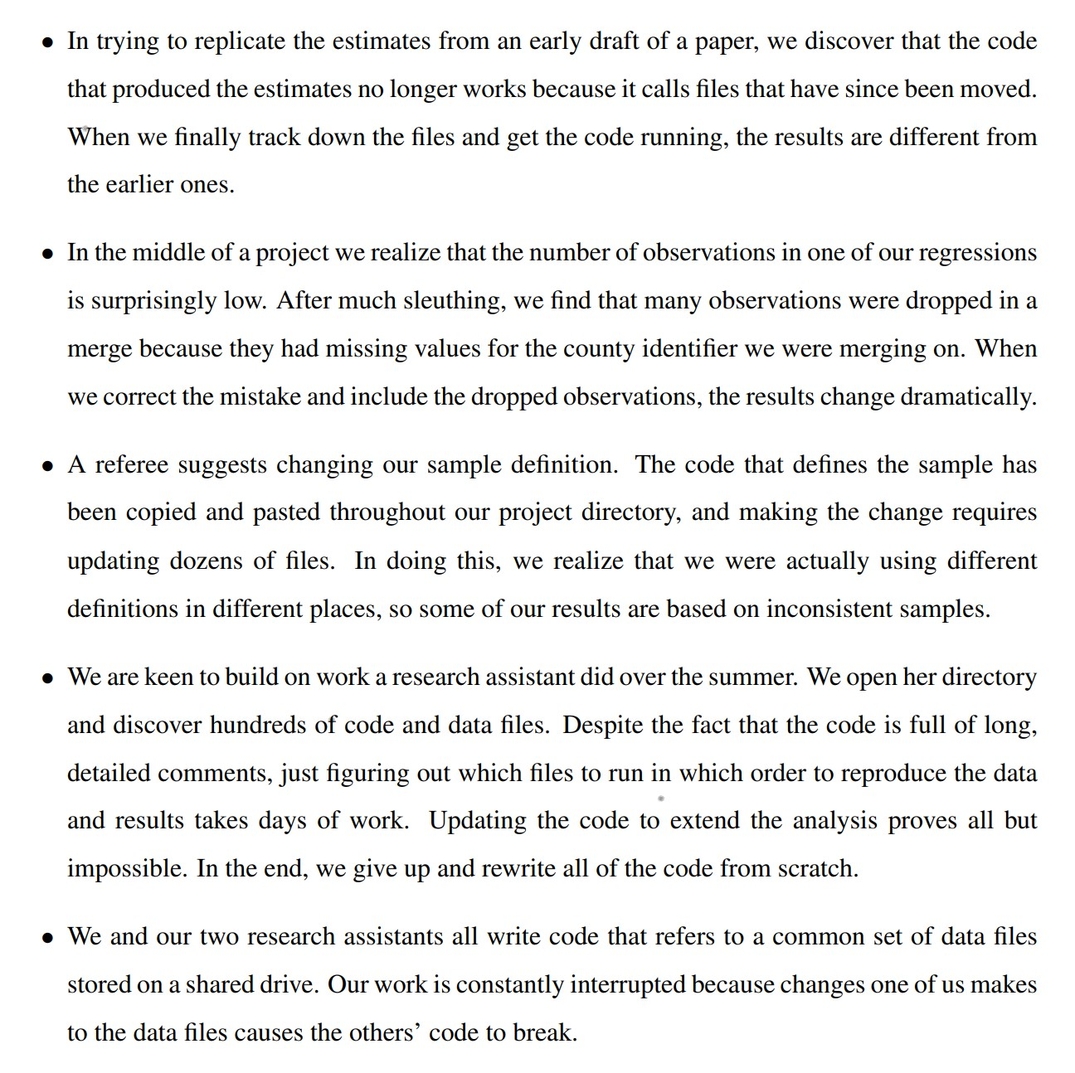
What can go wrong?
From Gentzkow & Shapiro (2014)

Slide 5
What is Better Engineering?
Code is for humans.
“Bus Factor”, or the “Lottery Factor”
Right now, you probably have projects which would be impossible for another person, or even future-you, to pick up and adapt.
Good engineering practices that let you…
move faster
with fewer errors
They aren’t hard! You will build the muscle, and it will come naturally.

Slide 6
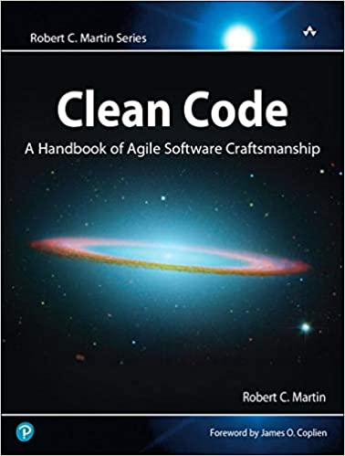
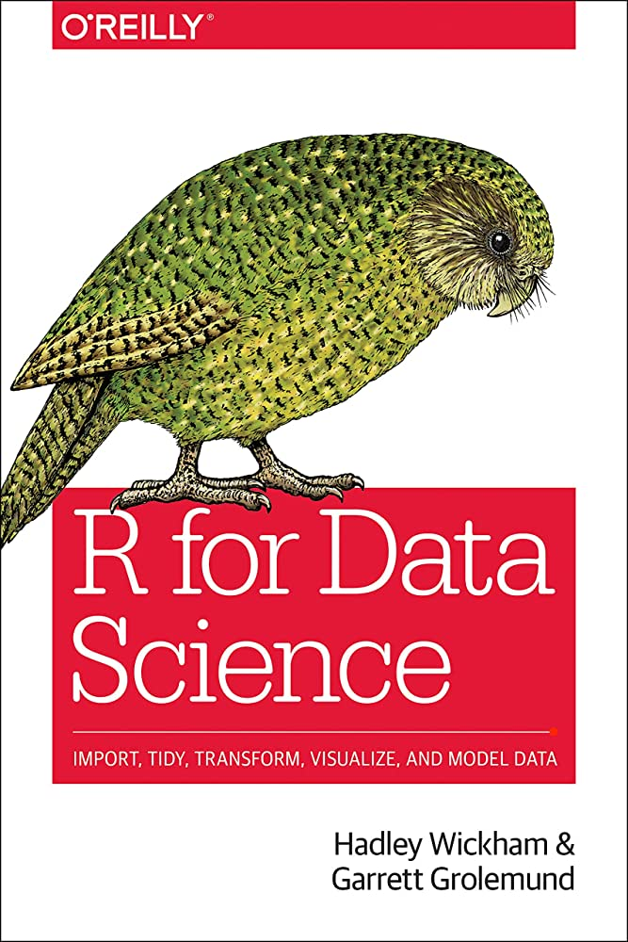
Inspired by

Slide 7
Today: Three Topics
Don’t Repeat Yourself
Modularity
Confident Automation
This is all aspirational. I don’t do all of this for all projects. But building these muscles will 10x your code.

Slide 8
Theme 1: “Don’t Repeat Yourself”
You may copy and paste code once. That’s it.

Slide 9
Copy-pasted logic
df <- data.frame(
a = rnorm(10),
b = rnorm(10),
c = rnorm(10),
d = rnorm(10)
)
df$a <- (df$a - min(df$a, na.rm = TRUE)) /
(max(df$a, na.rm = TRUE) - min(df$a, na.rm = TRUE))
df$b <- (df$b - min(df$b, na.rm = TRUE)) /
(max(df$b, na.rm = TRUE) - min(df$a, na.rm = TRUE))
df$c <- (df$c - min(df$c, na.rm = TRUE)) /
(max(df$c, na.rm = TRUE) - min(df$c, na.rm = TRUE))
df$d <- (df$d - min(df$d, na.rm = TRUE)) /
(max(df$d, na.rm = TRUE) - min(df$d, na.rm = TRUE))

Slide 10
Step 1: Create a function
df <- data.frame(
a = rnorm(10),
b = rnorm(10),
c = rnorm(10),
d = rnorm(10)
)
my_rescale <- function(x) {
rng <- range(x, na.rm = TRUE)
return(
(x - rng[1]) / (rng[2] - rng[1])
)
}
df$a <- my_rescale(df$a)
df$b <- my_rescale(df$b)
df$c <- my_rescale(df$c)
df$d <- my_rescale(df$d)

Slide 11
Step 2: Use loops or another map
df <- data.frame(
a = rnorm(10),
b = rnorm(10),
c = rnorm(10),
d = rnorm(10)
)
my_rescale <- function(x) {
rng <- range(x, na.rm = TRUE)
return(
(x - rng[1]) / (rng[2] - rng[1])
)
}
df |> mutate(across(a:d, my_rescale))

Slide 12
DRY: Functions
What was achieved?
Fewer mistakes.
Easier to understand.
Naming things helps readability.
Clear SLA (Service Level Agreement)
“Encapsulation”, i.e. easy to replace with a new method.
*Testable*.

Slide 13
Functions in R
scale_to_range <- function(x, upper, lower=0, bounds_error=TRUE){
res <- (x – lower) / (upper-lower)
if(bounds_error){
if(res > 1| res < 0){
stop(“Bad values!”)
}
}
return(res)
}

Slide 14
Data reused in multiple places
df <- read.csv(
"C:/Users/Jonathan/papers/data/data_2000.csv"
)
election_metadata <- read.csv(
"C:/Users/Jonathan/papers/data/elections.csv"
)
candidates <- read.csv(
"C:/Users/Jonathan/papers/data/candidates.csv"
)
df$is_last_four_elections <- (
ymd("2022-11-08") - ymd(df$date)
) <= years(4)
df$age <- (ymd("2022-11-08") - ymd(df$birth_date))

Slide 15
Data reused in multiple places
# could also setwd().
DATA_DIR <- "C:/Users/Jonathan/papers/data/"
ELECTION_DATE <- "2022-11-08"
df <- read.csv(paste0(DATA_DIR, "data_2000.csv"))
election_metadata <- read.csv(
paste0(DATA_DIR, "elections.csv")
)
candidates <- read.csv(paste0(DATA_DIR, "candidates.csv"))
df$is_last_four_elections <- (
ymd(ELECTION_DATE) - ymd(df$date)
) <= years(4)
df$age <- (ymd(ELECTION_DATE) - ymd(df$date))

Slide 16
Don’t write any information twice
What counts as “information”?
Directories
Solution: setwd()
Reused strings, dates, values
Solution: STRING_CONSTANT
Analytic choices (regression specification, cleaning choice)
Solution: functions

Slide 17
Theme 2: Modularity
Separate your program into independent, interchangeable modules. Later steps depend only on the (minimal) outputs of the prior steps.

Slide 18
My original workflow
Download raw data
Clean it by hand
Gigantic script that reshaped the data, ran analysis, generated plots.
I did some cleaning here, too!
Hard-coded assumptions hidden everywhere including settings, file locations, dates.
This would often break. Only way to check was post-hoc, or error debugging.
Write report by hand. Copy numbers from printed output.

Slide 19
A few simple rules for modular code
Large steps go in separate scripts. Write outputs to files.
clean_data.R, fit_models.R, report.R
Your scripts should mostly define functions.
It only does work at the end, if at all.

Slide 20
Rules for modular data cleaning
Store the raw data. Never modify this file.
Clean the data using code. Never touch by hand.
Write outputs to processed_data/
Everything downstream simply assumes this data exists.
Write test script that produces summary outputs, tests, and plots.

Slide 21
Theme 3: Confident Automation
Don’t do anything by hand.
Data cleaning
Moving files
Making maps
Why?

Slide 22
How to avoid mistakes?
Automate your diagnostics.
Print summary stats
Create plots
Use tests
I like r library `testthat`

Slide 23
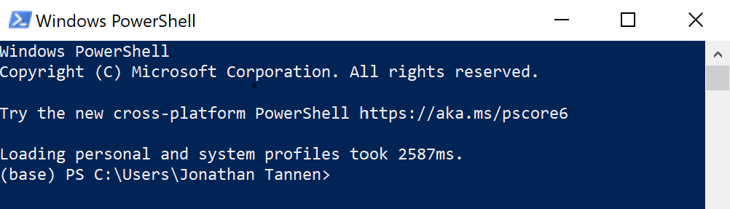
What to use for automation?
R can do almost everything
Move files
Call other software
For everything else, there’s shell

Slide 24
Example of project management
Let’s demo usethis and testthat.

Slide 25
Common shell commands
Change Directory: cd
List files: ls
Copy files: cp
Move files: mv
Delete files: rm
Run an R script: rscript

Slide 26
Basics of a shell command
command arg [--options]

