Slide 1
Welcome!
Before we start, make sure you’ve downloaded the Session 3 files from github:
https://github.com/jtannen/r-for-datascience
And install two packages:
install.packages(“dplyr”)
install.packages(“tidyr”)
(We are using the same CSVs as last time.)

Slide 2
R for Data Science III: Data Wrangling
Jonathan Tannen

Slide 3
Workshop Schedule
Intro to R dataframes
Visualizations with ggplot
Data Wrangling with the Tidyverse
GIS with sf
Software Engineering for Researchers
Regression

Slide 4
“Data Wrangling”
99% of the data tasks you ever need to do are:
subset your data (dplyr)
create new variables (dplyr)
summarise data (dplyr)
join datasets (dplyr)
“reshape” your data (tidyr)
visualize your data (ggplot2)

Slide 5
Let’s do it

Slide 6
dplyr vs. base R
Choosing a subset of rows:
mydf[mydf$age > 20, ]
filter(mydf, age > 20)

Slide 7
dplyr vs. base R
Choosing a subset of columns:
mydf[ , c(“first_name”, “last_name”, “age”)]
select(mydf, first_name, last_name, age)
select(mydf, first_name:age)

Slide 8
dplyr vs. base R
Adding a column:
mydf$full_name <- paste(
mydf$first_name,
mydf$last_name
)
mydf <- mutate(
mydf,
fullname = paste(first_name, last_name)
)

Slide 9
dplyr vs. base R
Create a summary dataframe:
aggregate(
mydf,
IND= c(mydf$state, mydf$year),
FUN = …
)
grouped_df <- group_by(mydf, state, year)
summarise(
grouped_df,
median_income = median(income)
)

Slide 10
dplyr
filter(mydf, age > 20)
select(mydf, first_name, last_name, age)
select(mydf, first_name:age)
mutate(
mydf,
fullname = paste(first_name, last_name)
)
grouped_df <- group_by(mydf, state, year)
summarise(
grouped_df,
median_income = median(income)
)

Slide 11
Piping |>

Slide 12
Piping |>
Let’s calculate the median wage, by year and state, among people over 25.
First, filter, then add a column, then group_by, then summarise.
summarise(
group_by(
mutate(
filter(mydf, age >= 25),
income = wage * hours_worked
),
state, year
),
median_income = median(income)
)

Slide 13
Piping |>
Let’s calculate the median wage, by year and state, among people over 25.
First, filter, then add a column, then group_by, then summarise.
summarise(
group_by(
mutate(
filter(mydf, age >= 25),
income = wage * hours_worked
),
state, year
),
median_income = median(income)
)

Slide 14
Piping |>
Let’s calculate the median wage, by year and state, among people over 25.
First, filter, then add a column, then group_by, then summarise.
summarise(
group_by(
mutate(
filter(mydf, age >= 25),
wage = income / hours_worked
),
state, year
),
median_income = median(income)
)

Slide 15
Piping |>
Let’s calculate the median wage, by year and state, among people over 25.
First, filter, then add a column, then group_by, then summarise.
summarise(
group_by(
mutate(
filter(mydf, age >= 25),
wage = income / hours_worked
),
state, year
),
median_income = median(income)
)

Slide 16
Piping |>
Let’s calculate the median wage, by year and state, among people over 25.
First, filter, then add a column, then group_by, then summarise.
summarise(
group_by(
mutate(
filter(mydf, age >= 25),
wage = income / hours_worked
),
state, year
),
median_wage = median(wage)
)

Slide 17
Piping |>
function(mydf, arg1 = a, arg2 = b)
mydf |> funtion(arg1 = a, arg2 = b)
mydf |>
filter(age >= 25) |>
mutate(wage = income / hours_worked) |>
group_by(state, year) |>
summarise(median_wage = median(wage))

Slide 18
Piping |>
function(mydf, arg1 = a, arg2 = b)
mydf |> funtion(arg1 = a, arg2 = b)
mydf |>
filter(age >= 25) |>
mutate(wage = income / hours_worked) |>
group_by(state, year) |>
summarise(median_wage = median(wage))

Slide 19
Piping |>
summarise(
group_by(
mutate(
filter(mydf, age >= 25),
wage = income / hours_worked
),
state, year
),
median_wage = median(wage)
) mydf |>
filter(age >= 25) |>
mutate(wage = income / hours_worked) |>
group_by(state, year) |>
summarise(median_wage = median(wage))

Slide 20
“Data Wrangling”
99% of the data tasks you ever need to do are:
subset your data (dplyr)
create new variables (dplyr)
create summaries (dplyr)
merge datasets (dplyr)
“reshape” your data (tidyr)
visualize your data (ggplot2)

Slide 21
Merging Datasets
Sales
id | nbhd | price | sq.ft. | saledate
1523 | Fairmount | 5234 | 12465 | 11/01/15
3463 | Fishtown | 2345 | 34523 | 04/12/05
5477 | Fox Chase | 2346 | 62345 | 02/05/10
4563 | Overbrook | 7546 | 35674 | 12/23/06
3486 | Fishtown | 4563 | 3452 | 01/02/11
Neighborhoods
nbhd | Pop | Pop Dens | Dist to CBD
Cedar Park | 5234 | 12465 | 4.5
Fairmount | 2345 | 34523 | 2.6
Fishtown | 2346 | 62345 | 1.8
Fox Chase | 7546 | 35674 | 6.8
Girard Estate | 4563 | 3452 | 4.3

Slide 22
Merging Datasets
id | nbhd | price | sq.ft. | saledate
1523 | Fairmount | 5234 | 12465 | 11/01/15
3463 | Fishtown | 2345 | 34523 | 04/12/05
5477 | Fox Chase | 2346 | 62345 | 02/05/10
4563 | Overbrook | 7546 | 35674 | 12/23/06
3486 | Fishtown | 4563 | 3452 | 01/02/11
nbhd | Pop | Pop Dens | Dist to CBD
Cedar Park | 5234 | 12465 | 4.5
Fairmount | 2345 | 34523 | 2.6
Fishtown | 2346 | 62345 | 1.8
Fox Chase | 7546 | 35674 | 6.8
Girard Estate | 4563 | 3452 | 4.3
In general, will replicate rows as many times as matches dictate.
inner_join(x,y): only keep matches
left_join(x,y): keep all rows in x (rows without a match will get NA values)
right_join(x,y): keep all rows in y
full_join(x,y): keep all rows in both
left_join(df1, df2, by = ‘nbhd’)
left_join(df1, df2, by = c(‘neighborhood’ = ‘nbhd’))

Slide 23
“tidy” Datasets
long
wide
nbhd | year | phi
Fairmount | 2001 | 124
Fairmount | 2002 | 135
Fairmount | 2003 | 146
Overbrook | 2001 | 103
Overbrook | 2002 | 114
Overbrook | 2003 | 123
nbhd | 2001 | 2002 | 2003
Fairmount | 124 | 135 | 146
Overbrook | 103 | 114 | 123

Slide 24
“tidy” Datasets
long
wide
nbhd | year | phi
Fairmount | 2001 | 124
Fairmount | 2002 | 135
Fairmount | 2003 | 146
Overbrook | 2001 | 103
Overbrook | 2002 | 114
Overbrook | 2003 | 123
nbhd | 2001 | 2002 | 2003
Fairmount | 124 | 135 | 146
Overbrook | 103 | 114 | 123
pivot_wider(
df,
names_from= year,
values_from = phi
)

Slide 25
“tidy” Datasets
long
wide
nbhd | year | phi
Fairmount | 2001 | 124
Fairmount | 2002 | 135
Fairmount | 2003 | 146
Overbrook | 2001 | 103
Overbrook | 2002 | 114
Overbrook | 2003 | 123
nbhd | 2001 | 2002 | 2003
Fairmount | 124 | 135 | 146
Overbrook | 103 | 114 | 123
pivot_wider(
df,
names_from= year,
values_from = phi
)

Slide 26
“tidy” Datasets
long
wide
nbhd | year | phi
Fairmount | 2001 | 124
Fairmount | 2002 | 135
Fairmount | 2003 | 146
Overbrook | 2001 | 103
Overbrook | 2002 | 114
Overbrook | 2003 | 123
nbhd | y2001 | y2002 | y2003
Fairmount | 124 | 135 | 146
Overbrook | 103 | 114 | 123
pivot_longer(
wide_df,
y2001:y2003,
names_to = “year”,
values_to = “phi”
)

Slide 27
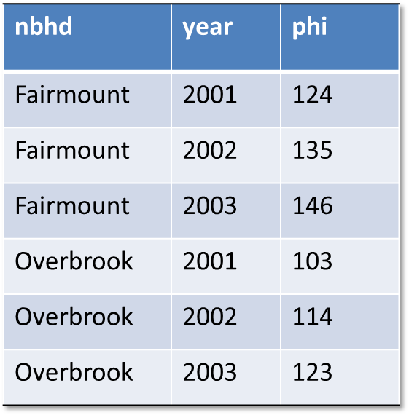


Long vs. Wide
Long
Good for analysis with group_by, ggplot
Hard to read. Bad for cross-year comparison.

Slide 28
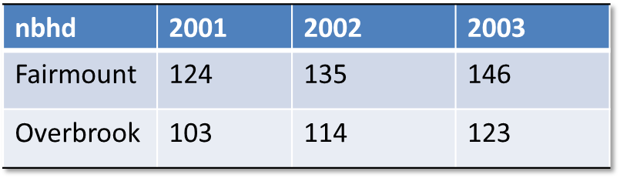
Long vs. Wide
Long
Good for analysis with group_by, ggplot
Hard to read. Bad for cross-year comparison.
candidate.y,
Wide
Easy to read, good for across row comparison.
Terrible to do batch analysis (consider trying to find the mean phi for each year, or the mean phi for a nbhd).

Slide 29
Let’s do it

