Slide 1
Welcome!
Before we start, make sure you:
- have R and RStudio installed.
- have downloaded from github three files:
https://github.com/jtannen/r-for-datascience/tree/main/session-1
workshop_1.R
workshop_1_pairprogramming.R
acs_phila_2015_5yr.csv
- Download “Properties (CSV)” from
https://www.opendataphilly.org/dataset/opa-property-assessments

Slide 2
R for Data Science Workshop 1: Intro to R
Jonathan Tannen
Presented February 2023

Slide 3

About me
Taught high school for a bit
Ph.D. in Urban Demography
Self-taught programmer (in R!)
Eventually became an Engineering Manager in Responsible AI
Now a Senior Data Scientist working on elections
Also blog at sixtysixwards.com

Slide 4
What is R?
Software for statistical analysis.
Fully functional programming language
Open Source (free)
Community of true believeRs
Evolving set of packages

Slide 5
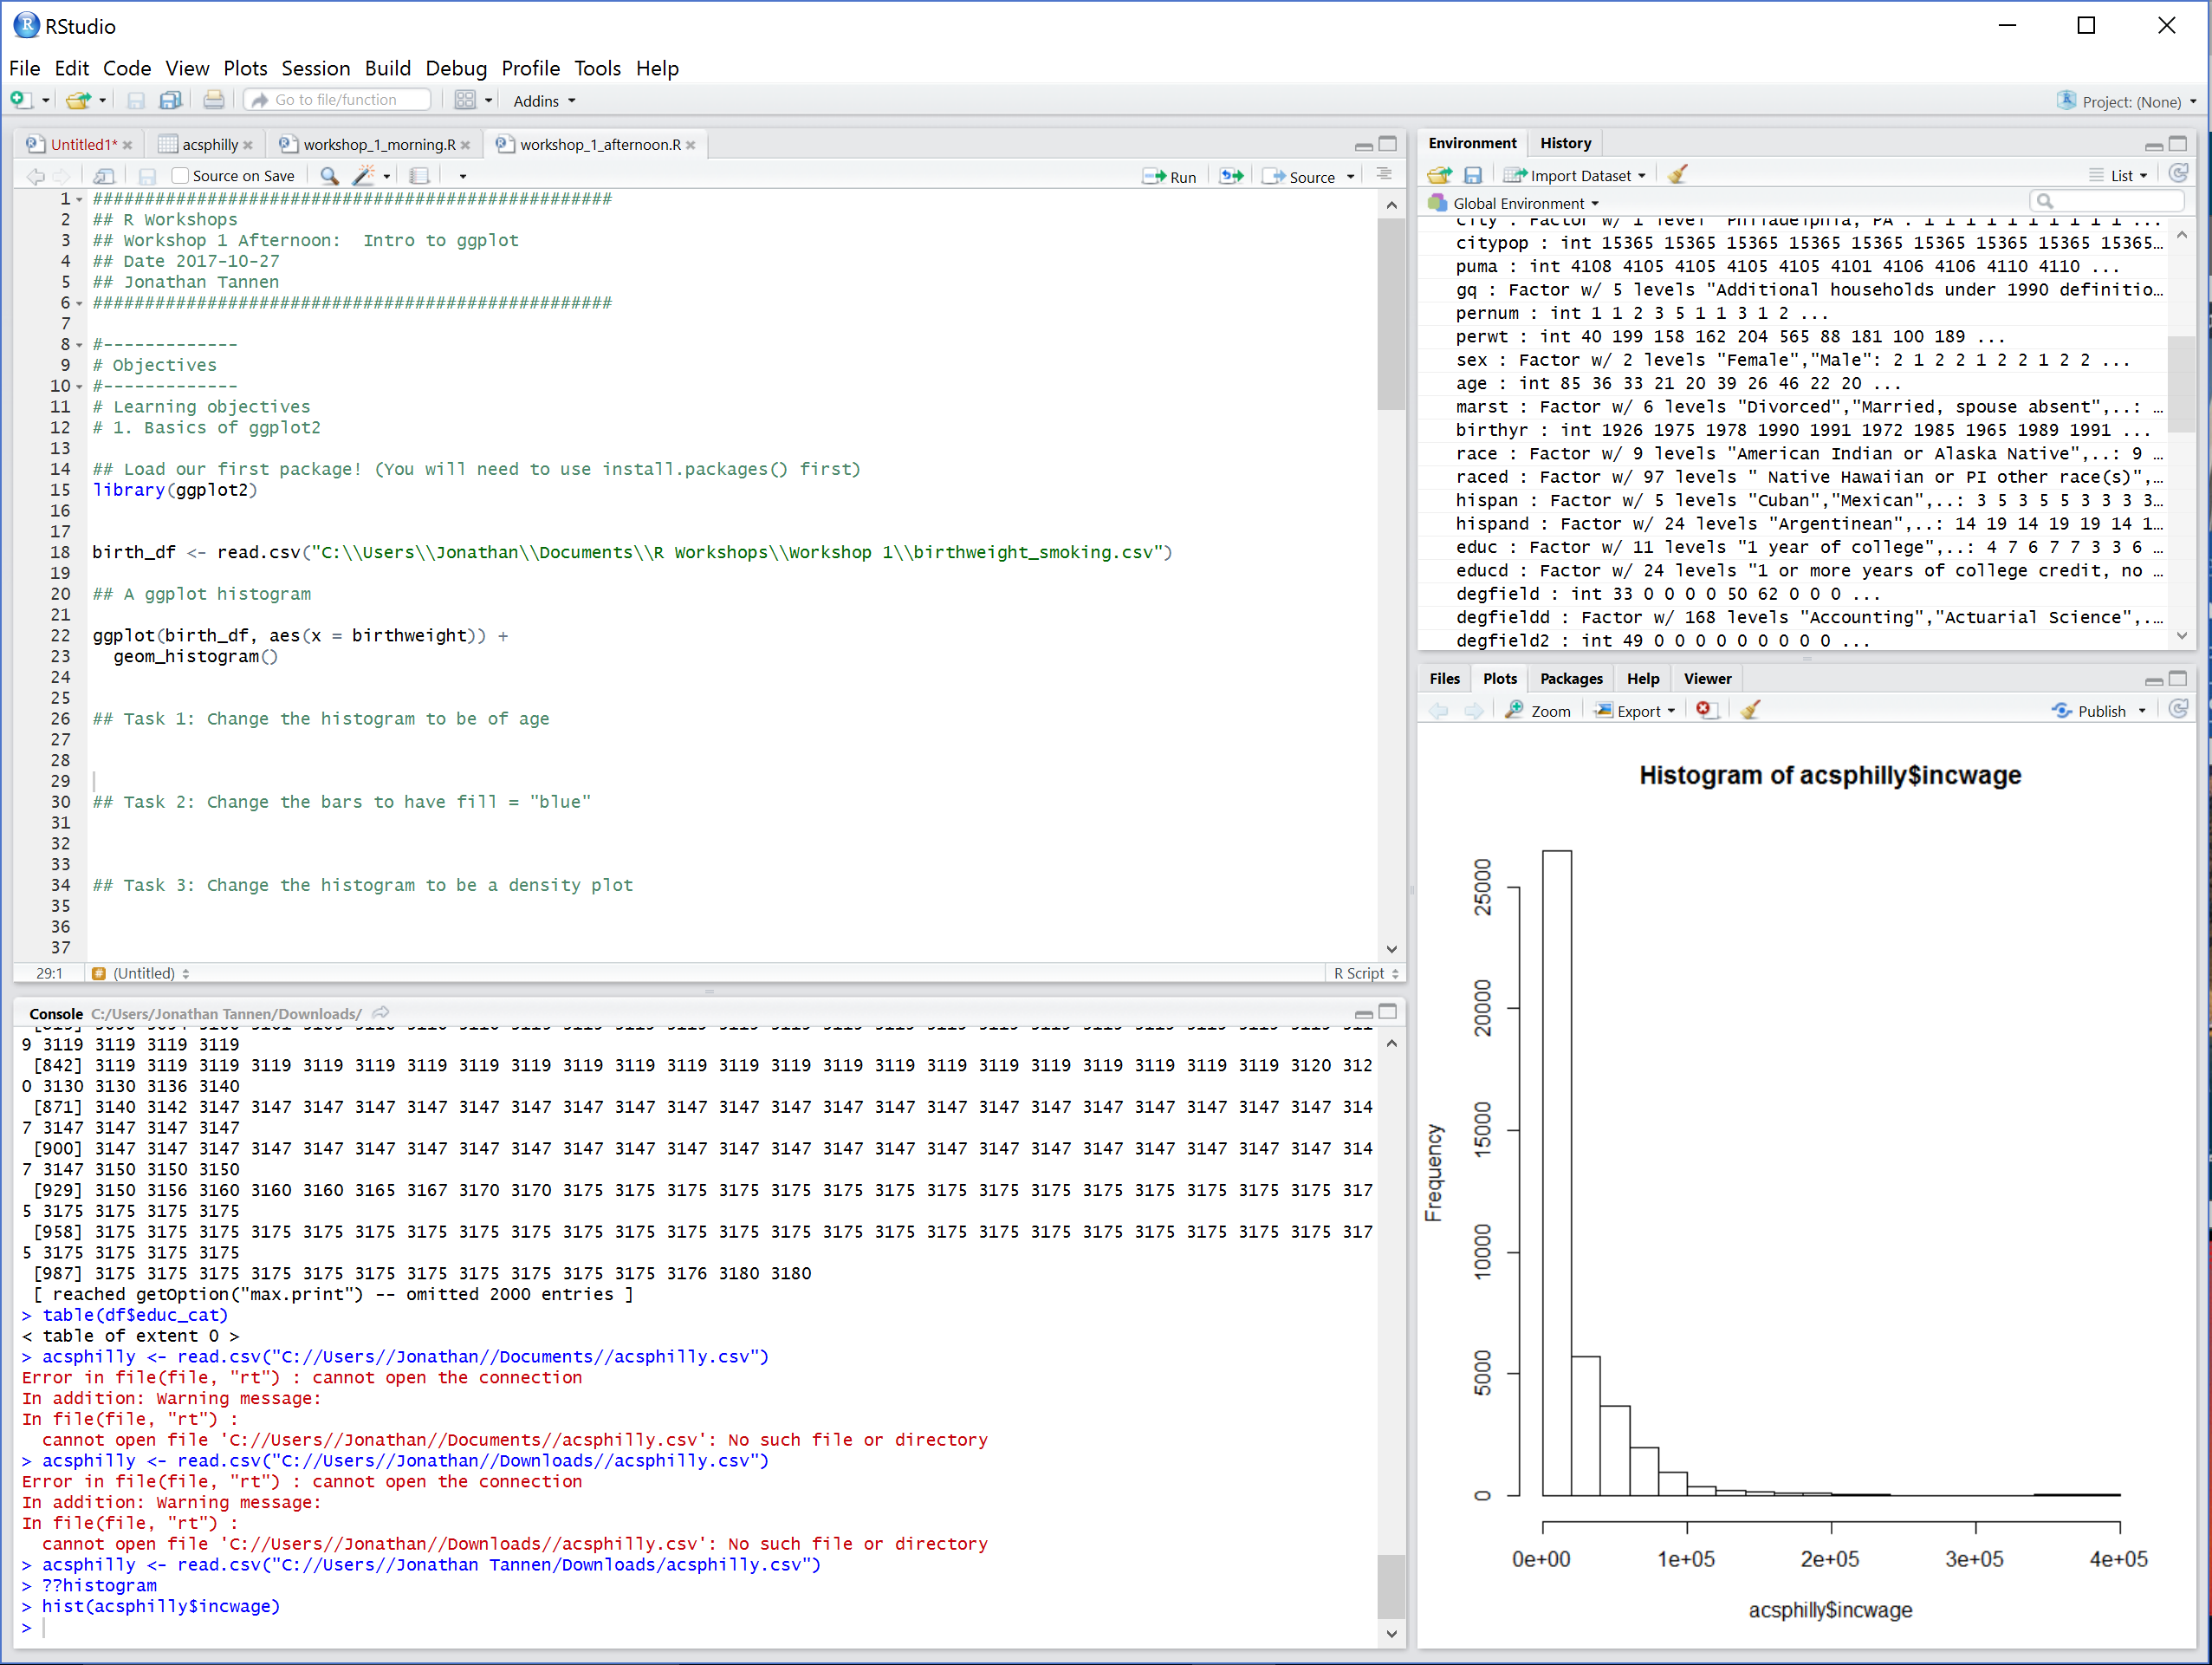
What is RStudio?
RStudio is a GUI (Graphical User Interface).
It is a user-friendly wrapper around R.

Slide 6
Workshop Course Material
Inspired by the book R for Data Science, by Hadley Wickham and Garrett Grolemund
Freely available at http://r4ds.had.co.nz/

Slide 7
Goals for the Workshop
Be able to do core data work (munging, visualizing) in R.
Be able to *learn new things*.
R help files.
Google.

Slide 8
Getting to know you
What do you work on?
What is your current coding workstream?
What would you hope to get out of the sessions?

Slide 9
Workshop Schedule
Intro to R dataframes
Visualizations with ggplot
Data Munging with the Tidyverse
GIS with sf
Software Engineering for Researchers
Regression

Slide 10
Structure of the Workshops
“We do, you do”.
9-10:30 – Intro to R
10:30-11:30 – Pair Programing
11:30-12:00 – Review Solutions

Slide 11
Goals for this morning
Be able to open datasets in RStudio.
Be able to navigate datasets.
Understand the use of scripts.
Be able to use help.
Be able to use base R functions.

Slide 12
Enough talking. Let’s go!

Slide 13
Functions
install.packages()
library()
read.csv()
<-
c()
head(), dim()
`$`
[,], `:`
+, -, *, /, ^
<, >, <=, >=, ==
& (and), | (or)
min(), max(), which.min(), which.max()
log(), log10()
paste(), paste0()
grep(), grepl()
substr()
plot()
hist()
?, ??
median(), mean(), weighted.average()

