Slide 1
Welcome!
Before we start, make sure you’ve downloaded the Session 2 files from github:
https://github.com/jtannen/r-for-datascience
(We are using the same CSVs as last time.)

Slide 2
R for Data Science II: Visualizations with ggplot
Fels Institute of Government
Jonathan Tannen

Slide 3
Workshop Schedule
Intro to R dataframes
Visualizations with ggplot
Data Munging with the Tidyverse
GIS with sf
Software Engineering for Researchers
Regression

Slide 4
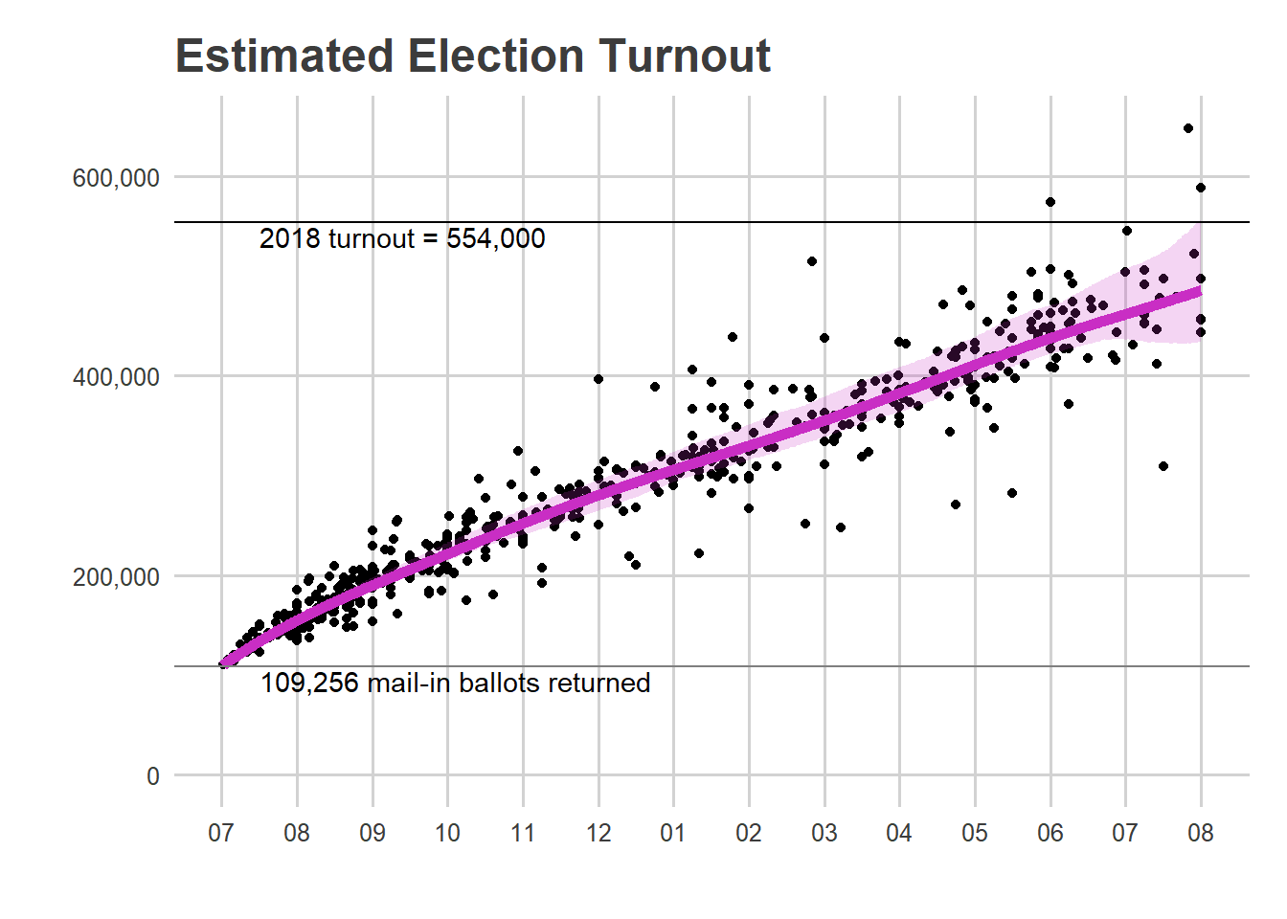
ggplot

Slide 5
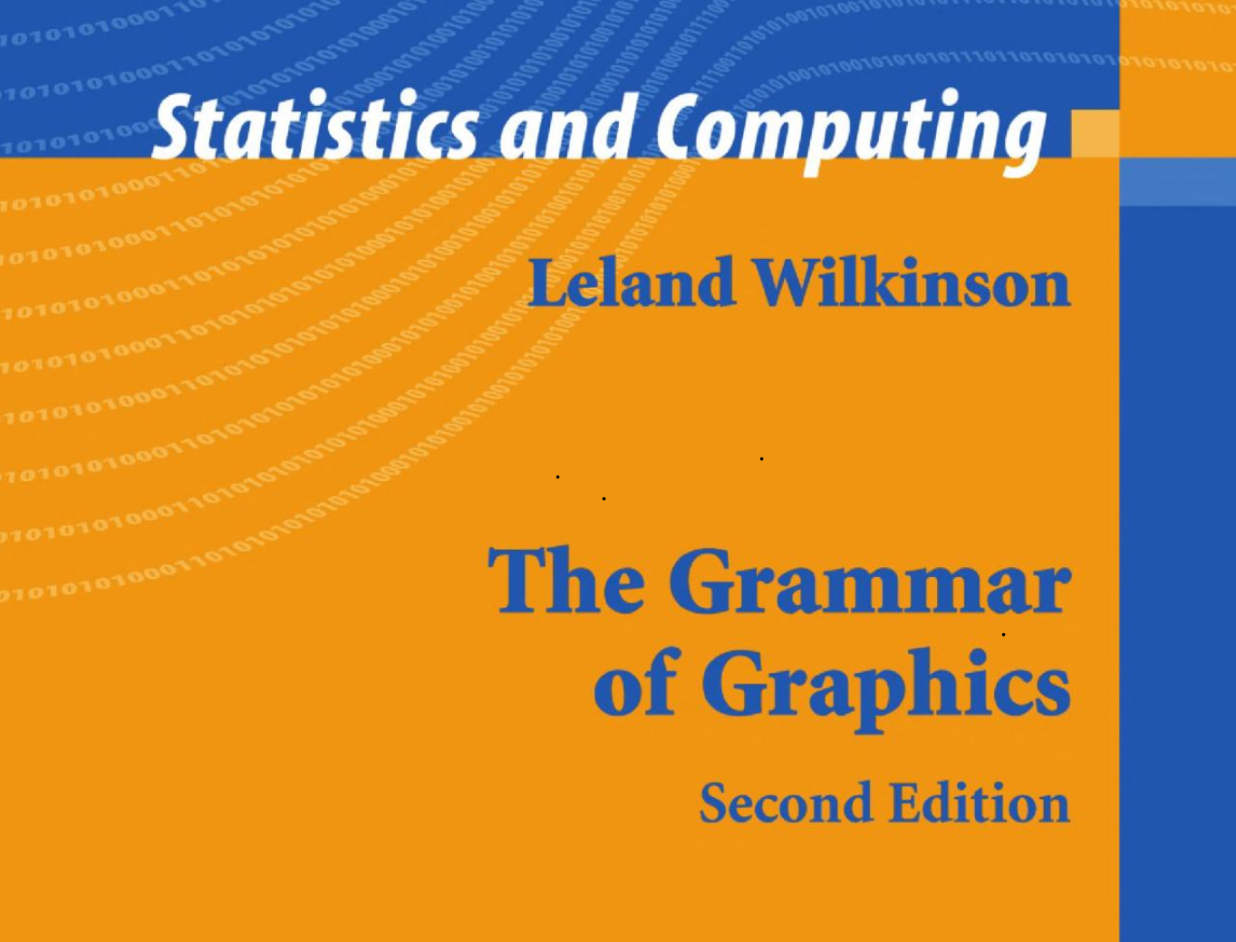
What is ggplot?
An R package for making visualizations.
It is structured very differently from typical functions, built around the philosophy of a “grammar of graphics”.
Used by the nytimes, fivethirtyeight, everyone else.

Slide 6
Let’s open ggplot.

Slide 7
a ggplot command
ggplot(
opa_df,
aes(x=sale_date, y=ppsf, color=zoning)
) +
geom_point(size=0.5) +
geom_smooth(aes(group=zoning))

Slide 8
a ggplot command
ggplot(
opa_df,
aes(x=sale_date, y=ppsf, color=zoning)
) +
geom_point(size=0.5) +
geom_smooth(aes(group=zoning))
base command
layers

Slide 9
a ggplot command
ggplot(
opa_df,
aes(x=sale_date, y=ppsf, color=zoning)
) +
geom_point(size=0.5) +
geom_smooth(aes(group=zoning))
dataframe
aesthetics
layers

Slide 10
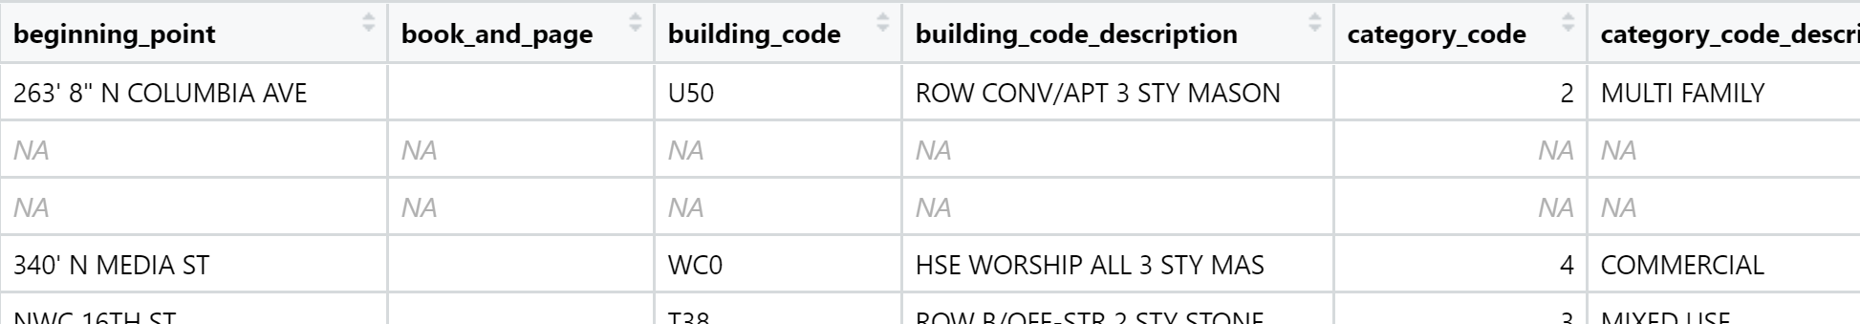
aesthetics
Aesthetics map variables in your dataframe to features of the plot.
They are wrapped in aes().
You can define them in the first ggplot command, or in a layer.
Common aesthetics:
x alpha shape
y group label
size linetype angle
color fill fontface

Slide 11
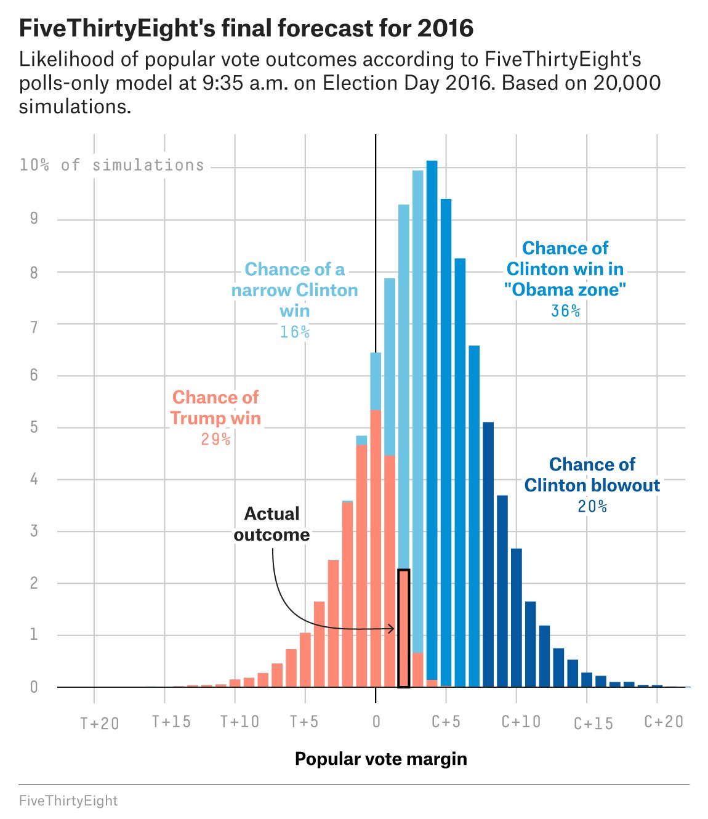

Slide 12
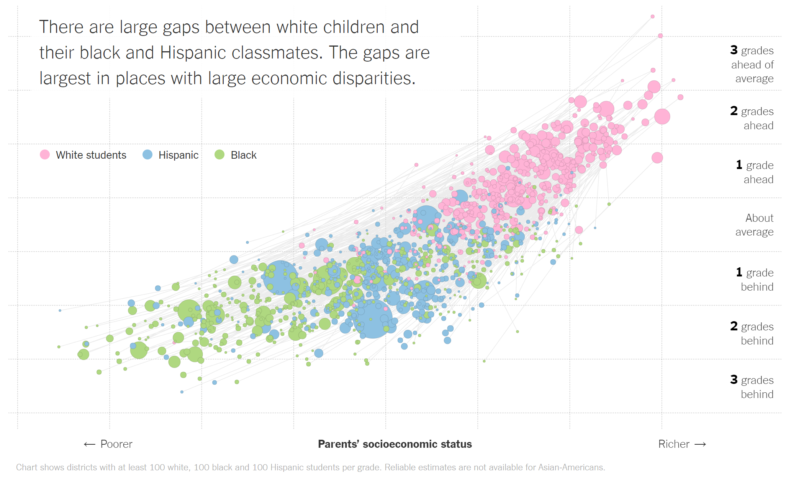

Slide 13
aesthetics vs parameters
aesthetics
ggplot(
opa_df,
aes(x=sale_date, y=ppsf, color=zoning)
) +
geom_point(size=0.5) +
geom_smooth(aes(group=zoning))
parameter

Slide 14
layers vs controls
ggplot(
opa_df,
aes(x=sale_date, y=ppsf, color=zoning)
) +
geom_point(size=0.5) +
geom_smooth(aes(group=zoning))
layers
Layers and control are added on to a plot.
Common Layers
geom_point geom_polygon geom_text geom_abline
geom_jitter geom_boxplot geom_smooth geom_hline
geom_histogram geom_density geom_sf geom_vline
Common Control
ggtitle annotate xlim facet_wrap
labs scale_fill_discrete ylim facet_grid
Xlab, ylab scale_<aesthetic>_<type> coord_cartesion

Slide 15
Resources
Cheat Sheet: https://www.rstudio.com/wp-content/uploads/2015/03/ggplot2-cheatsheet.pdf
Tutorial: http://tutorials.iq.harvard.edu/R/Rgraphics/Rgraphics.html

Slide 16
Let’s do it

