Slide 1
Welcome!
Before we start, make sure you:
- have R and RStudio installed.
have downloaded from github two files:
www.github.com/jtannen/r-for-datascience
session-1/workshop_1.R
sessions-1/workshop_1_pairprogramming.R
Download “Properties (CSV)” from https://www.opendataphilly.org/dataset/opa-property-assessments

Slide 2
R for Data Science Workshop 1: Data Munging
Jonathan Tannen
Presented February 2023

Slide 3
What is R?
Software for statistical analysis.
Fully functional programming language
Open Source (free)
Community of true believeRs
Evolving set of packages

Slide 4
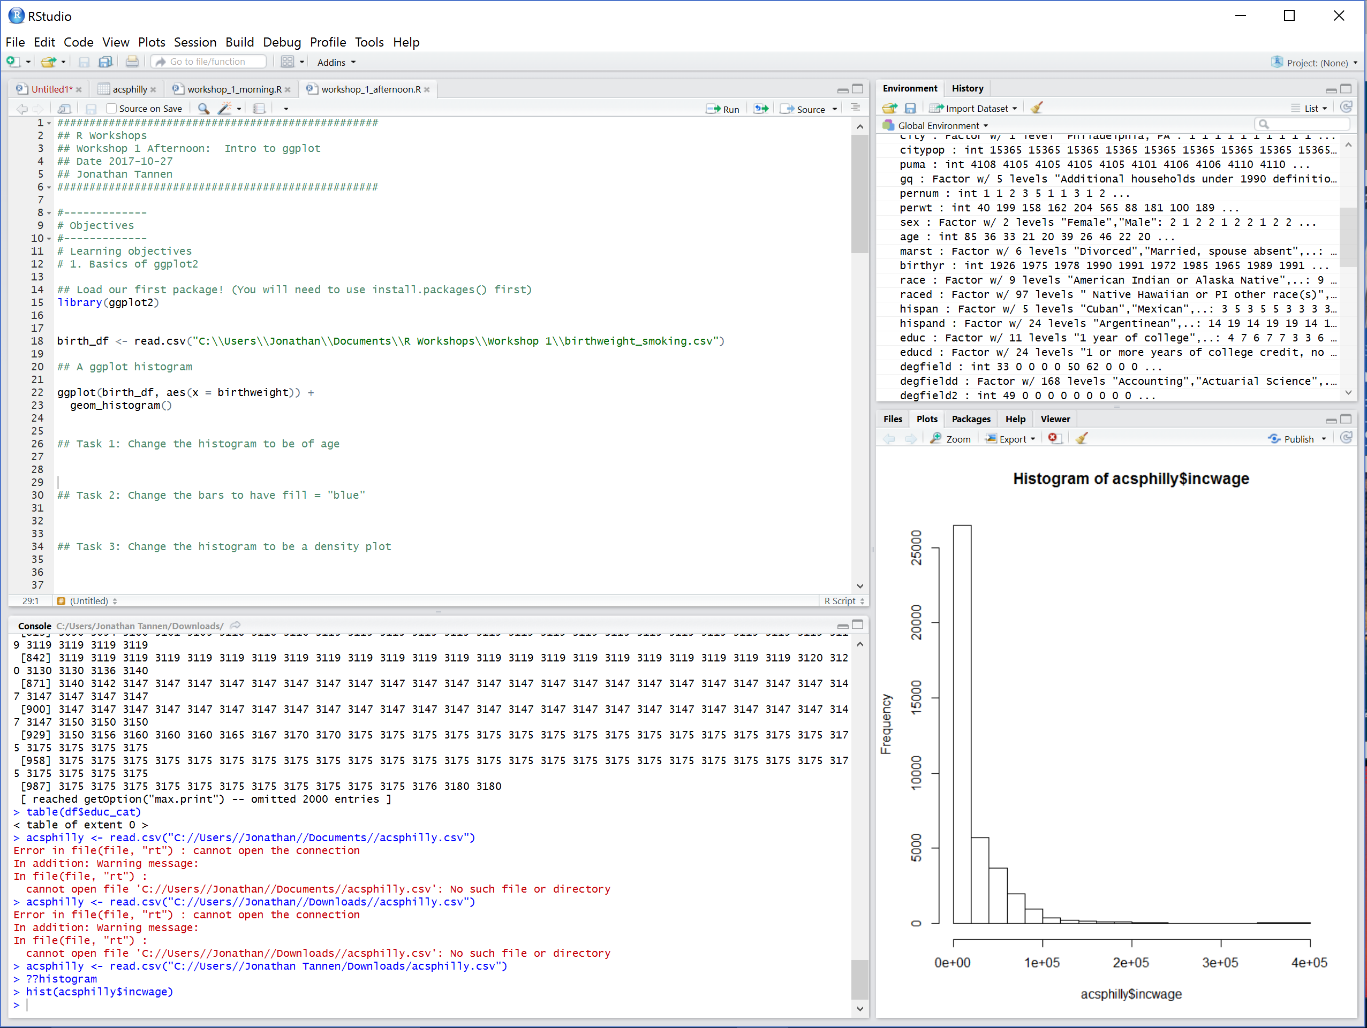
What is RStudio?
RStudio is a GUI (Graphical User Interface).
It is a user-friendly wrapper around R.

Slide 5
Workshop Course Material
Inspired by the book R for Data Science, by Hadley Wickham and Garrett Grolemund
Freely available at http://r4ds.had.co.nz/

Slide 6
Goals for the Workshops
Be able to open data in R and perform basic tasks.
Be able to *learn new things*.
R help files.
Google.

Slide 7
Workshop Schedule
Intro to R dataframes
Visualizations with ggplot
Data Munging with the Tidyverse
GIS with sf
Software Engineering for Researchers
Regression

Slide 8
Structure of the Workshops
“We do, you do”.
9-10:30 – Intro to R
10:30-11:30 – Pair Programing
11:30-12:00 – Review Solutions

Slide 9
Goals for this morning
Be able to open datasets in RStudio.
Be able to navigate datasets.
Understand the use of scripts.
Dataset operations: assignment, summarizing, grouping.
Be able to use help.

Slide 10
Enough talking. Let’s go!

Slide 11
Functions
install.packages()
library()
read.csv()
<-
c()
head(), dim()
`$`
[,], `:`
+, -, *, /, ^
<, >, <=, >=, ==
& (and), | (or)
min(), max(), which.min(), which.max()
log(), log10()
paste(), paste0()

