Slide 1
Welcome!
Download the Session 5 file from github: https://github.com/jtannen/r-for-datascience/session-5-engineering

Slide 2
R for Data Science V: Software Engineering for Researchers
Jonathan Tannen

Slide 3
Workshop Schedule
Intro to R dataframes
Visualizations with ggplot
Data Wrangling with the Tidyverse
GIS with sf
Software Engineering for Researchers
Regression

Slide 4
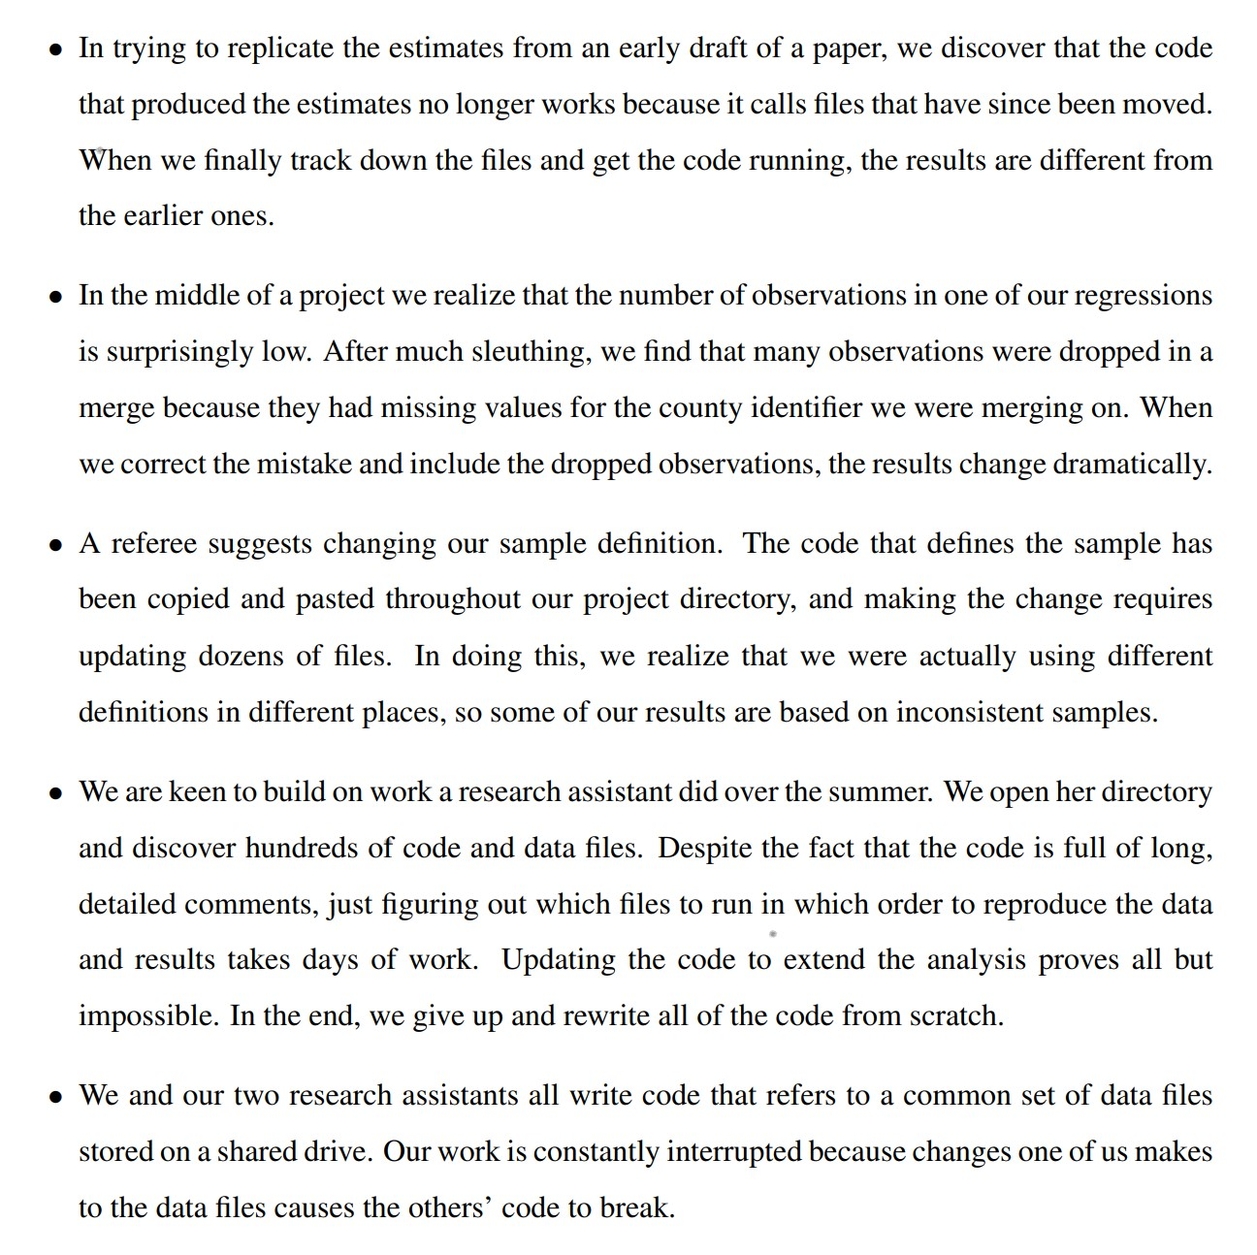
What can go wrong?
From Gentzkow & Shapiro (2014)

Slide 5
What is Better Engineering?
Code is for computers. Good code is for humans.
“Bus Factor”, or the “Lottery Factor”
Right now, you probably have projects which would be impossible for another person, or even future-you, to pick up and adapt.
Good engineering practices that let you…
move faster
with fewer errors
They aren’t hard! You will build the muscle, and it will come naturally.

Slide 6
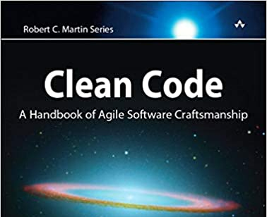
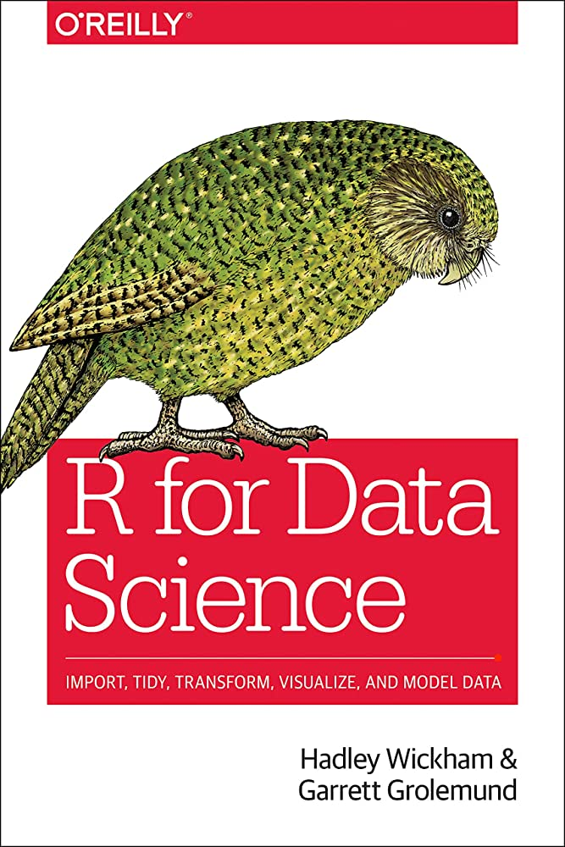
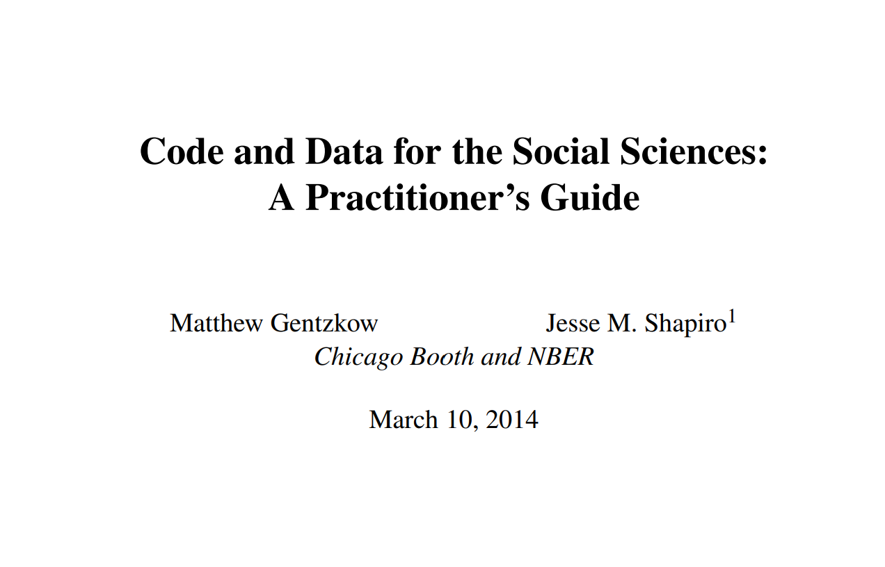
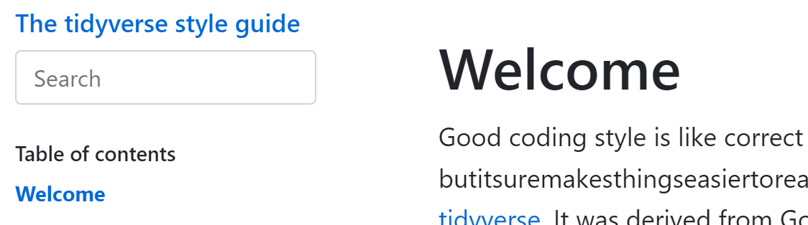
Inspired by

Slide 7
Today: Four Three Topics
Don’t Repeat Yourself
Modularity
Confident Automation
git & version control
This is all aspirational. I don’t do all of this for all projects. But building these muscles will 10x your code.

Slide 8
Theme 1: “Don’t Repeat Yourself”
You may copy and paste code once. That’s it.

Slide 9
Copy-pasted logic
df <- data.frame(
a = rnorm(10),
b = rnorm(10),
c = rnorm(10),
d = rnorm(10)
)
df$a <- (df$a - min(df$a, na.rm = TRUE)) /
(max(df$a, na.rm = TRUE) - min(df$a, na.rm = TRUE))
df$b <- (df$b - min(df$b, na.rm = TRUE)) /
(max(df$b, na.rm = TRUE) - min(df$a, na.rm = TRUE))
df$c <- (df$c - min(df$c, na.rm = TRUE)) /
(max(df$c, na.rm = TRUE) - min(df$c, na.rm = TRUE))
df$d <- (df$d - min(df$d, na.rm = TRUE)) /
(max(df$d, na.rm = TRUE) - min(df$d, na.rm = TRUE))

Slide 10
Step 1: Create a function
df <- data.frame(
a = rnorm(10),
b = rnorm(10),
c = rnorm(10),
d = rnorm(10)
)
my_rescale <- function(x) {
rng <- range(x, na.rm = TRUE)
return(
(x - rng[1]) / (rng[2] - rng[1])
)
}
df$a <- my_rescale(df$a)
df$b <- my_rescale(df$b)
df$c <- my_rescale(df$c)
df$d <- my_rescale(df$d)

Slide 11
Step 2: Use loops or another map
df <- data.frame(
a = rnorm(10),
b = rnorm(10),
c = rnorm(10),
d = rnorm(10)
)
my_rescale <- function(x) {
rng <- range(x, na.rm = TRUE)
return(
(x - rng[1]) / (rng[2] - rng[1])
)
}
df |> mutate(across(a:d, my_rescale))

Slide 12
DRY: Functions
What was achieved?
Fewer mistakes.
Easier to understand.
Naming things helps readability.
Clear SLA (Service Level Agreement)
“Encapsulation”, i.e. easy to replace with a new method.
*Testable*.

Slide 13
Functions in R
scale_to_range <- function(
x,
upper,
lower=0,
bounds_error=TRUE
){
res <- (x – lower) / (upper-lower)
if(bounds_error){
if(any(res > 1 | res < 0)) stop("Bad values!") }
return(res)
}

Slide 14
Naming
“There are only two hard things in Computer Science: cache invalidation and naming things.” -- Phil Karlton
Use full words.
Use lower_snake_case.
Not CamelCase
For constants use ALL_CAPS.

Slide 15
Data reused in multiple places
df <- read.csv(
"C:/Users/Jonathan/papers/data/data_2000.csv"
)
election_metadata <- read.csv(
"C:/Users/Jonathan/papers/data/elections.csv"
)
candidates <- read.csv(
"C:/Users/Jonathan/papers/data/candidates.csv"
)
df$is_last_four_elections <- (
ymd("2022-11-08") - ymd(df$date)
) <= years(4)
df$age <- (ymd("2022-11-08") - ymd(df$birth_date))

Slide 16
Data reused in multiple places
# could also setwd().
DATA_DIR <- "C:/Users/Jonathan/papers/data/"
ELECTION_DATE <- "2022-11-08"
df <- read.csv(paste0(DATA_DIR, "data_2000.csv"))
election_metadata <- read.csv(
paste0(DATA_DIR, "elections.csv")
)
candidates <- read.csv(paste0(DATA_DIR, "candidates.csv"))
df$is_last_four_elections <- (
ymd(ELECTION_DATE) - ymd(df$date)
) <= years(4)
df$age <- (ymd(ELECTION_DATE) - ymd(df$date))

Slide 17
Don’t write any information thrice
What counts as “information”?
Directories
Solution: setwd()
Reused strings, dates, values
Solution: STRING_CONSTANT
Analytic choices (regression specification, cleaning choice)
Solution: functions

Slide 18
Theme 2: Modularity
Separate your program into independent, interchangeable modules. Later steps depend only on the (minimal) outputs of the prior steps.

Slide 19
My original workflow
Download raw data
Clean it by hand
Gigantic script that reshaped the data, ran analysis, generated plots.
I did some cleaning here, too!
Hard-coded assumptions hidden everywhere including settings, file locations, dates.
This would often break. Only way to check was post-hoc, or error debugging.
Write report by hand. Copy numbers from printed output.

Slide 20
A few simple rules for modular code
Large steps go in separate scripts. Write outputs to files.
clean_data.R, fit_models.R, report.R
Your scripts should mostly define functions.
It only does work at the end, if at all.

Slide 21
Rules for modular data cleaning
Store the raw data in a folder raw_data/.
Never modify this file.
Clean the data using code. Never touch by hand.
Write outputs to processed_data/
Everything downstream simply assumes this data exists.
Write a test script that produces summary outputs, tests, and plots.

Slide 22
Let’s look at the turnout tracker.

Slide 23
Example of project management
Demo of usethis

Slide 24
Theme 3: Confident Automation
Don’t do anything by hand.
Data cleaning
Moving files
Making maps
Why?

Slide 25
How to avoid mistakes?
Automate your diagnostics.
Print summary stats
Create plots
Use tests
I like r library `testthat`

Slide 26
Example of testing
Demo of testthat
(if time)

Slide 27
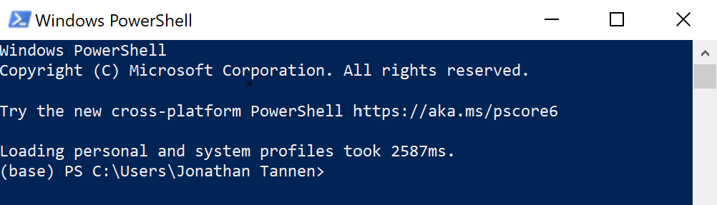
What to use for automation?
R can do almost everything
Move files
Call other software
For everything else, there’s shell

Slide 28
Common shell commands
Change Directory: cd
List files: ls
Copy files: cp
Move files: mv
Delete files: rm
Run an R script: rscript

Slide 29
Basics of a shell command
command arg [--options]

