Slide 1
Welcome!
Before we start, make sure you:
- have R and RStudio installed.
have downloaded from github two files:
www.github.com/jtannen/r-for-datascience
session-1/workshop_1.R
sessions-1/workshop_1_pairprogramming.R
Download “Properties (CSV)” from https://www.opendataphilly.org/dataset/opa-property-assessments

Slide 2
R for Data Science Workshop 1: Data Munging
Jonathan Tannen
Presented February 2023

Slide 3
What is R?
Software for statistical analysis.
Fully functional programming language
Open Source (free)
Community of true believeRs
Evolving set of packages

Slide 4
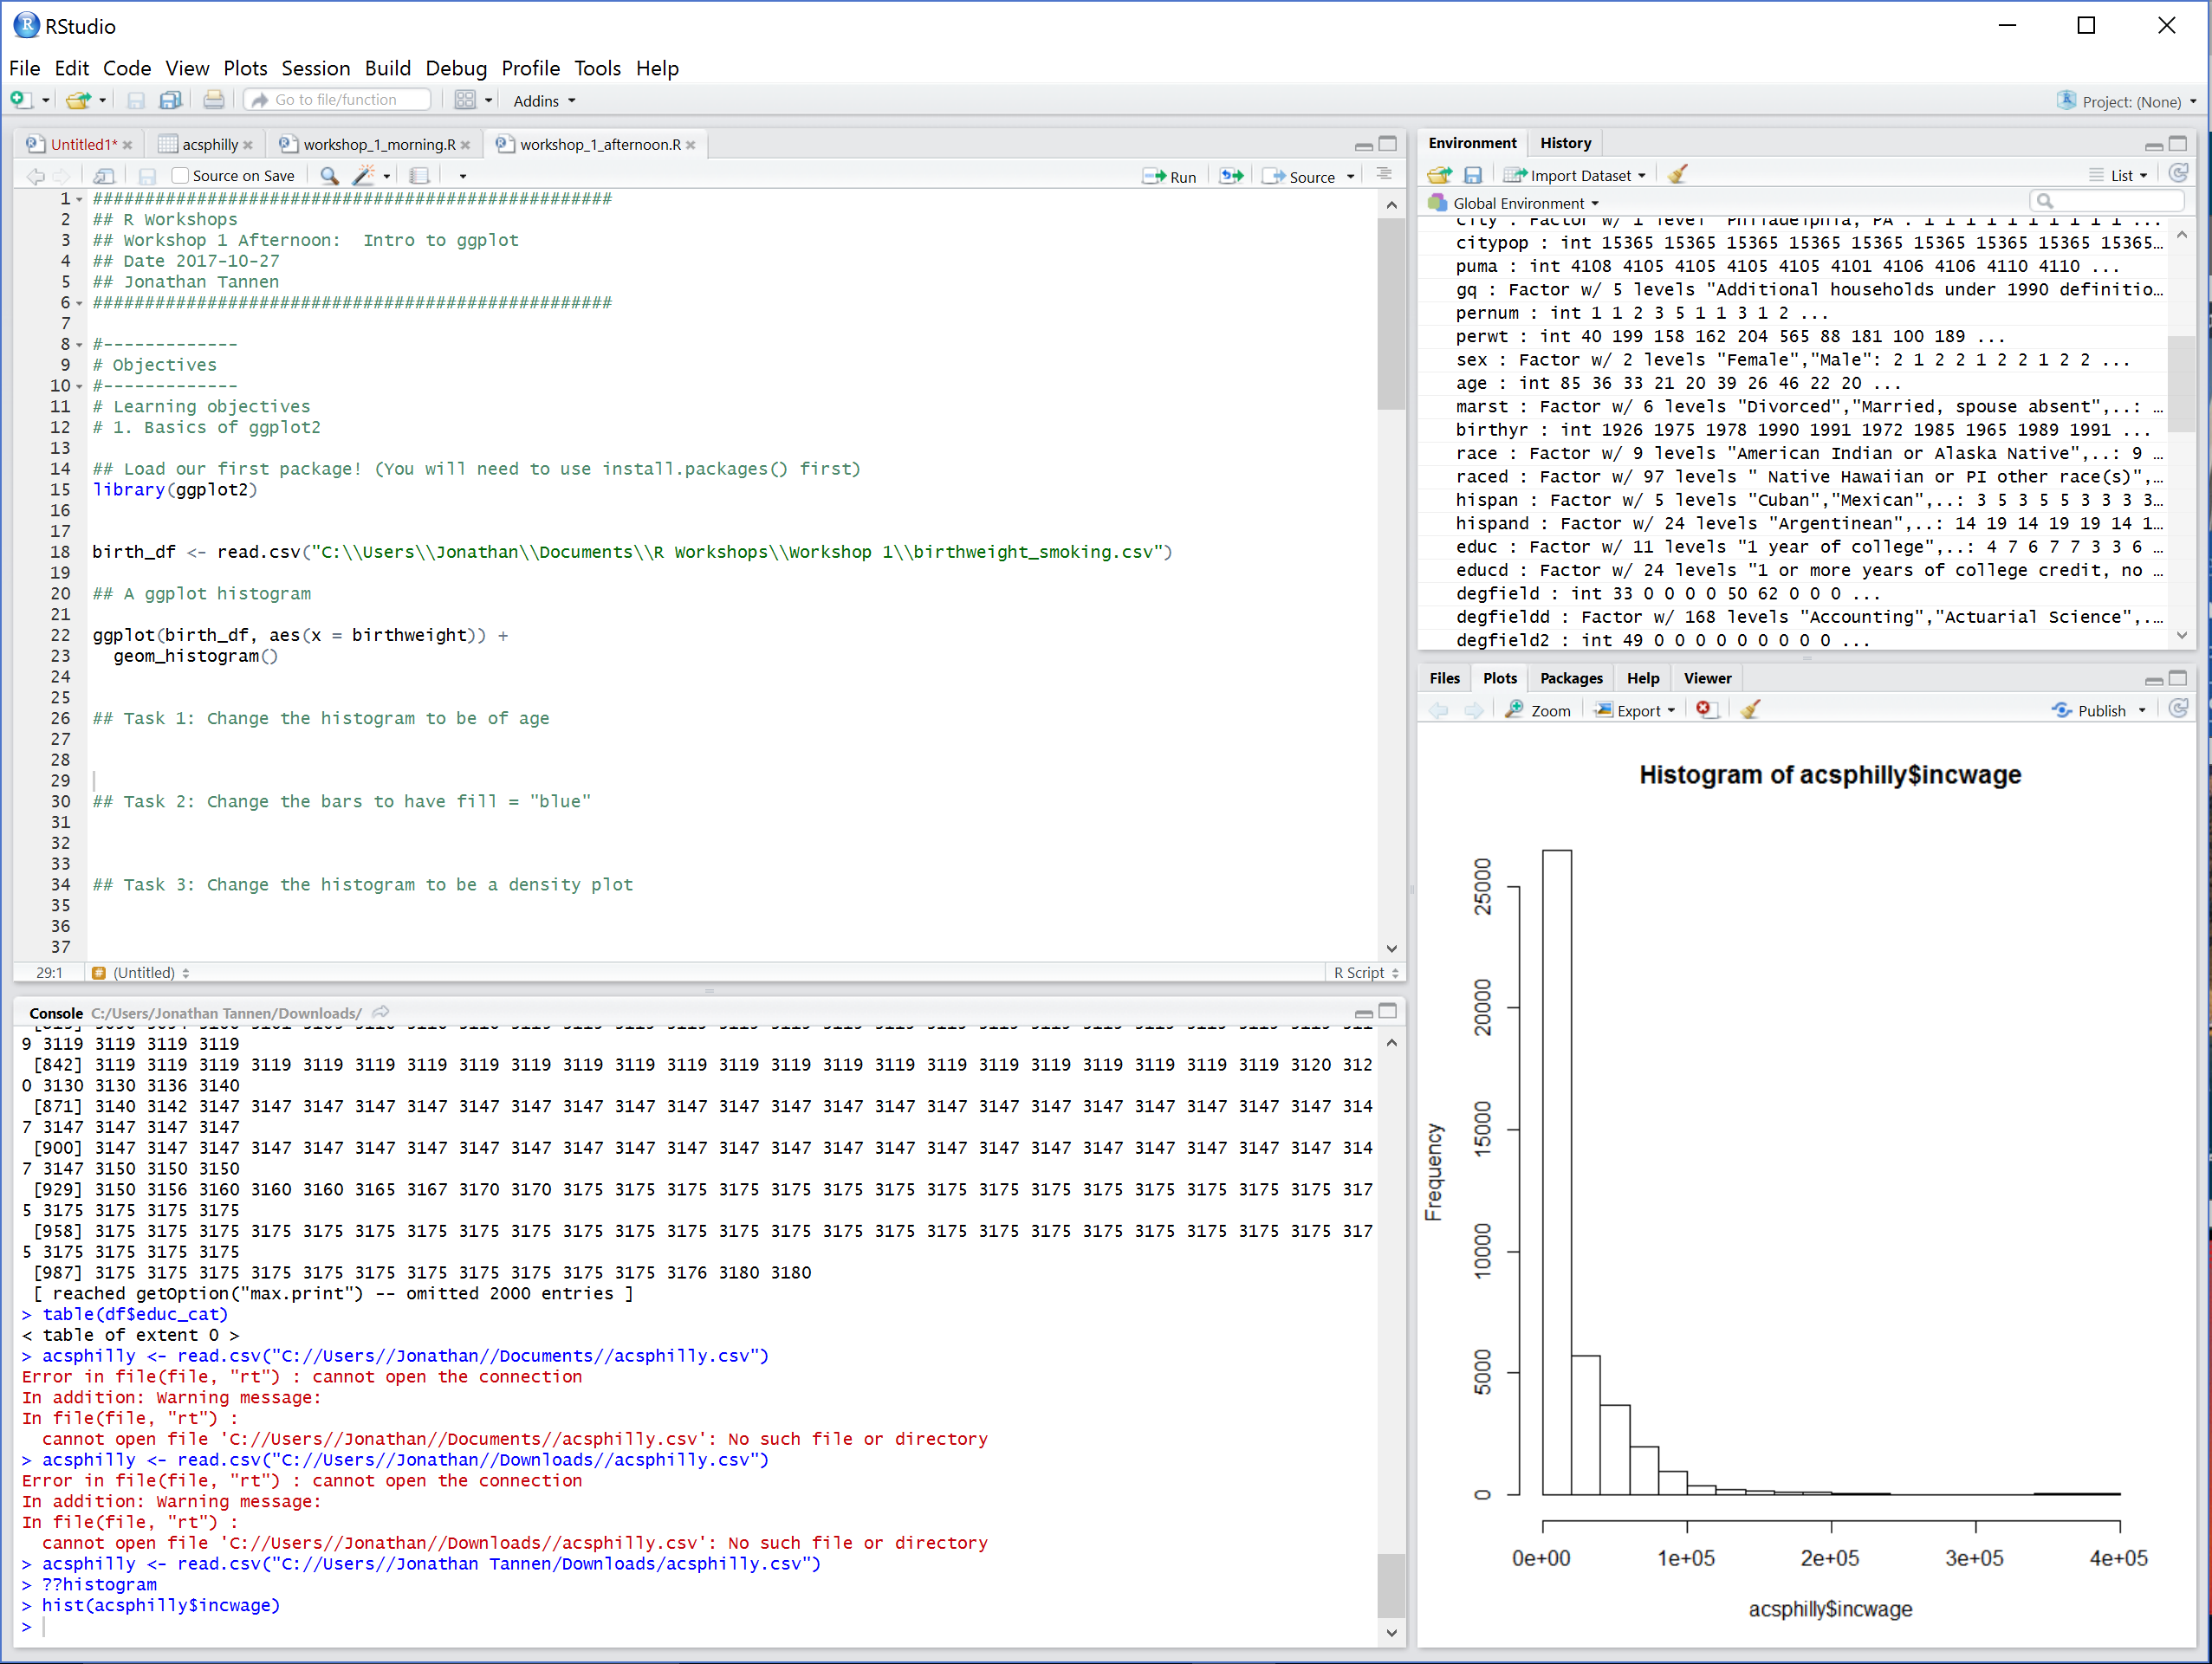
What is RStudio?
RStudio is a GUI (Graphical User Interface).
It is a user-friendly wrapper around R.

Slide 5
Workshop Course Material
Inspired by the book R for Data Science, by Hadley Wickham and Garrett Grolemund
Freely available at http://r4ds.had.co.nz/

Slide 6
Goals for the Workshops
Be able to open data in R and perform basic tasks.
Be able to *learn new things*.
R help files.
Google.

Slide 7
Workshop Schedule
Intro to R dataframes
Visualizations with ggplot
Data Munging with the Tidyverse
GIS with sf
Software Engineering for Researchers
Regression

Slide 8
Structure of the Workshops
“We do, you do”.
9-10:30 – Intro to R
10:30-11:30 – Pair Programing
11:30-12:00 – Review Solutions

Slide 9
Goals for this morning
Be able to open datasets in RStudio.
Be able to navigate datasets.
Understand the use of scripts.
Be able to use help.
Be able to use base R functions.

Slide 10
Enough talking. Let’s go!

Slide 11
Functions
install.packages()
library()
read.csv()
<-
c()
head(), dim()
`$`
[,], `:`
+, -, *, /, ^
<, >, <=, >=, ==
& (and), | (or)
min(), max(), which.min(), which.max()
log(), log10()
paste(), paste0()
grep(), grepl()
substr()

