Slide 1
How the Brain Moves: Understanding Motion-Based Brain States Using Deep Learning Techniques
Joshua Tapper
Supervisor: Dr. Ignasi Cos
Universitat de Barclona
July 8th 2025

Slide 2
Agenda
01
02
03
04
05
06
Background
Preprocessing
Training
Provide project motivation and explain data
Show how data was prepared for training
Discuss the models and training methodology
Interpretability
Results
Conclusions
Introduce our methods for feature attribution
Present results of training analysis
Offer final thoughts

Slide 3
01
Background

Slide 4
Motivation
Problem
Neural data can be very informative, but it is also highly-dimensional, non-linear, and noisy, making it difficult to understand.
Model Classification
Deep learning models can be trained on neural data to learn its complex patterns and achieve accurately classification.
Model Interpretability
After model training, we can extract input feature importance to better understand the input data and thus our brains.

Slide 5
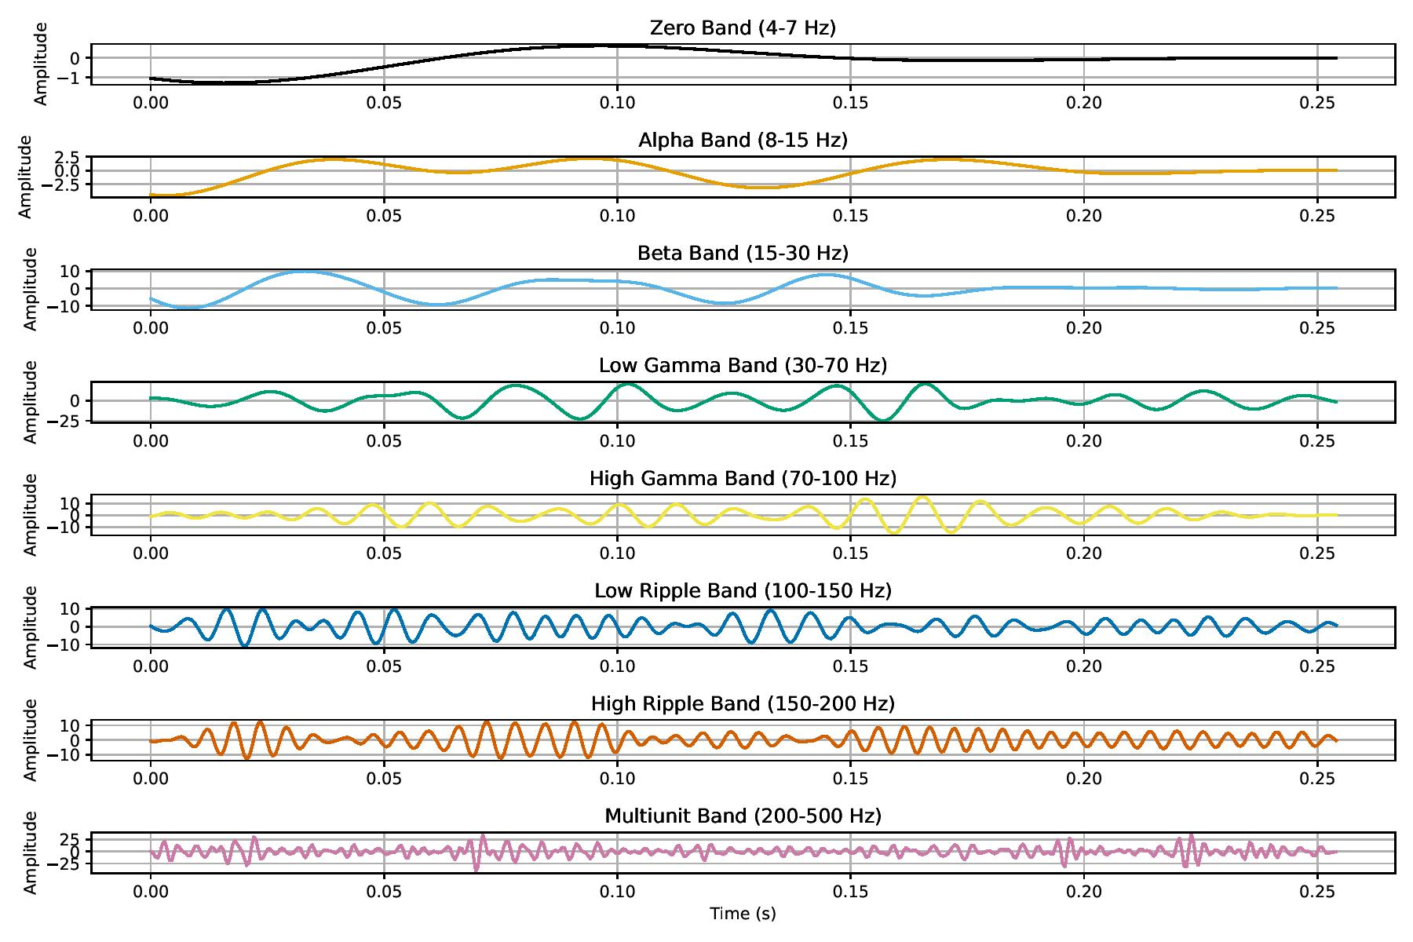
Data Source
Data comes from Local Field Potentials (LFPs)
Invasive procedure to record electrical activity within the brain
Higher spatial resolution on a smaller subset of the brain when compared to electroencephalograms (EEGs)
Notes:
Invasiveness means we can capture wider range of frequencies
LFP data much less tested
Explain why we separate bands (associated with different levels of activity)

Slide 6
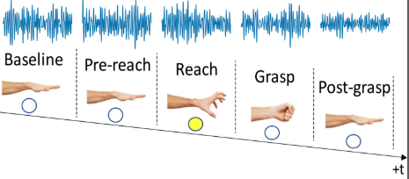
Experiment Overview
Data comes from the experiment described in DePass et al., 2022.
In that experiment neural data is recorded while macaque monkeys perform a series of movements using both their left and right hands.
Data is recorded on 256 channels from five regions of the brain: the left and right ventral premotor cortex (PMv), the left and right dorsal premotor cortex (PMd) and the left primary motor (M1).
We have in total 1575 samples and 9 classes from our data.
Singular baseline class and separate classes per movement and hand.
Notes:
Data comes from Montreal, was given to authors who work with UB
All five regions are associated with brain movement
Dorsal – triggered by environmental cues
Ventral – within reach objects

Slide 7
02
Preprocessing

Slide 8
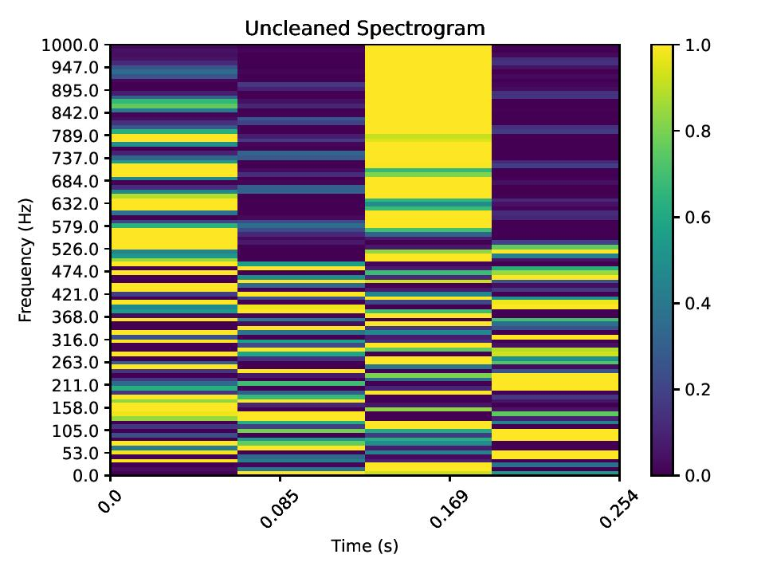
Spectrograms
Data was transformed into spectrograms, which are visual representations of how frequency changes over time.
This allows us to use image analysis techniques to learn and classify the data.

Slide 9
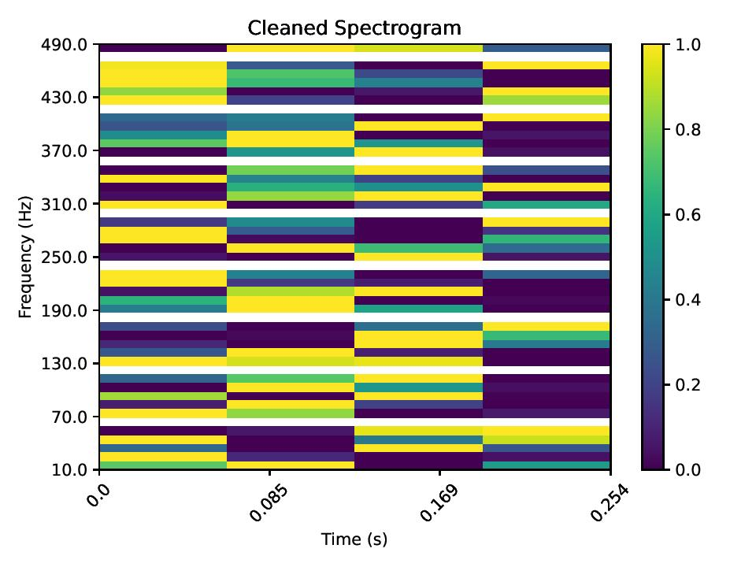
Data Cleaning
Two data cleaning methods were used:
Bad Channel Deletion – removes channels that are too flat or noisy when compared to the overall dataset.
Spectrogram Cleaning – Limits frequency values to cutoff artifact noise and deletes data around 60 Hz powerline spikes.

Slide 10
03
Training

Slide 11
Methodology Overview
01
02
03
Decoder
Classifier
Feature Attribution
Models learns to represent data in a latent space
Models learns to classify reduced data
Extract importance values of input features
Trained Together

Slide 12
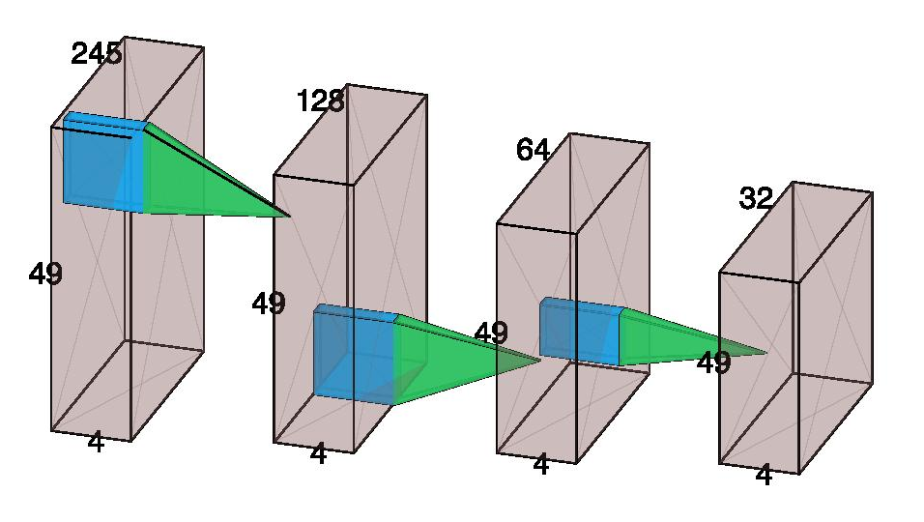
Encoder
01
02
03
The encoder reduces the channel dimension of the data from 245 to 32 while maintaining the spectrogram dimensions.
The architecture follows the Convolutional Autoencoder structure but does not include the decoder.
The encoder is combined with a classification model so that the decoder optimizes using the classification loss.

Slide 13
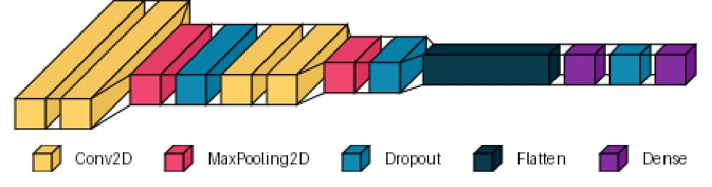
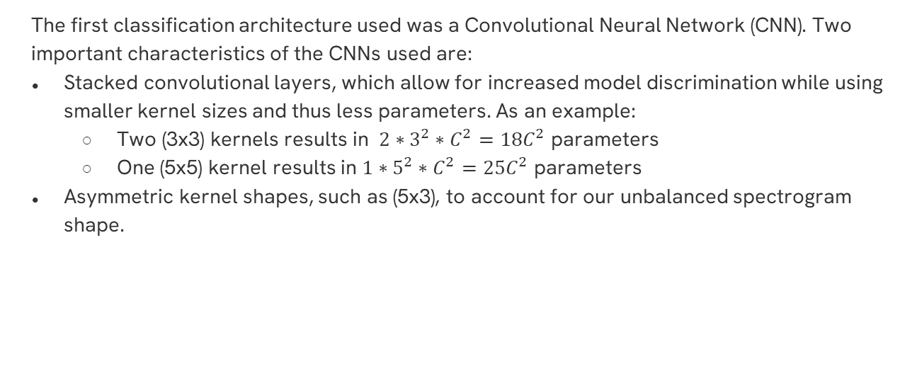
CNN
01
02
03
The first classification architecture used was a Convolutional Neural Network (CNN). Two important characteristics of the CNNs used are:
Stacked convolutional layers, which allow for increased model discrimination while using smaller kernel sizes and thus less parameters. As an example:
Two (3x3) kernels results in $2∗3^{2}∗C^{2}=18C^{2}$ parameters
One (5x5) kernel results in $1∗5^{2}∗C^{2}=25C^{2}$ parameters
Asymmetric kernel shapes, such as (5x3), to account for our unbalanced spectrogram shape.
Notes:
C represents channels of the stack

Slide 14
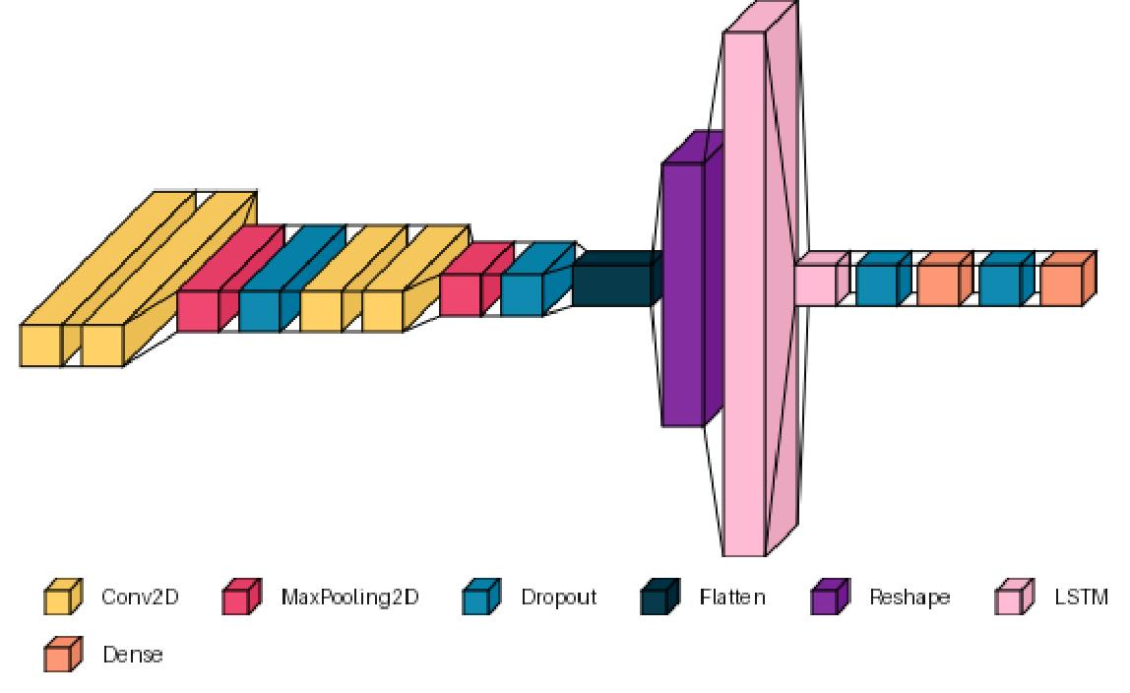
CNN-LSTM
01
02
03
The second architecture builds upon the CNN architecture by adding two stacked Long Short-Term Memory (LSTM) layers.

Slide 15
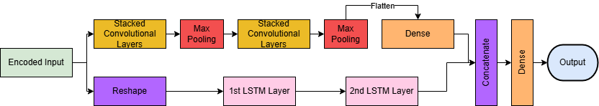
Parallel Model
01
02
03
The final classification architecture used is a Parallel CNN and LSTM model, which trains both architectures separately and concatenates the outputs.
Notes:
Dropout is not shown
New or novel use case

Slide 16
Training Strategy
01
02
03
All three model architectures had parameters optimized through a light Grid Search (a few hundred combinations per architecture).
All models used an Adam optimizer with the Sparse Categorical Crossentropy Loss.
The train/test split was 80%/20%.
Models were trained using Early Stopping and Learning Rate Decay.

Slide 17
04
Interpretability

Slide 18
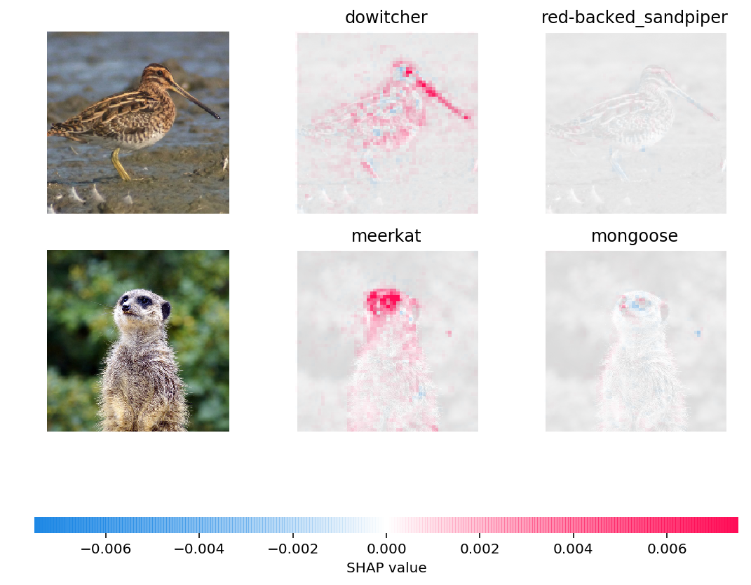
SHAP
01
02
03
A game theory-based feature attribution approach that indicates how much an input feature impacts the prediction for a given class.
Two SHAP explainers were used:
DeepExplainer (preferred method)
KernelExplainer (problematic for our models)

Slide 19
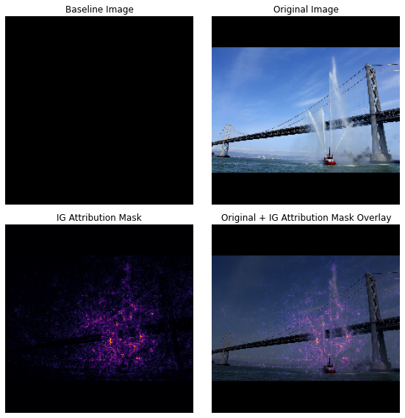
Integrated Gradients
01
02
03
Performs feature attribution using gradients, which compare how a feature changes the output when compared to a baseline image.
Integrated Gradients were calculated for 100 test samples per model and averaged to yield feature importance.
A baseline black image was used.

Slide 20
Ablation
01
02
03
In our case, ablation refers to setting the values of a set of input features to 0 and evaluating how that impacts the accuracy of trained models.
“Importance” is then simply the loss in accuracy the ablated features cause.
Three manners of ablation were performed:
Individual channel ablation
Brain region ablation
Frequency band ablation

Slide 21
05
Results

Slide 22
Training Methodology Comparison
Model | Data Cleaning | Dimensionality Reduction | Test Accuracy
CNN | Yes | Encoder | 75.2%
CNN-LSTM | Yes | Encoder | 83.2%
Parallel | Yes | Encoder | 82.2%
CNN | Yes | PCA | 74.6%
CNN-LSTM | Yes | PCA | 71.4%
Parallel | Yes | PCA | 71.7%
CNN | No | Encoder | 81.2%
CNN-LSTM | No | Encoder | 78.0%
Parallel | No | Encoder | 75.5%
CNN | Yes | None | 78.4%
CNN-LSTM | Yes | None | 77.1%
Parallel | Yes | None | 80.3%

Slide 23
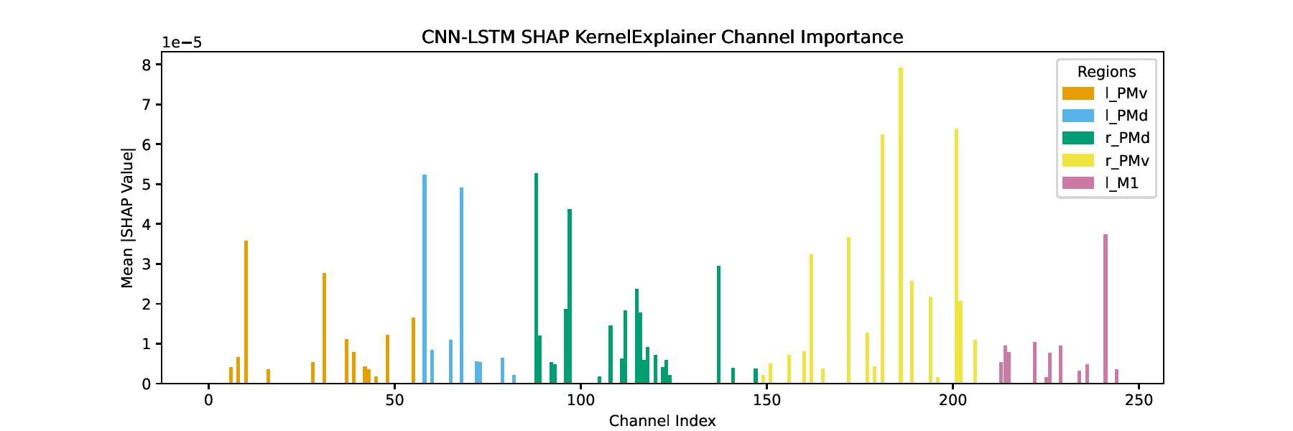
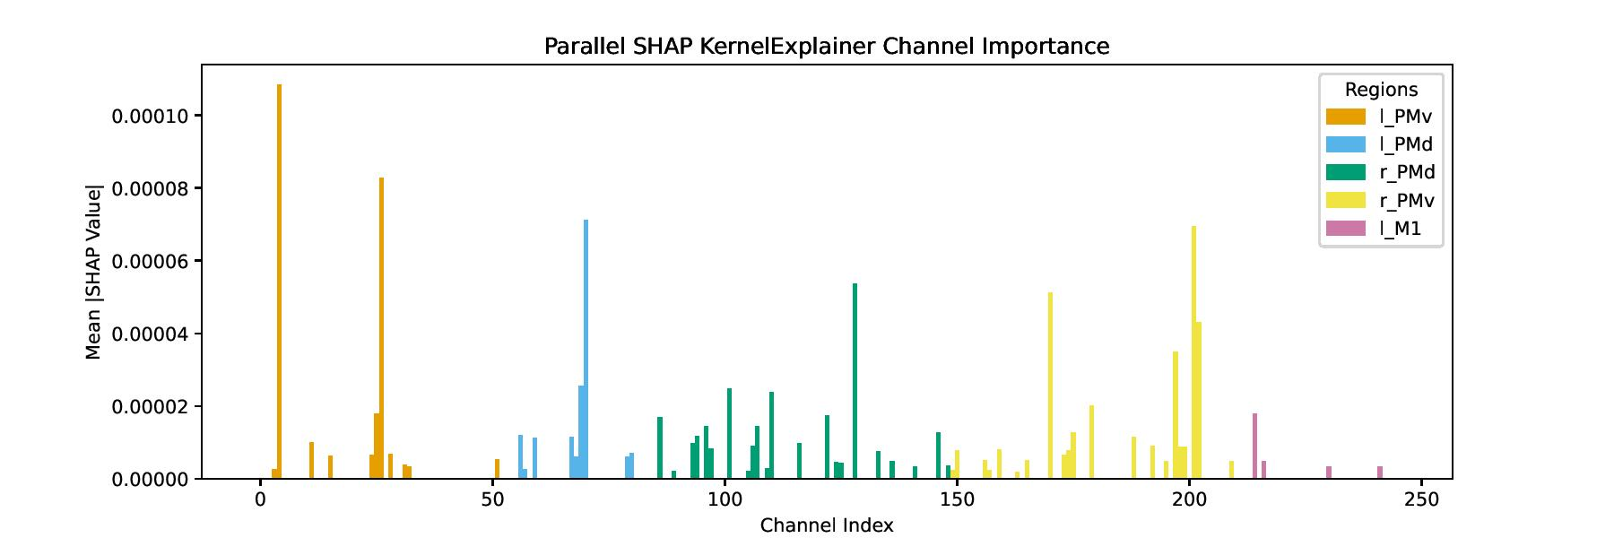
Problems with SHAP
Values of top channels are much lower than CNN values.
Many missing values implies many features were not tested at all.

Slide 24
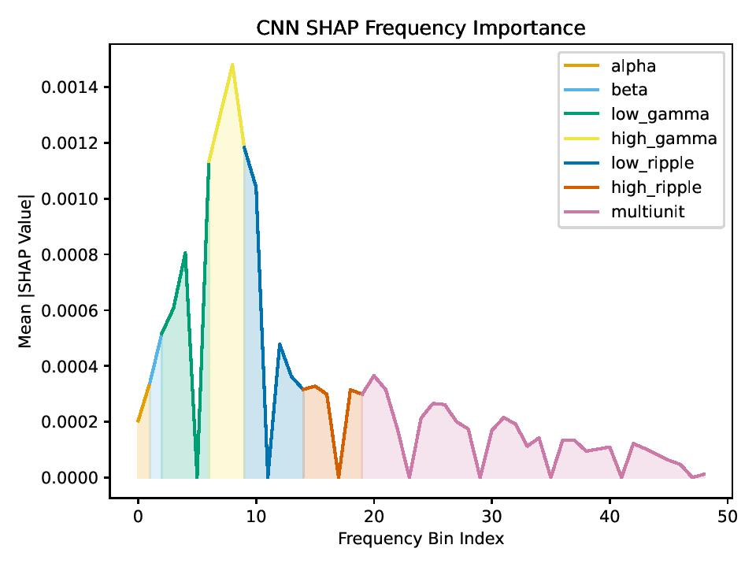
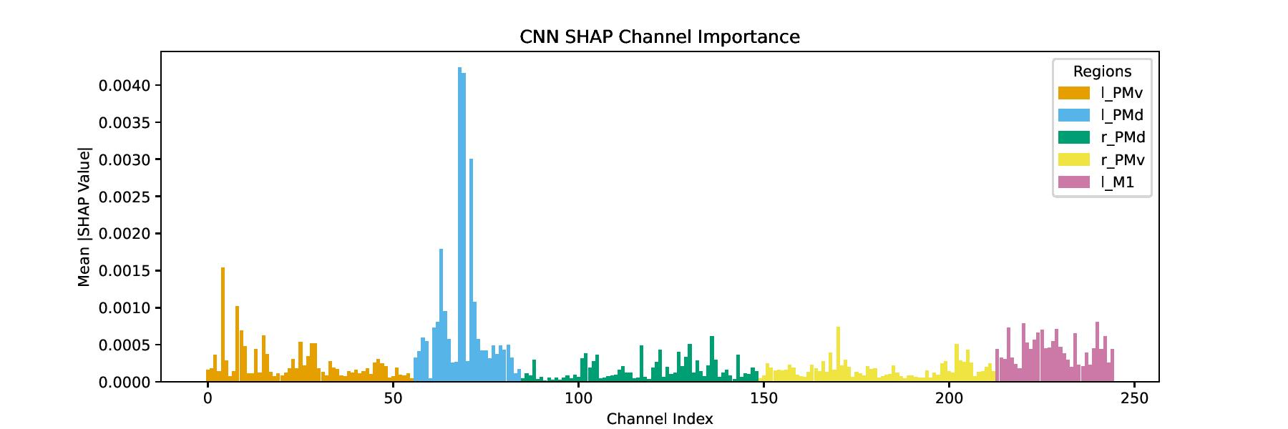
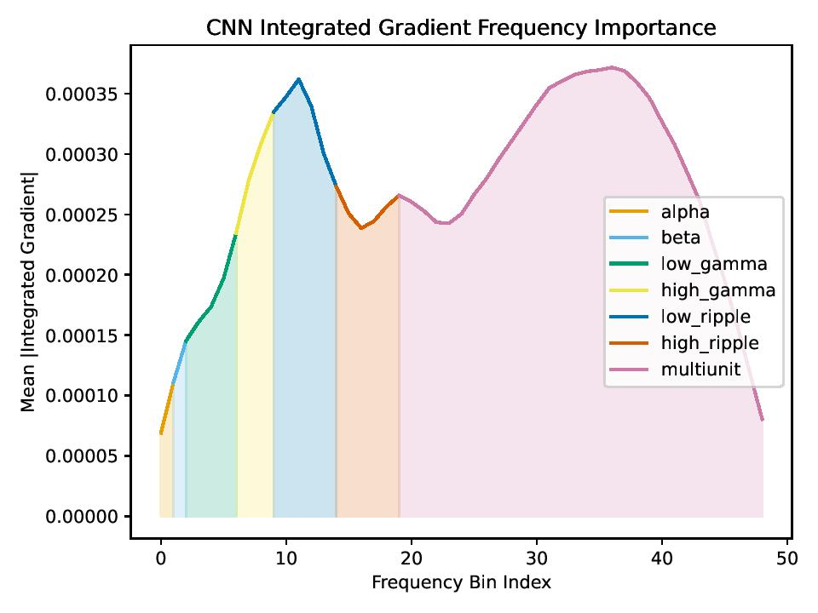
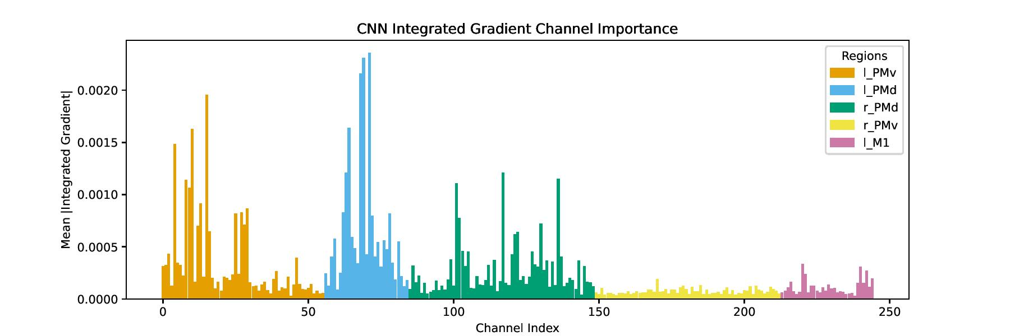
SHAP Importances
Integrated Gradient Importances

Slide 25
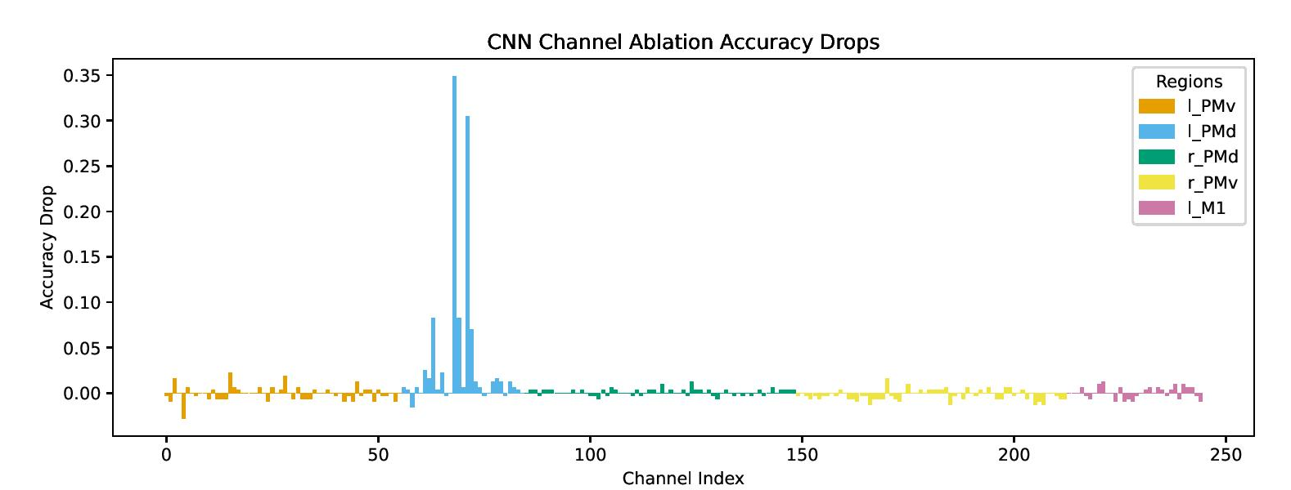
Channel Ablation
The left PMd again shows clear top importances.
We also still see the subregion of particularly high importance within the PMd.
Accuracy increases suggest more aggressive bad channel deletion can be tested.

Slide 26
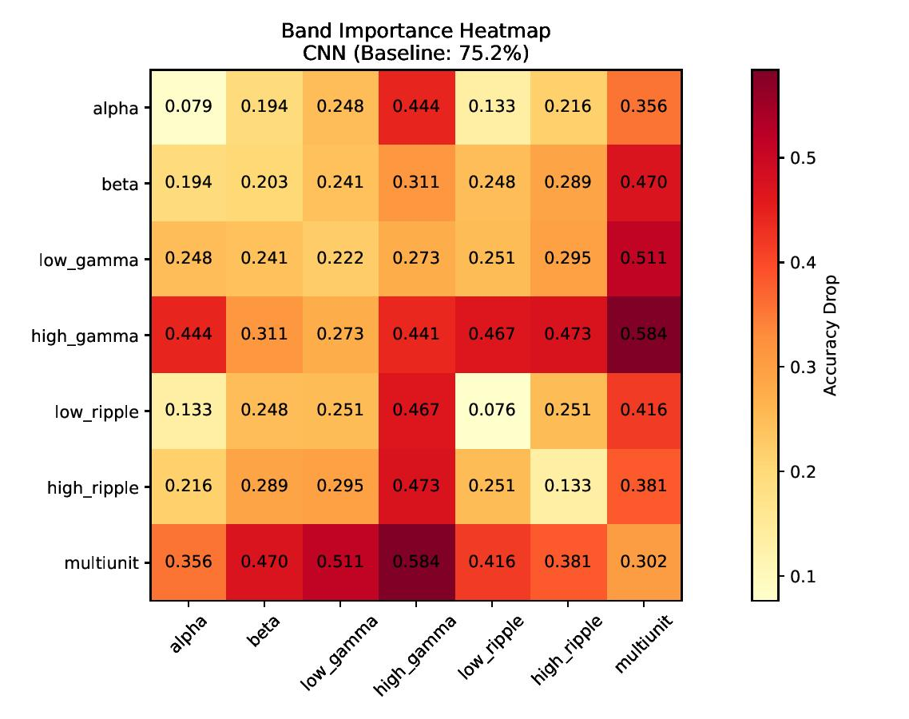
Frequency Ablation
The multiunit band and high gamma bands cause the largest drops in accuracy.
The CNN-LSTM and Parallel models show a similar pattern but are less robust to multiunit ablation and more robust to the ablation of all other bands.

Slide 27
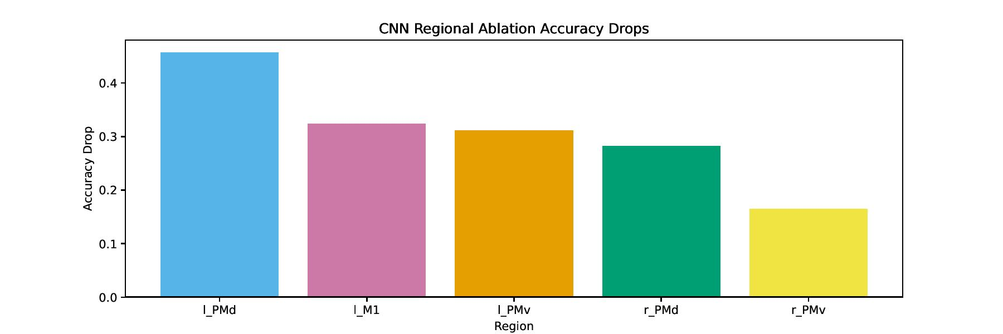
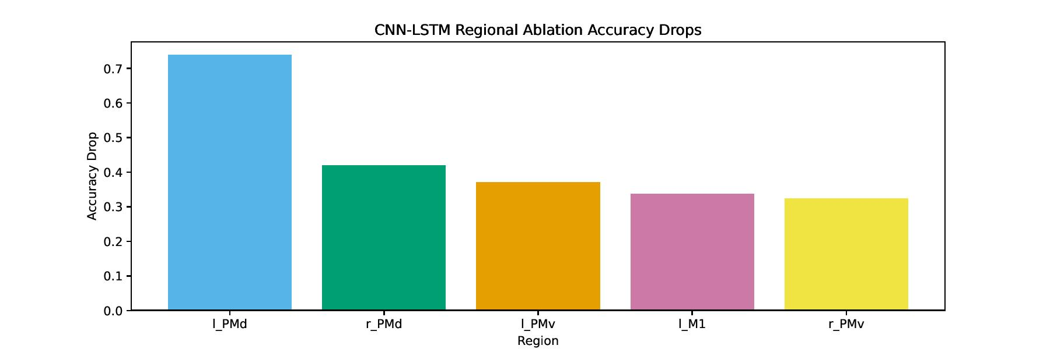
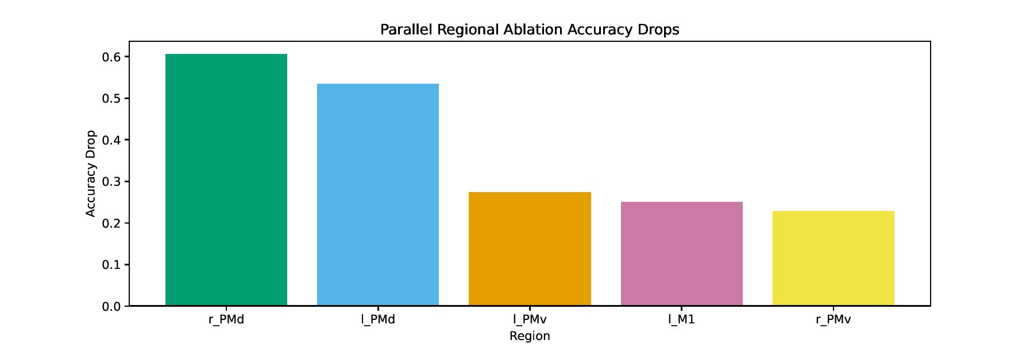
Regional Ablation
The left PMd again shows high importance.
The right PMd causes surprisingly high accuracy drops given perceived lower importance using other methods.

Slide 28
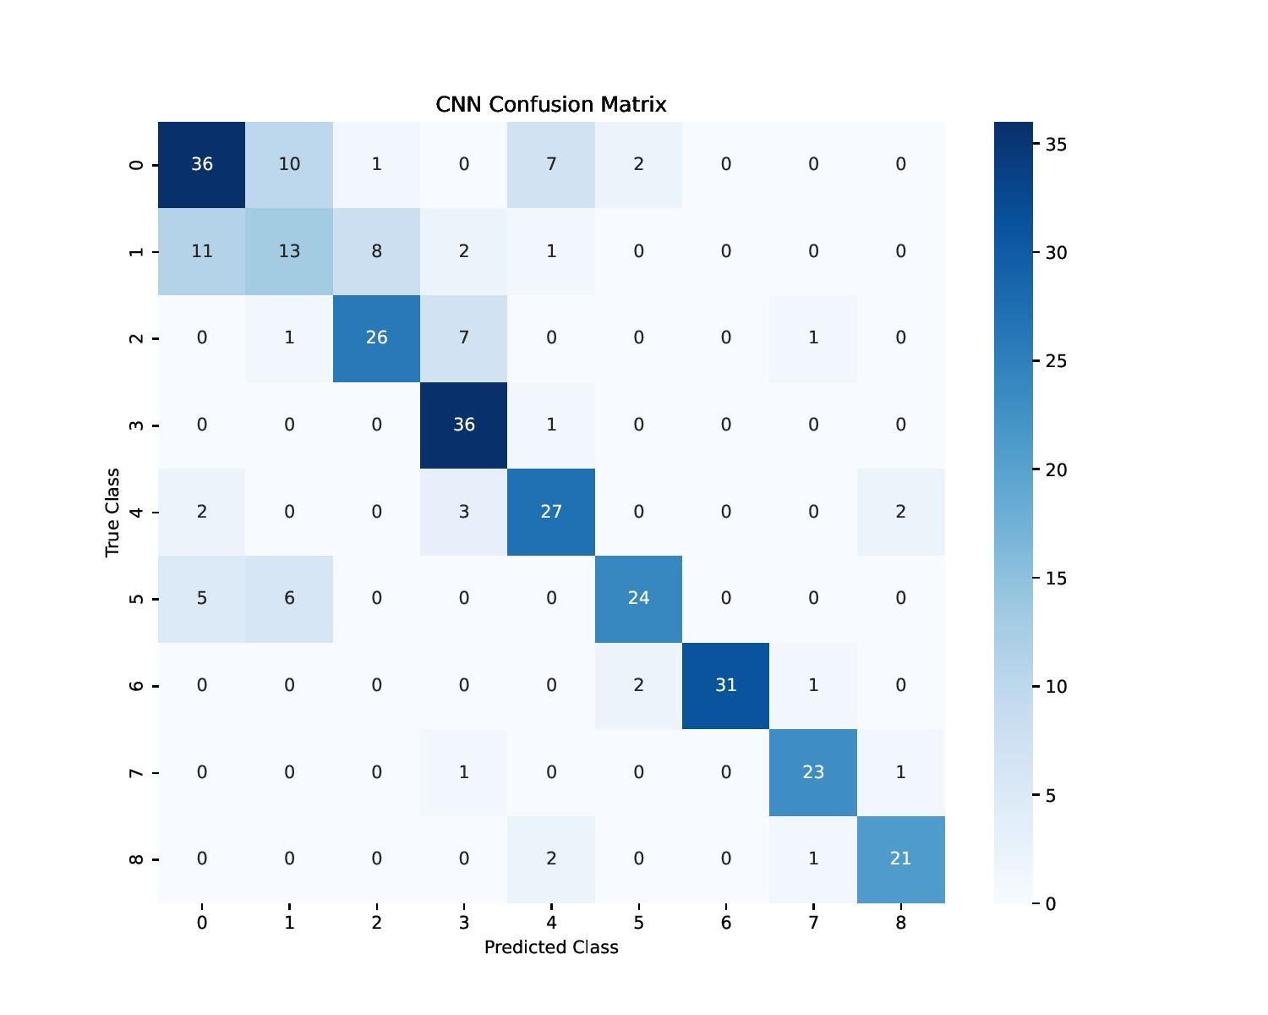
Confusion Matrix
There is lots of confusion between the baseline class and the pre-reach/post-grasp classes, especially the left-handed pre-reach class.
Models are more successful at predicting the reach and grasp stages.
Models are also generally better at right-handed predictions than left-handed ones.

Slide 29
06
Conclusions

Slide 30
Comparison with Di Croce’s Reservoir Computing
Model Performance
Reservoir computing achieved an 89% accuracy while classifying on 10 classes and using amplitude smoothing as additional preprocessing.
Feature Importance
Di Croce found similar accuracies when training on all five regions. For frequencies, his results were best when training on the multiunit band, and second best when using the gamma and ripple bands.
Overall Thoughts
Reservoir computing appears stronger in performance and robustness when it comes to predictions, but those qualities can make it more difficult for precise feature attribution.

Slide 31
Future Ideas and Suggestions
Models can be further optimized through more expansive grid searches.
More testing can be done on spectrogram creation and data cleaning.
Models can be trained on specific regions and frequency bands to assess how much valuable information they contain.
SHAP provides feature importances per class, which could provide more insight in how different types of movement are signaled differently within the brain.

Slide 32
Final Discussion
Training Results
Important Features
Our models prove that accurate multiclass classification using LFP data is possible.
The left PMd, multiunit band, and high gamma band are highly important for the prediction of movement.
Model Architecture
Attribution Methods
The CNN-LSTM and Parallel architectures produced similarly strong results. An intramodel decoder can offer additional utility and outperforms methods like PCA.
SHAP, Integrated Gradients, and ablation all provide interesting insights. SHAP might be stronger than Integrated Gradients but has more limited use.

Slide 33
Thank You!
Code and full report of this project are available on GitHub. For any questions please contact:
jtappeta214@alumnes.ub.edu

