Slide 1
Clasificación en Python.
Prof José Antonio Taquía Gutiérrez
https://www.kaggle.com/ash316/eda-to-prediction-dietanic

Slide 2
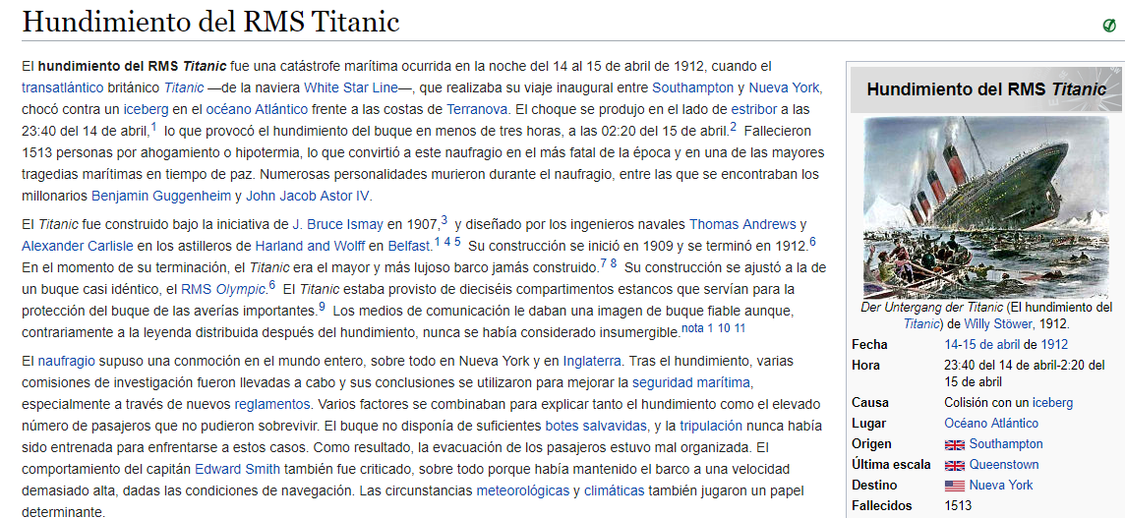

Slide 3
El hundimiento del Titanic es uno de los naufragios más infames de la historia. El 15 de abril de 1912, durante su viaje inaugural, el Titanic se hundió después de colisionar con un iceberg, matando a 1502 de 2224 pasajeros y tripulantes. Es por eso que el nombre DieTanic. Este es un desastre muy inolvidable que nadie en el mundo puede olvidar.
Se necesitaron unos $ 7,5 millones para construir el Titanic y se hundió bajo el océano debido a una colisión. El Titanic Dataset es un muy buen conjunto de datos para que los investigadores comiencen un viaje en la ciencia de datos y participen en competiciones en Kaggle.
El objetivo de este cuaderno es dar una idea de cómo es el flujo de trabajo en cualquier problema de modelado predictivo. ¿Cómo verificamos las características, cómo agregamos nuevas características y algunos conceptos de aprendizaje automático? Intenté mantener el portátil lo más básico posible para que incluso los novatos puedan comprender cada fase del mismo.

Slide 4
Part1: Exploratory Data Analysis(EDA):
1)Analysis of the features.
2)Finding any relations or trends considering multiple features.

Slide 5
Part2: Feature Engineering and Data Cleaning:
1)Adding any few features.
2)Removing redundant features.
3)Converting features into suitable form for modeling.

Slide 6
Part3: Predictive Modeling
1)Running Basic Algorithms.
2)Cross Validation.
3)Ensembling.
4)Important Features Extraction.

Slide 7
Part1: Exploratory Data Analysis(EDA) In [1]:
import numpy as np
import pandas as pd
import matplotlib.pyplot as plt
import seaborn as sns
plt.style.use('fivethirtyeight')
import warnings
warnings.filterwarnings('ignore')
%matplotlib inline

Slide 8
data=pd.read_csv('../input/train.csv')
data.head()
data.isnull().sum() #checking for total null values

Slide 9
f,ax=plt.subplots(1,2,figsize=(18,8))
data['Survived'].value_counts().plot.pie(explode=[0,0.1],autopct='%1.1f%%',ax=ax[0],shadow=True)
ax[0].set_title('Survived')
ax[0].set_ylabel('')
sns.countplot('Survived',data=data,ax=ax[1])
ax[1].set_title('Survived')
plt.show()

Slide 10
t is evident that not many passengers survived the accident.
Out of 891 passengers in training set, only around 350 survived i.e Only 38.4% of the total training set survived the crash. We need to dig down more to get better insights from the data and see which categories of the passengers did survive and who didn't.
We will try to check the survival rate by using the different features of the dataset. Some of the features being Sex, Port Of Embarcation, Age,etc.
First let us understand the different types of features.

Slide 11
Types Of Features¶
Categorical Features:
A categorical variable is one that has two or more categories and each value in that feature can be categorised by them.For example, gender is a categorical variable having two categories (male and female). Now we cannot sort or give any ordering to such variables. They are also known as Nominal Variables.
Categorical Features in the dataset: Sex,Embarked.
Ordinal Features:
An ordinal variable is similar to categorical values, but the difference between them is that we can have relative ordering or sorting between the values. For eg: If we have a feature like Height with values Tall, Medium, Short, then Height is a ordinal variable. Here we can have a relative sort in the variable.
Ordinal Features in the dataset: PClass
Continous Feature:
A feature is said to be continous if it can take values between any two points or between the minimum or maximum values in the features column.

Slide 12
Analysing The Features
Sex--> Categorical Feature
data.groupby(['Sex','Survived'])['Survived'].count()
f,ax=plt.subplots(1,2,figsize=(18,8))
data[['Sex','Survived']].groupby(['Sex']).mean().plot.bar(ax=ax[0])
ax[0].set_title('Survived vs Sex')
sns.countplot('Sex',hue='Survived',data=data,ax=ax[1])
ax[1].set_title('Sex:Survived vs Dead')
plt.show()

Slide 13
This looks interesting. The number of men on the ship is lot more than the number of women. Still the number of women saved is almost twice the number of males saved. The survival rates for a women on the ship is around 75% while that for men in around 18-19%.
This looks to be a very important feature for modeling. But is it the best?? Lets check other features.

Slide 14
Pclass --> Ordinal Feature
pd.crosstab(data.Pclass,data.Survived,margins=True).style.background_gradient(cmap='summer_r')
f,ax=plt.subplots(1,2,figsize=(18,8))
data['Pclass'].value_counts().plot.bar(color=['#CD7F32','#FFDF00','#D3D3D3'],ax=ax[0])
ax[0].set_title('Number Of Passengers By Pclass')
ax[0].set_ylabel('Count')
sns.countplot('Pclass',hue='Survived',data=data,ax=ax[1])
ax[1].set_title('Pclass:Survived vs Dead')
plt.show()

Slide 15
People say Money Can't Buy Everything. But we can clearly see that Passenegers Of Pclass 1 were given a very high priority while rescue. Even though the the number of Passengers in Pclass 3 were a lot higher, still the number of survival from them is very low, somewhere around 25%.
For Pclass 1 %survived is around 63% while for Pclass2 is around 48%. So money and status matters. Such a materialistic world.
Lets Dive in little bit more and check for other interesting observations. Lets check survival rate with Sex and PclassTogether.

Slide 16
pd.crosstab([data.Sex,data.Survived],data.Pclass,margins=True).style.background_gradient(cmap='summer_r')
sns.factorplot('Pclass','Survived',hue='Sex',data=data)
plt.show()

Slide 17
We use FactorPlot in this case, because they make the seperation of categorical values easy.
Looking at the CrossTab and the FactorPlot, we can easily infer that survival for Women from Pclass1 is about 95-96%, as only 3 out of 94 Women from Pclass1 died.
It is evident that irrespective of Pclass, Women were given first priority while rescue. Even Men from Pclass1 have a very low survival rate.
Looks like Pclass is also an important feature. Lets analyse other features.

Slide 18
Age--> Continous Feature
print('Oldest Passenger was of:',data['Age'].max(),'Years')
print('Youngest Passenger was of:',data['Age'].min(),'Years')
print('Average Age on the ship:',data['Age'].mean(),'Years')

Slide 19
f,ax=plt.subplots(1,2,figsize=(18,8))
sns.violinplot("Pclass","Age", hue="Survived", data=data,split=True,ax=ax[0])
ax[0].set_title('Pclass and Age vs Survived')
ax[0].set_yticks(range(0,110,10))
sns.violinplot("Sex","Age", hue="Survived", data=data,split=True,ax=ax[1])
ax[1].set_title('Sex and Age vs Survived')
ax[1].set_yticks(range(0,110,10))
plt.show()

Slide 20
Observations:
1)The number of children increases with Pclass and the survival rate for passenegers below Age 10(i.e children) looks to be good irrespective of the Pclass.
2)Survival chances for Passenegers aged 20-50 from Pclass1 is high and is even better for Women.
3)For males, the survival chances decreases with an increase in age.

Slide 21
s we had seen earlier, the Age feature has 177 null values. To replace these NaN values, we can assign them the mean age of the dataset.
But the problem is, there were many people with many different ages. We just cant assign a 4 year kid with the mean age that is 29 years. Is there any way to find out what age-band does the passenger lie??
Bingo!!!!, we can check the Name feature. Looking upon the feature, we can see that the names have a salutation like Mr or Mrs. Thus we can assign the mean values of Mr and Mrs to the respective groups.
''What's In A Name??''---> Feature :p

Slide 22
data['Initial']=0
for i in data:
data['Initial']=data.Name.str.extract('([A-Za-z]+)\.') #lets extract the Salutations
Okay so here we are using the Regex: [A-Za-z]+).. So what it does is, it looks for strings which lie between A-Z or a-z and followed by a .(dot). So we successfully extract the Initials from the Name.

Slide 23
pd.crosstab(data.Initial,data.Sex).T.style.background_gradient(cmap='summer_r') #Checking the Initials with the Sex

Slide 24
Okay so there are some misspelled Initials like Mlle or Mme that stand for Miss. I will replace them with Miss and same thing for other values.
data['Initial'].replace(['Mlle','Mme','Ms','Dr','Major','Lady','Countess','Jonkheer','Col','Rev','Capt','Sir','Don'],['Miss','Miss','Miss','Mr','Mr','Mrs','Mrs','Other','Other','Other','Mr','Mr','Mr'],inplace=True)
data.groupby('Initial')['Age'].mean() #lets check the average age by Initials

Slide 25
## Assigning the NaN Values with the Ceil values of the mean ages
data.loc[(data.Age.isnull())&(data.Initial=='Mr'),'Age']=33
data.loc[(data.Age.isnull())&(data.Initial=='Mrs'),'Age']=36
data.loc[(data.Age.isnull())&(data.Initial=='Master'),'Age']=5
data.loc[(data.Age.isnull())&(data.Initial=='Miss'),'Age']=22
data.loc[(data.Age.isnull())&(data.Initial=='Other'),'Age']=46

Slide 26
data.Age.isnull().any() #So no null values left finally

Slide 27
f,ax=plt.subplots(1,2,figsize=(20,10))
data[data['Survived']==0].Age.plot.hist(ax=ax[0],bins=20,edgecolor='black',color='red')
ax[0].set_title('Survived= 0')
x1=list(range(0,85,5))
ax[0].set_xticks(x1)
data[data['Survived']==1].Age.plot.hist(ax=ax[1],color='green',bins=20,edgecolor='black')
ax[1].set_title('Survived= 1')
x2=list(range(0,85,5))
ax[1].set_xticks(x2)
plt.show()

Slide 28
Observations:
1)The Toddlers(age<5) were saved in large numbers(The Women and Child First Policy).
2)The oldest Passenger was saved(80 years).
3)Maximum number of deaths were in the age group of 30-40.

Slide 29
sns.factorplot('Pclass','Survived',col='Initial',data=data)
plt.show()
he Women and Child first policy thus holds true irrespective of the class.

Slide 30
Embarked--> Categorical Value
pd.crosstab([data.Embarked,data.Pclass],[data.Sex,data.Survived],margins=True).style.background_gradient(cmap='summer_r')

Slide 31
Chances for Survival by Port Of Embarkation¶
sns.factorplot('Embarked','Survived',data=data)
fig=plt.gcf()
fig.set_size_inches(5,3)
plt.show()
The chances for survival for Port C is highest around 0.55 while it is lowest for S.

Slide 32
f,ax=plt.subplots(2,2,figsize=(20,15))
sns.countplot('Embarked',data=data,ax=ax[0,0])
ax[0,0].set_title('No. Of Passengers Boarded')
sns.countplot('Embarked',hue='Sex',data=data,ax=ax[0,1])
ax[0,1].set_title('Male-Female Split for Embarked')
sns.countplot('Embarked',hue='Survived',data=data,ax=ax[1,0])
ax[1,0].set_title('Embarked vs Survived')
sns.countplot('Embarked',hue='Pclass',data=data,ax=ax[1,1])
ax[1,1].set_title('Embarked vs Pclass')
plt.subplots_adjust(wspace=0.2,hspace=0.5)
plt.show()

Slide 33
Observations:
1)Maximum passenegers boarded from S. Majority of them being from Pclass3.
2)The Passengers from C look to be lucky as a good proportion of them survived. The reason for this maybe the rescue of all the Pclass1 and Pclass2 Passengers.
3)The Embark S looks to the port from where majority of the rich people boarded. Still the chances for survival is low here, that is because many passengers from Pclass3 around 81% didn't survive.
4)Port Q had almost 95% of the passengers were from Pclass3.

Slide 34
sns.factorplot('Pclass','Survived',hue='Sex',col='Embarked',data=data)
plt.show()
Observations:
1)The survival chances are almost 1 for women for Pclass1 and Pclass2 irrespective of the Pclass.
2)Port S looks to be very unlucky for Pclass3 Passenegers as the survival rate for both men and women is very low.(Money Matters)
3)Port Q looks looks to be unlukiest for Men, as almost all were from Pclass 3.

Slide 35
Filling Embarked NaN
As we saw that maximum passengers boarded from Port S, we replace NaN with S.
data['Embarked'].fillna('S',inplace=True)
data.Embarked.isnull().any()# Finally No NaN values

