Slide 1
Sprint 2 Java the Hutt
By Jacob Augustine, Tyler Dansby, Nick Kaliher, Tejaswini Kancharla, and Josh Welch

Slide 2
Agenda
Brief overview of Congo
Sprint Artifacts
Meetings
Progress
Backend Development
Review and Retrospective
Demo
Questions

Slide 3
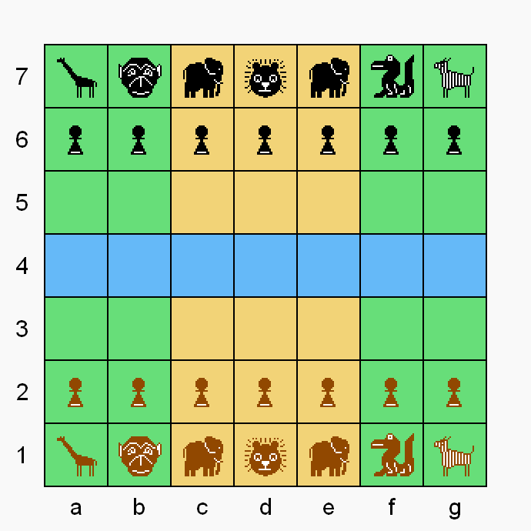
Congo
A player wins when they capture the opponents lion, or the the opponent only has their lion left.

Slide 4
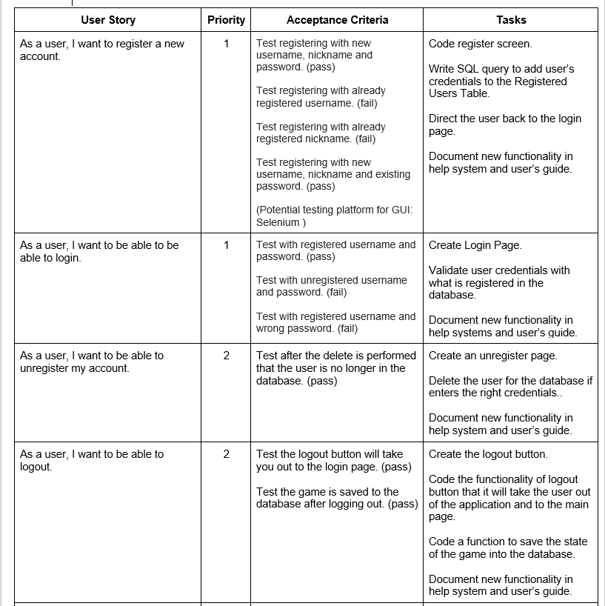
User Stories

Slide 5
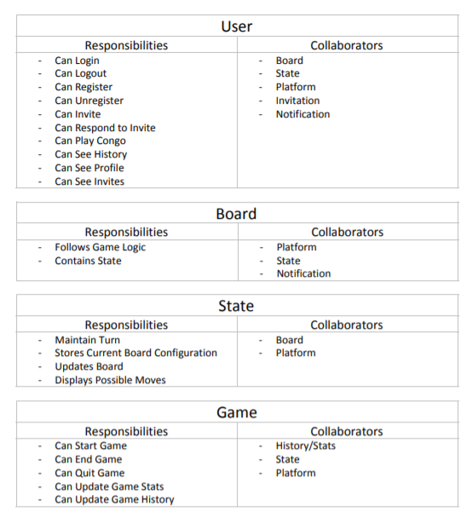
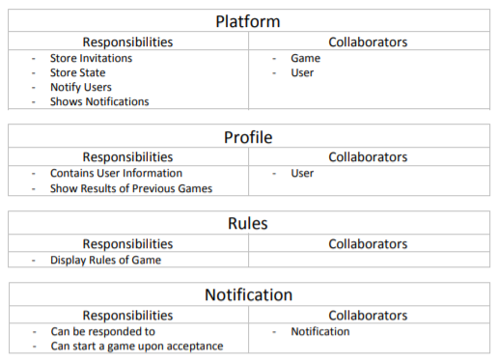
CRC Cards

Slide 6
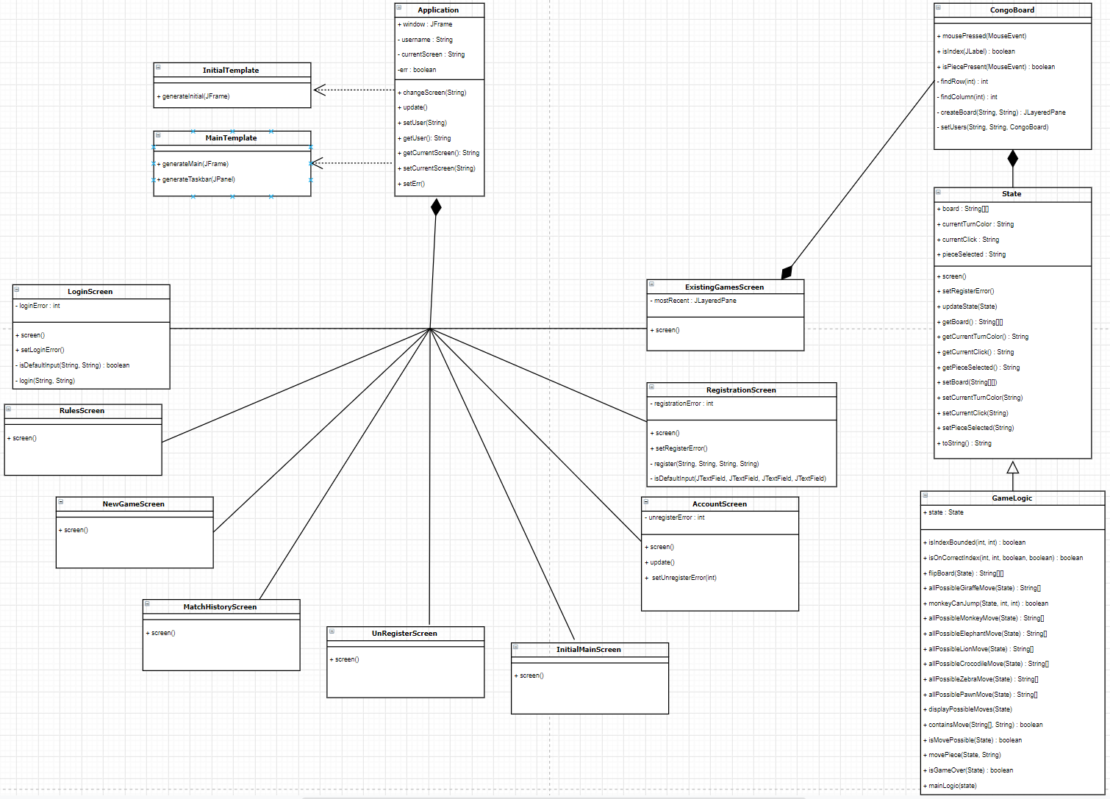
Class Diagram

Slide 7
Meetings
Meeting 1 (Developers meeting)
We discussed the new requirements from the product owner.
Noted down the questions we had regarding the newly specified user stories for Sprint 2.
Meeting 2 (with PO) - Prioritization
Met with product owner for backlog prioritization.
Discussed architecture of newly introduced user stories.
Meeting 3 - 5 (Developers meeting)
Discussed database options and decided on using a Raspberry Pi.
Board UI overhaul (new color scheme and piece icons)
Monkey logic
Meeting 6 (with PO) - Sprint Review
Met with the product owner to demo the current state of our application.
Meeting 7 (Developers meeting)
Met with team to fix the things that were broken in the demo.
Worked on the database, Game Board GUI and Integration of board with game logic.
Developed some unit tests.

Slide 8
Progress
Completely Done:
Registering a user
Log in by a registered user
Log out by the user
GUI changes
Partially Done:
Unregistering an user
Board and game logic integration

Slide 9
Back-end Progress
Raspberry Pi
Set up with new OS and loaded SQL Server
Opened ports and access required for connectivity
Database
Fully developed for User information
Partially developed for Game information

Slide 10
Review and Retrospective
Sprint Review
Sprint Retrospective

Slide 11
DEMO!!

Slide 12
Questions?

