Slide 1
Web Scraping
MIE1624
Group 1
January 21, 2019

Slide 2
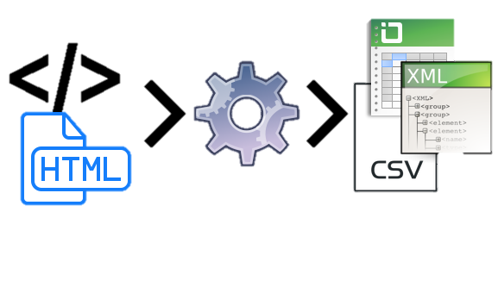
Web Scraping
Technique to extract information from websites
Assignment: extract Data Scientist job information from Indeed.ca

Slide 3
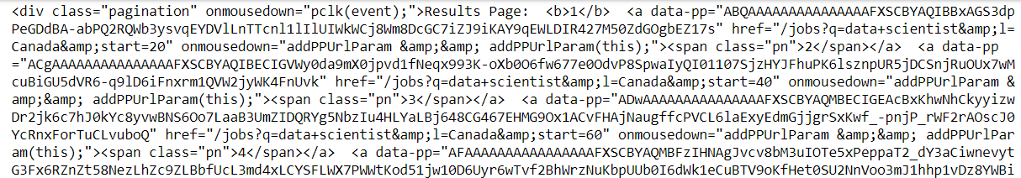
HTML
Hyper Text Markup Language
Describes structure of web pages
Can be stuctured and unstructured
Elements are represented by tags
i.e. “heading”, “paragraph”, “table”
Tags are used to render content (they are not displayed)
Notes:
Structured data is data that has a pre-defined data model or organized in a defined manner
Unstructured data is data that is not ordered nor is there a pre-defined model

Slide 4
Import Packages
pandas
numpy
requests
matplotlib
bs4 → BeautifulSoup
time

Slide 5
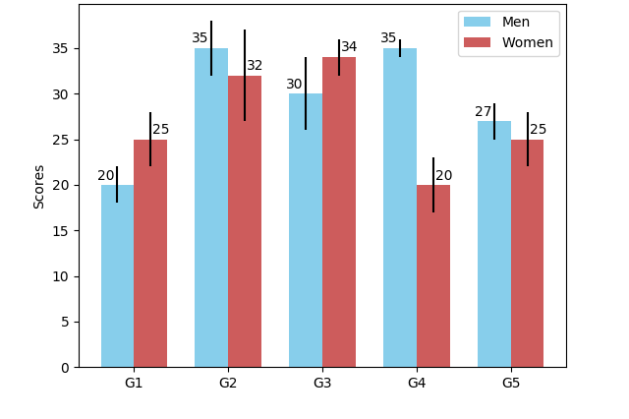
Import Packages
Pandas
Create and manipulate data structures
Requests
Requests.get → get webpages
Requests.text → read content of webpage (html)
MatPlotLib
Visualize results

Slide 6
Import Packages
BeautifulSoup
HTML parsing
Parsing: the process of analyzing a string of symbols based on syntactic relationships
.find_all() → search for exact string
Time
Reference time
i.e. add a delay

Slide 7
Function Logic
Import libraries
Generate links to search results pages
Scrape HTMLs of job postings
Parse job postings
Check for duplicates
Display results
Save as .csv

Slide 8
Parsing Structure
https://www.indeed.ca/jobs?q=data+scientist&l=Canada&start
https://www.indeed.ca/jobs?q=data+scientist&l=Canada&start=20
https://ca.indeed.com/viewjob?jk=7e2dd397dd38c06c&tk=1d1jhbcdi4o0o802&from=serp&vjs=3
https://ca.indeed.com/viewjob?jk=8c40680359e160e5&tk=1d1jhbcdi4o0o802&from=serp&vjs=3
https://www.indeed.ca/jobs?q=data+scientist&l=Canada&start=40
Search link
Posting Links
Job Description & Skills
https://www.indeed.ca/jobs?q=data+scientist&l=Canada&start=60
Search Results Links
Toronto, ON
AMZN CAN Fulfillment Svcs, ULC
Skills: Programming languages, communication, problem solving, project management, etc.
Data Scientist- Machine Learning

Slide 9
Jupyter Notebook

Slide 10
Results Table
 | job_title | job_company | job_location | date
0 | Data Scientist | Loblaw Digital | Toronto, ON | 30 days ago
1 | Data Scientist | SPORTLOGiQ | Montreal, QC
2 | Data Scientist | Groom & Associates | Montreal, QC | 28 days ago
3 | Data Scientist | Walmart Canada | Mississauga, ON | 3 days ago
4 | Full-time opportunities for students & recent graduates: Data & Applied Sciences | Microsoft | Canada | 30+ days ago

Slide 11
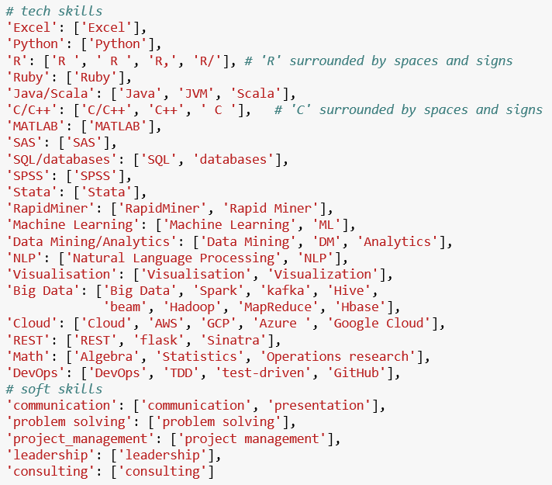
Skills keywords

Slide 12
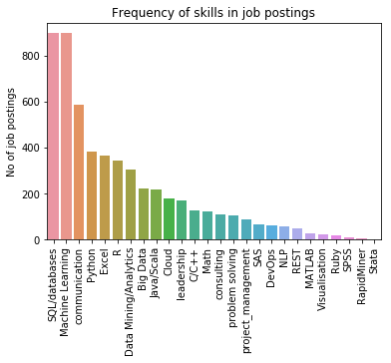
Frequency of Skills

Slide 13
Challenges
Context for keyword search
Parsing non-specific keywords
i.e. R, C (both programming languages and letters in the alphabet)
Keywords are predefined
Need for delays between http get() requests
Different webpages can have different HTML structure and tags
Manual verification of datasets
i.e. jobs were re-posted → duplicates

Slide 14
Thank you

