Slide 1

Wavelets and Denoising
Jun Ge and Gagan Mirchandani
Electrical and Computer Engineering Department
The University of Vermont
October 10, 2003
Research day, Computer Science Department, UVM

Slide 2
signal
Notes:
We like signals. One-dimensional, two-dimensional, three-dimensional. They carry useful information.

Slide 3
noise
signal
noisy signal
Notes:
We don’t like noise. Typically, noise does not provide useful information. However noise is unavoidable during measurement and/or transmission of signals. The types of noise are many. Additive or multiplicative. White or colored, etc. The incorporated noise degrades the human interpretation, or computer-aided analysis of signals.
We need to do something.

Slide 4
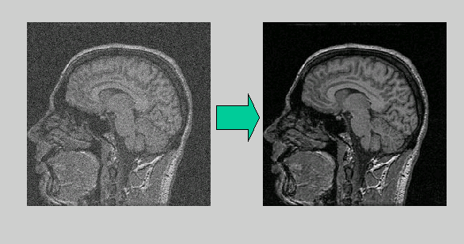
What is denoising?
Goal:
  Remove noise
  Preserve useful information
Applications:
  Medical signal/image analysis (ECG, CT, MRI etc.)
  Data mining
  Radio astronomy image analysis
Notes:
Denoising (noise reduction) is to remove noise as much as possible while preserving useful information as much as possible. This is the first step in many applications. For example, the left is a noisy MR brain image. Before the analysis, we would like to clean it up.

Slide 5
noise
signal
noisy signal
Wiener filtering
Notes:
Among other techniques, Wiener filtering is a powerful tool for additive noise reduction. In practice, we need to estimate the signal and noise spectra. In addition, in its basis form, the Wiener theory assumes that the signals are stationary processes. This assumption is not realistic in many practical scenarios. A local wiener filtering method was proposed in the early 80’s to improve the noise reduction performance in practice. This method has been implemented in MATLAB. In the mid 80’s, wavelet analysis came out as a complement of the traditional Fourier analysis. There are two major properties of wavelet basis: it is a unconditional basis for a variety of function spaces, it’s approximation power is better than Fourier basis.

Slide 6
noise
signal
noisy signal
Wiener filtering
Wavelet Shrinkage
1-D
Notes:
There two properties were used by Donoho and Johnstone in the Wavelet Shrinkage. They proposed two wavelet shrinkage methods in early 90’s: hard-thresholding and soft-thresholding. Wavelet hard-thresholding is a near-optimal MMSE solution. Wavelet soft-thresholding is a near-optimal constrained minimization solution. However, the success of wavelet shrinkage for 1d signal does not directly bring the same for high dimensional signals. Usually, the 2D wavelet representation is realized using tensor product of 1D wavelets.

Slide 7
noise
signal
noisy signal
Wiener filtering
Wavelet Shrinkage
2-D (m-D)
1-D
Geometrical Analysis

Slide 8
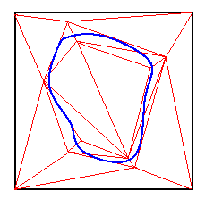
Incorporating geometrical structure
Two possible solutions:
Constructing non-separable parsimonious representations for two dimensional signals (e.g., ridgelets (Donoho et al.), edgelets (Vetterli et al.), bandlets (Mallat et al.), triangulation), no fast algorithms yet.
Incorporating geometrical information (inter- and intra-scale correlation) in the analysis because wavelet decorrelation is not complete.

Slide 9
noise
signal
noisy signal
Wiener filtering
Wavelet Shrinkage
2-D (m-D)
1-D
Geometrical Analysis
Statistical Approach
(Bayesian, parametric)

Slide 10
noise
signal
noisy signal
Wiener filtering
Wavelet Shrinkage
2-D (m-D)
1-D
Geometrical Analysis
Statistical Approach
(Bayesian, parametric)
Deterministic/Statistical Approach
(non-parametric)

Slide 11
noise
signal
noisy signal
Wiener filtering
Wavelet Shrinkage
2-D (m-D)
1-D
Geometrical Analysis
Statistical Approach
(Bayesian, parametric)
Deterministic/Statistical Approach
(non-parametric)
Nonseparable basis

Slide 12
noise
signal
noisy signal
Wiener filtering
Wavelet Shrinkage
2-D (m-D)
1-D
Geometrical Analysis
Statistical Approach
(Bayesian, parametric)
Deterministic/Statistical Approach
(non-parametric)
Geometrical Decorrelation
Nonseparable basis

Slide 13
noise
signal
noisy signal
Wiener filtering
Wavelet Shrinkage
2-D (m-D)
1-D
Geometrical Analysis
Statistical Approach
(Bayesian, parametric)
Deterministic/Statistical Approach
(non-parametric)
Geometrical Decorrelation
Nonseparable basis
Inter-scale (MPM)

Slide 14
Multiscale Product Method
Idea: capture inter-scale correlation
Nonlinear edge detection (Rosenfeld 1970)
Noise reduction for medical images (Xu et al. 1994)
Analyzed by Sadler and Swami (1999)

Slide 15
Multiscale Product Method
The algorithm:
save a copy of the W (m, n) to WW (m, n)
loop for each wavelet scale m {
loop for the iteration process {
calculate the power of Corr2(m, n) and W (m, n)
rescale he power of Corr2(m, n) to that of W (m, n)
for each pixel n {
if |Corr2(m,n)| > |W (m, n)|
mask (m, n) = 1, Corr2(m, n) = 0, W (m, n) = 0 }
} iterate until the power of W (m, n) < the noise threshold T (m)
apply the “spatial filter mask” to the saved WW (m, n)}

Slide 16
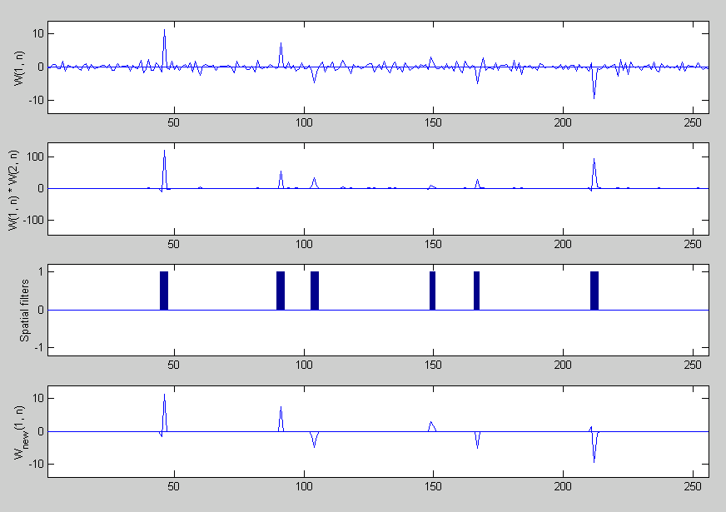
Multiscale Product Method

Slide 17
noise
signal
noisy signal
Wiener filtering
Wavelet Shrinkage
2-D (m-D)
1-D
Geometrical Analysis
Statistical Approach
(Bayesian, parametric)
Deterministic/Statistical Approach
(non-parametric)
Geometrical Decorrelation
Nonseparable basis
Inter-scale (MPM)
Intra-scale (LCA)

Slide 18
Local Covariance Analysis: Motivation
Idea: Capture intra-scale correlation
Feature extraction (e.g., edge detection) is one of the most important areas of image analysis and computer vision.
Edge Detection: intensity image → edge map ( a map of edge related pixel sites).
  Significance Measure (e.g., the magnitude of the directional gradient)
  Thresholding (e.g., Canny’s hysteresis thresholding)
Canny Edge Detectors | Mallat’s quadratic spline wavelet
False detections are unavoidable
Looking for better significance measure

Slide 19
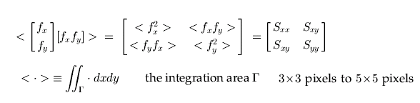
Local Covariance Analysis
Plessy corner detector (Noble 1988): a spatial average of an outer product of the gradient vector
Image field categorization (Ando 2000): gradient covariance form differential Gaussian Filters
Cross correlation of the gradients along x- and y-coordinates:

Slide 20


Local Covariance Analysis
The covariance matrix is Hermitian and positive semidefinite → the two eigenvalues are real and positive
The two eigenvalues are the principle components of the (fx, fy) distribution.
A dimensionless and normalized homogeneity measure is defined as the ratio of the multiplicative average to the additive average (Ando 2000)
A significance measure is defined as

Slide 21
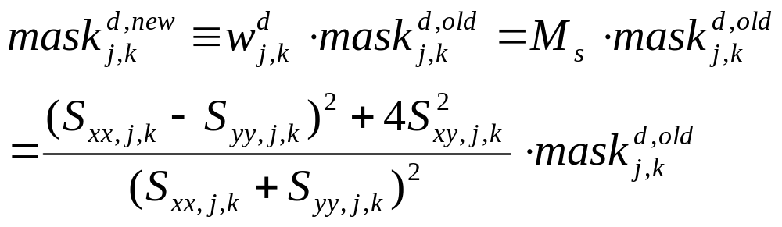
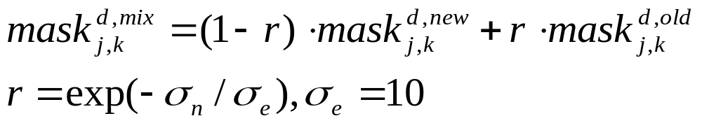
A New Data-Driven Shrinkage Mask
Experimental results indicate that the new mask offers better performance only for relatively high level (standard deviation) noise.
r is an empirical parameter which provides the mixture of masks.

Slide 22
Comparison with several algorithms
wiener2 in MATLAB
Xu et al. (IEEE Trans. Image Processing, 1994)
Donoho (IEEE Trans. Inform. Theory, 1995)
Strela (in 3rd European Congress of Mathematics, Barcelona, July 2000)
Portilla et al. (Technical Report, Computer Science Dept., New York University, Sept. 2002)

Slide 23
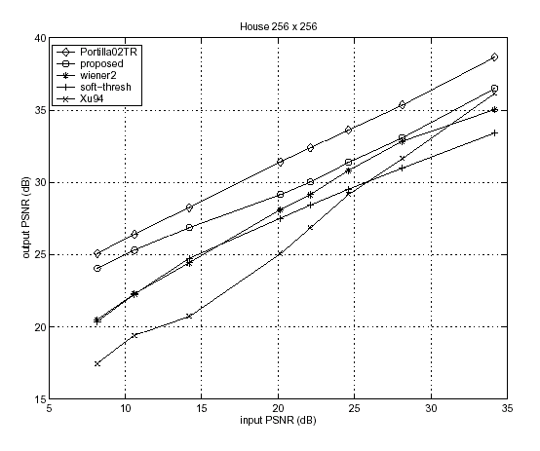
Experimental Results

Slide 24
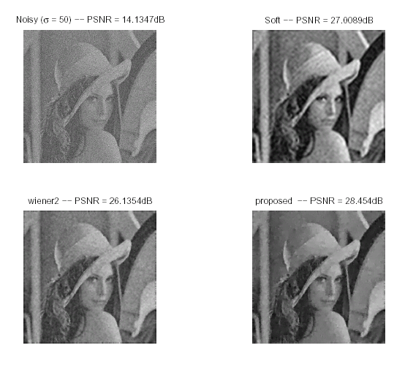
Experimental Results

Slide 25
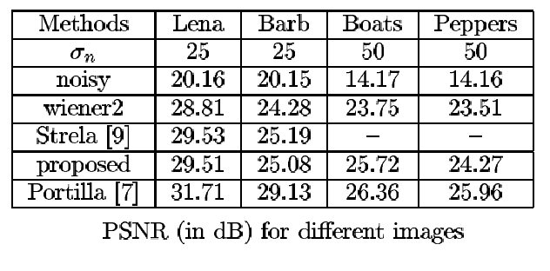
Experimental Results

Slide 26
Appendix
What is a wavelet?
What is good about wavelet analysis?
What is denoising?
Why choose wavelets to denoise?

Slide 27
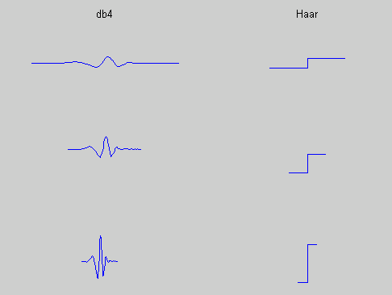
What is a wavelet?
A wavelet is an elementary function
which satisfies certain admissible conditions
whose dilates and shifts give a Riesz (stable) basis of L^2(R)

Slide 28
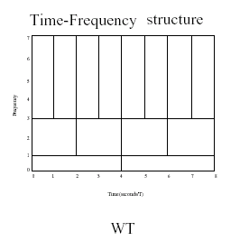
What is good about wavelet analysis?
Simultaneous time and frequency localizations
Unconditional basis for a variety of classes of functions spaces
Approximation power
A complement to Fourier analysis

Slide 29
Why choose wavelets to denoise?
Wavelet Shrinkage (Donoho-Johnstone 1994)
Unconditional basis:
  Magnitude is an important significance measure
  A binary classifier:
Wavelet coefficients → {signal, noise}
  generalization: Bayesian approach
Approximation power:
  n-term nonlinear approximation
  generalization: restricted nonlinear approximation

Slide 30
Statistical Modeling
Gaussian Markov Random Fields
Statistical modeling of wavelet coefficients:
  Marginal Models:
    Generalized Gaussian distributions
    Gaussian Scale Mixtures
  Joint Models:
    Hidden Markov Tree models
Notes:
Modeling the statistics of natural images is a challenging task, partly because of the high
dimensionality of the signal. Two basic assumptions are commonly made in order to reduce
dimensionality. The first is that the probability structure may be defined locally. Typically,
one makes a Markov assumption, that the probability density of a pixel, when conditioned
on a set of neighbors, is independent of the pixels beyond the neighborhood. The second
is an assumption of spatial homogeneity: the distribution of values in a neighborhood is the
same for all such neighborhoods, regardless of absolute spatial position. Although the most
common model arising from these two assumptions is a Gaussian Markov random field, the
restriction to second-order processes is not required, and is problematic for image modeling,
where the complexity of local geometric structures are not well described by Gaussian densities.
The power of statistical image models can be substantially improved by transforming the
signal from the pixel domain to a new representation, in which higher-order statistical
properties are simplified.

Slide 31
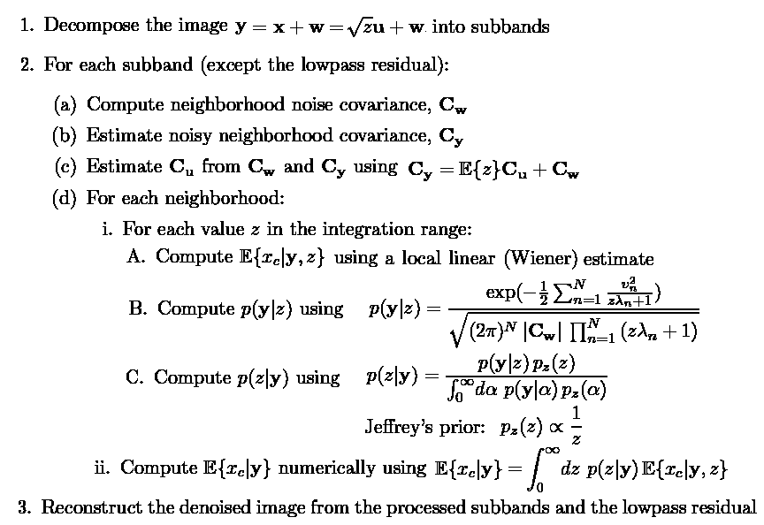
Denoising Algorithm using GSM Model and a Bayes least squares estimator
(Portilla et al. 2002)

