Slide 1
Data Stream Monitoring, Information Security, and Temporal Data Mining
X. Sean Wang

Slide 2
Data Stream Monitoring
Given:
  Data come into the system in a high rate
  Many pre-determined monitoring conditions (or queries)
Requirements:
  Real-time or near real-time response
  Minimum resource requirement

Slide 3
Applications
Health care:
  Tele-monitoring
Homeland security:
  Detecting bio-attack or disease outbreak by monitoring over-the-counter drug sales, school attendance, and other data streams
Military application:
  Peripheral defense with sensors

Slide 4
Quality of Service (QoS)
Quality and performance measures:
  How many data items can be processed per second?
  How accurate are the answers?
  How fast the response time is?
  …
QoS
  Provide quality and performance guarantees

Slide 5
Approximate Monitoring
When quality can be measured approximately (or with probability):
  E.g., trigger an action when the corresponding condition is true with a 90% probability
  E.g., among all conditions that are reported true (and hence each triggers an action), 90% are correct

Slide 6
Research Questions
How to estimate the quality and related probability
How to optimize queries when quality is measured in terms of probability
How to optimize queries considering the continuous nature of the queries
How to determine the tradeoffs between performance and resource usage

Slide 7
Information Privacy & Security
In general:
  Data can only be accessed by the authorized users
  Legitimate use of data is protected
  Data integrity is guaranteed

Slide 8
Information Release Control
Access control
  Label data to allow access only to the rightful users
Release control
  Check data when it’s release into “outside” to see if it can be released
  Complements access control
  Prevent insider attacks

Slide 9
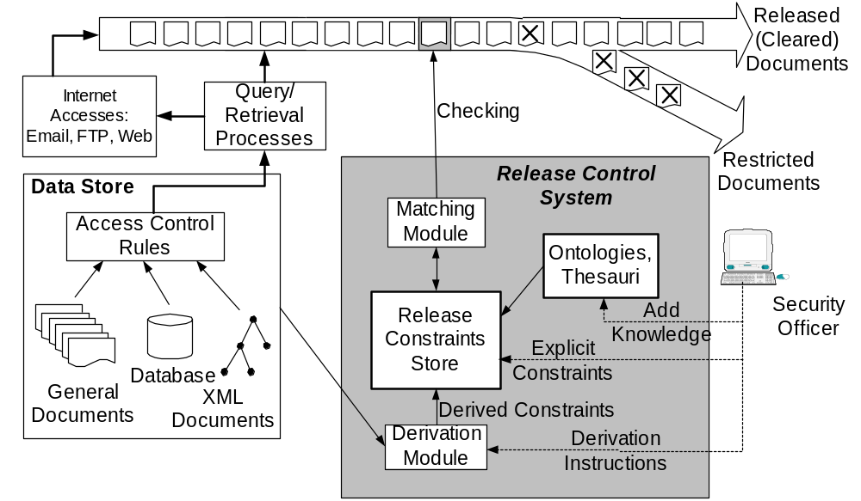
System Architecture

Slide 10
Release Control
Research questions
  What are the release control rules
  How to find them
  How to efficiently check outgoing data for release violations
  What about inferences: some data values may imply some sensitive data values
Machine learning based approach
  User (security officer) feedback: similar to feedback provided to “spam” filter

Slide 11
Temporal Data Mining
Generally, temporal data mining:
  Time related trends
  Time related repetitions
  Time related surprises
What’s “time related” anyway?
  One interesting aspect: Calendar-based patterns

Slide 12
Calendar-based Pattern Discovery
Simple:
  Find any event that occurs on the third Monday of every month
More difficulty:
  Find events that occur in terms of some kind of calendar pattern

Slide 13
Calendar-based Patterns
Research questions
  What’s an interesting calendar-based pattern?
    “Third Monday of every month” may be interesting
    How about: “third Monday of every month except it’s also the 21st day of the month, unless it’s a Full Moon day and it’s a school holiday and so on….”

Slide 14
Calendar-based Patterns
Research directions
  Calendar algebra
  Reasoning about calendar-based patterns
  Efficient mining algorithms

Slide 15
Conclusion
Data Stream Monitoring
Information Release Control
Calendar-base Pattern Discovery

