Slide 1
Cost Modeling of Spatial Query Operators Using Nonparametric Regression
Songtao Jiang
Department of Computer Science
University of Vermont
October 10, 2003

Slide 2
Three Commonly used Spatial Operators
Range query
Range (reference object, range)
K nearest neighbor
KNN (reference object, number of neighbors)
Window query
Window (a rectangle)

Slide 3
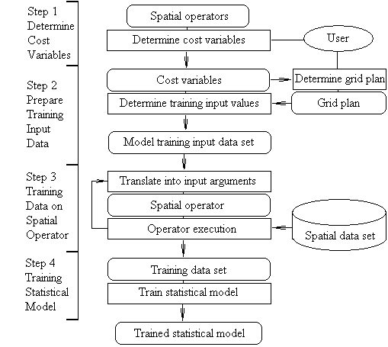
Our Approach
Training process
Building model

Slide 4
Cost variables
Range query: <x, y, distance>
Window query: <x_left, y_bottom, x_right, y_top>
(x_left, y_bottom) is the low left corner
(x_right, y_top) is the upper right corner
KNN: <x, y, number>

Slide 5
Data sets
Real data set: 500,000 meters by 300,000 meters two dimensional space, 15,000 spatial objects, the distribution is unknown (Urban Areas of Counties in the Pennsylvania State. URL: http://www.psu.edu/access/urban.shtml)
Synthetic data set: 10,000 meters by 10,000 meters two dimensional space, 1000 or 10,000 objects, the distributions are uniform or Gaussian.

Slide 6
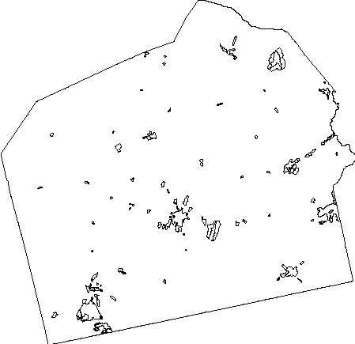
Urban area of Adams County in Pennsylvania State

Slide 7
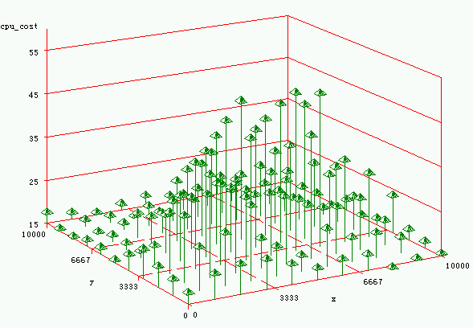
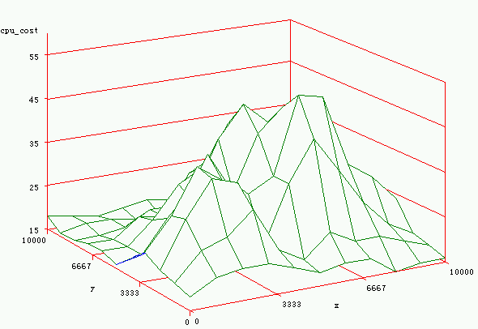
Statistical Model (an example)
Range query, Distance = 1000 meters

Slide 8
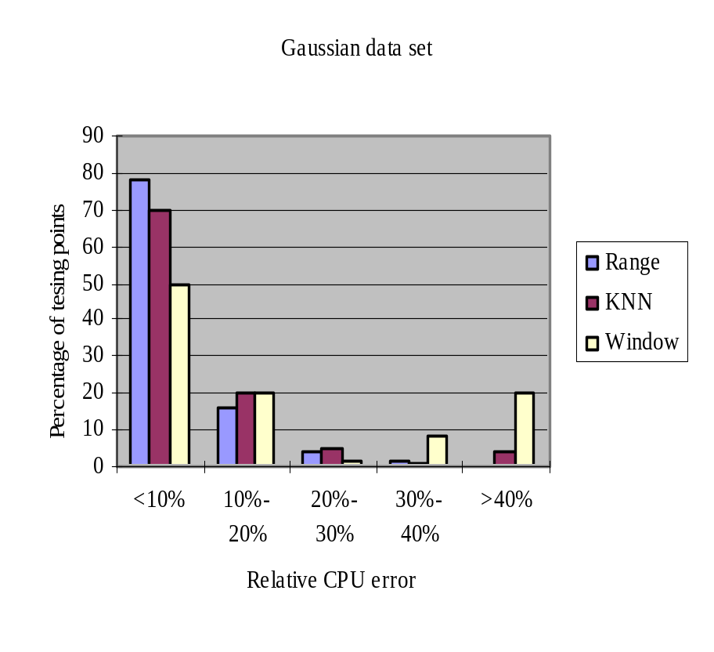
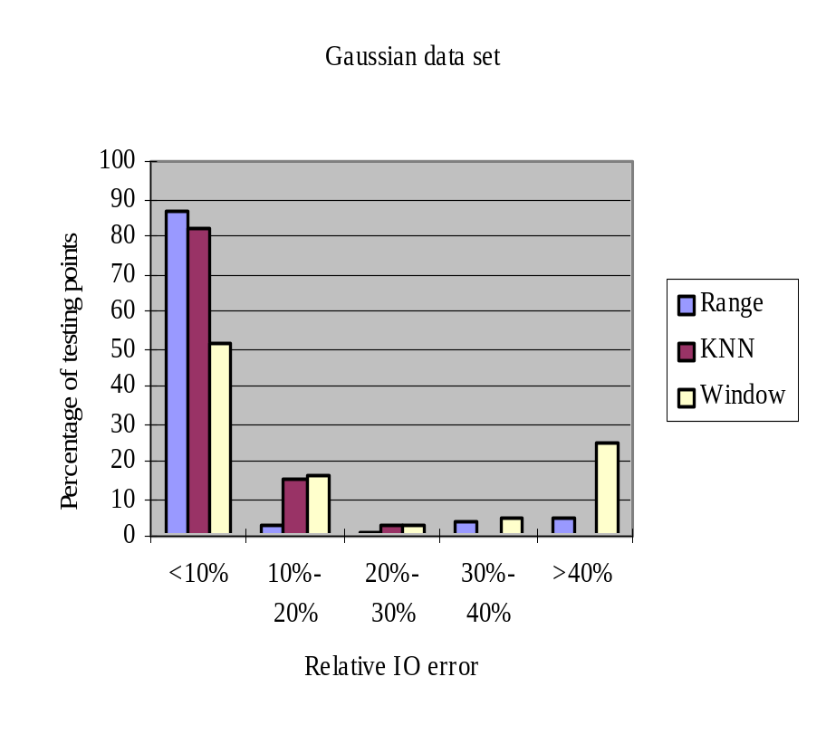
Results (1)
Varying spatial operator

Slide 9
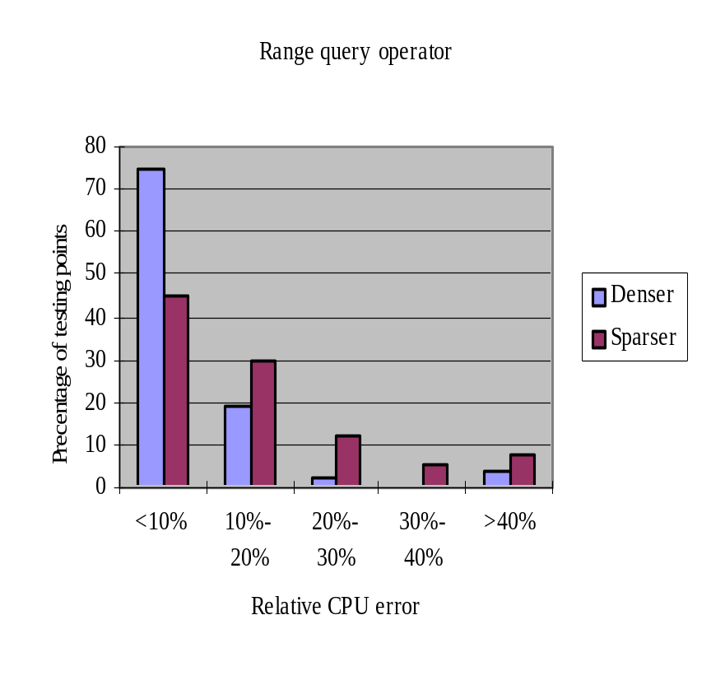
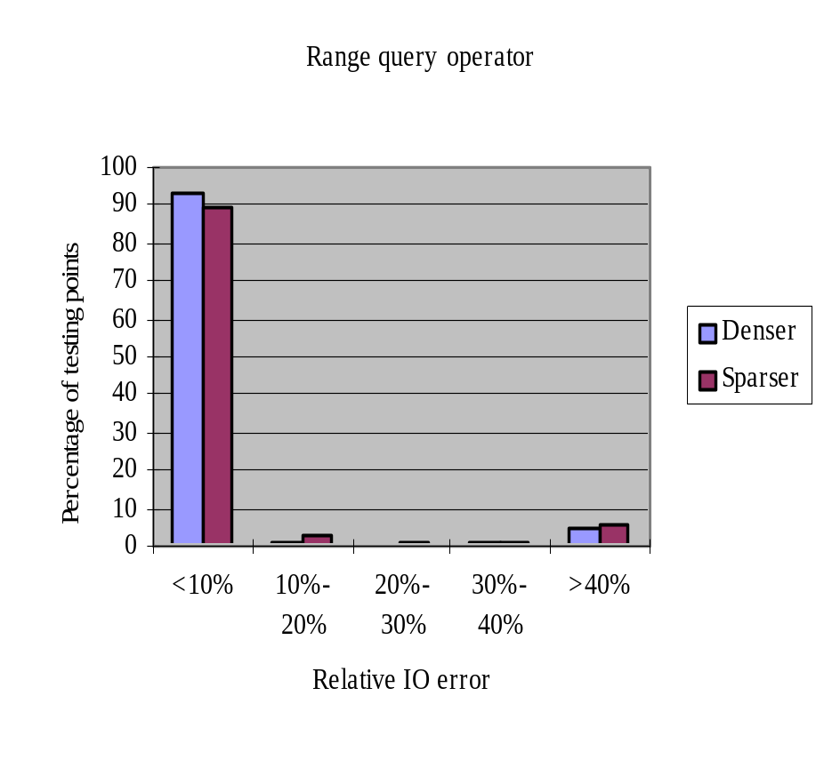
Results (2)
Varying spatial data set density

Slide 10
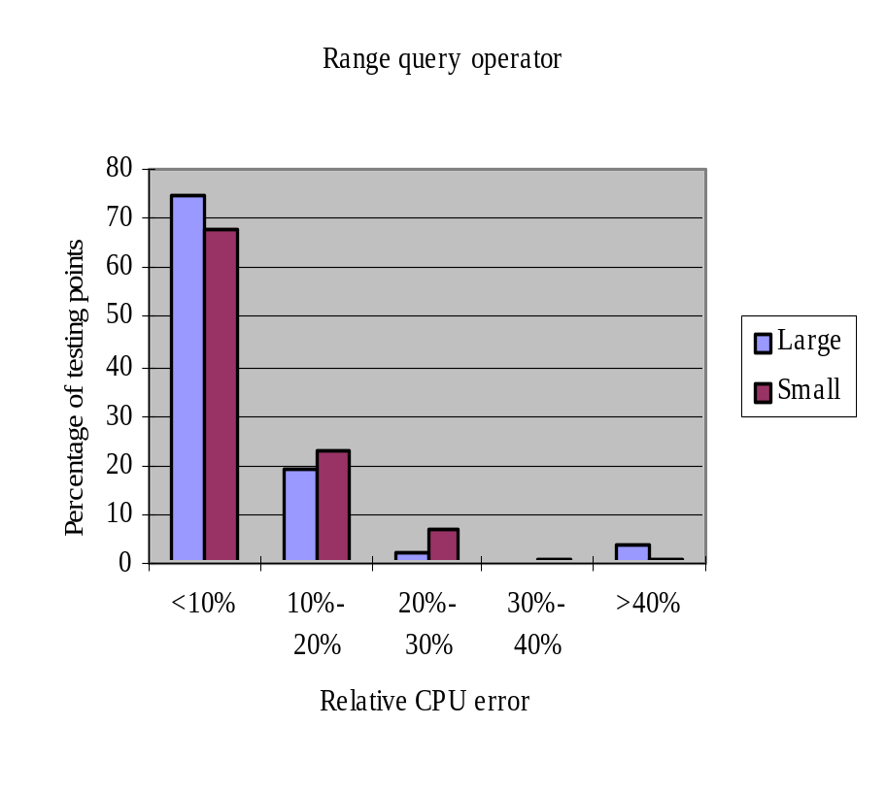
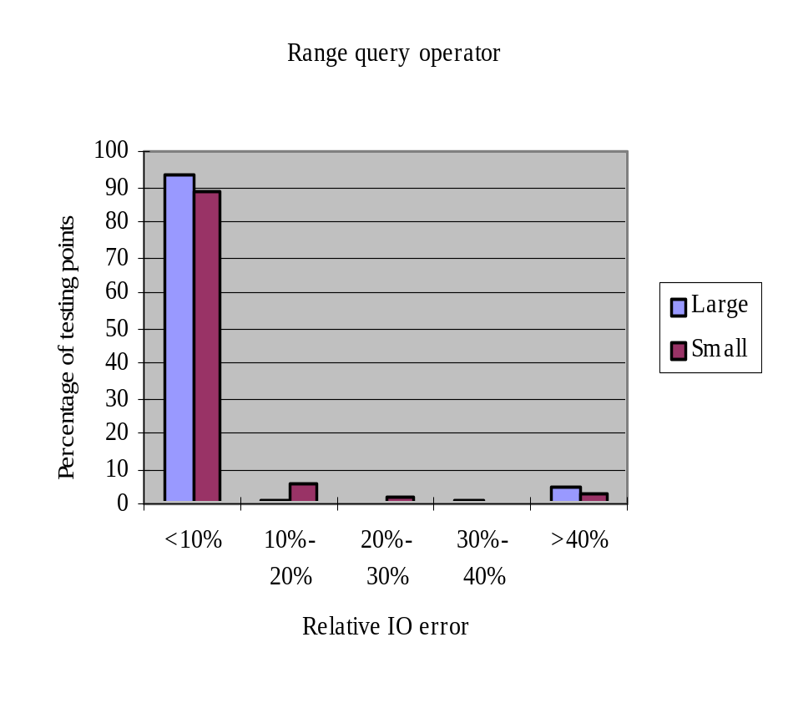
Results (3)
Varying training data set size

Slide 11
Conclusion
Accuracy
Easy to use
Time tolerance
Training overhead is small

