Slide 1
Expressing and Optimizing
Similarity-based Queries in SQL
Like Gao (ISE, GMU)
Min Wang (IBM T.J. Watson)
X. Sean Wang (CS, UVM)

Slide 2
Similarity-based Queries
Motivation
Similarity-based query: a query involving one or more similarity search(es) and other standard (relational) operations. Similarity search is the operation that finds out the nearest neighbor or near neighbors of a query object from a set of (pattern) objects.
Similarity-based queries exist in applications of different domains.
  Data types involved could be:
    Image, text, time series, protein structure, multimedia documents, etc.
  Similarity measures are diverse, e.G., For time series,
    Minkowski metrics, correlation coefficient, etc..
Common characteristics: a similarity search is usually very time consuming!
  Data volume is huge;
  Similarity measure may be complicated.
A not well-studied problem, although.
  Efficient algorithms exist for a single similarity search.
  Techniques exist for optimizing SQL with UDPs (user-defined-predicates).

Slide 3



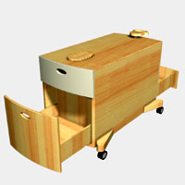
Example
Expressing Similarity-based Queries in SQL
Select FileName
From DogFromGoogle D
Where animal looks like ‘bibi’
and Color in Picture is roughly “Gray”
and PictureDate > 2002/1/1
DogFromGoogle
FileName | PictureDate | Picture
Dog1.jpg | 1999/1/3 | 50k
Dog2.bmp | 2002/9/10
Dogcart.jpg | 1994/4/21
… | … | …
Bibi.jpg
UDT: supported by DBMS
i.e., BLOB

Slide 4

NN_UDPs: Nearest Neighbor User-Defined Predicates
Expressing Similarity-based Queries in SQL
Select FileName
From DogFromGoogle D
Where animal looks like ‘bibi’
and Color in Picture is roughly “Gray”
and PictureDate > 2002/1/1
Select FileName
From DogFromGoogle D
Where NN_UDP1(D.Picture, ‘bibi’, D, 10, 50.0)
and NN_UDP2(D.Picture,“Gray”, D, , 0.1)
and D.PictureDate > 2002/1/1

Slide 5
NN_UDP and NN_OP
Optimization
NN_UDP:
  Is a pattern one of the nearest neighbors of query object in pattern set?
NN_OP
  Return all the nearest neighbors of query object in pattern set.
Equivalency:
  NN_UDP and NN_OP are interchangeable (with some changes to the query)
  To do NN_OP with NN_UDP: need to scan all patterns
  To do NN_UDP with NN_OP: need to test if the result contains the interested pattern
  Which one is better depends on the situation we are dealing with!
Optimization problem
  Find the right combination of NN_OP and NN_UDP

Slide 6
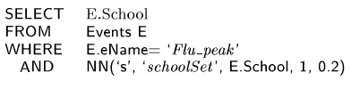
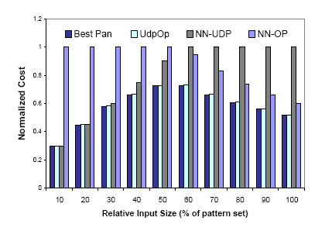
Result 1
Experiment with Monitoring Streaming Time Series

Slide 7
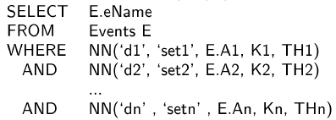
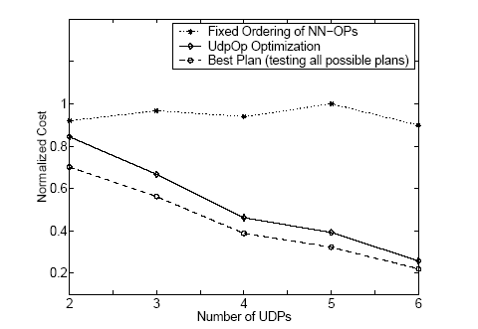
Experiment with Monitoring Streaming Time Series
Result 2

Slide 8
Conclusion & Future Work
Similarity queries require new optimization strategies
The use of NN_UDP makes the query easier to write
The use of a ‘right’ combination of NN_UDP and NN_OP makes the query more efficient to execute
Future Work:
Experiments with “real” DBMS and more data types
Prediction of costs is important and needs more work

