Slide 1
Data Mining Research
Research Team
  Dr. Xingquan (Hill) Zhu, supported by DOD
  Dr. Ying Yang, supported by DOE EPSCoR
  Stella Chen, partially supported by NASA EPSCoR
  Jeff Stone, supported by DOE EPSCoR
  Me - Xindong Wu
  In collaboration with others

Slide 2
Research Topics
Data Mining – Dealing with Large Amounts of Data from Different Sources
  Noise identification
  Negative rules
  Mining in multiple databases
Web Information Exploration – Applying AI and Data Mining Techniques
  Digital libraries with user profiles using data mining tools

Slide 3
Representative Publications: August 2001 – Date
X Wu and S Zhang, Synthesizing High-Frequency Rules from Different Data Sources, IEEE Transactions on Knowledge and Data Engineering, Vol. 15, No. 2, March/April 2003, 353-367.
X Zhu and X Wu, Mining Video Associations for Efficient Database Management, Proceedings of the 18th Intl. Joint Conference on Artificial Intelligence (IJCAI-03), Acapulco, Mexico, August 12-15, 2003, 1422-1424.
X Zhu, X Wu and Q Chen, Eliminating Class Noise in Large Datasets, Proceedings of the 20th International Conference on Machine Learning (ICML-2003), Washington D.C., August 21-24, 2003, 920-927.
X Wu, C Zhang and S Zhang, Mining Both Positive and Negative Association Rules, Proceedings of the 19th International Conference on Machine Learning (ICML-2002), The University of New South Wales, Sydney, Australia, 8-12 July 2002, 658-665.
H Huang, X Wu, and R Relue, Association Analysis with One Scan of Databases, Proceedings of the 2002 IEEE International Conference on Data Mining (ICDM '02), December 9 - 12, 2002.
R Relue, X Wu, and H Huang, Efficient Runtime Generation of Association Rules, Proceedings of the 10th ACM International Conference on Information and Knowledge Management (ACM CIKM 2001), November 5-10, 2001, 466-473.

Slide 4
Multi-Layer Induction in Large, Noisy Databases
Xingquan Zhu
Host Advisor: Dr. Xindong Wu
Project Sponsor: U.S. Army Research Office

Slide 5
Outline
Project Introduction
  What’s the problem?
Solutions
  Noise handling
  Multi-layer Induction
  Partitioning & learning
Project Related Research
  Multimedia systems
  Video mining

Slide 6
What’s the Problem?
Inductive Learning:
  Induce knowledge from training set.
    Decision tree, decision rules
    Use the knowledge to classify other unknown instances.
The Existence of Noise:
  Corrupt learned knowledge
  Decrease classification accuracy
The Problems of Large Dataset:
  Too large to be handled at one run.
  Learning from partitioned subsets could decrease the accuracy.

Slide 7
Solutions
Noise Handling:
  Most learning algorithms can tolerate noise, but that’s not enough.
  Noise instances identification and correction
    Noise from class label
    Noise from attributes
Partitioning & Learning:
  Partition dataset into subsets, and learn one base classifier from one subset.
  Vote from all base classifiers by adopting various combination (or selection) mechanisms
    Classifier combining
    Classifier selection
  Results are reasonable positive
    Hard to beat in most circumstances
    But the novelty is a problem

Slide 8
Solutions
Multi-layer Induction:
  Partitioning data into N subsets
  Learning theory T₁ from subset S₁.
  Forward T₁ to S₂, and re-learn a new theory T₂.
  Iteratively go through all subset and get the final theory T_{N}
  Likely, from T₁ to T_{N}, the accuracy becomes higher and higher
    T₁ ≤ T₂ ≤ T₃, .., ≤ T_{N}
Advantages:
  Inherently handle large and dynamic datasets
  Negotiable (Scalable) resource schedule mechanism
    Mining very large dataset with limited CPU and memory
    More time, more CUP may incur higher accuracy.
  Could be easily extend to distributed datasets
Disadvantage:
  Noise accumulation

Slide 9
Related Research Issues
Multimedia Data Mining:
  Half a terabyte, 9000 hours of motion pictures are produced / yearly
  3000 TV stations → 24,000 terabytes data.
  Spy satellites, Remote sensing images
  Security, surveillance videos.
Video data mining:
  Video association mining
    Clustering video shots into clustering → video units
    Exploring visual/audio cues → video units
    Finding associated video units, and use the inherent correlations (sequential patterns) to explore knowledge.
      Video events (Basketball video “goals”), suspicious parking vehicles

Slide 10
Funding: department of energy (DOE)
PI: Xindong Wu
Postdoc: Ying Yang

Slide 11
Problem statement
Identify malicious errors in classification learning.

Slide 12
Context of classification
Domain of interest;
  instances
    attribute values + class labels
< Att1, Att2, … , Attn, Class>
< Age, Weight, … , Blood pressure, Diabetes?>

Slide 13
Current situation
  Classification error :)
  Attribute error :(
  Malicious error :?

Slide 14
Work in progress
Use a good learner (say, C4.5 or NB) to classify the instance under inspection. If inconsistence exists, then it is suspicious.

Slide 15
Work in progress (cont.)
    Identify and drop attributes that are irrelevant to learning the underlying concept :
      whether there is error or not, does not matter too much;
      reduce systematic error of the learner:
        irrelevant attributes for decision trees (C4.5);
        inter-dependent attributes for Naïve-Bayes (NB).

Slide 16
Work in progress (cont.)
Identify instances which, if are dropped, contribute to increasing the classification performance:
  data are more consistent to support some concept.
Supply suspicious instances to domain knowledge to check whether malicious errors exist.

Slide 17
Stella Chen (MSc Student)
A summer project: Online Interactive Data Ming (supported by NASA EPSCoR)
http://www.cs.uvm.edu:9180/DMT/index.html

Slide 18
Thesis Work
Induction on Partitioned Data

Slide 19
What is Induction
Given a data set, inductive learning aims to discover patterns in the data and form concepts that describe the data .
For example
Fever | Cough | Disease A
0 | 0 | 0
0 | 1 | 0
1 | 0 | 1
1 | 1 | 1
Rule:
Fever = 1 => Disease A
Notes:
Background Information.My focus is classification.

Slide 20
Why on Partitioned Data
Database is very large
Database is distributed at different locations
To overcome the memory limitation of existing inductive learning algorithms
Notes:
Why partition ?

Slide 21
5 Strategies
Rule-Example Conversion
Rule Weighting
Iteration
Good Rule Selection
Data Dependent Rule Selection

Slide 22
7 Schemes
Rule-Example Conversion
Rule Weighting
Simple Iteration
Iteration-Voting
Good Rule Selection
Good Rule Selection-Voting
Data Dependent Rule Selection

Slide 23
Result
Iteration and Data Dependent Rule Selection are the two most effective strategies (classification accuracy, the variety of the data sets that can be dealt with). These two strategies, combined with the Voting technique, can generate schemes, which outperform Simple Voting scheme consistently.

Slide 24
Project Overview – Jeff Stone (MSc Student)
A Semantic Network for Modeling Biological Knowledge in Multiple Databases

Slide 25
Semantic Network as a Dictionary
Biology is a knowledge-based discipline.
Potential problems in representation of data:
  Biological objects rarely have a single function.
  Function often depends on a biological state.
  Several different names often exist for the same entity.
Semantic networks can overcome these problems and are a common type of machine-readable dictionaries.
Example of Semantic Network:
WordNet: http://www.cogsci.princeton.edu/~wn/

Slide 26
Semantic Network Structure
Represented as a Directed Acyclic Graph (DAG).
Nodes represent a general categorization of a concept.
Concept classes reside at the nodes.
Each node possibly containing several concept classes.
Links to other concepts represents relationships.
These links define the semantic neighborhood of the concept.

Slide 27
Our Semantic Network
Based on the NLM UMLS Semantic Network
Semantic Type are nodes that are either a biological entity, or a biological event.
  65 semantic types added.
  16 types were removed for a total of 183 nodes.
Relationships links are either hierarchical (is-a) relationships or Associate-with relationships that link concepts together.
  15 new relationships for a total of 69.
Dictionary terms reside in the concept classes at each node.

Slide 28
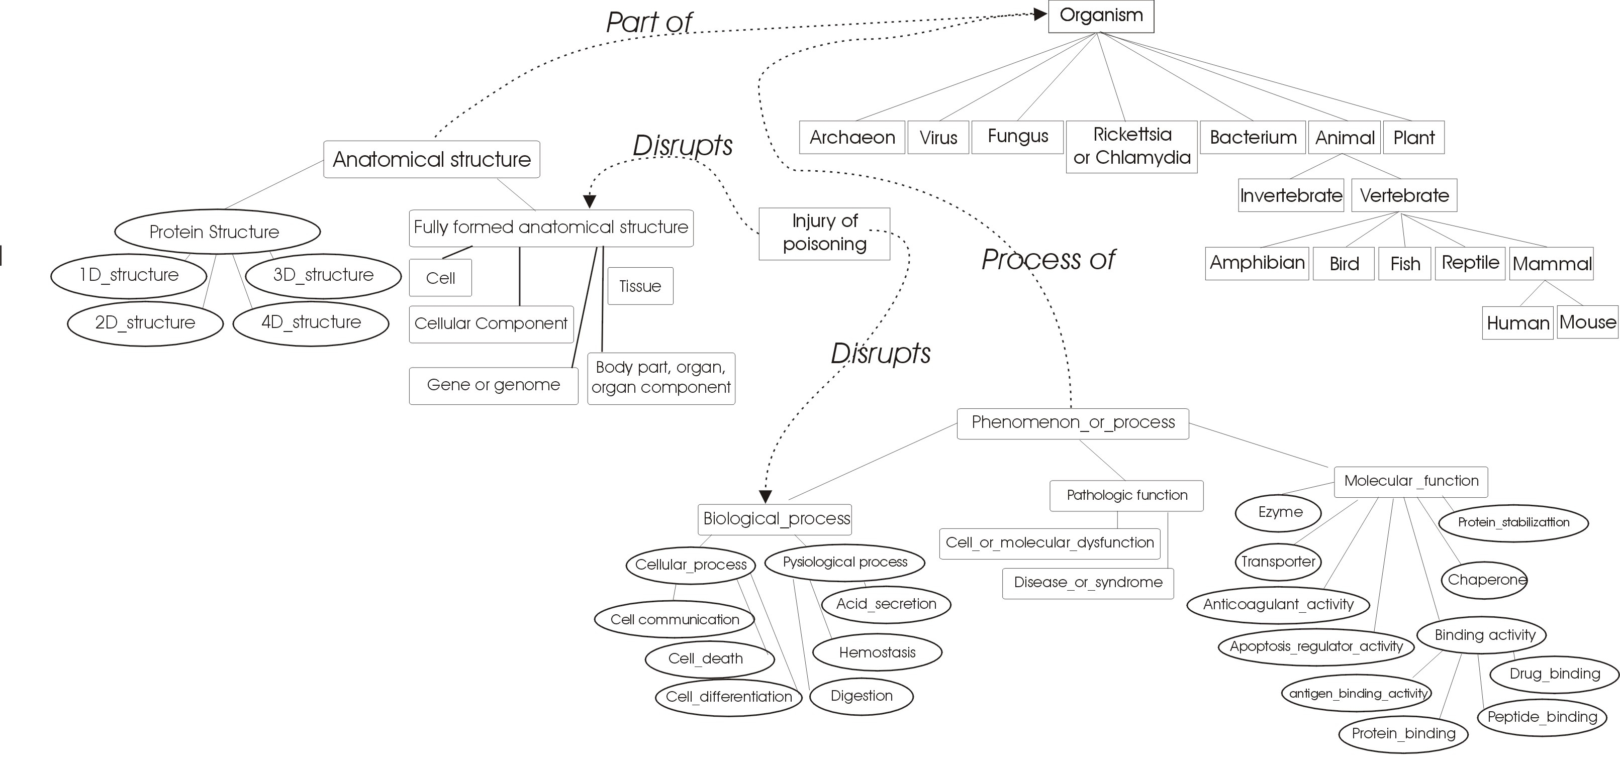
Semantic Network Overview
FOR MORE INFO...
http://www.cs.uvm.edu:9180/library

