Slide 1
C++

Slide 2
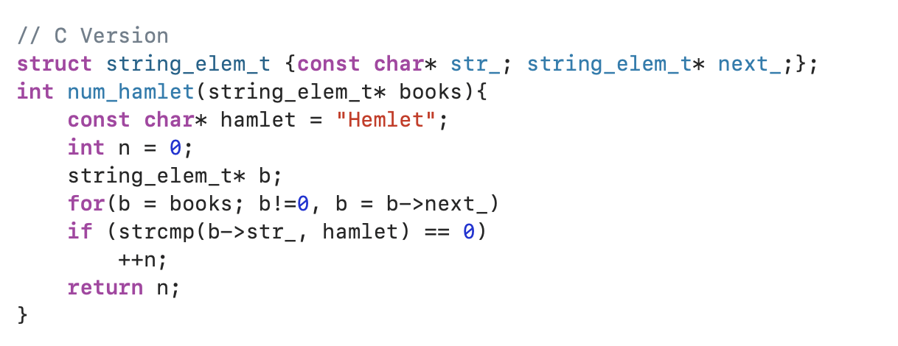
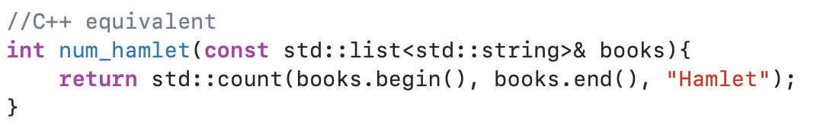
Why C++?
C++ is a highly portable language which offers zero-cost abstractions.
C++ provides programmers with the ability to write and manage large, expressive, and robust code bases.
Pointers to raw memory addresses are not visible at all
Abstraction
String_elem_t
For loop and if-condition
Char* and strcmp
Notes:
The more developers working on a code base, the larger the code base becomes. We need abstractions such as functions, classes, data structures, layers, and so on in order to manage the complexity of a large-scale code base. But constantly adding abstraction and new levels of indirection comes at a price – efficiency. This is where zero cost abstractions play its role. A lot of abstractions offered by C++ comes at a very low price. At a minimum, C++ offers efficient alternatives at hot spots where performance really is a concern.

Slide 3
Abstractions
C++ classes are abstractions of C-structs and regular functions.
C++ polymorphism is the abstraction of function pointers.
C++ lambda functions are abstraction of C++ classes.
Templates are abstractions of generating C++ code.

Slide 4
Programming Pitfalls
Monstrous source files with thousands of lines
Member functions with hundreds or thousands of lines of inscrutable code
Volumes of dead code
Built time extending into several hours
High number of defects
Logic too convoluted by quick fixes to be safely managed
Code duplicated across files, classes, and modules
Code riddled with long-obsolete coding practices

