Slide 1
Web Information Processing

Slide 2
Course Introduction
The course provides an introduction to client-server information processing followed by an in-depth overview of the components and architecture of HTTP-based web applications. All the concepts described focus on progressive enhancements (separation of structure, presentation and behavior) and best practices in interactive, database-driven, web application development. The course also provides an overview of MVC, design practices in relation to web development.

Slide 3
Main Content
HTML
CSS
JavaScript

Slide 4
What is HTML?
HTML is a markup language for describing web documents (web pages).
HTML stands for Hyper Text Markup Language
A markup language is a set of markup tags
HTML documents are described by HTML tags
Each HTML tag describes different document content

Slide 5
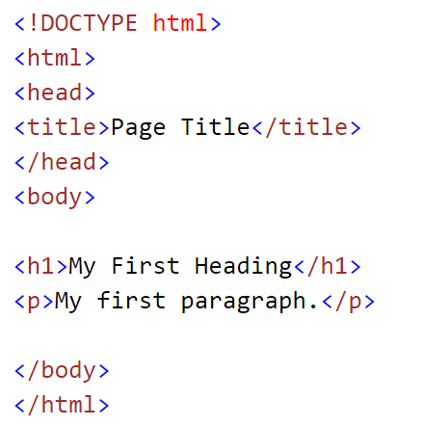
HTML Example
A small HTML document:
The DOCTYPE declaration defines the document type to be HTML
The text between <html> and </html> describes an HTML document
The text between <head> and </head> provides information about the document
The text between <title> and </title> provides a title for the document
The text between <body> and </body> describes the visible page content
The text between <h1> and </h1> describes a heading
The text between <p> and </p> describes a paragraph

Slide 6
HTML Tags
HTML tags are keywords (tag names) surrounded by angle brackets:
<tagname>content</tagname>
HTML tags normally come in pairs like <p> and </p>
The first tag in a pair is the start tag, the second tag is the end tag
The end tag is written like the start tag, but with a slash before the tag name
The start tag is often called the opening tag. The end tag is often called the closing tag

Slide 7
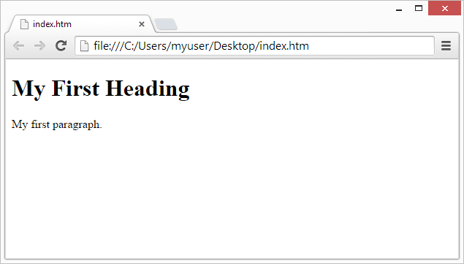
Web Browsers
The purpose of a web browser (Chrome, IE, Firefox, Safari) is to read HTML documents and display them.
The browser does not display the HTML tags, but uses them to determine how to display the document:

Slide 8
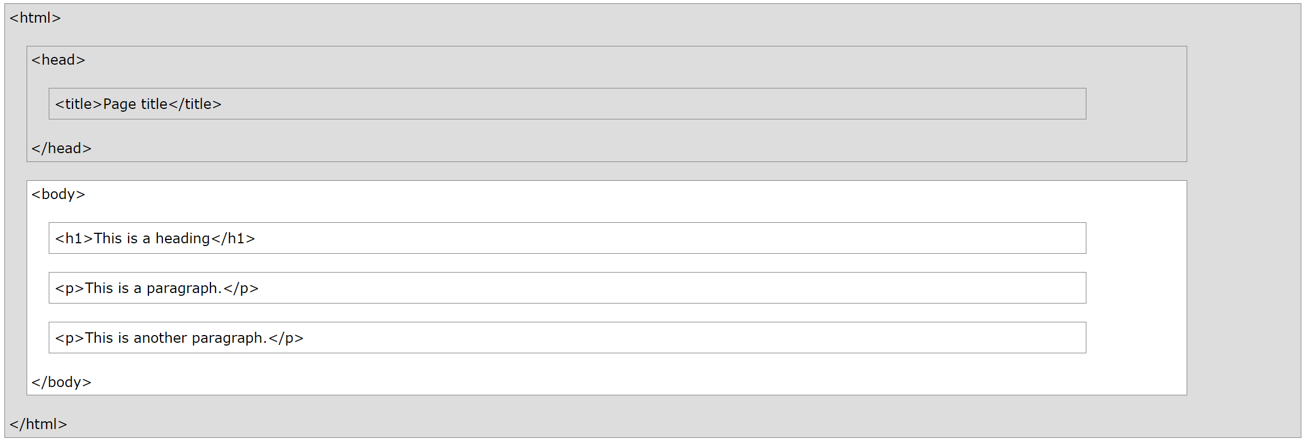
HTML Page Structure
Below is a visualization of an HTML page structure:
Hint： Only the <body> area (the white area) is displayed by the browser

Slide 9
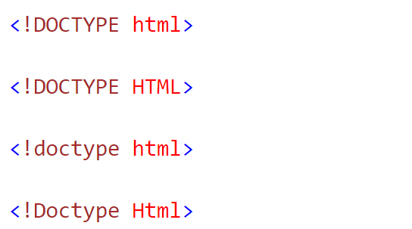
<!DOCTYPE> Declaration
The <!DOCTYPE> declaration helps the browser to display a web page correctly.
There are different document types on the web.
To display a document correctly, the browser must know both type and version.
The doctype declaration is not case sensitive. All cases are acceptable:

Slide 10
HTML Versions
Since the early days of the web, there have been many versions of HTML:
Version | Year
HTML | 1991
HTML 2.0 | 1995
HTML 3.2 | 1997
HTML 4.01 | 1999
XHTML | 2000
HTML5 | 2014
Notes:
From html version 1.0 to html 5 which was declared in 2014

Slide 11
Common Declarations
HTML5
<!DOCTYPE html>
HTML 4.01
<!DOCTYPE HTML PUBLIC "-//W3C//DTD HTML 4.01 Transitional//EN" "http://www.w3.org/TR/html4/loose.dtd">
XHTML 1.0
<!DOCTYPE html PUBLIC "-//W3C//DTD XHTML 1.0 Transitional//EN" "http://www.w3.org/TR/xhtml1/DTD/xhtml1-transitional.dtd">
Notes:
For html5, you only need to declare <!DOCTYPE html>, for HTML 4.01 and XHTML 1.0, you need to include the corresponding dtd files.

Slide 12
HTML EDITORS

Slide 13
Write HTML
HTML can be edited by using professional HTML editors like:
Microsoft WebMatrix
Sublime Text
Webstorm
VS CODE
However, for learning HTML we recommend a text editor like Notepad, EditPlus, or TextEdit (Mac). We believe using a simple text editor is a good way to learn HTML.

Slide 14
How to use Notepad
Step 1: Open Notepad
To open Notepad in Windows 7 or earlier:
Click Start (bottom left on your screen). Click All Programs. Click Accessories. Click Notepad.
To open Notepad in Windows 8 or later:
Open the Start Screen (the window symbol at the bottom left on your screen). Type Notepad.

Slide 15
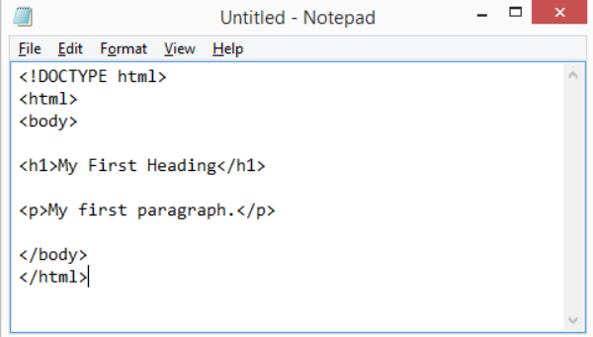
How to use Notepad
Step 2: Write Some HTML
Write or copy some HTML into Notepad.

Slide 16
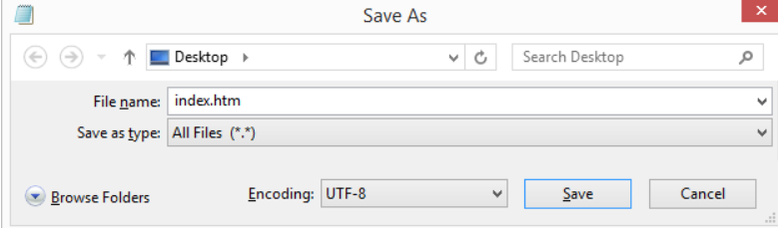
How to use Notepad
Step 3: Save the HTML Page
Save the file on your computer.
Select File > Save as in the Notepad menu.
Name the file "index.html" or any other name ending with html or htm.
UTF-8 is the preferred encoding for HTML files.
ANSI encoding covers US and Western European characters only.

Slide 17

How to use Notepad
Step 4: View HTML Page in Your Browser
Open the saved HTML file in your favorite browser.
The result will look much like this:

Slide 18
HTML Elements

Slide 19
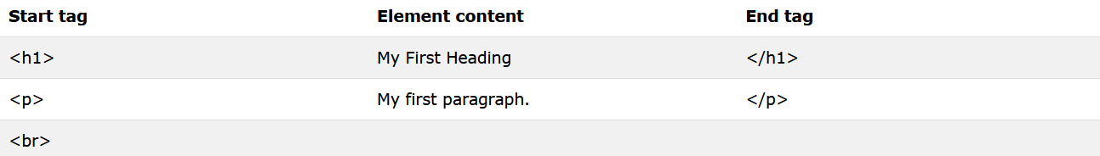
HTML Elements
HTML documents are made up by HTML elements. HTML elements are written with a start tag, with an end tag, with the content between <tagname>content</tagname>
The HTML element is everything from the start tag to the end tag:
<p>My first HTML paragraph.</p>

Slide 20
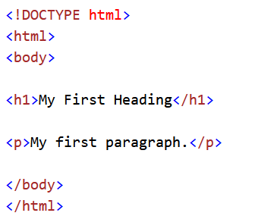
HTML Elements
All HTML documents must start with a type declaration: <!DOCTYPE html>.
The HTML document itself begins with <html> and ends with </html>.
The visible part of the HTML document is between <body> and </body>.
Notes:
We have seen this example before. In conclusion, we should know that

Slide 21
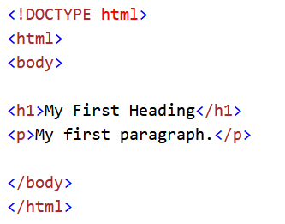
Nested HTML Elements
HTML elements can be nested (elements can contain elements).
All HTML documents consist of nested HTML elements.
This example contains 4 HTML elements:

Slide 22
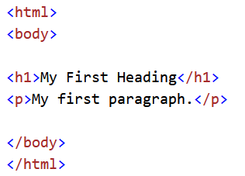
Nested HTML Elements
The <html> element defines the whole document.
It has a start tag <html> and an end tag </html>.
The element content is another HTML element (the <body> element).

Slide 23
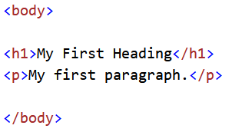
Nested HTML Elements
The <body> element defines the document body.
It has a start tag <body> and an end tag </body>.
The element content is two other HTML elements (<h1> and <p>).

Slide 24
Nested HTML Elements
The <h1> element defines a heading.
It has a start tag <h1> and an end tag </h1>.
The element content is: My First Heading.

Slide 25
Nested HTML Elements
The <p> element defines a paragraph.
It has a start tag <p> and an end tag </p>.
The element content is: My first paragraph.

Slide 26
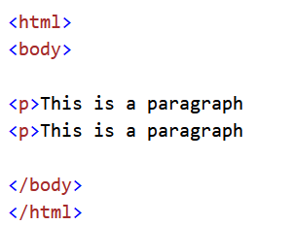
Nested HTML Elements
Some HTML elements will display correctly, even if you forget the end tag:
The example above works in all browsers, because the closing tag is considered optional.
Never rely on this. It might produce unexpected results and/or errors if you forget the end tag.

Slide 27
Empty HTML Elements
HTML elements with no content are called empty elements.
<br> is an empty element without a closing tag (the <br> tag defines a line break).
Empty elements can be "closed" in the opening tag like this: <br />.
HTML5 does not require empty elements to be closed. But if you want stricter validation, or you need to make your document readable by XML parsers, you should close all HTML elements.

Slide 28
HTML Tip: Use Lowercase Tags
HTML tags are not case sensitive: <P> means the same as <p>.
The HTML5 standard does not require lowercase tags, but we recommends lowercase in HTML4, and demands lowercase for stricter document types like XHTML.

Slide 29
HTML Attributes

Slide 30
HTML Attributes
HTML elements can have attributes
Attributes provide additional information about an element
Attributes are always specified in the start tag
Attributes come in name/value pairs like: name="value"

Slide 31
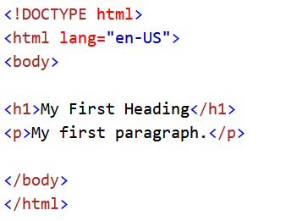
The lang Attribute
The document language can be declared in the <html> tag.
The language is declared in the lang attribute, which specifies the language of the element's content.
Declaring a language is important for accessibility applications (screen readers) and search engines:
Common examples are "en" for English, "es" for Spanish, "fr" for France and so on.

Slide 32
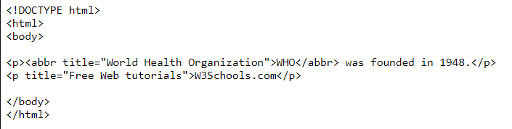

The title Attribute
HTML paragraphs are defined with the <p> tag.
In this example, the <p> element has a title attribute.
The title attribute specifies extra information about an element.
The information is most often shown as a tooltip text when the mouse moves over the element.

Slide 33

The href Attribute
HTML links are defined with the <a> tag. The link address is specified in the href attribute:
<a href="http://www.fzu.edu.cn">This is a link</a>

Slide 34
Size Attributes
HTML images are defined with the <img> tag.
The filename of the source (src), and the size of the image (width and height) are all provided as attributes:
<img src="123.jpg" width="104" height="142">
The image size is specified in pixels: width="104" means 104 screen pixels wide.

Slide 35

The alt Attribute
The alt attribute specifies an alternative text to be used, when an HTML element cannot be displayed.
The value of the attribute can be read by "screen readers". This way, someone "listening" to the webpage, i.e. a blind person, can "hear" the element.
<img src="123.jpg" alt="123.com" width="104" height="142">

Slide 36
Use Lowercase Attributes
The HTML5 standard does not require lower case attribute names.
The title attribute can be written with upper or lower case like Title and/or TITLE.
We recommends lowercase in HTML4, and demands lowercase for stricter document types like XHTML.

Slide 37
Quote Attribute Values
The HTML5 standard does not require quotes around attribute values.
The href attribute, demonstrated above, can be written as:
<a href=http://www.fzu.edu.cn>
Using quotes are the most common. Omitting quotes can produce errors.
we always use quotes around attribute values.

Slide 38
Single or Double Quotes
Double style quotes are the most common in HTML, but single style can also be used.
In some situations, when the attribute value itself contains double quotes, it is necessary to use single quotes:

Slide 39
Attribute Summary
All HTML elements can have attributes
The HTML title attribute provides additional "tool-tip" information
The HTML href attribute provides address information for links
The HTML width and height attributes provide size information for images
The HTML alt attribute provides text for screen readers
We always use lowercase HTML attribute names
We always quote attributes with double quotes

Slide 40
HTML Headings

Slide 41
HTML Headings
Headings are important in HTML documents, they are defined with the <h1> to <h6> tags.
<h1> defines the most important heading. <h6> defines the least important heading.

Slide 42
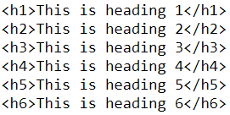
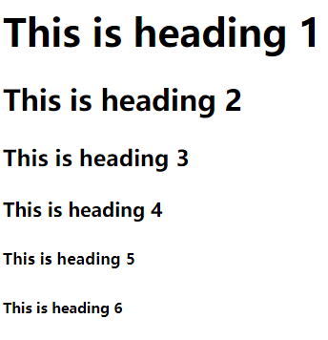
HTML Headings Example
Note: Browsers automatically add some empty space (a margin) before and after each heading.

Slide 43
Headings Are Important
Use HTML headings for headings only. Don't use headings to make text BIG or bold.
Search engines use your headings to index the structure and content of your web pages.

Slide 44
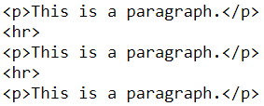
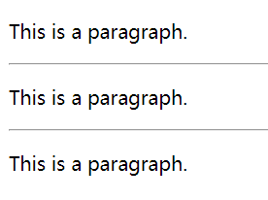
HTML Horizontal Rules
The <hr> tag creates a horizontal line in an HTML page.
The hr element can be used to separate content:

Slide 45
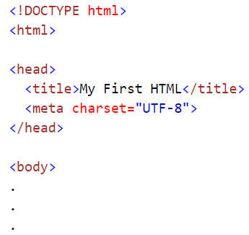

HTML <head>
The HTML <head> element has nothing to do with HTML headings.
The HTML <head> element contains meta data. Meta data are not displayed.
The HTML <head> element is placed between the <html> tag and the <body> tag:
Note: Meta data means data about data. HTML meta data is data about the HTML document.

Slide 46
HTML <title>
The HTML <title> element is meta data. It defines the HTML document's title.
The title will not be displayed in the document, but might be displayed in the browser tab.

Slide 47
The HTML <meta>
The HTML <meta> element is also meta data.
It can be used to define the character set, and other information about the HTML document.

Slide 48
More Meta Elements
When talking about HTML styles, we will discover more meta elements:
The HTML <style> element is used to define internal CSS style sheets.
The HTML <link> element is used to define external CSS style sheets.

Slide 49
HTML Paragraphs

Slide 50
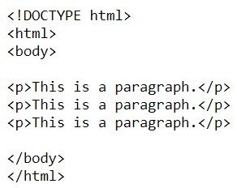
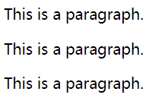
HTML Paragraphs
HTML documents are divided into paragraphs.
The HTML <p> element defines a paragraph.
Example:
Note: Browsers automatically add some white space before and after a paragraph.

Slide 51
HTML Display
You cannot be sure how HTML will be displayed.
Large or small screens, and resized windows will create different results.
With HTML, you cannot change the output by adding extra spaces or extra lines in your HTML code.
The browser will remove extra spaces and extra lines when the page is displayed.
Any number of spaces, and any number of new lines, count as only one space.

Slide 52
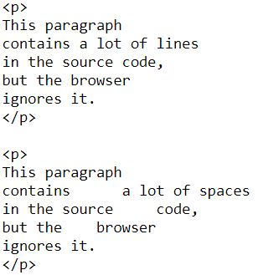

HTML Display Example

Slide 53

HTML Line Breaks
The HTML <br> element defines a line break.
Use <br> if you want a line break (a new line) without starting a new paragraph:
Example:
The <br> element is an empty HTML element. It has no end tag.

Slide 54
HTML Styles

Slide 55
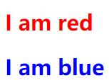
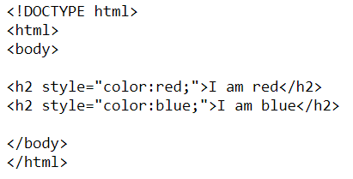
HTML Styles

Slide 56
The HTML Style Attribute
Setting the style of an HTML element, can be done with the style attribute.
The HTML style attribute has the following syntax:
style="property:value;"
The property is a CSS property. The value is a CSS value.

Slide 57
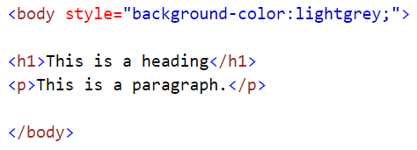
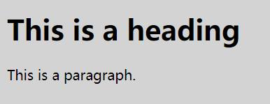
HTML Background Color
The background-color property defines the background color for an HTML element:
This example sets the background for a page to lightgrey:

Slide 58

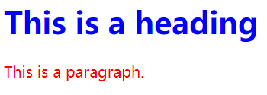
HTML Text Color
The color property defines the text color for an HTML element:
Example:

Slide 59

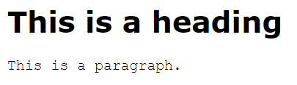
HTML Fonts
The font-family property defines the font to be used for an HTML element:
Example:

Slide 60

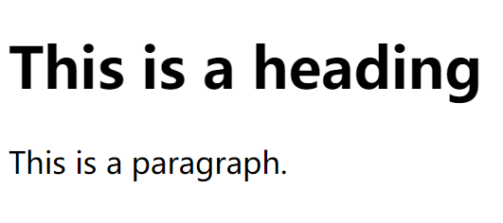
HTML Text Size
The font-size property defines the text size for an HTML element:
Example:

Slide 61


HTML Text Alignment
The text-align property defines the horizontal text alignment for an HTML element:
Example:

Slide 62
Style Summary
Use the style attribute for styling HTML elements
Use background-color for background color
Use color for text colors
Use font-family for text fonts
Use font-size for text sizes
Use text-align for text alignment

Slide 63
HTML Formatting

Slide 64
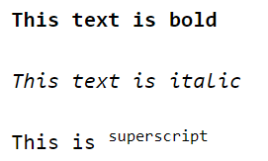
Text Formatting

Slide 65
HTML Formatting Elements
HTML also defines special elements for defining text with a special meaning.
HTML uses elements like <b> and <i> for formatting output, like bold or italic text. Formatting elements were designed to display special types of text:
Bold text
Important text
Italic text
Emphasized text
Marked text
Small text
Deleted text
Inserted text
Subscripts
Superscripts

Slide 66


HTML Bold and Strong Formatting
The HTML <b> element defines bold text, without any extra importance.
Examples:

Slide 67


HTML Bold and Strong Formatting
The HTML <strong> element defines strong text, with added semantic "strong" importance.
Examples:

Slide 68


HTML Italic and Emphasized Formatting
The HTML <i> element defines italic text, without any extra importance.
Examples:

Slide 69


HTML Italic and Emphasized Formatting
The HTML <em> element defines emphasized text, with added semantic importance.
Examples:
Hint: Browsers display <strong> as <b>, and <em> as <i>.However, there is a difference in the meaning of these tags: <b> and <i> defines bold and italic text,but <strong> and <em> means that the text is "important".

Slide 70

HTML Small Formatting
The HTML <small> element defines small text.
Examples:
<h2>HTML Small Formatting</h2>
<h2> <small> HTML Small Formatting </small></h2>

Slide 71

HTML Marked Formatting
The HTML <mark> element defines marked or highlighted text.
Examples:

Slide 72

HTML Deleted Formatting
The HTML <del> element defines deleted (removed) text.
Examples:

Slide 73

HTML Inserted Formatting
The HTML <ins> element defines inserted (added) text.
Examples:

Slide 74

HTML Subscript Formatting
The HTML <sub> element defines subscripted text.
Examples:
Notes:
Subscript text appears half a character below the normal line, and is sometimes rendered in a smaller font.

Slide 75

HTML Superscript Formatting
The HTML <sup> element defines superscripted text.
Examples:

Slide 76
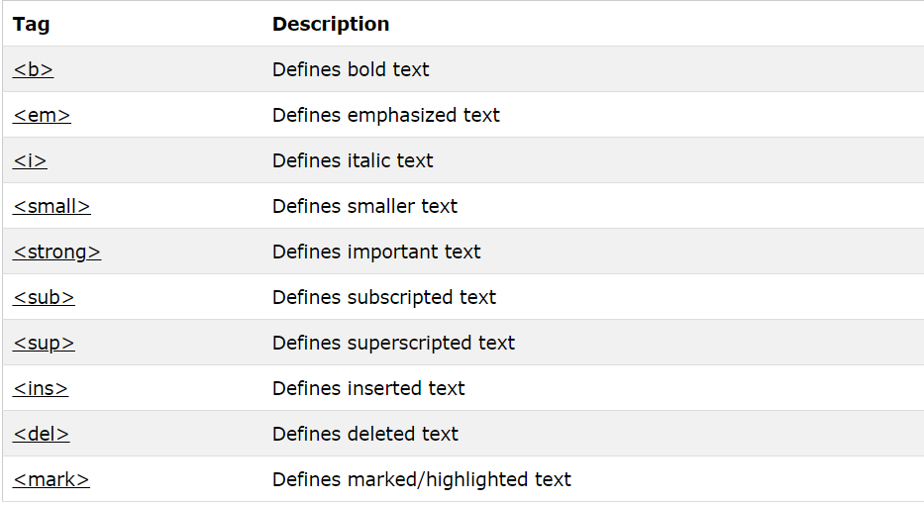
HTML Text Formatting Elements

Slide 77
HTML Comments

Slide 78

HTML Comment Tags
You can add comments to your HTML source by using the following syntax:
Example:
Note: There is an exclamation point (!) in the opening tag, but not in the closing tag.

Slide 79
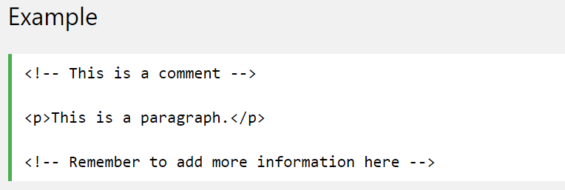
HTML Comment Tags
Comments are not displayed by the browser, but they can help document your HTML.
With comments you can place notifications and reminders in your HTML:

Slide 80
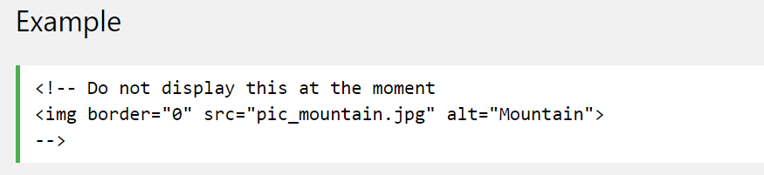
HTML Comment Tags
Comments are also great for debugging HTML, because you can comment out HTML lines of code, one at a time, to search for errors:

Slide 81
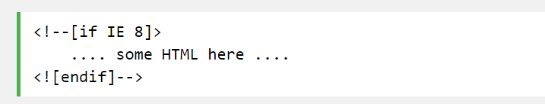
Conditional Comments
You might stumble upon conditional comments in HTML:
Examples：
Conditional comments defines HTML tags to be executed by Internet Explorer only.

