Slide 1
CSS INTRODUCTION

Slide 2
Why uses CSS?
CSS stands for Cascading Style Sheets
CSS describes how HTML elements are to be displayed on screen, paper, or in other media
CSS saves a lot of work. It can control the layout of multiple web pages all at once
External stylesheets are stored in CSS files

Slide 3
CSS Solved a Big Problem
HTML was NEVER intended to contain tags for formatting a web page!
HTML was created to describe the content of a web page, like:
<h1>This is a heading</h1>
<p>This is a paragraph.</p>
When tags like <font>, and color attributes were added to the HTML 3.2 specification. Development of large websites, where fonts and color information were added to every single page, became a long and expensive process.
To solve this problem, the World Wide Web Consortium (W3C) created CSS. CSS removed the style formatting from the HTML page!

Slide 4
CSS SYNTAX AND SELECTORS

Slide 5
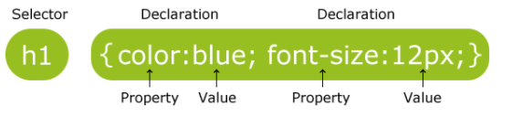
CSS Syntax
A CSS rule-set consists of a selector and a declaration block:
The selector points to the HTML element you want to style.
The declaration block contains one or more declarations separated by semicolons.
Each declaration includes a CSS property name and a value, separated by a colon.
A CSS declaration always ends with a semicolon, and declaration blocks are surrounded by curly braces.

Slide 6
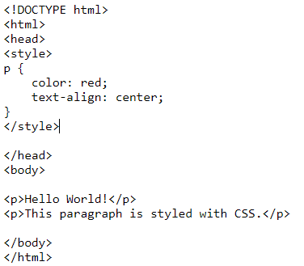

CSS Syntax
In the following example all <p> elements will be center-aligned, with a red text color:

Slide 7
CSS Selectors
CSS selectors are used to "find" (or select) HTML elements based on their element name, id, class, attribute, and more.
element Selector
id Selector
class Selector
Grouping Selectors

Slide 8
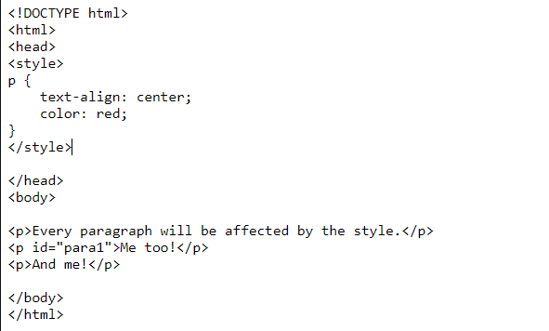
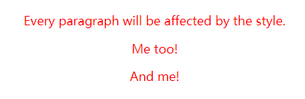
CSS Selectors
The element selector selects elements based on the element name.
You can select all <p> elements on a page like this (in this case, all <p> elements will be center-aligned, with a red text color):

Slide 9
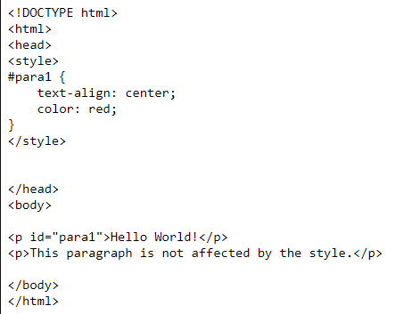

CSS Selectors
The id selector uses the id attribute of an HTML element to select a specific element. The id of an element should be unique within a page, so the id selector is used to select one unique element!
To select an element with a specific id, write a hash (#) character, followed by the id of the element.
The style rule below will be applied to the HTML element with id="para1":

Slide 10
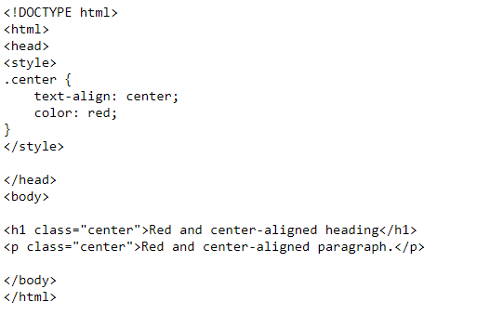
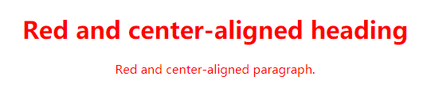
CSS Selectors
The class selector selects elements with a specific class attribute.
To select elements with a specific class, write a period (.) character, followed by the name of the class.
In the example below, all HTML elements with class="center" will be red and center-aligned:

Slide 11
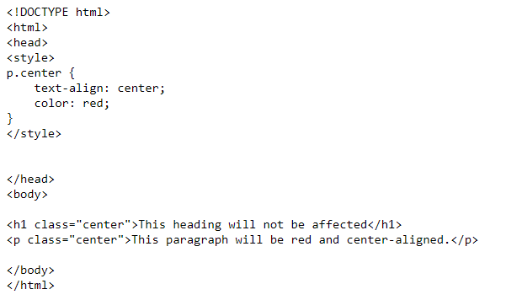

CSS Selectors
You can also specify that only specific HTML elements should be affected by a class.
In the example below, only <p> elements with class="center" will be center-aligned:

Slide 12
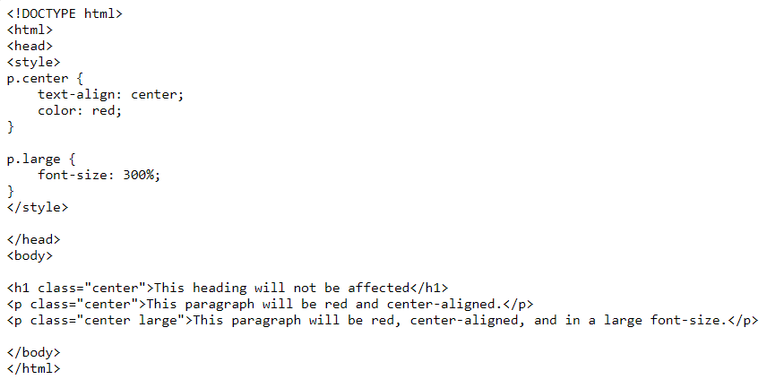
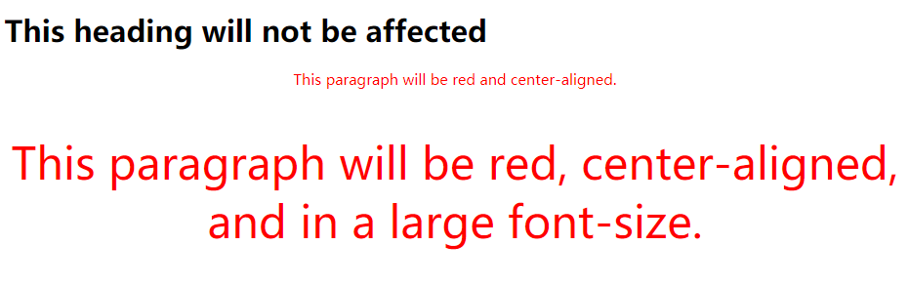

CSS Selectors
HTML elements can also refer to more than one class.
In the example below, the <p> element will be styled according to class="center" and class="large":
  A class name cannot start with a number!

Slide 13
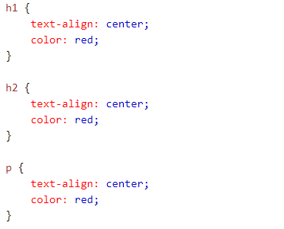
Grouping Selectors
If you have elements with the same style definitions, like this:

Slide 14
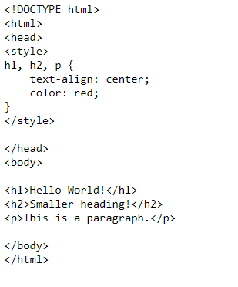

Grouping Selectors
It will be better to group the selectors, to minimize the code.
To group selectors, separate each selector with a comma.
In the example below we have grouped the selectors from the code above:

Slide 15
CSS HOW TO…

Slide 16
Three Ways to Insert CSS
When a browser reads a style sheet, it will format the HTML document according to the information in the style sheet.
There are three ways of inserting a style sheet:
  External style sheet
  Internal style sheet
  Inline style

Slide 17

External Style Sheet
Each page must include a reference to the external style sheet file inside the <link> element. The <link> element goes inside the <head> section:

Slide 18
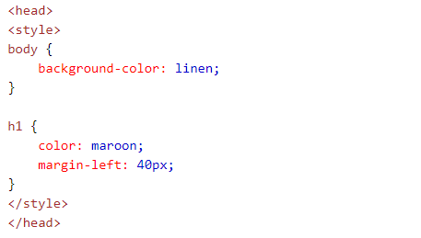
Internal Style Sheet
An internal style sheet may be used if one single page has a unique style.
Internal styles are defined within the <style> element, inside the <head> section of an HTML page:

Slide 19
Inline Styles
An inline style may be used to apply a unique style for a single element.
To use inline styles, add the style attribute to the relevant element. The style attribute can contain any CSS property.

Slide 20
Multiple Style Sheets-Cascading Order
What style will be used when there is more than one style specified for an HTML element?
All the styles will "cascade" into a new "virtual" style sheet by the following rules, where number one has the highest priority:
  Inline style (inside an HTML element)
  External and internal style sheets (in the head section)
  Browser default
So, an inline style (inside a specific HTML element) has the highest priority, which means that it will override a style defined inside the <head> tag, or in an external style sheet, or a browser default value.

Slide 21
CSS COLORS

Slide 22
CSS Colors
Colors are displayed combining RED, GREEN, and BLUE light.
Colors in CSS are most often specified by:
  a valid color name - like "red"
  an RGB value - like "rgb(255, 0, 0)"
  a HEX value - like "#ff0000"
Notes:
Number sign
bracket

Slide 23
CSS BACKGROUNDS

Slide 24
CSS Backgrounds
The CSS background properties are used to define the background effects for elements.
CSS background properties:
  background-color
  background-image
  background-repeat
  background-attachment
  background-position

Slide 25
Background Color
The background-color property specifies the background color of an element.
With CSS, a color is most often specified by:
  a valid color name - like "red"
  a HEX value - like "#ff0000"
  an RGB value - like "rgb(255,0,0)"

Slide 26
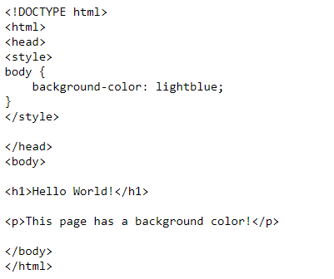

Background Color
The background-color property specifies the background color of an element.

Slide 27
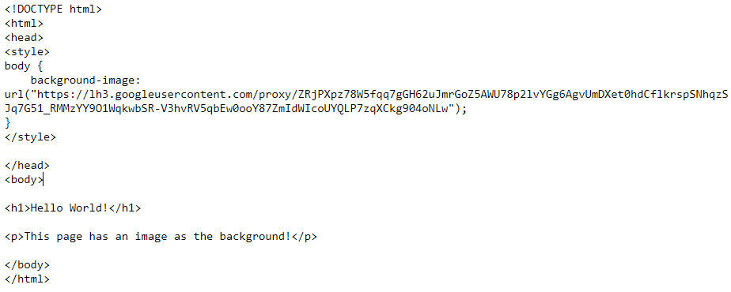

Background Image
The background-image property specifies an image to use as the background of an element.
By default, the image is repeated both horizontally and vertically，so it covers the entire element.
The background image for a page can be set like this:

Slide 28
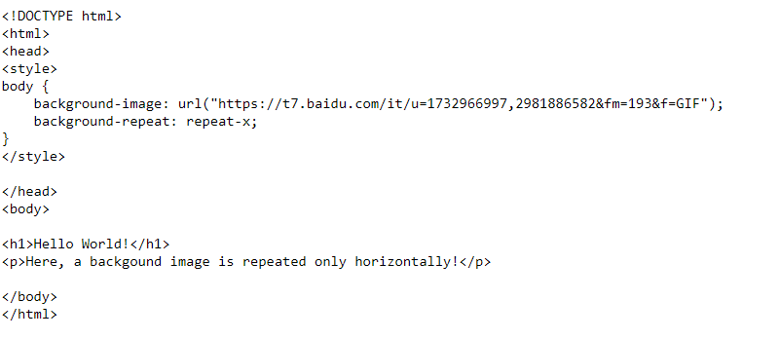

Background Image - Repeat
If the image above is repeated only horizontally ( background-repeat: repeat-x ) , the background will look like this:

Slide 29
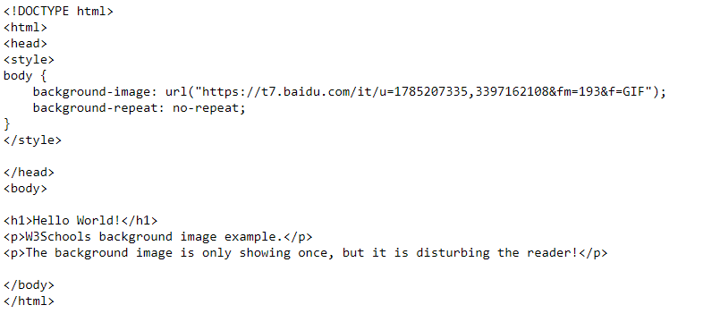

Background Image - Set position and no-repeat
Showing the background image only once is also specified by the background-repeat property:

Slide 30
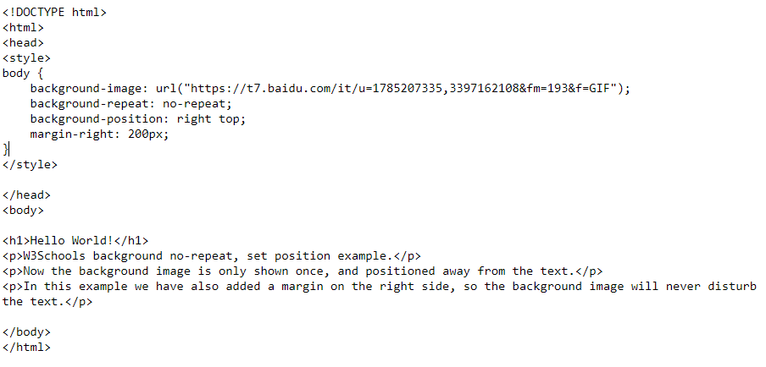
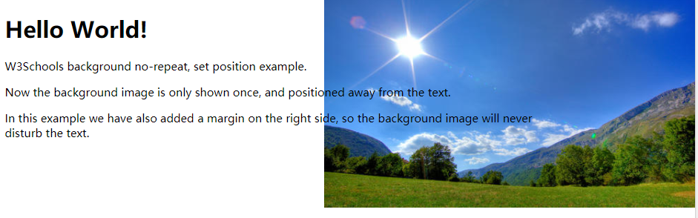
Background Image - Set position and no-repeat
We can change the position of the background image by the background-position property:

Slide 31
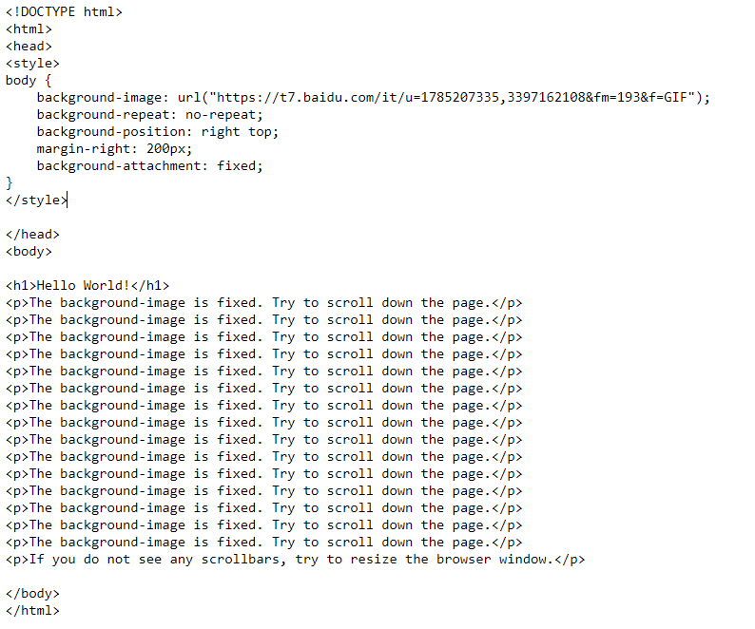
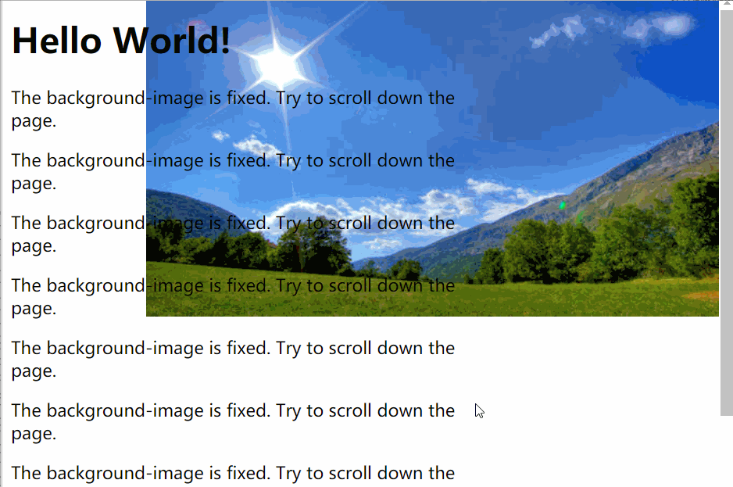
Background Image - Fixed position
To specify that the background image should be fixed (will not scroll with the rest of the page), use the background-attachment property:

Slide 32
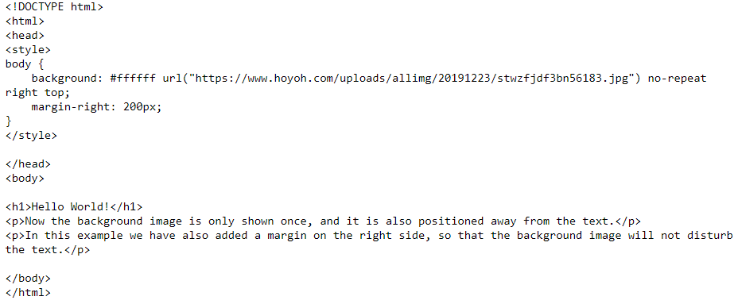
Background - Shorthand property
To shorten the code, it is also possible to specify all the background properties in one single property. This is called a shorthand property.
The shorthand property for background is background :

Slide 33
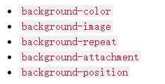
Background - Shorthand property
When using the shorthand property the order of the property values is:
It does not matter if one of the property values is missing, as long as the other ones are in this order.

Slide 34
CSS BORDERS

Slide 35
CSS Border Properties
The CSS border properties allow you to specify the style, width, and color of an element's border.

Slide 36
Border Style
The border-style property specifies what kind of border to display.
The following values are allowed:
  dotted- Defines a dotted border
  dashed- Defines a dashed border
  solid- Defines a solid border
  double- Defines a double border
  groove- Defines a 3D grooved border. The effect depends on the border-color value
  ridge- Defines a 3D ridged border. The effect depends on the border-color value
  inset- Defines a 3D inset border. The effect depends on the border-color value
  outset - Defines a 3D outset border. The effect depends on the border-color value
  none - Defines no border
  hidden- Defines a hidden border
The border-style property can have from one to four values (for the top border, right border, bottom border, and the left border).

Slide 37
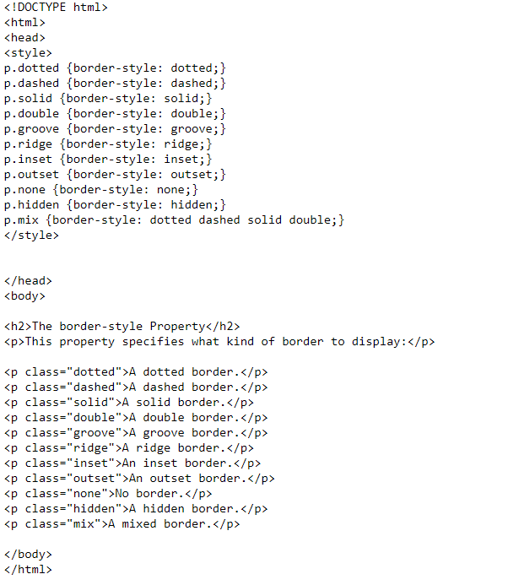
Border Style
Example:

Slide 38
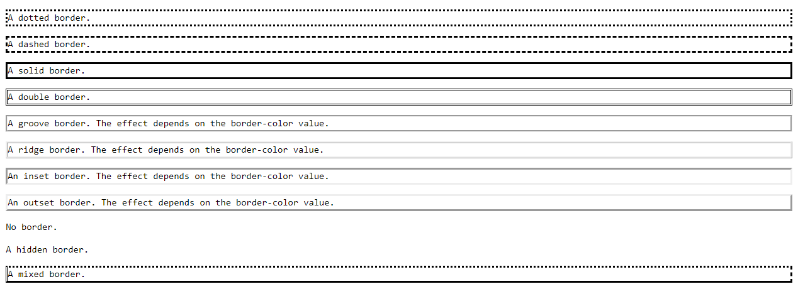

Border Style
Result:
Note: None of the OTHER CSS border properties will have ANY effect unless the border-style property is set!

Slide 39
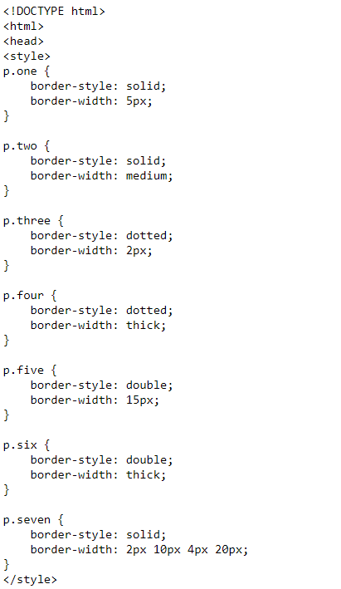
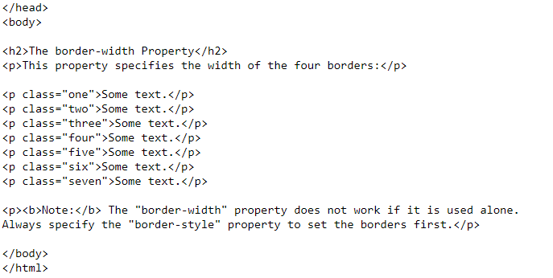
Border Width
The border-width property specifies the width of the four borders.
The width can be set as a specific size (in px, pt, cm, em, etc) or by using one of the three pre-defined values: thin, medium, or thick.
The border-width property can have from one to four values (for the top border, right border, bottom border, and the left border).

Slide 40
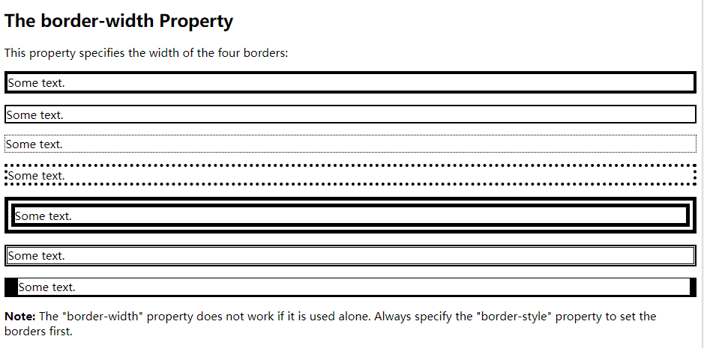
Border Width
Result：

Slide 41
Border Color
The border-color property is used to set the color of the four borders.
The border-color property can have from one to four values (for the top border, right border, bottom border, and the left border).

Slide 42
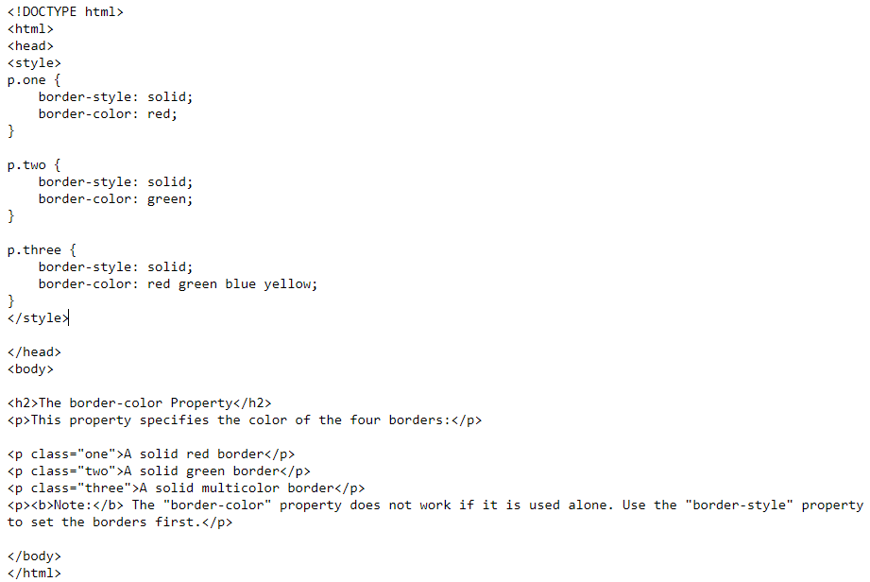
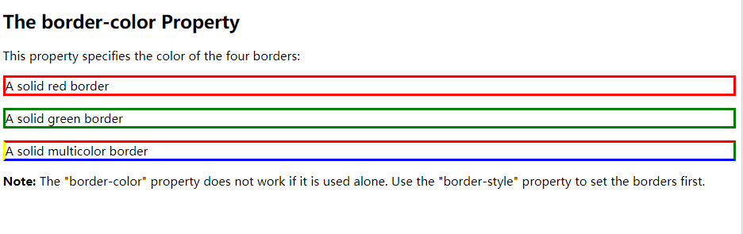
Border Color
If border-color is not set, it inherits the color of the element.

Slide 43
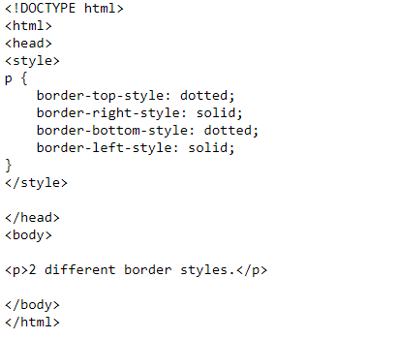
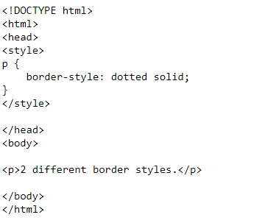
Border - Individual Sides
In CSS, there is also properties for specifying each of the borders (top, right, bottom, and left)
The example on the right side gives the same result as the example on the left side

Slide 44
Border - Individual Sides
If the border-style property has four values:
border-style: dotted solid double dashed;
  top border is dotted
  right border is solid
  bottom border is double
  left border is dashed
If the border-style property has three values:
border-style: dotted solid double;
  top border is dotted
  right and left borders are solid
  bottom border is double

Slide 45
Border - Individual Sides
If the border-style property has two values:
border-style: dotted solid;
  top and bottom borders are dotted
  right and left borders are solid
If the border-style property has one value:
border-style: dotted;
  all four borders are dotted

Slide 46
Border - Shorthand Property
As you can see from the examples above, there are many properties to consider when dealing with borders.
To shorten the code, it is also possible to specify all the individual border properties in one property.
The border property is a shorthand property for the following individual border properties:
  border-width
  border-style(required)
  border-color

Slide 47
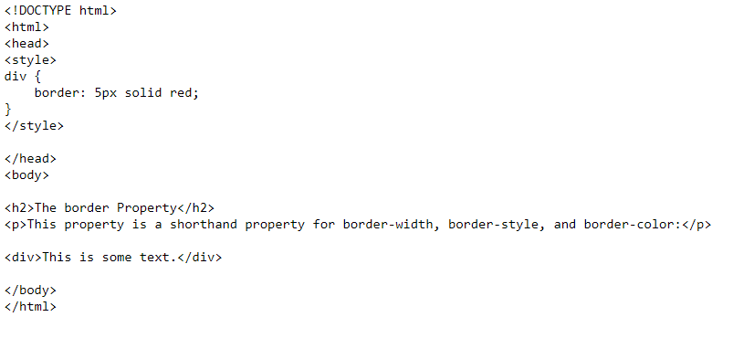
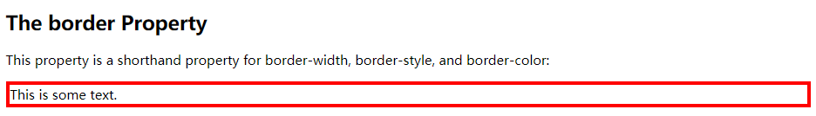
Border - Shorthand Property

Slide 48
CSS MARGINS

Slide 49
CSS Margin Properties
The CSS margin properties are used to generate space around elements.
The margin properties set the size of the white space OUTSIDE the border.

Slide 50

Margin - Individual Sides
CSS has properties for specifying the margin for each side of an element:
  margin-top
  margin-right
  margin-bottom
  margin-left
All the margin properties can have the following values:
  auto - the browser calculates the margin
  length - specifies a margin in px, pt, cm, etc.
  % - specifies a margin in % of the width of the containing element
  inherit - specifies that the margin should be inherited from the parent element
Note: It is also possible to use negative values for margins; to overlap content

Slide 51
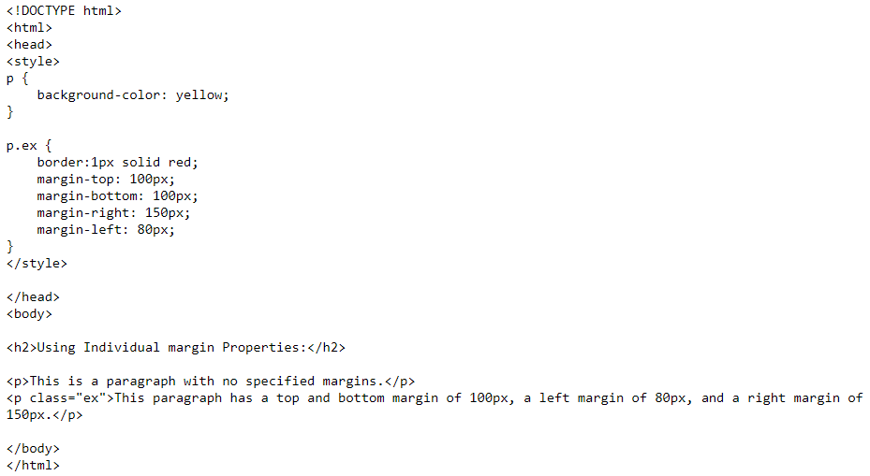
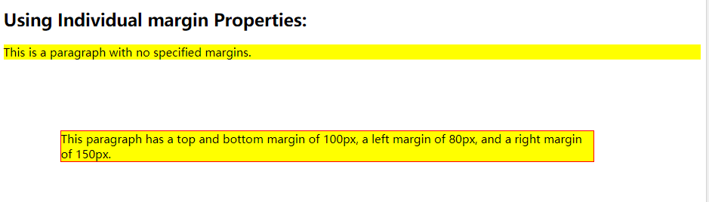
Margin - Individual Sides
The following example sets different margins for all four sides of a <p> element:

Slide 52
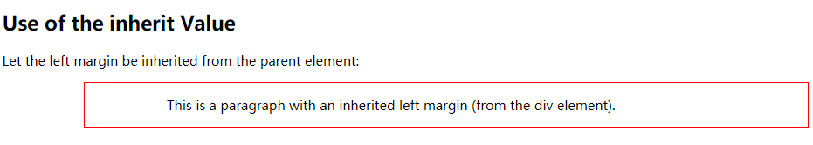
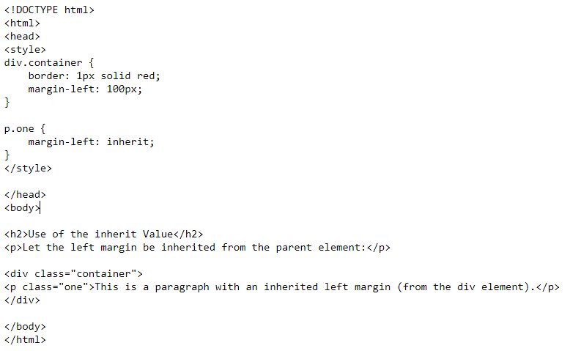
Margin - Individual Sides
The following example lets the left margin be inherited from the parent element:

Slide 53
Margin - Shorthand Property
To shorten the code, it is possible to specify all the margin properties in one property.
The margin property is a shorthand property for the following individual margin properties:
  margin-top
  margin-right
  margin-bottom
  margin-left

Slide 54
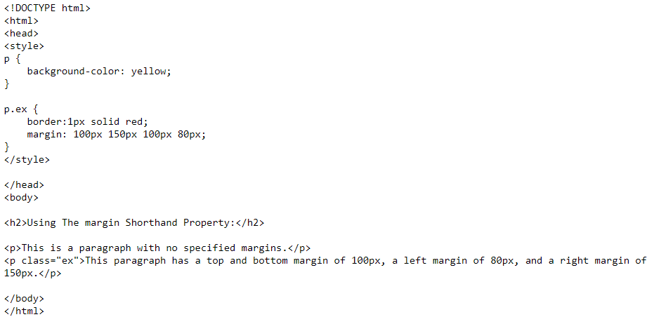
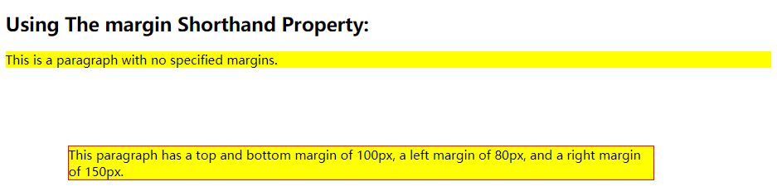
Margin - Shorthand Property
Example：

Slide 55
Margin - Shorthand Property
So, here is how it works:
If the margin property has four values:
margin: 25px 50px 75px 100px;
  top margin is 25px
  right margin is 50px
  bottom margin is 75px
  left margin is 100px
If the margin property has three values:
margin: 25px 50px 75px;
  top margin is 25px
  right and left margins are 50px
  bottom margin is 75px

Slide 56
Margin - Shorthand Property
If the margin property has two values:
margin: 25px 50px;
  top and bottom margins are 25px
  right and left margins are 50px
If the margin property has one value:
margin: 25px;
  all four margins are 25px

Slide 57
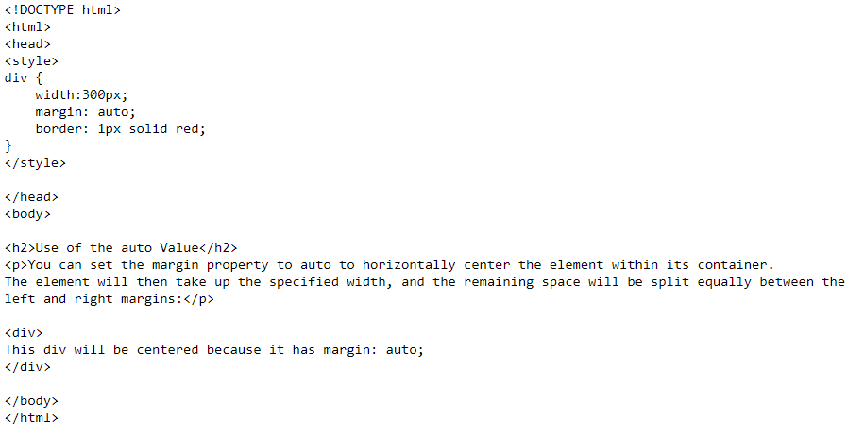
Use of The auto Value
You can set the margin property to auto to horizontally center the element within its container.
The element will then take up the specified width, and the remaining space will be split equally between the left and right margins:

Slide 58
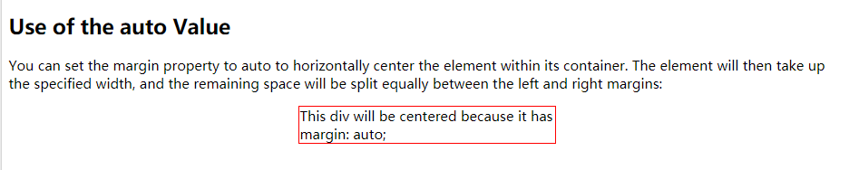
Use of The auto Value

Slide 59
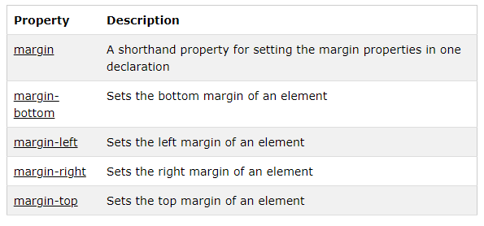
All CSS Margin Properties

