Slide 1
CSS PADDING

Slide 2
CSS Padding Properties
The CSS padding properties are used to generate space around content.
The padding properties set the size of the white space between the element content and the element border.

Slide 3
Padding - Individual Sides
CSS has properties for specifying the padding for each side of an element:
  padding-top
  padding-right
  padding-bottom
  padding-left
All the padding properties can have the following values:
  length - specifies a padding in px, pt, cm, etc.
  % - specifies a padding in % of the width of the containing element
  inherit - specifies that the padding should be inherited from the parent element

Slide 4
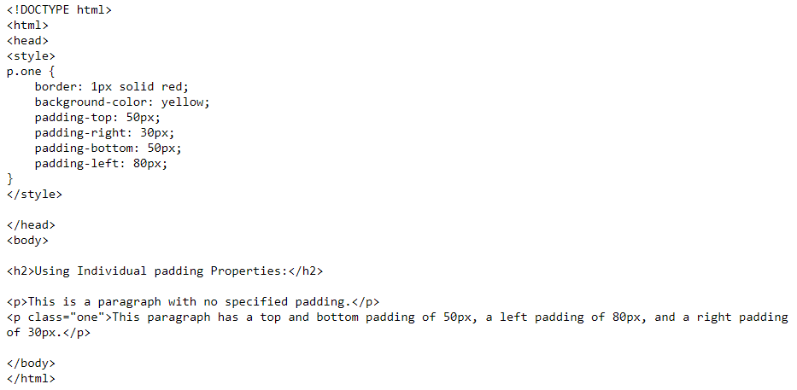
Padding - Individual Sides
The following example sets different padding for all four sides of a <p> element:
CSS 的 `padding` 属性用于在内容周围生成空间。`padding` 属性设置的是元素内容与元素边框之间的空白区域大小。

Slide 5
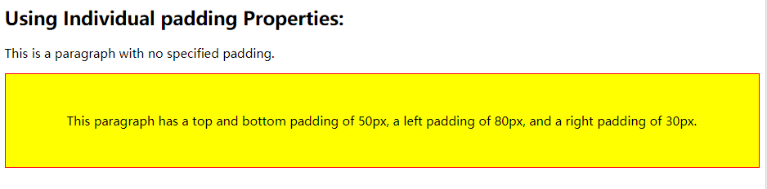
Padding - Individual Sides

Slide 6
Padding - Shorthand Property
The padding property is a shorthand property for the following individual padding properties:
  padding-top
  padding-right
  padding-bottom
  padding-left

Slide 7
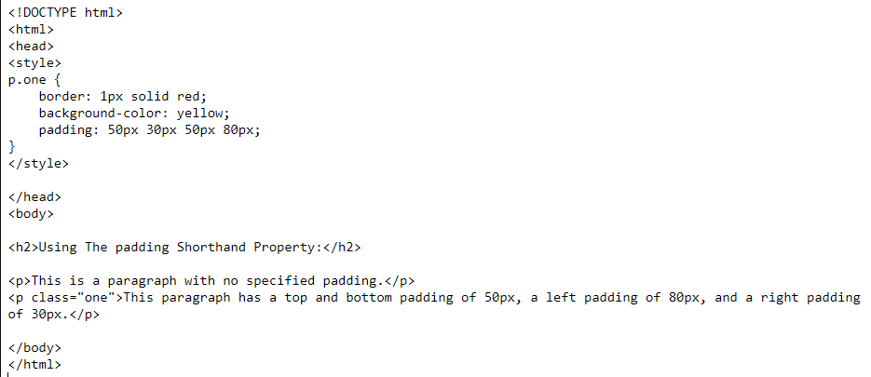
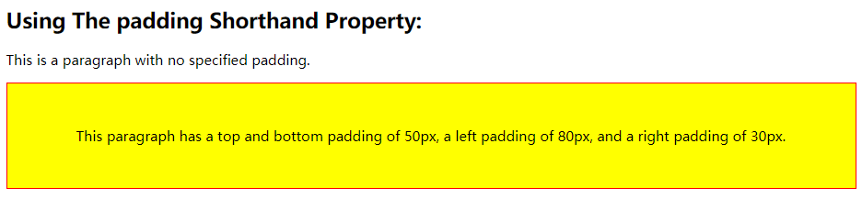
Padding - Shorthand Property
Example:

Slide 8
CSS Height and Width Dimensions

Slide 9
What is CSS Dimension Properties?
The CSS dimension properties allow you to control the height and width of an element.
This element has a width of 100%.

Slide 10
How to set Height and Width？
The height and width can be set to auto (this is default. Means that the browser calculates the height and width), or be specified in length values, like px, cm, etc., or in percent (%) of the containing block.
The height and width properties do not include padding, borders, or margins; they set the height/width of the area inside the padding, border, and margin of the element!

Slide 11
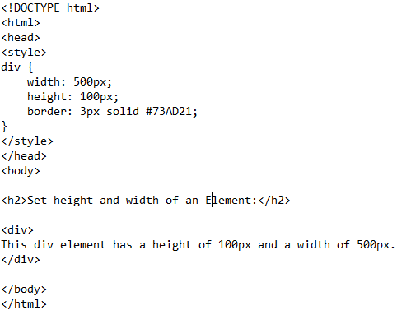
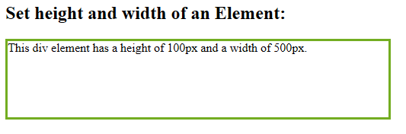
How to set Height and Width？
Example:
Result:

Slide 12
Setting Max-width
The max-width property is used to set the maximum width of an element.
The max-width can be specified in length values, like px, cm, etc., or in percent (%) of the containing block, or set to none (this is default. Means that there is no maximum width).
The problem with the <div> above occurs when the browser window is smaller than the width of the element (500px). The browser then adds a horizontal scrollbar to the page.
Using max-width instead, in this situation,will improve the browser's handling of small windows.

Slide 13
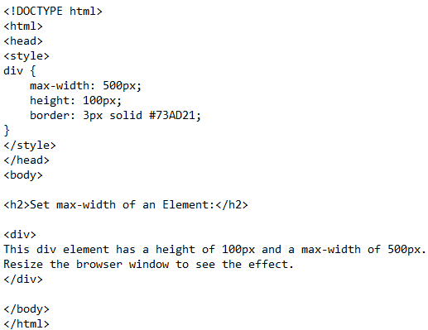
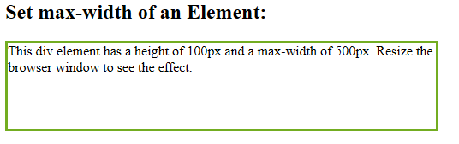
How to set Height and Width？
Example:
Result:
Note: The value of the max-width property overrides width.

Slide 14
CSS Text

Slide 15
What is CSS text formatting？
This text is styled with some of the text formatting properties.
The heading uses the text-align, text-transform, and color properties.
The paragraph is indented, aligned, and the space between characters is specified.

Slide 16
How to use CSS text alignment ?
The text-align property is used to set the horizontal alignment of a text.
A text can be left or right aligned, centered, or justified.

Slide 17
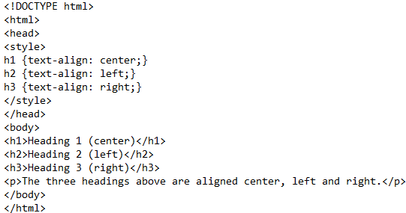
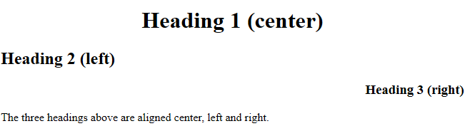
How to use CSS text alignment ?
The following example shows center aligned, and left and right aligned text (left alignment is default if text direction is left-to-right, and right alignment is default if text direction is right-to-left):

Slide 18
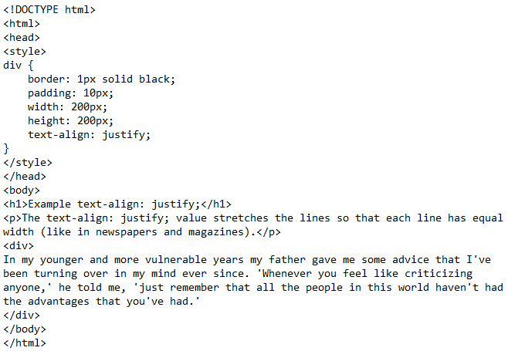

How to use CSS text alignment ?
When the text-align property is set to "justify", each line is stretched so that every line has equal width, and the left and right margins are

Slide 19
How to use CSS text decoration ?
The text-decoration property is used to set or remove decorations from text.
The value text-decoration: none; is often used to remove underlines from links.

Slide 20
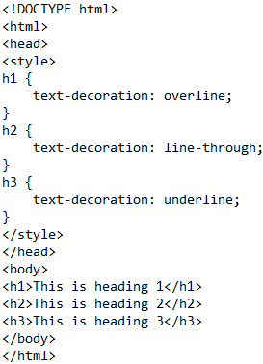
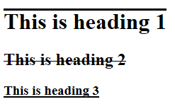
How to use CSS text alignment ?
The other text-decoration values are used to decorate text:

Slide 21
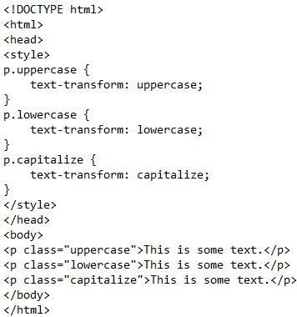
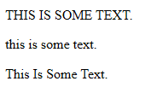
How to use CSS text transformation ?
The text-transform property is used to specify uppercase and lowercase letters in a text. It can be used to turn everything into uppercase or lowercase letters, or capitalize the first letter of each word

Slide 22
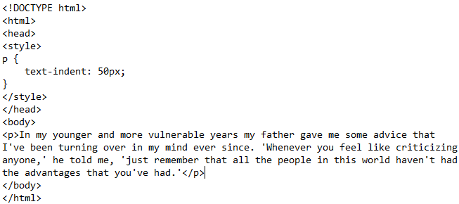

How to use CSS text indentation ?
The text-indent property is used to specify the indentation of the first line of a text.

Slide 23
CSS Fonts

Slide 24
What is CSS fonts?
The CSS font properties define the font family, boldness, size, and the style of a text, In CSS, there are two types of font family names:
generic family - a group of font families with a similar look (like "Serif" or "Monospace")
font family - a specific font family (like "Times New Roman" or "Arial")

Slide 25
How to set Font Family
The font family of a text is set with the font-family property.
The font-family property should hold several font names as a "fallback" system. If the browser does not support the first font, it tries the next font, and so on.
Start with the font you want, and end with a generic family, to let the browser pick a similar font in the generic family, if no other fonts are available.
Note: If the name of a font family is more than one word, it must be in quotation marks, like: "Times New Roman".

Slide 26
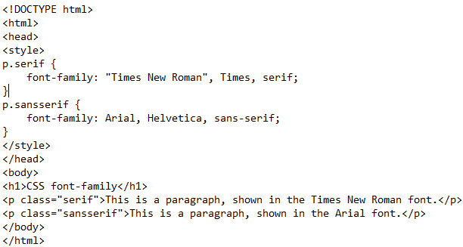

How to set Font Family
More than one font family is specified in a comma-separated list:

Slide 27
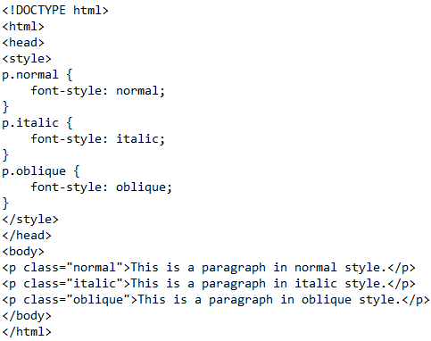

How to set Font Style
The font-style property is mostly used to specify italic text.
normal - The text is shown normally
italic - The text is shown in italics
oblique - The text is "leaning" (oblique is very similar to italic, but less supported)

Slide 28
How to set Font Size
The font-size property sets the size of the text.
Being able to manage the text size is important in web design. However, you should not use font size adjustments to make paragraphs look like headings, or headings look like paragraphs.
Always use the proper HTML tags, like <h1> - <h6> for headings and <p> for paragraphs.
The font-size value can be an absolute, or relative size.

Slide 29
How to set Font Size
Absolute size:
Sets the text to a specified size
Does not allow a user to change the text size in all browsers (bad for accessibility reasons)
Absolute size is useful when the physical size of the output is known
Relative size:
Sets the size relative to surrounding elements
Allows a user to change the text size in browsers
Note: If you do not specify a font size, the default size for normal text, like paragraphs, is 16px (16px=1em).

Slide 30
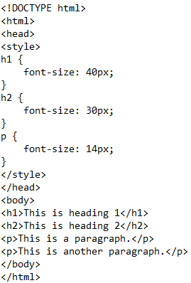
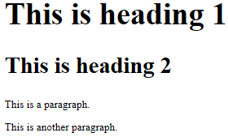
How to set Font Size with Pixels
Setting the text size with pixels gives you full control over the text size:
Hint: If you use pixels, you can still use the zoom tool to resize the entire page.

Slide 31
How to set Font Size with Em
To allow users to resize the text (in the browser menu), many developers use em instead of pixels.
The em size unit is recommended by the W3C.
1em is equal to the current font size. The default text size in browsers is 16px. So, the default size of 1em is 16px.
The size can be calculated from pixels to em using this formula: pixels/16=em
with the em size, it is possible to adjust the text size in all browsers.

Slide 32
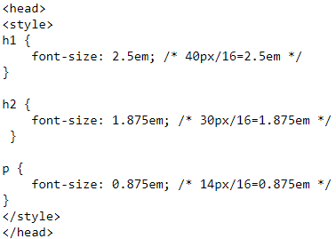
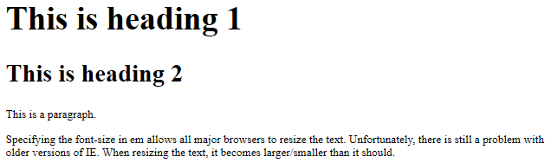
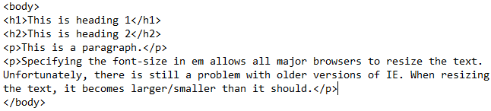
How to set Font Size with Em

Slide 33
CSS Links

Slide 34

What is CSS Links?
With CSS, links can be styled in different ways.
Links can be styled with any CSS property (e.g. color, font-family, background, etc.).

Slide 35
How to Style Links
links can be styled differently depending on what state they are in. The four links states are:
a:link - a normal, unvisited link
a:visited - a link the user has visited
a:hover - a link when the user mouses over it
a:active - a link the moment it is clicked

Slide 36
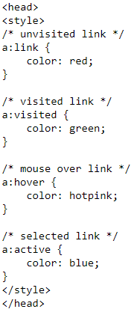
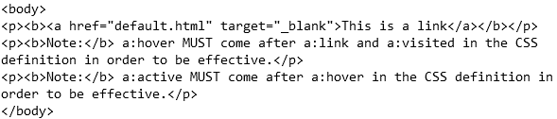
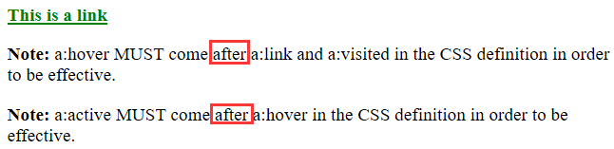
How to Style Links
Example:
Result:

Slide 37
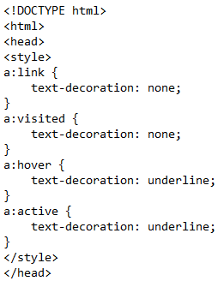
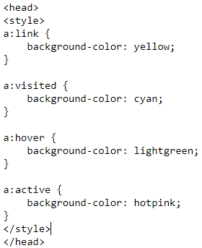
How to set Text Decoration
The text-decoration property is mostly used to remove underlines from links:
The background-color property can be used to specify a background color for links:

Slide 38
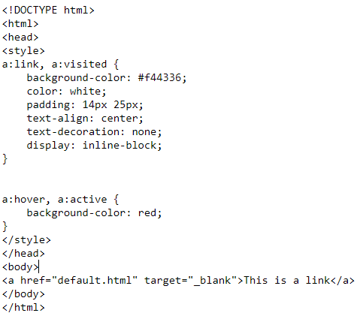

Advanced - How to set Link Buttons
This example demonstrates a more advanced example where we combine several CSS properties to display links as boxes/buttons.
The main difference compared to display: inline is that display: inline-block allows you to set the width and height on the element

Slide 39
CSS Lists

Slide 40
What is CSS Lists?
In HTML, there are two main types of lists:
unordered lists (<ul>) - the list items are marked with bullets
ordered lists (<ol>) - the list items are marked with numbers or letters
The CSS list properties allow you to:
Set different list item markers for ordered lists
Set different list item markers for unordered lists
Set an image as the list item marker
Add background colors to lists and list items

Slide 41
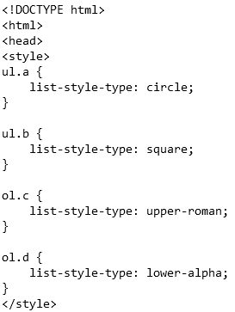
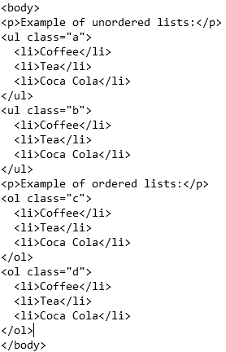
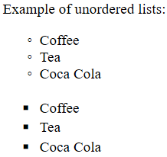
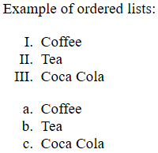
Different List Item Markers
The list-style-type property specifies the type of list item marker. The following example shows some of the available list item markers:
Note: Some of the values are for unordered lists, and some for ordered lists.

Slide 42
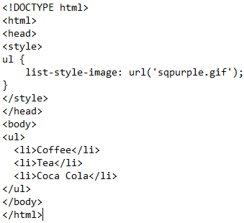

An Image as The List Item Marker
The list-style-image property specifies an image as the list item marker:
Example:
Result:

Slide 43
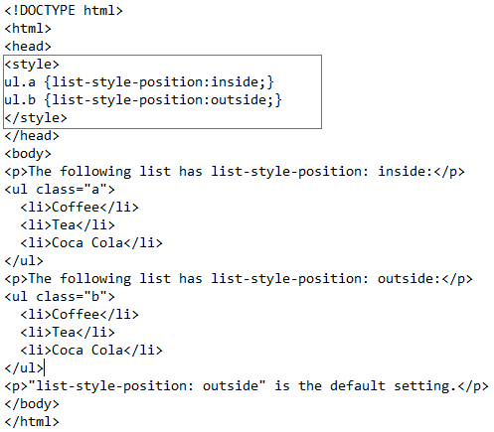
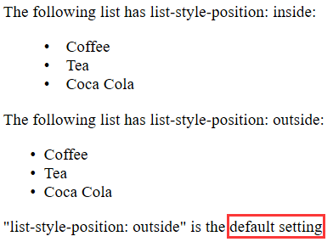
Position The List Item Markers
The list-style-position property specifies whether the list-item markers should appear inside or outside the content flow:

Slide 44


Position The List Item Markers
outside
List item markers are placed outside the text, and wrapping text is not aligned according to the markers.
inside
List item markers are placed within the text, and the wrapping text is aligned according to the markers.
Notes:
Inside：列表项目标记放置在文本以内，且环绕文本根据标记对齐。
Outside：默认值。保持标记位于文本的左侧。列表项目标记放置在文本以外，且环绕文本不根据标记对齐。

Slide 45
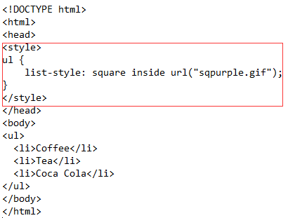

List - Shorthand property
The list-style property is a shorthand property. It is used to set all the list properties in one declaration:

Slide 46
List - Shorthand property
When using the shorthand property, the order of the property values are:
list-style-type (if a list-style-image is specified, the value of this property will be displayed if the image for some reason cannot be displayed)
list-style-position (specifies whether the list-item markers should appear inside or outside the content flow)
list-style-image (specifies an image as the list item marker)
If one of the property values above are missing, the default value for the missing property will be inserted, if any.

Slide 47
Styling List With Colors
We can also style lists with colors, to make them look a little more interesting.
Anything added to the <ol> or <ul> tag, affects the entire list, while properties added to the <li> tag will affect the individual list items

Slide 48
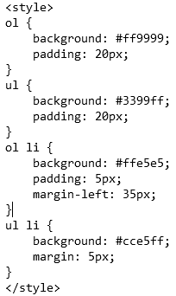
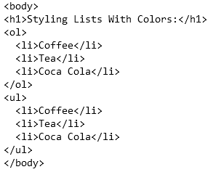
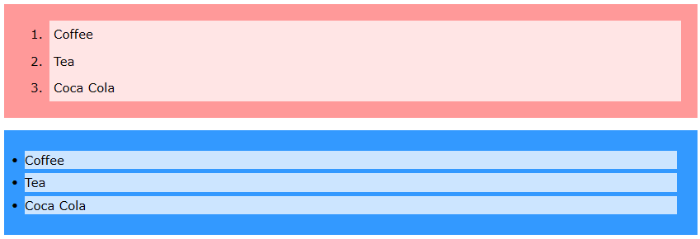
Styling List With Colors
Result:

Slide 49
CSS Tables

Slide 50
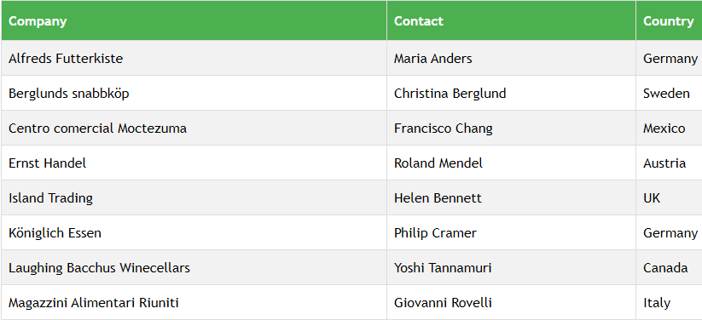
What is CSS Tables?
The look of an HTML table can be greatly improved with CSS:

Slide 51
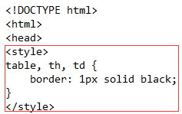
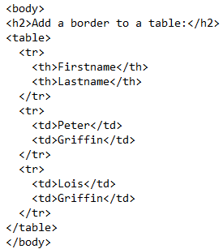

Table Borders
To specify table borders in CSS, use the border property. The example below specifies a black border for <table>, <th>, and <td> elements:
Result:
Hint: Notice that the table in the example above has double borders. This is because both the table and the <th> and <td> elements have separate borders.

Slide 52

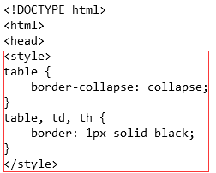
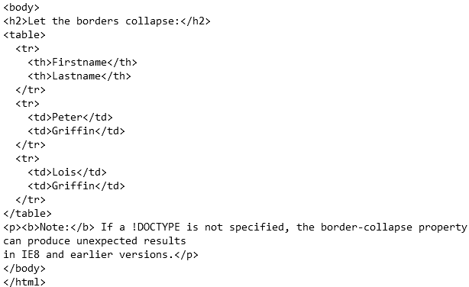
Collapse Table Borders
The border-collapse property sets whether the table borders should be collapsed into a single border:

Slide 53
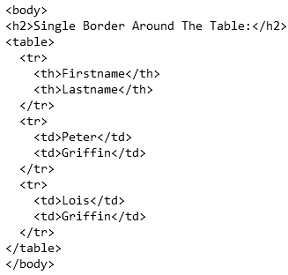
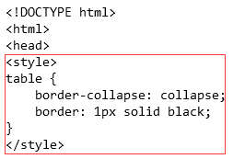

Collapse Table Borders
If you only want a border around the table, only specify the border property for <table>:

Slide 54
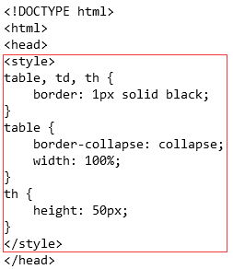
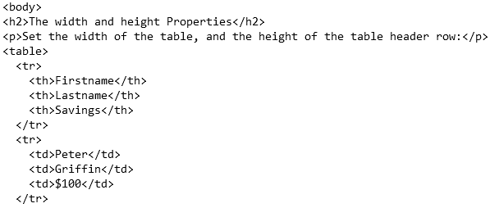
Table Width and Height
Width and height of a table are defined by the width and height properties. The example below sets the width of the table to 100%, and the height of the <th> elements to 50px:

Slide 55
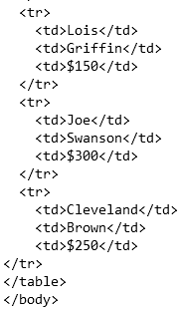

Table Width and Height

Slide 56



Horizontal Alignment
The text-align property sets the horizontal alignment (like left, right, or center) of the content in <th> or <td>. By default, the content of <th> elements are center-aligned and the content of <td> elements are left-aligned. The following example left-aligns the text in <th> elements:

Slide 57

Horizontal Alignment

Slide 58
Vertical Alignment
The vertical-align property sets the vertical alignment (like top, bottom, or middle) of the content in <th> or <td>.
By default, the vertical alignment of the content in a table is middle (for both <th> and <td> elements).

Slide 59



Vertical Alignment
The following example sets the vertical text alignment to bottom for <td> elements:

Slide 60


Horizontal Dividers
Add the border-bottom property to <th> and <td> for horizontal dividers:

Slide 61



Hoverable Table
Use the :hover selector on <tr> to highlight table rows on mouse over:

Slide 62


Striped Tables
For zebra-striped tables, use the nth-child() selector and add a background-color to all even (or odd) table rows:

Slide 63


Table Color
The example below specifies the background color and text color of <th> elements:

