Slide 1
CSS FLOAT

Slide 2

CSS Float And Clear
The float property specifies whether or not an element should float.
The clear property is used to control the behavior of floating elements.

Slide 3
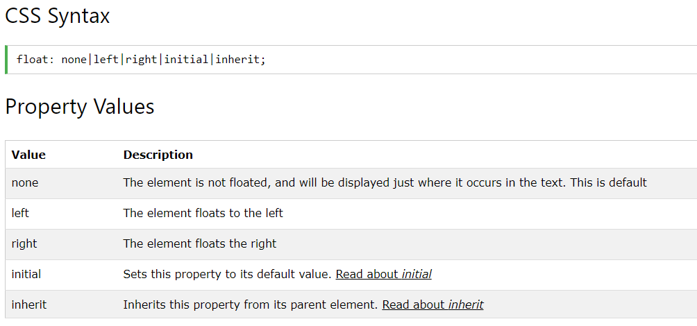
CSS Float

Slide 4
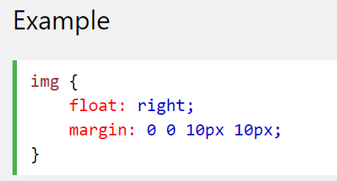
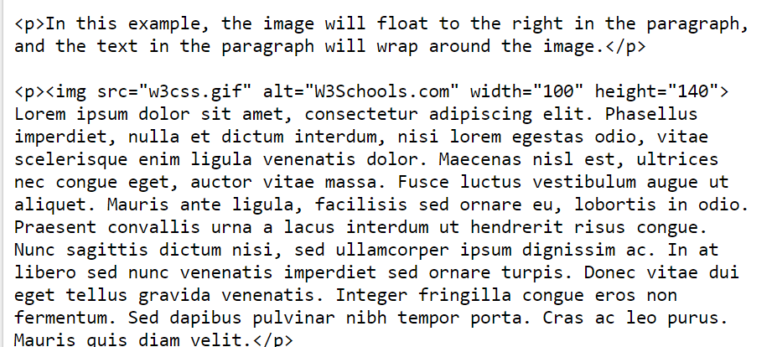
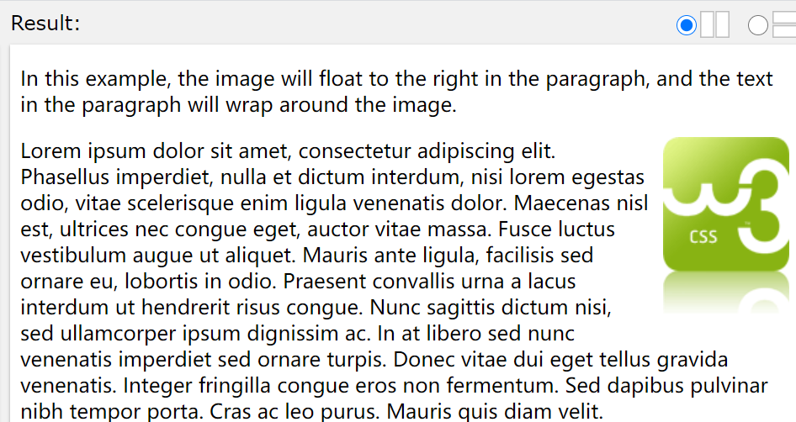
The Float Property
The float property can be used to wrap text around images. The following example specifies that an image should float to the right in a text:

Slide 5
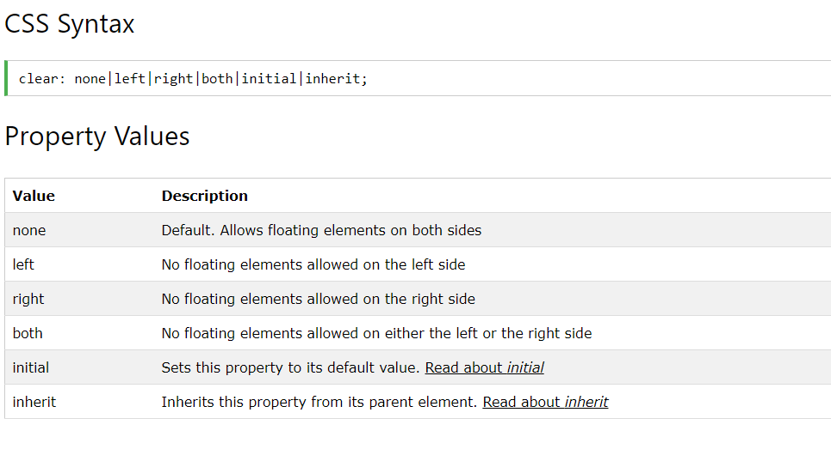
The Clear Property

Slide 6
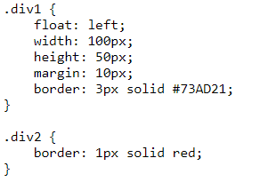
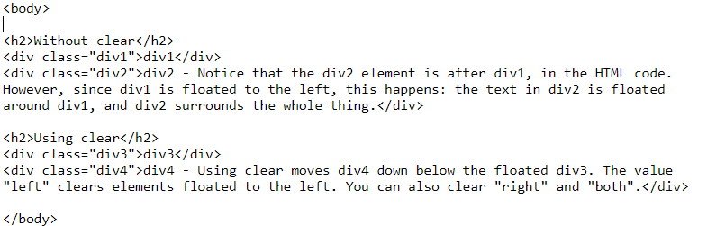
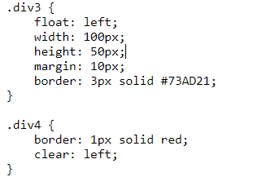
The Clear Property
The clear property is used to control the behavior of floating elements. Elements after a floating element will flow around it. To avoid this, use the clear The clear property specifies on which sides of an element floating elements are not allowed to float:

Slide 7
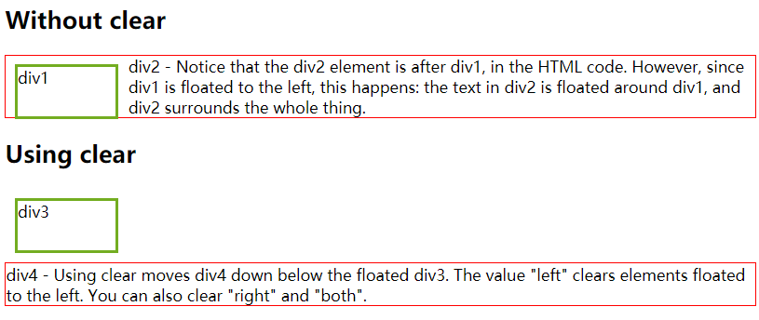
The Clear Property

Slide 8
CSS Navigation Bar

Slide 9
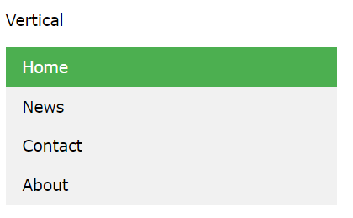
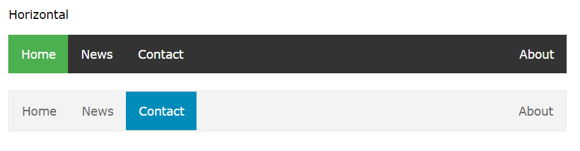
Demo: Navigation Bars
With CSS you can transform boring HTML menus into good-looking navigation bars.

Slide 10
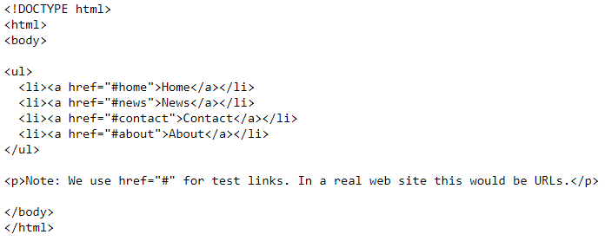
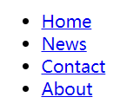
Navigation Bar = List of Links
A navigation bar needs standard HTML as a base.
In our examples we will build the navigation bar from a standard HTML list.
A navigation bar is basically a list of links, so using the <ul> and <li> elements makes perfect sense:

Slide 11
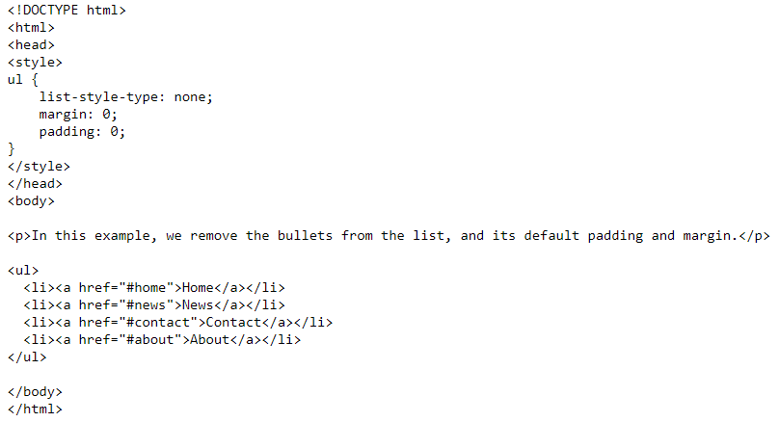
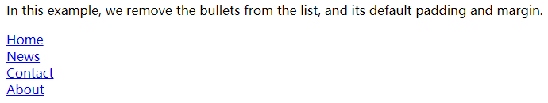
Navigation Bar = List of Links
Now remove the bullets and the margins and padding from the list:
list-style-type: none; - Removes the bullets. A navigation bar does not need list markers
Set margin: 0; and padding: 0; to remove browser default settings
The code in the example above is the standard code used in both vertical, and horizontal navigation bars.

Slide 12
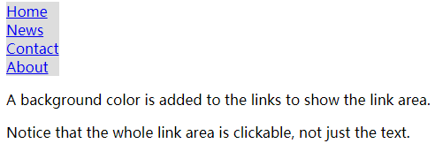
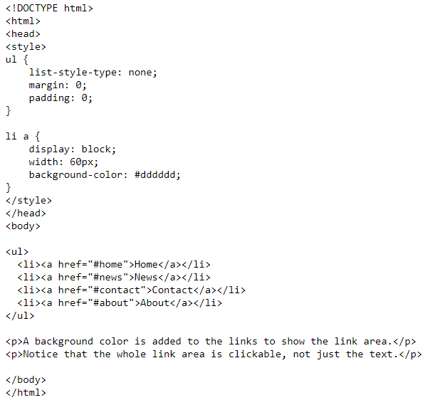
Vertical Navigation Bar
To build a vertical navigation bar, you can style the <a> elements inside the list, in addition to the code above:
display: block; - Displaying the links as block elements makes the whole link area clickable (not just the text), and it allows us to specify the width (and padding, margin, height, etc. if you want)
width: 60px; - Block elements take up the full width available by default. We want to specify a 60 pixels width

Slide 13
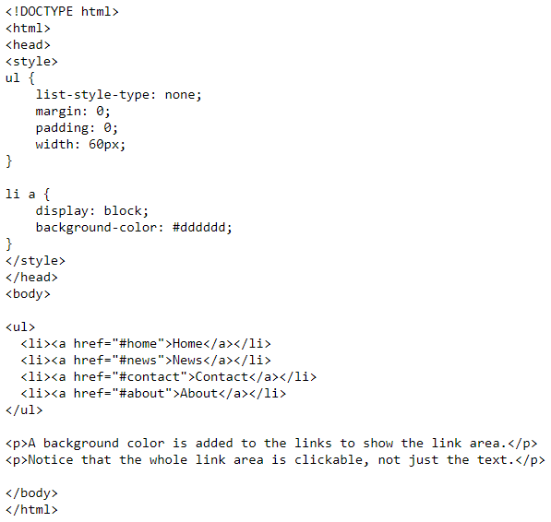
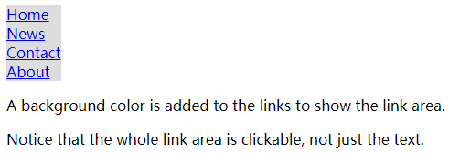
Vertical Navigation Bar
You can also set the width of <ul>, and remove the width of <a>, as they will take up the full width available when displayed as block elements. This will produce the same result as our previous example:

Slide 14
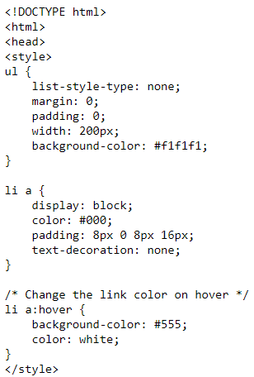
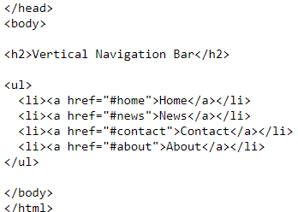
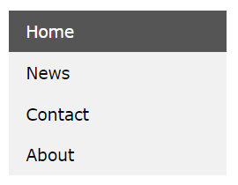
Vertical Navigation Bar Examples
Create a basic vertical navigation bar with a gray background color and change the background color of the links when the user moves the mouse over them:

Slide 15
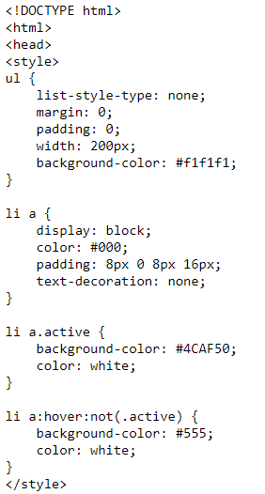
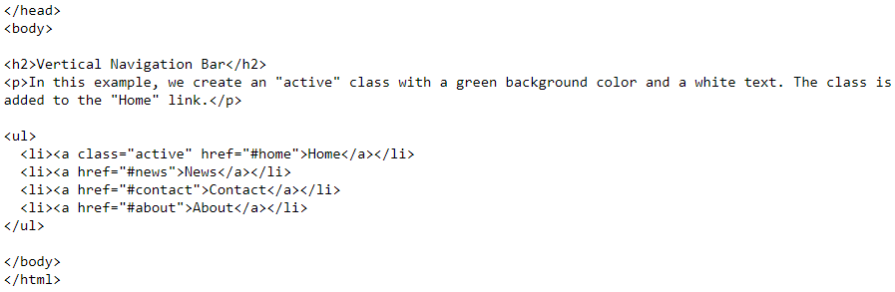
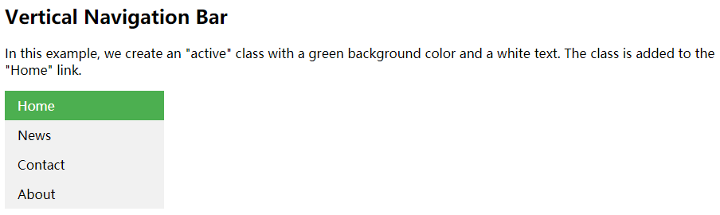
Vertical Navigation Bar Examples
Active/Current Navigation Link: Add an "active" class to the current link to let the user know which page he/she is on:

Slide 16
Vertical Navigation Bar Examples
Center Links & Add Borders
Add text-align:center to <li> or <a> to center the links.
Add the border property to <ul>, add a border around the navbar. If you also want borders inside the navbar, add a border-bottom to all <li> elements, except for the last one:

Slide 17
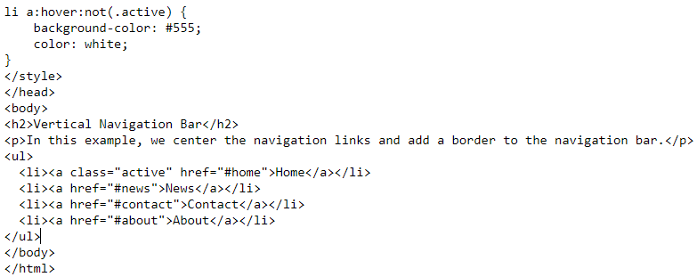
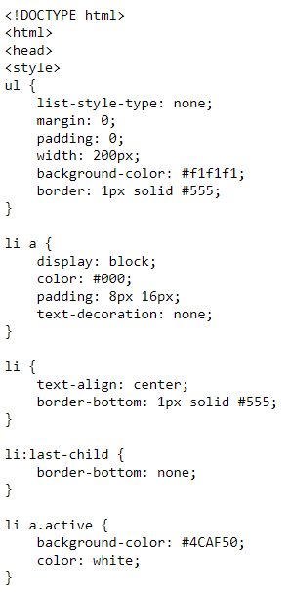
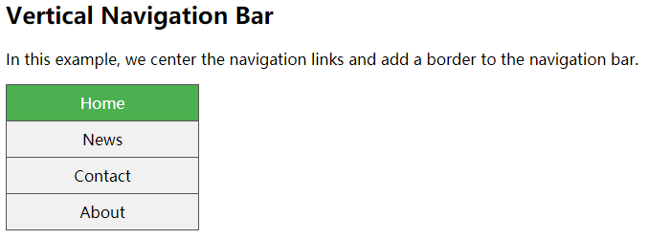
Vertical Navigation Bar Examples
Example:

Slide 18
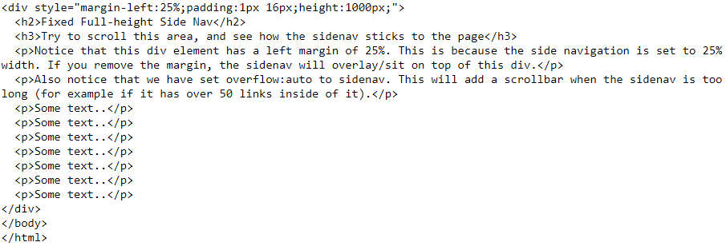
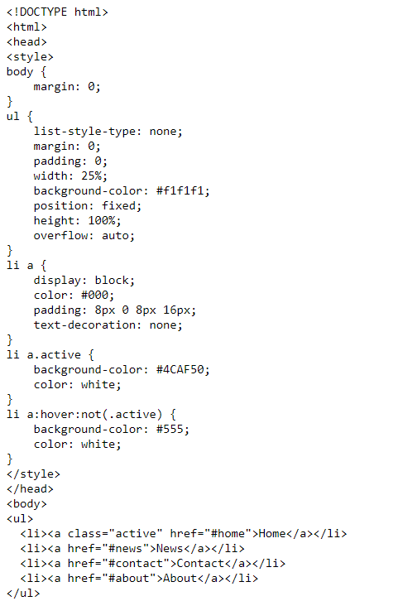
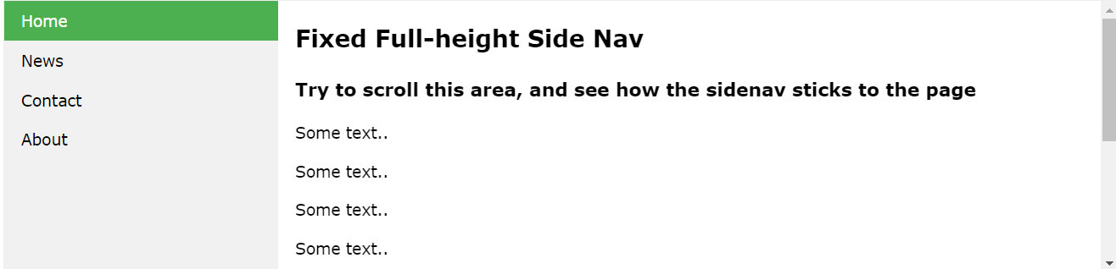
Vertical Navigation Bar Examples
Full-height Fixed Vertical Navbar: Create a full-height, "sticky" side navigation:

Slide 19
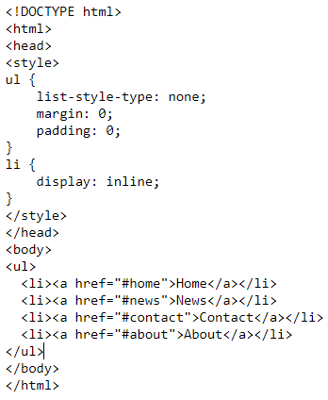

Horizontal Navigation Bar
There are two ways to create a horizontal navigation bar. Using inline or floating list items.
Inline List Items: One way to build a horizontal navigation bar is to specify the <li> elements as inline, in addition to the "standard" code above:
Example explained:
display: inline; - By default, <li> elements are block elements. Here, we remove the line breaks before and after each list item, to display them on one line

Slide 20
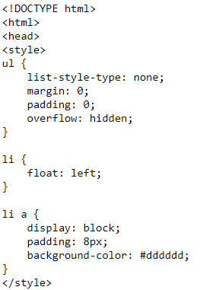
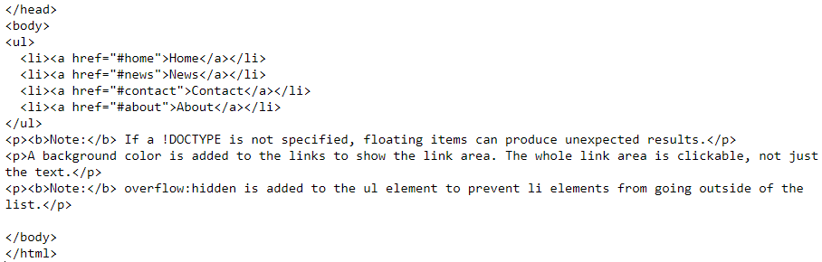
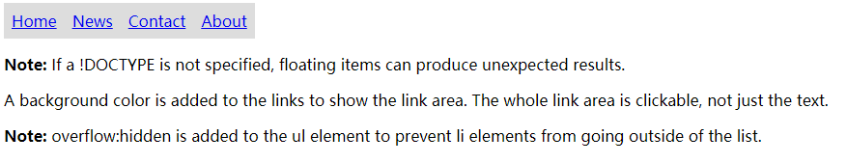
Horizontal Navigation Bar
Floating List Items: Another way of creating a horizontal navigation bar is to float the <li> elements, and specify a layout for the navigation links:

Slide 21
Horizontal Navigation Bar
Example explained:
float: left; - use float to get block elements to slide next to each other
display: block; - Displaying the links as block elements makes the whole link area clickable (not just the text), and it allows us to specify padding (and height, width, margins, etc. if you want)
padding: 8px; - Since block elements take up the full width available, they cannot float next to each other. Therefore, specify some padding to make them look good
background-color: #dddddd; - Add a gray background-color to each a element

Slide 22
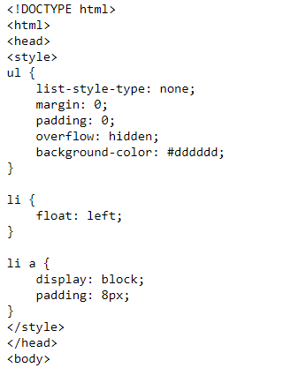
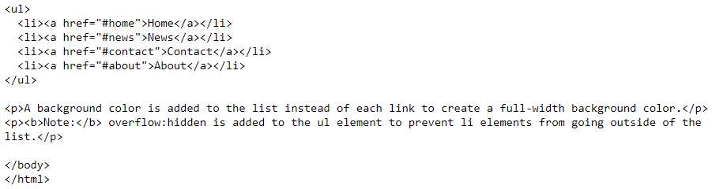
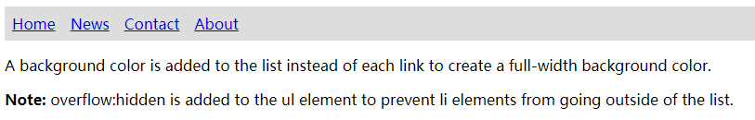
Horizontal Navigation Bar
Tip: Add the background-color to <ul> instead of each <a> element if you want a full-width background color:

Slide 23
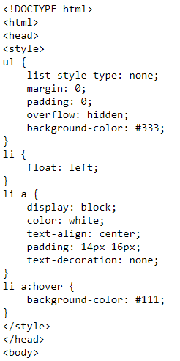
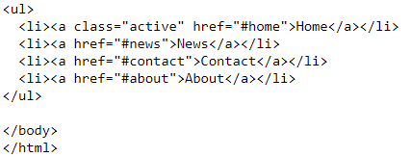

Horizontal Navigation Bar Examples
EX: Create a basic horizontal navigation bar with a dark background color and change the background color of the links when the user moves the mouse over them:

Slide 24


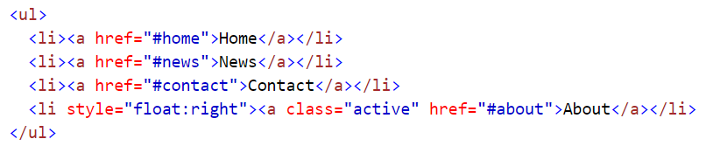
Horizontal Navigation Bar Examples
Active/Current Navigation Link: Add an "active" class to the current link to let the user know which page he/she is on:
Right-Align Links:Right-align links by floating the list items to the right (float:right;):

Slide 25
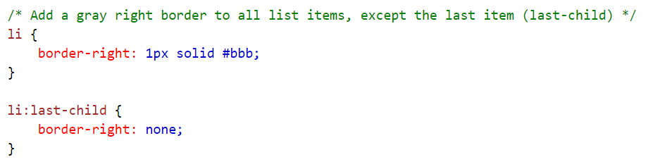
Horizontal Navigation Bar Examples
Border Dividers: Add the border-right property to <li> to create link dividers:

Slide 26
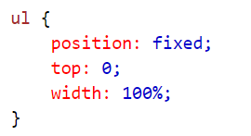
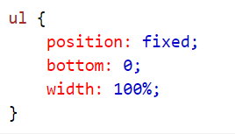
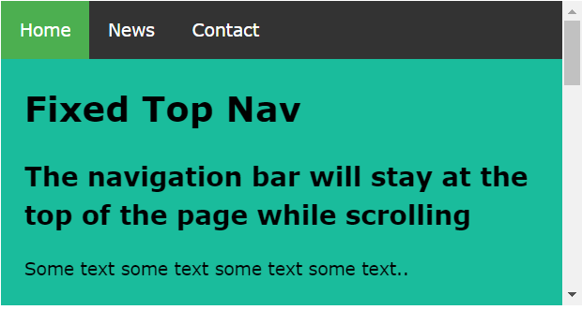
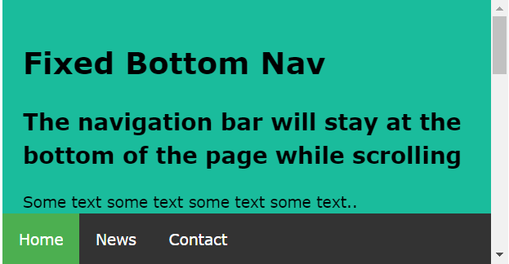
Horizontal Navigation Bar Examples
Fixed Navigation Bar：Make the navigation bar stay at the top or the bottom of the page, even when the user scrolls the page:
Fixed Top:
Fixed Bottom:

Slide 27
CSS Forms

Slide 28
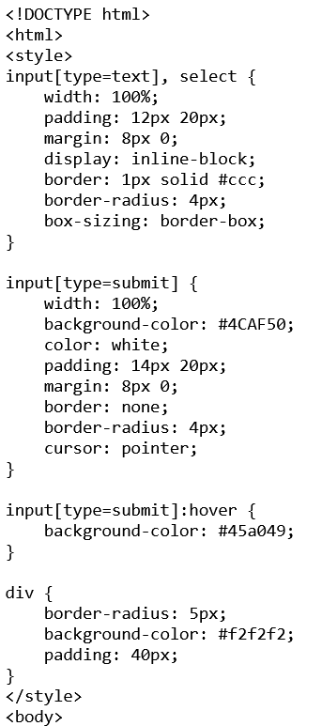
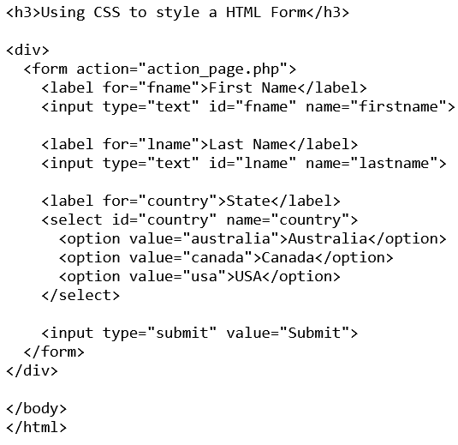
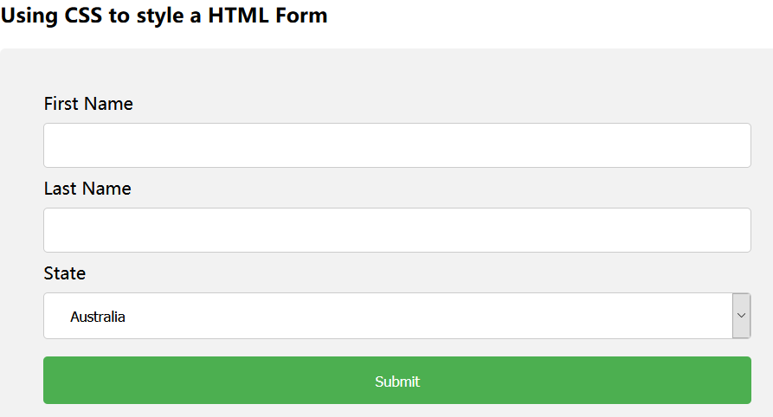
The look of an HTML form can be greatly improved with CSS:

Slide 29
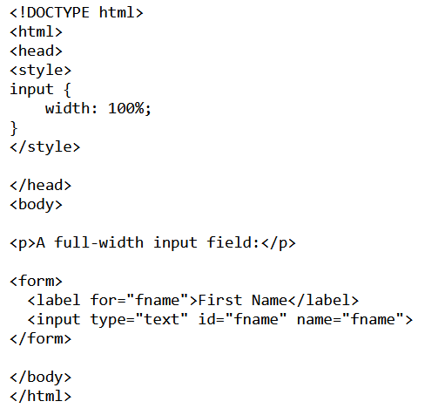

Styling Input Fields
Use the width property to determine the width of the input field:

Slide 30
Styling Input Fields
The example above applies to all <input> elements. If you only want to style a specific input type, you can use attribute selectors:
input[type=text] - will only select text fields
input[type=password] - will only select password fields
input[type=number] - will only select number fields

Slide 31


Padded Inputs
Use the padding property to add space inside the text field.
Tip: When you have many inputs after each other, you might also want to add some margin, to add more space outside of them:
Note that we have set the box-sizing property to border-box. This makes sure that the padding and eventually borders are included in the total width and height of the elements.

Slide 32


Bordered Inputs
Use the border property to change the border size and color, and use the border-radius property to add rounded corners:

Slide 33


Bordered Inputs
If you only want a bottom border, use the border-bottom property:

Slide 34


Colored Inputs
Use the background-color property to add a background color to the input, and the color property to change the text color:

Slide 35



Focused Inputs
By default, some browsers will add a blue outline around the input when it gets focus (clicked on). You can remove this behavior by adding outline: none; to the input.
Use the :focus selector to do something with the input field when it gets focus:

Slide 36


Focused Inputs
Notes:
-webkit-transition:width 2s; /* Safari and Chrome */

Slide 37


Input with icon/image
If you want an icon inside the input, use the background-image property and position it with the background-position property. Also notice that we add a large left padding to reserve the space of the icon:

Slide 38


Animated Search Input
In this example we use the CSS3 transition property to animate the width of the search input when it gets focus
CSS3 transitions allows you to change property values smoothly (from one value to another), over a given duration.

Slide 39


Styling Textareas
Tip: Use the resize property to prevent textareas from being resized (disable the "grabber" in the bottom right corner):

Slide 40


Styling Select Menus

Slide 41


Styling Input Buttons

Slide 42
CSS Pagination

Slide 43

Simple Pagination
If you have a website with lots of pages, you may wish to add some sort of pagination to each page:
To create a pagination, style a HTML list:

Slide 44


Simple Pagination
Example：

Slide 45


Active and Hoverable Pagination
Highlight the current page with an .active class, and use the :hover selector to change the color of each page link when moving the mouse over them:

Slide 46



Active and Hoverable Pagination
Example：

Slide 47


Rounded Active and Hoverable Buttons
Add the border-radius property if you want a rounded "active" and "hover" button:

Slide 48



Rounded Active and Hoverable Buttons
Example：

Slide 49

Hoverable Transition Effect
Add the transition property to the page links to create a transition effect on hover:

Slide 50



Hoverable Transition Effect
Example：

Slide 51


Bordered Pagination
Use the border property to add borders to the pagination:

Slide 52



Bordered Pagination
Example：

Slide 53

Rounded Borders
Tip: Add rounded borders to your first and last link in the pagination:

Slide 54



Rounded Borders

Slide 55

Space Between Links
Tip: Add the margin property if you do not want to group the page links:

Slide 56



Space Between Links

Slide 57


Pagination Size
Change the size of the pagination with the font-size property:

Slide 58



Pagination Size
Example：

Slide 59


Centered Pagination
To center the pagination, wrap a container element around it (like <div>), and add text-align:center

Slide 60



Centered Pagination

Slide 61


Breadcrumbs
Another variation of pagination is so-called "breadcrumbs":

Slide 62


Breadcrumbs
The :before selector inserts content before the content of the selected element.

