Slide 1
JavaScript Strings

Slide 2
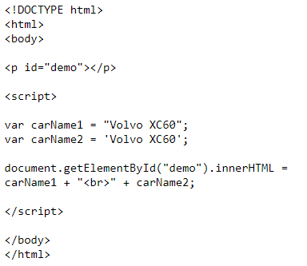
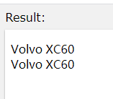
JavaScript Strings
A JavaScript string simply stores a series of characters like "John Doe". A string can be any text inside quotes. You can use single or double quotes:

Slide 3
JavaScript String Methods

Slide 4
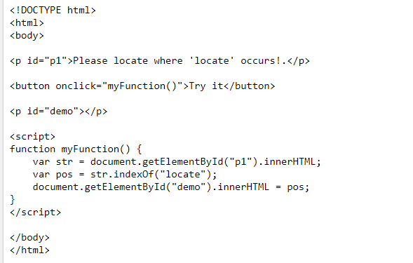
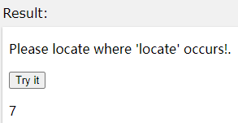
Finding a String in a String
The indexOf() method returns the index of (the position of) the first occurrence of a specified text in a string:

Slide 5
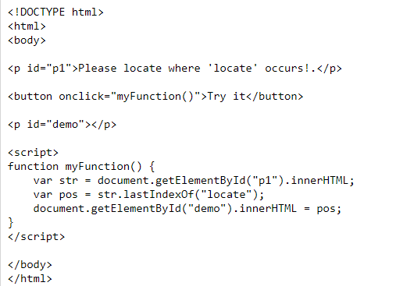
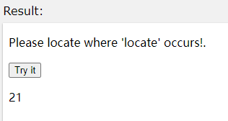
Finding a String in a String
The lastIndexOf() method returns the index of the last occurrence of a specified text in a string:
Both the indexOf(), and the lastIndexOf() methods return -1 if the text is not found. Both methods accept a second parameter as the starting position for the search.

Slide 6
Extracting String Parts
There are 3 methods for extracting a part of a string:
slice(start, end)
substring(start, end)
substr(start, length)

Slide 7
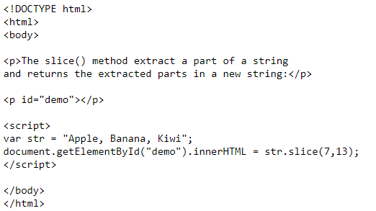
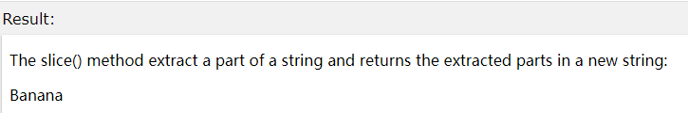
The slice() Method
slice() extracts a part of a string and returns the extracted part in a new string. The method takes 2 parameters: the starting index (position), and the ending index (position). This example slices out a portion of a string from position 7 to position 13:

Slide 8
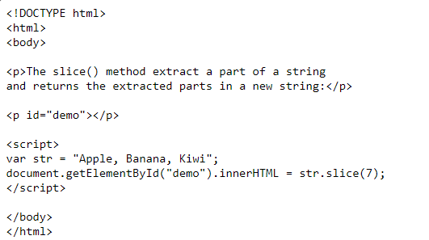
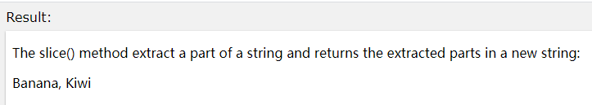
The slice() Method
If you omit the second parameter, the method will slice out the rest of the string:

Slide 9
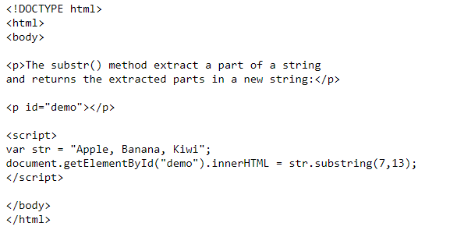
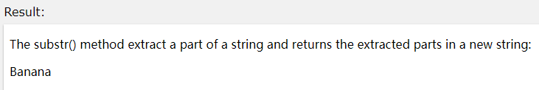
The substring() Method
substring() is similar to slice().
If you omit the second parameter, substring() will slice out the rest of the string.

Slide 10
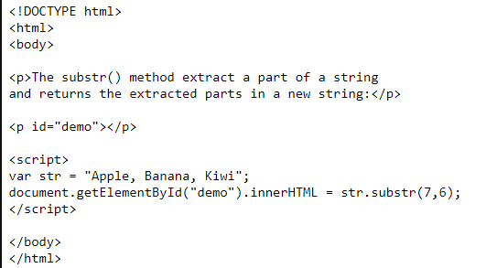
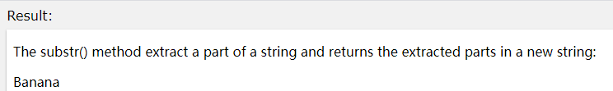
The substr() Method
substr() is similar to slice(). The difference is that the second parameter specifies the length of the extracted part. If you omit the second parameter, substr() will slice out the rest of the string.

Slide 11
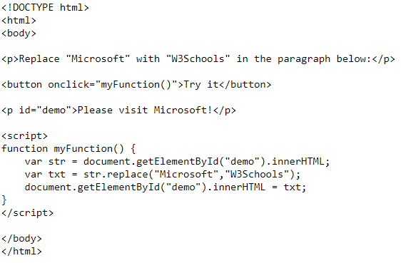
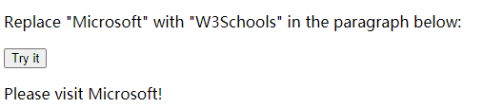
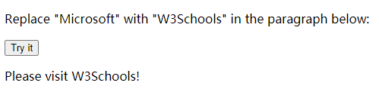
Replacing String Content
The replace() method replaces a specified value with another value in a string:

Slide 12
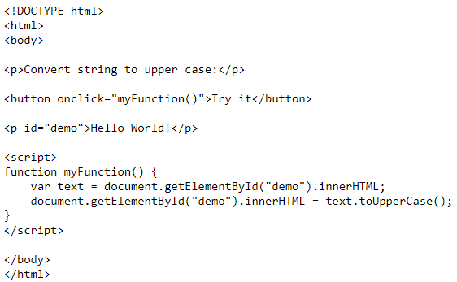
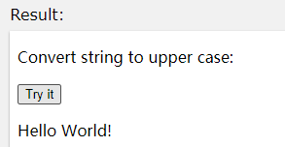
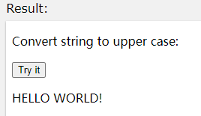
Converting to Upper and Lower Case
A string is converted to upper case with toUpperCase():

Slide 13
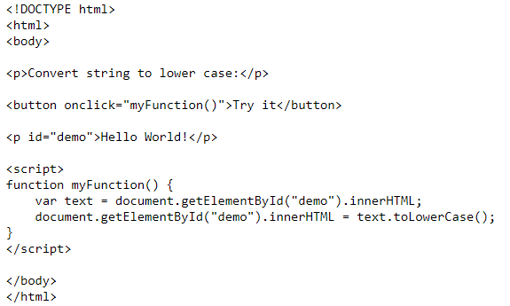
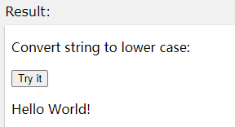
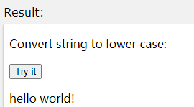
Converting to Upper and Lower Case
A string is converted to lower case with toLowerCase():

Slide 14
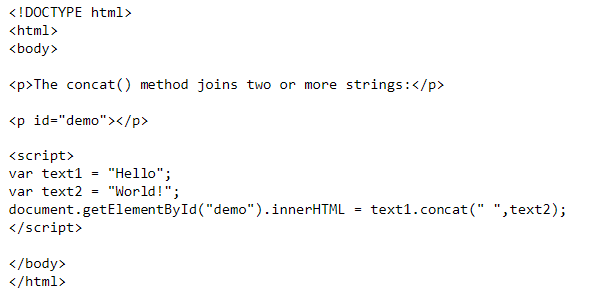
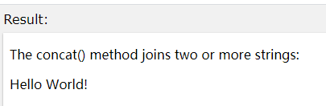
The concat() Method
concat() joins two or more strings:

Slide 15
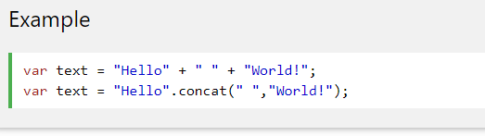
The concat() Method
The concat() method can be used instead of the plus operator. These two lines do the same:

Slide 16
Extracting String Characters
There are 2 safe methods for extracting string characters:
charAt(position)
charCodeAt(position)

Slide 17
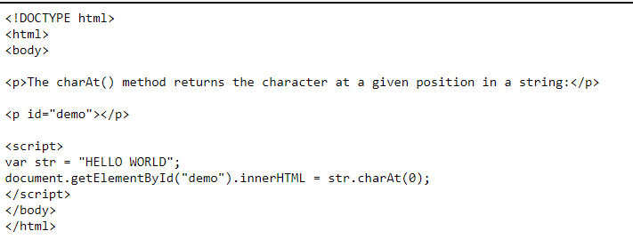
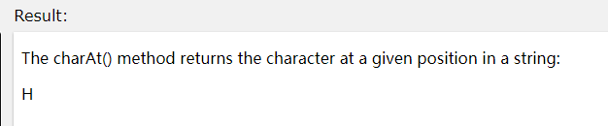
The charAt() Method
The charAt() method returns the character at a specified index (position) in a string:

Slide 18
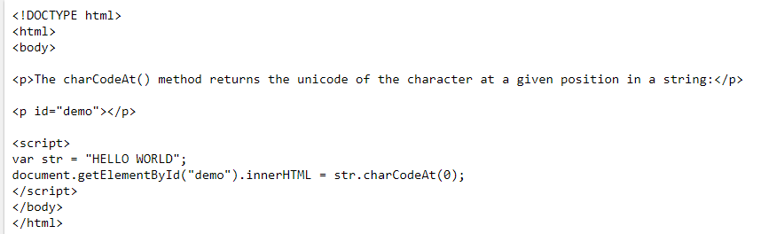
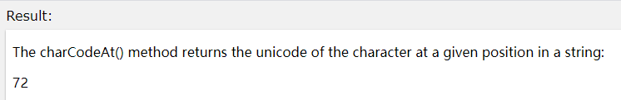
The charCodeAt() Method
The charCodeAt() method returns the unicode of the character at a specified index in a string:

Slide 19
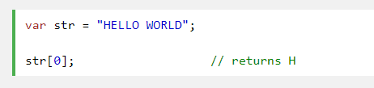
Accessing a String as an Array is Unsafe
You might have seen code like this, accessing a string as an array:
This is unsafe and unpredictable:
It does not work in all browsers (not in IE5, IE6, IE7)
It makes strings look like arrays (but they are not)
str[0] = "H" does not give an error (but does not work)
If you want to read a string as an array, convert it to an array first.

Slide 20
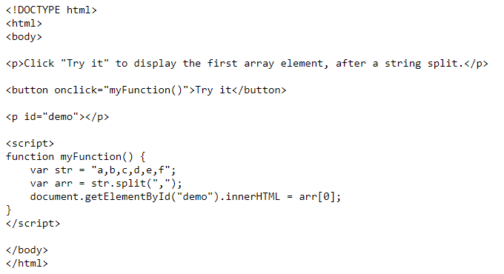
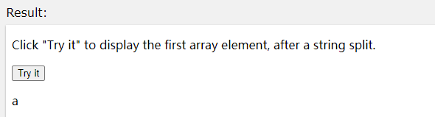
Converting a String to an Array
A string can be converted to an array with the split() method:

Slide 21
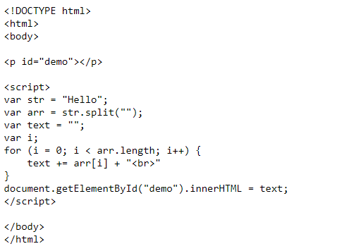
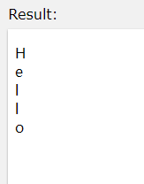
Converting a String to an Array
If the separator is omitted, the returned array will contain the whole string in index [0]. If the separator is "", the returned array will be an array of single characters:

Slide 22
JavaScript Numbers

Slide 23
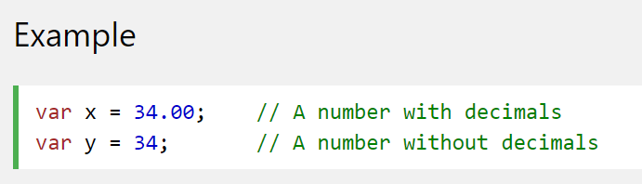
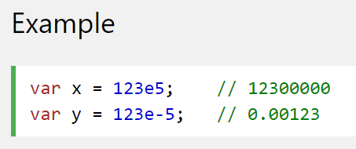
JavaScript Numbers
JavaScript has only one type of number. Numbers can be written with, or without, decimals. JavaScript numbers can be written with, or without decimals:
Extra large or extra small numbers can be written with scientific (exponent) notation:

Slide 24
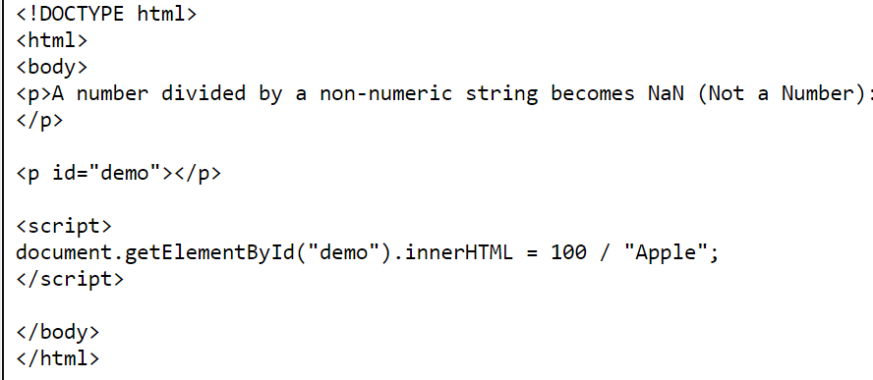
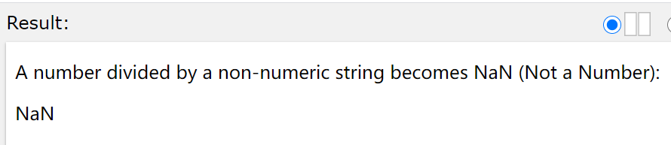
NaN - Not a Number
NaN is a JavaScript reserved word indicating that a value is not a number. Trying to do arithmetic with a non-numeric string will result in NaN (Not a Number):

Slide 25
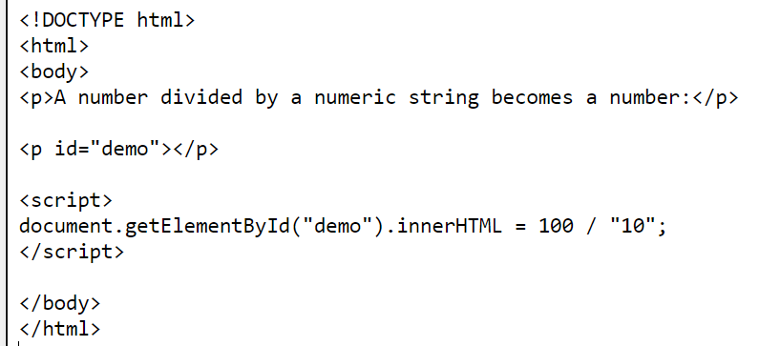
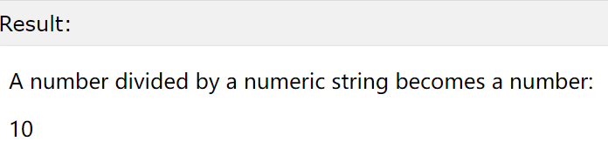
NaN - Not a Number
However, if the string contains a numeric value , the result will be a number:

Slide 26
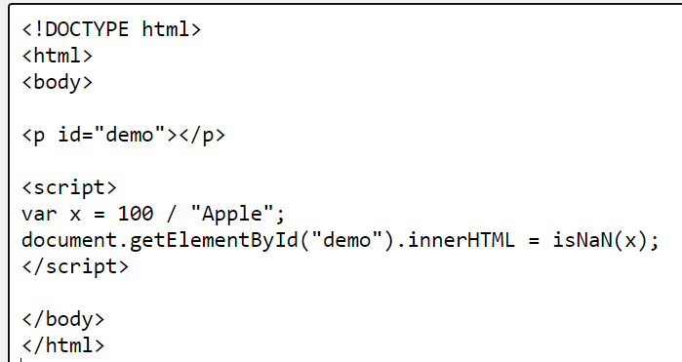
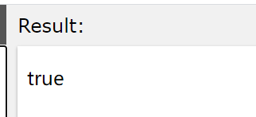
NaN - Not a Number
You can use the global JavaScript function isNaN() to find out if a value is a number.

Slide 27
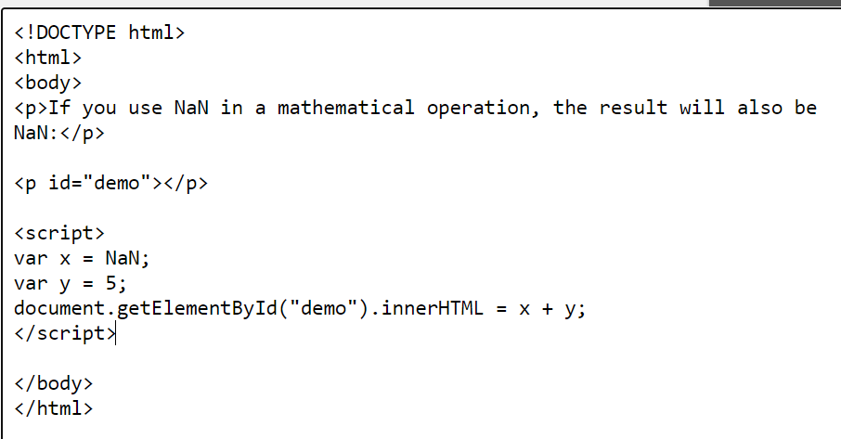
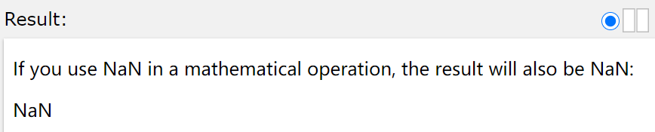
NaN - Not a Number
Watch out for NaN. If you use NaN in a mathematical operation, the result will also be NaN:

Slide 28
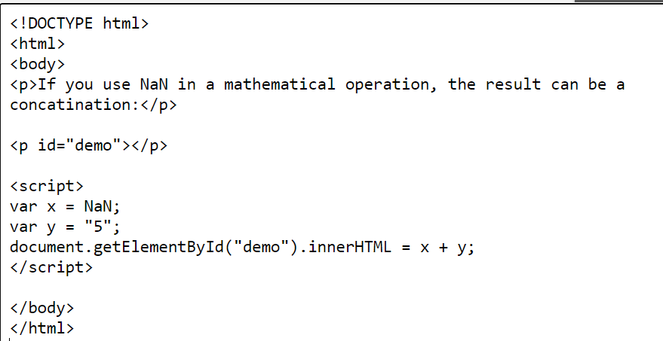
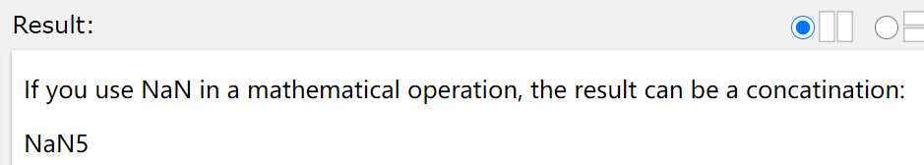
NaN - Not a Number
Or the result might be a concatenation:

Slide 29
JavaScript Number Methods

Slide 30
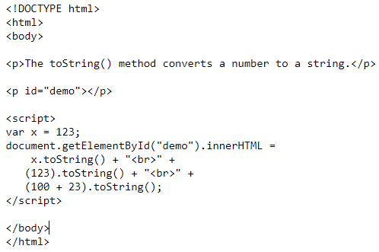
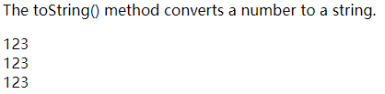
The toString() Method
toString() returns a number as a string.
All number methods can be used on any type of numbers (literals, variables, or expressions):
Example:

Slide 31
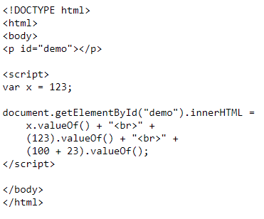

The valueOf() Method
valueOf() returns a number as a number.
Example:

Slide 32
The valueOf() Method
In JavaScript, a number can be a primitive value (typeof = number) or an object (typeof = object).
The valueOf() method is used internally in JavaScript to convert Number objects to primitive values.
There is no reason to use it in your code.
Hint : In JavaScript, all data types have a valueOf() and a toString() method.

Slide 33
Converting Variables to Numbers
There are 3 JavaScript functions that can be used to convert variables to numbers:
The Number() method
The parseInt() method
The parseFloat() method
These methods are not number methods, but global JavaScript methods. JavaScript global functions can be used on all JavaScript data types.

Slide 34


The Number() Method
Number(), can be used to convert JavaScript variables to numbers:
Hint : Used on Date(), the Number() method returns the number of milliseconds since 1.1.1970.

Slide 35


The parseInt() Method
parseInt() parses a string and returns a whole number. Spaces are allowed. Only the first number is returned:
If the number cannot be converted, NaN (Not a Number) is returned.

Slide 36


The parseFloat() Method
parseFloat() parses a string and returns a number. Spaces are allowed. Only the first number is returned:
If the number cannot be converted, NaN (Not a Number) is returned.

Slide 37
JavaScript Math

Slide 38


The Math Object
The Math object allows you to perform mathematical tasks.
The Math object includes several mathematical methods.
One common use of the Math object is to create a random number:
Example:
Hint : Math has no constructor. No methods have to create a Math object first.

Slide 39




Math.min() and Math.max()
Math.min() and Math.max() can be used to find the lowest or highest value in a list of arguments:

Slide 40


Math.random()
Math.random() returns a random number between 0 (inclusive), and 1 (exclusive):
Hint : Math.random() always returns a number lower than 1.

Slide 41


Math.round()
Math.round() rounds a number to the nearest integer:

Slide 42


Math.ceil()
Math.ceil() rounds a number up to the nearest integer:

Slide 43


Math.floor()
Math.floor() rounds a number down to the nearest integer:

Slide 44
JavaScript Dates

Slide 45
JavaScript Date Formats
The Date object lets you work with dates (years, months, days, hours, minutes, seconds, and milliseconds)
A JavaScript date can be written as a string:
Wed Mar 24 2021 08:48:05 GMT+0800 (中国标准时间)
or as a number:
1616546885576
Dates written as numbers, specifies the number of milliseconds since January 1, 1970, 00:00:00.

Slide 46

Displaying Dates
In this example, we use a script to display dates inside a <p> element with id="demo":
The script above says: assign the value of Date() to the content (innerHTML) of the element with id="demo".

Slide 47
Creating Date Objects
The Date object lets us work with dates.
A date consists of a year, a month, a day, an hour, a minute, a second, and milliseconds.
Date objects are created with the new Date() constructor.

Slide 48

Creating Date Objects
Using new Date(), creates a new date object with the current date and time:

Slide 49

Creating Date Objects
Using new Date(number), creates a new date object as zero time plus the number.
Zero time is 01 January 1970 00:00:00 UTC. The number is specified in milliseconds:
JavaScript dates are calculated in milliseconds from 01 January, 1970 00:00:00 Universal Time (UTC). One day contains 86,400,000 millisecond.

Slide 50

Creating Date Objects
Using new Date(7 numbers), creates a new date object with the specified date and time:
Zero time is 01 January 1970 00:00:00 UTC. The number is specified in milliseconds:
JavaScript dates are calculated in milliseconds from 01 January, 1970 00:00:00 Universal Time (UTC). One day contains 86,400,000 millisecond.

Slide 51
Date Methods
When a Date object is created, a number of methods allow you to operate on it.
Date methods allow you to get and set the year, month, day, hour, minute, second, and millisecond of objects, using either local time or UTC (universal, or GMT) time.

Slide 52


Displaying Dates
When you display a date object in HTML, it is automatically converted to a string, with the toString() method.
Is the same as:
Result:

Slide 53

Date Get Methods
Get methods are used for getting a part of a date. Here are the most common (alphabetically):

Slide 54

Date Set Methods
Set methods are used for setting a part of a date. Here are the most common (alphabetically):

Slide 55


Date Input - Parsing Dates
If you have a valid date string, you can use the Date.parse() method to convert it to milliseconds.
Date.parse() returns the number of milliseconds between the date and January 1, 1970:

Slide 56


Date Input - Parsing Dates
You can then use the number of milliseconds to convert it to a date object:

Slide 57


Compare Dates
Dates can easily be compared.
The following example compares today's date with January 14, 2100:
Hint : JavaScript counts months from 0 to 11. January is 0. December is 11.

Slide 58
JavaScript Arrays

Slide 59

What is an Array?
An array is a special variable, which can hold more than one value at a time，and you can access the values by referring to an index number.
Using an array literal is the easiest way to create a JavaScript Array.
Syntax:
Example

Slide 60

You Can Have Different Objects in One Array
JavaScript variables can be objects. Arrays are special kinds of objects.
Because of this, you can have variables of different types in the same Array.
You can have objects in an Array. You can have functions in an Array. You can have arrays in an Array:

Slide 61


The length Property
The length property of an array returns the length of an array (the number of array elements).
Hint : The length property is always one more than the highest array index.

Slide 62


Adding Array Elements
The easiest way to add a new element to an array is using the push method:

Slide 63

Adding Array Elements
New element can also be added to an array using the length property:
The length property provides an easy way to append new elements to an array without using the push() method.

Slide 64


Adding Array Elements
Adding elements with high indexes can create undefined "holes" in an array:

Slide 65


Looping Array Elements
The best way to loop through an array, is using a "for" loop:

Slide 66
JavaScript Arrays Methods

Slide 67


Converting Arrays to Strings
The JavaScript method toString() converts an array to a string of (comma separated) array values.

Slide 68


Converting Arrays to Strings
The join() method also joins all array elements into a string.
It behaves just like toString(), but in addition you can specify the separator:

Slide 69
Popping and Pushing
When you work with arrays, it is easy to remove elements and add new elements.
This is what popping and pushing is:
Popping items out of an array, or pushing items into an array.

Slide 70


Popping
The pop() method removes the last element from an array, and returns the value that was "popped out":

Slide 71


Pushing
The push() method adds a new element to an array (at the end), and returns the new array length:

Slide 72


Shifting Elements
Shifting is equivalent to popping, working on the first element instead of the last.
The shift() method removes the first array element and "shifts" all other elements to a lower index, returns the string that was "shifted out".

Slide 73


Shifting Elements
The unshift() method adds a new element to an array (at the beginning), and "unshifts" older elements, returns the new array length.

Slide 74


Splicing an Array
The splice() method can be used to add new items to an array:

Slide 75
Splicing an Array
The first parameter (2) defines the position where new elements should be added (spliced in).
The second parameter (0) defines how many elements should be removed.
The rest of the parameters ("Lemon" , "Kiwi") define the new elements to be added.

Slide 76


Using splice() to Remove Elements
With clever parameter setting, you can use splice() to remove elements without leaving "holes" in the array:

Slide 77
Using splice() to Remove Elements
The first parameter (0) defines the position where new elements should be added (spliced in).
The second parameter (1) defines how many elements should be removed.
The rest of the parameters are omitted. No new elements will be added.

Slide 78


Sorting an Array
The sort() method sorts an array alphabetically:

Slide 79


Reversing an Array
The reverse() method reverses the elements in an array.
You can use it to sort an array in descending order:

Slide 80
Numeric Sort
By default, the sort() function sorts values as strings.
This works well for strings ("Apple" comes before "Banana").
However, if numbers are sorted as strings, "25" is bigger than "100", because "2" is bigger than "1".
Because of this, the sort() method will produce incorrect result when sorting numbers.
You can fix this by providing a compare function:

Slide 81
The Compare Function
The purpose of the compare function is to define an alternative sort order.
The compare function should return a negative, zero, or positive value, depending on the arguments:
When the sort() function compares two values, it sends the values to the compare function, and sorts the values according to the returned (negative, zero, positive) value.

Slide 82
The Compare Function
Example:
When comparing 40 and 100, the sort() method calls the compare function(40,100).
The function calculates 40-100, and returns -60 (a negative value).
The sort function will sort 40 as a value lower than 100.

Slide 83


Numeric Sort

Slide 84


Numeric Sort
or

Slide 85


Numeric Sort
Use the same trick to sort an array descending:

Slide 86


Numeric Sort
or

Slide 87


Joining Arrays
The concat() method can take any number of array arguments, and creates a new array by concatenating these arrays

Slide 88


Slicing an Array
The slice() method slices out a piece of an array into a new array.
This example slices out a part of an array starting from array element 1 ("Orange"):

Slide 89


Slicing an Array
This example slices out a part of an array starting from array element 3 ("Apple"):

Slide 90


Slicing an Array
The slice() method can take two arguments like slice(1,3).
The method then selects elements from the start argument, and up to (but not including) the end argument.

Slide 91


Slicing an Array
If the end argument is omitted, like in the first examples, the slice() method slices out the rest of the array.

Slide 92
JavaScript Scope

Slide 93
JavaScript Scope
In JavaScript, objects and functions are also variables.
In JavaScript, scope is the set of variables, objects, and functions you have access to.
JavaScript has function scope: The scope changes inside functions.

Slide 94


Local JavaScript Variables
Variables declared within a JavaScript function, become LOCAL to the function. Local variables have local scope: They can only be accessed within the function.
Since local variables are only recognized inside their functions, variables with the same name can be used in different functions. Local variables are created when a function starts, and deleted when the function is completed.

Slide 95


Global JavaScript Variables
A variable declared outside a function, becomes GLOBAL. A global variable has global scope: All scripts and functions on a web page can access it.

Slide 96



Automatically Global
If you assign a value to a variable that has not been declared, it will automatically become a GLOBAL variable. This code example will declare carName as a global variable, even if it is executed inside a function.

Slide 97
The Lifetime of JavaScript Variables
The lifetime of a JavaScript variable starts when it is declared.
Local variables are deleted when the function is completed.
Global variables are deleted when you close the page.
Function arguments (parameters) work as local variables inside functions.

Slide 98


Global Variables in HTML
With JavaScript, the global scope is the complete JavaScript environment. In HTML, the global scope is the window object: All global variables belong to the window object.

