Slide 1
JavaScript DOM

Slide 2
What is the DOM
The DOM is a W3C (World Wide Web Consortium) standard.
The DOM defines a standard for accessing documents:
The W3C DOM standard is separated into 3 different parts:
  Core DOM - standard model for all document types
  XML DOM - standard model for XML documents
  HTML DOM - standard model for HTML documents

Slide 3
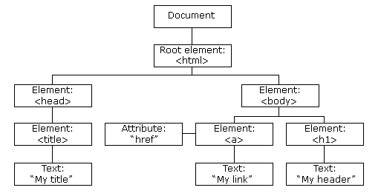
The HTML DOM (Document Object Model)
When a web page is loaded, the browser creates a Document Object Model of the page. The HTML DOM model is constructed as a tree of Objects:

Slide 4
The HTML DOM (Document Object Model)
With the object model, JavaScript gets all the power it needs to create dynamic HTML:
JavaScript can change all the HTML elements in the page
JavaScript can change all the HTML attributes in the page
JavaScript can change all the CSS styles in the page
JavaScript can remove existing HTML elements and attributes
JavaScript can add new HTML elements and attributes
JavaScript can react to all existing HTML events in the page
JavaScript can create new HTML events in the page

Slide 5
JavaScript - HTML DOM Methods
HTML DOM methods are actions you can perform (on HTML Elements).
HTML DOM properties are values (of HTML Elements) that you can set or change.
The DOM Programming Interface：
The HTML DOM can be accessed with JavaScript (and with other programming languages).
In the DOM, all HTML elements are defined as objects.
The programming interface is the properties and methods of each object.
A property is a value that you can get or set (like changing the content of an HTML element).
A method is an action you can do (like add or deleting an HTML element).

Slide 6
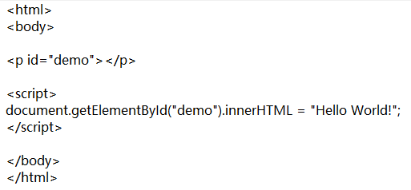

JavaScript - HTML DOM Methods
The following example changes the content (the innerHTML) of the <p> element with id=“demo”, getElementById is a method, innerHTML is a property.
The getElementById Method：The most common way to access an HTML element is to use the id of the element.
innerHTML：The easiest way to get the content of an element is by using the innerHTML property.

Slide 7
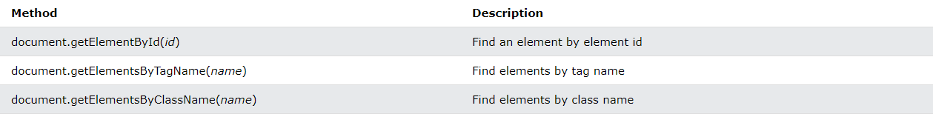
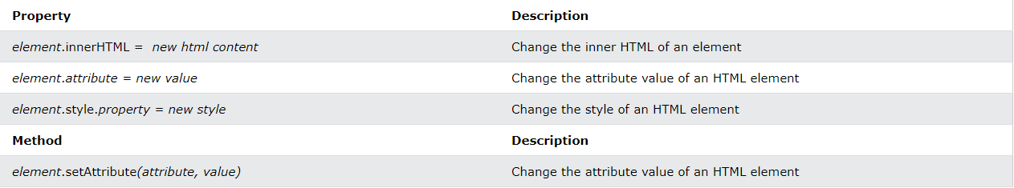
JavaScript - HTML DOM Methods
Finding HTML Elements
Changing HTML Elements

Slide 8
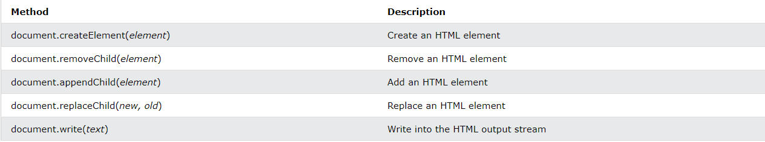
JavaScript - HTML DOM Methods
Adding and Deleting Elements
Adding Events Handlers

Slide 9
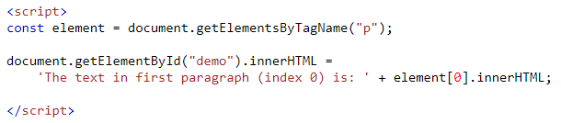
JavaScript HTML DOM Elements
Finding HTML Elements，There are several ways to do this:
    Finding HTML elements by id
    Finding HTML elements by tag name
    Finding HTML elements by class name
    Finding HTML elements by CSS selectors
    Finding HTML elements by HTML object collections
Finding HTML Elements by Tag Name，This example finds all <p> elements:

Slide 10


JavaScript HTML DOM Elements
Finding HTML Elements by Class Name, use getElementsByClassName()，This example returns a list of all elements with class="intro".
Finding HTML Elements by CSS Selectors, use the querySelectorAll() method, This example returns a list of all <p> elements with class="intro".

Slide 11
JavaScript HTML DOM Elements
The following HTML objects (and object collections) are also accessible:
document.anchors
document.body
document.documentElement
document.embeds
document.forms
document.head
document.images
document.links
document.scripts
document.title

Slide 12
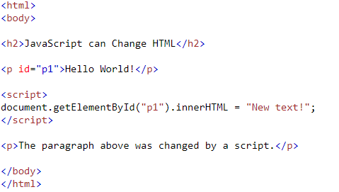
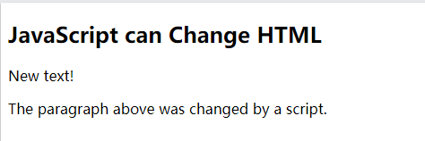
DOM - Changing HTML Content
To change the content of an HTML element, use this syntax:
document.getElementById(id).innerHTML = new HTML

Slide 13
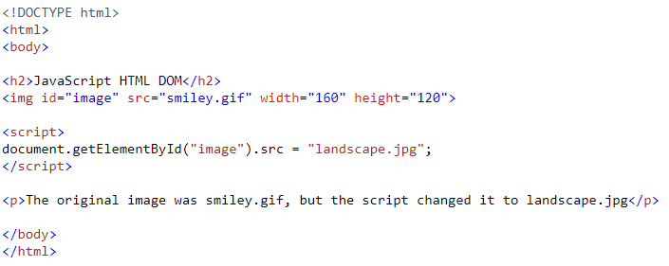
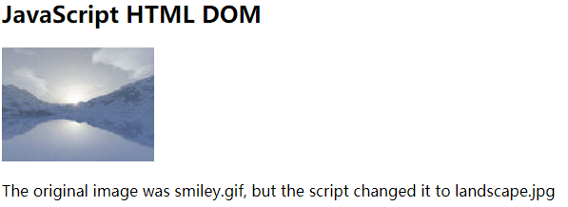
DOM - Changing HTML Attribute
To change the value of an HTML attribute, use this syntax:
document.getElementById(id).attribute = new value

Slide 14
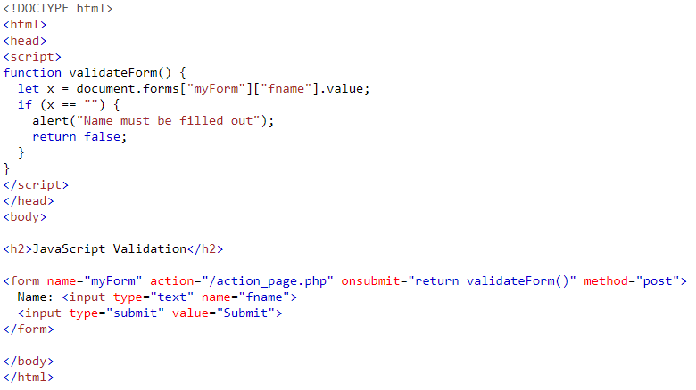
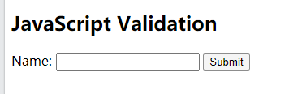
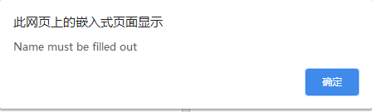
JavaScript Form Validation
HTML form validation can be done by JavaScript.
If a form field (fname) is empty, this function alerts a message, and returns false, to prevent the form from being submitted:

Slide 15
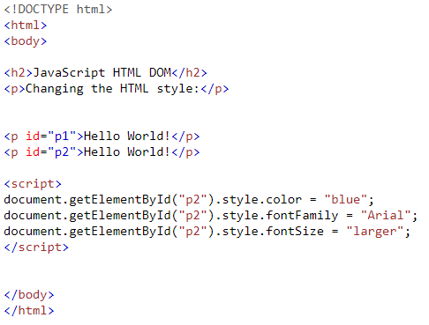
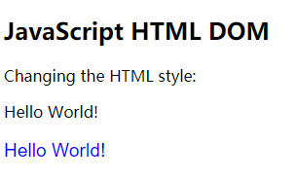
DOM - Changing CSS
To change the style of an HTML element, use this syntax:
document.getElementById(id).style.property = new style

Slide 16
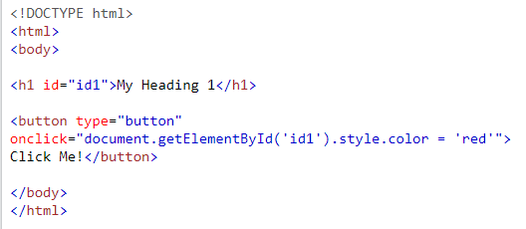

DOM - Changing CSS
The HTML DOM allows you to execute code when an event occurs.
Events are generated by the browser when "things happen" to HTML elements
    An element is clicked on
    The page has loaded
    Input fields are changed

Slide 17
JavaScript DOM Events

Slide 18
DOM Events
HTML DOM allows JavaScript to react to HTML events:
Examples of HTML events:
    When a user clicks the mouse
    When a web page has loaded
    When an image has been loaded
    When the mouse moves over an element
    When an input field is changed
    When an HTML form is submitted
    When a user strokes a key

Slide 19
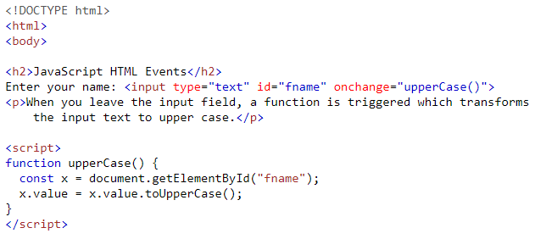


DOM Events
The onload and onunload Events
The onload and onunload events are triggered when the user enters or leaves the page.
The onload event can be used to check the visitor's browser type and browser version, and load the proper version of the web page based on the information.
The onload and onunload events can be used to deal with cookies.
The onchange Event:The onchange event is often used in combination with validation of input fields.

Slide 20
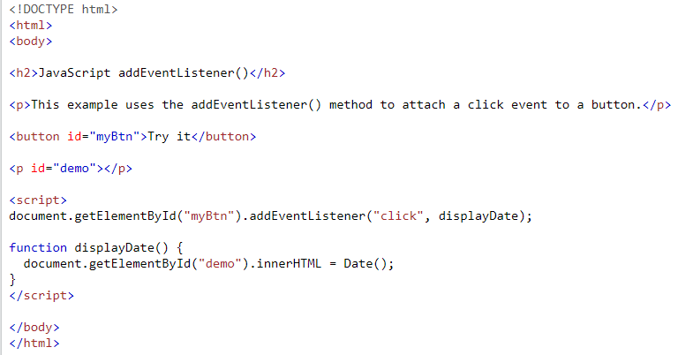
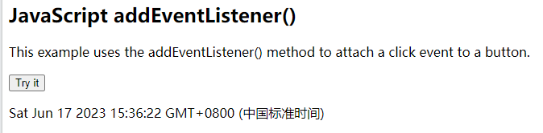
DOM EventListener
The addEventListener() method
adds an event listener that fires when a user clicks a button:

Slide 21
DOM EventListener
The addEventListener() method
Syntax
element.addEventListener(event, function, useCapture);
The first parameter is the type of the event (like "click" or "mousedown" or any other HTML DOM Event.)
The second parameter is the function we want to call when the event occurs.
The third parameter is a boolean value specifying whether to use event bubbling or event capturing. This parameter is optional.
Note that you don't use the "on" prefix for the event; use "click" instead of "onclick".

Slide 22
Event Bubbling or Event Capturing?
Event bubbling and capturing are two methods that are used to handle events in the Document Object Model (DOM) of a web page. When an event occurs, it triggers the event handlers that are registered on the element where the event occurred. These event handlers can propagate the event further up the DOM tree either through capturing or bubbling.
With event bubbling, when an event is triggered, it first runs on the innermost child element and then moves up the DOM tree until it reaches the root element. On the other hand, with event capturing, the event is first executed on the root element, and then it moves down the DOM tree until it reaches the target element.
Both of these methods have their advantages and disadvantages. Event bubbling is the default method used by most web browsers, and it can be used to handle events on multiple elements with a single event handler. On the other hand, event capturing is more efficient and can be used to cancel the event propagation before it reaches the target element.

Slide 23
Event Bubbling or Event Capturing?
Event Bubbling:
<div id="outer">
<div id="inner">
</div>
</div>
<script>
const outer = document.querySelector('#outer');
const inner = document.querySelector('#inner');
outer.addEventListener('click', () => {
console.log('Outer clicked');
});
inner.addEventListener('click', () => {
console.log('Inner clicked');
});
</script>
In this example, when you click on the inner div, the click event will first be captured by the inner div and then bubble up to the outer div. As a result, the console will log “Inner clicked” first, and then “Outer clicked”.

Slide 24
Event Bubbling or Event Capturing?
<div id="outer">
<div id="inner">
</div>
</div>
<script>
const outer = document.querySelector('#outer');
const inner = document.querySelector('#inner');
outer.addEventListener('click', () => {
console.log('Outer clicked');
}, true);
inner.addEventListener('click', () => {
console.log('Inner clicked');
}, true);
</script>
Event Capturing
In this example, we have added the third parameter “true” to the event listener. This means that the event listener uses event capturing instead of event bubbling. When you click on the inner div, the click event will first be captured by the outer div and then move down to the inner div. As a result, the console will log “Outer clicked” first, and then “Inner clicked”.

Slide 25
Event Bubbling or Event Capturing?
Use event delegation to handle events on multiple elements with a single event handler.
Use event capturing to cancel event propagation before it reaches the target element.
Avoid attaching too many event listeners to individual nodes, as this can lead to performance issues.
When working with event bubbling, use the event.stopPropagation() method to prevent child elements from triggering the same event.

Slide 26


DOM EventListener
Add Many Event Handlers to the Same Element
The addEventListener() method allows you to add many events to the same element, without overwriting existing events:
You can add events of different types to the same element:

Slide 27
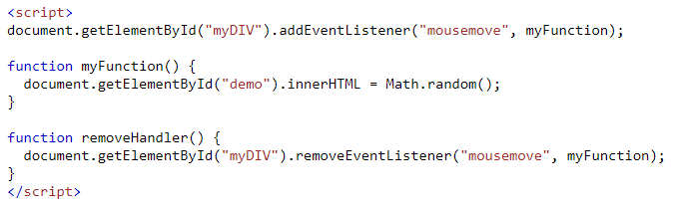
DOM EventListener
The removeEventListener() method
The removeEventListener() method removes event handlers that have been attached with the addEventListener() method:

Slide 28
JavaScript DOM Navigation

Slide 29
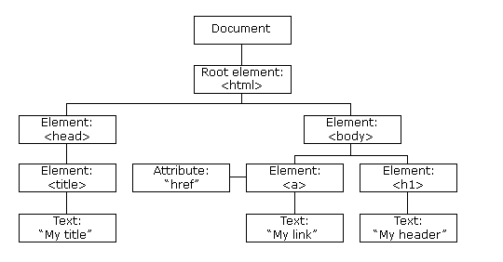
DOM Navigation
DOM Nodes: everything in an HTML document is a node:
  The entire document is a document node
  Every HTML element is an element node
  The text inside HTML elements are text nodes
  Every HTML attribute is an attribute node (deprecated)
  All comments are comment nodes

Slide 30
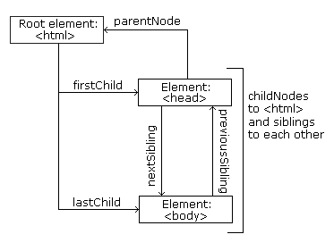
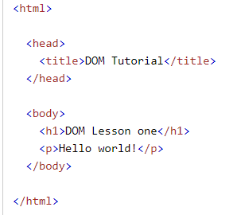
DOM Navigation
Node Relationships
From the HTML above you can read:
<html> is the root node
<html> has no parents
<html> is the parent of <head> and <body>
<head> is the first child of <html>
<body> is the last child of <html>
and:
<head> has one child: <title>
<title> has one child (a text node): "DOM Tutorial"
<body> has two children: <h1> and <p>
<h1> has one child: "DOM Lesson one"
<p> has one child: "Hello world!"
<h1> and <p> are siblings

Slide 31
DOM Navigation
Navigating Between Nodes
You can use the following node properties to navigate between nodes with JavaScript:
  parentNode
  childNodes[nodenumber]
  firstChild
  lastChild
  nextSibling
  previousSibling

Slide 32
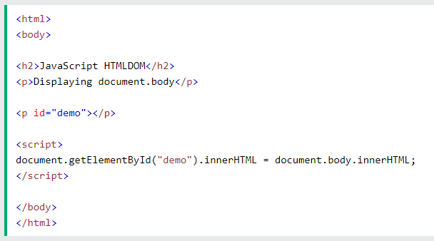
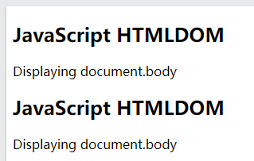
DOM Navigation
DOM Root Nodes
There are two special properties that allow access to the full document:
  document.body - The body of the document
  document.documentElement - The full document, returns the Element that is the root element of the document (for example, the <html> element for HTML documents).

Slide 33
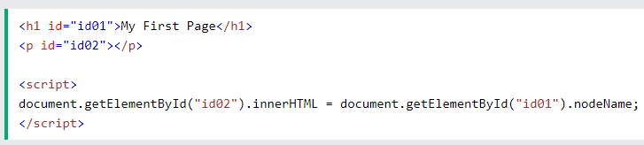

DOM Navigation
The nodeName Property: the nodeName property specifies the name of a node.
  nodeName is read-only
  nodeName of an element node is the same as the tag name
  nodeName of an attribute node is the attribute name
  nodeName of a text node is always #text
  nodeName of the document node is always #document
Note: nodeName always contains the uppercase tag name of an HTML element.

Slide 34
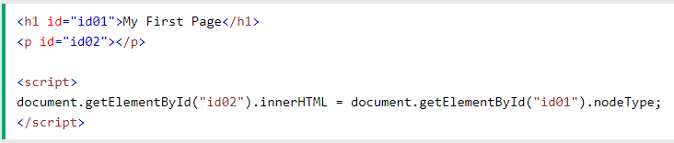

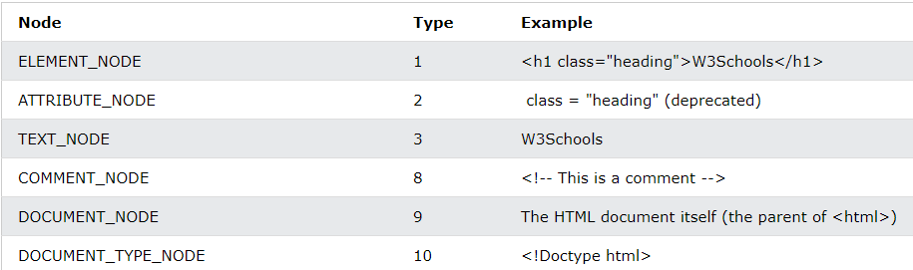
DOM Navigation
The nodeType Property
The nodeType property is read only. It returns the type of a node.
The most important nodeType properties are:

Slide 35
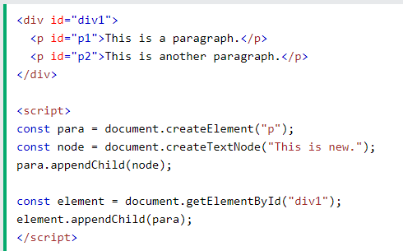
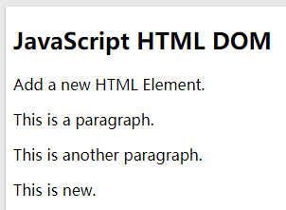
DOM Nodes (Elements)
Creating New HTML Elements (Nodes)
To add a new element to the HTML DOM, you must create the element (element node) first, and then append it to an existing element.

Slide 36
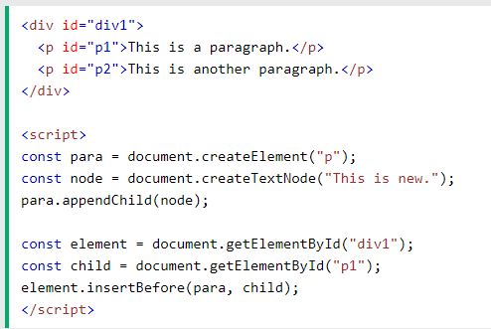
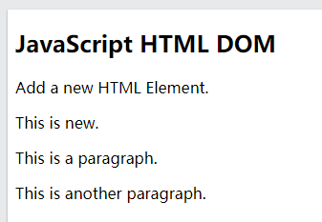
DOM Nodes (Elements)
Creating new HTML Elements - insertBefore()
The appendChild() method in the previous example, appended the new element as the last child of the parent. If you don't want that you can use the insertBefore() method:

Slide 37
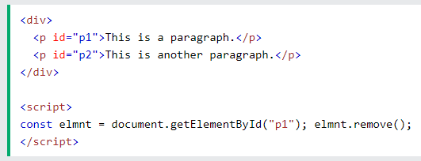
DOM Nodes (Elements)
Removing Existing HTML Elements
To remove an HTML element, use the remove() method:

Slide 38
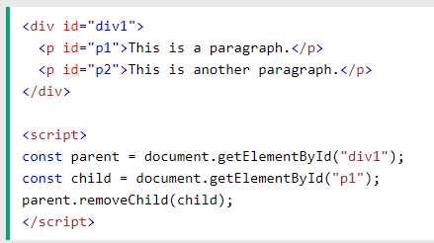
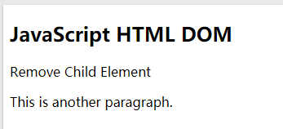
DOM Nodes (Elements)
Removing a Child Node
The remove() method does not work in older browsers. For browsers that does not support the remove() method, you have to find the parent node to remove an element:

Slide 39
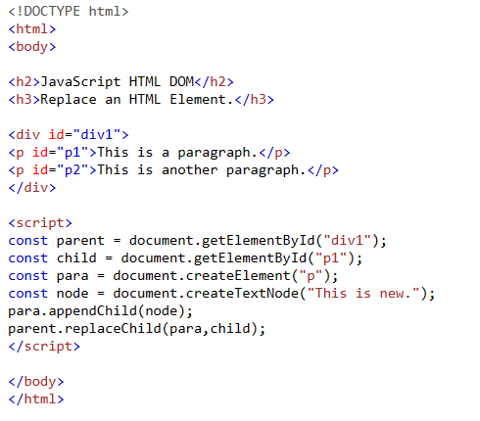
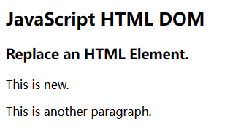
DOM Nodes (Elements)
Replacing HTML Elements
To replace an element to the HTML DOM, use the replaceChild() method:

Slide 40
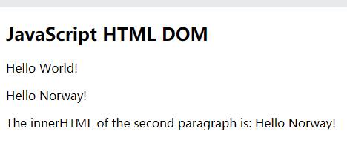
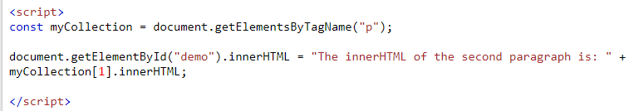
DOM Collections
The HTMLCollection Object
  The getElementsByTagName() method returns an HTMLCollection object
  An HTMLCollection object is an array-like list (collection) of HTML elements.
  The following code selects all <p> elements in a document:
To access the second <p> element you can write:

Slide 41
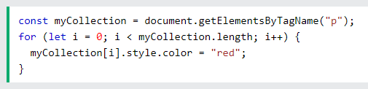
DOM Collections
HTML Collection Length
  The length property defines the number of elements in an HTMLCollection
  The length property is useful when you want to loop through the elements in a collection
An HTMLCollection is NOT an array!
  An HTMLCollection may look like an array, but it is not.
  You can loop through the list and refer to the elements with a number (just like an array).
  However, you cannot use array methods like valueOf(), pop(), push(), or join() on an HTMLCollection.

Slide 42
DOM Node Lists
The HTML DOM NodeList Object
  A NodeList object is a list (collection) of nodes extracted from a document.
  A NodeList object is almost the same as an HTMLCollection object.
  Some (older) browsers return a NodeList object instead of an HTMLCollection for methods like getElementsByClassName().
  All browsers return a NodeList object for the property childNodes.
  Most browsers return a NodeList object for the method querySelectorAll().

Slide 43

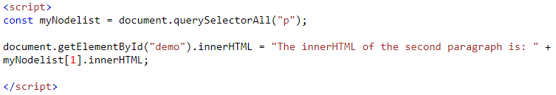
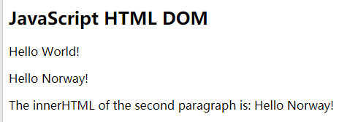
DOM Node Lists
The HTML DOM NodeList Object
  The following code selects all <p> nodes in a document:
To access the second <p> node you can write:

Slide 44
DOM Node Lists
The Difference Between an HTMLCollection and a NodeListThe
An HTMLCollection is a collection of document elements.
A NodeList is a collection of document nodes (element nodes, attribute nodes, and text nodes).
The getElementsByClassName() and getElementsByTagName() methods return a live HTMLCollection.
The querySelectorAll() method returns a static NodeList.
The childNodes property returns a live NodeList.
Not an Array!
  A NodeList may look like an array, but it is not.
  You can loop through a NodeList and refer to its nodes by index.
  But, you cannot use Array methods like push(), pop(), or join() on a NodeList.

