Slide 1
HTML Colors

Slide 2
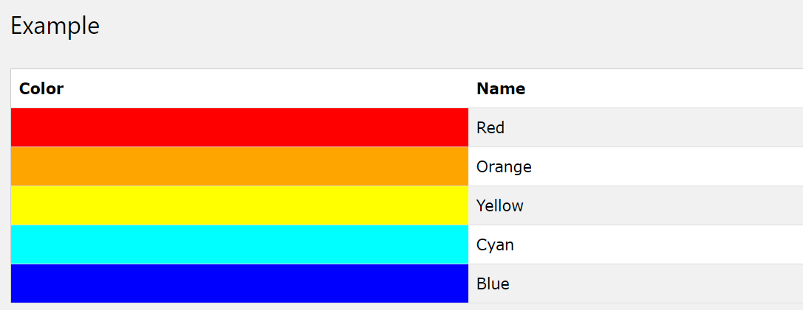
Color Names
With CSS, colors can be set by using color names:
CSS supports 140 standard color names.

Slide 3
RGB (Red, Green, Blue)
With HTML, RGB color values can be specified using this formula: rgb(red, green, blue)
Each parameter (red, green, and blue) defines the intensity of the color between 0 and 255.
For example, rgb(255,0,0) is displayed as red, because red is set to its highest value (255) and the others are set to 0.

Slide 4
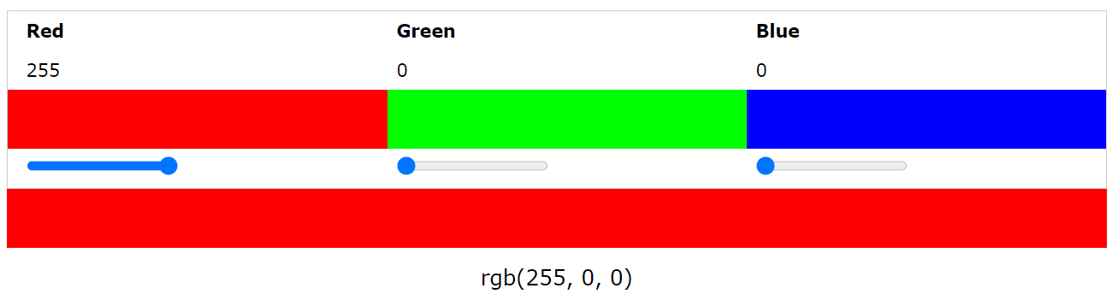
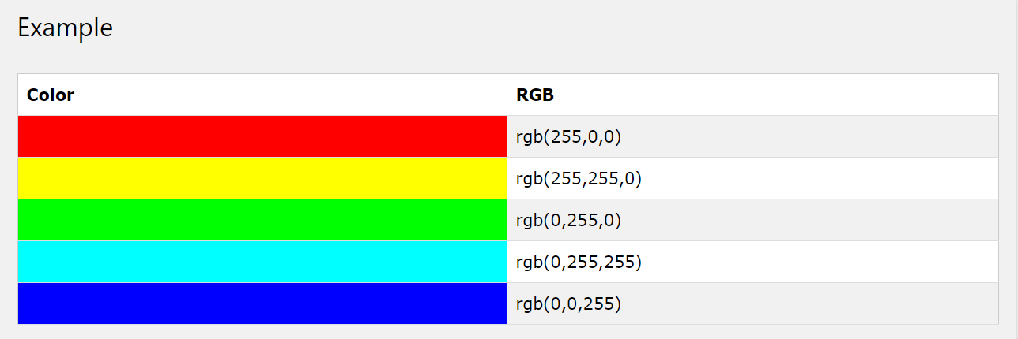
RGB (Red, Green, Blue)

Slide 5
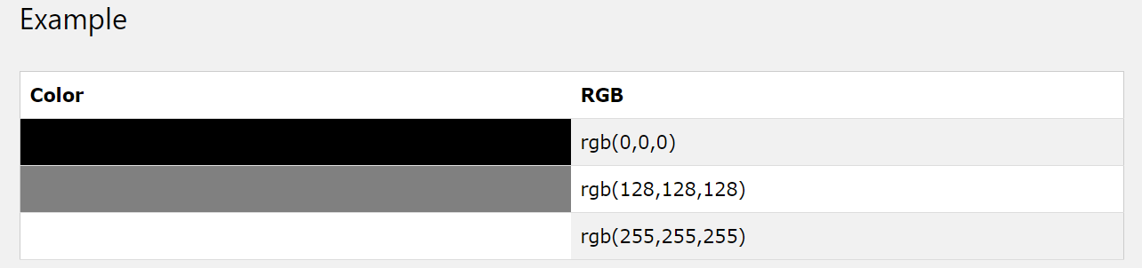
RGB (Red, Green, Blue)
Shades of gray are often defined using equal values for all the 3 light sources:

Slide 6
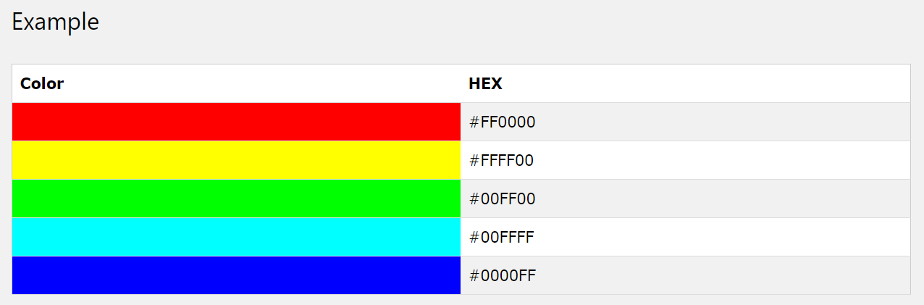
Hexadecimal Colors
With HTML, RGB values can also be specified using hexadecimal color values in the form: #RRGGBB, where RR (red), GG (green) and BB (blue) are hexadecimal values between 00 and FF (same as decimal 0-255).
For example, #FF0000 is displayed as red, because red is set to its highest value (FF) and the others are set to the lowest value (00).
Notes:
number sign

Slide 7
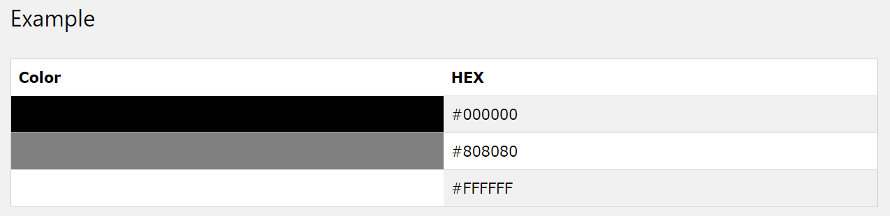
Hexadecimal Colors
Shades of gray are often defined using equal values for all the 3 light sources:

Slide 8
HTML CSS

Slide 9
What is CSS?
CSS stands for Cascading Style Sheets.
CSS describes how HTML elements are to be displayed on screen, paper, or in other media
CSS saves a lot of work. It can control the layout of multiple web pages all at once
External stylesheets are stored in CSS files

Slide 10
How to use CSS
Styling can be added to HTML elements in 3 ways:
Inline - using a style attribute in HTML elements
Internal - using a <style> element in the HTML <head> section
External - using one or more external CSS files
The most common way to add styling, is to keep the styles in separate CSS files

Slide 11

Inline Styling
Inline styling is used to apply a unique style to single HTML element:
Inline styling uses the style attribute.
This example changes the text color of the <h1> element to blue:

Slide 12
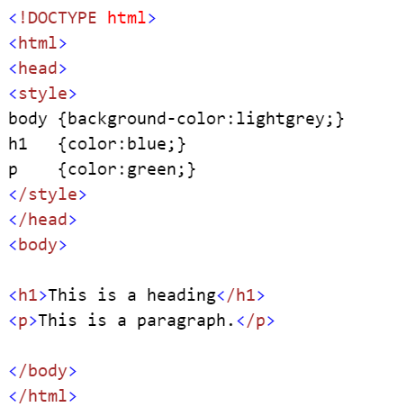
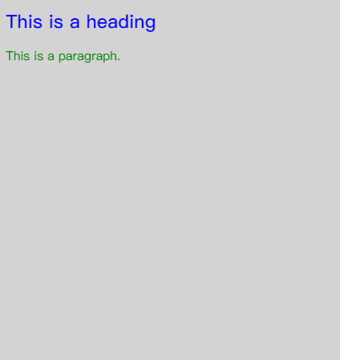
Internal Styling
Internal styling is used to define a style for one HTML page. It’s defined in the <head> section of an HTML page, within a <style> element:
Example:

Slide 13
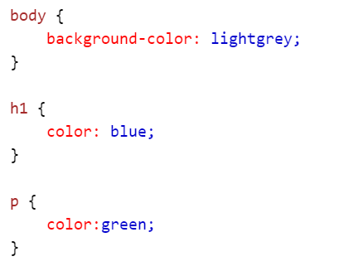
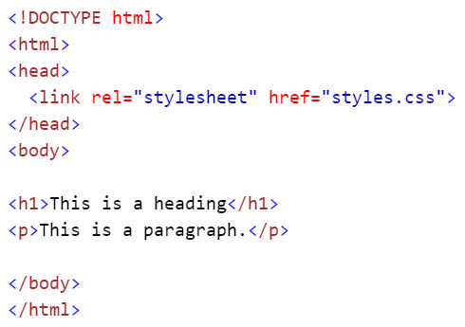
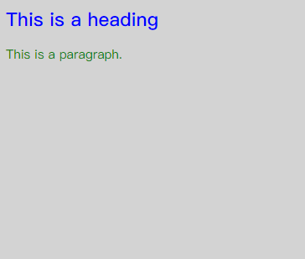
External Styling
An external style sheet is used to define the style for many pages. With an external style sheet, you can change the look of an entire web site by changing one file! To use an external style sheet, add a link to it in the <head> section of the HTML page.
The required rel attribute specifies the relationship between the current document and the linked document/resource; the href attribute specifies the location of the style sheet.
Styles.css
page.html
Result

Slide 14
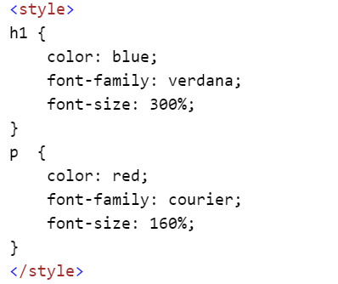
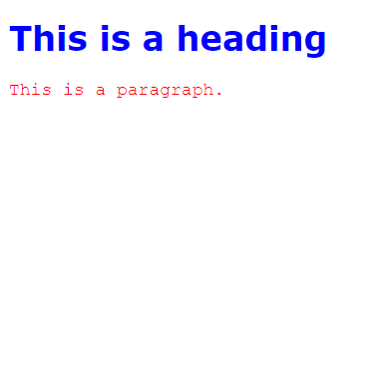

CSS Fonts
The CSS color property defines the text color to be used for the HTML element.
The CSS font-family property defines the font to be used for the HTML element.
The CSS font-size property defines the text size to be used for the HTML element.
Example:

Slide 15
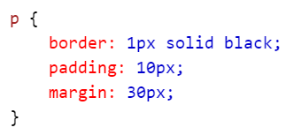
The CSS Box Model
Every HTML element has a box around it, even if you cannot see it.
Example:
The CSS border property defines a visible border around an HTML element.
The CSS padding property defines a padding (space) inside the border.
The CSS margin property defines a margin (space) outside the border:

Slide 16
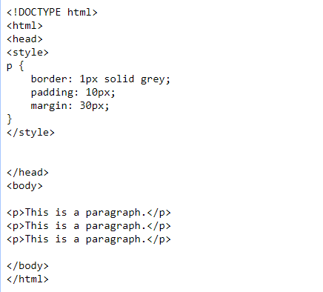
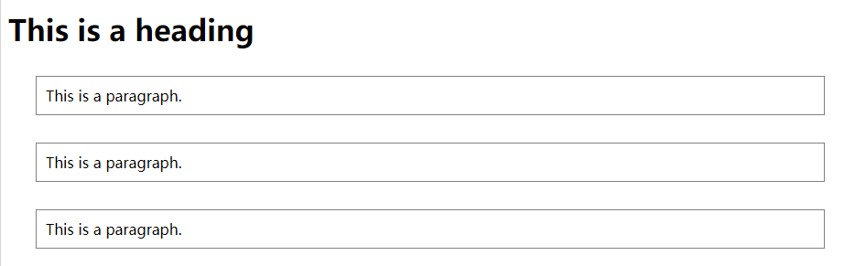
The CSS Box Model

Slide 17
The id Attribute
All the examples above use CSS to style HTML elements in a general way.
To define a special style for one special element, first add an id attribute to the element:
then define a style for the element with the specific id:

Slide 18
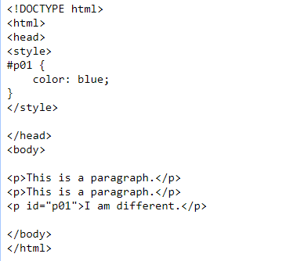
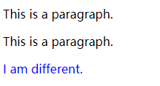
The id Attribute

Slide 19

The class Attribute
To define a style for a special type (class) of elements, add a class attribute to the element:
Now you can define a different style for elements with the specific class:

Slide 20
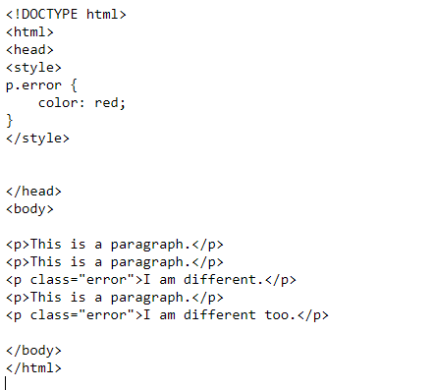

The class Attribute

Slide 21
HTML CSS Summary
Use the HTML style attribute for inline styling
Use the HTML <style> element to define internal CSS
Use the HTML <link> element to refer to an external CSS file
Use the HTML <head> element to store <style> and <link> elements
Use the CSS color property for text colors
Use the CSS font-family property for text fonts
Use the CSS font-size property for text sizes
Use the CSS border property for visible element borders
Use the CSS padding property for space inside the border
Use the CSS margin property for space outside the border

Slide 22
HTML LINKS

Slide 23
HTML Links - Hyperlinks
Links are found in nearly all web pages. Links allow users to click their way from page to page.
HTML links are hyperlinks.
You can click on a link and jump to another document.
When you move the mouse over a link, the mouse arrow will turn into a little hand.

Slide 24
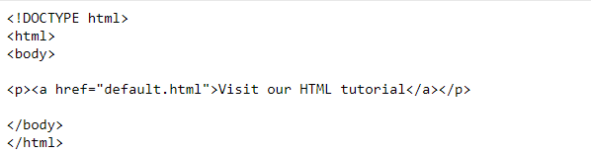

HTML Links - Syntax
The HTML <a> tag defines a hyperlink. It has the following syntax:
The most important attribute of the <a> element is the href attribute, which indicates the link's destination.
The link text is the part that will be visible to the reader.
Clicking on the link text, will send the reader to the specified URL address.
Example:
Tip: Links can of course be styled with CSS, to get another look!

Slide 25
HTML Links – The target Attribute
By default, the linked page will be displayed in the current browser window. To change this, you must specify another target for the link.
The target attribute specifies where to open the linked document.
The target attribute can have one of the following values:
_self - Default. Opens the document in the same window/tab as it was clicked
_blank - Opens the document in a new window or tab
_parent - Opens the document in the parent frame
_top - Opens the document in the full body of the window
Example:

Slide 26
HTML Links -Colors
When you move the mouse over a link, two things will normally happen:
The mouse arrow will turn into a little hand
The color of the link element will change
By default, a link will appear like this (in all browsers):
An unvisited link is underlined and blue
A visited link is underlined and purple
An active link is underlined and red (A link becomes activated when the user clicks on it)
Hint ： You can change the default colors, by using styles

Slide 27
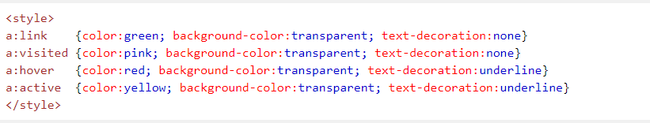



HTML Links -Colors

Slide 28
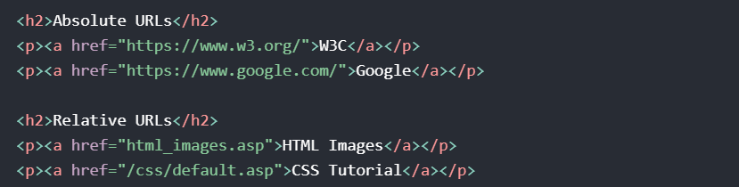
Absolute URLs vs. Relative URLs
Both examples above are using an absolute URL (a full web address) in the href attribute.
A local link (a link to a page within the same website) is specified with a relative URL (without the "https://www" part):
a relative URL is relative to the current directory.
If the relative URL has a leading slash, it means that is relative to the root domain

Slide 29
More on Absolute URLs and Relative URLs
Use a full URL to link to a web page:
Link to a page located in the html folder on the current web site:
Link to a page located in the same folder as the current page:

Slide 30
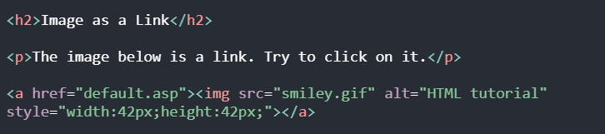

HTML Links – Use an Image as a link
To use an image as a link, just put the <img> tag inside the <a> tag:
Result:

Slide 31
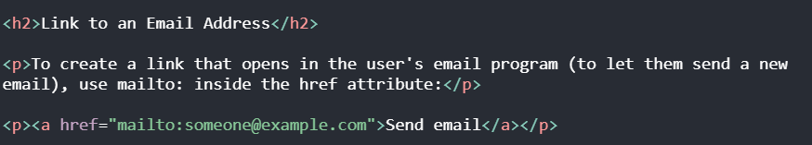
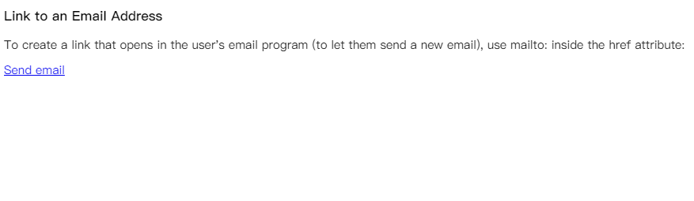
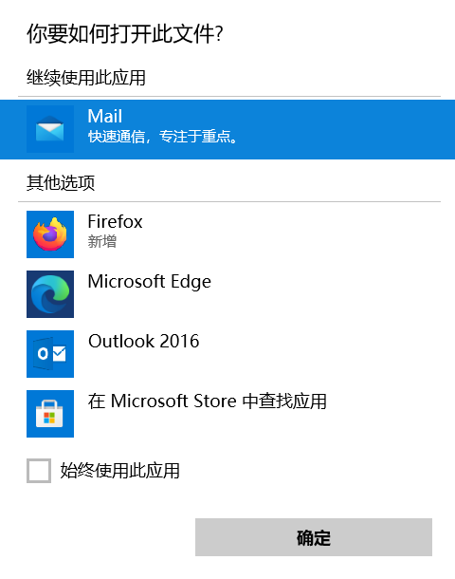
Link to an Email Address
Use mailto: inside the href attribute to create a link that opens the user's email program (to let them send a new email):
Clicking on the link will show a window:
After click

Slide 32
Summary
Use the <a> element to define a link
Use the href attribute to define the link address
Use the target attribute to define where to open the linked document
Use the <img> element (inside <a>) to use an image as a link
Use the mailto: scheme inside the href attribute to create a link that opens the user's email program

Slide 33
HTML Images

Slide 34
HTML Images Syntax
In HTML, images are defined with the <img> tag.
The <img> tag is empty, it contains attributes only, and does not have a closing tag.
The src attribute specifies the URL (web address) of the image:
The alt Attribute:
  The alt attribute specifies an alternate text for an image, if the image cannot be displayed.
  Example:

Slide 35
HTML Images Syntax
Image Size – Width and Height:
  You can use the style attribute to specify the width and height of an image.
  The values are specified in pixels (use px after the value):
  Alternatively, you can use width and height attributes. Here, the values are specified in pixels by default:
Hint: Always specify the width and height of an image. If width and height are not specified, the page will flicker while the image loads.

Slide 36
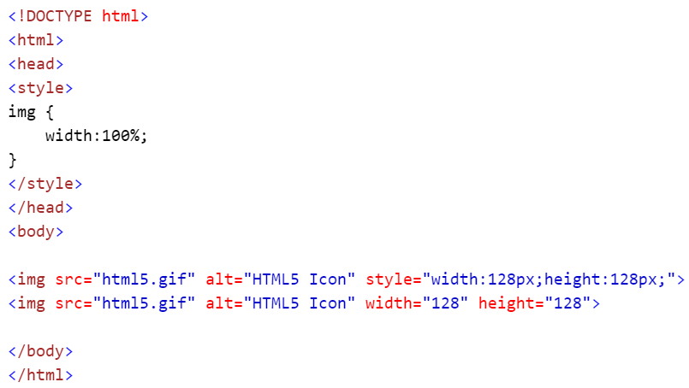
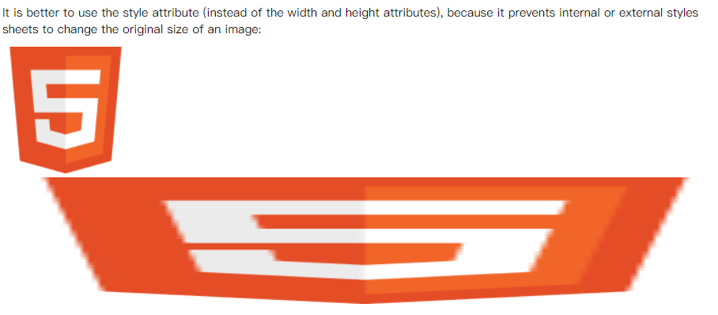
Width and Height or Style?
Both the width, height, and style attributes are valid in the latest HTML5 standard.
We suggest you use the style attribute. It prevents styles sheets from changing the original size of images:

Slide 37
Images in Another Place
Image in Another Folder
  If not specified, the browser expects to find the image in the same folder as the web page.
  However, it is common to store images in a sub-folder. You must then include the folder name in the src attribute:
Image in Another Server
  Some web sites store their images on image servers.
  Actually, you can access images from any web address in the world:

Slide 38
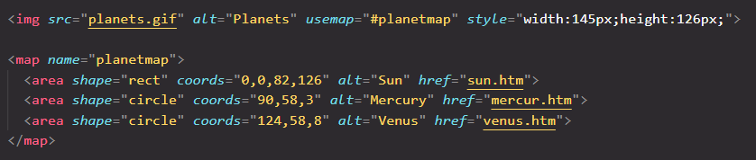
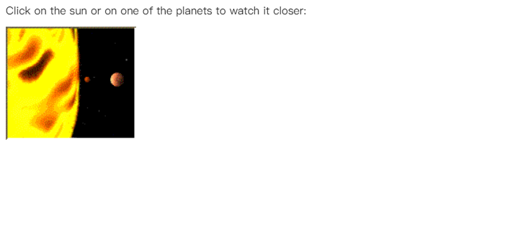
Image Maps
Use the <map> tag to define an image-map. An image-map is an image with clickable areas.
The name attribute of the <map> tag is associated with the <img>'s usemap attribute and creates a relationship between the image and the map.
The <map> tag contains a number of <area> tags, that defines the clickable areas in the image-map:

Slide 39
HTML Image Summary
Use the HTML <img> element to define an image
Use the HTML src attribute to define the URL of the image
Use the HTML alt attribute to define an alternate text for an image, if it cannot be displayed
Use the HTML width and height attributes to define the size of the image
Use the CSS width and height properties to define the size of the image (alternatively)
Use the HTML <map> element to define an image-map
Use the HTML <area> element to define the clickable areas in the image-map
Use the HTML <img>'s element usemap attribute to point to an image-map

Slide 40
HTML TABLES

Slide 41
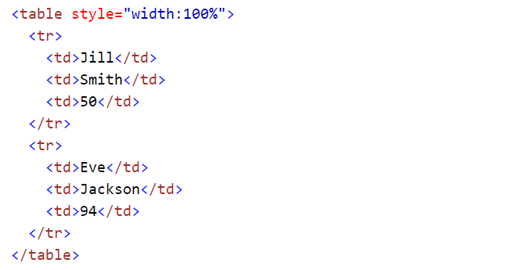
HTML Table Example
Example

Slide 42

Defining HTML Tables
Example explained:
Tables are defined with the <table> tag.
Tables are divided into table rows with the <tr> tag.
Table rows are divided into table data with the <td> tag.
A table row can also be divided into table headings with the <th> tag.
Table data <td> are the data containers of the table.
They can contain all sorts of HTML elements like text, images, lists, other tables, etc.

Slide 43
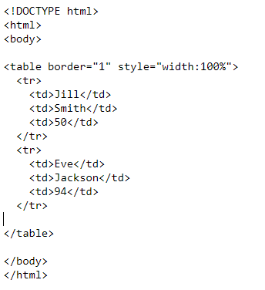
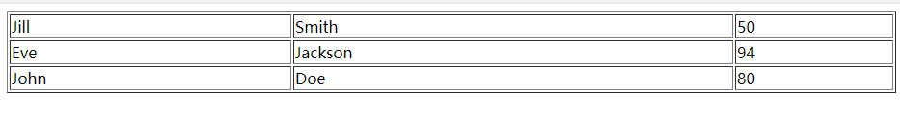
An HTML Table with a Border Attribute
If you do not specify a border for the table, it will be displayed without borders. A border can be added using the border attribute:
The border attribute is on its way out of the HTML standard! It is better to use CSS

Slide 44
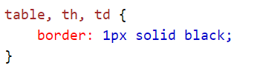
An HTML Table with a Border Attribute
To add borders, use the CSS border property:
Example：
Remember to define borders for both the table and the table cells.

Slide 45
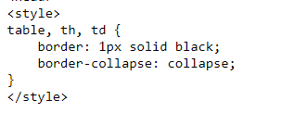
An HTML Table with Collapsed Borders
If you want the borders to collapse into one border, add CSS border-collapse
Example：

Slide 46
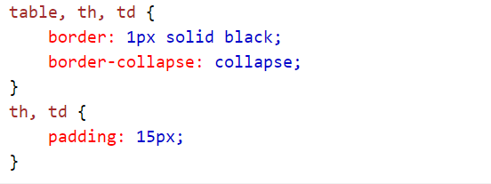
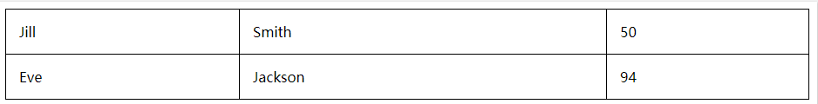
An HTML Table with Cell Padding
Cell padding specifies the space between the cell content and its borders.
If you do not specify a padding, the table cells will be displayed without padding.
To set the padding, use the CSS padding property:
Example：

Slide 47
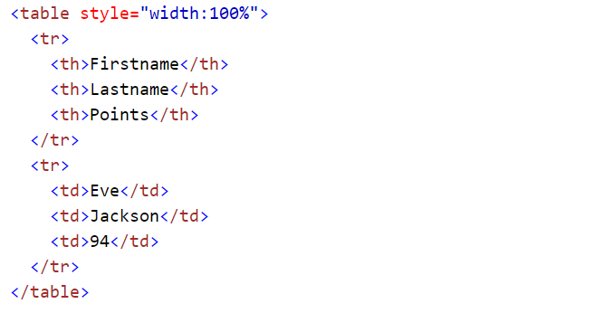
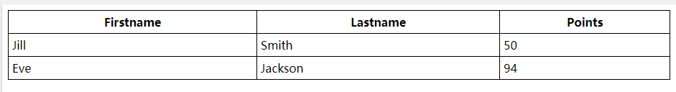
HTML Table Headings
Table headings are defined with the <th> tag.
By default, all major browsers display table headings as bold and centered:

Slide 48

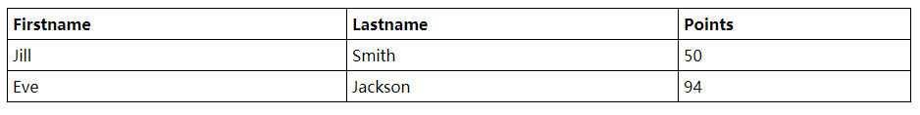
HTML Table Headings
To left-align the table headings, use the CSS text-align property:
Example：

Slide 49
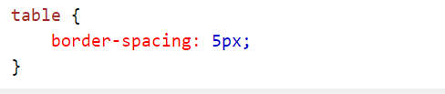
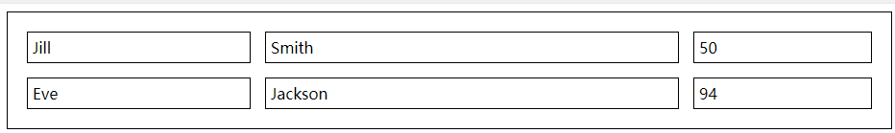

An HTML Table with Border Spacing
Border spacing specifies the space between the cells.
To set the border spacing for a table, use the CSS border-spacing property:
Example：
If the table has collapsed borders, border-spacing has no effect.

Slide 50
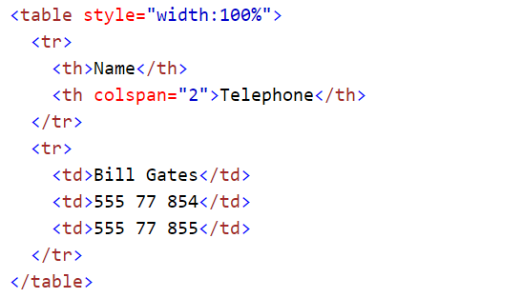
Table Cells that Span Many Columns
To make a cell span more than one column, use the colspan attribute:

Slide 51
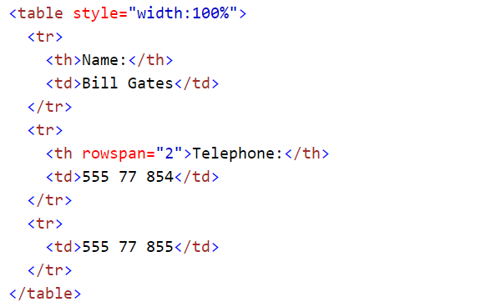
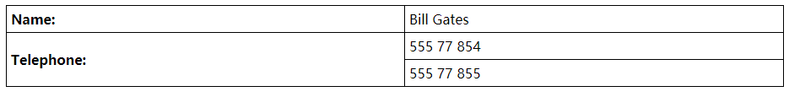
Table Cells that Span Many Rows
To make a cell span more than one row, use the rowspan attribute:

Slide 52
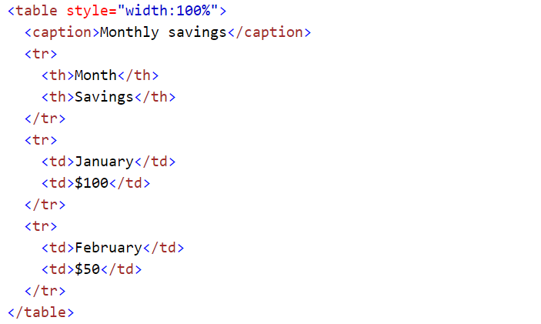
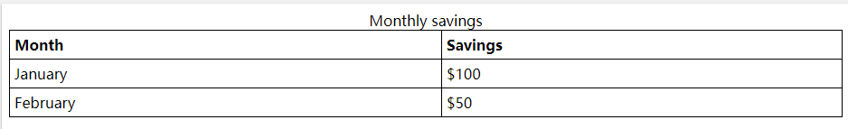
An HTML Table With a Caption
To add a caption to a table, use the <caption> tag:
The <caption> tag must be inserted immediately after the <table> tag.

Slide 53
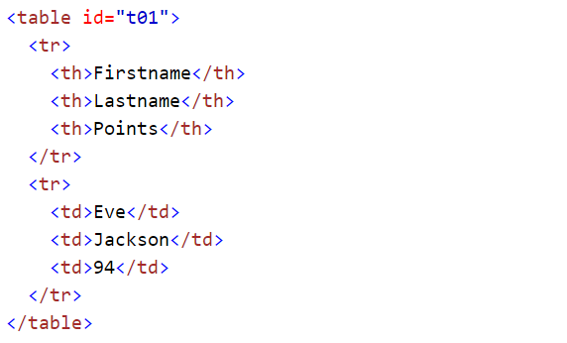
A Special Style for One Table
To define a special style for a special table, add an id attribute to the table:
Example：

Slide 54
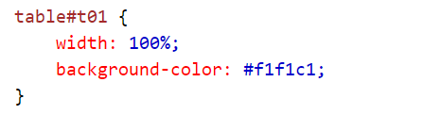
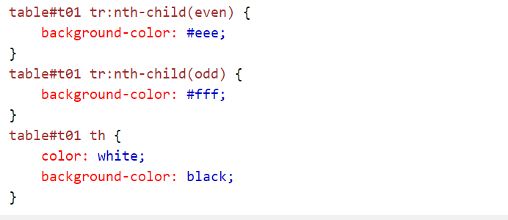
A Special Style for One Table
Now you can define a special style for this table:
And add more styles:

Slide 55

A Special Style for One Table

Slide 56
HTML Table Summary
Use the HTML <table> element to define a table
Use the HTML <tr> element to define a table row
Use the HTML <td> element to define a table data
Use the HTML <th> element to define a table heading
Use the HTML <caption> element to define a table caption
Use the CSS border property to define a border
Use the CSS border-collapse property to collapse cell borders
Use the CSS padding property to add padding to cells
Use the CSS text-align property to align cell text
Use the CSS border-spacing property to set the spacing between cells
Use the colspan attribute to make a cell span many columns
Use the rowspan attribute to make a cell span many rows
Use the id attribute to uniquely define one table

Slide 57
HTML LISTS

Slide 58


HTML LISTS
HTML defines a number of elements that you can use to create lists of content items. can create ordered, unordered, and descriptive lists.
Example of an unordered list and an ordered list in HTML:

Slide 59
Unordered HTML Lists - The Style Attribute
A style attribute can be added to an unordered list, to define the style of the marker:
Style | Description
list-style-type:disc | The list items will be marked with bullets (default)
list-style-type:circle | The list items will be marked with circles
list-style-type:square | The list items will be marked with squares
list-style-type:none | The list items will not be marked

Slide 60


Unordered Lists Example

Slide 61


Unordered Lists Example

Slide 62


Unordered Lists Example

Slide 63


Unordered Lists Example

Slide 64


Ordered HTML Lists
An ordered list starts with the <ol> tag. Each list item starts with the <li> tag. The list items will be marked with numbers:
Example

Slide 65

Ordered HTML Lists - The Type Attribute
A type attribute can be added to an ordered list, to define the type of the marker:

Slide 66


Ordered Lists Example

Slide 67


Ordered Lists Example

Slide 68


Ordered Lists Example

Slide 69


Ordered Lists Example

Slide 70


Ordered Lists Example

Slide 71


Nested HTML Lists
List can be nested (lists inside lists):

Slide 72


Horizontal Lists
HTML lists can be styled in many different ways with CSS. One popular way, is to style a list to be displayed horizontally:

Slide 73



Horizontal Lists
With a little extra style, you can make it look like a menu:

Slide 74
Summary
Use the HTML <ul> element to define an unordered list
Use the HTML style attribute to define the bullet style
Use the HTML <ol> element to define an ordered list
Use the HTML type attribute to define the numbering type
Use the HTML <li> element to define a list item
Use the HTML <dl> element to define a description list
Use the HTML <dt> element to define the description term
Use the HTML <dd> element to define the description data
Lists can be nested inside lists
List items can contain other HTML elements
Use the CSS property display:inline to display a list horizontally

