Slide 1
HTML5 Introduction

Slide 2

What is New in HTML5?
The DOCTYPE declaration for HTML5 is very simple:
The character encoding (charset) declaration is also very simple:

Slide 3
New HTML5 Elements
The most interesting new elements are:
New semantic elements like <header>, <footer>, <article>, and <section>.
New form control attributes like number, date, time, calendar, and range.
New graphic elements: <canvas>.
New multimedia elements: <audio> and <video>.

Slide 4
New HTML5 API's
The most interesting new API's are:
HTML Geolocation
HTML Drag and Drop
HTML Local Storage
HTML Application Cache
HTML Web Workers
HTML SSE

Slide 5
Elements Removed in HTML5
Element | Use instead | Function
<acronym> | <abbr> | defines an acronym
<applet> | <object> | defines an embedded applet
<basefont> | CSS | specifies a default text-color, font-size, or font-family for all the text in a document.
<big> | CSS | defines bigger text
<center> | CSS | center-align text
<dir> | <ul> | list directory titles
<font> | CSS | specifies the font face, font size, and color of text
<frame> |  | defines one particular window (frame) within a <frameset>，Each <frame> in a <frameset> can have different attributes
<frameset> |  | holds one or more <frame> elements. Each <frame> element can hold a separate document，The <frameset> element specifies HOW MANY columns or rows there will be in the frameset, and HOW MUCH percentage/pixels of space will occupy each of them
<noframes> |  | a fallback tag for browsers that do not support frames，can be used to link to a non-frameset version of the web site or to display a message to users that frames are required
<strike> | CSS | defines strikethrough text
<tt> | CSS | defines teletype text
The following HTML4 elements have been removed from HTML5:

Slide 6
HTML5 New Elements

Slide 7
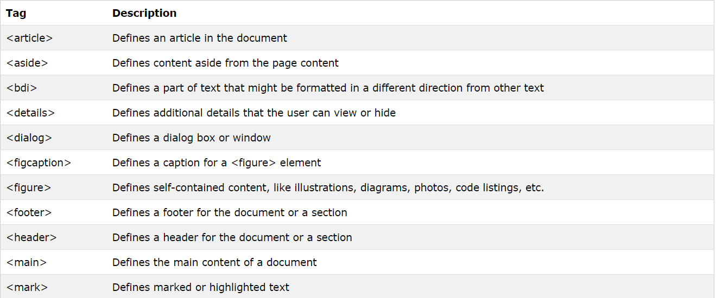
New Semantic/Structural Elements
HTML5 offers new elements for better document structure:

Slide 8
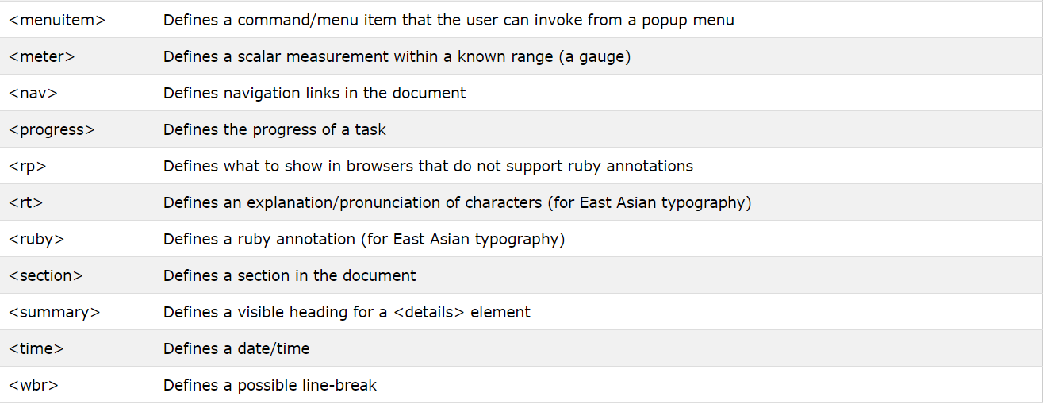
New Semantic/Structural Elements

Slide 9
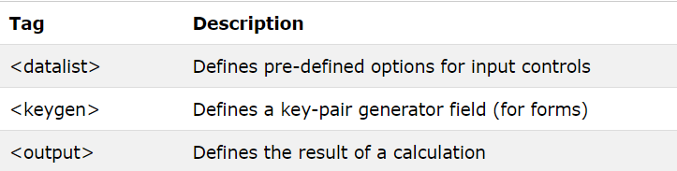
New Form Elements

Slide 10
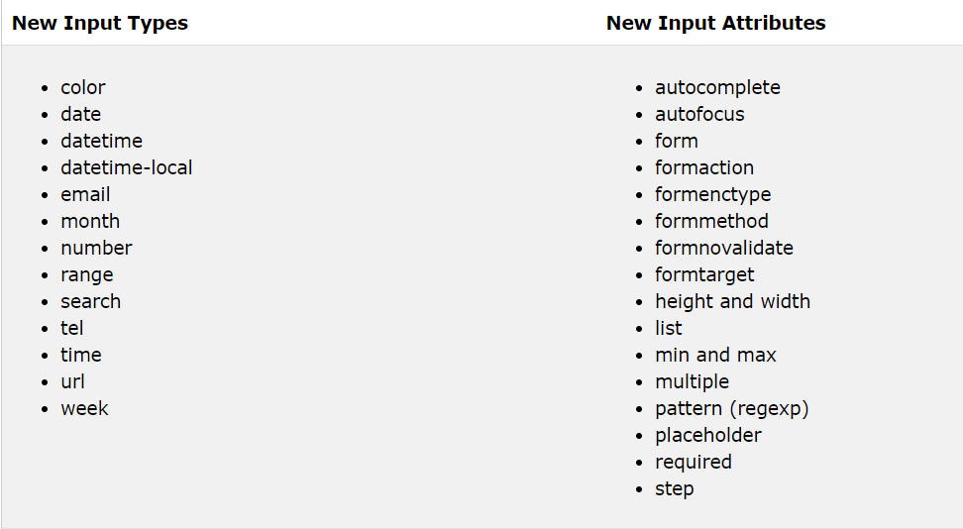
New Input Types
Notes:
HTML5 also introduces some new input types and input attributes. Here is a list.

Slide 11
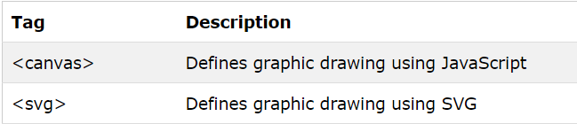
HTML5 Graphics

Slide 12
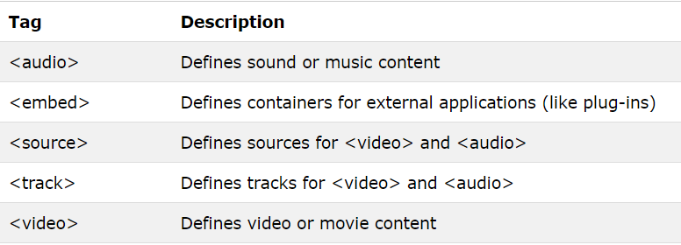
New Media Elements

Slide 13
HTML5 Semantic Elements

Slide 14
What are Semantic Elements?
Semantics is the study of the meanings of words and phrases in language.
Semantic elements are elements with a meaning.
A semantic element clearly describes its meaning to both the browser and the developer.
Examples of non-semantic elements: <div> and <span> - Tells nothing about its content.
Examples of semantic elements: <form>, <table>, and <img> - Clearly defines its content.

Slide 15
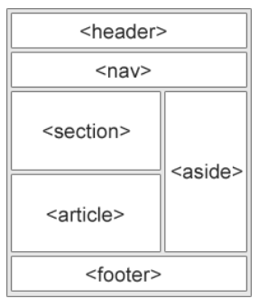
New Semantic Elements in HTML5
Many web sites contain HTML code like: <div id="nav"> <div class="header"> <div id="footer"> to indicate navigation, header, and footer.
HTML5 offers new semantic elements to define different parts of a web page:
<article>
<aside>
<details>
<figcaption>
<figure>
<footer>
<header>
<main>
<mark>
<nav>
<section>
<summary>
<time>

Slide 16
HTML5 <section> Element
The <section> element defines a section in a document.
A section is a the semantic grouping of content, typically with a heading.
A Web site's home page could be split into sections for introduction, content, and contact information.

Slide 17
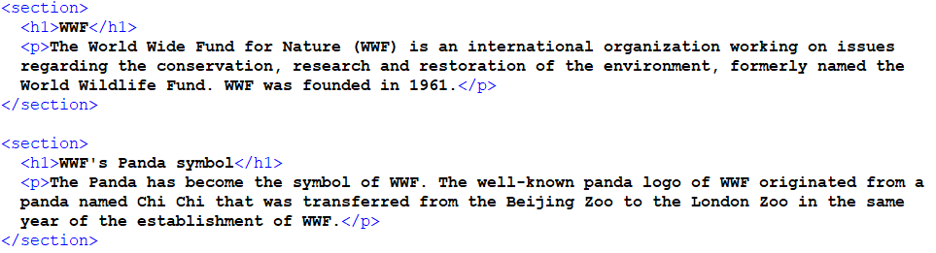
HTML5 <section> Element
Example:
Notes:
Here is an example. In this example, the web page is divided into two section. The first section introduces WMF, and the second section introduces WMF’s panda symbol.

Slide 18
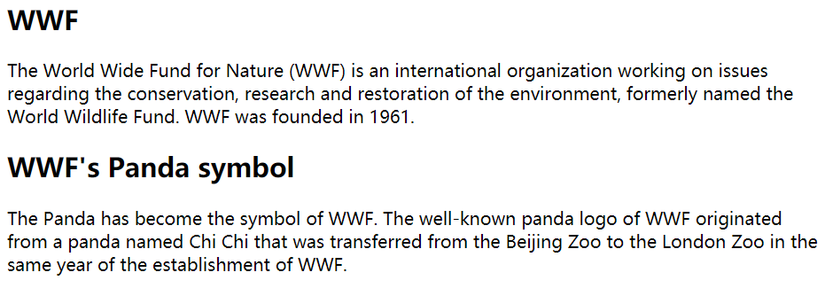
HTML5 <section> Element

Slide 19
HTML5 <article> Element
The <article> element specifies independent, self-contained content.
An article should make sense on its own, and it should be possible to read it independently from the rest of the web site.
Examples of where an <article> element can be used:
Forum post
Blog post
Newspaper article

Slide 20
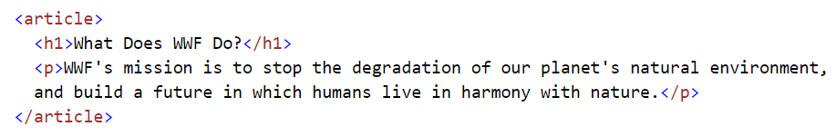
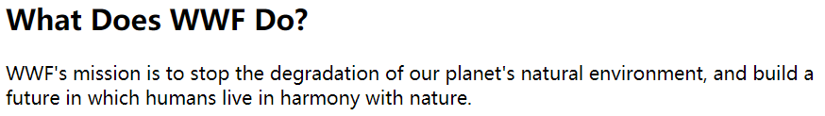
HTML5 <article> Element
Example:

Slide 21
Nesting Semantic Elements
In the HTML5 standard, the <article> element defines a complete, self-contained block of related elements. The <section> element is defined as a block of related elements.
Can we use the definitions to decide how to nest elements? No, we cannot!
On the Internet, you will find HTML pages with <section> elements containing <article> elements, and <article> elements containing <sections> elements.
You will also find pages with <section> elements containing <section> elements, and <article> elements containing <article> elements.

Slide 22
HTML5 <header> Element
The <header> element specifies a header for a document or section.
The <header> element should be used as a container for introductory content.
We can have several <header> elements in one document.

Slide 23
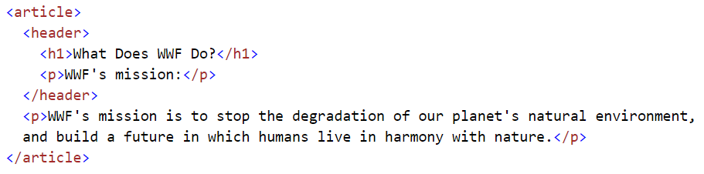
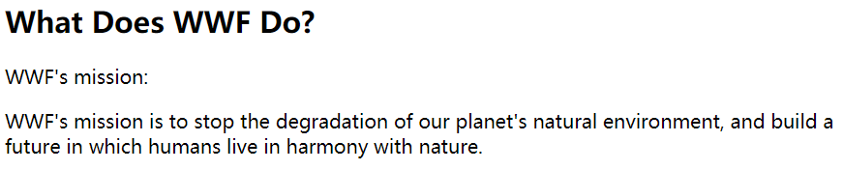
HTML5 <header> Element
The following example defines a header for an article:

Slide 24
HTML5 <footer> Element
The <footer> element specifies a footer for a document or section.
A <footer> element should contain information about its containing element.
A footer typically contains the author of the document, copyright information, links to terms of use, contact information, etc.
You can have several <footer> elements in one document.

Slide 25
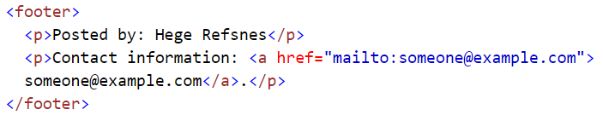

HTML5 <footer> Element
Example:

Slide 26
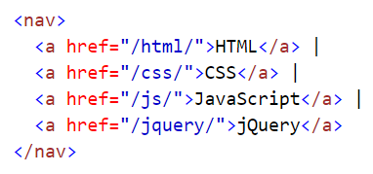

HTML5 <nav> Element
The <nav> element defines a set of navigation links.
The <nav> element is intended for large blocks of navigation links. However, not all links in a document should be inside a <nav> element!
Example
Notes:
Here is an example of nav element that defines four navigation links for html, css, js and jquery.

Slide 27
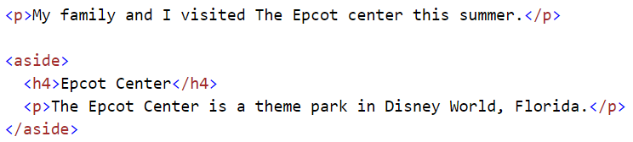
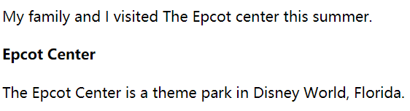
HTML5 <aside> Element
The <aside> element defines some content aside from the content it is placed in (like a sidebar).
The aside content should be related to the surrounding content.
Example
Notes:
Epcot: 未来世界公园
<aside>标签通常作为侧边栏布局，可以放置相关说明、提示、引用、附加注释、广告、网站分类等信息

Slide 28

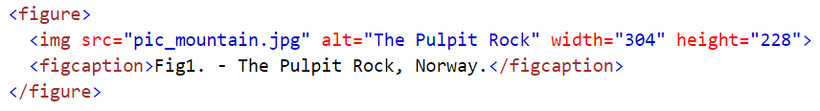
HTML5 <figure> and <figcaption> Elements
In books and newspapers, it is common to have captions with images.
The purpose of a caption is to add a visual explanation to an image.
With HTML5, images and captions can be grouped together in <figure> elements:
The <img> element defines the image, the <figcaption> element defines the caption.

Slide 29
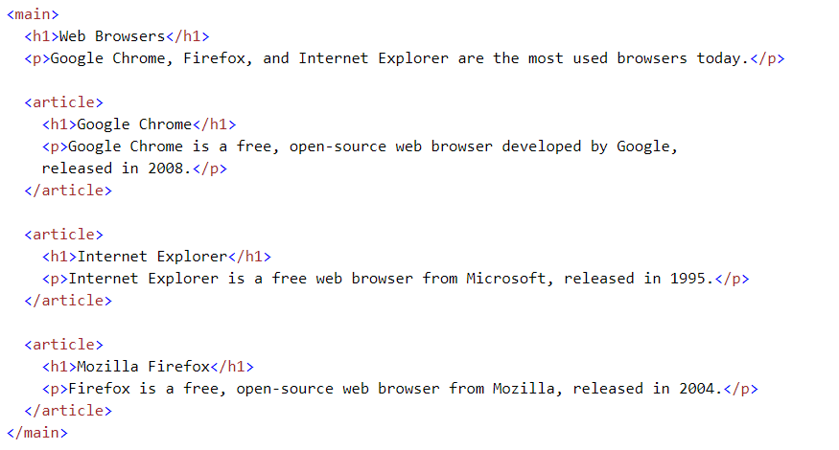
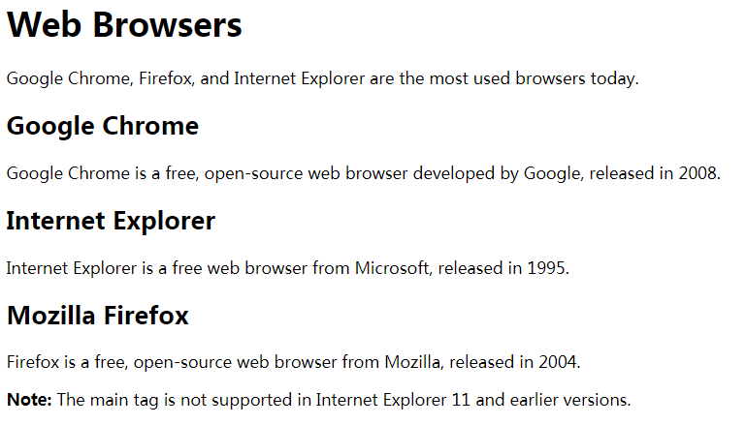
HTML5 <main> Element
The <main> tag specifies the main content of a document.
The content inside the <main> element should be unique to the document. It should not contain any content that is repeated across documents such as sidebars, navigation links, copyright information, site logos, and search forms.
There must not be more than one <main> element in a document. The <main> element must NOT be a descendant of an <article>, <aside>, <footer>, <header>, or <nav> element.

Slide 30

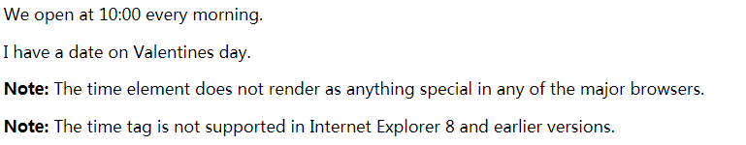
HTML5 <time> Element
The <time> tag defines a human-readable date/time.
This element can also be used to encode dates and times in a machine-readable way so that user agents can offer to add birthday reminders or scheduled events to the user's calendar, and search engines can produce smarter search results.
Hint: the datetime attribute represents a machine-readable date/time of the <time> element

Slide 31

HTML5 <mark> Element
The <mark> tag defines marked text.
Use the <mark> tag if you want to highlight parts of your text.

Slide 32
Why Semantic HTML5 Elements?
With HTML4, developers used their own favorite attribute names to style page elements : header, top, bottom, footer, menu, navigation, main, container, content, article, sidebar, topnav, ... This made it impossible for search engines to identify the correct web page content.
With HTML5 elements like: <header> <footer> <nav> <section> <article>, this will become easier.
A Semantic Web allows data to be shared and reused across applications, enterprises, and communities.

Slide 33
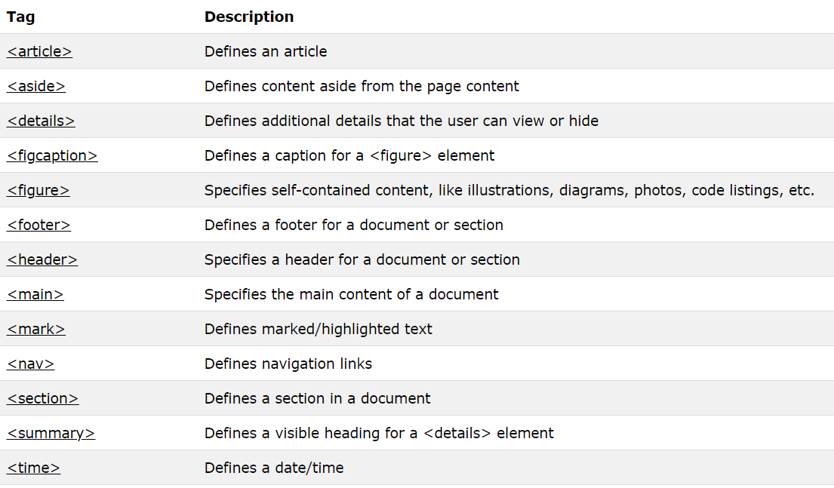
Semantic Elements in HTML5
Below is an alphabetical list of the new semantic elements in HTML5.

Slide 34
HTML5 Migration

Slide 35
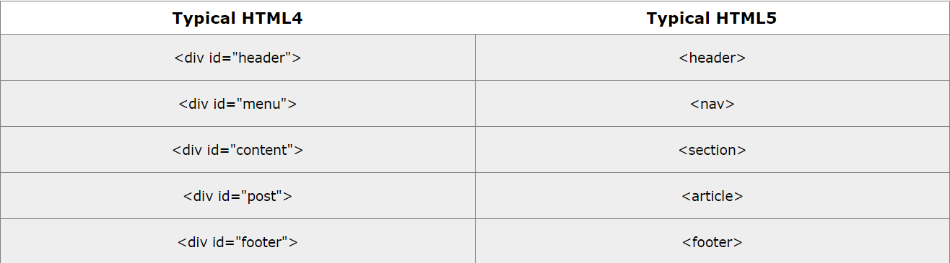
Migration from HTML4 to HTML5
how to migrate from a typical HTML4 page to a typical HTML5 page.

Slide 36
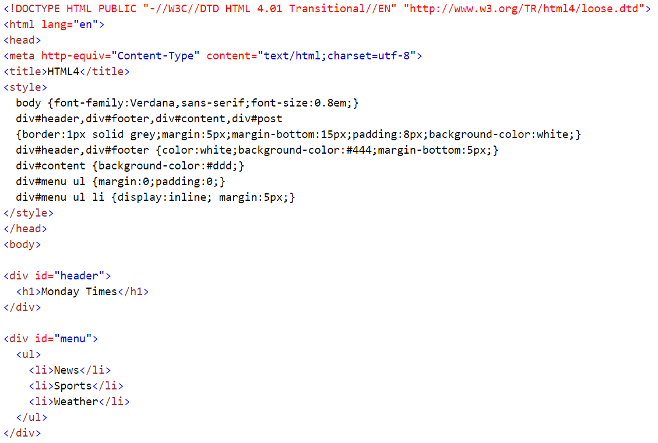
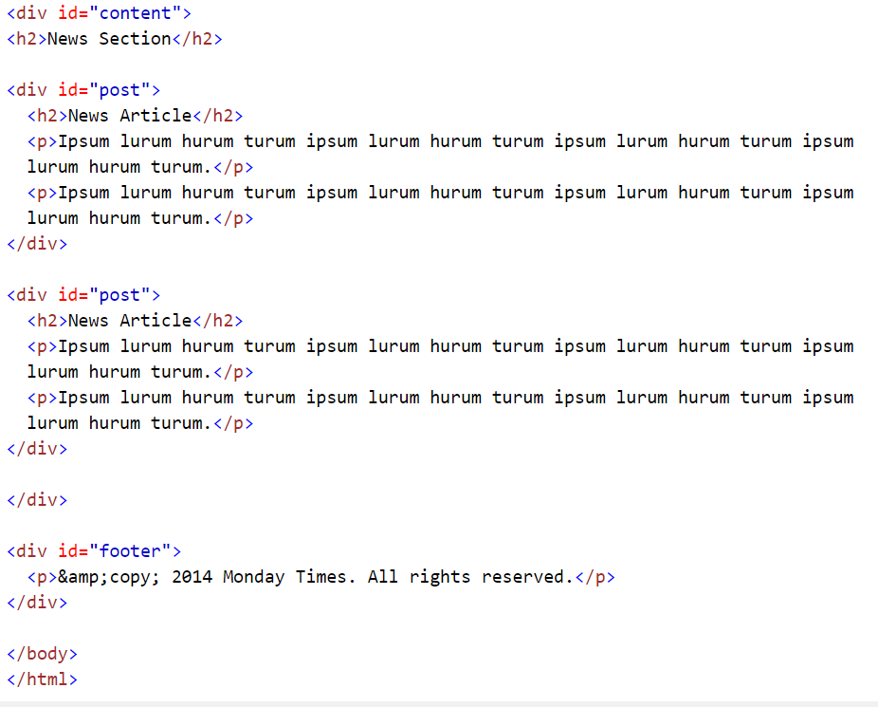
A Typical HTML4 Page
Example:

Slide 37
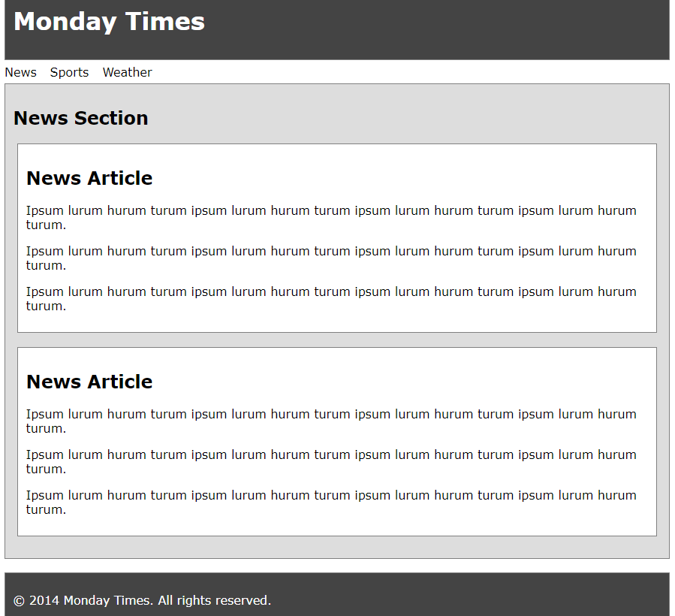
A Typical HTML4 Page

Slide 38

Change to HTML5 Doctype
Change the doctype, from the HTML4 doctype:
to the HTML5 doctype:

Slide 39

Change to HTML5 Encoding
Change the encoding information, from HTML4:
to HTML5:

Slide 40
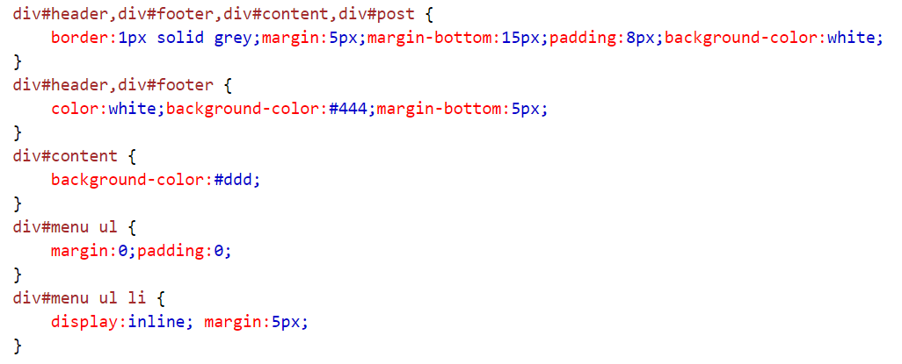
Add CSS for HTML5 Semantic Elements
Look at your existing CSS styles:

Slide 41
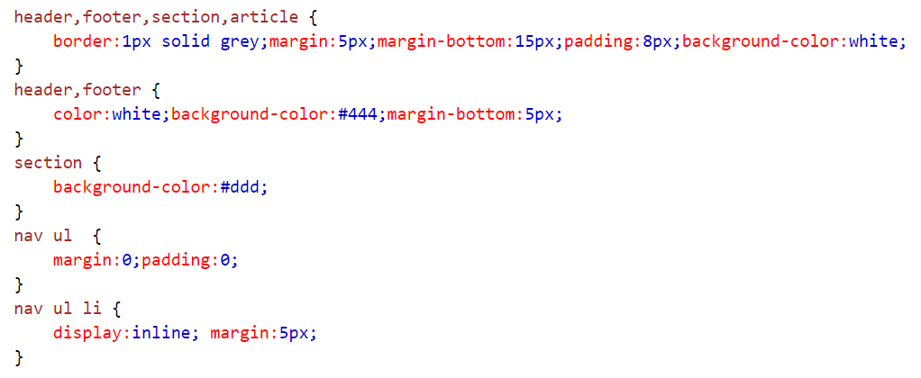
Add CSS for HTML5 Semantic Elements
Duplicate with equal CSS styles for HTML5 semantic elements:

Slide 42
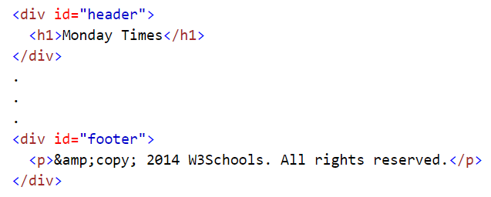
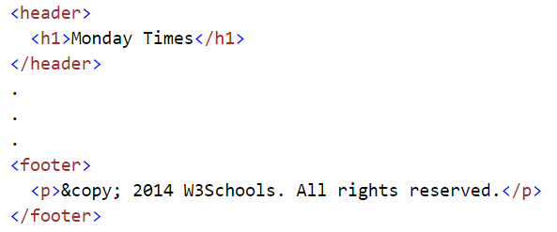
Change to HTML5 <header> and <footer>
Change the <div> elements with id="header" and id="footer":
to HTML5 semantic <header> and <footer> elements:

Slide 43
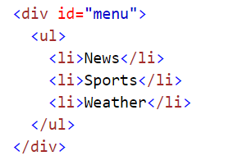
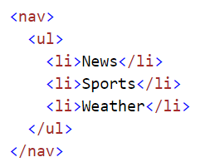
Change to HTML5 <nav>
Change the <div> element with id="menu":
to an HTML5 semantic <nav> element:

Slide 44
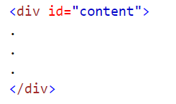
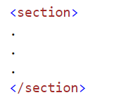
Change to HTML5 <section>
Change the <div> element with id="content":
to an HTML5 semantic <section> element:

Slide 45
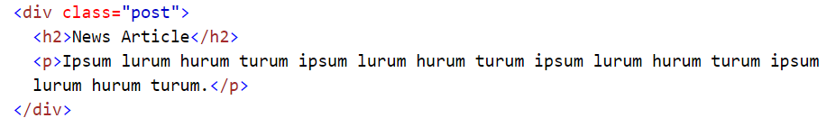
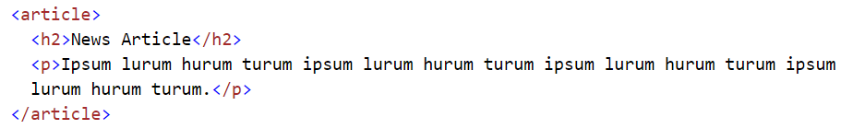
Change to HTML5 <article>
Change the <div> element with class="post":
to HTML5 semantic <article> elements:

Slide 46
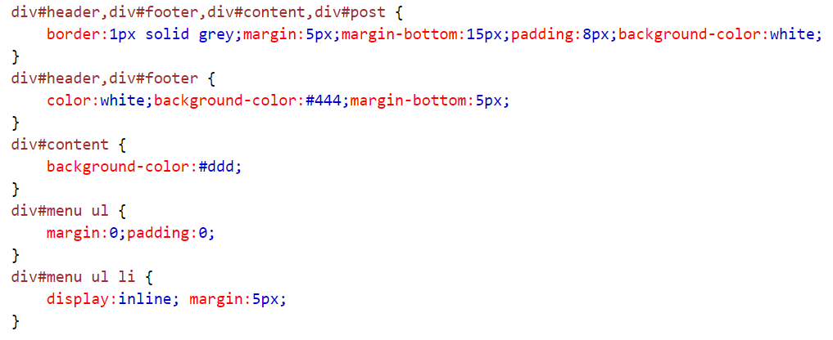
Change to HTML5 <article>
Remove these "no longer needed" <style> elements:

Slide 47
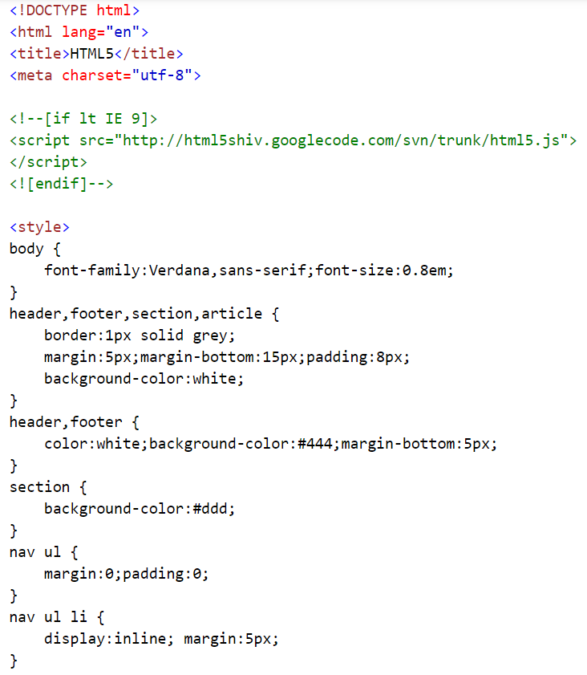
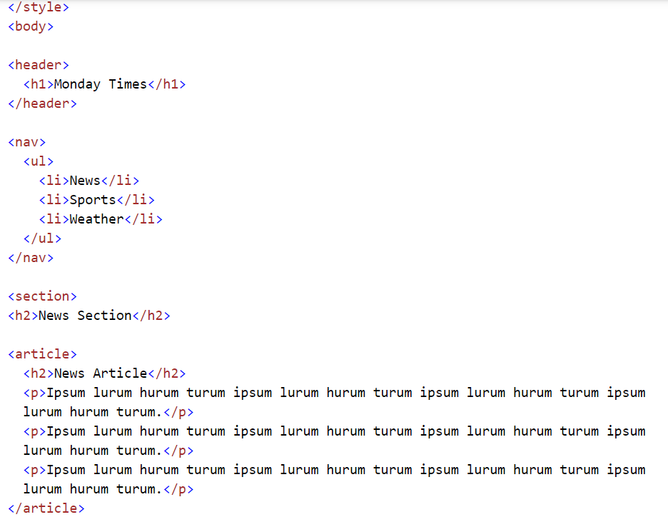
A Typical HTML5 Page
Finally you can remove the <head> tags. They are not needed in HTML5:

Slide 48
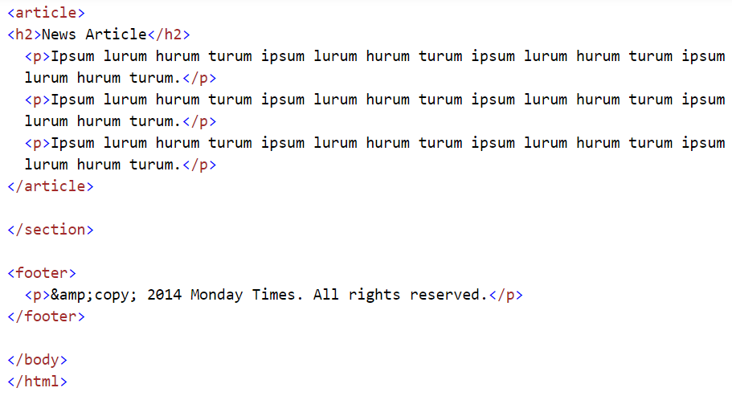
A Typical HTML5 Page

Slide 49
HTML5 Style Guide and Coding Conventions

Slide 50
HTML Coding Conventions
Web developers are often uncertain about the coding style and syntax to use in HTML.
Between 2000 and 2010, many web developers converted from HTML to XHTML.
With XHTML, developers were forced to write valid and "well-formed" code.
HTML5 is a bit more sloppy when it comes to code validation.
With HTML5, you must create your own Best Practice, Style Guide and Coding Conventions.

Slide 51
Why use Style?
A consequent use of style, makes it easier for others to understand and use your HTML.
In the future, programs like XML readers, may want to read your HTML.
Using a well-formed "close to XHTML" syntax, can be smart.
Always keep your style smart, tidy, clean, and well-formed.

Slide 52


Use Correct Document Type
Always declare the document type as the first line in your document:
If you want consistency with lower case tags, you can use:

Slide 53
Use Lower Case Element Names
HTML5 allows mixing uppercase and lowercase letters in element names.
We recommend using lowercase element names:
Mixing uppercase and lowercase names is bad
Developers are used to using lowercase names (as in XHTML)
Lowercase look cleaner
Lowercase are easier to write

Slide 54
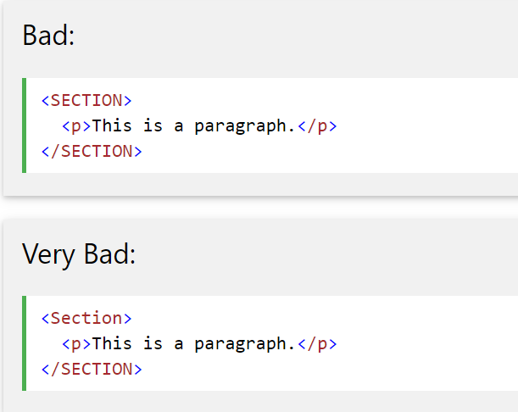
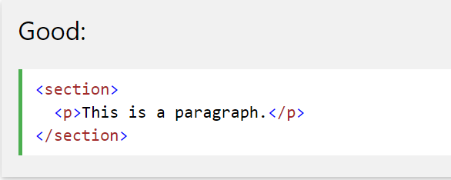
Use Lower Case Element Names
Example:
Notes:
Bad example : mix-use lowercase letter and uppercase letter in one element.

Slide 55
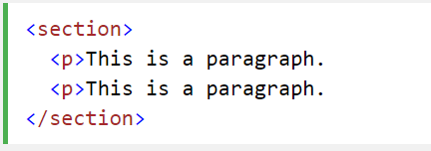
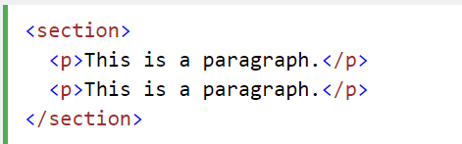
Close All HTML Elements
In HTML5, you don't have to close all elements (for example the <p> element).
We recommend closing all HTML elements:
Looking bad:
Looking good:

Slide 56


Close Empty HTML Elements
In HTML5, it is optional to close empty elements.
This is allowed:
This is also allowed:
The slash (/) is required in XHTML and XML.
If you expect XML software to access your page, it might be a good idea to keep it.

Slide 57
Use Lower Case Attribute Names
HTML5 allows mixing uppercase and lowercase letters in attribute names.
We recommend using lowercase attribute names:
Mixing uppercase and lowercase names is bad
Developers are used to using lowercase names (as in XHTML)
Lowercase look cleaner
Lowercase are easier to write
Notes:
The reason is the same as using lowercase letters in element names.

Slide 58


Use Lower Case Attribute Names
Example:
Looking bad:
Looking good:

Slide 59
Quote Attribute Values
HTML5 allows attribute values without quotes.
We recommend quoting attribute values:
You have to use quotes if the value contains spaces
Mixing styles is never good
Quoted values are easier to read

Slide 60


Quote Attribute Values
Example:
This will not work, because the value contains spaces:
This will work:

Slide 61
Image Attributes
Always use the alt attribute with images. It is important when the image cannot be viewed.
Always define image size. It reduces flickering because the browser can reserve space for images before they are loaded.

Slide 62
Spaces and Equal Signs
Spaces around equal signs is legal:
But space-less is easier to read, and groups entities better together:

Slide 63
Avoid Long Code Lines
When using an HTML editor, it is inconvenient to scroll right and left to read the HTML code.
Try to avoid code lines longer than 80 characters.

Slide 64
Blank Lines and Indentation
Do not add blank lines without a reason.
For readability, add blank lines to separate large or logical code blocks.
For readability, add 2 spaces of indentation. Do not use TAB.
Do not use unnecessary blank lines and indentation. It is not necessary to use blank lines between short and related items. It is not necessary to indent every element:

Slide 65
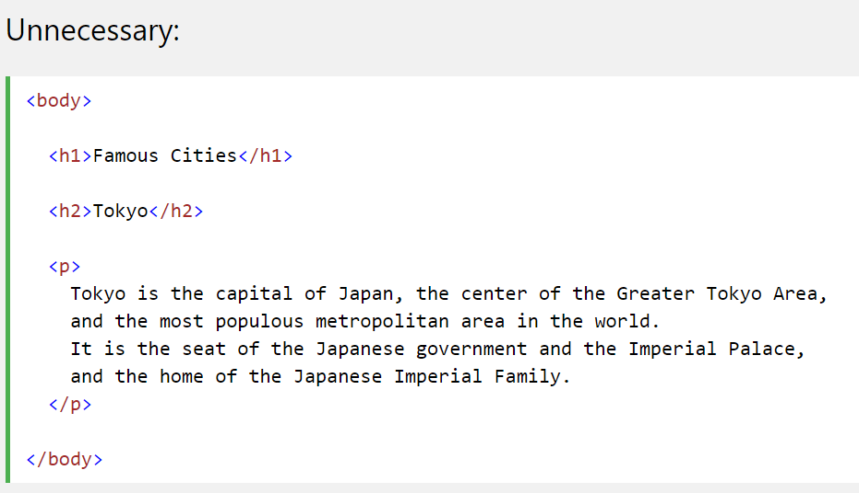
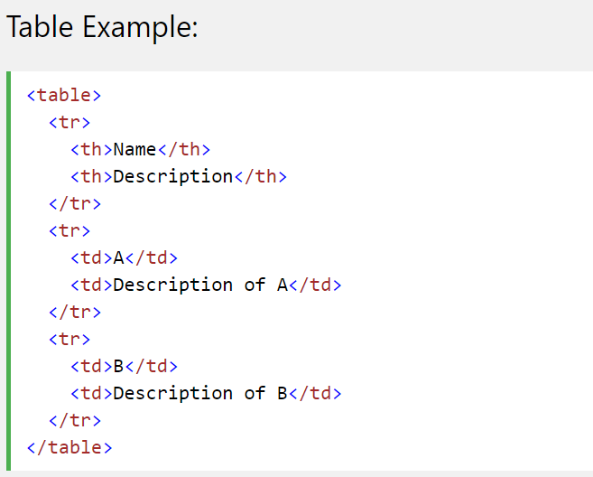
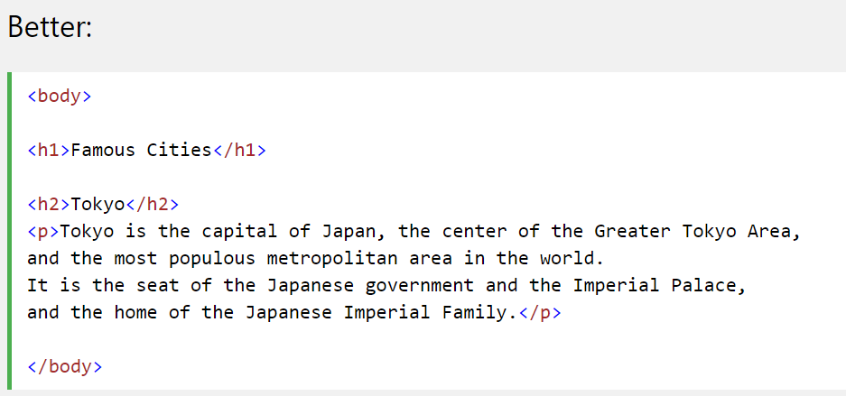
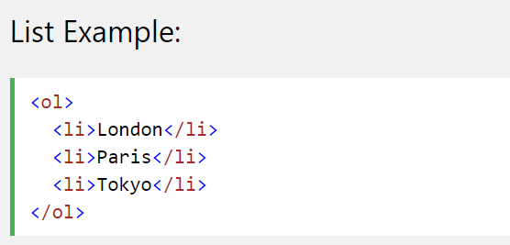
Blank Lines and Indentation
Example:

Slide 66
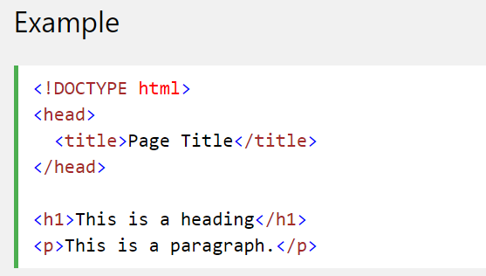
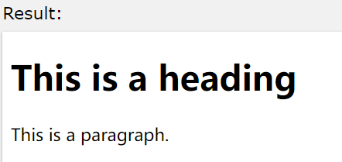
Omitting <html> and <body>?
In the HTML5 standard, the <html> tag and the <body> tag can be omitted.
The following code will validate as HTML5:

Slide 67

Omitting <html> and <body>?
We do not recommend omitting the <html> and <body> tags.
The <html> element is the document root. It is the recommended place for specifying the page language:
Declaring a language is important for accessibility applications (screen readers) and search engines.
Omitting <html> or <body> can crash DOM and XML software.
Omitting <body> can produce errors in older browsers (IE9).

Slide 68
Omitting <head> ?
In the HTML5 standard, the <head> tag can also be omitted.
By default, browsers will add all elements before <body>, to a default <head> element.
You can reduce the complexity of HTML, by omitting the <head> tag:

Slide 69


Omitting <head> ?
Omitting tags is unfamiliar to web developers. It needs time to be established as a guideline.

