Slide 1

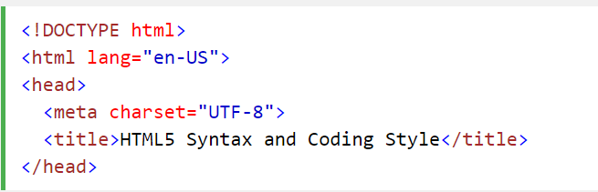
Meta Data
The <title> element is required in HTML5. Make the title as meaningful as possible:
To ensure proper interpretation, and correct search engine indexing, both the language and the character encoding should be defined as early as possible in a document:

Slide 2

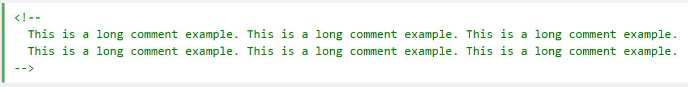
HTML Comments
Short comments should be written on one line, with a space after <!-- and a space before -->:
Long comments, spanning many lines, should be written with <!-- and --> on separate lines:
Long comments are easier to observe, if they are indented 2 spaces.

Slide 3

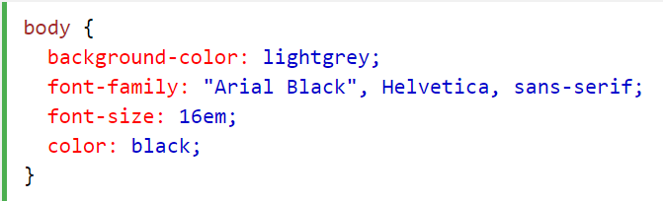
Style Sheets
Use simple syntax for linking style sheets (the type attribute is not necessary):
Short rules can be written compressed, on one line, like this:
Long rules should be written over multiple lines:

Slide 4

Loading JavaScript in HTML
Use simple syntax for loading external scripts (the type attribute is not necessary):

Slide 5
Use Lower Case File Names
Most web servers (Apache, Unix) are case sensitive about file names:
london.jpg cannot be accessed as London.jpg.
Other web servers (Microsoft, IIS) are not case sensitive:
london.jpg can be accessed as London.jpg or london.jpg.
If you use a mix of upper and lower case, you have to be extremely consistent.
If you move from a case insensitive, to a case sensitive server, even small errors will break your web.
To avoid these problems, always use lower case file names (if possible).

Slide 6
File Extensions
HTML files should have a .html extension (or .htm).
CSS files should have a .css extension.
JavaScript files should have a .js extension.

Slide 7
Differences Between .htm and .html
There is no difference between the .htm and .html extensions. Both will be treated as HTML by any web browser or web server.
The differences are cultural:
.htm "smells" of early DOS systems where the system limited the extensions to 3 characters.
.html "smells" of Unix operating systems that did not have this limitation.

Slide 8
Technically Differences
When a URL does not specify a filename (like http://www.fzu.edu.cn/), the server returns a default filename. Common default filenames are index.html, index.htm, default.html, and default.htm.
If your server is configured only with "index.html" as default filename, your file must be named "index.html", not "index.htm."
However, servers can be configured with more than one default filename, and normally you can set up as many default filenames as needed.
Anyway, the full extension for HTML files is .html, and there's no reason it should not be used.

Slide 9
HTML5 Canvas

Slide 10
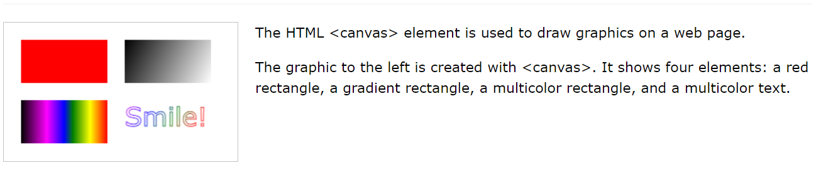
What is HTML Canvas?

Slide 11
What is HTML Canvas?
The HTML <canvas> element is used to draw graphics, on the fly, via scripting (usually JavaScript).
The <canvas> element is only a container for graphics. You must use a script to actually draw the graphics.
Canvas has several methods for drawing paths, boxes, circles, text, and adding images.

Slide 12
Canvas Examples
A canvas is a rectangular area on an HTML page. By default, a canvas has no border and no content.
The markup looks like this:
Note: Always specify an id attribute (to be referred to in a script), and a width and height attribute to define the size of the canvas.

Slide 13
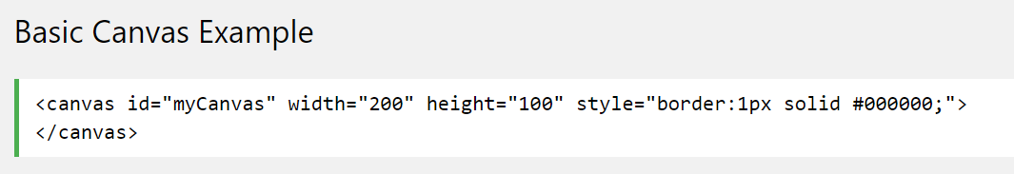
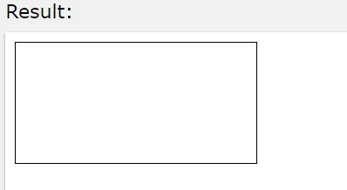
Canvas Examples
To add a border, use the style attribute:

Slide 14
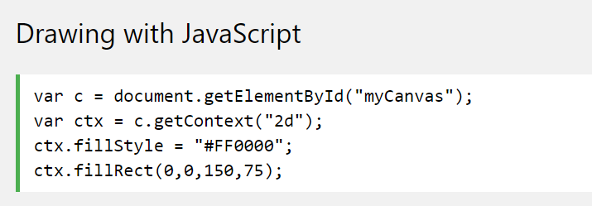
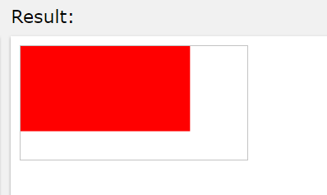
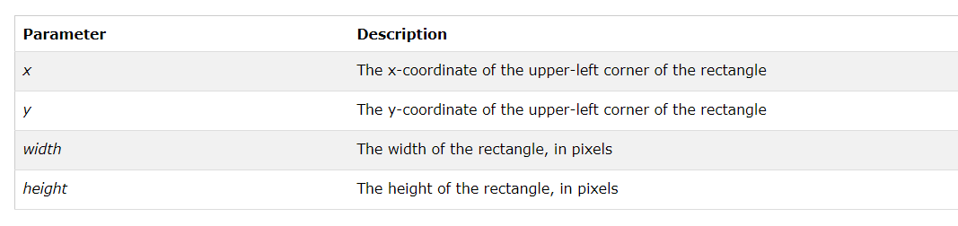
Canvas Examples

Slide 15
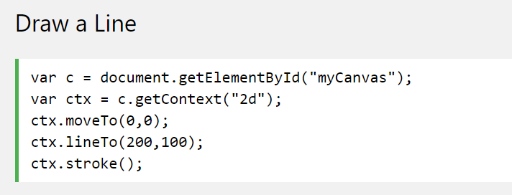
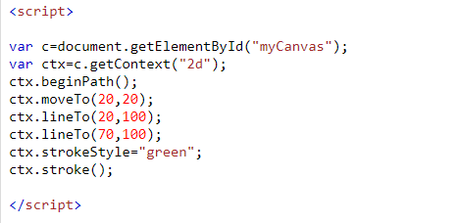
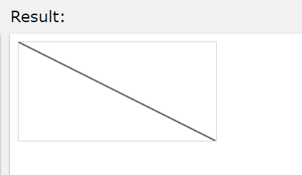

Canvas Examples
moveto() : Moves the path to the specified point in the canvas, without creating a line
beginPath(): Begins a path, or resets the current path
lineto(): Adds a new point and creates a line from that point to the last specified point in the canvas
stroke(): Actually draws the path you have defined

Slide 16
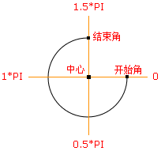

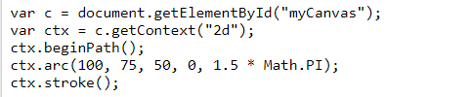
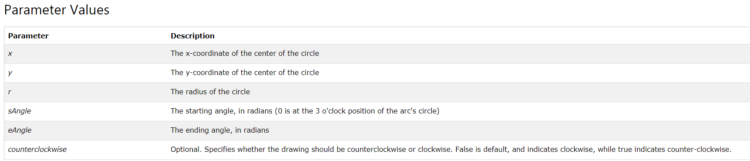
Canvas Examples
Draw a circle

Slide 17
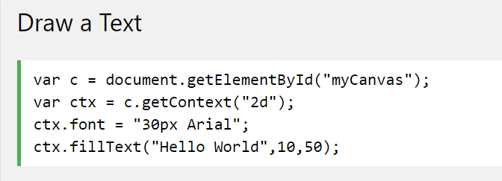
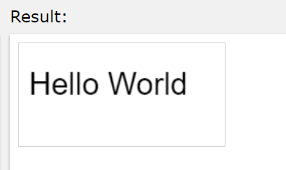
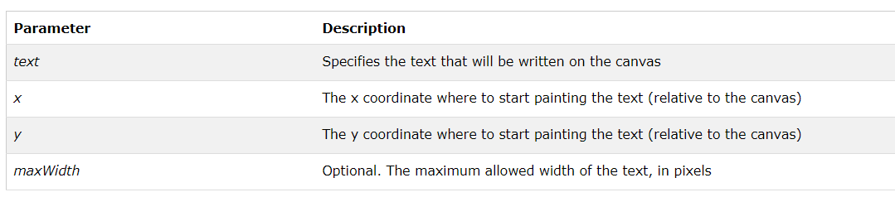
Canvas Examples

Slide 18
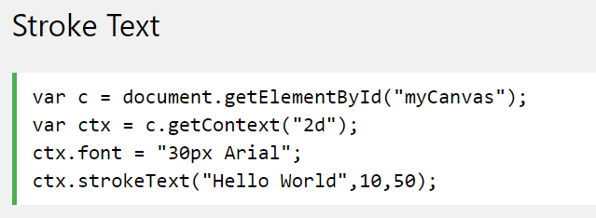
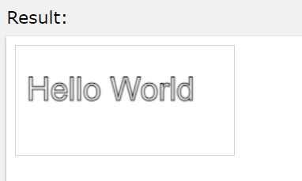
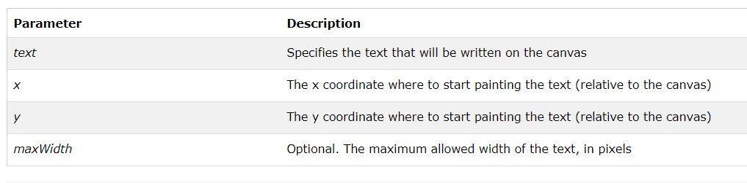
Canvas Examples
No fill

Slide 19
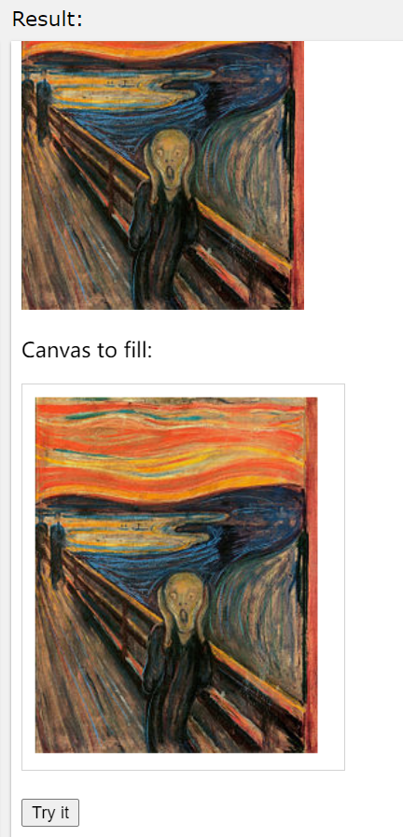
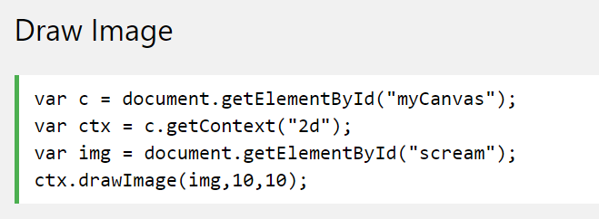
Canvas Examples

Slide 20
HTML Multimedia

Slide 21
What is Multimedia?
Multimedia comes in many different formats. It can be almost anything you can hear or see.
Examples: Pictures, music, sound, videos, records, films, animations, and more.
Web pages often contain multimedia elements of different types and formats.

Slide 22
Browser Support
The first web browsers had support for text only, limited to a single font in a single color.
Later came browsers with support for colors and fonts, and even support for pictures!
The support for sounds, animations, and videos is handled differently by various browsers. Different types and formats are supported, and some formats require extra helper programs (plug-ins) to work.
Hopefully this will become history. HTML5 multimedia promises an easier future for multimedia.

Slide 23
Multimedia Formats
Multimedia elements (like sounds or videos) are stored in media files.
The most common way to discover the type of a file, is to look at the file extension.
Multimedia files also have their own formats and different extensions like: .swf, .wav, .mp3, .mp4, .mpg, .wmv, and .avi.

Slide 24
HTML5 Video

Slide 25
Playing Videos in HTML
Before HTML5, there was no standard for showing videos on a web page.
Before HTML5, videos could only be played with a plug-in (like flash).
The HTML5 <video> element specifies a standard way to embed a video in a web page.

Slide 26
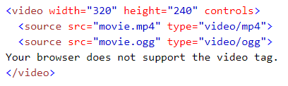
The HTML <video> Element
To show a video in HTML, use the <video> element:
Example：

Slide 27
How it Works
The controls attribute adds video controls, like play, pause, and volume.
If height and width are not set, the browser does not know the size of the video. The effect will be that the page will change (or flicker) while the video loads. It is a good idea to always include width and height attributes.
Text between the <video> and </video> tags will only display in browsers that do not support the <video> element.
Multiple <source> elements can link to different video files. The browser will use the first recognized format.

Slide 28
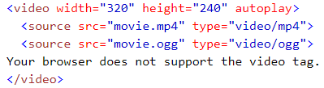
HTML <video> Autoplay
To start a video automatically use the autoplay attribute:
Example：
Tips: The autoplay attribute does not work in mobile devices like iPad and iPhone.

Slide 29
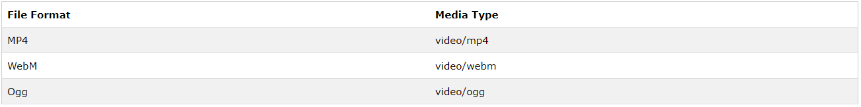
HTML Video
Currently, there are 3 supported video formats for the <video> element: MP4, WebM, and Ogg:

Slide 30
HTML Video - Methods, Properties, and Events
HTML5 defines DOM methods, properties, and events for the <video> element.
This allows you to load, play, and pause videos, as well as setting duration and volume.
There are also DOM events that can notify you when a video begins to play, is paused, etc.

Slide 31
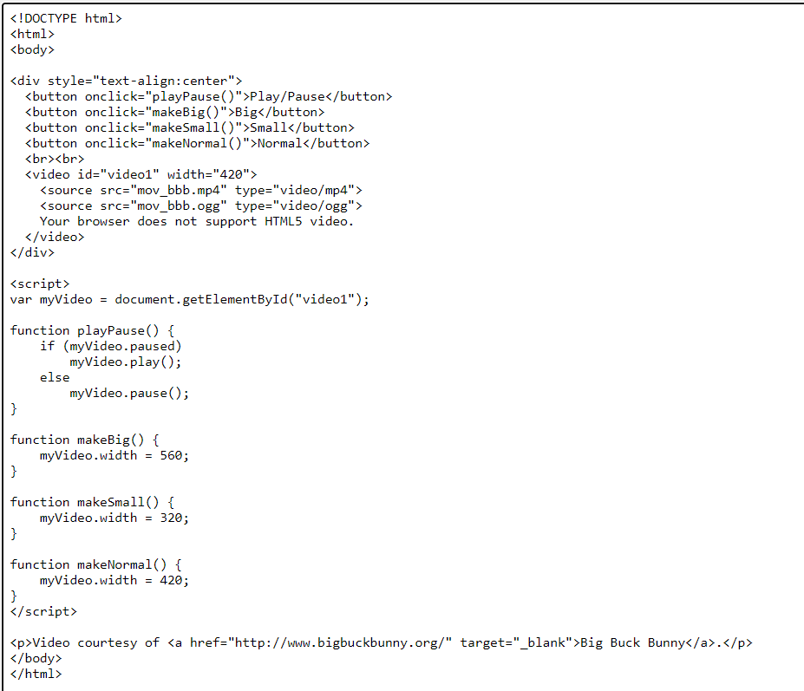
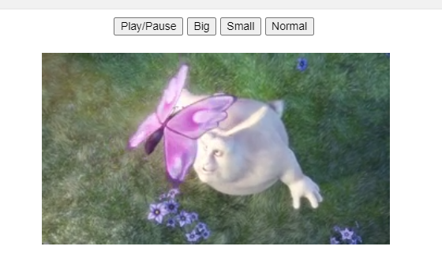
HTML Video

Slide 32
HTML5 Audio

Slide 33
Audio on the Web
Before HTML5, there was no standard for playing audio files on a web page.
Before HTML5, audio files could only be played with a plug-in (like flash).
The HTML5 <audio> element specifies a standard way to embed audio in a web page.

Slide 34
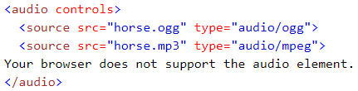
The HTML <audio> Element
To play an audio file in HTML, use the <audio> element:
Example：

Slide 35
HTML Audio - How It Works
The controls attribute adds audio controls, like play, pause, and volume.
Text between the <audio> and </audio> tags will display in browsers that do not support the <audio> element.
Multiple <source> elements can link to different audio files. The browser will use the first recognized format.

Slide 36
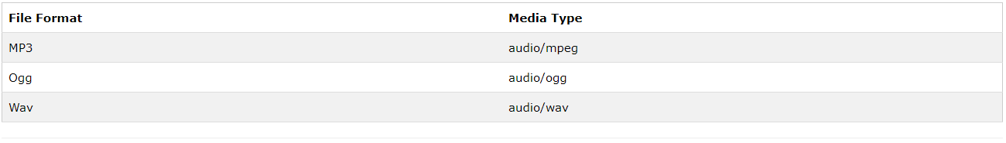
HTML Audio - Browser Support
Currently, there are 3 supported file formats for the <audio> element: MP3, Wav, and Ogg:

Slide 37
HTML Audio - Methods, Properties, and Events
HTML5 defines DOM methods, properties, and events for the <audio> element.
This allows you to load, play, and pause audios, as well as set duration and volume.
There are also DOM events that can notify you when an audio begins to play, is paused, etc.
For a full DOM reference, go to our HTML5 Audio/Video DOM Reference.

Slide 38
HTML5 Geolocation

Slide 39
What is HTML Geolocation API ?
The HTML Geolocation API is used to get the geographical position of a user.
Since this can compromise privacy, the position is not available unless the user approves it.

Slide 40
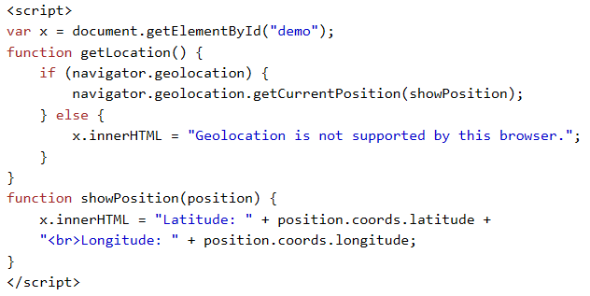
How to use the HTML Geolocation？
The getCurrentPosition() method is used to get the user's position.
The example below returns the latitude and longitude of the user's position:

Slide 41

How to use the HTML Geolocation？
Result:
Example explained
Check if Geolocation is supported
If supported, run the getCurrentPosition() method. If not, display a message to the user
If the getCurrentPosition() method is successful, it returns a coordinates object to the function specified in the parameter (showPosition)
The showPosition() function outputs the Latitude and Longitude
Hint: The example above is a very basic Geolocation script, with no error handling.

Slide 42
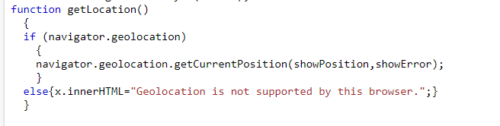
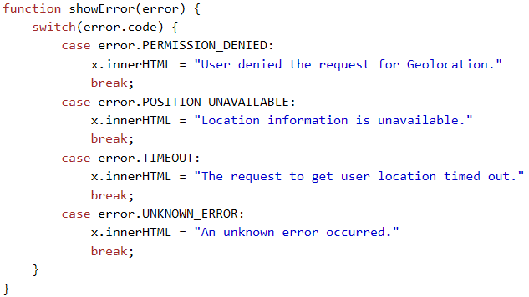

Handling Errors and Rejections
The second parameter of the getCurrentPosition() method is used to handle errors. It specifies a function to run if it fails to get the user's location:
Result:

Slide 43
Location-specific Information
Geolocation is also very useful for location-specific information, like:
Up-to-date local information
Showing Points-of-interest near the user
Turn-by-turn navigation (GPS)

Slide 44
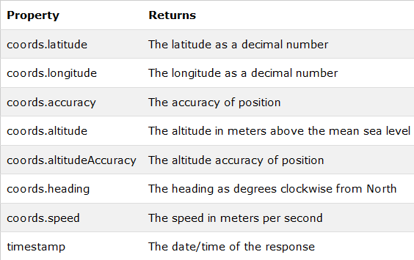
The getCurrentPosition() Method - Return Data
The getCurrentPosition() method returns an object if it is successful.
The latitude, longitude and accuracy properties are always returned. The other properties are returned if available:

Slide 45
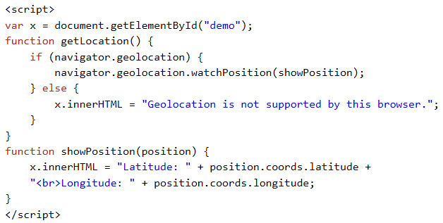
Other interesting Methods
watchPosition() - Returns the current position of the user and continues to return updated position as the user moves (like the GPS in a car).
clearWatch() - Stops the watchPosition() method.
The example below shows the watchPosition() method. You need an accurate GPS device to test this (like iPhone):

Slide 46
HTML5 DRAG and DROP

Slide 47


Drag and Drop
Drag and drop is a very common feature. It is when you "grab" an object and drag it to a different location.
In HTML5, drag and drop is part of the standard, and any element can be draggable.
The advantage of having drag and drop built into the browser is that it is properly integrated into the operating system and, as you will see, works between browsers.

Slide 48
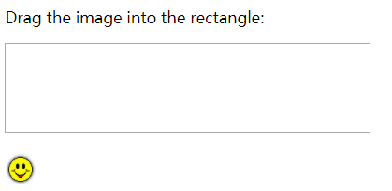
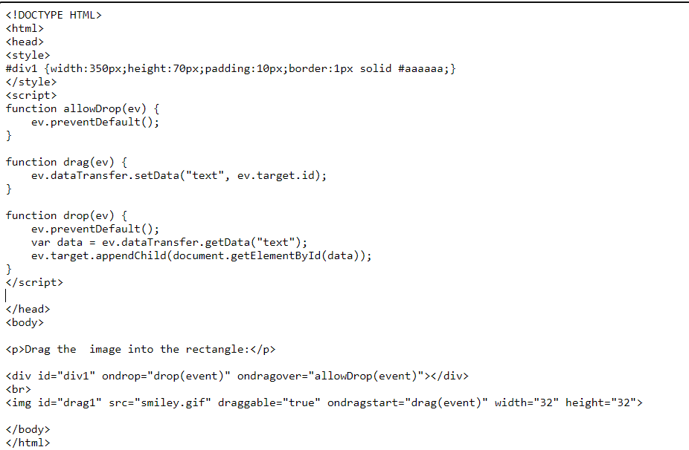
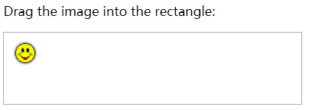
HTML Drag and Drop Example
The example below is a simple drag and drop example:

Slide 49
Make an Element Draggable
First of all:
To make an element draggable, set the draggable attribute to true:
<img id="drag1" src=“smiley.gif" draggable="true” ondragstart="drag(event)" width="336" height="69">

Slide 50

What to Drag - ondragstart and setData()
Then, specify what should happen when the element is dragged.
In the example above, the ondragstart attribute calls a function, drag(event), that specifies what data to be dragged.
The dataTransfer.setData() method sets the data type and the value of the dragged data:
In this case, the data type is "text" and the value is the id of the draggable element ("drag1").

Slide 51
Where to Drop - ondragover
The ondragover event specifies where the dragged data can be dropped.
By default, data/elements cannot be dropped in other elements. To allow a drop, we must prevent the default handling of the element.
This is done by calling the event.preventDefault() method for the ondragover event:

Slide 52
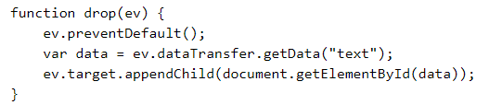
Do the Drop - ondrop
When the dragged data is dropped, a drop event occurs.
In the example above, the ondrop attribute calls a function, drop(event):
Code explained:
Call preventDefault() to prevent the browser default handling of the data (default is open as link on drop)
Get the dragged data with the dataTransfer.getData() method. This method will return any data that was set to the same type in the setData() method
The dragged data is the id of the dragged element ("drag1")
Append the dragged element into the drop element

Slide 53
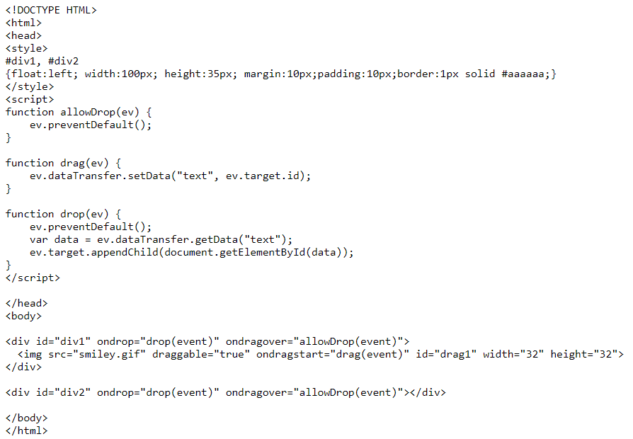



drag image back and forth

Slide 54
HTML5 LOCAL STORAG

Slide 55
What is HTML Local Storage?
With local storage, web applications can store data locally within the user's browser.
Before HTML5, application data had to be stored in cookies, included in every server request. Local storage is more secure, and large amounts of data can be stored locally, without affecting website performance.
Unlike cookies, the storage limit is far larger (at least 5MB) and information is never transferred to the server.
Local storage is per origin (per domain and protocol). All pages, from one origin, can store and access the same data.

Slide 56
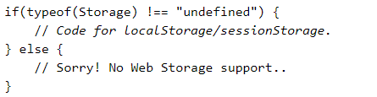
HTML Local Storage Objects
HTML local storage provides two objects for storing data on the client:
  window.localStorage - stores data with no expiration date
  window.sessionStorage - stores data for one session (data is lost when the browser tab is closed)
Before using local storage, check browser support for localStorage and sessionStorage:

Slide 57
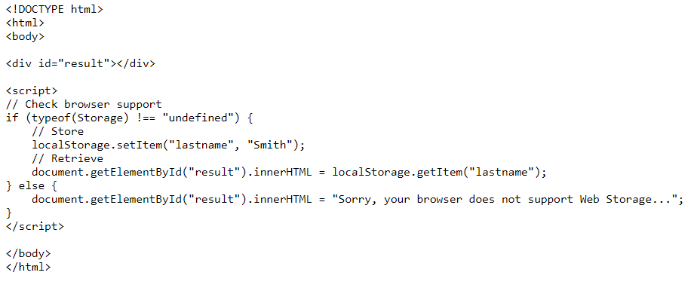

HTML Local Storage Objects

Slide 58
HTML Local Storage Objects
Before using local storage, check browser support for localStorage and sessionStorage:

Slide 59

The localStorage Object
Create a localStorage name/value pair with name="lastname" and value="Smith"
Retrieve the value of "lastname" and insert it into the element with id="result"

Slide 60

The localStorage Object
The localStorage object stores the data with no expiration date. The data will not be deleted when the browser is closed, and will be available the next day, week, or year.
The example above could also be written like this:

Slide 61
The localStorage Object
The syntax for removing the "lastname" item from local storage is as follows:
Note: Name/value pairs are always stored as strings. Remember to convert them to another format when needed!

Slide 62
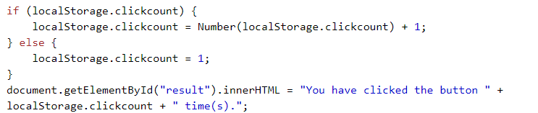
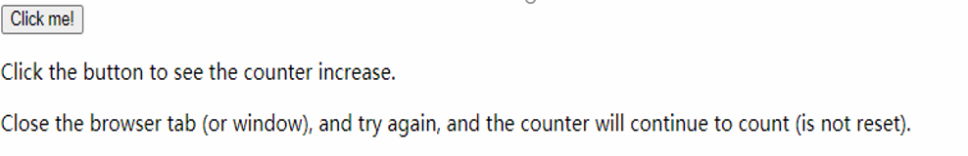
The localStorage Object
The following example counts the number of times a user has clicked a button. In this code the value string is converted to a number to be able to increase the counter:
Result：

Slide 63
The sessionStorage Object
The sessionStorage object is equal to the localStorage object, except that it stores the data for only one session.
The data is deleted when the user closes the specific browser tab.

Slide 64
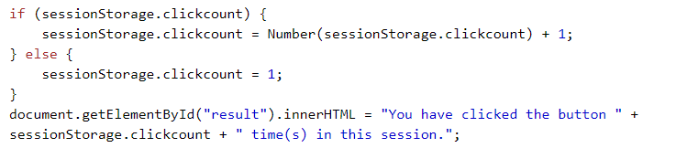

The sessionStorage Object
The following example counts the number of times a user has clicked a button, in the current session:
Result:

Slide 65
HTML5 Web Workers

Slide 66
What is Web Worker?
When executing scripts in an HTML page, the page becomes unresponsive until the script is finished.
A web worker is a JavaScript that runs in the background, independently of other scripts, without affecting the performance of the page. You can continue to do whatever you want: clicking, selecting things, etc., while the web worker runs in the background.

Slide 67
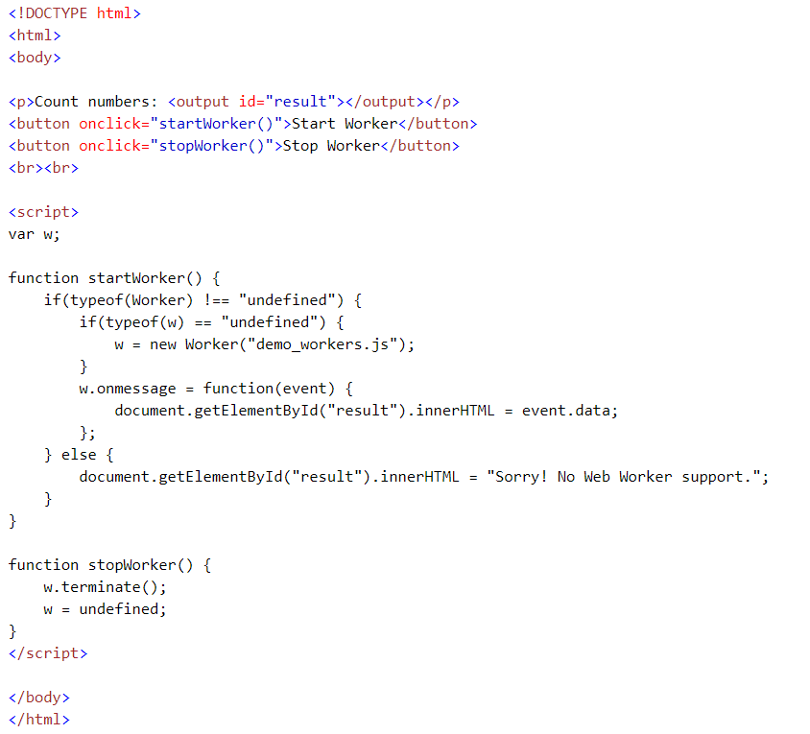
HTML Web Workers Example

Slide 68
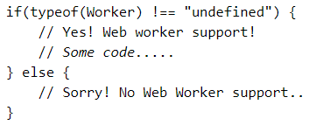
Check Web Worker Support
Before creating a web worker, check whether the user's browser supports it:

Slide 69
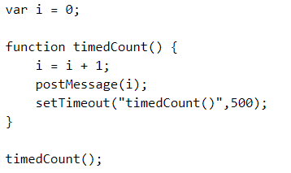
Create a Web Worker File
Now, let's create our web worker in an external JavaScript. Here, we create a script that counts. The script is stored in the "demo_workers.js"
The important part of the code above is the postMessage() method - which is used to post a message back to the HTML page.
Note: Normally web workers are not used for such simple scripts, but for more CPU intensive tasks.

Slide 70

Create a Web Worker Object
Now that we have the web worker file, we need to call it from an HTML page.
The following lines checks if the worker already exists, if not - it creates a new web worker object and runs the code in "demo_workers.js":

Slide 71

Create a Web Worker Object
Then we can send and receive messages from the web worker by adding an "onmessage" event listener to the web worker.
When the web worker posts a message, the code within the event listener is executed. The data from the web worker is stored in event.data.

Slide 72

Terminate a Web Worker
When a web worker object is created, it will continue to listen for messages (even after the external script is finished) until it is terminated.
To terminate a web worker, and free browser/computer resources, use the terminate() method.
If you set the worker variable to undefined, after it has been terminated, you can set the w as undefined:

Slide 73
Web Workers and the DOM
Since web workers are in external files, they do not have access to the following JavaScript objects:
The window object
The document object
The parent object

