Slide 1
CSS Box Model

Slide 2
What is CSS Box Model?
All HTML elements can be considered as boxes.
In CSS, the term "box model" is used when talking about design and layout.
The CSS box model is essentially a box that wraps around every HTML element.
It consists of: margins, borders, padding, and the actual content.

Slide 3
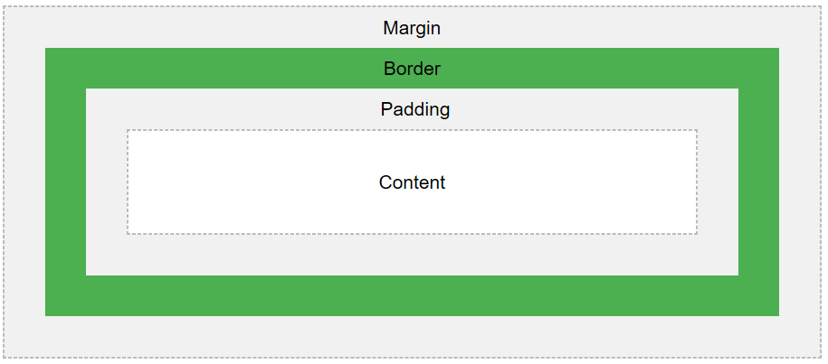
What is CSS Box Model?
The image below illustrates the box model:

Slide 4
What is CSS Box Model?
Explanation of the different parts:
Content - The content of the box, where text and images appear
Padding - Clears an area around the content. The padding is transparent
Border - A border that goes around the padding and content
Margin - Clears an area outside the border. The margin is transparent
The box model allows us to add a border around elements, and to define space between elements.

Slide 5
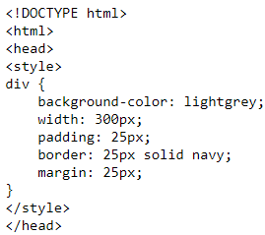
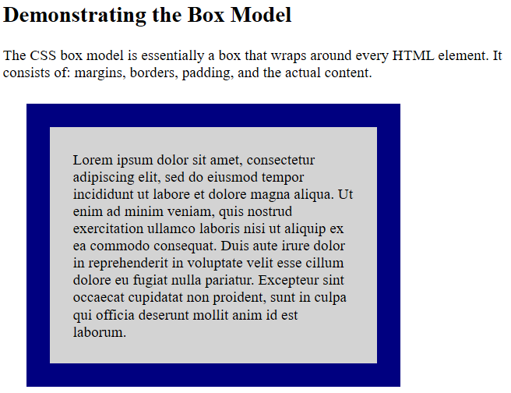
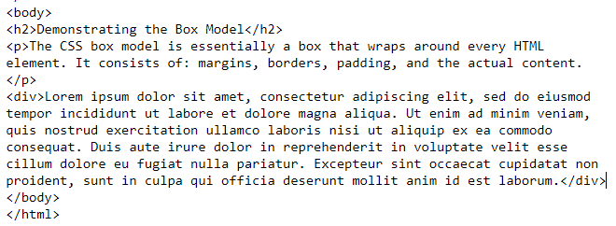
How to set the CSS Box Model？

Slide 6
Width and Height of an Element
When you set the width and height properties of an element with CSS, you just set the width and height of the content area.
To calculate the full size of an element, you must also add padding, borders and margins.
The total width of an element should be calculated like this:
Total element width = width + left padding + right padding + left border + right border + left margin + right margin
The total height of an element should be calculated like this:
Total element height = height + top padding + bottom padding + top border + bottom border + top margin + bottom margin

Slide 7
CSS DISPLAY

Slide 8
The Display Property
The display property specifies if/how an element is displayed. Every HTML element has a default display value depending on what type of element it is. The default display value for most elements is block or inline.
inline | Default value. Displays an element as an inline element (like <span>)
block | Displays an element as a block element (like <p>)
inline-block | Displays an element as an inline-level block container. The inside of this block is formatted as block-level box, and the element itself is formatted as an inline-level box

Slide 9
Block-level/inline Elements
A block-level element always starts on a new line and takes up the full width available (stretches out to the left and right as far as it can).
An inline element does not start on a new line and only takes up as much width as necessary.
Examples of block-level elements:
Examples of inline elements:
<div>, <h1> - <h6>,<p>,<form>
<header>,<footer>,<section>
<span>,<a>,<img>

Slide 10
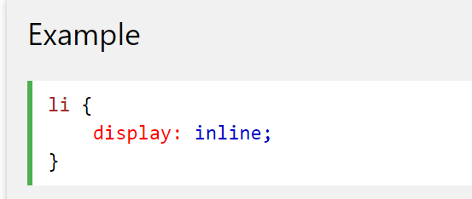
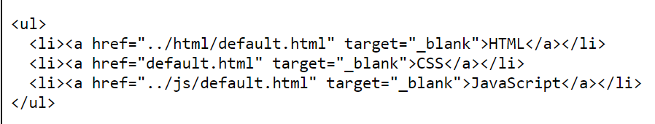

Override The Default Display Value
Every element has a default display value. However, you can override this. Changing an inline element to a block element, or vice versa, can be useful for making the page look a specific way, and still follow the web standards. A common example is making inline <li> elements for horizontal menus:

Slide 11
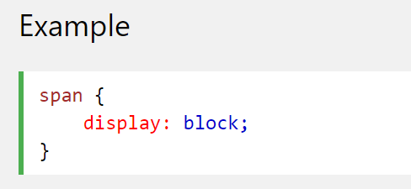
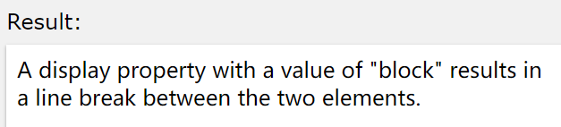
Override The Default Display Value
Setting the display property of an element only changes how the element is displayed, NOT what kind of element it is. So, an inline element with display: block, is not allowed to have other block elements inside it. The following example displays <span> elements as block elements:

Slide 12
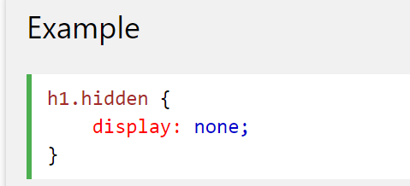
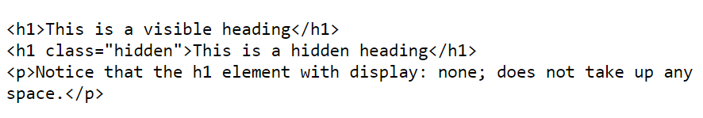
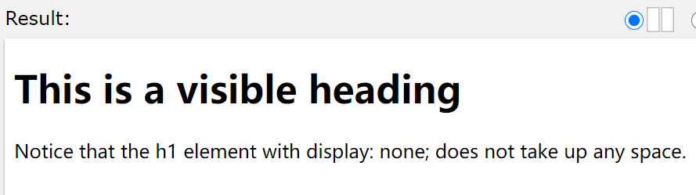
Hide an Element - display:none or visibility:hidden?
Hiding an element can be done by setting the display property to none . The element will be hidden, and the page will be displayed as if the element is not there:

Slide 13
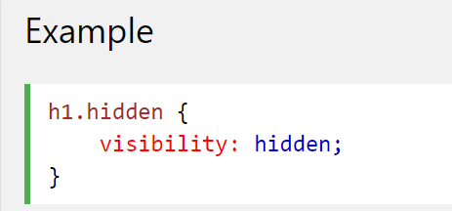
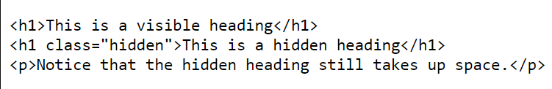
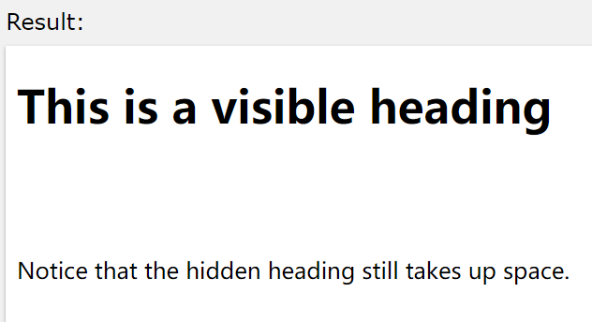
Hide an Element - display:none or visibility:hidden?
visibility:hidden; also hides an element. However, the element will still take up the same space as before. The element will be hidden, but still affect the layout:

Slide 14
The inline-block Value
In contrast to display: inline, display: inline-block allows width and height to be set on elements and padding is preserved, while display: inline does not. The main difference compared to display:block is that display:inline-block does not add a newline after the element

Slide 15
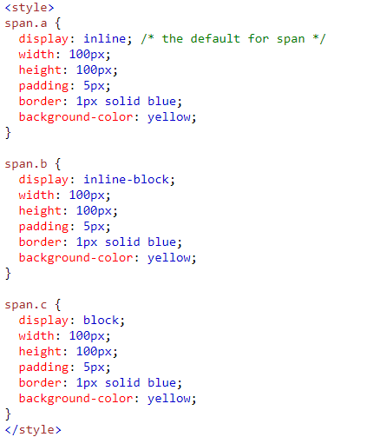
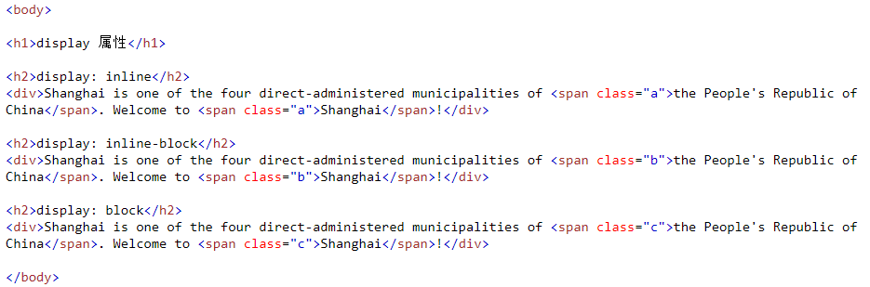
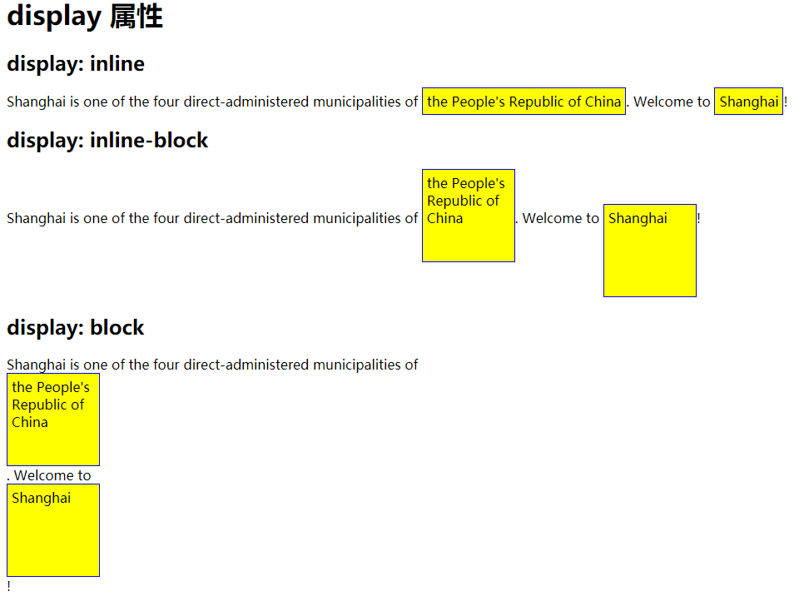
Example

Slide 16
CSS POSITION

Slide 17
The Position Property
The position property specifies the type of positioning method used for an element. There are four different position values:
·static
·relative
·fixed
·absolute
Elements are then positioned using the top, bottom, left, and right properties. However, these properties will not work unless the position property is set first. They also work differently depending on the position value.

Slide 18
Position: Static
HTML elements are positioned static by default. Static positioned elements are not affected by the top, bottom, left, and right properties. An element with position:static; is not positioned in any special way; it is always positioned according to the normal flow of the page:

Slide 19
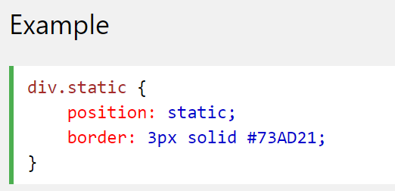
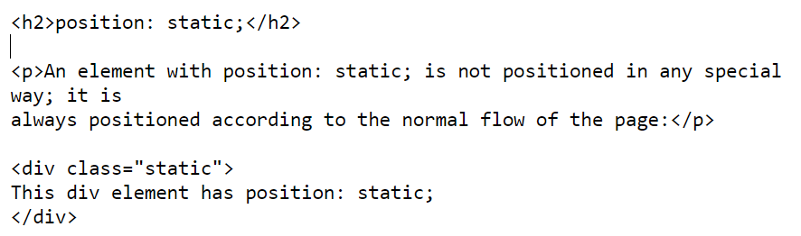
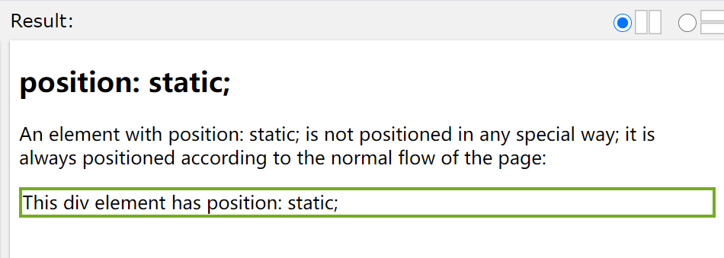
Position: Static Example

Slide 20
Position: Relative
An element with position: relative; is positioned relative to its normal position. Setting the top, right, bottom, and left properties of a relatively-positioned element will cause it to be adjusted away from its normal position. Other content will not be adjusted to fit into any gap left by the element.

Slide 21
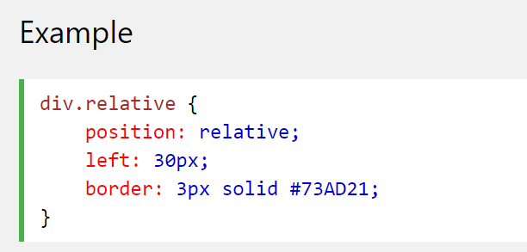
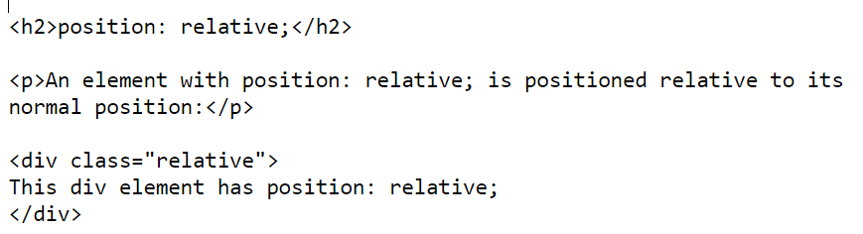
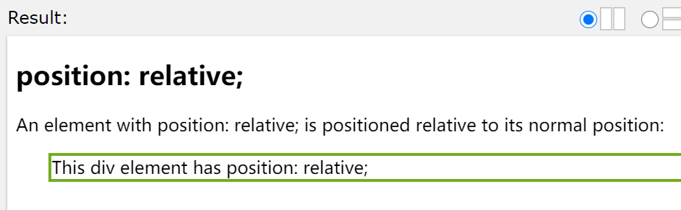
Position: Relative Example

Slide 22
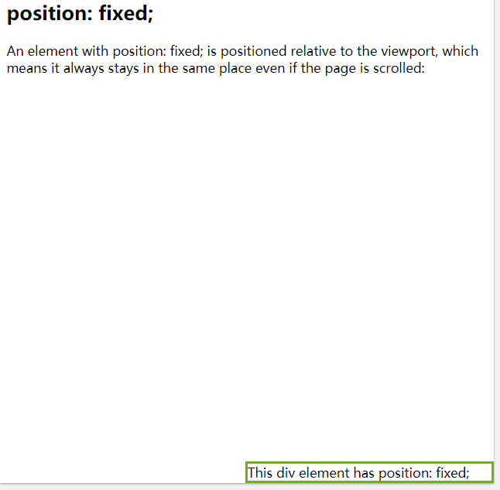
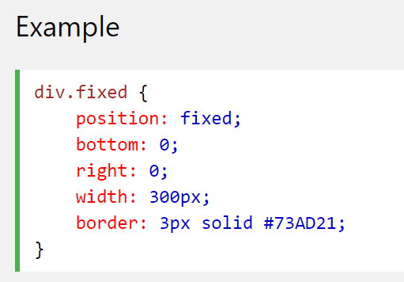
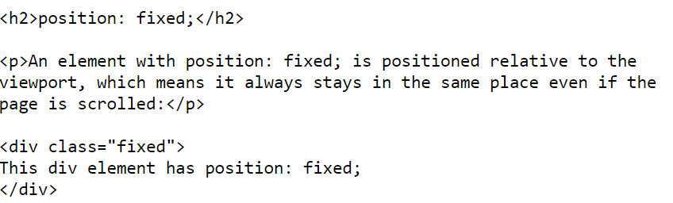
Position: Fixed
An element with position: fixed; is positioned relative to the viewport, which means it always stays in the same place even if the page is scrolled. The top, right, bottom, and left properties are used to position the element.
Notes:
A fixed element does not leave a gap in the page where it would normally have been located.

Slide 23
Position: Absolute
An element with position: absolute; is positioned relative to the nearest positioned ancestor (instead of positioned relative to the viewport, like fixed). However; if an absolute positioned element has no positioned ancestors, it uses the document body, and moves along with page scrolling.
Note: A "positioned" element is one whose position is anything except static.

Slide 24
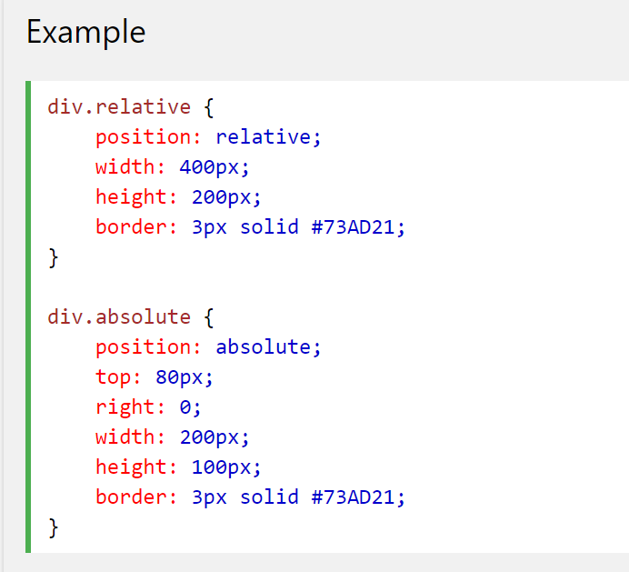
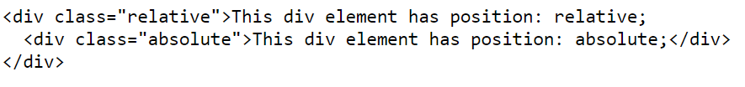
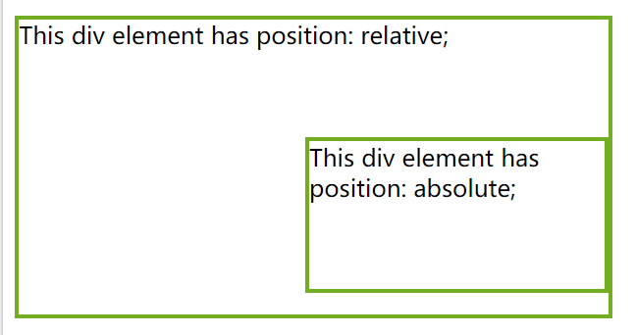
Position: Absolute Example

Slide 25
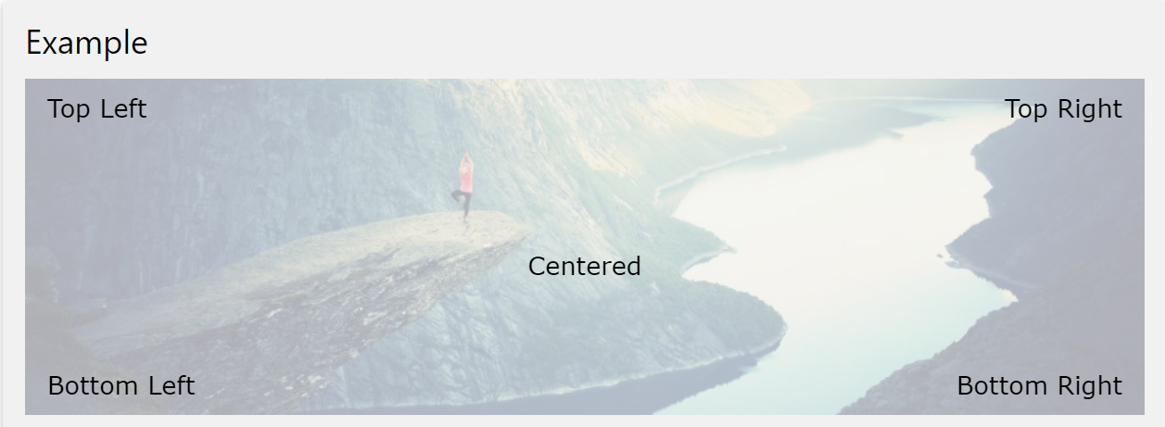
Positioning Text In an Image
How to position text over an image:

Slide 26
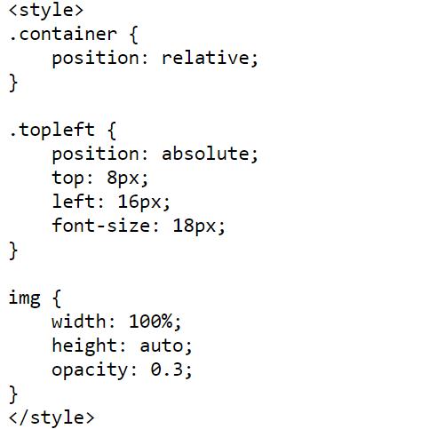
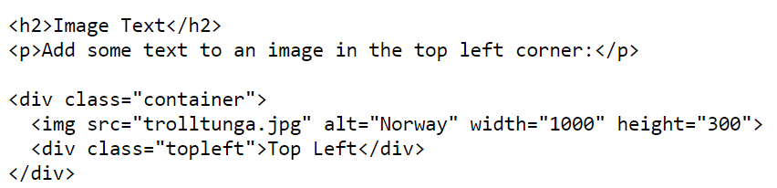
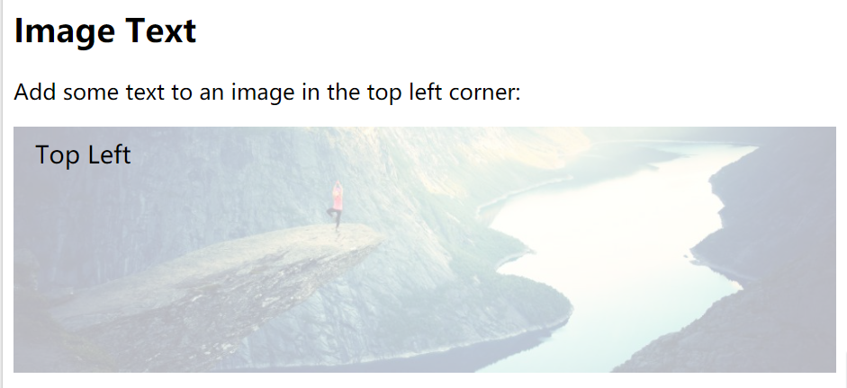
Top Left

Slide 27
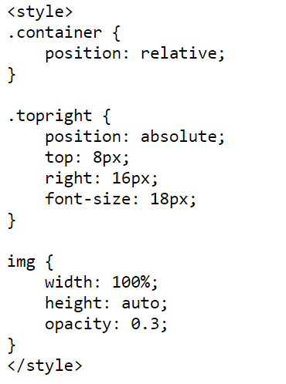
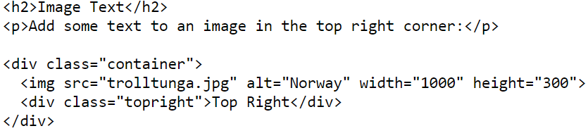
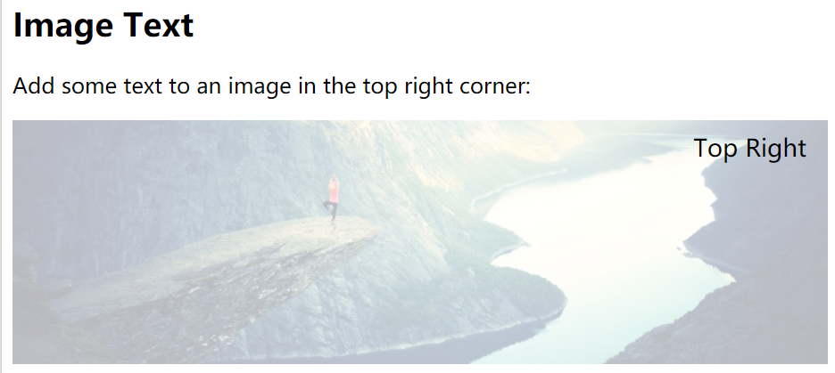
Top Right

Slide 28
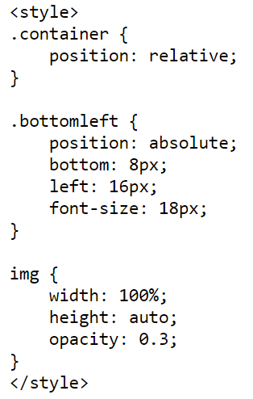
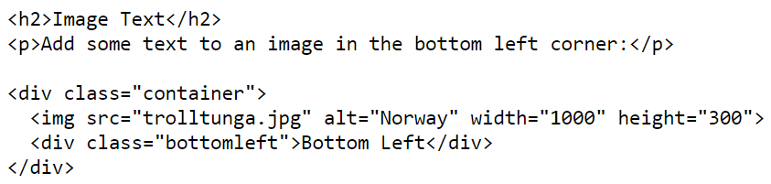
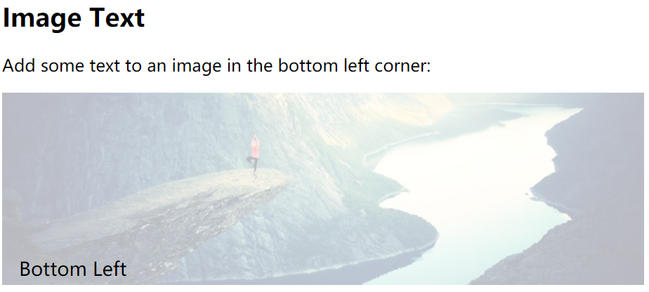
Bottom Left

Slide 29
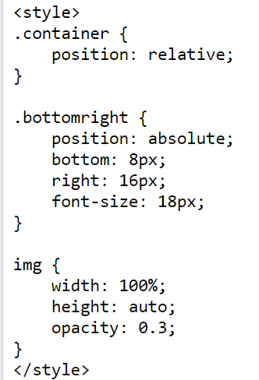
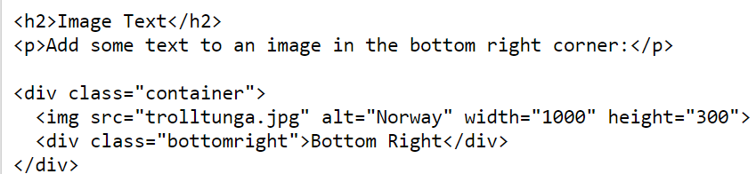
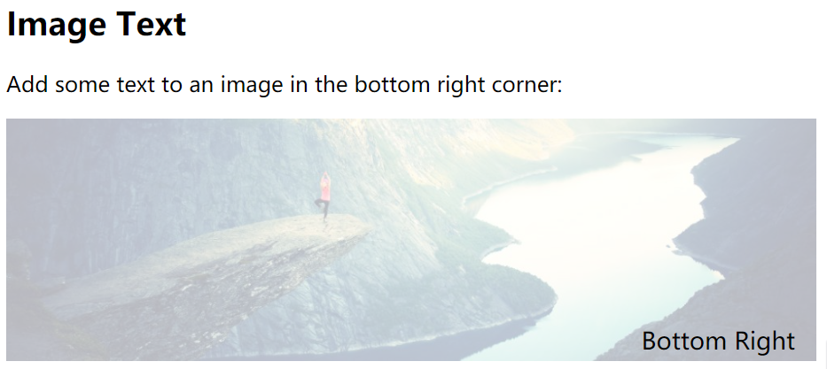
Bottom Right

Slide 30
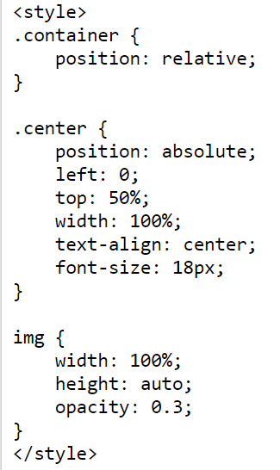
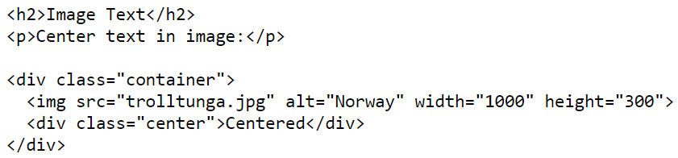
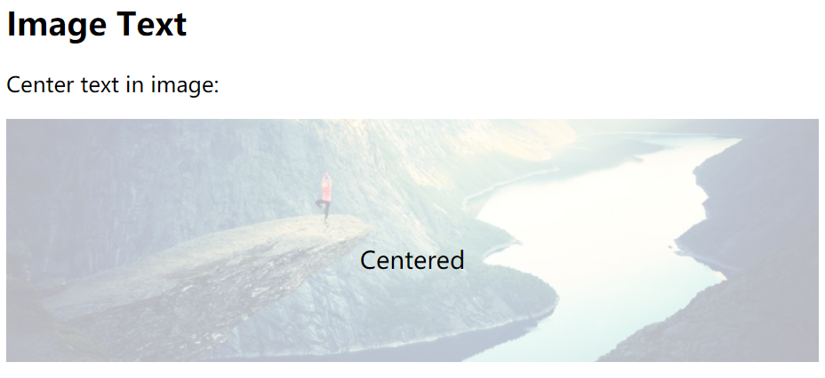
Centered

Slide 31
CSS COMBINATORS

Slide 32
CSS Combinators
A CSS selector can contain more than one simple selector. Between the simple selectors, we can include a combinator. There are four different combinators in CSS3:
descendant selector (space)
child selector (>)
adjacent sibling selector (+)
general sibling selector (~)
Notes:
后代选择器 (空格)
子选择器 (>)
相邻兄弟选择器 (+)
通用兄弟选择器 (~)

Slide 33
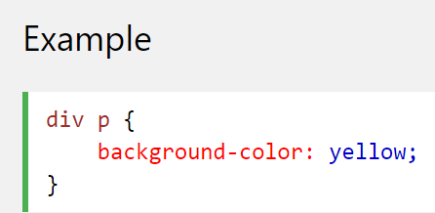
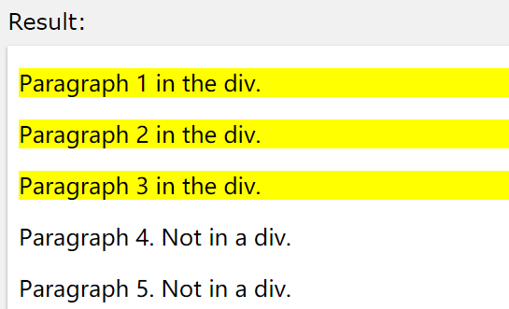
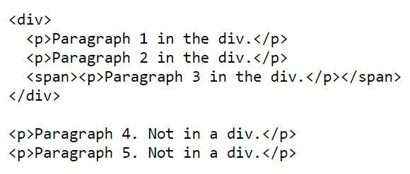
Descendant Selector
The descendant selector matches all elements that are descendants of a specified element. The following example selects all <p> elements inside <div> elements:

Slide 34
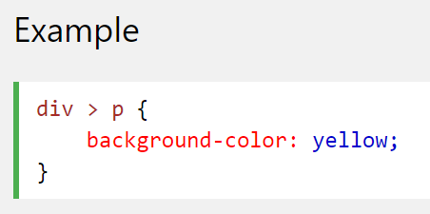
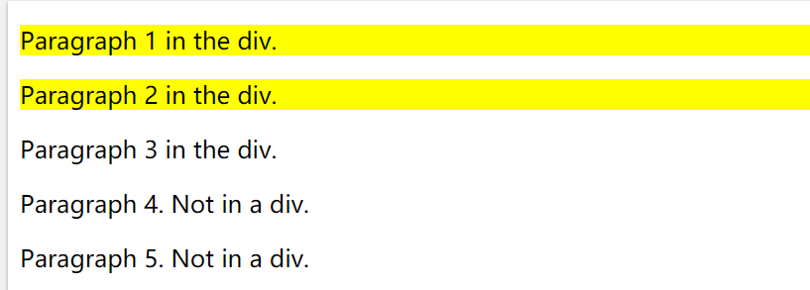

Child Selector
The child selector selects all elements that are the immediate children of a specified element. The following example selects all <p> elements that are immediate children of a <div> element:

Slide 35



Adjacent Sibling Selector
The adjacent sibling selector selects all elements that are the adjacent siblings of a specified element. Sibling elements must have the same parent element, and "adjacent" means "immediately following". The following example selects all <p> elements that are placed immediately after <div> elements:

Slide 36



General Sibling Selector
The general sibling selector selects all elements that are siblings of a specified element. The following example selects all <p> elements that are siblings of <div> elements:

Slide 37
CSS PSEUDO-CLASSES

Slide 38
What are Pseudo-classes?
A pseudo-class is used to define a special state of an element. For example, it can be used to:
Style an element when a user mouses over it
Style visited and unvisited links differently
Style an element when it gets focus
The syntax of pseudo-classes:
selector:pseudo-class {
property:value;
}
Notes:
伪类用于定义元素的特殊状态。

Slide 39



Anchor Pseudo-classes
Links can be displayed in different ways:

Slide 40



Pseudo-classes and CSS Classes
Pseudo-classes can be combined with CSS classes: When you hover over the link in the example, it will change color:

Slide 41




Hover on <div>
An example of using the :hover pseudo-class on a <div> element:

Slide 42



CSS - The :first-child Pseudo-class
The :first-child pseudo-class matches a specified element that is the first child of another element. In the following example, the selector matches any <p> element that is the first child of any element:

Slide 43



Match the first <i> element in all <p> elements
In the following example, the selector matches the first <i> element in all <p> elements:

Slide 44



Match all <i> elements in all first child <p> elements
In the following example, the selector matches all <i> elements in <p> elements that are the first child of another element:

Slide 45

All CSS Pseudo Classes

Slide 46

All CSS Pseudo Classes

Slide 47

All CSS Pseudo Classes

Slide 48
CSS Attribute Selectors

Slide 49
Style HTML Elements With Specific Attributes
It is possible to style HTML elements that have specific attributes or attribute values.

Slide 50


CSS [attribute] Selector
The [attribute] selector is used to select elements with a specified attribute.
The following example selects all <a> elements with a target attribute:

Slide 51


CSS [attribute="value"] Selector
The [attribute="value"] selector is used to select elements with a specified attribute and value.
The following example selects all <a> elements with a target="_blank" attribute:

Slide 52

CSS [attribute~="value"] Selector
The [attribute~="value"] selector is used to select elements with an attribute value containing a specified word.
The following example selects all elements with a title attribute that contains a space-separated list of words, one of which is "flower":

Slide 53

CSS [attribute~="value"] Selector
Result:
The example above will match elements with title="flower", title="summer flower", and title="flower new", but not title="my-flower" or title="flowers".

Slide 54


CSS [attribute|="value"] Selector
The [attribute|="value"] selector is used to select elements with the specified attribute starting with the specified value.
The following example selects all elements with a class attribute value that begins with "top":
Note: The value has to be a whole word, either alone, like class="top", or followed by a hyphen( - ), like class="top-text"!

Slide 55


CSS [attribute^="value"] Selector
The [attribute^="value"] selector is used to select elements whose attribute value begins with a specified value.
The following example selects all elements with a class attribute value that begins with "top":
Note: The value does not have to be a whole word!

Slide 56


CSS [attribute$="value"] Selector
The [attribute$="value"] selector is used to select elements whose attribute value ends with a specified value.
The following example selects all elements with a class attribute value that ends with "test":
Note: The value does not have to be a whole word!

Slide 57

CSS [attribute*="value"] Selector
The [attribute*="value"] selector is used to select elements whose attribute value contains a specified value.
The following example selects all elements with a class attribute value that contains "te":
Note: The value does not have to be a whole word!

Slide 58


Styling Forms
The attribute selectors can be useful for styling forms without class or ID:

