Slide 1
JavaScript Introduction

Slide 2
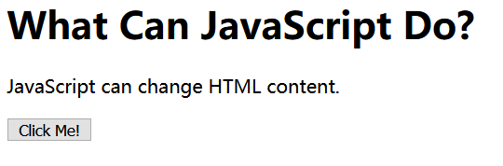
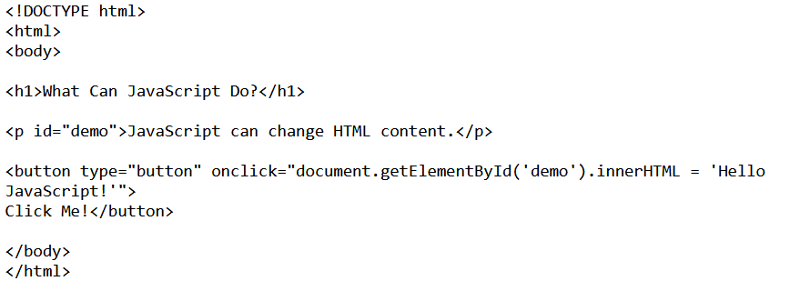
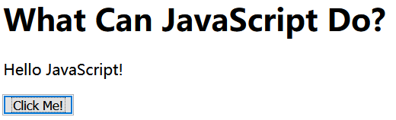
JavaScript Can Change HTML Content
One of many HTML methods is getElementById().
This example uses the method to "find" an HTML element (with id="demo"), and changes the element content (innerHTML) to "Hello JavaScript":

Slide 3
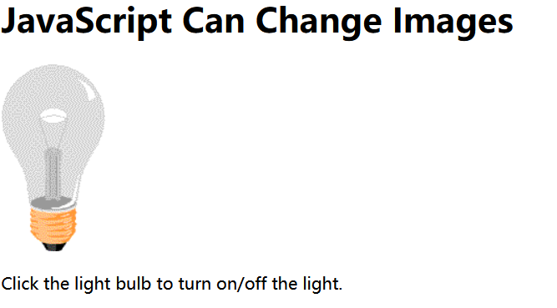
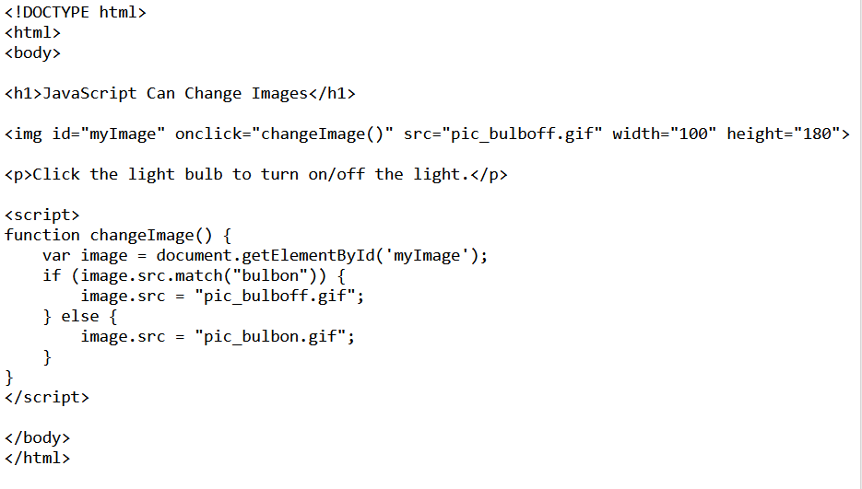
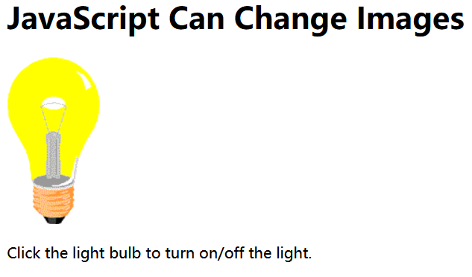
JavaScript Can Change HTML Attributes
This example changes an HTML image, by changing the src attribute of an <img> tag:

Slide 4
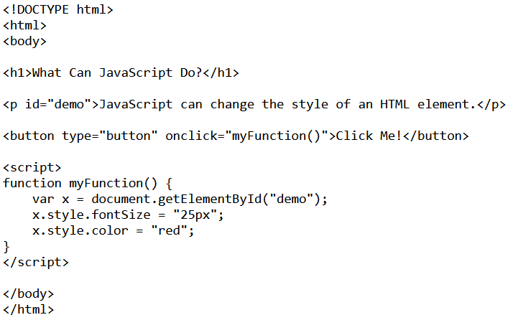
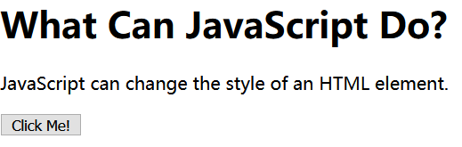
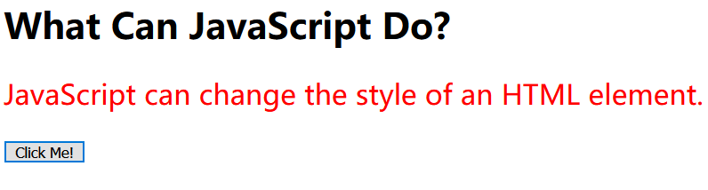
JavaScript Can Change HTML Styles (CSS)
Changing the style of an HTML element, is a variant of changing an HTML attribute:

Slide 5
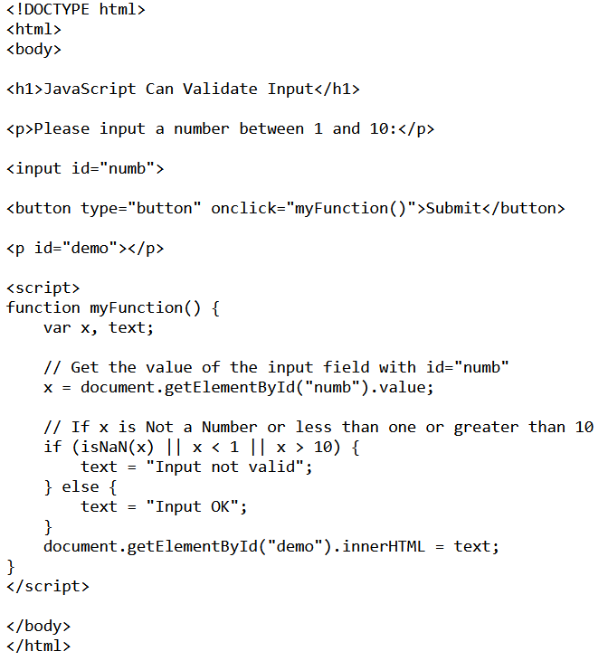
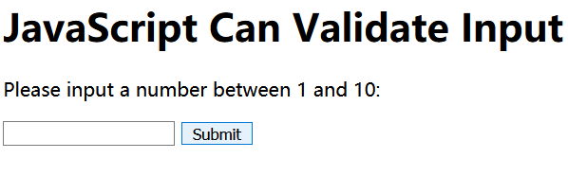
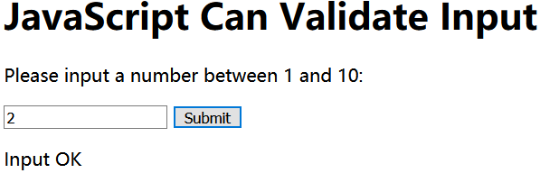
JavaScript Can Validate Data
JavaScript is often used to validate input:

Slide 6
JavaScript Where To

Slide 7

The <script> Tag
JavaScript can be placed in the <body> and the <head> sections of an HTML page.
In HTML, JavaScript code must be inserted between <script> and </script> tags.

Slide 8
JavaScript Functions and Events
A JavaScript function is a block of JavaScript code, that can be executed when "asked" for.
For example, a function can be executed when an event occurs, like when the user clicks a button.
You can place any number of scripts in an HTML document.
Scripts can be placed in the <body>, or in the <head> section of an HTML page, or in both.

Slide 9
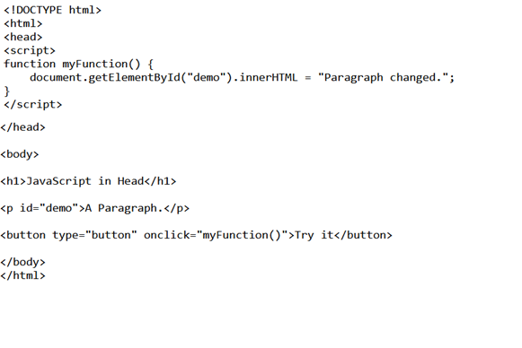
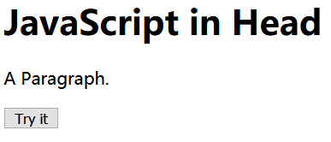
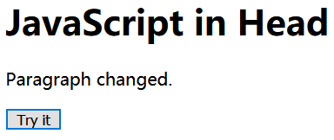
JavaScript in <head>
In this example, a JavaScript function is placed in the <head> section of an HTML page.
The function is invoked (called) when a button is clicked:

Slide 10
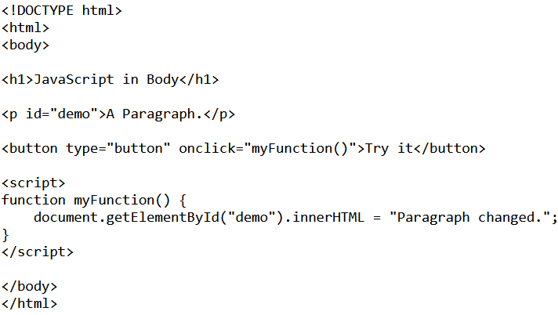
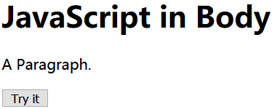
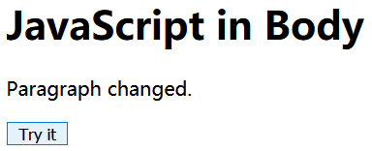
JavaScript in <body>
In this example, a JavaScript function is placed in the <body> section of an HTML page.
The function is invoked (called) when a button is clicked:

Slide 11

External JavaScript
Scripts can also be placed in external files:
External scripts are practical when the same code is used in many different web pages.
JavaScript files have the file extension .js.
To use an external script, put the name of the script file in the src (source) attribute of a <script> tag:

Slide 12
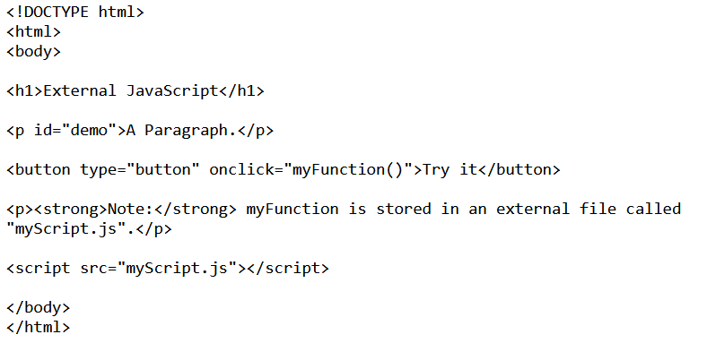
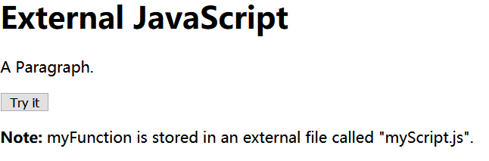
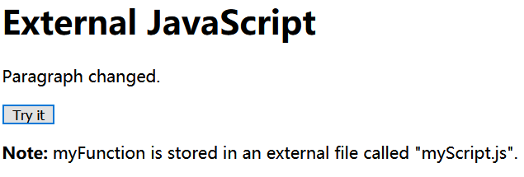
External JavaScript
You can place an external script reference in <head> or <body> as you like.
The script will behave as if it was located exactly where the <script> tag is located.

Slide 13
External JavaScript Advantages
Placing JavaScripts in external files has some advantages:
  It separates HTML and code
  It makes HTML and JavaScript easier to read and maintain
  Cached JavaScript files can speed up page loads

Slide 14
JavaScript Output

Slide 15
JavaScript Display Possibilities
JavaScript can "display" data in different ways:
  Writing into an alert box, using window.alert().
  Writing into the HTML output using document.write().
  Writing into an HTML element, using innerHTML.
  Writing into the browser console, using console.log().

Slide 16
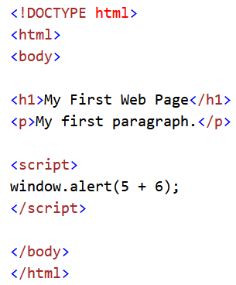
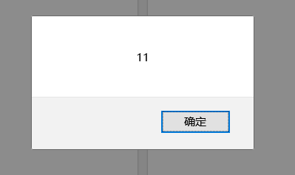
Using window.alert()
You can use an alert box to display data:

Slide 17
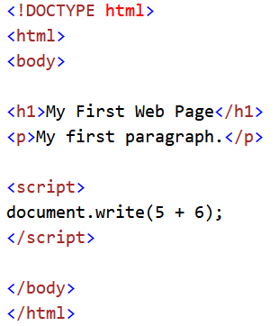
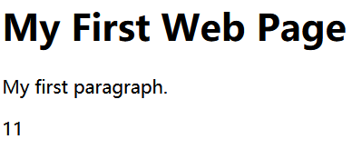
Using document.write()
For testing purposes, it is convenient to use document.write():

Slide 18
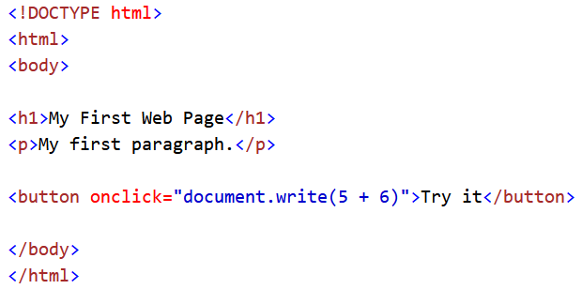
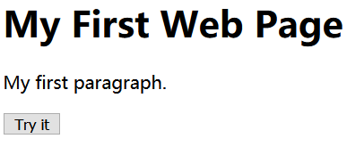

Using document.write()
Using document.write() after an HTML document is fully loaded, will delete all existing HTML:

Slide 19
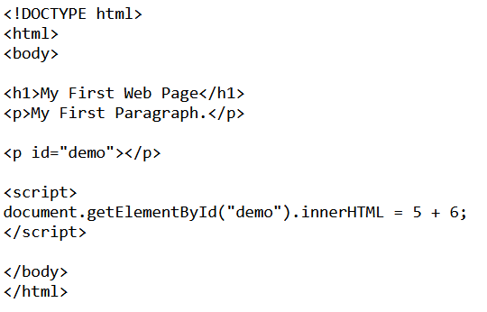
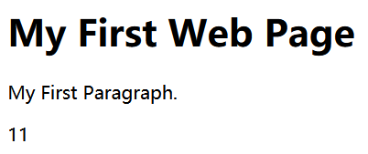
Using innerHTML
To access an HTML element, JavaScript can use the document.getElementById(id) method.
The id attribute defines the HTML element. The innerHTML property defines the HTML content:

Slide 20
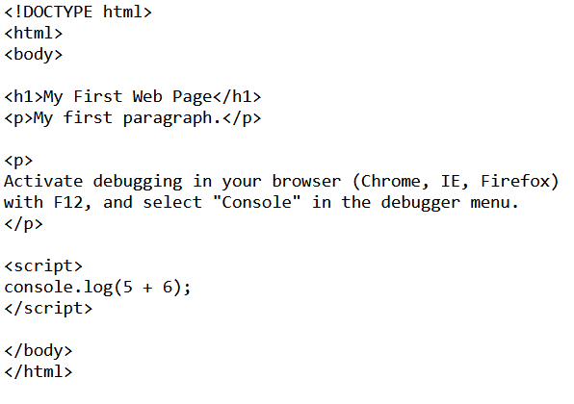
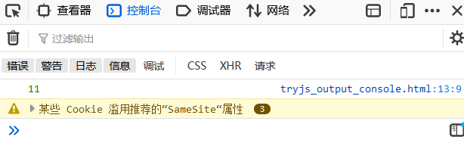
Using console.log()
In your browser, you can use the console.log() method to display data.
Activate the browser console with F12, and select "Console" in the menu.

Slide 21
JavaScript Character Set
JavaScript uses the Unicode character set.
Unicode covers (almost) all the characters, punctuations, and symbols in the world.

Slide 22
JavaScript Statements

Slide 23
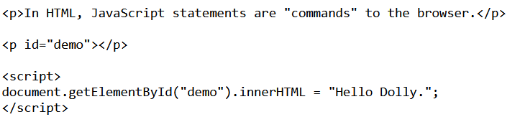

JavaScript Statements
This statement tells the browser to write "Hello Dolly." inside an HTML element with id="demo":

Slide 24
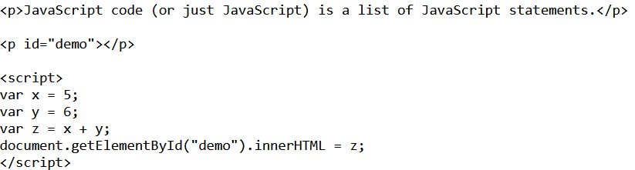

JavaScript Programs
Most JavaScript programs contain many JavaScript statements.
The statements are executed, one by one, in the same order as they are written.
In this example x, y, and z are given values, and finally z is displayed:

Slide 25
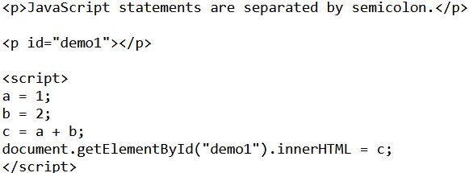


Semicolons ;
Semicolons separate JavaScript statements. Add a semicolon at the end of each executable statement:
When separated by semicolons, multiple statements on one line are allowed:

Slide 26

JavaScript White Space
JavaScript ignores multiple spaces. You can add white space to your script to make it more readable.
The following lines are equivalent:
A good practice is to put spaces around operators ( = + - * / ):

Slide 27
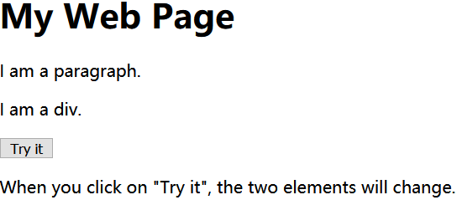
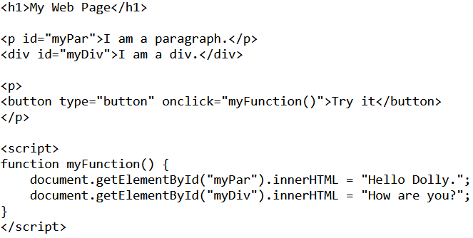
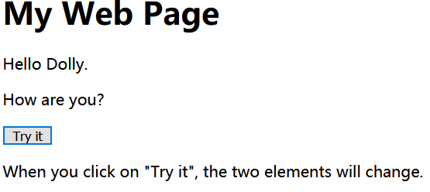
JavaScript Code Blocks
JavaScript statements can be grouped together in code blocks, inside curly brackets {...}.
The purpose of code blocks is to define statements to be executed together.
One place you will find statements grouped together in blocks, are in JavaScript functions:

Slide 28
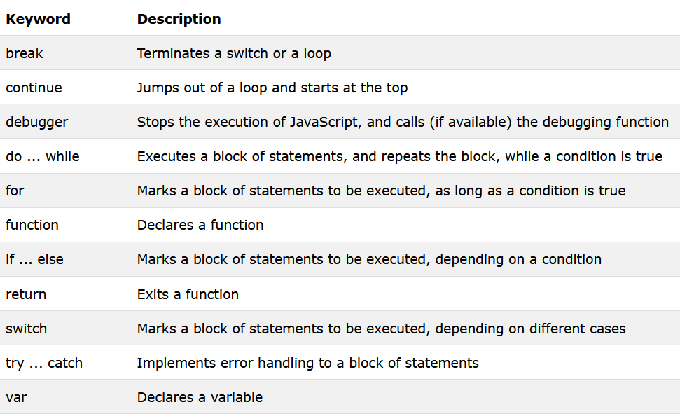
JavaScript Keywords
JavaScript statements often start with a keyword to identify the JavaScript action to be performed.
Here is a list of some of the keywords you will learn about in this tutorial:

Slide 29
JavaScript Comments

Slide 30
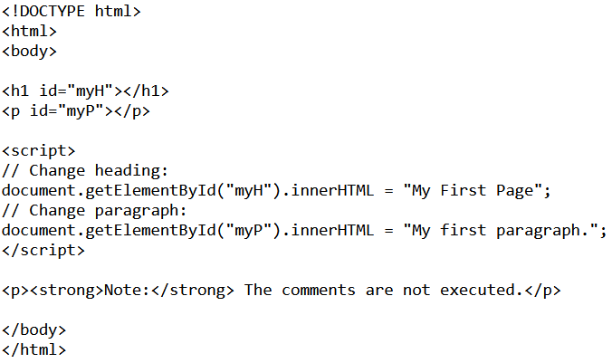
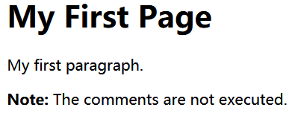
Single Line Comments
Single line comments start with //
Any text between // and the end of the line, will be ignored by JavaScript (will not be executed)
This example uses a single line comment before each line, to explain the code:

Slide 31
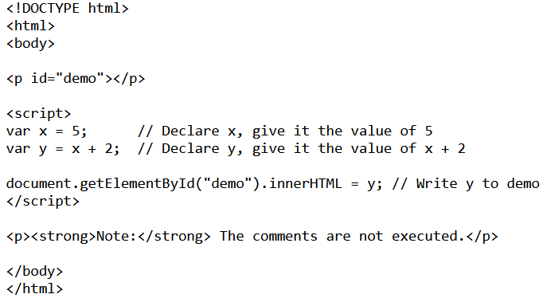
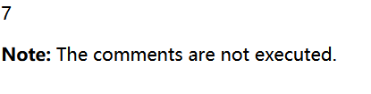
Single Line Comments
This example uses a single line comment at the end of each line, to explain the code:

Slide 32
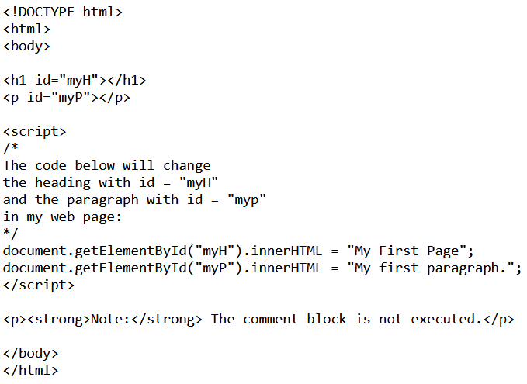
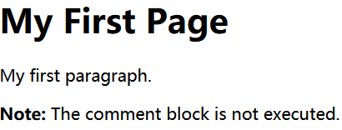
Multi-line Comments
Multi-line comments start with /* and end with */.
Any text between /* and */ will be ignored by JavaScript.
This example uses a multi-line comment (a comment block) to explain the code:

Slide 33
JavaScript Variables

Slide 34

JavaScript Variables
JavaScript variables are containers for storing data values.
In this example, x, y, and z, are variables:
From the example above, you can expect:
x stores the value 5
y stores the value 6
z stores the value 11

Slide 35
JavaScript Identifiers
All JavaScript variables must be identified with unique names.
These unique names are called identifiers.
Identifiers can be short names (like x and y), or more descriptive names (age, sum, totalVolume).
The general rules for constructing names for variables (unique identifiers) are:
  Names can contain letters, digits, underscores, and dollar signs.
  Names must begin with a letter
  Names can also begin with $ and _
  Names are case sensitive (y and Y are different variables)
  Reserved words (like JavaScript keywords) cannot be used as names

Slide 36
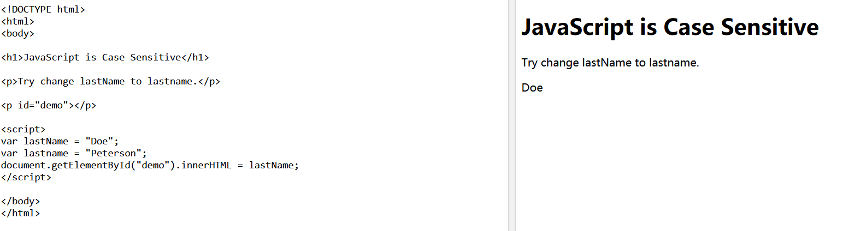
JavaScript is Case Sensitive
All JavaScript identifiers are case sensitive.
The variables lastName and lastname, are two different variables.
JavaScript does not interpret VAR or Var as the keyword var.

Slide 37
JavaScript and Camel Case
Historically, programmers have used three ways of joining multiple words into one variable name:
  Hyphens:
  first-name, last-name, master-card, inter-city.
  Underscore:
  first_name, last_name, master_card, inter_city.
Camel Case:
  FirstName, LastName, MasterCard, InterCity.
  In programming languages, especially in JavaScript, camel case often starts with a lowercase letter:
  firstName, lastName, masterCard, interCity.

Slide 38

The Assignment Operator
In JavaScript, the equal sign (=) is an "assignment" operator, not an "equal to" operator.
(It calculates the value of x + 5 and puts the result into x. The value of x is incremented by 5.)

Slide 39


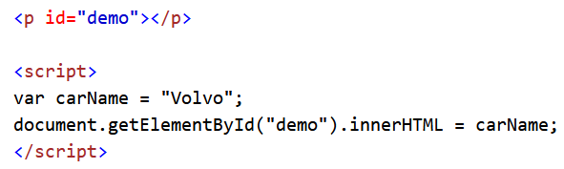
Declaring (Creating) JavaScript Variables
Creating a variable in JavaScript is called "declaring" a variable.
You declare a JavaScript variable with the var keyword:
After the declaration, the variable has no value. (Technically it has the value of undefined)
To assign a value to the variable, use the equal sign:

Slide 40

One Statement, Many Variables
You can declare many variables in one statement.
Start the statement with var and separate the variables by comma:
A declaration can span multiple lines:

Slide 41
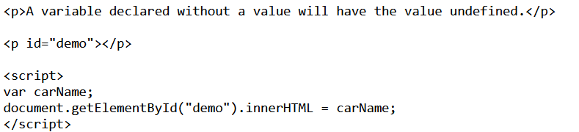

Value = undefined
A variable declared without a value will have the value undefined.
The variable carName will have the value undefined after the execution of this statement:

Slide 42
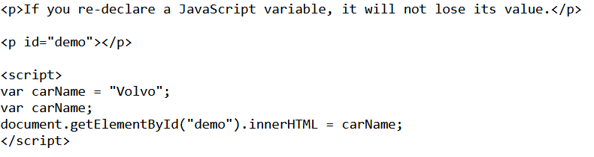

Re-Declaring JavaScript Variables
If you re-declare a JavaScript variable, it will not lose its value.
The variable carName will still have the value "Volvo" after the execution of these statements:

Slide 43
JavaScript Operators

Slide 44
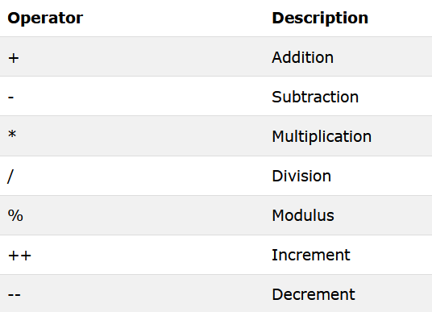
JavaScript Arithmetic Operators
Arithmetic operators are used to perform arithmetic on numbers (literals or variables).

Slide 45
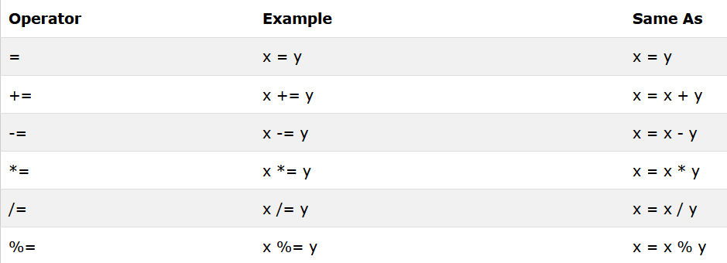
JavaScript Assignment Operators
Assignment operators assign values to JavaScript variables.

Slide 46

JavaScript String Operators
The + operator can also be used to add (concatenate) strings. When used on strings, the + operator is called the concatenation operator.
The result of txt3 will be:

Slide 47


JavaScript String Operators
The += assignment operator can also be used to add (concatenate) strings:
The result of txt1 will be:

Slide 48


Adding Strings and Numbers
adding a number and a string will return a string:
The result of x, y, and z will be:
The rule is: If you add a number and a string, the result will be a string!

Slide 49

JavaScript Comparison and Logical Operators

Slide 50

JavaScript Comparison and Logical Operators
if the operands are of different types, return false.
If both operands are objects, return true only if they refer to the same object.
If both operands are null or both operands are undefined, return true.
If either operand is NaN, return false.
Otherwise, compare the two operand's values:
  Numbers must have the same numeric values.
  Strings must have the same characters in the same order.
  Booleans must be both true or both false.

Slide 51

JavaScript Comparison and Logical Operators
The equality (==) operator checks whether its two operands are equal, returning a Boolean result. Unlike the strict equality operator, it attempts to convert and compare operands that are of different type

Slide 52
JavaScript Data Types

Slide 53

JavaScript Data Types
JavaScript variables can hold many data types: numbers, strings, arrays, objects and more:

Slide 54


The Concept of Data Types Example

Slide 55


The Concept of Data Types Example
JavaScript evaluates expressions from left to right. Different sequences can produce different results:

Slide 56


The Concept of Data Types Example
In the first example, JavaScript treats 16 and 4 as numbers, until it reaches "Volvo". In the second example, since the first operand is a string, all operands are treated as strings.

Slide 57

JavaScript Has Dynamic Types
JavaScript has dynamic types. This means that the same variable can be used as different types:

Slide 58

JavaScript Strings
A string (or a text string) is a series of characters like "John Doe". Strings are written with quotes. You can use single or double quotes:

Slide 59


JavaScript Strings Example
You can use quotes inside a string, as long as they don't match the quotes surrounding the string:

Slide 60

JavaScript Numbers
JavaScript has only one type of numbers. Numbers can be written with, or without decimals:

Slide 61


JavaScript Numbers Example
Extra large or extra small numbers can be written with scientific (exponential) notation:

Slide 62

JavaScript Booleans
Booleans can only have two values: true or false. Booleans are often used in conditional testing.

Slide 63


JavaScript Arrays
JavaScript arrays are written with square brackets. Array items are separated by commas. The following code declares (creates) an array called cars, containing three items (car names):
Array indexes are zero-based, which means the first item is [0], second is [1], and so on.

Slide 64


JavaScript Objects
JavaScript objects are written with curly braces. Object properties are written as name: value pairs, separated by commas.
The object (person) in the example above has 4 properties: firstName, lastName, age, and eyeColor.

Slide 65


The typeof Operator
You can use the JavaScript typeof operator to find the type of a JavaScript variable:

Slide 66

JavaScript Type Operators

Slide 67


Undefined
In JavaScript, a variable without a value, has the value undefined. The typeof is also undefined.

Slide 68


Undefined
Any variable can be emptied, by setting the value to undefined. The type will also be undefined.

Slide 69


Empty Values
An empty value has nothing to do with undefined. An empty string variable has both a value and a type.

Slide 70


Null
In JavaScript null is "nothing". It is supposed to be something that doesn't exist. the data type of null is an object.
You can empty an object by setting it to null:

Slide 71


Null
You can also empty an object by setting it to undefined:

Slide 72


Difference Between Undefined and Null

Slide 73
JavaScript Functions

Slide 74


JavaScript Functions
A JavaScript function is a block of code designed to perform a particular task. A JavaScript function is executed when "something" invokes it (calls it).

Slide 75

JavaScript Function Syntax
A JavaScript function is defined with the function keyword, followed by a name, followed by parentheses (). Function names can contain letters, digits, underscores, and dollar signs (same rules as variables). The parentheses may include parameter names separated by commas: (parameter1, parameter2, ...) The code to be executed, by the function, is placed inside curly brackets: {}
Function parameters are the names listed in the function definition. Function arguments are the real values received by the function when it is invoked. Inside the function, the arguments behave as local variables.

Slide 76


Function Return
When JavaScript reaches a return statement, the function will stop executing. If the function was invoked from a statement, JavaScript will "return" to execute the code after the invoking statement. Functions often compute a return value. The return value is "returned" back to the "caller":

Slide 77


The () Operator Invokes the Function
Using the example above, toCelsius refers to the function object, and toCelsius() refers to the function result.

Slide 78
JavaScript Objects

Slide 79

Real Life Objects, Properties, and Methods
In real life, a car is an object. A car has properties like weight and color, and methods like start and stop:
All cars have the same properties, but the property values differ from car to car. All cars have the same methods, but the methods are performed at different times.

Slide 80



JavaScript Objects
Objects are variables too. But objects can contain many values. This code assigns many values (Fiat, 500, white) to a variable named car:
The values are written as name: value pairs (name and value separated by a colon).

Slide 81

Object Properties
The name: values pairs (in JavaScript objects) are called properties.

Slide 82

Object Methods
Methods are actions that can be performed on objects. Methods are stored in properties as function definitions.

Slide 83

Accessing Object Properties
You can access object properties in two ways:

Slide 84


Accessing Object Properties Example1

Slide 85


Accessing Object Properties Example2
Notes:
Square bracket

Slide 86

Accessing Object Methods
You access an object method with the following syntax:

Slide 87


Accessing Object Methods Example

Slide 88


Accessing Object Methods Example
If you access the fullName property, without (), it will return the function definition:

