Slide 1
CS342300
Operating Systems
(作業系統)
Instructor: Professor Fred Nen-Fu Huang
Department of CS, NTHU, E-mail: nfhuang@cs.nthu.edu.tw
TA:黃亭瑋 E-mail: wei84914@gmail.com
簡瑜成 E-mail: f14041054@ncku.edu.tw
許哲維 E-mail: jer71146@gmail.com
吳宥璇 E-mail: wuyou0815@gmail.com
戴佇珅 E-mail: rodneytai97@gmail.com
鍾巫成圃 E-mail: ken86915@gmail.com

Slide 2
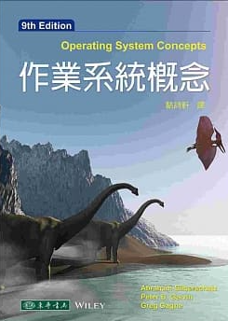
Operating System Concepts
Silberschatz, Galvin and Gagne (9th Ed.)

Slide 3
Operating System Concepts
Part 1 Overview
Chapter 1 Introduction
Chapter 2 System Structures
Part 2 Process Management
Chapter 3 Process Concept
Chapter 4 Multithreaded Programming
Chapter 5 Process Scheduling
Part 3 Process Coordination
Chapter 6 Synchronization
Chapter 7 Deadlocks
Part 4 Memory Management
Chapter 8 Memory Management Strategies
Chapter 9 Virtual Memory Management

Slide 4
Operating System Concepts
Part 5 Storage Management
Chapter 10 File-System
Chapter 11 Implementing File-Systems
Chapter 12 Secondary-Storage Structure
Chapter 13 I/O Systems
Part 6 Protection and Security
Chapter 14 System Protection
Chapter 15 System Security
Part 7 Distributed Systems
Chapter 16 Distributed Operating Systems
Chapter 17 Distributed File Systems
Chapter 18 Distributed Synchronizations

Slide 5
Operating System Concepts
Part 8 Special Purpose Systems
Chapter 19 Real-Time Systems
Chapter 20 Multimedia Systems
Part 9 Case Studies
Chapter 21 The Linux System
Chapter 22 Windows XP
Chapter 23 Influential Operating Systems

Slide 6
NachOS Programming Project x 3 (each 5%)
  System-call
  Multi-programming
  Process Scheduling
  You need to report and demo your programming
  Team works, 2-3 members each team

Slide 7
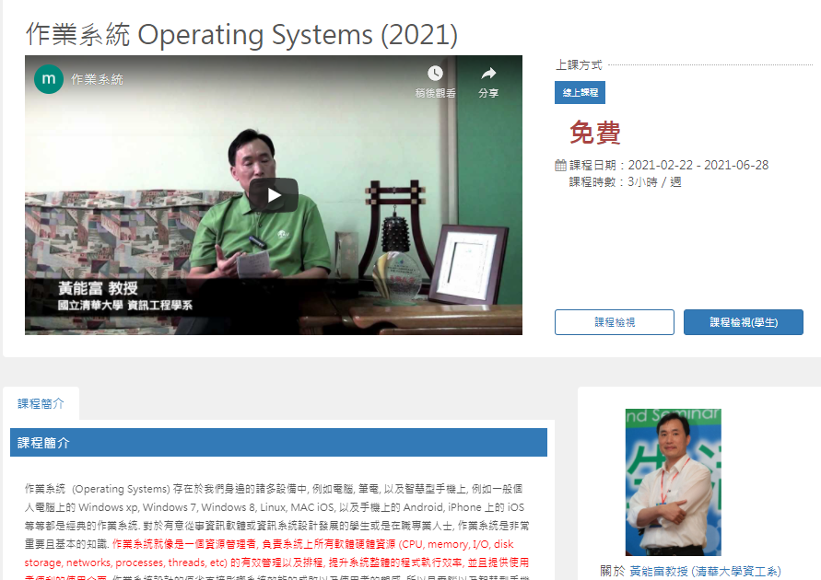
On-line MOOC Course
https://www.sharecourse.net/sharecourse/course/view/courseInfo/2439

Slide 8
Score Distribution
1st Mid-term Test (Chapters 1-5, 20%)
2nd Mid-term Test (Chapters 6-9, 20%)
Final Test (Chapters 10-13, 20%)
Chapter exercise (20%)
Programming projects (15%)
Classroom Performance (5%)

