Slide 1



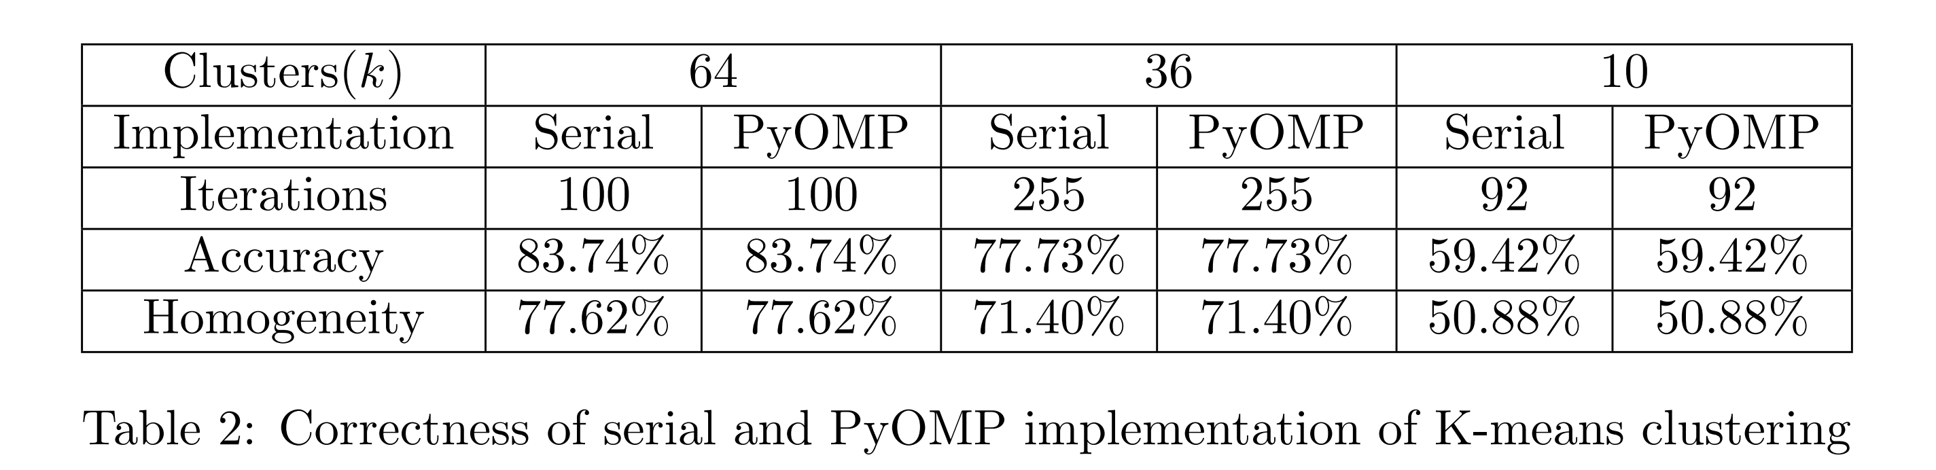
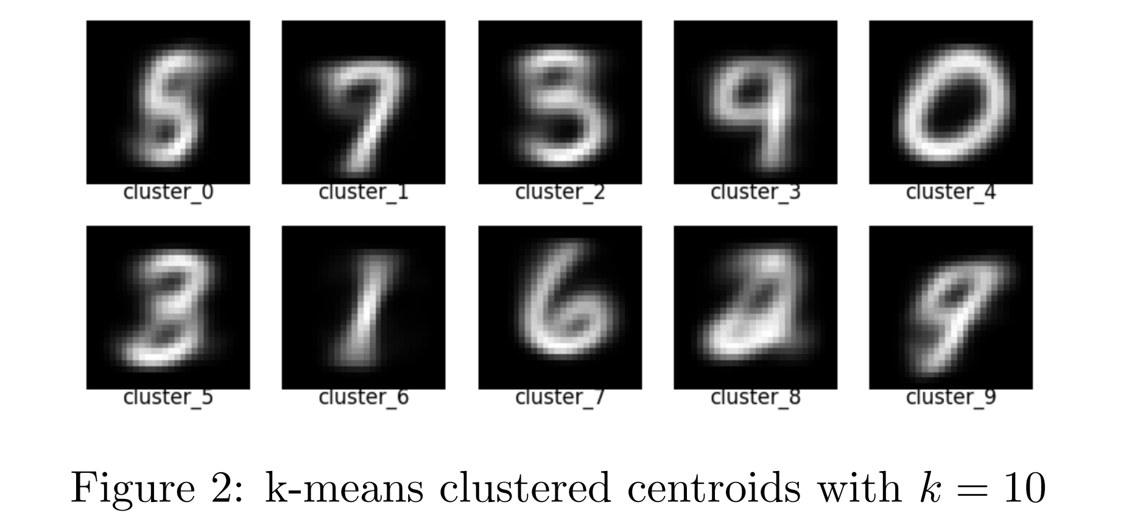
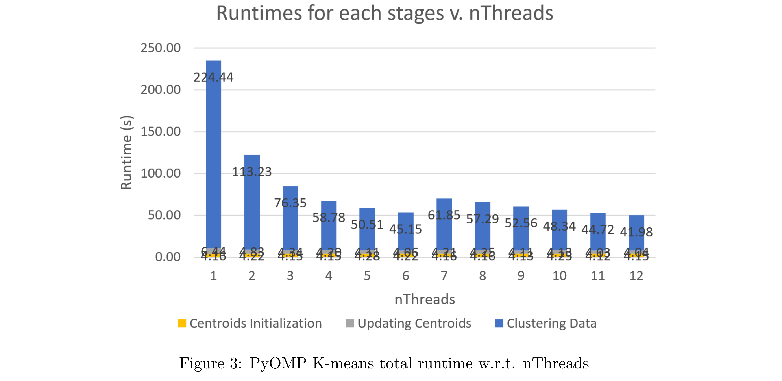
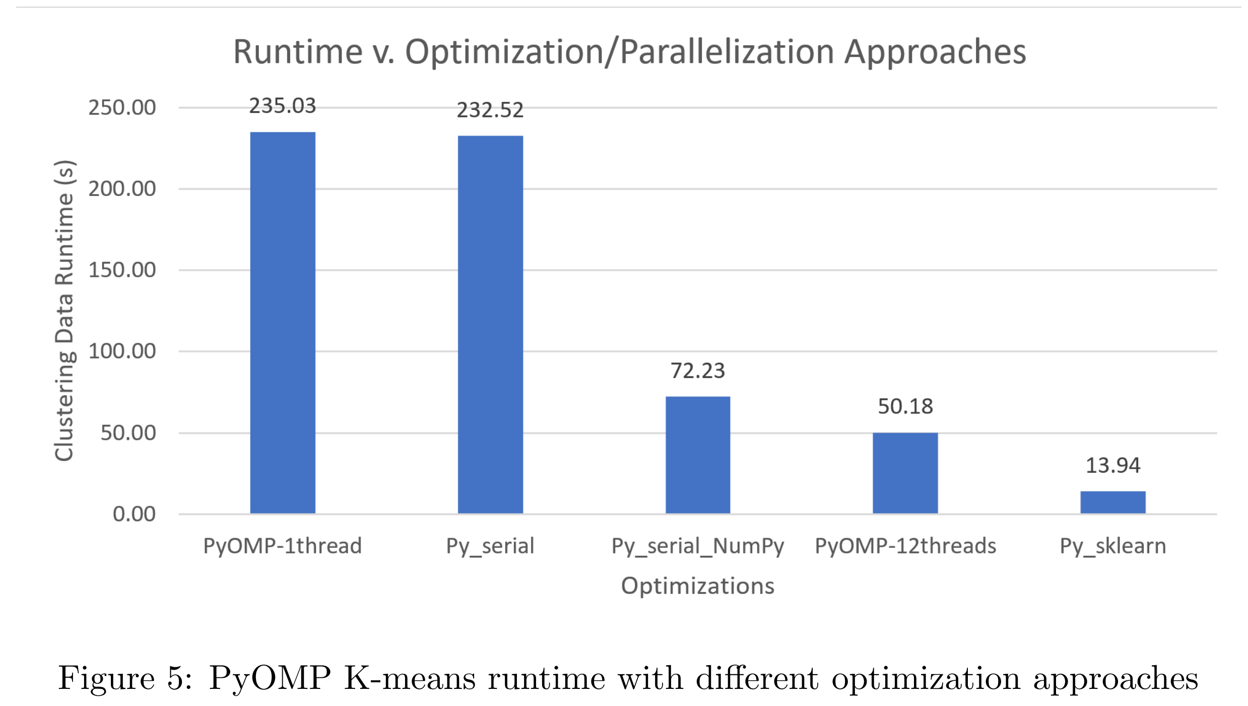
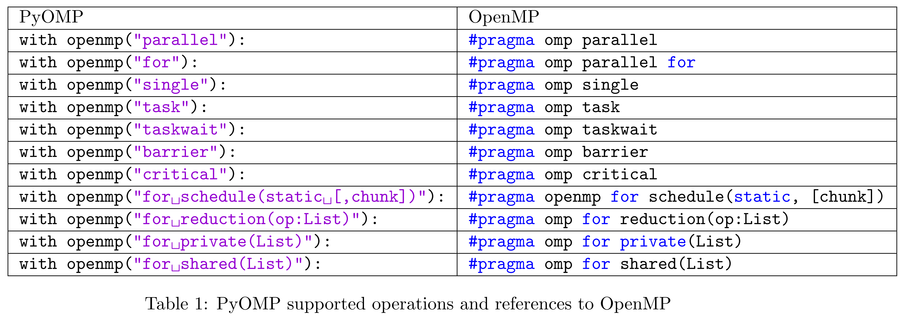
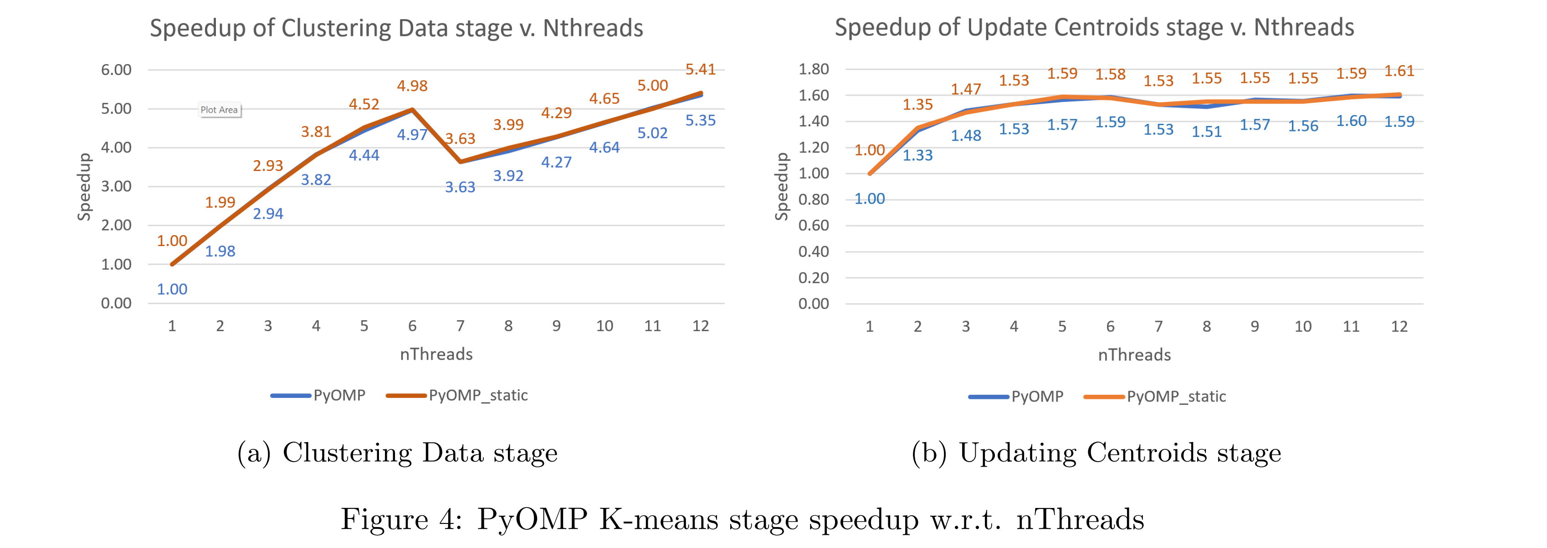
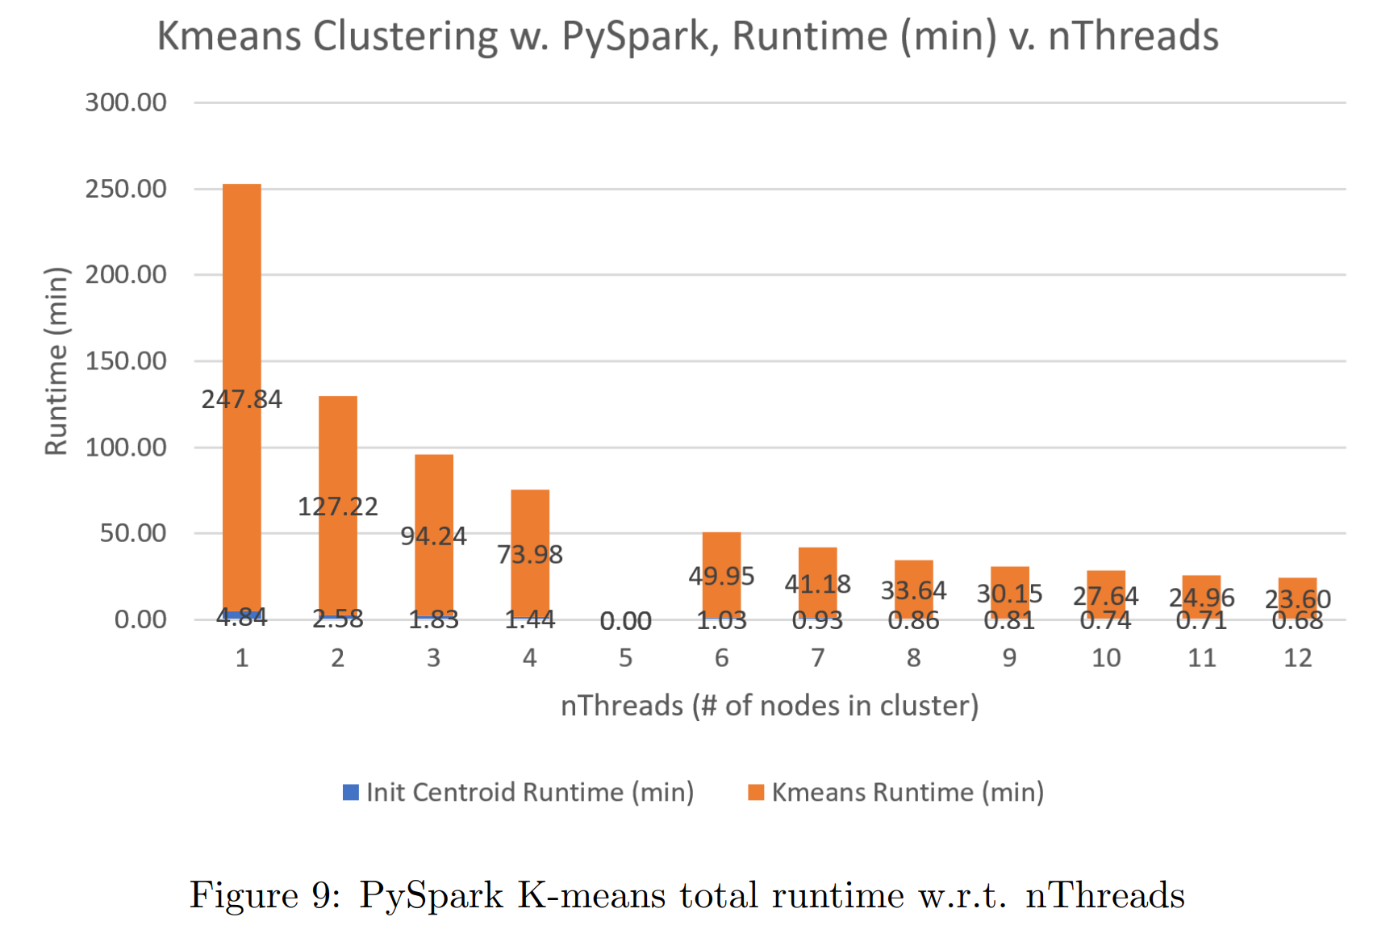
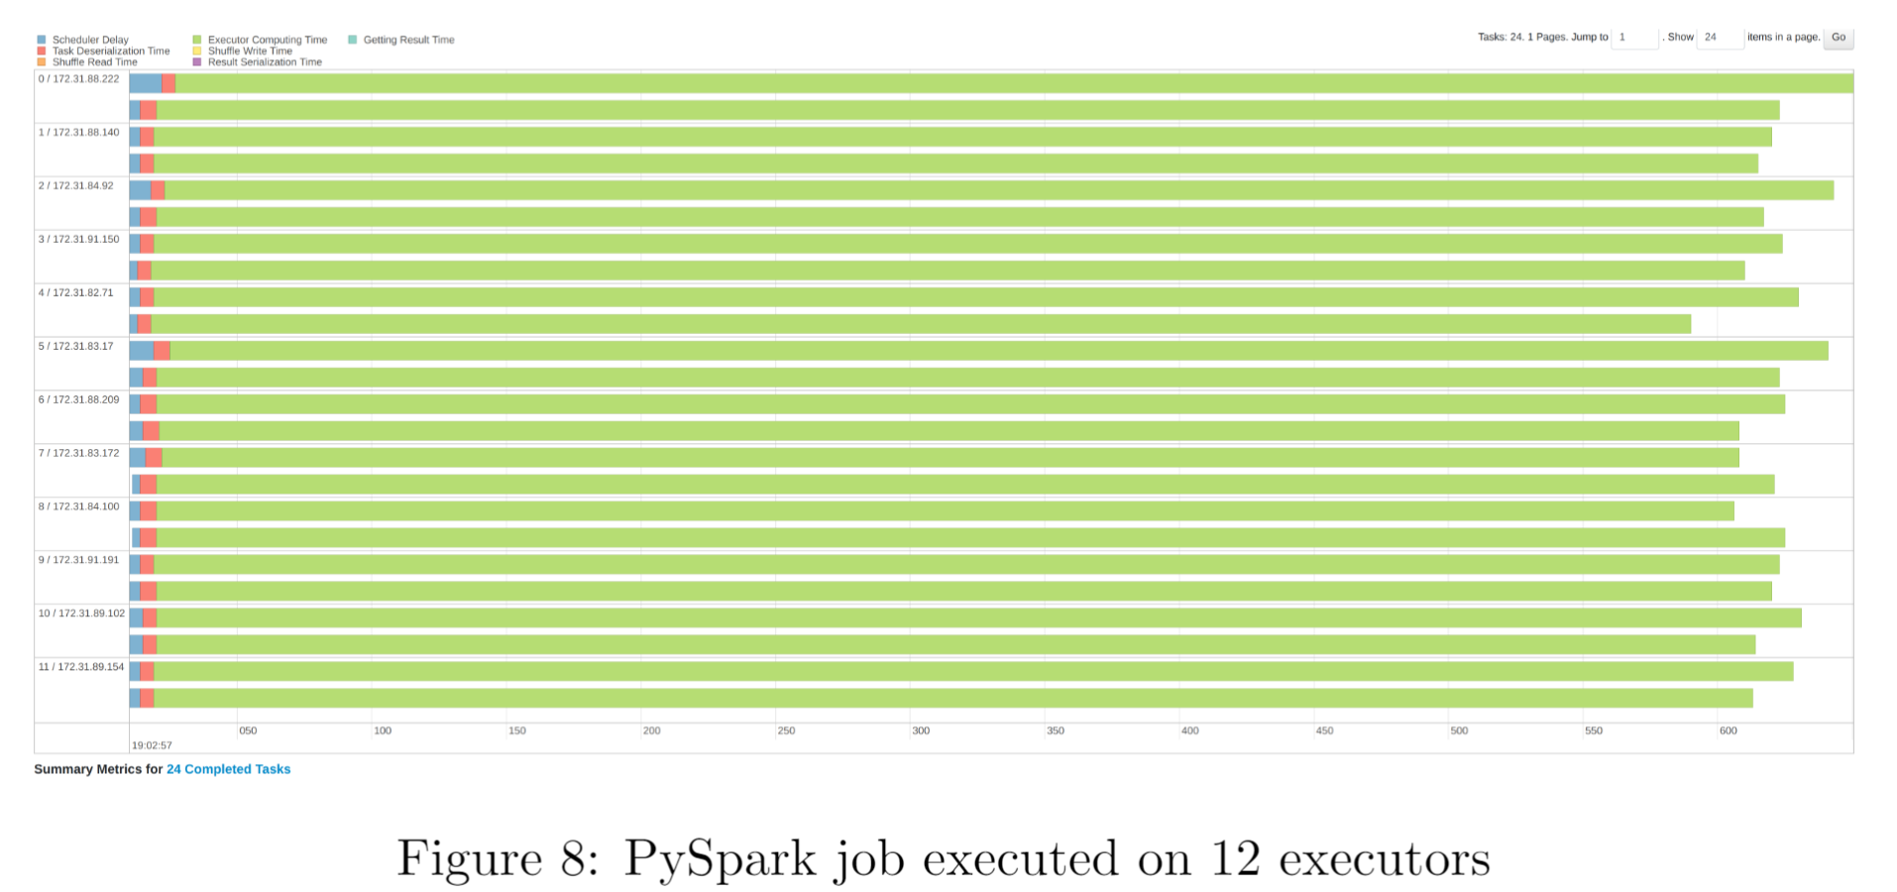
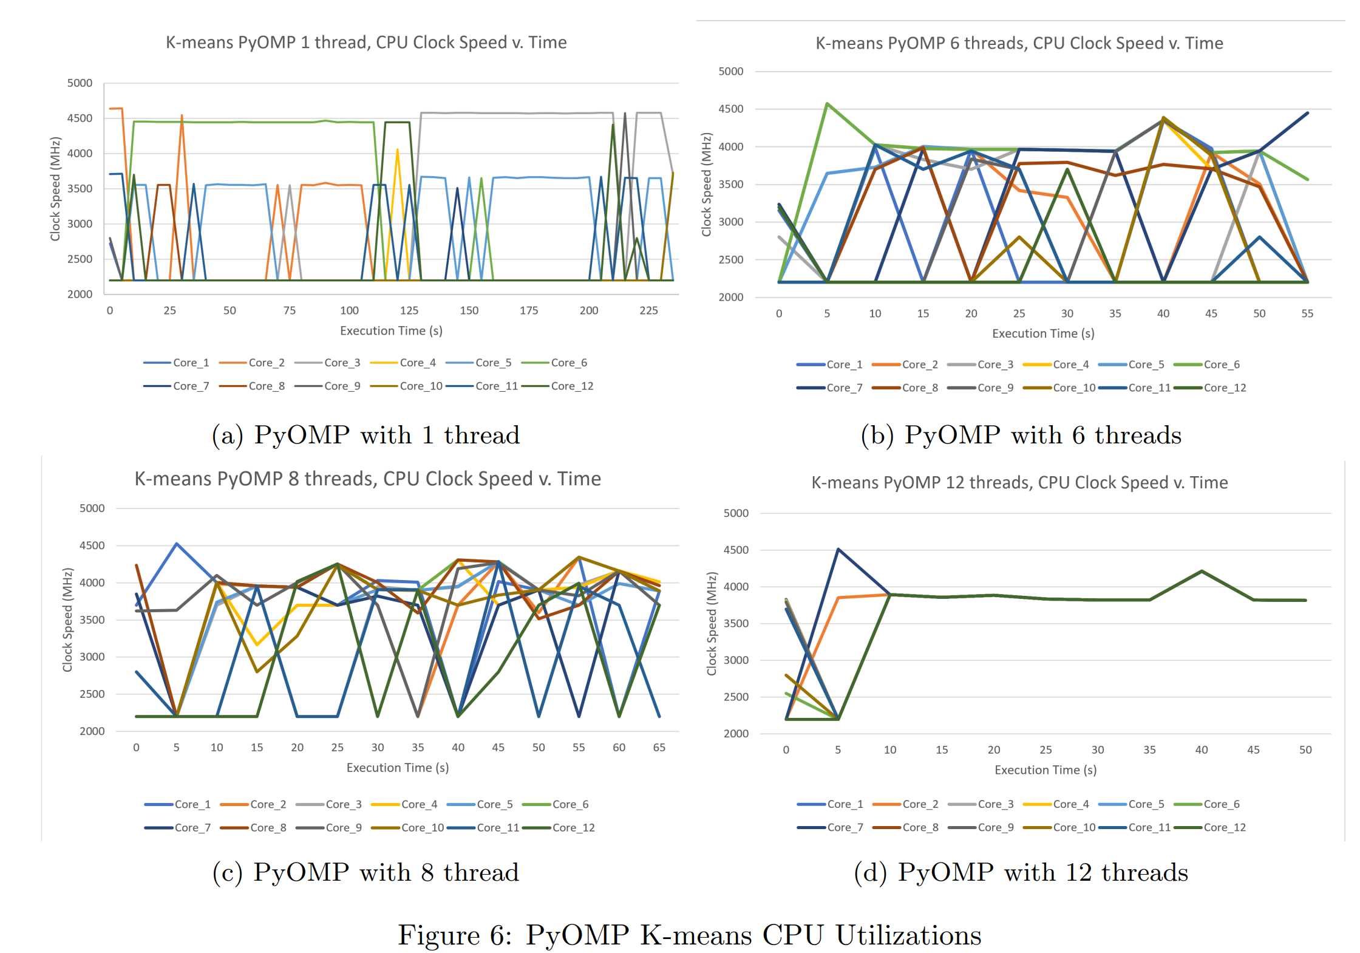
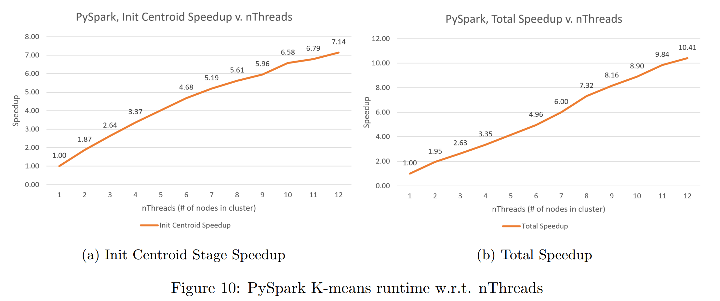

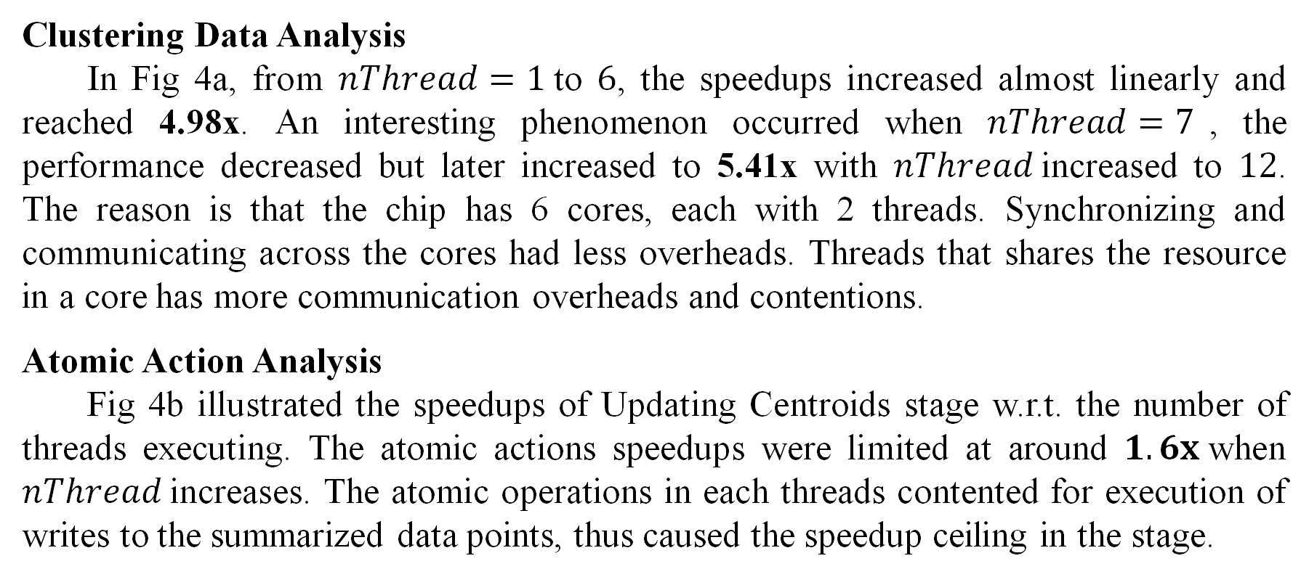
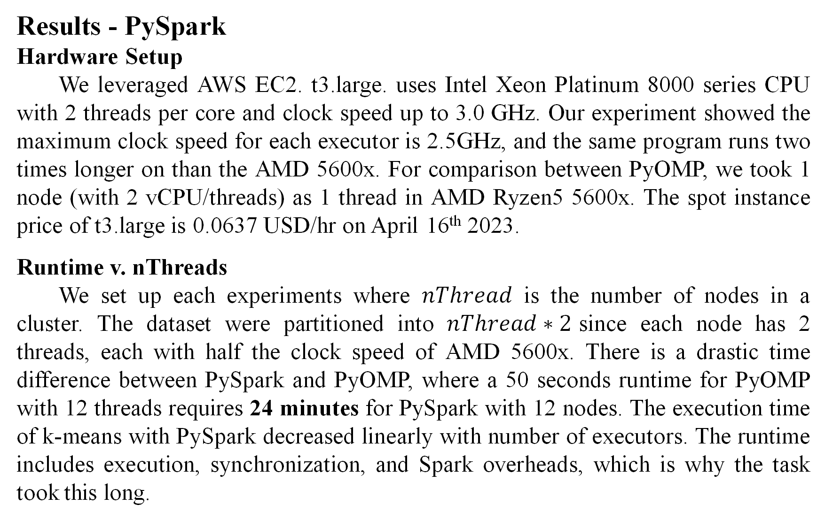
Supercomputer or Cloud Computing?
Large-scale, High-computation Data Clustering Tasks with PyOMP on single machine and with PySpark on AWS EC2 instances
Jhao-Ting Chen (jhaoting), Wei-Lun Chiu (weilunc)
Carnegie Mellon University – 15-618 Parallel Computer Architecture and Programming – Final Project
Project Website
Abstract
We compared the performance and costs of executing data clustering algorithms on a multi-core machine with PyOMP and on a set of workers with comparable resource constraints of AWS instances with PySpark. We analyzed the serial, parallelized, and distributed implementation of two clustering algorithms: K-means and DBSCAN, evaluated their trade-off between performance, financial cost, and different algorithmic strategies.
PyOMP
PyOMP, released by Intel Corp., provides an easy-to-use API that allows developers to parallelize their Python code with minimal modifications, by adding OpenMP directives to their code. Built upon Numba, PyOMP offers users an OpenMP-similar syntax for accessibility. Programs written in C with OpenMP performs only 2.8% faster than programs in PyOMP. Numba is just-in-time (JIT) compiler that translates Python into optimized machine code at runtime, just before execution, providing significant speedups for computationally intensive tasks. Numba uses LLVM as the backend for its JIT compiler, capable of many optimization techniques including vectorization, automatic parallelization, and loop unrolling. Example PyOMP operations are shown in Table 1.
Results – PyOMP
Hardware Setup
We ran the experiments on one of our personal computer with AMD Ryzen5 5600x as CPU. AMD 5600x has 6 cores (12 threads), maximum clock speed of 4.6 GHz. The pricing of AMD Ryzen5 5600x is 299 $USD.
Serial Implementation Analysis
Runtime v. nThreads
The runtime for the three stages in k-means are shown in Fig 3. Clustering Data stage accounts for most of the runtime. This is expected since clustering data points involves heavy computation on Euclidean distances.
Clustering Data Analysis
In Fig 4a, from $nThread=1$to $6$, the speedups increased almost linearly and reached 4.98x. An interesting phenomenon occurred when $nThread=7$, the performance decreased but later increased to 5.41x with $nThread$increased to $12$. The reason is that the chip has 6 cores, each with 2 threads. Synchronizing and communicating across the cores had less overheads. Threads that shares the resource in a core has more communication overheads and contentions.
Atomic Action Analysis
Fig 4b illustrated the speedups of Updating Centroids stage w.r.t. the number of threads executing. The atomic actions speedups were limited at around $1.6x$when $nThread$increases. The atomic operations in each threads contented for execution of writes to the summarized data points, thus caused the speedup ceiling in the stage.
PySpark
PySpark is a Python API for Apache Spark, a distributed computing system used for big data processing and analytics. Spark is designed to work with large-scale data processing tasks that require high-speed data processing and distributed computing capabilities. PySpark provides even more easy-to-use interface for users to handle data analytic tasks in Python.
Results - PySpark
Hardware Setup
We leveraged AWS EC2. t3.large. uses Intel Xeon Platinum 8000 series CPU with 2 threads per core and clock speed up to 3.0 GHz. Our experiment showed the maximum clock speed for each executor is 2.5GHz, and the same program runs two times longer on than the AMD 5600x. For comparison between PyOMP, we took 1 node (with 2 vCPU/threads) as 1 thread in AMD Ryzen5 5600x. The spot instance price of t3.large is 0.0637 USD/hr on April 16th 2023.
Runtime v. nThreads
We set up each experiments where $nThread$ is the number of nodes in a cluster. The dataset were partitioned into $nThread∗2$since each node has 2 threads, each with half the clock speed of AMD 5600x. There is a drastic time difference between PySpark and PyOMP, where a 50 seconds runtime for PyOMP with 12 threads requires 24 minutes for PySpark with 12 nodes. The execution time of k-means with PySpark decreased linearly with number of executors. The runtime includes execution, synchronization, and Spark overheads, which is why the task took this long.
Different Optimization Approaches
In Fig 5, we see that the same program but optimized with NumPy operations achieves a speedup comparing with plain implementation. Our PyOMP implementation with 12 threads speedup out-performed the NumPy-optimized program by 1.44x. The fastest scikit-learn implements has more optimized K-means algorithm with built-in OpenMP support on multi-threading.
CPU Utilization Analysis
To better inspect the threads utilization during execution, we logged the CPU clock rate. For PyOMP parallelized implementation, some logs are shown in Fig 6. As demonstrated in Fig 6a, there is always 1 core with the clock speed at about 4.5 GHz due to context swtiching. Fig 6b demonstrated the cores were executing exact same computation.
Conclusion – PyOMP
Our implementation of k-means clustering parallelized with PyOMP achieved 5.41x speedup on a 6 core, 12 threads CPU; and 4.98x speedup with 6 cores. The speedup out-performed the NumPy-optimized implementation by 1.44x. We examined the maximum speedup of 1.6x for atomic operations. For AMD Ryzen5 5600x, the speedup with over 6 threads declined due to resource sharing within a core. We inspected the execution of PyOMP on switching context with CPU clock speed.
Conclusion
The same workload executed 50.18s with a 299.00 $USD AMD Ryzen5 5600x, whereas executed 1440s with 13 (with driver node) AWS EC2 t3.large instance total of 0.33 $USD. The two use cases has its suitable scenario, it’s a trade-off between speed and resource constraints.
Conclusion - PySpark
Our implementation of k-means clustering parallelized with PySpark achieved 10.41x speedup on a 12-node cluster, with each node having 2 vCPUs, each having half of the computation power of AMD Ryzen5 5600x. The speedup increased linearly with respect to the number of node executing. However, due to the heavy overhead of Spark job and synchronization across nodes, the runtime is drastically slower than PyOMP implementation of the same code.
DBSCAN Results are on Project Website: jtchen0528/cmu-15618-project

