Slide 1



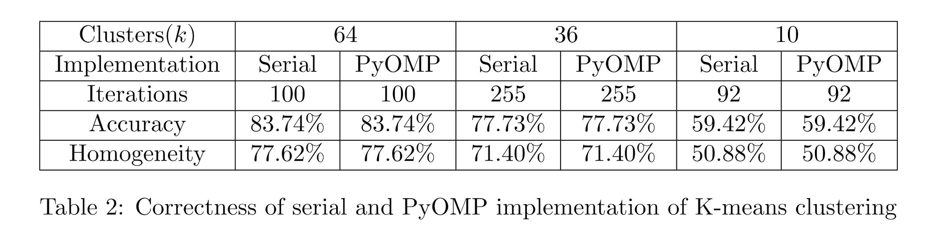
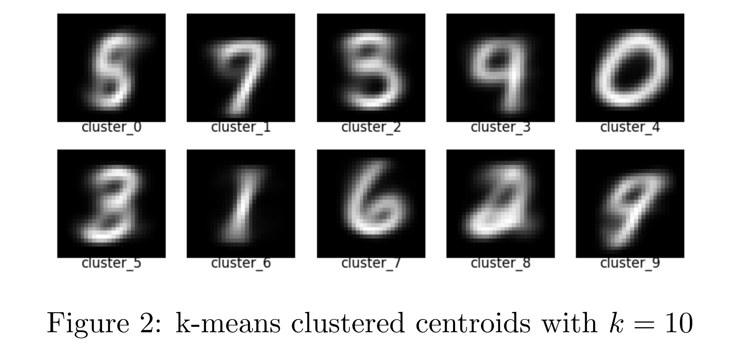
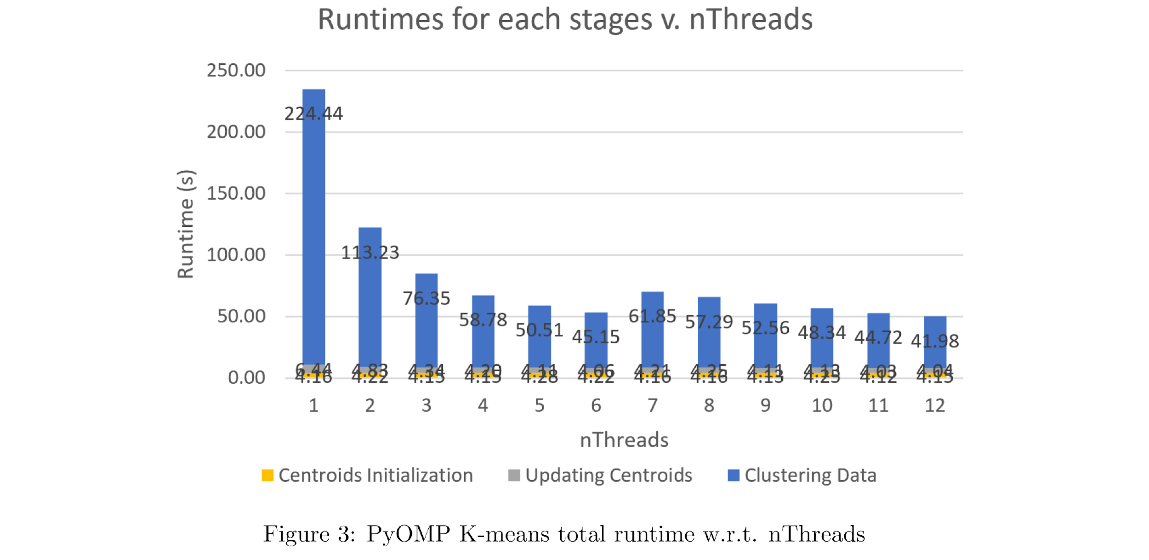
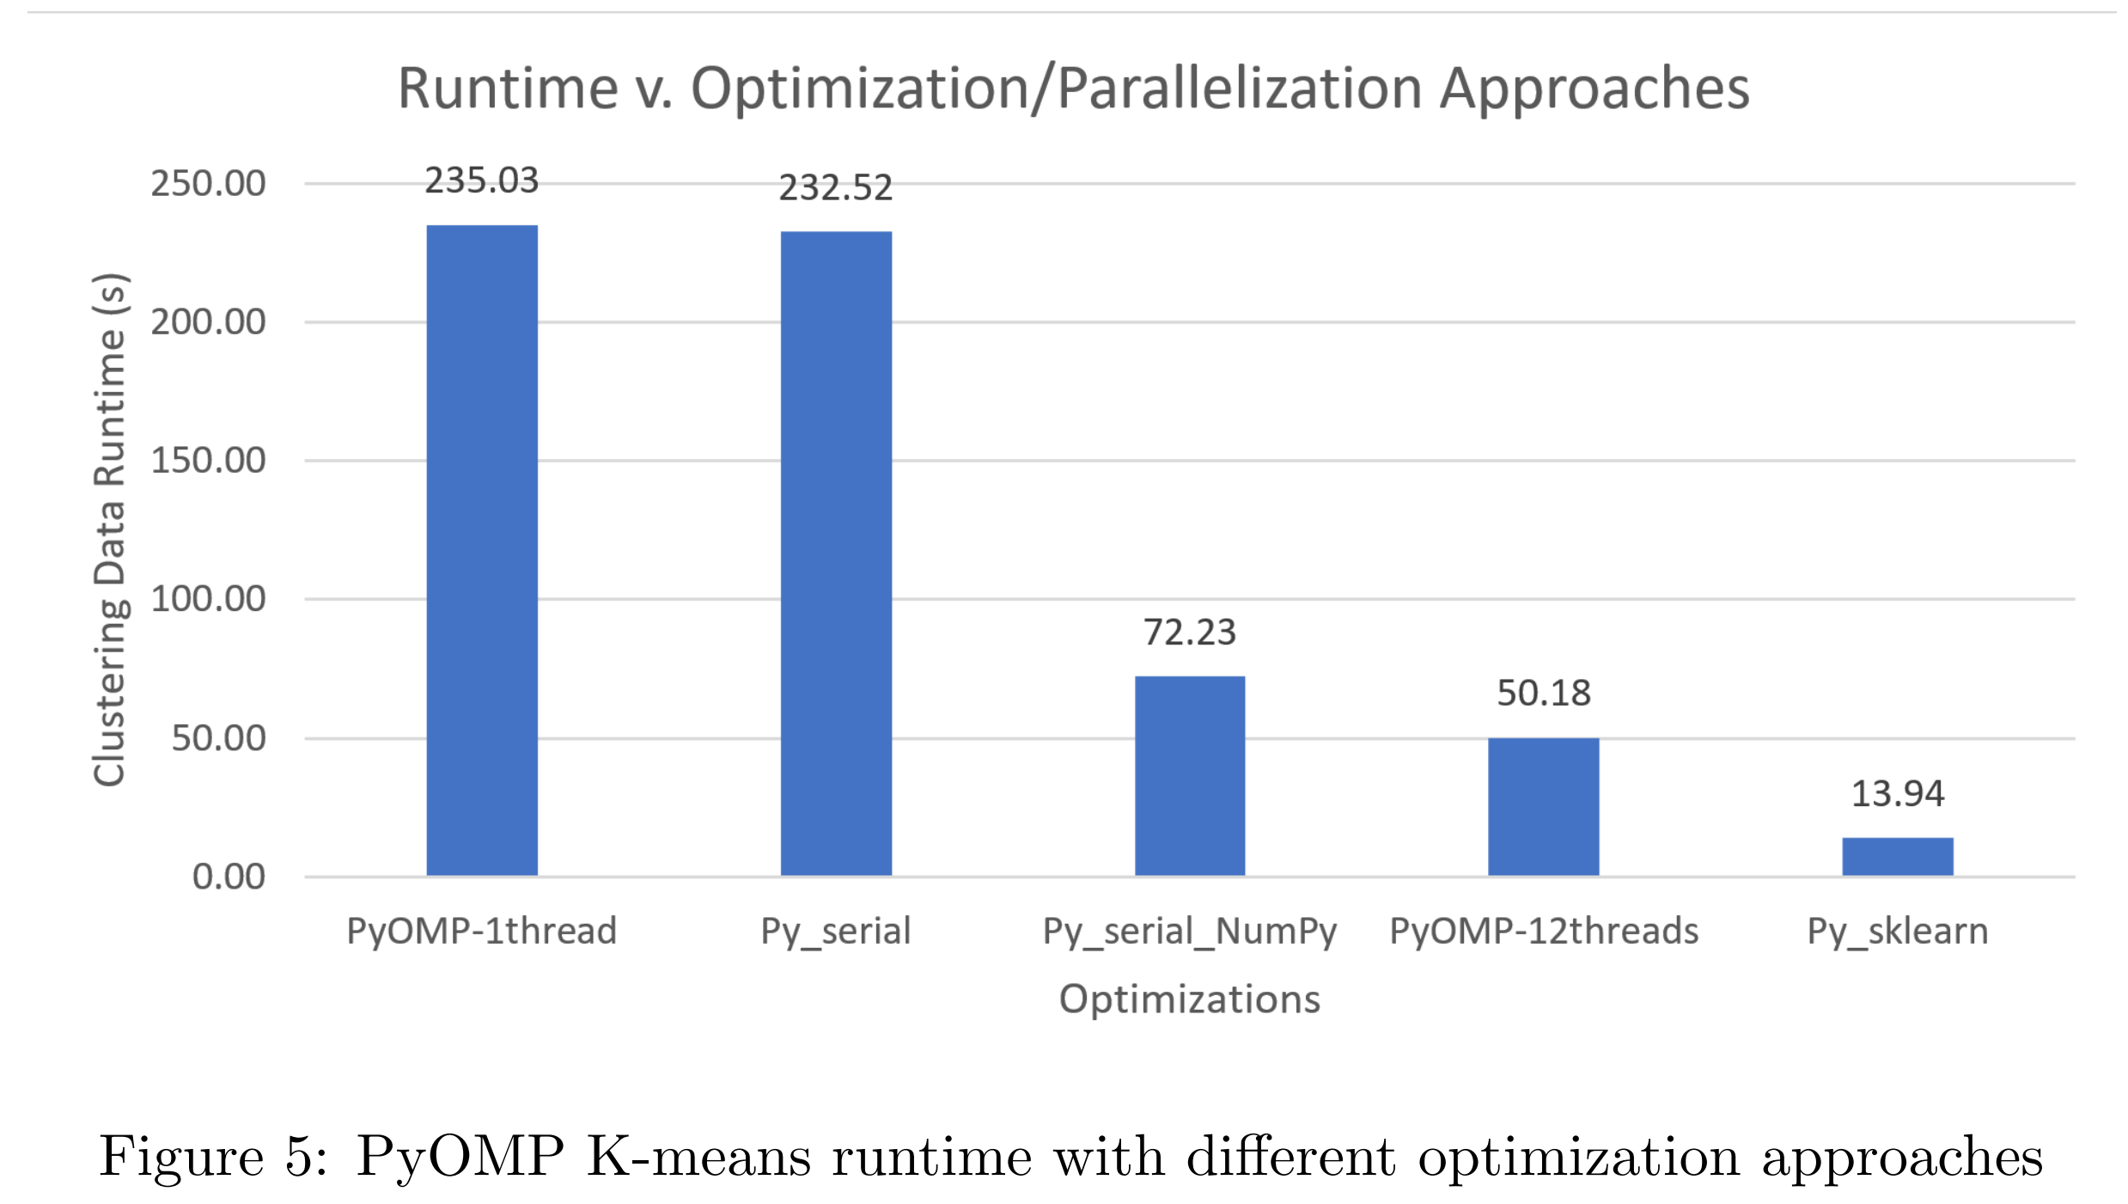
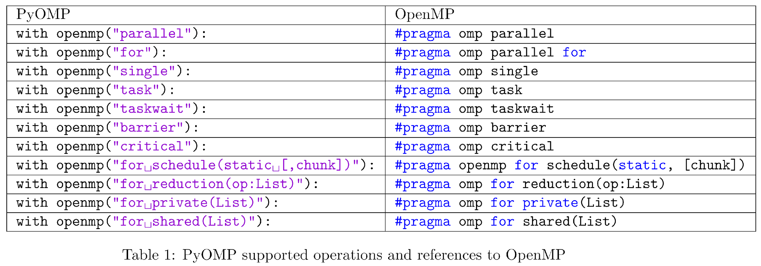
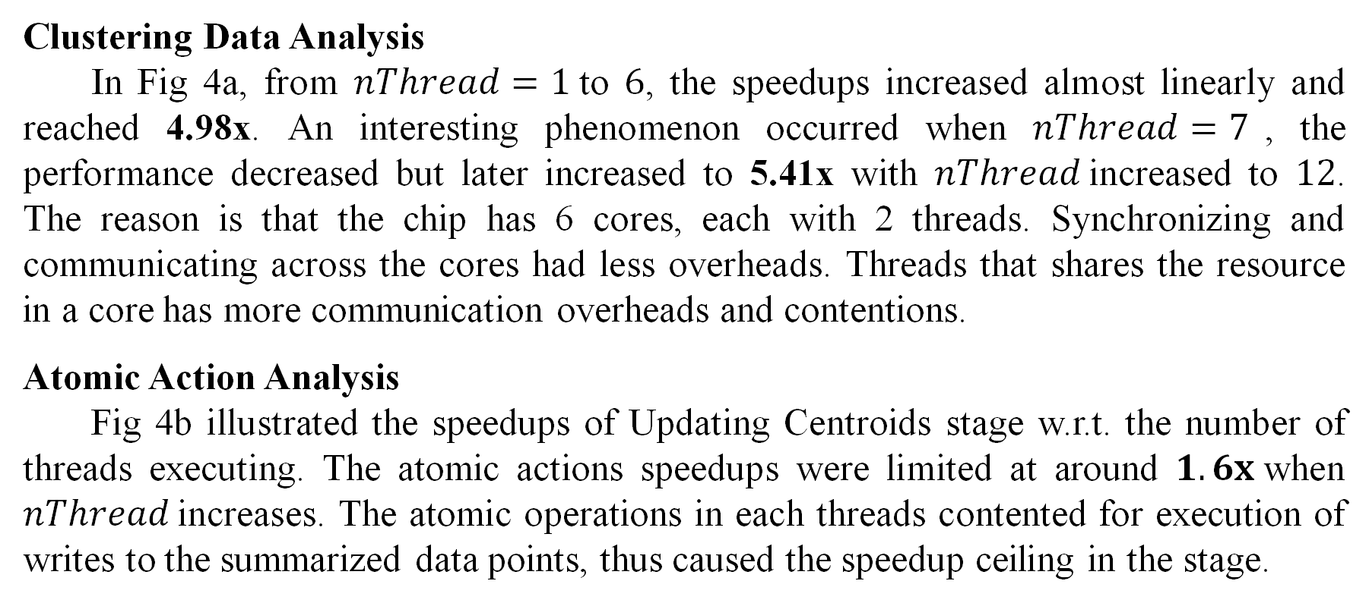
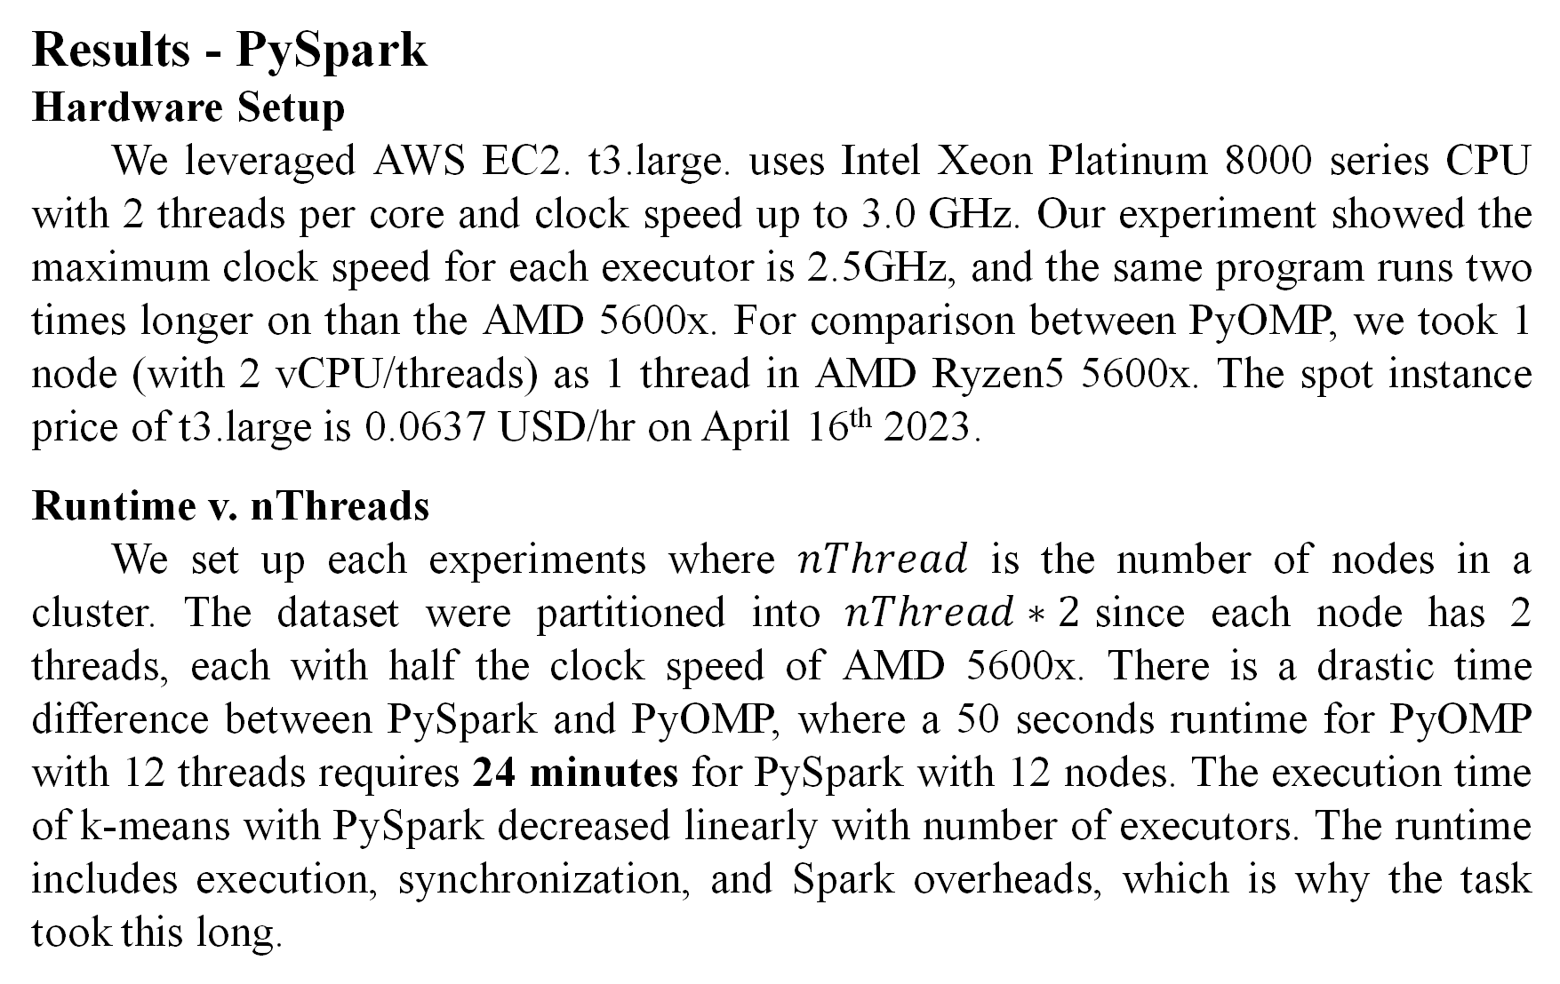
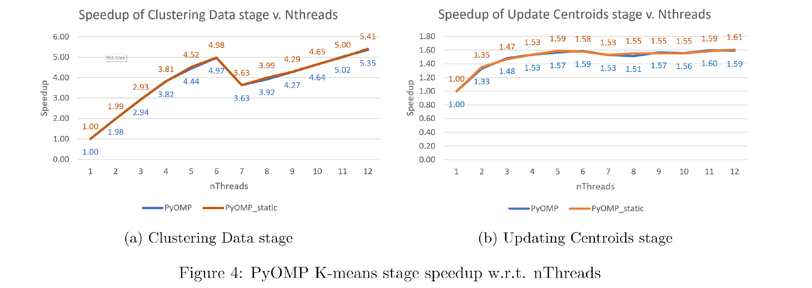
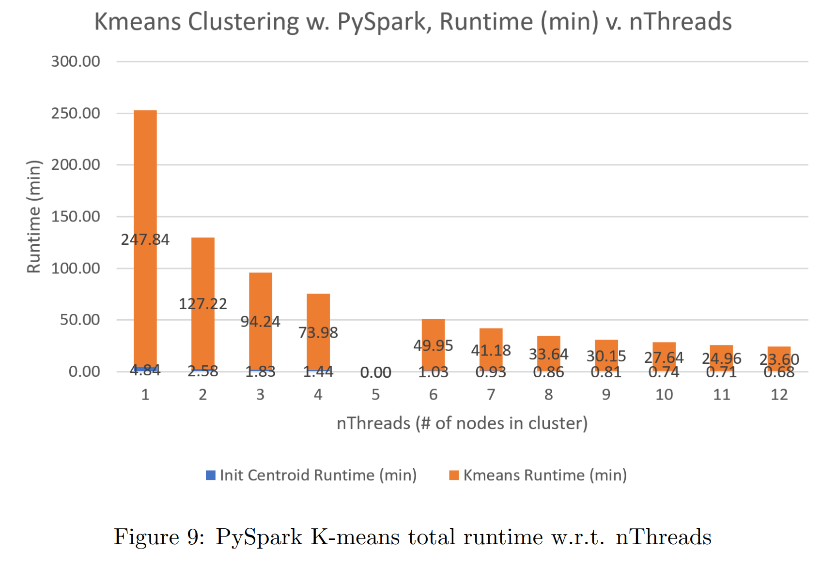
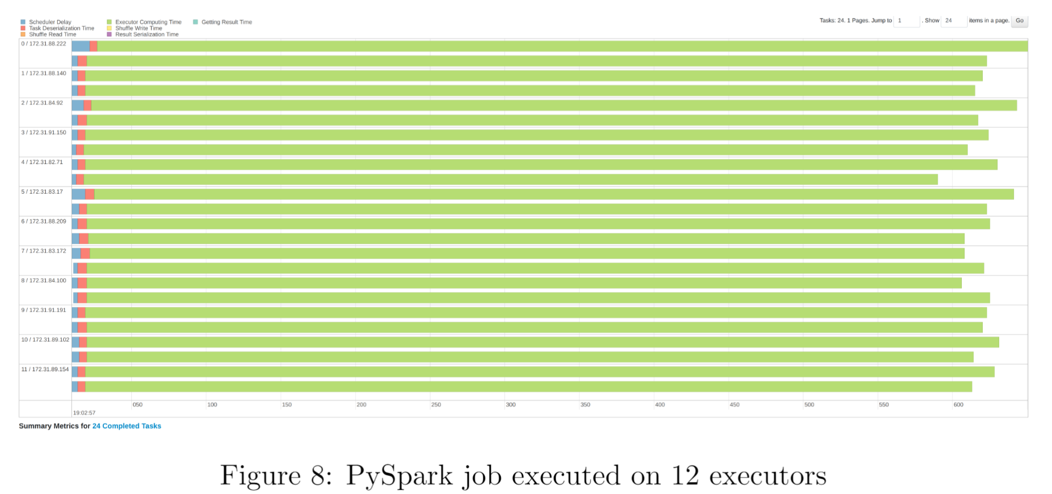
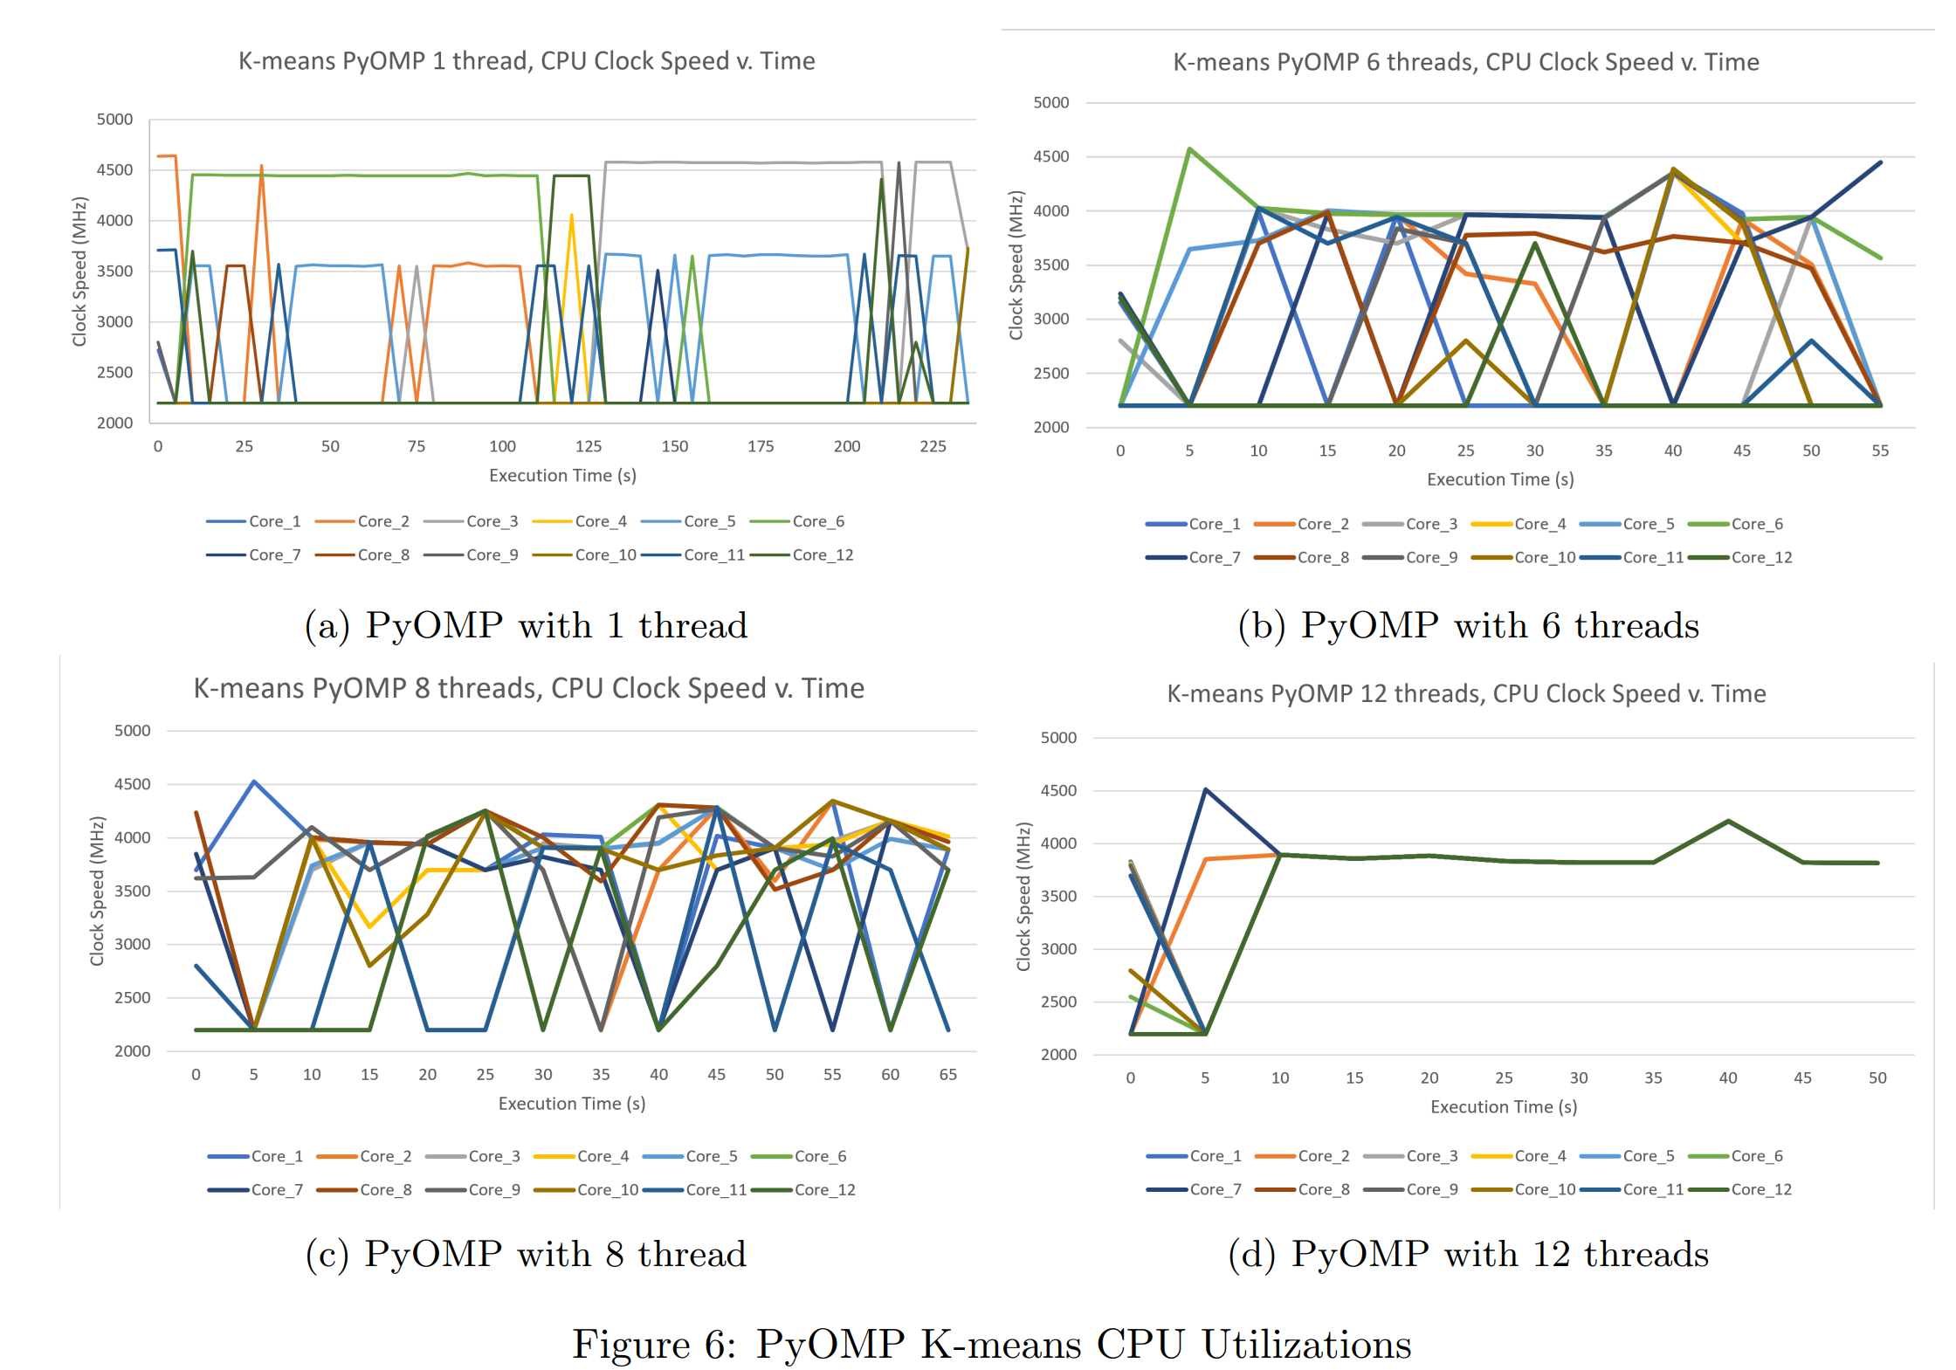
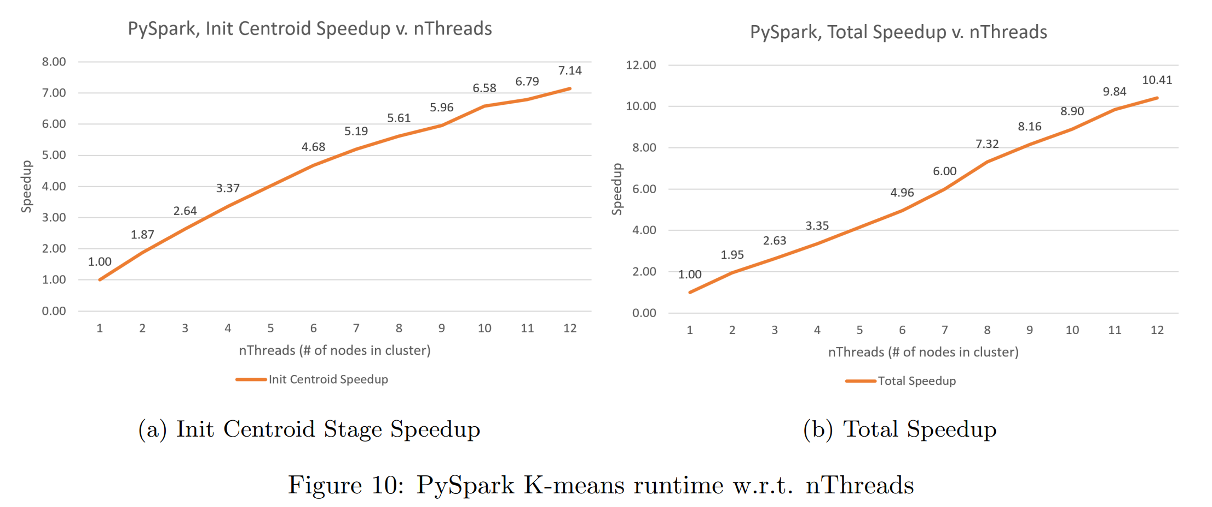

Supercomputer or Cloud Computing?
Large-scale, High-computation Data Clustering Tasks with PyOMP on single machine and with PySpark on AWS EC2 instances
Jhao-Ting Chen (jhaoting), Wei-Lun Chiu (weilunc)
Carnegie Mellon University – 15-618 Parallel Computer Architecture and Programming – Final Project
Project Website
Abstract
We compared the performance and costs of executing data clustering algorithms on a multi-core machine with PyOMP and on a set of workers with comparable resource constraints of AWS instances with PySpark. We analyzed the serial, parallelized, and distributed implementation of two clustering algorithms: K-means and DBSCAN, evaluated their trade-off between performance, financial cost, and different algorithmic strategies.
PyOMP
PyOMP, released by Intel Corp., provides an easy-to-use API that allows developers to parallelize their Python code with minimal modifications, by adding OpenMP directives to their code. Built upon Numba, PyOMP offers users an OpenMP-similar syntax for accessibility. Programs written in C with OpenMP performs only 2.8% faster than programs in PyOMP. Numba is just-in-time (JIT) compiler that translates Python into optimized machine code at runtime, just before execution, providing significant speedups for computationally intensive tasks. Numba uses LLVM as the backend for its JIT compiler, capable of many optimization techniques including vectorization, automatic parallelization, and loop unrolling. Example PyOMP operations are shown in Table 1.
Results – PyOMP
Hardware Setup
We ran the experiments on one of our personal computer with AMD Ryzen5 5600x as CPU. AMD 5600x has 6 cores (12 threads), maximum clock speed of 4.6 GHz. The pricing of AMD Ryzen5 5600x is 299 $USD.
Serial Implementation Analysis
Runtime v. nThreads
The runtime for the three stages in k-means are shown in Fig 3. Clustering Data stage accounts for most of the runtime. This is expected since clustering data points involves heavy computation on Euclidean distances.
PySpark
PySpark is a Python API for Apache Spark, a distributed computing system used for big data processing and analytics. Spark is designed to work with large-scale data processing tasks that require high-speed data processing and distributed computing capabilities. PySpark provides even more easy-to-use interface for users to handle data analytic tasks in Python.
Different Optimization Approaches
In Fig 5, we see that the same program but optimized with NumPy operations achieves a speedup comparing with plain implementation. Our PyOMP implementation with 12 threads speedup out-performed the NumPy-optimized program by 1.44x. The fastest scikit-learn implements has more optimized K-means algorithm with built-in OpenMP support on multi-threading.
CPU Utilization Analysis
To better inspect the threads utilization during execution, we logged the CPU clock rate. For PyOMP parallelized implementation, some logs are shown in Fig 6. As demonstrated in Fig 6a, there is always 1 core with the clock speed at about 4.5 GHz due to context swtiching. Fig 6b demonstrated the cores were executing exact same computation.
Conclusion – PyOMP
Our implementation of k-means clustering parallelized with PyOMP achieved 5.41x speedup on a 6 core, 12 threads CPU; and 4.98x speedup with 6 cores. The speedup out-performed the NumPy-optimized implementation by 1.44x. We examined the maximum speedup of 1.6x for atomic operations. For AMD Ryzen5 5600x, the speedup with over 6 threads declined due to resource sharing within a core. We inspected the execution of PyOMP on switching context with CPU clock speed.
Conclusion
The same workload executed 50.18s with a 299.00 $USD AMD Ryzen5 5600x, whereas executed 1440s with 13 (with driver node) AWS EC2 t3.large instance total of 0.33 $USD. The two use cases has its suitable scenario, it’s a trade-off between speed and resource constraints.
Conclusion - PySpark
Our implementation of k-means clustering parallelized with PySpark achieved 10.41x speedup on a 12-node cluster, with each node having 2 vCPUs, each having half of the computation power of AMD Ryzen5 5600x. The speedup increased linearly with respect to the number of node executing. However, due to the heavy overhead of Spark job and synchronization across nodes, the runtime is drastically slower than PyOMP implementation of the same code.
DBSCAN Results are on Project Website: jtchen0528/cmu-15618-project

Slide 2



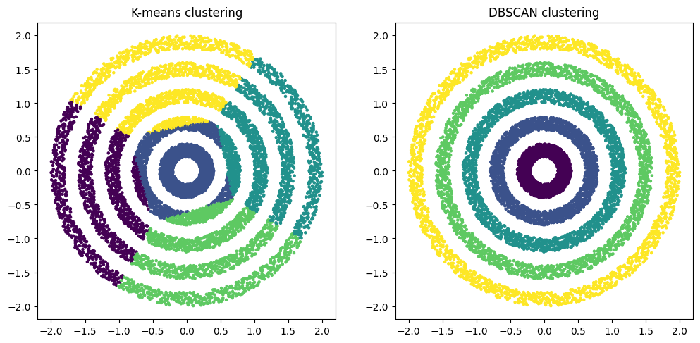
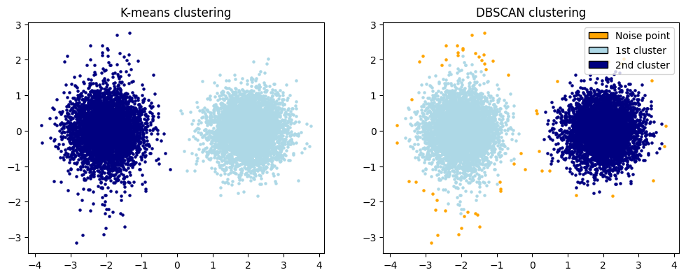
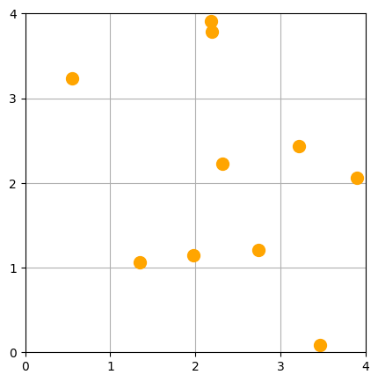
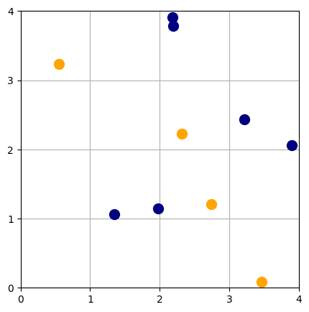
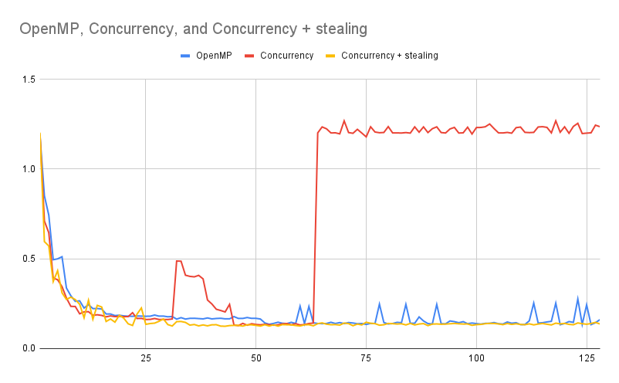
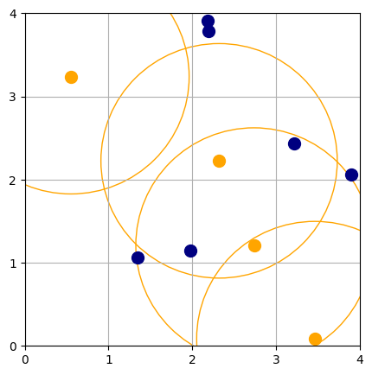
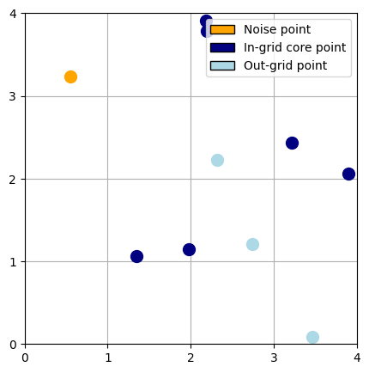
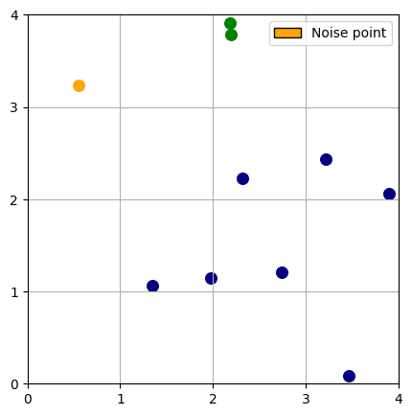
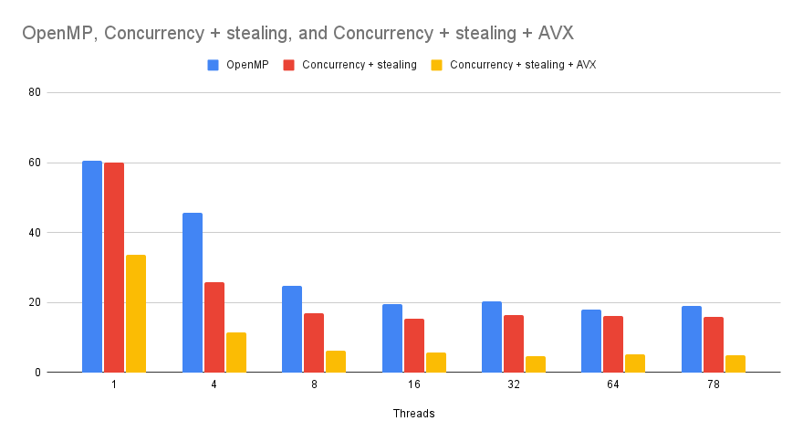
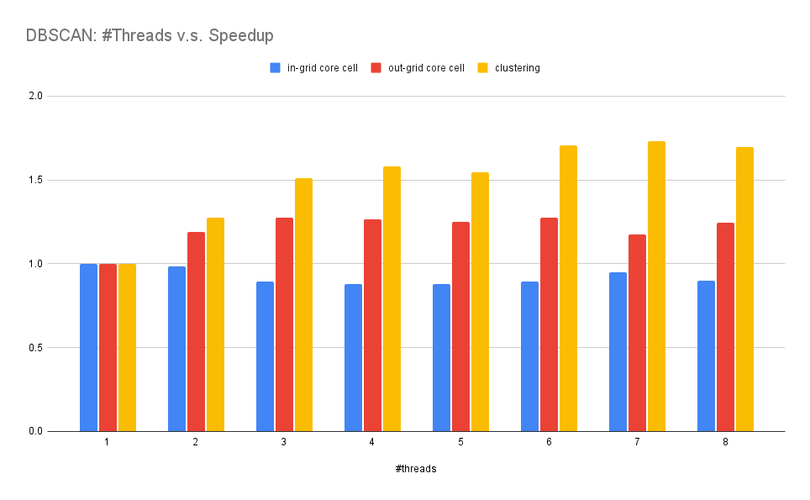
From Python to C++: A Journey to Efficient DBSCAN
Student: Wei-Lun Chiu, Jhao-Ting Chen
Carnegie Mellon University, Pittsburgh, PA
DBSCAN: What, Why, How?
Density-Based Spatial Clustering of Applications with Noise
Cennectivity-based: it produce desired results
Noise-tolerant: it exclude the noise points
Grid-based DBSCAN Visualization (𝞮 is minimum connectivity threshold)
Analysis of Python Parallelism
The main obstacle: Global Interpreter Lock (GIL)
No multi-thread parallelism allowed!
PyOMP
Generate machine code. Super-fast (near C-level performance).
Restrictions:
No dynamic array, set, etc. No complex data structure
No recursive. No incomplete type. (No tree allowed!)
Multiprocessing Module
Generates processes. Each process has its own GIL.
Too much overhead, too slow. Only 1.7x speedup with 6 threads.
Analyzing Serial Runtimes in C++
Procedure | Runtime(s) | Percentage
Gridify | 0.011691 | 0.9538%
Mark in-grid cores | 1.68 * 10⁻⁶ | 0.0001%
Mark out-grid cores | 0.00318535 | 0.2599%
Expand | 1.21085 | 98.7861%
Table 1: Runtime and percentage breakdown for each step of the procedure
C++ Concurrency API for Parallelism
Part of C++ Standard Library since C++11
Parallel implementation of expand in grid-based DBSCAN using
lock-free UNION-FIND data structure for neighboring cell connectivity.
Workload Balancing with Work-Stealing
Observed workload imbalance (Red line in the following figure)
Implement a work-stealing mechanism to balance workload (yellow line)
Thread-Specific work queues and fine-grained locks
Non-busy threads attempt to steal work from (treadID+1)%nthreads.
Initial Points
(𝞮 = 1.41, minimum cluster size = 2)
2. Mark In-grid Core Cells
(any cell with more than 2 points)
𝞮
Runtime(s)
3. Mark Out-grid Core Cells
(any non-core cell contain a point connects to more than 1 points)
4. Finalized Point Classification
(core point and noise point)
𝞮
#Threads
Performance Analysis with Perf
Memory allocation/release (45%)
Floating point arithmetic (28%)
Floating Point Optimization with AVX
Optimize floating point arithmetic with AVX instructions to achieve
12.79x speedup.
5. Core Cell Clustering Expansion
(Bichromatic Closest Pair < 𝞮)
6. Complete!
(Result: 2 clusters, 1 noise points)
Runtime(s)
Poor Parallel Performance in Python
Speed Up
Only 1.7x Speedup on 6 Threads
#Ts | OpenMP | Concurrency + steal | Con. + steal + AVX
1 | 60.5908 (0.99x) | 59.9386 (1.00x) | 33.683 (1.78x)
4 | 45.5341 (1.32x) | 25.7059 (2.33x) | 11.5379 (5.20x)
8 | 24.6547 (2.43x) | 16.8995 (3.55x) | 6.08641 (9.86x)
16 | 19.4427 (3.09x) | 15.2388 (3.94x) | 5.57829 (10.76x)
32 | 20.3203 (2.95x) | 16.4425 (3.65x) | 4.69244 (12.79x)
64 | 17.8841 (3.35x) | 16.1772 (3.71x) | 5.05127 (11.88x)
78 | 19.089 (3.14x) | 15.9645 (3.76x) | 4.80074 (12.50x)
#Threads
#Threads
Table 2: Execution times (in seconds) for various thread counts and parallelization strategies

