Slide 1
HotMethods Demo
1
What is method profiling?
Method profiling with Java Flight Recorder
Demo: Profiling the HotMethods application with JFR
2
3

Slide 2
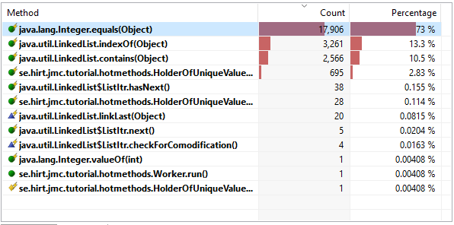
Method Profiling
Software Profiling is a means to identify an application’s most frequently run code
Even slight optimizations to these hotspots can result in dramatic performance improvements
Java Flight Recorder provides Method Profiling: it can count the most frequently run Java methods over a period of time

Slide 3
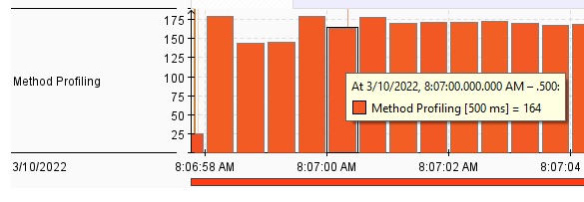

Method Profiling Cont’d
JFR samples the running environment to see what threads are actually doing
Occurs tens to hundreds of times a second
Statistical sampling is good approximation of the real behavior
Very low overhead, can run in production
Counts the number of method invocations, not overall time spent in those methods

