Slide 1
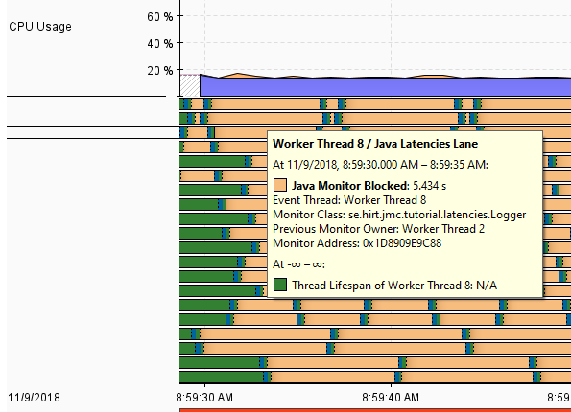
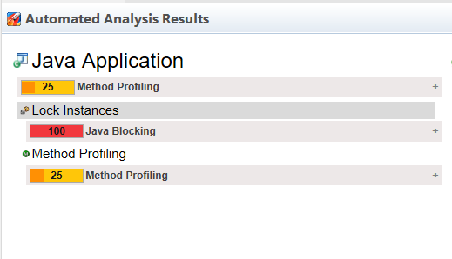

Latencies Demo
1
Multithreaded app, lower than expected throughput
Demo: Investigating latency related problems with JFR/JMC
2

