Slide 1
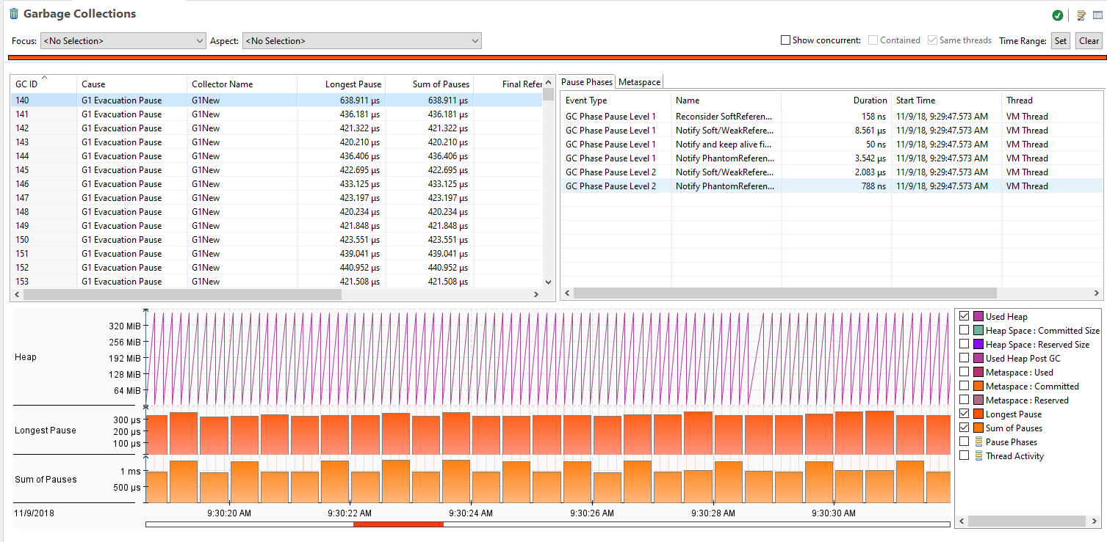
Garbage Collection Behavior Demo
1
Detailed information about garbage collection
Investigate allocation profiling information
2

Slide 2
Autoboxing
Automatic conversion between primitive type and its corresponding wrapper class
Example
JDK 5 and later:
Integer iObj = 42;
Before JDK 5, no autoboxing:
Integer iObj = new Integer(42);
Convenience: easier to read
Java runtime might create temporary objects as part of the conversion
int primitive
Integer object
42
value:
42

