Slide 1
Embedded Workforce Platform Integration
A resilient onboarding experience connecting partner and employment platforms.
Independent Case Study
Resilient Embedded Experience
Independent architecture exercise using fictional platforms.
Illustrative design, not an internal or production system.
Provider = Employment Platform; Partner = Partner Platform.
Notes:
Independent Case Study. Independent architecture exercise using fictional platforms. Illustrative design, not an internal or production system. Partner means Partner Platform. Provider means Employment Platform. API capabilities, payloads, identifiers, lifecycle states, and roadmap phases are illustrative assumptions, not proprietary contracts or claims of deployment.

Slide 2
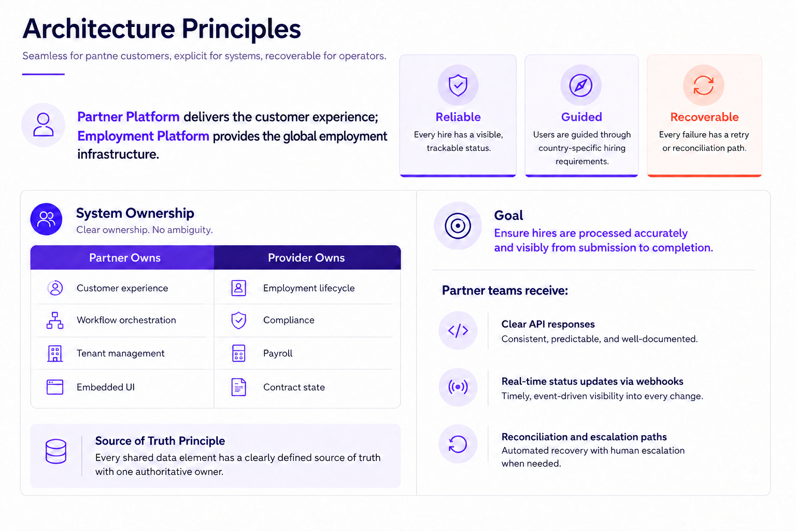
Seamless for partner customers, explicit for systems, recoverable for operators.

Slide 3
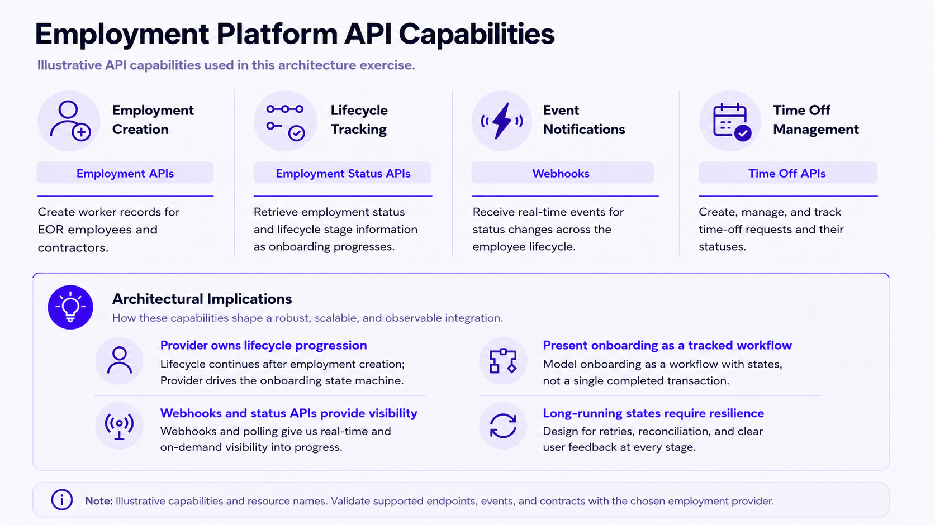

Slide 4
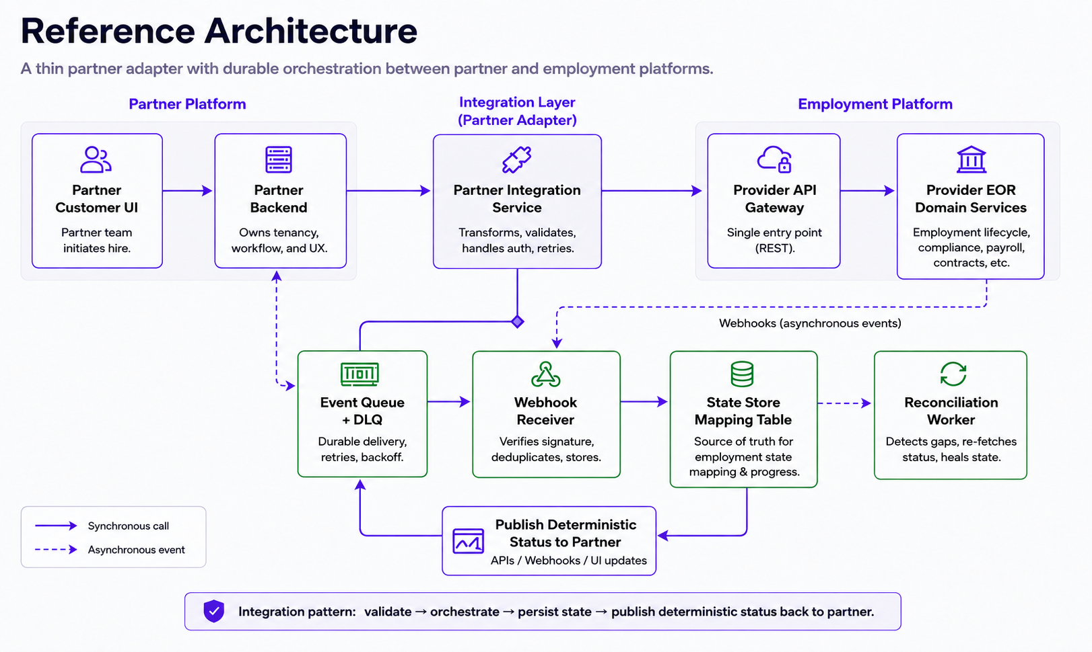
Notes:
The reference architecture is a conceptual component view. For inbound webhooks, verify the signature, persist to a durable queue, acknowledge receipt, then process asynchronously. The local state store owns mappings and workflow progress. The provider remains authoritative for employment and compliance records. DLQ means dead-letter queue.

Slide 5
Data Ownership Model
Make system ownership explicit before writing integration code.
Data domain
Authoritative system
Partner UX behavior
Partner customer / tenant
Partner Platform
Partner owns tenant context, permissions, and packaging.
Employment lifecycle
Employment Platform
Display provider stage/status; do not infer hidden compliance state.
Payroll/compliance fields
Employment Platform
Provider validates the record. Partner shows corrective tasks.
Draft hire shell
Partner until provider creation succeeds
Show “draft” locally; no provider employment record yet.
Cross-system identifiers
Mapping table
Use stable provider_employment_id + partner_employee_id mapping.
Partner owns the user experience; provider owns employment and compliance records.

Slide 6
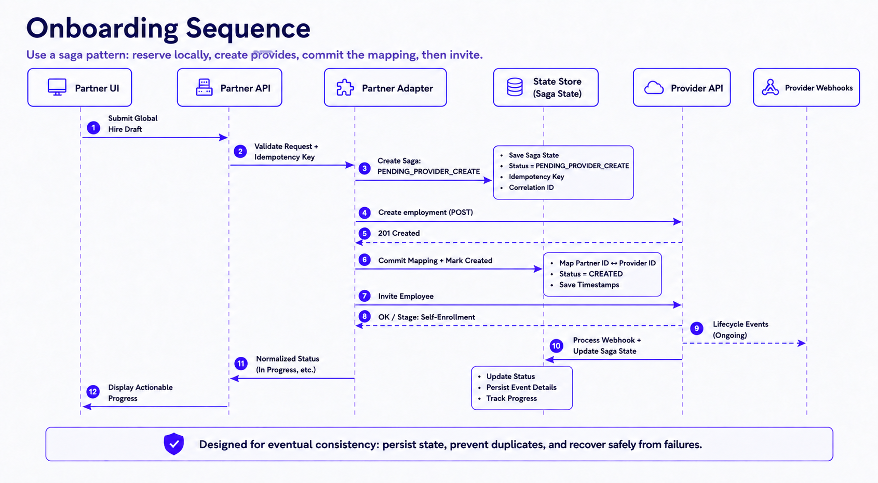
Use a saga pattern: reserve locally, create with the provider, commit the mapping, then invite.
Illustrative API example. Fields, states, and responses are fictional and require provider validation.
Notes:
Illustrative saga sequence, not a provider endpoint contract. Persist intent and a stable idempotency key before the provider call. Commit the returned provider identifier before inviting the employee. Provider webhooks enter the partner receiver and processor, which update saga state. If a create response is lost, recover the existing provider record before issuing another create.

Slide 7
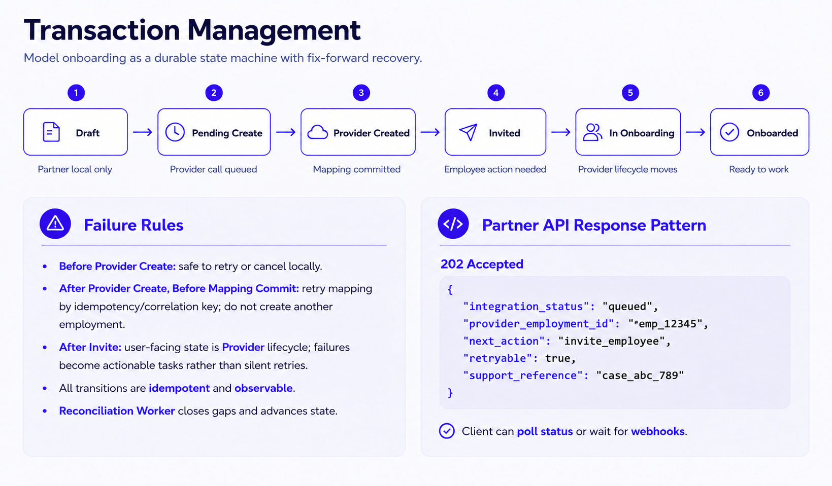
Illustrative API example. Fields, states, and responses are fictional and require provider validation.
Notes:
The response is an illustrative partner-facing status resource, not a provider payload. A provider identifier and invite action apply only after creation and mapping commit. Before provider creation succeeds, omit the provider identifier and return a pending-create state. Local deduplication alone cannot guarantee exactly-once creation after an ambiguous provider timeout. Recovery needs provider idempotency, a stable searchable external reference, or manual resolution.

Slide 8
Failure Handling & Recovery
Design the UI so failures are visible, specific, and recoverable.
Validation error
Provider API timeout
Show field-level corrections before creating the provider record.
Show “creating hire” with safe retry/backoff.
Action owner: User
Action owner: System (automatic retry)
Record created, mapping commit failed
Eligibility/compliance blocked
Show “syncing record” and prevent duplicate creation.
Show the next action and owner supplied by the provider.
Action owner: Operations / Reconciliation Worker
Action owner: Employee or provider
Do not expose raw transport errors to end users. Translate to business states with a support reference.

Slide 9
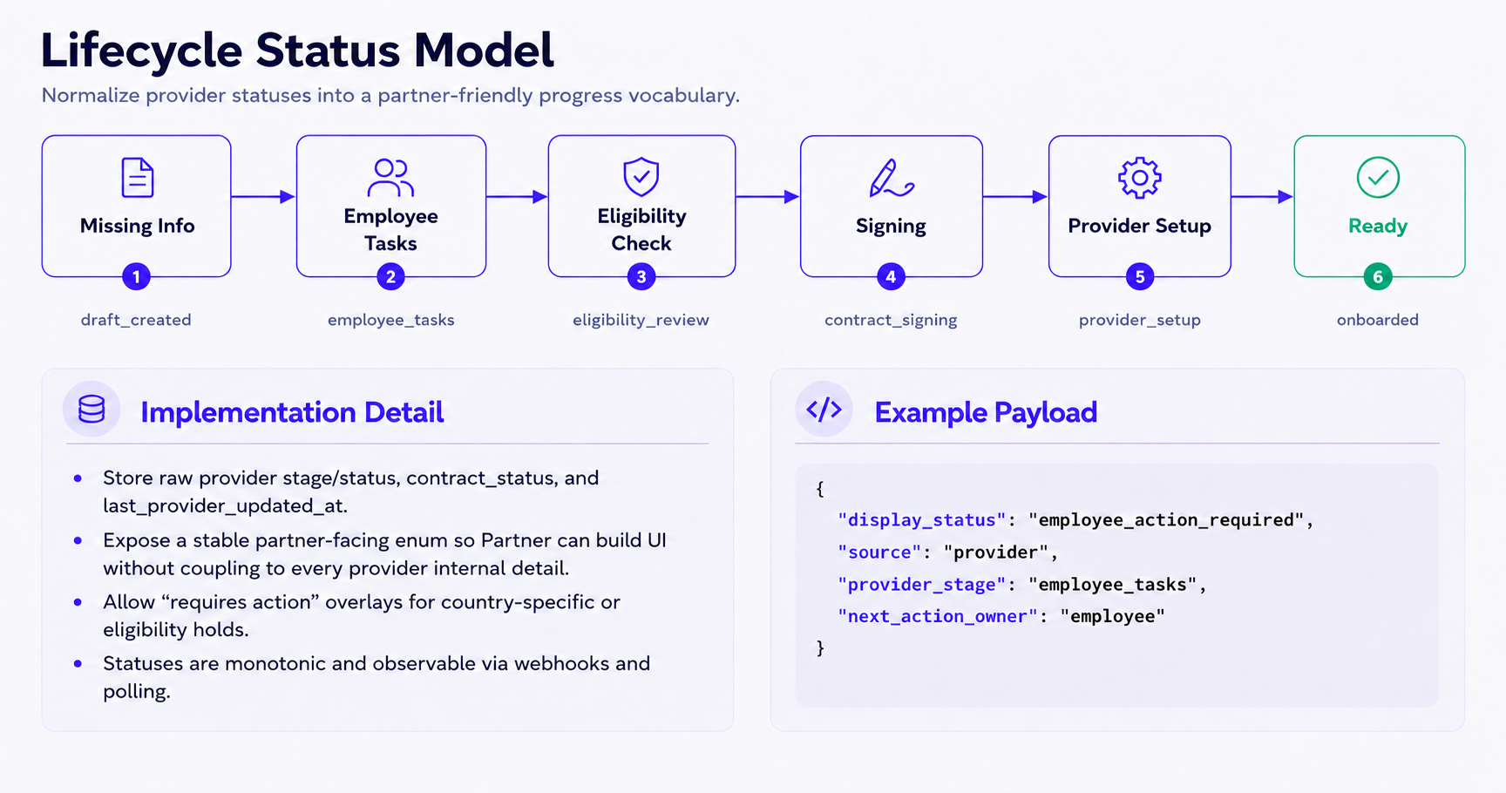
Illustrative API example. Fields, states, and responses are fictional and require provider validation.
Notes:
Lifecycle names and JSON fields are fictional examples. Monotonic progress is an intended display model for the normal onboarding path, not a guarantee about provider state. Preserve raw provider state and versions. Handle reopened tasks, corrections, holds, and offboarding through explicit transitions and action overlays.

Slide 10
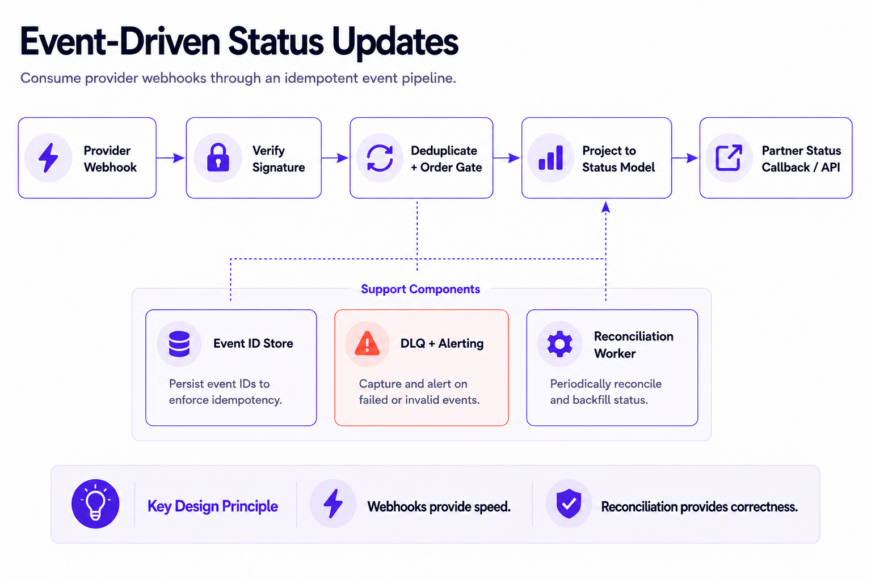
Notes:
Persist verified events before acknowledging delivery. Deduplicate and apply ordering checks atomically with state updates where possible. Webhooks provide timely notification. Reconciliation repairs missed updates, subject to provider availability and correct mapping rules.

Slide 11
Handling Duplicate, Out-of-order, and Missed Events
Design for eventual consistency when webhook delivery is imperfect.
Duplicate event
Out-of-order event
Ignore previously processed webhook events using an
idempotency key (event ID or composite key).
Validate timestamps/versions and fetch the latest provider state
before applying updates.
Recovery owner: Idempotency service
Recovery owner: Event processor
Missed event
Bad payload / unknown mapping
Periodic reconciliation compares active onboarding records against
the provider and backfills missing changes.
Route failed events to the DLQ, alert operations, and replay after
mapping correction.
Recovery owner: Reconciliation worker
Recovery owner: Operations / DLQ replay
Treat webhooks as change notifications, not the source of truth. Provider APIs remain authoritative for current state.

Slide 12
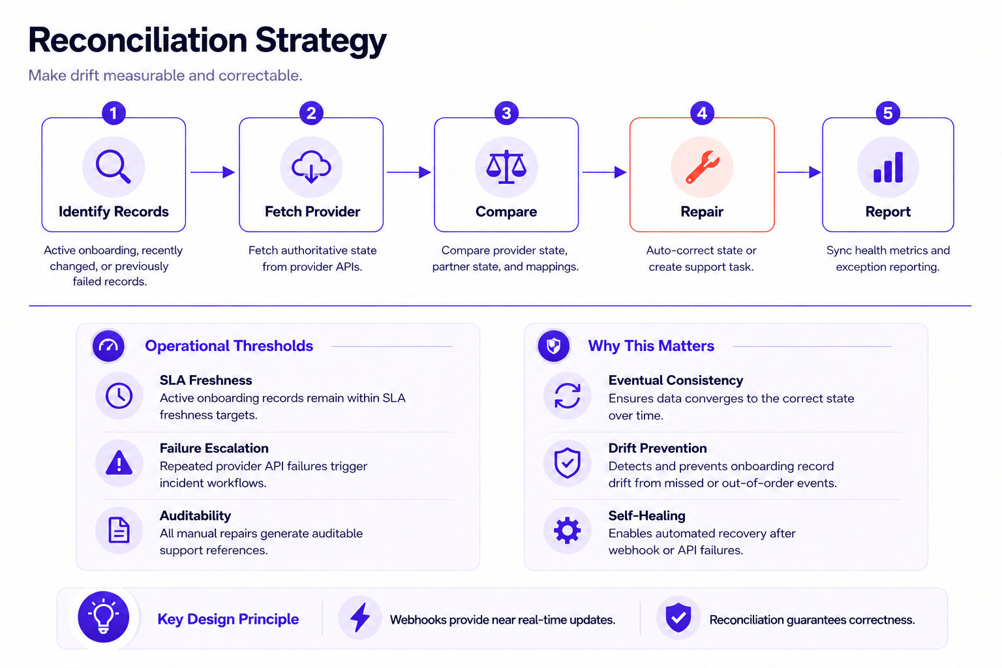
Notes:
Reconciliation supports eventual convergence when the provider is reachable and mappings and repair rules are correct. Correctness is a design objective, not an unconditional guarantee. Define measurable freshness targets for a future implementation. Escalate unresolved or ambiguous outcomes for review.

Slide 13
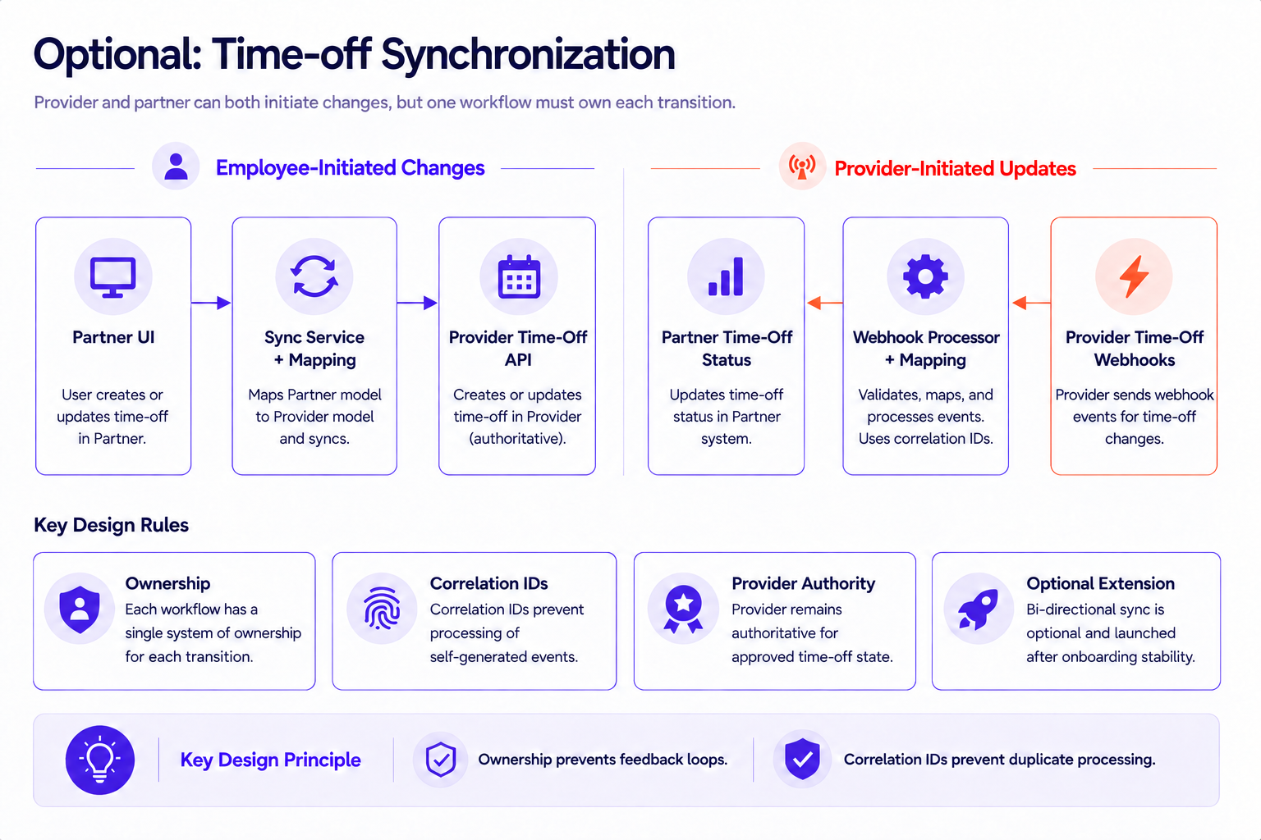
Notes:
Correlation IDs support traceability and origin detection. Prevent feedback loops with origin metadata, field ownership, no-op detection, and durable deduplication together. A correlation ID alone does not prevent duplicate processing.

Slide 14
Bidirectional Synchronization Considerations
Avoid infinite loops, stale UX, and conflicting state transitions.
Risk
Mitigation
Infinite update loop
Origin metadata + correlation IDs + no-op detection before outbound writes.
Concurrent edits
Use field ownership and approved conflict rules. Escalate unresolved conflicts.
State mismatch
Provider state is authoritative. Partner may show pending local changes.
Unsupported transition
Validate supported transitions. Direct users to the provider portal when required.
Public holiday / system-created leave
Keep provider-created records read-only unless the API supports updates.
Each system can update only the fields and transitions it owns.

Slide 15
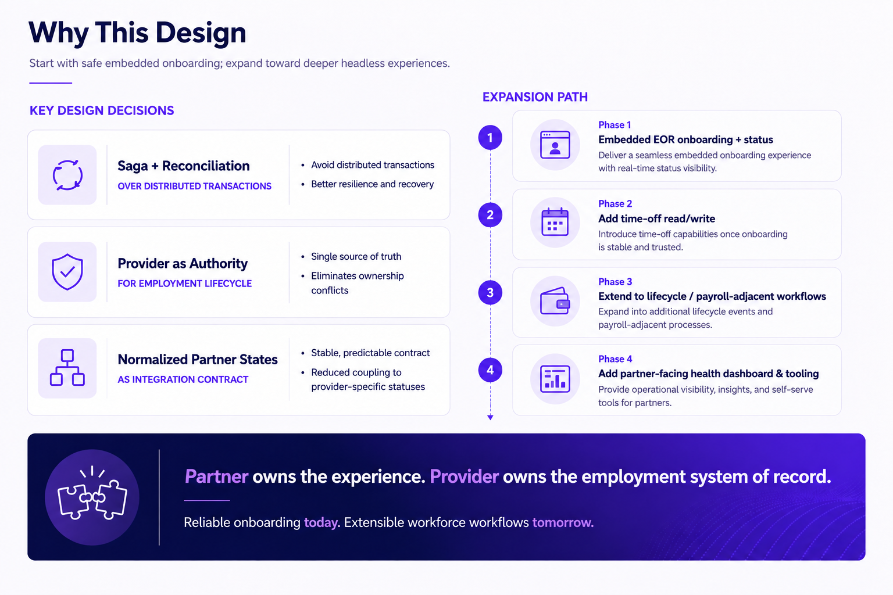
Notes:
The expansion path is a hypothetical roadmap for this independent exercise. Saga orchestration trades immediate atomicity for durable state, recovery logic, and eventual consistency. Reconciliation adds API load and repair complexity. Normalized states reduce coupling but require versioned mappings and retention of provider detail. Operational monitoring and recovery are prerequisites for the initial phase, even if a partner-facing dashboard comes later.

Slide 16
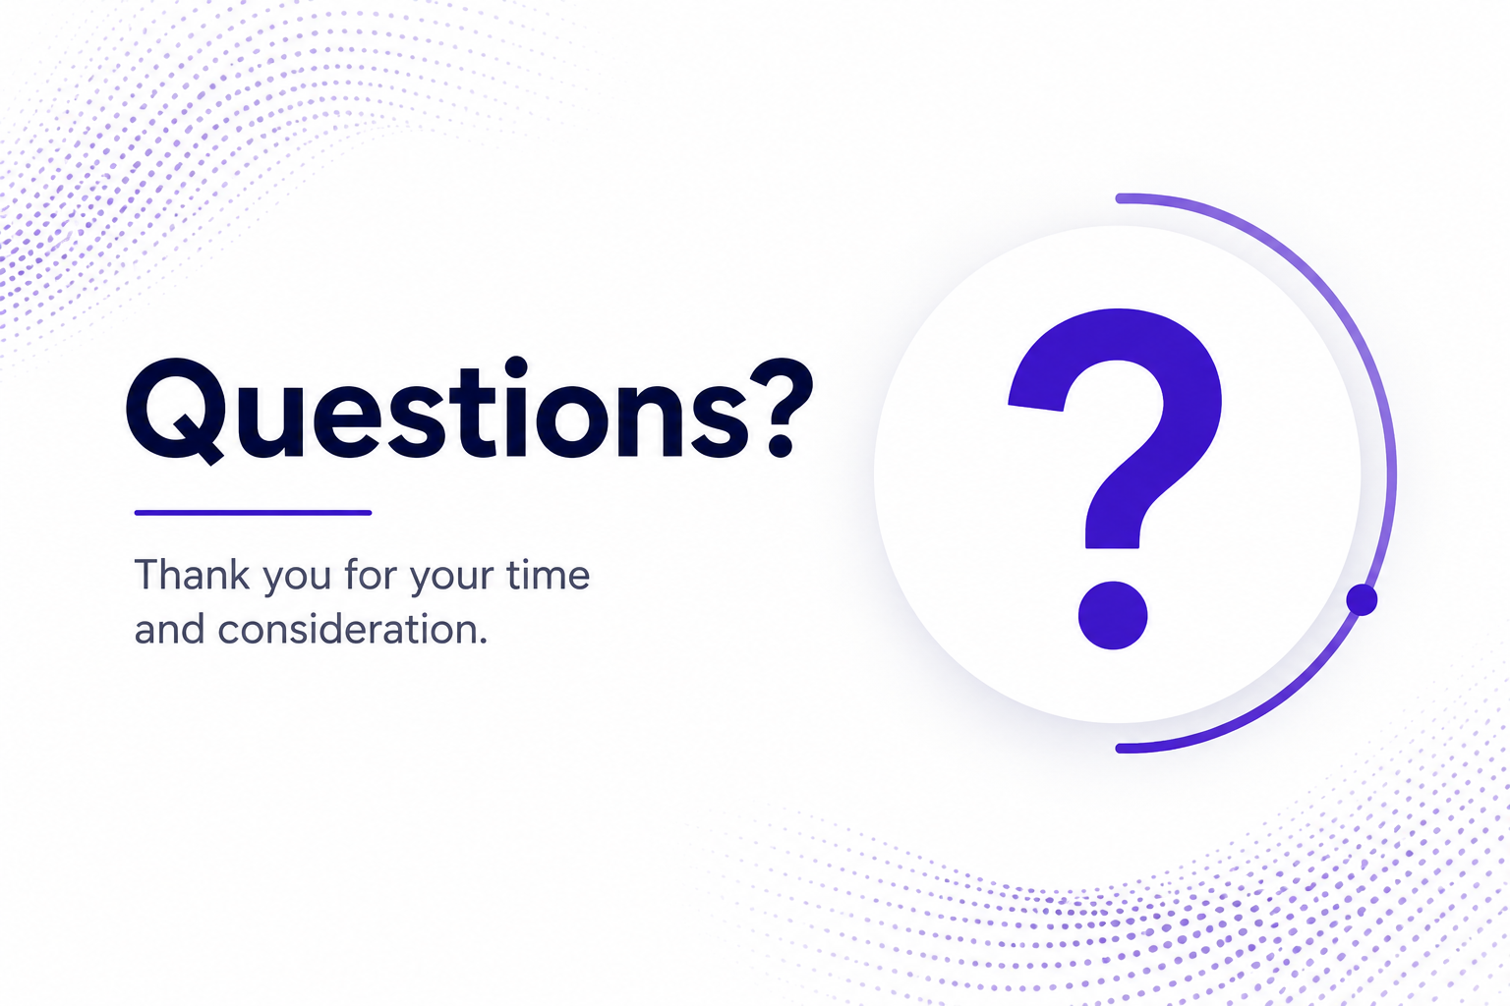

Slide 17
Appendix: API Contract Validation
Validation checklist for a hypothetical provider integration.
API access and authentication: OAuth, scopes, tenant context, embedded flows, and events.
Employment creation: create operations, sandbox environments, and organization identifiers.
Update and invite: employee invitations and visibility into employment stage/status.
Lifecycle stages: draft creation, employee tasks, eligibility, signing, onboarding, and offboarding.
Webhooks: callback registration, signatures, timestamps, retries, and event identity.
Time off: status ownership, create/update/cancel operations, and change notifications.
All API examples are illustrative. Validate endpoints, events, and payloads in the provider sandbox before any implementation.

Slide 18
Appendix: Assumptions and Open Questions
Questions for a provider evaluation before any implementation.
SDK / Embedded Components
Confirm whether provider SDKs or hosted flows support this experience, and where API-only UX is required.
Webhook Payload Contract
Confirm stable event IDs, timestamps, object IDs, retry behavior, and delivery-order guarantees.
Idempotency Support
Confirm provider idempotency support. If absent, define lookup and recovery for ambiguous create outcomes.
Rate Limits and Polling Windows
Define reconciliation cadence that respects API limits while keeping the partner UI fresh.
Sandbox Validation
For a future implementation, test required fields, failure paths, webhook replay, DLQ recovery, and support handoff.

