Slide 1

Are Charter Schools Really Better?
Does Region/Access to a University Affect Test Results?
Jeff Eickholt, Xiaodi Lin, Steven J. Bark
Data Analytics and Visualization Bootcamp Project 1

Slide 2
Charter Schools and Education Reform
Accountability
Rapid evaluation if it doesn’t work.
Choice
Parents dictate where to send their children.
Autonomy
Entrepreneurial and innovative.

Slide 3
But Only if the Schools Work!
The Dataset: 2019 Math STAAR Test
Texas Assessment of Academic Readiness (STAAR) Test 2019
Administered to all public schools (ISD and Charter) at the same time and under similar conditions (N>4000 schools)
Large dataset (#schools, demographics, geographical, socioeconomic, immigrant status, much more!)
CAVEATS: Only one standardized test, Grades 3-5!

Slide 4
Data Wrangling
School Level Data:
CSV File
Contained: School Type Address
Math STAAR Test Results:
CSV File
Master Dataset
Google Geocode API
Google Places API
Master Dataset
Census API

Slide 5
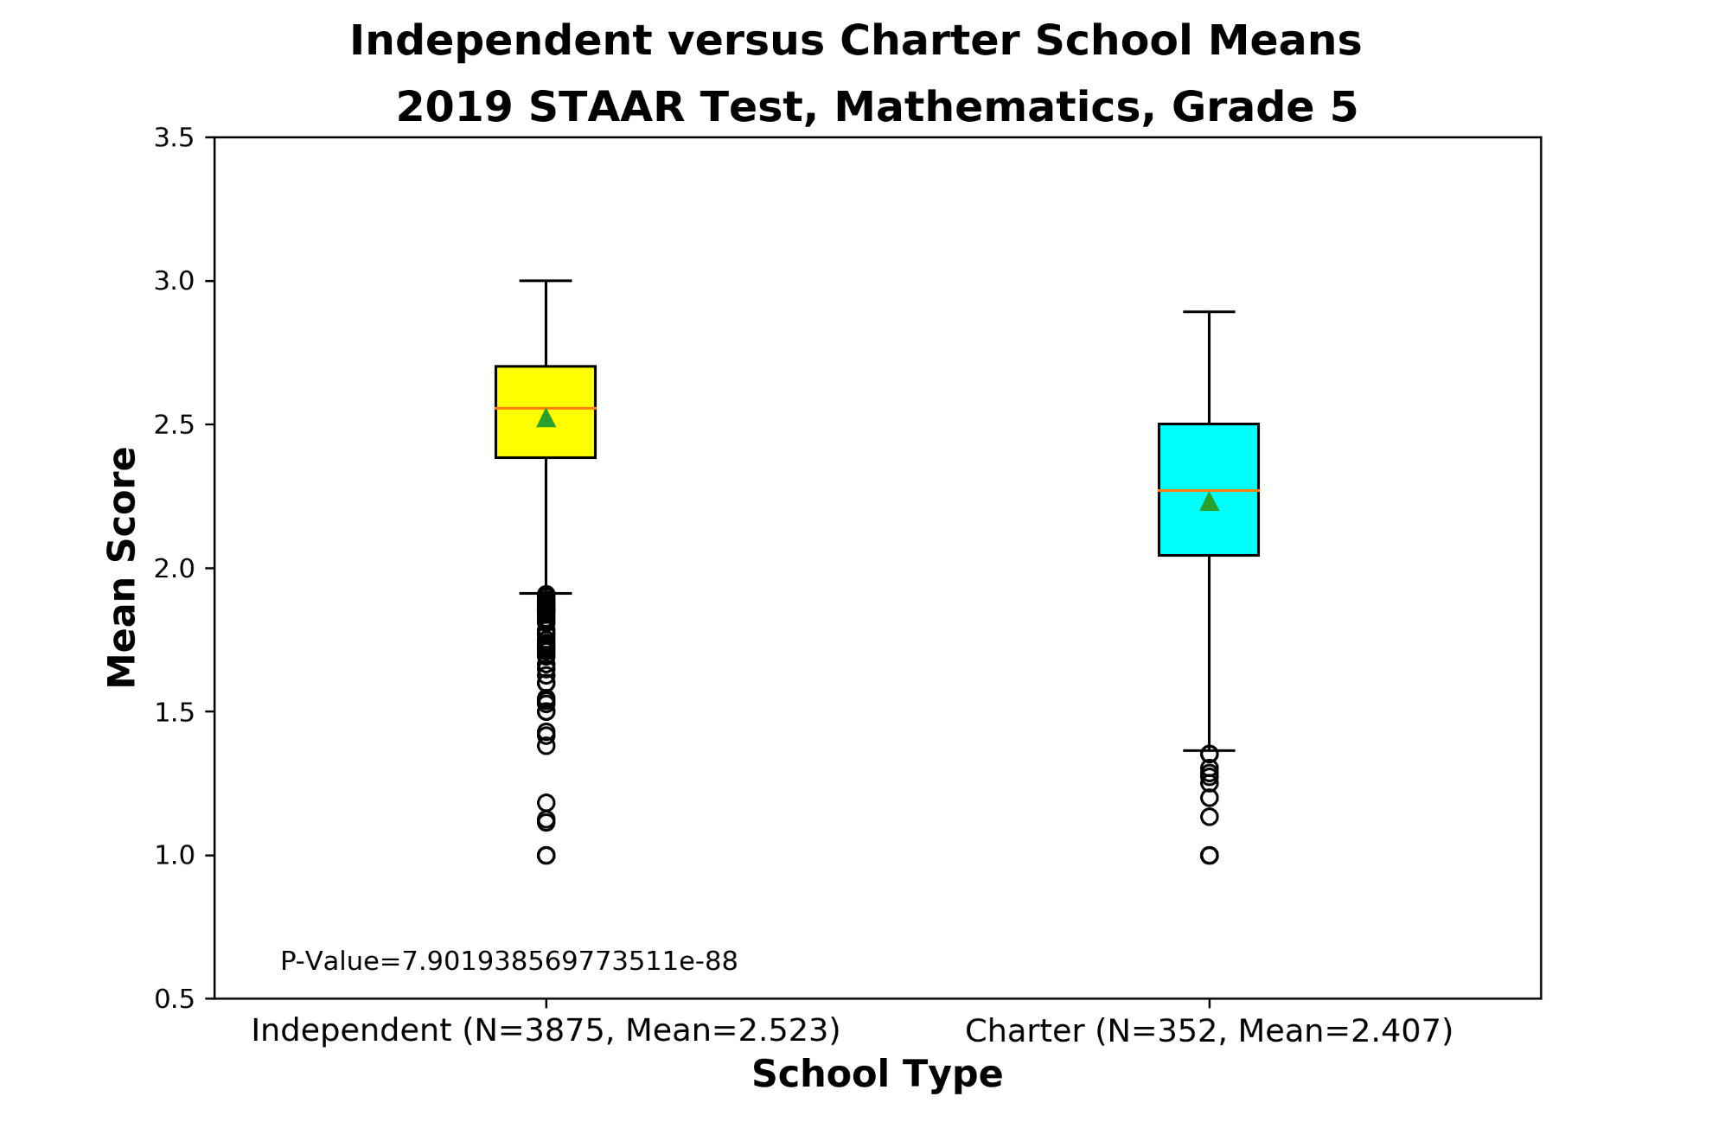

Slide 6
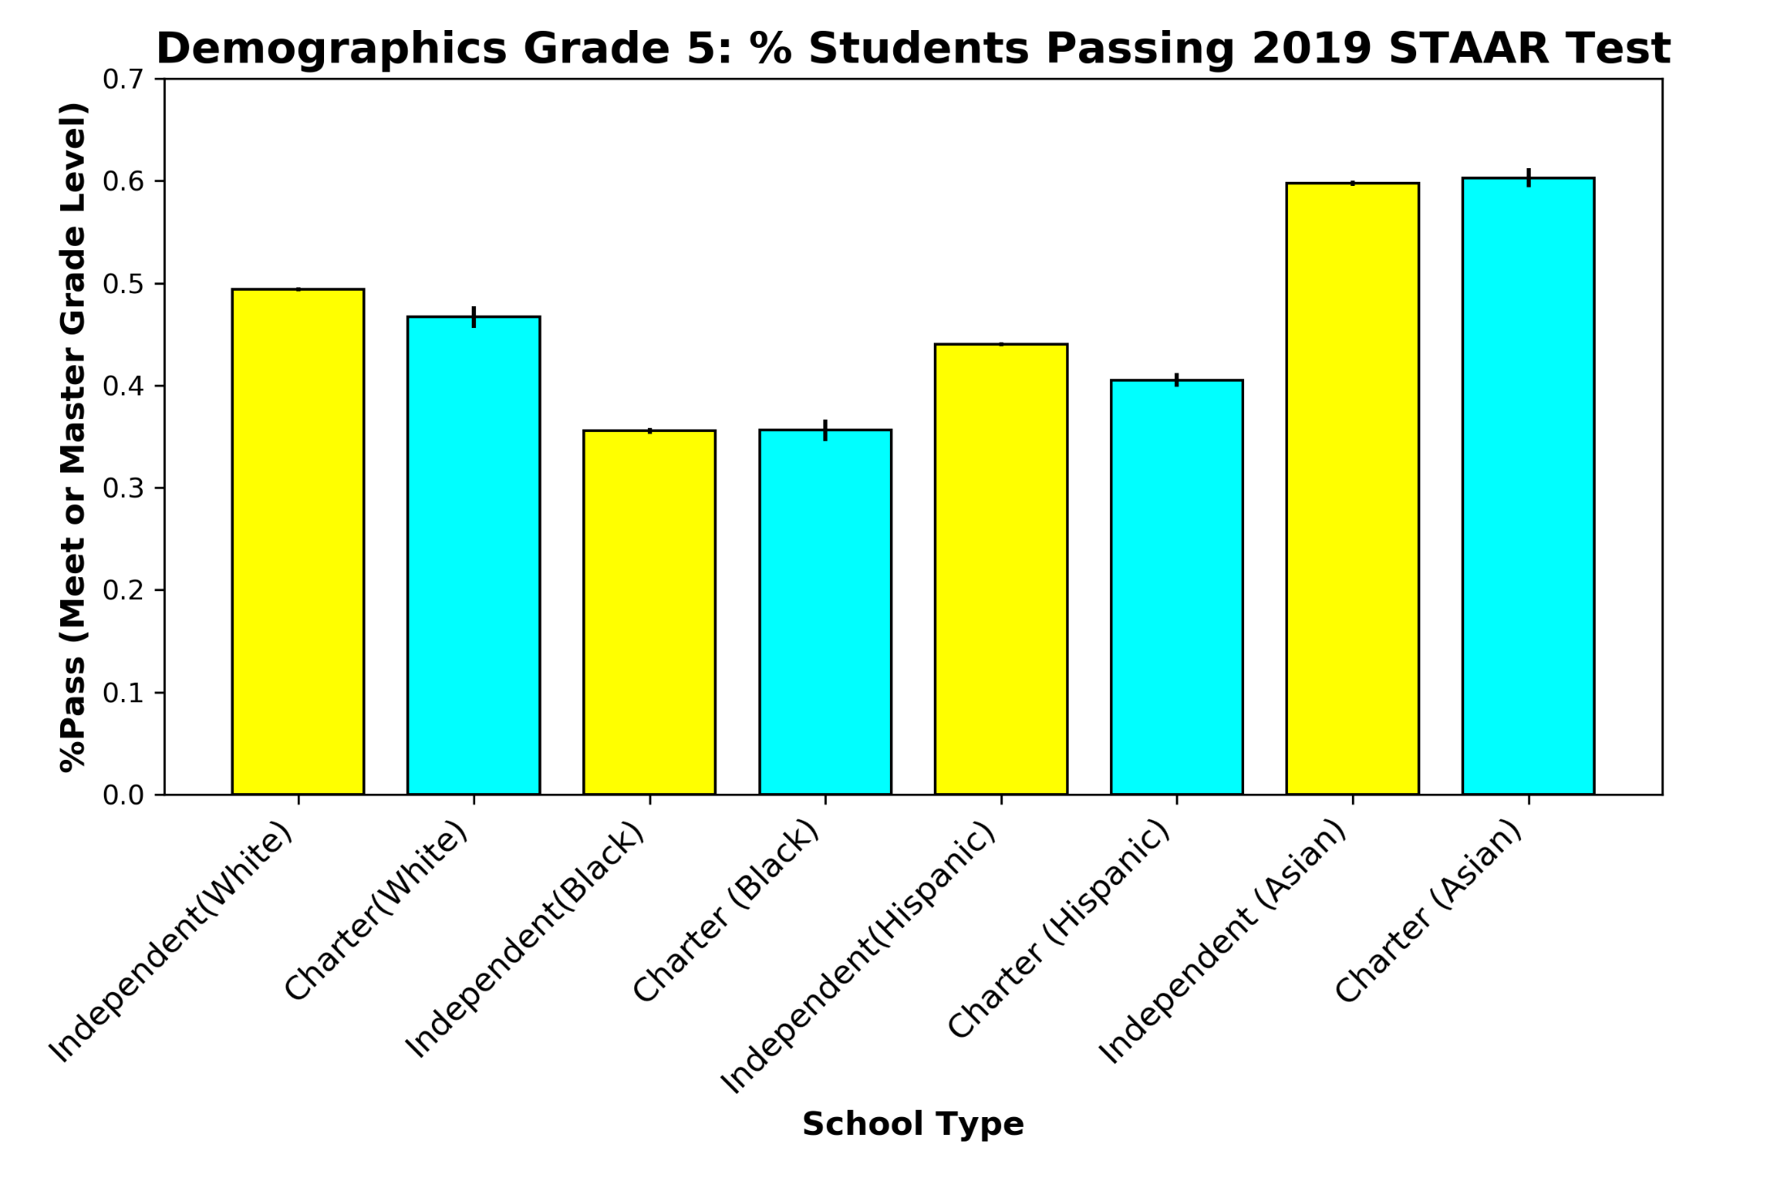

Slide 7
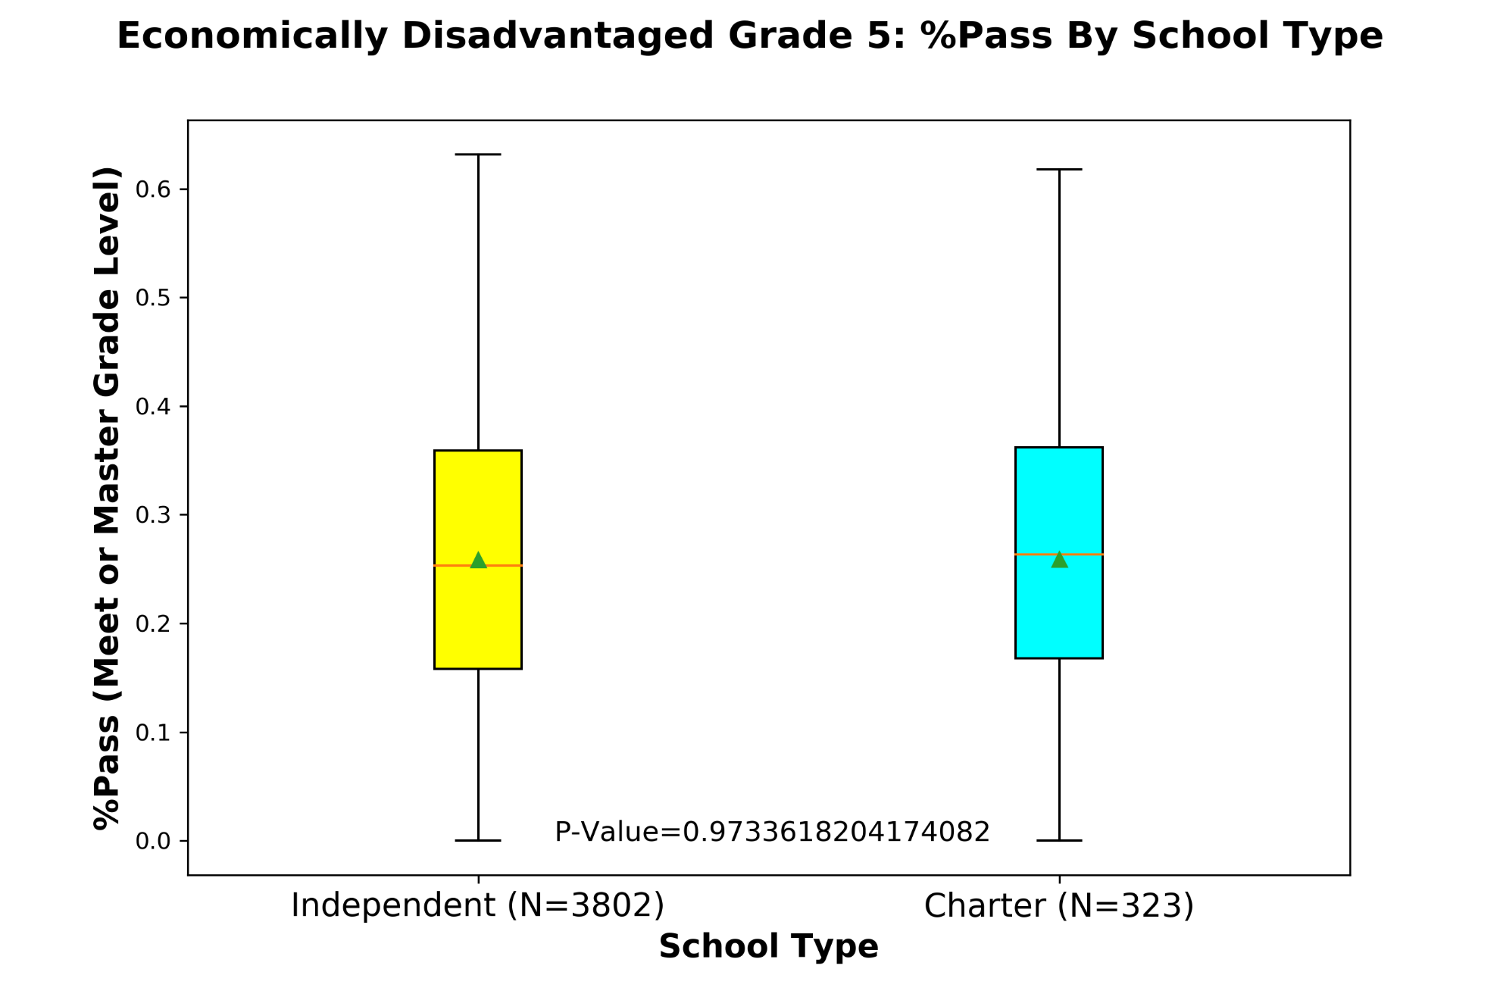

Slide 8

Geographical Analysis
Does Region of State Affect Test Result?
Does Access to Higher Learning Affect Test Results?

Slide 9
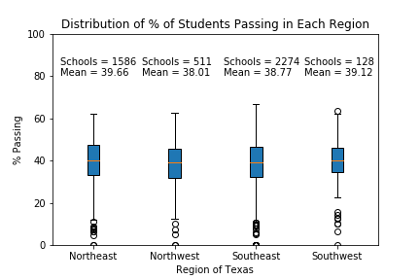

Geographical Analysis
Comparison of Regions

Slide 10
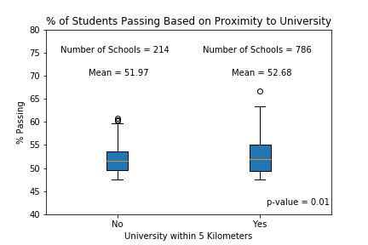
Geographical Analysis
Nearby University

Slide 11
Conclusions
No Advantage for Charter Schools
Global (Across All Schools in Texas)
Demographics
Economically Disadvantaged
Region Does Not Appear to Affect Test Results
Proximity to University Statistically Significant, but Is It Real?
Future Studies
Urban versus Rural Schools
Area Socioeconomics versus School Performance
Performance versus Years and Grades

