Slide 1

Are Charter Schools Really Better?
Jeff Eikholt, Xiaodi Lin, Steven J. Bark
Data Analytics and Visualization Bootcamp Project 1

Slide 2
Charter Schools and Education Reform
Accountability
Rapid evaluation if it doesn’t work.
Choice
Parents dictate where to send their children.
Autonomy
Entrepreneurial and innovative.

Slide 3
But Only if the Schools Work!
The Dataset: 2019 Math STAAR Test
Texas Assessment of Academic Readiness (STAAR) Test 2019
Administered to all public schools (ISD and Charter) at the same time and under similar conditions (N>4000 schools)
Large dataset (#schools, demographics, geographical, socioeconomic, immigrant status, much more!)
CAVEATS: Only one standardized test, Grades 3-5!

Slide 4
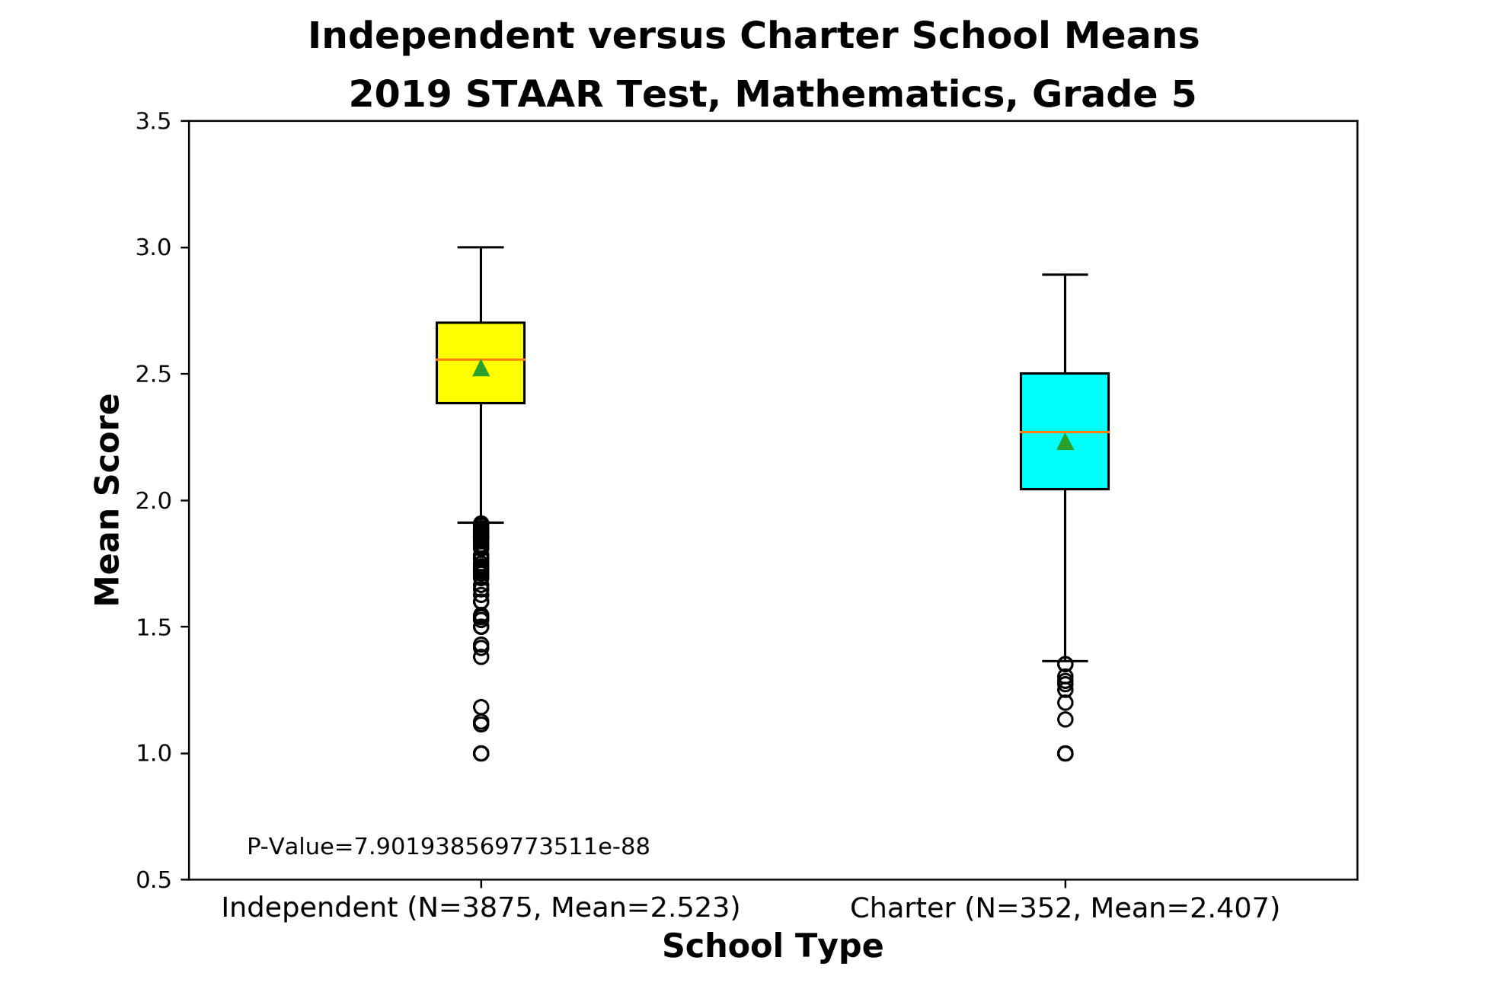

Slide 5
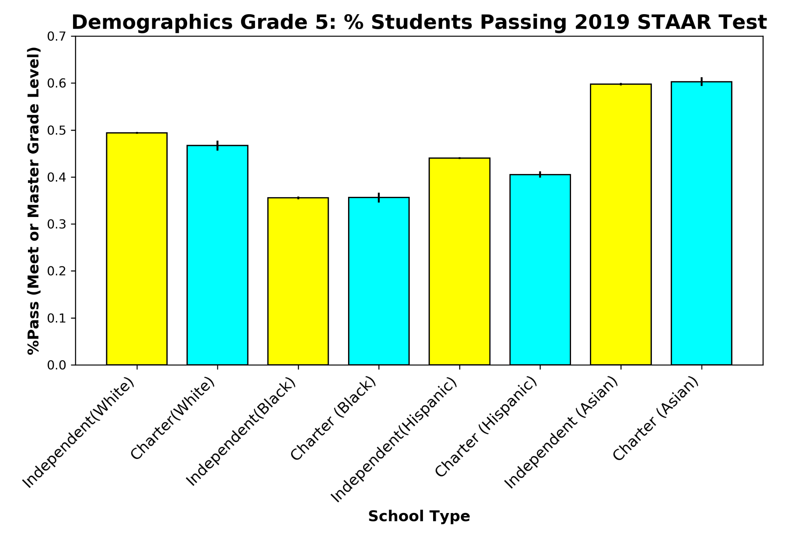

Slide 6
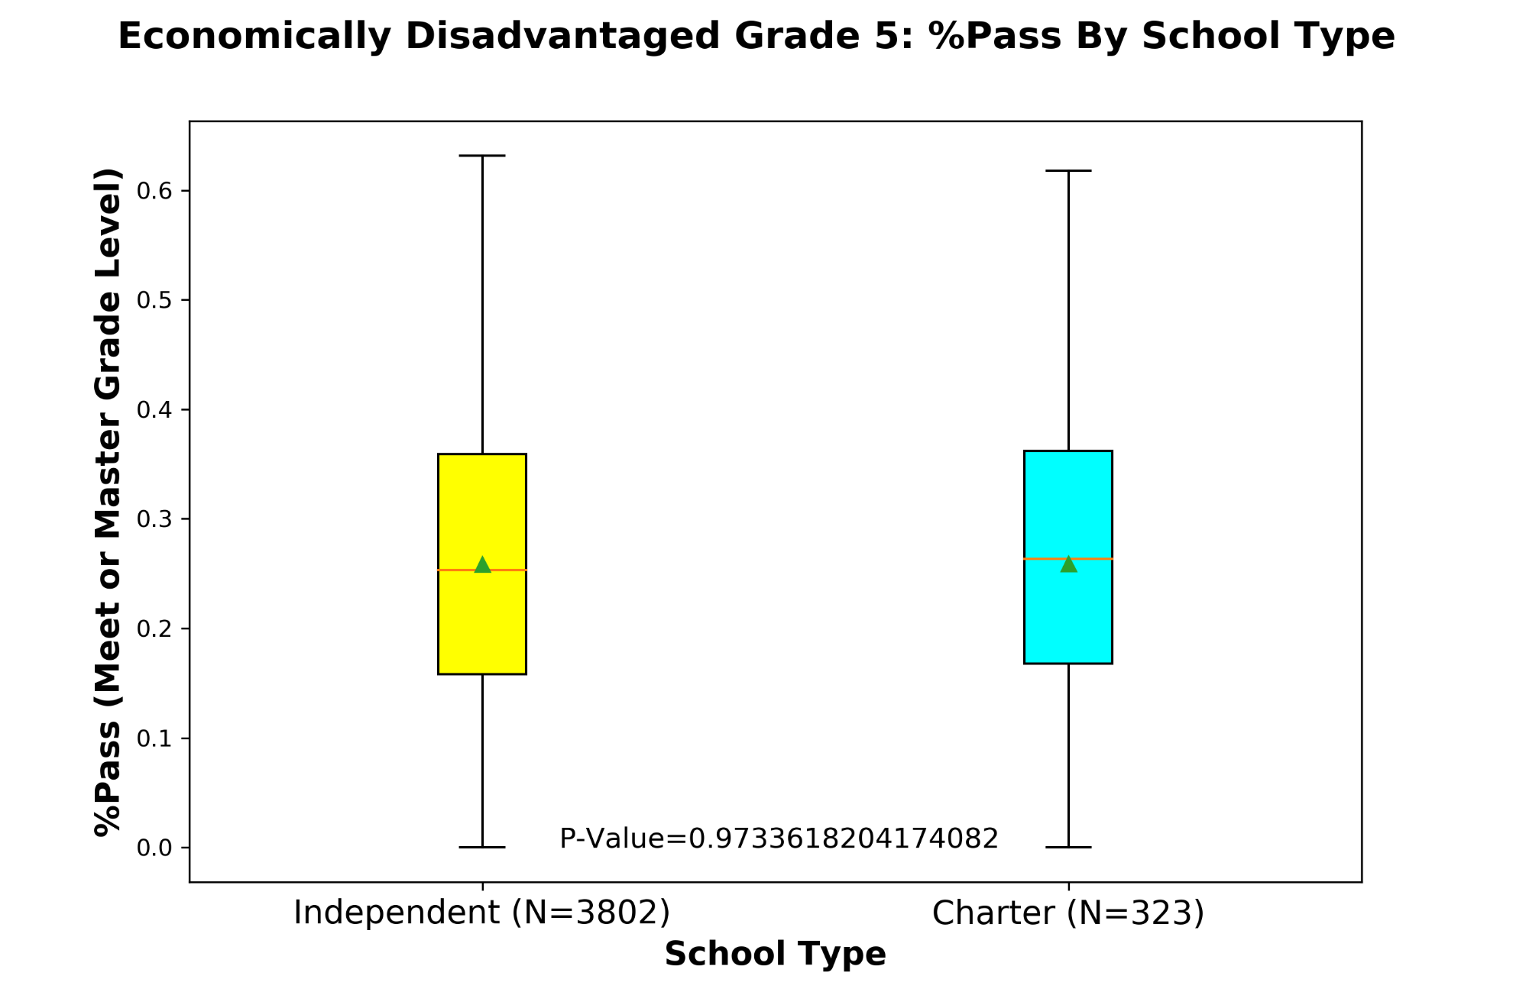

Slide 7
Conclusions
No Advantage for Charter Schools
Global (Across All Schools in Texas)
Demographics
Economically Disadvantaged
Future Studies
Urban versus Rural Schools
Socioeconomics of Particular Areas versus School Performance
Demographics of Schools versus Demographics of Areas
Performance versus Years and Grades

Slide 8

“If a nation expects to be ignorant and free, in a state of civilization, it expects what never was and never will be.”
Thomas Jefferson

