Slide 1

Scientific Computing on Heterogeneous Clusters using DRUM
(Dynamic Resource Utilization Model)
Jamal Faik¹, J. D. Teresco², J. E. Flaherty¹, K. Devine³ L.G. Gervasio¹
¹Department of Computer Science, Rensselaer Polytechnic Institute
²Department of Computer Science, Williams College
³Computer Science Research Institute, Sandia National Labs

Slide 2
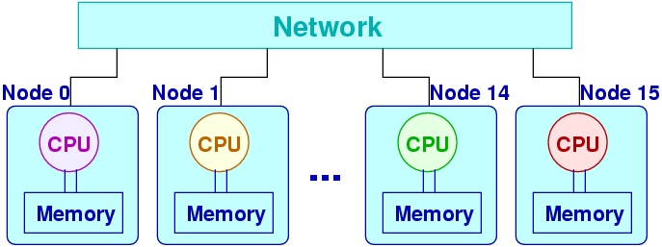
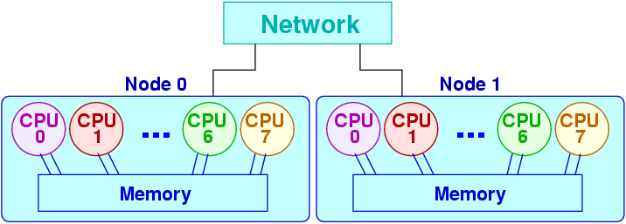
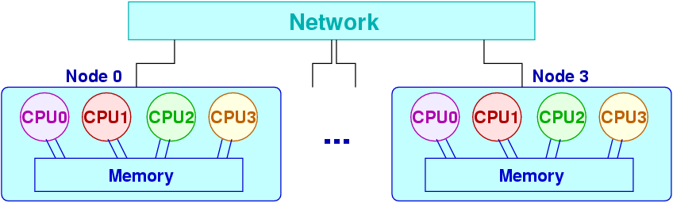

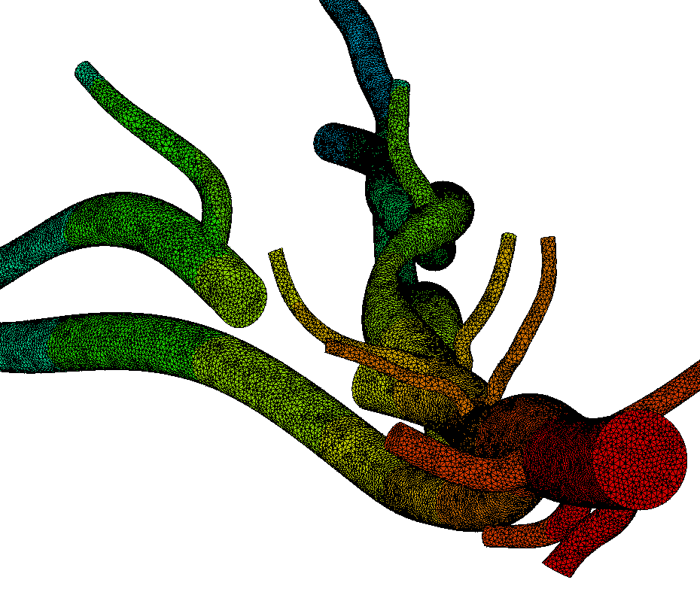
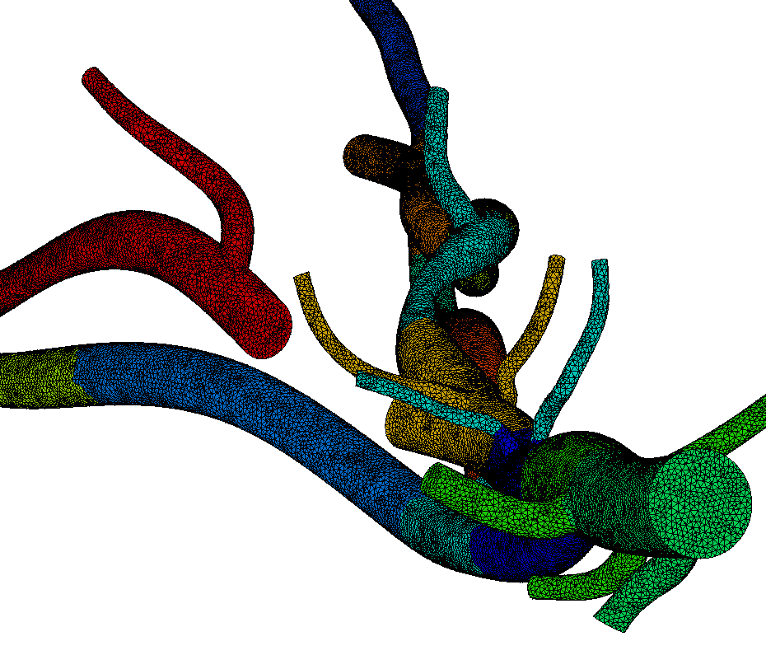
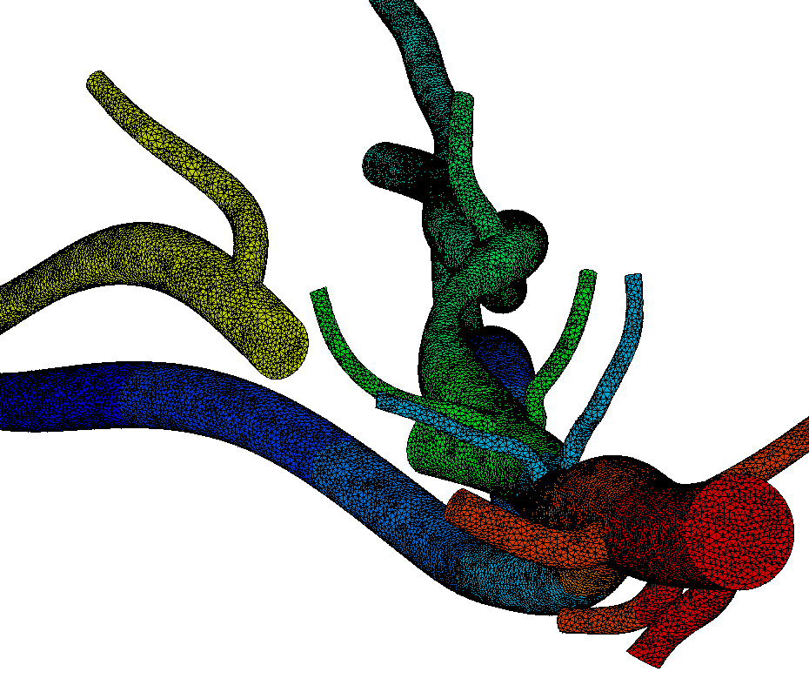
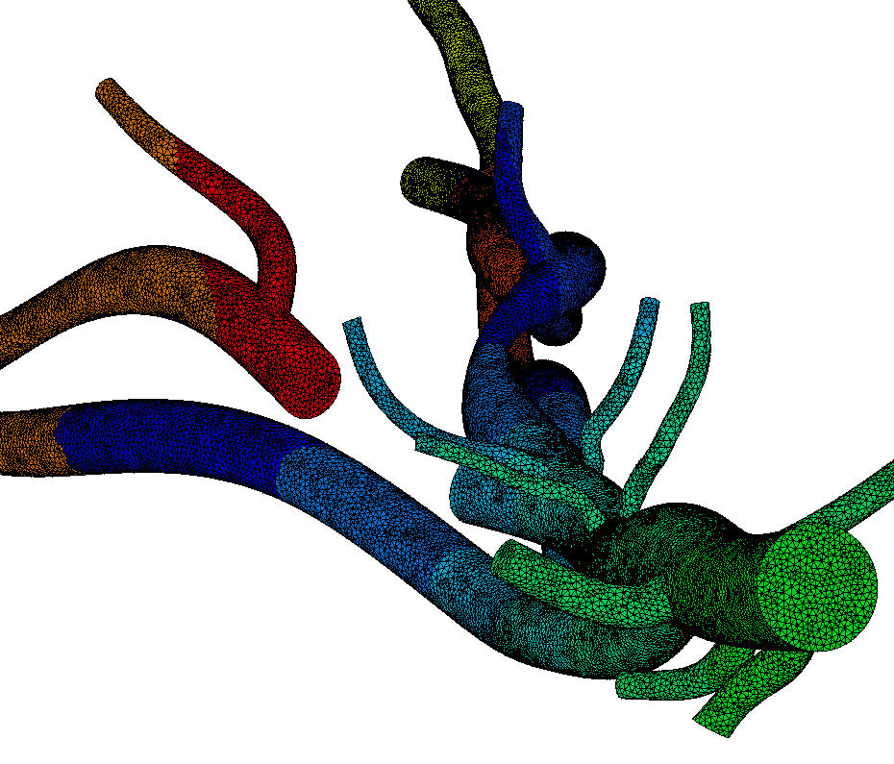
Load Balancing on Heterogeneous Clusters
Objective: Generate partitions, such that the number of elements in each partition matches the capabilities of the processor on which that partition is mapped
Minimize inter-node and/or inter-cluster communication
Single SMP –
strict balance
Uniprocessors - minimize communication
Two 8-way SMPs -
min comm across slow network
Four 4-way SMPs -
min comm across slow network

Slide 3
Resource Capabilities
What capabilities to monitor?
  Processing power
  Network bandwidth
  Communication volume
  Used and available Memory
How to quantify the heterogeneity?
  On which basis to compare the nodes?
How to deal with SMPs?

Slide 4
DRUM: Dynamic Resource
Utilization Model
A tree-based model of the execution environment
Internal nodes model communication points (switches, routers)
Leaf nodes model uni-processor (UP) computation nodes or symmetric multi-processors (SMPs)
Can be used by existing load balancer with minimal modifications
Router
UP
Switch
Switch
SMP
SMP
SMP
UP
UP
UP

Slide 5
Node Power
For each node in the tree, quantify capabilities by computing a power value
The power of a node is the percent of total load it can handle in accordance with its capabilities
A node’s n power includes processing power (p_{n}) and communication power (c_{n})
It is computed as a weighted sum of communication power and processing power
power_{n} = w_{cpu}p_{n} + w_{comm}c_{n}

Slide 6
Processing (CPU) power
Involves a static part obtained from benchmarks and a dynamic part
p_{n} = b_{n}(u_{n+} i_{n})
i_{n} = percent of CPU idle time
u_{n} = CPU utilization by local process
b_{n} = benchmark value
The processing power of internal nodes is computed as the sum of the powers of the node’s immediate children
For an SMP node n with m CPUs and k_{n} running application processes, we compute p_{n} as:

Slide 7
Communication power
A node’s communication power c_{n} at node n is estimated as the sum of average available bandwidth across all communication interfaces of node n
If during a given monitoring period T, λ_{n,i} and μ_{n,i} reflect the average rate of incoming and outgoing packets to and from node n, k the number of communication interfaces (links) at node n and s_{n,i} the maximum bandwidth for communication interface i, then:

Slide 8
Weights
What values for w_{comm} and w_{cpu}?
w_{comm+} w_{cpu}= 1
Values depend on the communication to processing ratio in the application, during the monitoring period.
Hard to estimate, especially when communication and processing are overlapped

Slide 9
Implementation
Topology description through XML file, generated from a graphical configuration tool (DRUMHead)
Benchmark (Linpack) is run to obtain MFLOPS for all computation nodes
Dynamic monitoring runs in parallel with application to collect data necessary for power computation

Slide 10
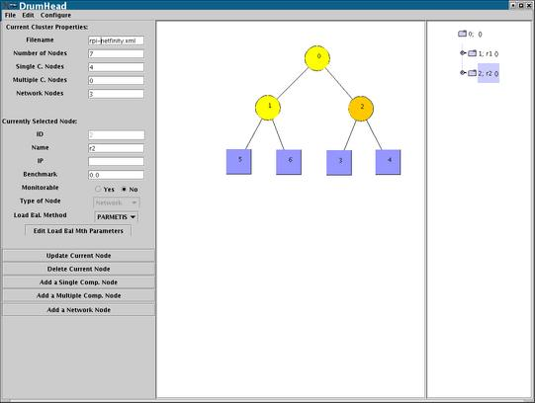
Configuration tool
Used to describe the topology
Also used to run benchmark (LINPACK) to get MFLOPS for computation nodes
Compute bandwidth values for all communication interfaces.
Generate XML file describing the execution environment

Slide 11
Dynamic Monitoring
Dynamic monitoring is implemented by two kind of monitors:
  CommInterface monitors collect communication traffic information
  CpuMem monitors collect cpu information
Monitors are run in separate threads

Slide 12
Monitoring
N11
commInterface MONITOR
Open
Start
Stop
GetPower
Execution environment
R1
R3
R4
cpuMem MONITOR
Open
Start
Stop
GetPower
N11
N12
N13
N14
R1
R2
R4

Slide 13
Interface to LB algorithms
DRUM_createModel
  Reads XML file and generates tree structure
  Specific computation nodes (representatives) monitor one (or more) communication nodes
  On SMPs, one processor monitors communication
DRUM_startMonitoring
  Starts monitors on every node in the tree
DRUM_stopMonitoring
  Stops the monitors and computes the powers

Slide 14



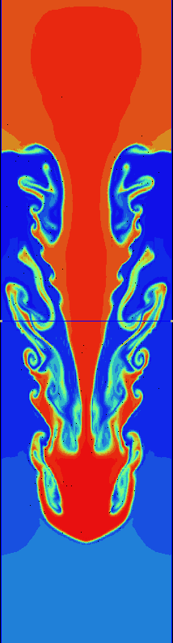
Experimental results
Obtained by running a two-dimensional Rayleigh-Taylor instability problem
Sun cluster with “fast” and “slow” nodes
Fast nodes are approximately 1.5 faster than slow nodes
Same number of slow and fast nodes
Used modified Zoltan Octree LB algorithm
Total execution time (s)
Processors | Octree | Octree + DRUM | Improvement
4 | 16440 | 13434 | 18%
6 | 12045 | 10195 | 16%
8 | 9722 | 7987 | 18%

Slide 15
DRUM on homogeneous clusters?
We ran Rayleigh-Taylor on a collection of homogeneous clusters and used DRUM-enabled Octree
  Experiments with a probing frequency of 1 second
Execution Time in seconds
Processors | Octree | Octree + DRUM
4 (fast) | 11462 | 11415
4 (slow) | 18313 | 17877

Slide 16
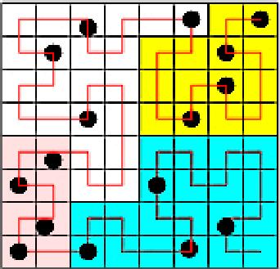
PHAML results with HSFC
Hilbert Space Filling Curve
Used DRUM to guide load balancing in the solution of a Laplace equation on a unit square
Used Bill Mitchell’s (NIST) Parallel Hierarchical Multi-Level (PHAML) software
Runs on a combination of “fast” and “slow” processors
The “fast” processors are 1.5 faster than the slow ones

Slide 17
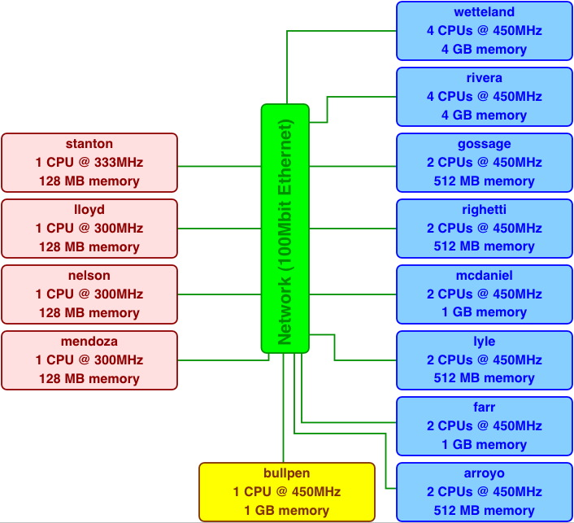
PHAML experiments on the
Williams College Bullpen cluster
We used DRUM to guide resource-aware HSFC load balancing in the adaptive solution of a Laplace equation on the unit square, using PHAML.
After 17 adaptive refinement steps, the mesh has 524,500 nodes.
Runs on the Williams College Bullpen cluster

Slide 18
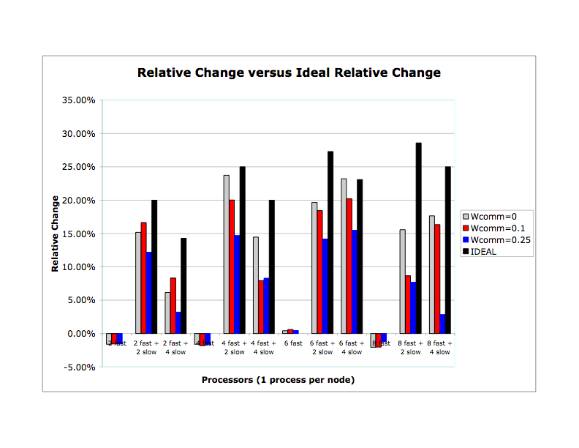
PHAML experiments (1)

Slide 19
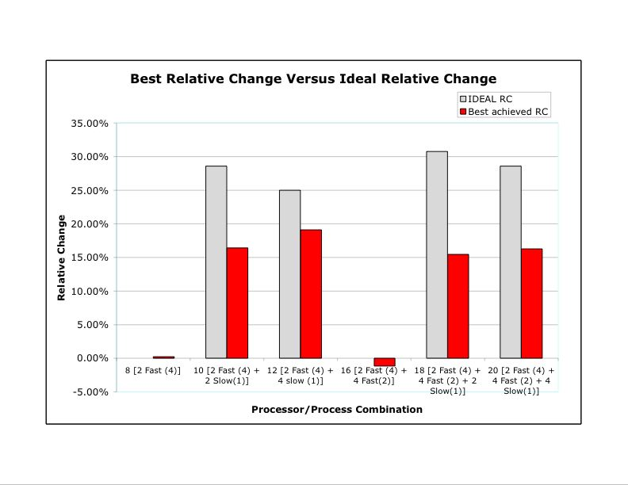
PHAML experiment (2)

Slide 20
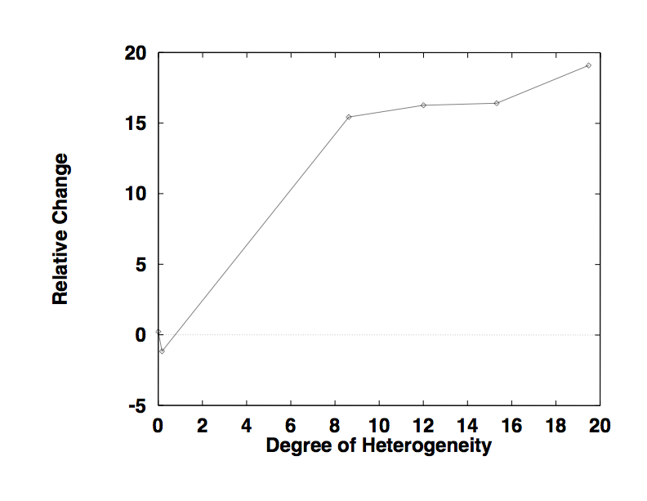
PHAML experiments: Relative Change vs. Degree of Heterogeneity
Improvement gained by using DRUM is more substantial when the cluster heterogeneity is bigger
We used a measure of degree of heterogeneity based on the variance of nodes MFLOPS obtained from the benchmark runs

Slide 21
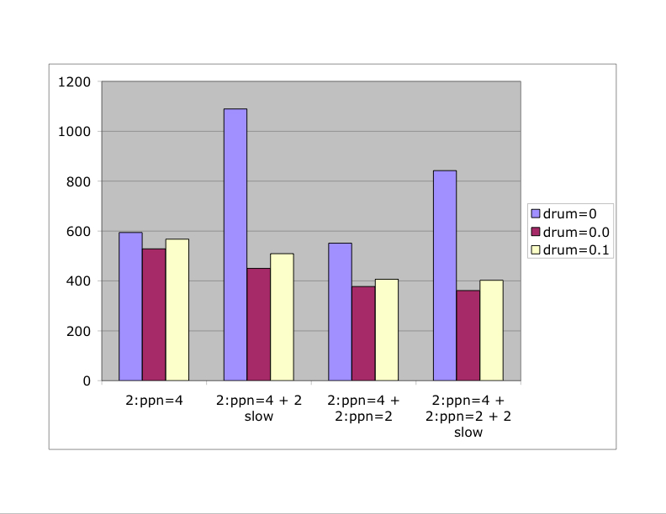
PHAML experiment
Non-dedicated Usage
Synthetic pure computational load (no communication) added on last two processors.

Slide 22
Latest DRUM efforts
Implementation using NWS measurement
Integration with Zoltan’s new hierarchical partitioning and load balancing.
Porting to Linux and AIX
Interaction between DRUM core and DRUMHead.
The primary funding for this work has been through Sandia National
Laboratories by contract 15162 and by the Computer Science Research
Institute. Sandia is a multiprogram laboratory operated by Sandia
Corporation, a Lockheed Martin Company, for the United States
Department of Energy's National Nuclear Security Administration under
contract DE-AC04-94AL85000.

Slide 23
Bckp1: Adaptive applications
Discretization of the solution domain by a mesh
Distribute the mesh over available processors
Compute solution on each element domain and integrate
Error resulting from discretization → refinement / coarsening of the mesh (mesh enrichment)
Mesh enrichment results in an imbalance of the number of elements assigned to each processor
Load Balancing becomes necessary

Slide 24
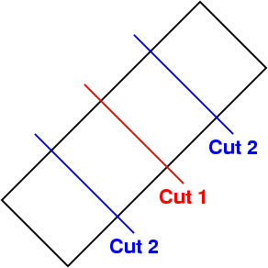
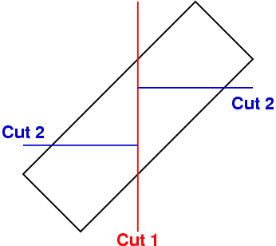
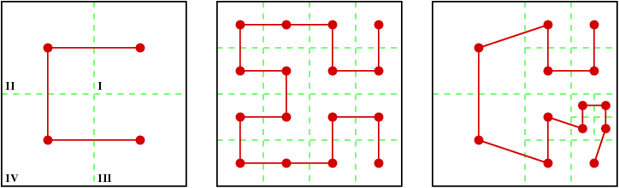
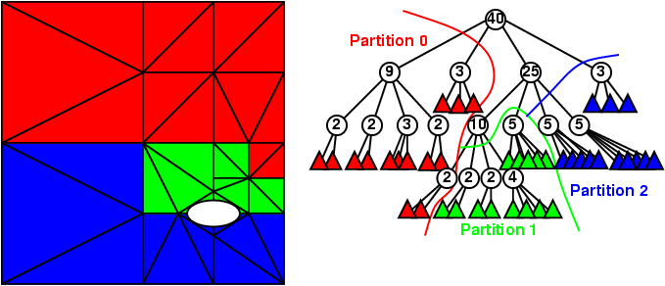
Dynamic Load Balancing
Graph-based methods (Metis, Jostle)
Geometric methods
  Recursive Inertial Bisection
  Recursive Coordinate Bisection
Octree/SFC methods

Slide 25
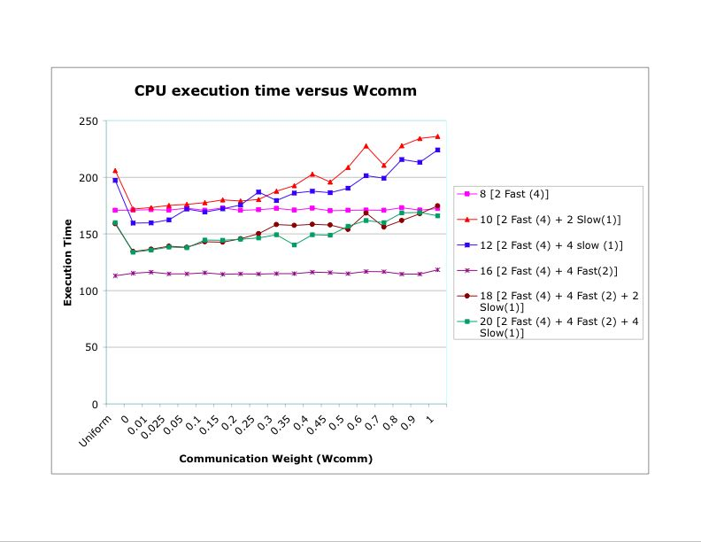
Backp2: PHAML experiments, communication weight study

