Slide 1
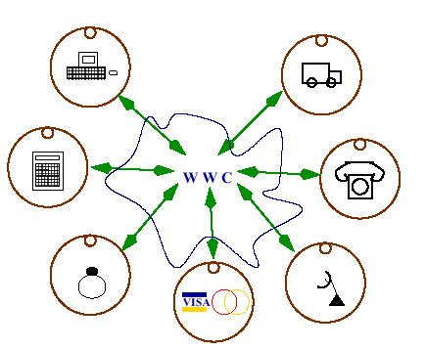
Middleware for Load Balancing
using Decentralized Agent Coordination
SIAM Computational Science and Engineering
Resource-Aware Parallel Computing (MS78)
Carlos Varela, cvarela@cs.rpi.edu
Department of Computer Science
Rensselaer Polytechnic Institute
http://wcl.cs.rpi.edu/
Graduate Students:
Travis Desell, Kaoutar El Maghraoui
February 15, 2005

Slide 2
Worldwide Computing
Computational Resources and Devices
  Large pool of idle resources available in the Internet
  Heterogeneous platforms
Networks
  Wide range of latencies/bandwidths
Dynamic resources
  Different degrees of availability
  Different types of failures
Research Goals
  Scalability to worldwide execution environments
  Inherent adaptability to environmental changes and resource availability
  Programmability and high-performance
Approach
  Adaptive reflective middleware to trigger automatic reconfiguration of applications
  High-level programming abstractions

Slide 3
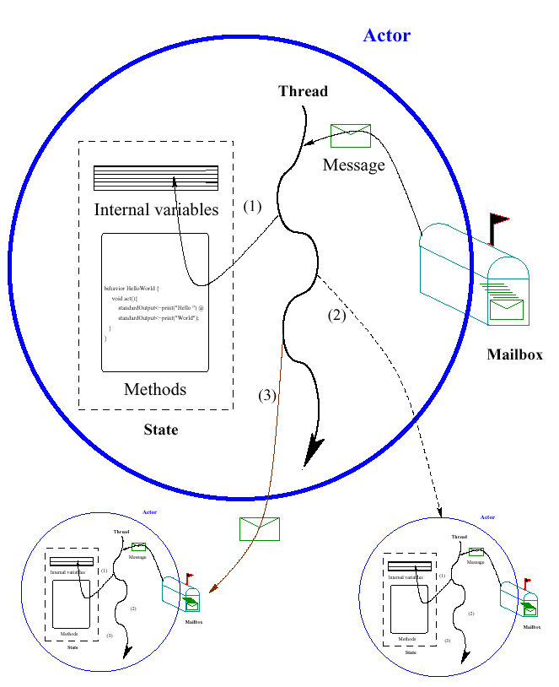
Actors/SALSA
Actor Model
  A reasoning framework to model concurrent computations
  Programming abstractions for distributed open systems
  G. Agha, Actors: A Model of Concurrent Computation in Distributed Systems. MIT Press, 1986.
SALSA
  Simple Actor Language System and Architecture
  An actor-oriented language for mobile and internet computing
  Programming abstractions for internet-based concurrency, distribution, mobility, and coordination
  C. Varela and G. Agha, “Programming dynamically reconfigurable open systems with SALSA”, ACM SIGPLAN Notices, OOPSLA 2001, 36(12), pp 20-34.

Slide 4
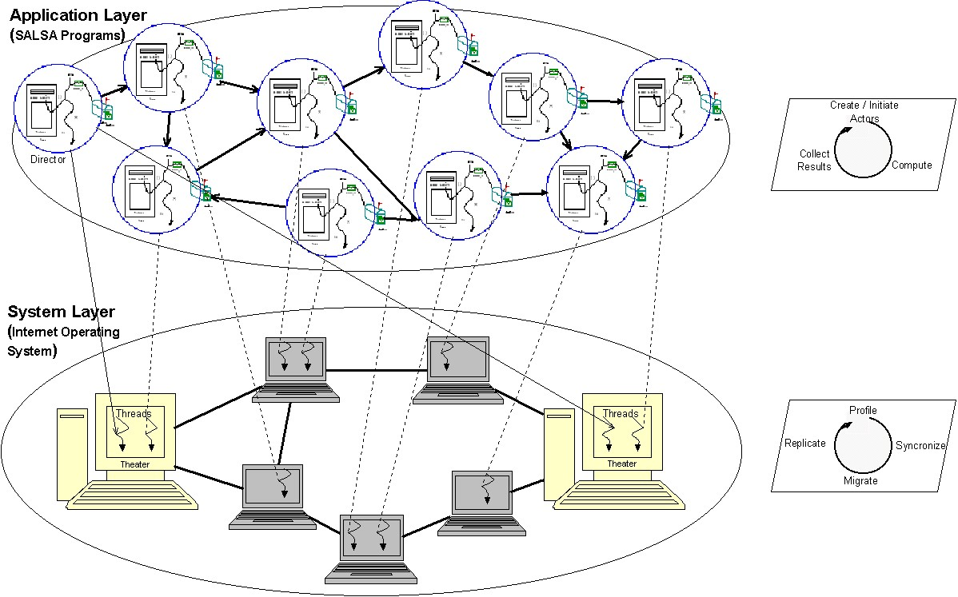
Middleware/IOS
Middleware
  A software layer between distributed applications and operating systems.
  Alleviates application programmers from directly dealing with distribution issues
    Heterogeneous hardware/O.S.s
    Load balancing
    Fault-tolerance
    Security
    Quality of service
Internet Operating System (IOS)
  A decentralized framework for adaptive, scalable execution
  Modular architecture to evaluate different distribution and reconfiguration strategies
  T. Desell, K. El Maghraoui, and C. Varela, “Load Balancing of Autonomous Actors over Dynamic Networks”, HICSS-37 Software Technology Track, Hawaii, January 2004. 10pp.

Slide 5
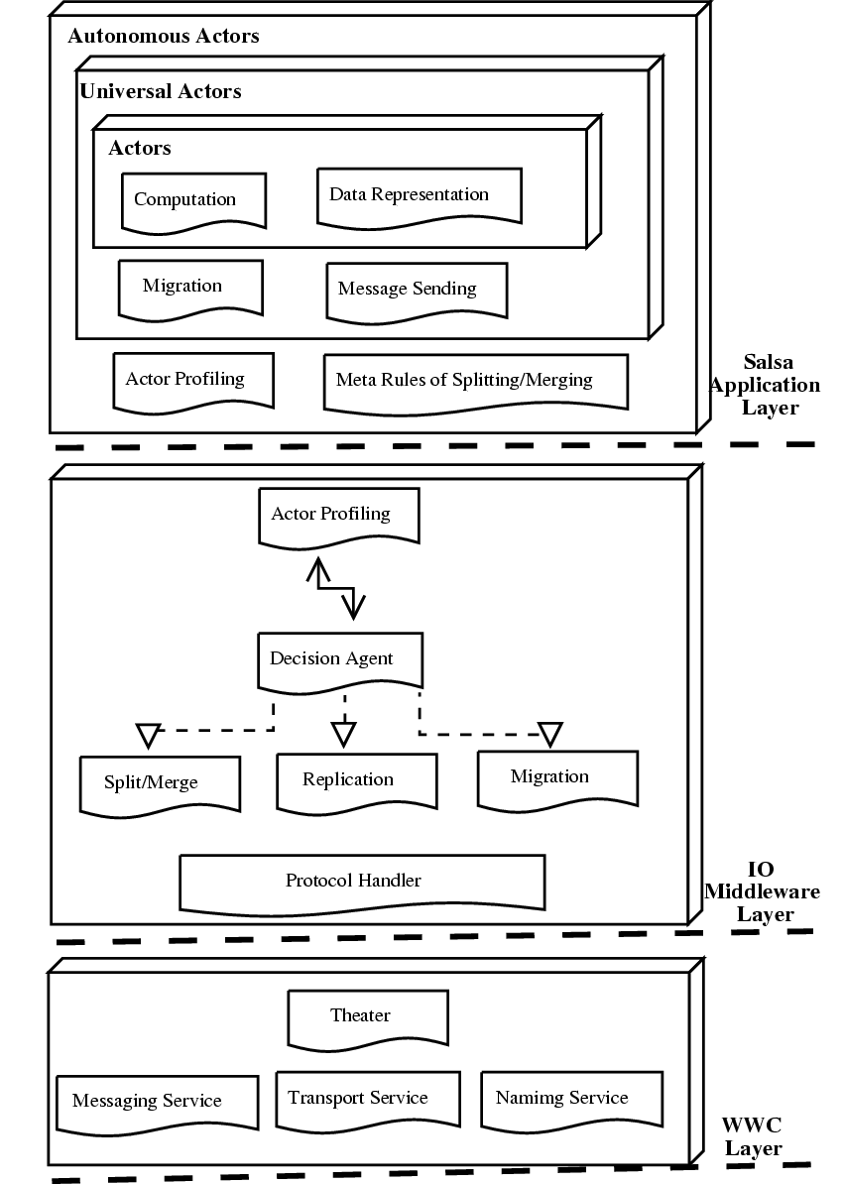
World-Wide Computer Architecture
SALSA application layer
  Programming language constructs for actor communication, migration, and coordination.
IOS middleware layer
  A Resource Profiling Component
    Captures information about actor and network topologies and available resources
  A Decision Component
    Takes migration, split/merge, or replication decisions based on profiled information
  A Protocol Component
    Performs communication between nodes in the middleware system
WWC run-time layer
  Theaters provide runtime support for actor execution and access to local resources
  Pluggable transport, naming, and messaging services

Slide 6
Autonomous Actors
Actors
  Unit of concurrency
  Asynchronous message passing
  State encapsulation
Universal actors
  Universal names
  Location/theater
  Ability to migrate between theaters
Autonomous actors
  Performance profiling to improve quality of service
  Autonomous migration to balance computational load
  Split and merge to tune granularity
  Replication to increase fault tolerance

Slide 7
Middleware Agents and Load Balancing
Middleware agents are organized in a virtual network and exchange information periodically
  New peers join and old peers leave
  Work loads change
  Middleware Agents can organize in different topologies, e.g., peer-to-peer (p2p) and cluster-to-cluster (c2c) virtual networks
IOS modular architecture enables using different load balancing and profiling strategies, e.g.:
  Random work-stealing (RS)
  Actor topology-sensitive work-stealing (ATS)
  Network topology-sensitive work-stealing (NTS)
  Weighted resource-sensitive work-stealing (WRS)

Slide 8
Random Work Stealing (RS)
Loosely based on Cilk’s random work stealing
Lightly-loaded theaters periodically send work steal packets to randomly picked peer theaters
Actors migrate from highly loaded theaters to lightly loaded theaters
Simple strategy: no broadcasts required
Stable strategy: it avoids additional traffic on overloaded networks

Slide 9
Actor Topology-Sensitive Work-Stealing (ATS)
An extension of RS to collocate actors that communicate frequently
Decision agent picks the actor that will minimize inter-theater communication after migration, based on
  Location of acquaintances
  Profiled communication history
Tries to minimize the frequency of remote communication improving overall system throughput

Slide 10
Network Topology-Sensitive Work-Stealing (NTS)
An extension of ATS to take the network topology and performance into consideration
Periodically profile end-to-end network performance among peer theaters
  Latency
  Bandwidth
Tries to minimize the cost of remote communication improving overall system throughput
  Tightly coupled actors stay within reasonably low latencies/ high bandwidths
  Loosely coupled actors can flow more freely

Slide 11
A General Model for Weighted Resource-Sensitive Work-Stealing (WRS)
Given:
  A set of resources, R = {r₀ … r_{n}}
  A set of actors, A = {a₀ … a_{n}}
  ω is a weight, based on importance of the resource r to the performance of a set of actors A
    0 ≤ ω(r,A) ≤ 1
    Σ^{all r} ω(r,A) = 1
  α(r,f) is the amount of resource r available at foreign node f
  υ(r,l,A) is the amount of resource r used by actors A at local node l
  M(A,l,f) is the estimated cost of migration of actors A from l to f
  L(A) is the average life expectancy of the set of actors A
The predicted increase in overall performance Γ gained by migrating A from l to f, where Γ ≤ 1:
  Δ(r,l,f,A) = (α(r,f) – υ(r,l,A)) / (α(r,f) + υ(r,l,A))
  Γ = Σ^{all r} (ω(r,A) * Δ(r,l,f,A)) – M(A,l,f)/(10+log L(A))
When work requested by f, migrate actor(s) A with greatest predicted increase in overall performance, if positive.

Slide 12
Preliminary Results
Application Actor Topologies
  Unconnected
  Sparse
  Tree
  Hypercube
Middleware Agent Topologies
  Peer-to-peer
  Cluster-to-cluster
Network Topologies
  Grid-like (set of homogeneous clusters)
  Internet-like (more heterogeneous)
Migration Policies
  Single Actor
  Actor Groups
Dynamic Networks

Slide 13
Unconnected and Sparse Application Topologies
Load balancing experiments use RR, RS and ATS

Slide 14
Tree and Hypercube Application Topologies
RS and ATS do not add substantial overhead to RR
ATS performs best in all cases with some interconnectivity

Slide 15
Peer-to-Peer Middleware Agent Topology (P2P)
List of peers, arranged in groups based on latency:
  Local (0-10 ms)
  Regional (11-100 ms)
  National (101-250 ms)
  Global (251+ ms)
Work steal requests:
  Propagated randomly within the closest group until time to live reached or work found
  Propagated to progressively farther groups if no work is found
Peers respond to steal packets when the decision component decides to reconfigure application based on performance model
Workstations
Mobile
Resources
Node
Node
Node
Node
Node
Node
Node
Node
Node
Node
Node
Node
Node
Cluster
Node
Node
Node
Node
Node
Node
Node
Node
Node
Node
Node
Node
Node
Node
Node
Node

Slide 16
Cluster-to-Cluster Middleware Agent Topology (C2C)
Hierarchical peer organization
Each cluster has a manager
Each node in a cluster reports periodically profiling information to manager
Managers perform intra-cluster load balancing
Cluster managers form a dynamic peer-to-peer network
  Managers may join, leave at any time
  Clusters can split and merge depending on network conditions
Inter-cluster load balancing is based on work-stealing similar to p2p protocol component
Clusters are organized dynamically based on latency
Cluster
Node
Node
Node
Cluster
Node
Cluster
Manager
Node
Node
Node
Node
Node
Node
Node
Cluster
Manager
Node
Node
Node
Node
Cluster
Node
Node
Node
Node
Node
Cluster
Manager
Node
Node
Node
Node

Slide 17
Physical Network Topologies
Grid-like Topology:
  Relatively homogeneous processors
  Very high performance networking within clusters (e.g., myrinet and gigabit ethernet)
  Networking between clusters dedicated with high bandwidth links (e.g., the extensible terascale facility)
Internet-like Topology:
  Wider range of processor architectures and operating systems
  Nodes are less reliable
  Networking between nodes can range from low bandwidth and latency to dedicated fiber optic links

Slide 18
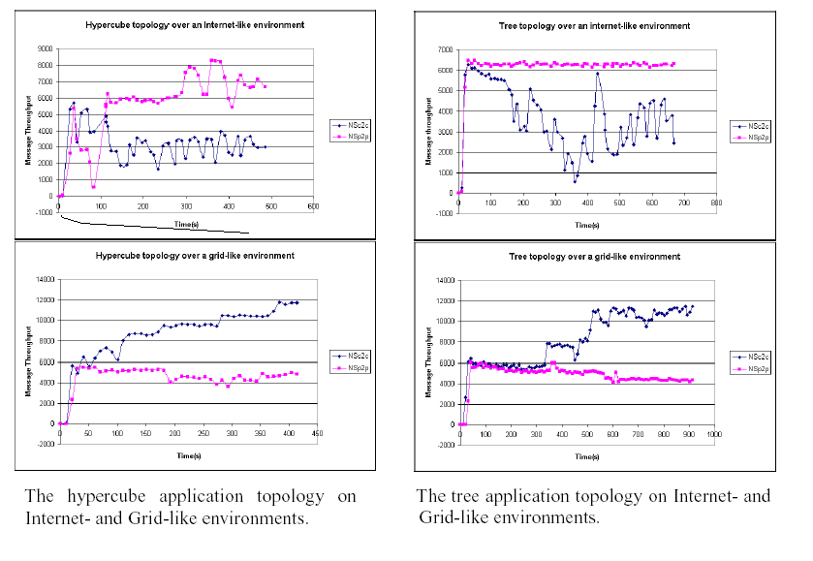
Results for applications with high communication to computation ratio

Slide 19
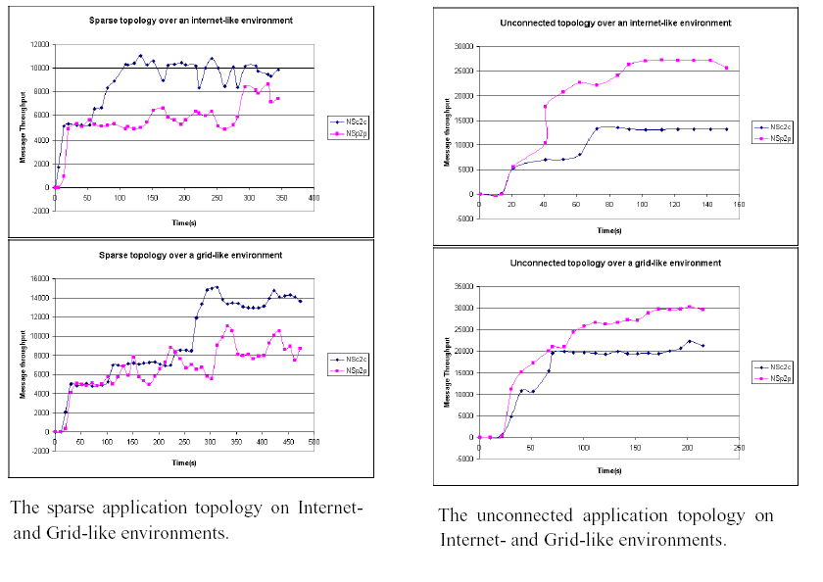
Results for applications with low communication-to-computation ratio

Slide 20
Middleware Agent Topology Evaluation Summary
Simulation results show that:
  The peer-to-peer protocol generally performs better in Internet-like environments, with the exception of the sparse application topology
  The cluster-to-cluster protocol generally performs better on grid-like environments, with the exception of the unconnected application topology

Slide 21
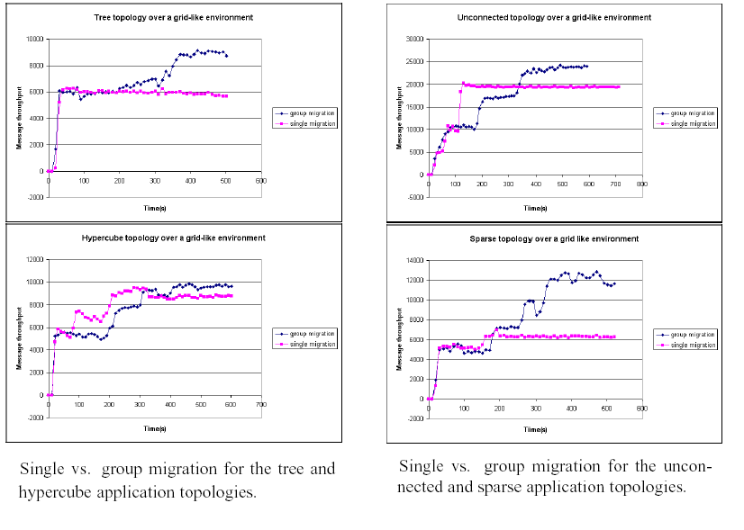
Single vs. Group Migration

Slide 22
Dynamic Networks
Theaters were added and removed dynamically to test scalability.
During the 1st half of the experiment, every 30 seconds, a theater was added.
During the 2nd half, every 30 seconds, a theater was removed
Throughput improves as the number of theaters grows.

Slide 23
Actor Distribution in Dynamic Networks
Both RS and ATS distributed actors evenly across the dynamic network of theaters

Slide 24
Ongoing/Future Work
Splitting, Merging, and Replication Components
Profiling Memory and Storage resources
Interoperability with existing high-performance messaging implementations (e.g., MPI, OpenMP)
  IOS/MPI project
Interoperability with Globus/Open Grid Services Architecture (OGSA)
Interoperability with Web Services

Slide 25
Related Work– Work Stealing/Internet Computing/P2P Systems
Work Stealing
  Cilk’s runtime system for multithreaded parallel programming
  Cilk’s scheduler’s techniques of work stealing
  R. D. Blumofe and C. E. Leiserson, “Scheduling Multithreaded Computations by Work Stealing”, FOCS 94
Internet Computing
  SETI@home (Berkeley)
  Folding@home (Stanford)
P2P Systems
  Distributed Storage: Freenet, KaZaA
  File Sharing: Napster, Gnutella
  Distributed Hashtables: Chord, CAN, Pastry

Slide 26
Related Work– Grid/Distributed Computing
Cluster/Grid/Internet Computing
  Condor, Globus, Legion, PlanetLab
Distributed Computing Services:
  WebOS, 2K, Network Weather Service
Much other work on distributed systems

Slide 27
Thank you
Software freely available at: http://wcl.cs.rpi.edu/ios/

Slide 28
Using the IOS middleware
Start IOS Peer Servers: a mechanism for peer discovery
Start a network of IOS theaters
Write your SALSA programs and extend all actors to autonomous actors
Bind autonomous actors to theaters
IOS automatically reconfigures the location of actors in the network for improved performance of the application.
IOS supports the dynamic addition and removal of theaters

