Slide 1
Program Analysis & FORWARD

Slide 2
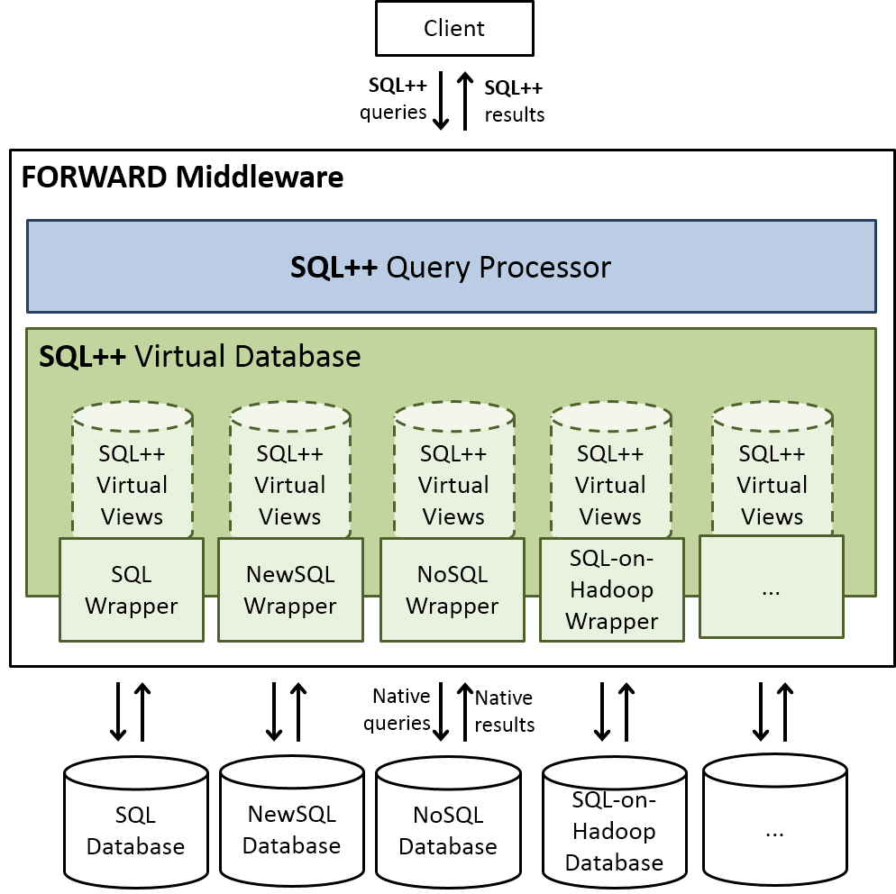
For each student, find all courses in which they are enrolled (Query 1)
SELECT s, (
SELECT c.cid
FROM Courses AS c
WHERE c.sid = s.sid) AS cids
FROM Students AS s;
SQL++
Notes:
Audience knows about holistic optimization

Slide 3
Apply holistic optimization on client
Benefits
Single semi-structured query
Access to data across SQL and NoSQL databases
Notes:
Audience knows about holistic optimization

Slide 4
Goal
Client Application Program
List findCoursesForStudents() {
List listSC = new ArrayList();
List students = query (“SELECT * FROM students“);
List enrollments = query (“SELECT * FROM enrollments”);
for (Student student : students) {
List cids = new ArrayList();
for (Enrollment enrollment : enrollments) {
if (student.sid == enrollment.sid) {
cids.add(enrollment.cid);
}
}
listSC.add(new StudentWithCids(student,cids));
}
return listSC;
}
PSEUDO-CODE : For each student, find all courses in which they are enrolled (Query 1)
Rewrite to SQL++
return forward.executeQuery(“SELECT s, (
SELECT c.cid FROM Courses AS c
WHERE c.sid = s.sid) AS cids
FROM Students AS s;”);
Notes:
Pseudo code => make leaps of reasoning in how lists are populated

Slide 5
Available Options
Alvin Cheung’s Query Synthesis
LINQ (Query Embedding)

Slide 6
Query SYNTHESIS

Slide 7
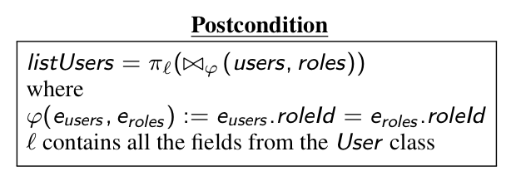
Query Synthesis
Get all users for which a role exists
(Query 2)
Infer declarative intent from code fragment as a post-condition
List<User> getRoleUser() {
List<User> listUsers = new ArrayList<>();
List<User> users = this.userDao.getUsers();
// Query : SELECT * FROM users
List<Role> roles = this.roleDao.getRoles();
// Query > SELECT * FROM roles
for (User u : users) {
for (Roles r : roles) {
if (u.roleId().equals(r.roleId())) {
U userok = u;
listUsers.add(userok);
}
}
}
return listUsers;
}
List<User> getRoleUser() {
List<User> listUsers = db.executeQuery(
"SELECT u" +
"FROM users u , roles r" +
"WHERE u.roleId == r.roleId" +
"ORDER BY u.roleId, r.roleId");
return listUsers;
}
Java Hibernate
Translate the post-condition into SQL

Slide 8
Translation Process
Identify code fragment
Compute Verification Conditions
Produce search space of valid loop invariants and
post-conditions
candidates
Pick one valid candidate set of invariants and post-condition
Generate SQL Code from post-condition
Exponential time algorithm. May take minutes for some code fragments

Slide 9
LINQ

Slide 10
LINQ Example
SQL-like Query language integrated within the imperative language (for example C#).
Query is not a string, it is expressed “inside” the language.
LINQ compiler will turn the statement into an efficient SQL query*
public List getRoleUser() {
var db = new DatabaseContext();
return from user in db.users
from role in db.roles
where user.roleId == role.roleId
select user;
}
Get all users for which a role exists
(Query 2)

Slide 11
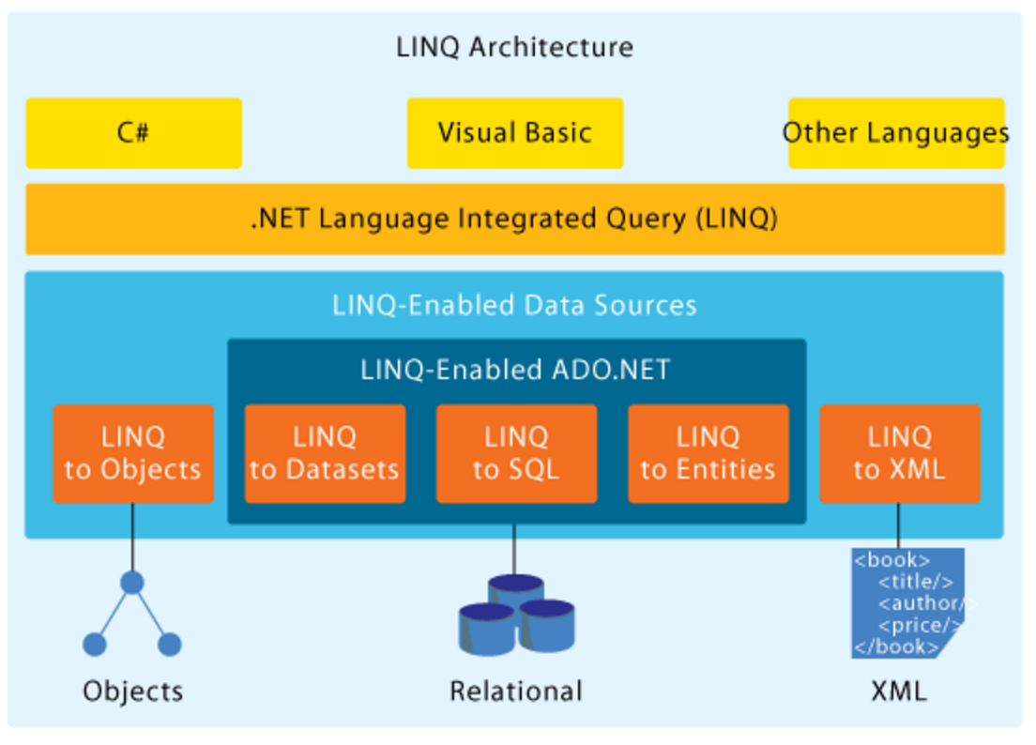
LINQ Architecture

Slide 12
LINQ Nested Result
public List findCoursesForStudents() {
var db = new DatabaseContext();
return from student in db.students
let cids = from enrollment in db.enrollments
where student.sid == enrollment.sid
select enrollment.cid
select new StudentWithCids()
{ Student = student, Cids = cids };
}
For each student, find all courses in which they are enrolled
(Query 1)

Slide 13
Comparison
 | Nested Data | Transform Time | Applicability | Fragment Characteristics
LINQ | Yes | ? (probably milliseconds) | C# program with LINQ | LINQ statement
Query Synthesis | No | Minutes | Any Java program with JDBC | Fragment semantically equivalent to relational selection, projection, join or total aggregation
Nested Data : can optimize code fragments where the result of the query processing contains a nested collection
Transform time : time to transform a single code fragment into its executable/optimized form.
Applicability : restrictions on the source program on top of which the optimization is applied
Fragment Characteristics : characteristics of the fragments that can be rewritten using the technique

Slide 14
Choose Query Synthesis

Slide 15
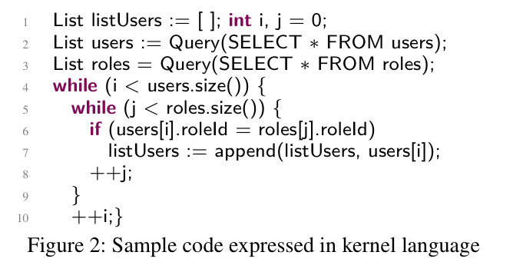
Convert to Kernel Code
Get all users for which a role exists
(Query 2)
List<User> getRoleUser() {
List<User> listUsers = new ArrayList<>();
List<User> users = this.userDao.getUsers();
// Query : SELECT * FROM users
List<Role> roles = this.roleDao.getRoles();
// Query > SELECT * FROM roles
for (User u : users) {
for (Roles r : roles) {
if (u.roleId().equals(r.roleId())) {
U userok = u;
listUsers.add(userok);
}
}
}
return listUsers;
}
Convert into
Kernel code

Slide 16
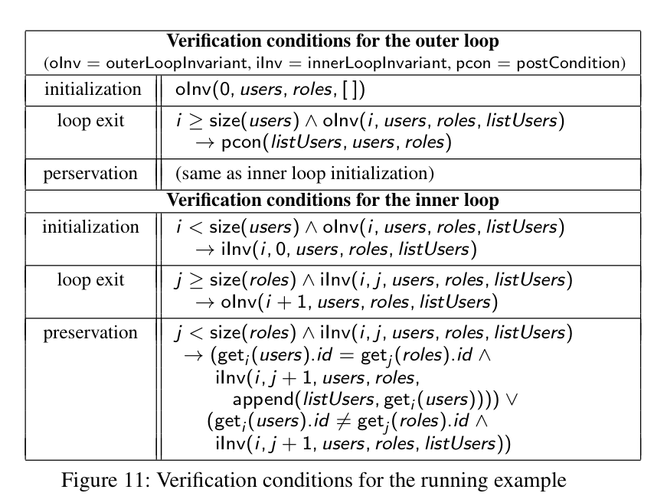
Generate VCs
Static Analysis

Slide 17
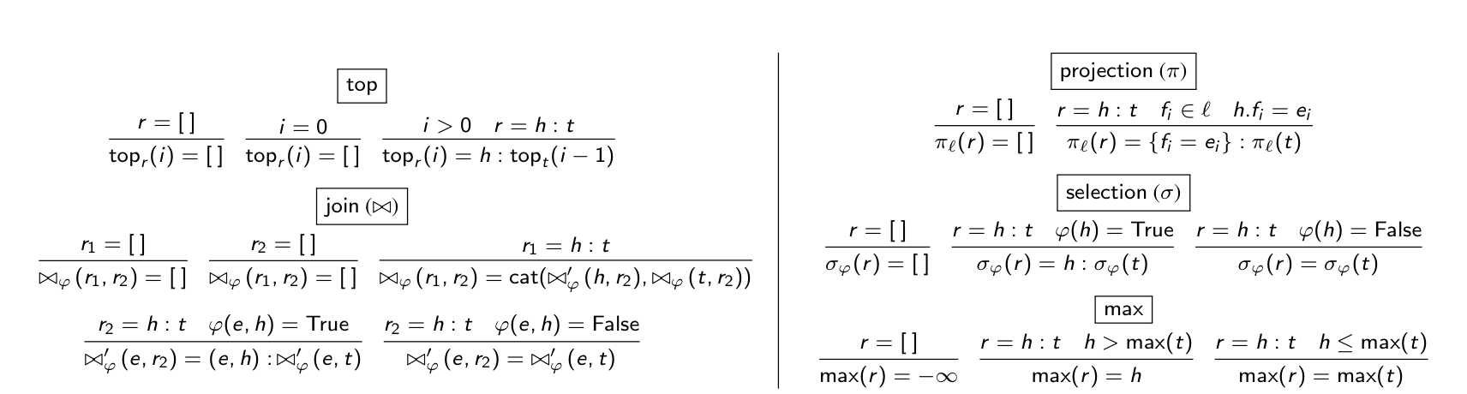
Theory of Ordered Relations
Goal : express loop invariants & post-conditions using TOR
THEORY OF ORDERED RELATIONS AXIOMS
Looks like relational algebra for ordered lists

Slide 18
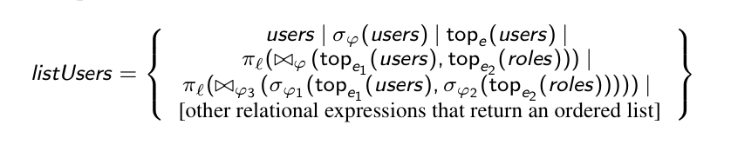
Generate and validate post-condition
Generate possible post-conditions

Slide 19
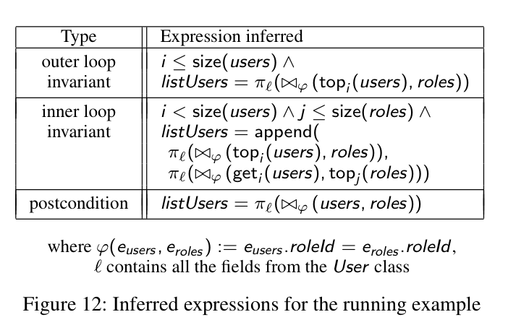
Generate and validate post-condition
Generate possible post-conditions

Slide 20
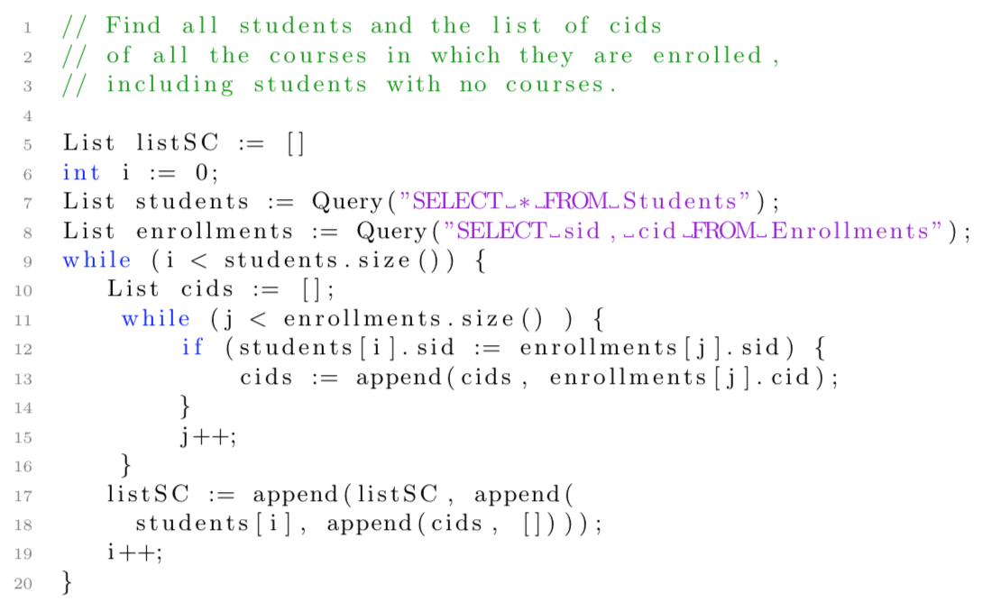
List findCoursesForStudents() {
List listSC = new ArrayList();
List students = this.studentDao.getStudents();
List enrollments = this.enrollDao.getEnrollments();
for (Student student : students) {
List cids = new ArrayList();
for (Enrollment enrollment : enrollments) {
if (student.sid == enrollment.sid) {
cids.add(enrollment.cid);
}
}
listSC.add(new StudentWithCids(student,cids));
}
return listSC;
}
For each student, find all courses in which they are enrolled
(Query 1)
Kernel Code
Convert into
Kernel code

Slide 21
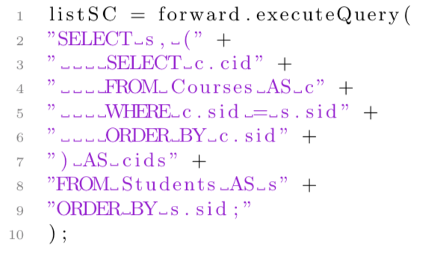
Alvin Cheung Nested Example
Kernel Code
Rewritten Output

Slide 22
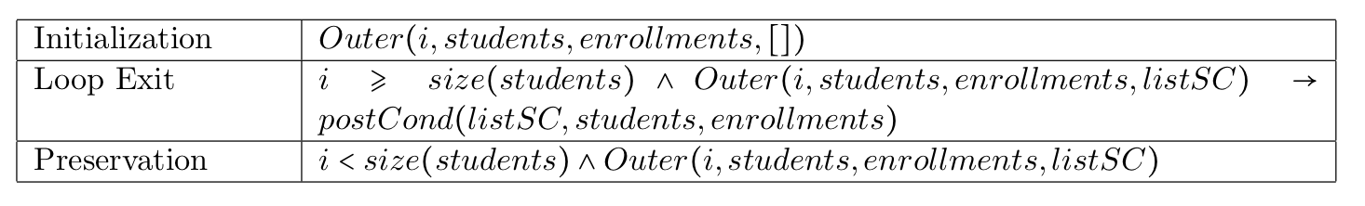
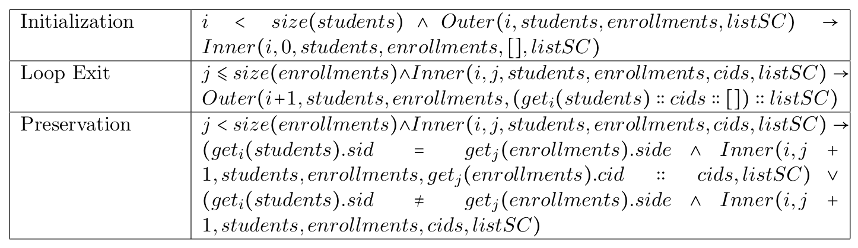
Kernel Code
Kernel Code
Analysis
Outer Loop
Inner Loop
Notes:
Outer, Inner and Post-Cond are unknown during the verification process. They are “discovered” when synthesis occurs.

Slide 23
We are now stuck
The TOR language is not expressive enough to generate loop invariants/post-conditions which will validate the verification conditions.
Solution :
Add axioms to the TOR language
What consequences on search space and validations?

Slide 24
Backup Slides

Slide 25
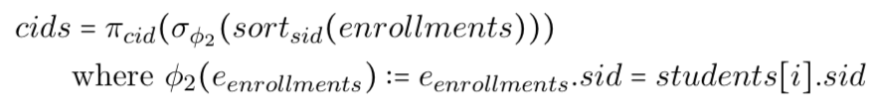
Inner Loop
Synthesis
Post condition
Assume it’s a constant
Notes:
The aglorithm needs a post-condition variable for the inner loop, which is not yet present

Slide 26
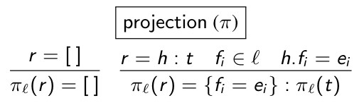
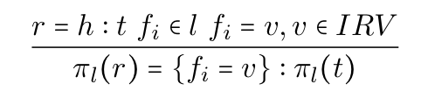
Outer Loop
Extend the language the language by adding the concept of inner result variable (IRV), and extend the TOR projection with one more axiom :
New Axiom

Slide 27

Outer loop
Synthesis + Normalization
Synthesis also uses inner loop VCs
Post condition
Inner Result Variable

Slide 28
Translate to FORWARD algebra
Translation to FORWARD algebra

Slide 29
Performance Evaluation

Slide 30
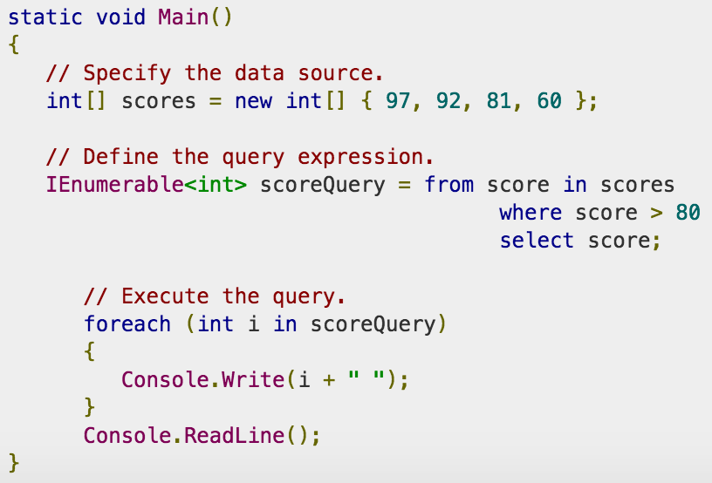
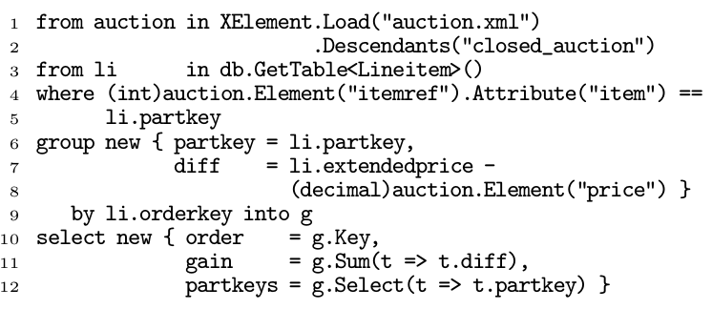
LINQ Example
Using Torsten Gurst’s technique, this LINQ query gets transformed into only two queries

Slide 31
LINQ Architecture

Slide 32
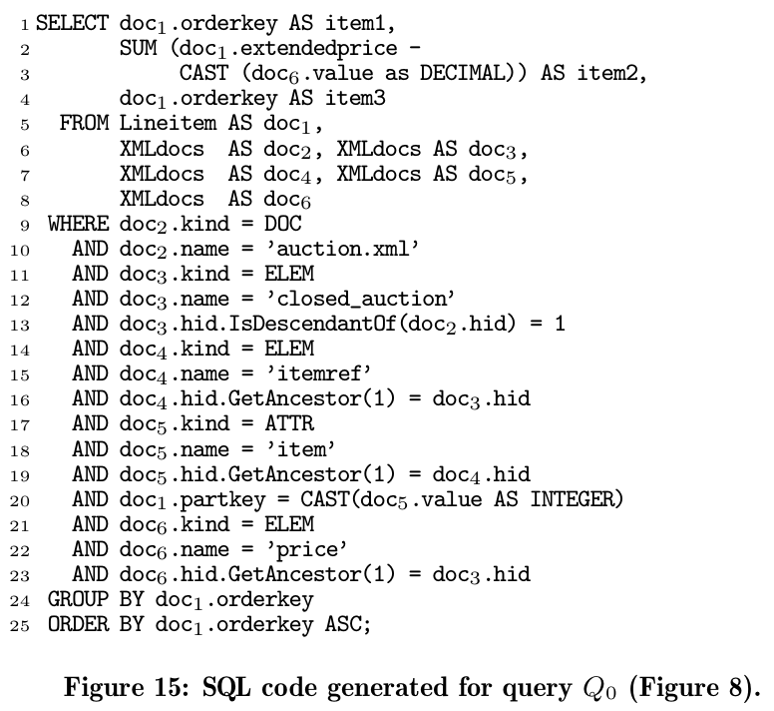
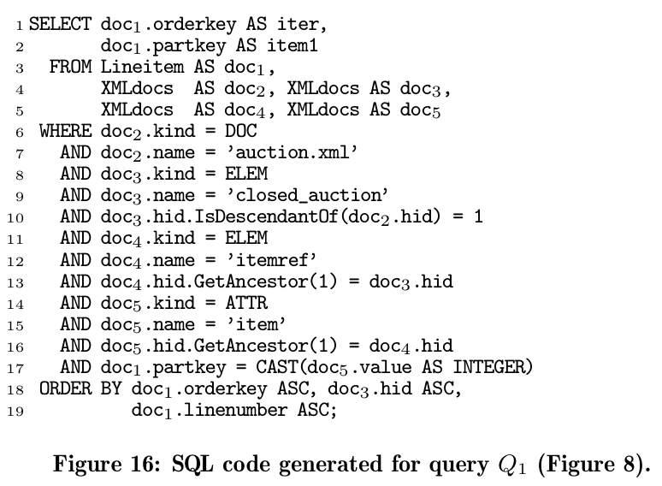
Avalanche-safe generated queries

Slide 33
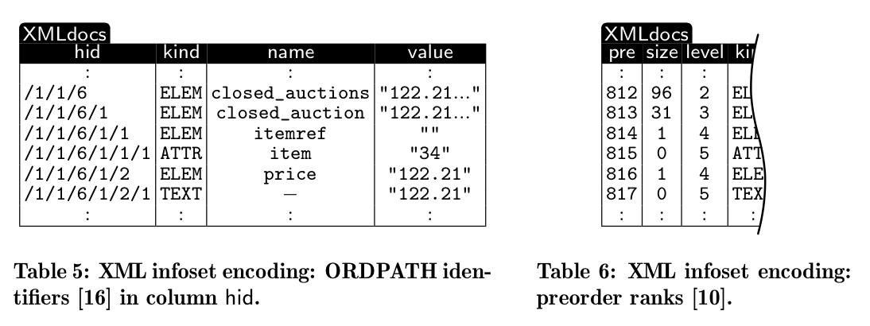
Relational Encoding of XML trees

Slide 34
Students Example (Nesting)
List<Pair<Student,List<Integer>>> listSC = new ArrayList<>();
List<Student> students = this.studentDAO.getStudents() ;
List<Enrollment> enrollments = this.enrollmentDAO.getEnrollments();
for (Student student : students) {
List<Integer> cids = new ArrayList<>();
for (Enrollment enrollment : enrollments) {
if (student.sid == enrollment.sid) {
cids.add(enrollment.cid);
}
}
listSC.add(Pair.of(student,cids));
}
Rewrite to SQL++
SELECT s, (
SELECT c.cid FROM Courses AS c
WHERE c.sid = s.sid ORDER BY c.sid
) AS cids
FROM Students AS s
ORDER BY s.sid;

Slide 35
Comparison
Framework | Expressiveness | Time to translate | Applicable
Alvin Cheung | Less expressive | minutes | Any JDBC/Java Hibernate program (less constraints)
Sudarshan | Less expressive | Less than a second (does not count time to batch procedures) | Any JDBC/Java Hibernate program (more constraints)
Torsten Gurst | More expressive | milliseconds | Programmer have to use ruby DSL or LINQ

Slide 36
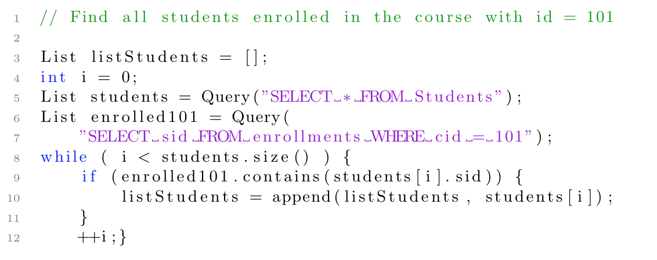
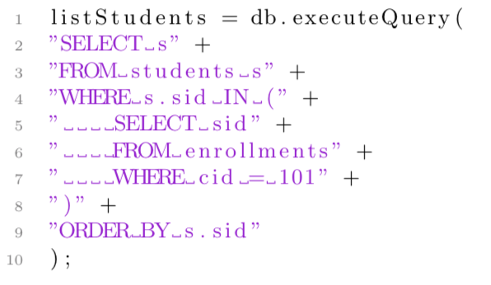
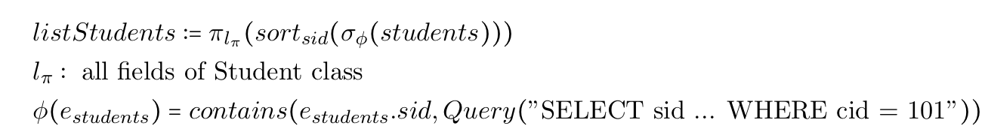
Alvin Cheung Contains Example
Kernel Code
Rewritten Output
Post-Condition

Slide 37
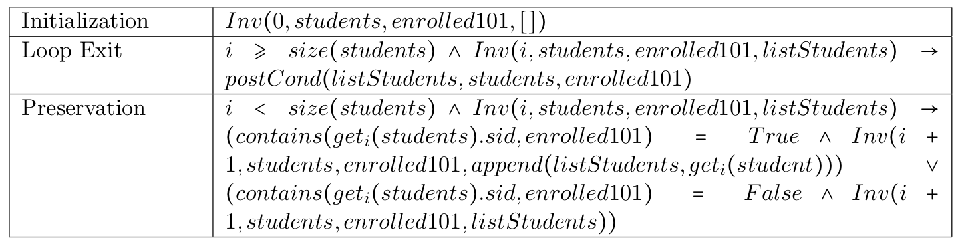
Verification Conditions
Kernel Code
Verification are obtained using a standard PL technique (Hoare’s Axiomatic Semantics) and use the kernel language syntax
Analysis
Verification Conditions

Slide 38
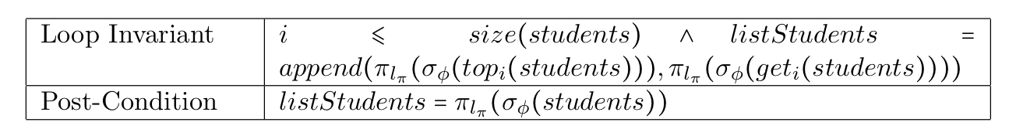

Loop Invariant & Post-Conditions
Verification Conditions
Synthesis
Result Variable

Slide 39
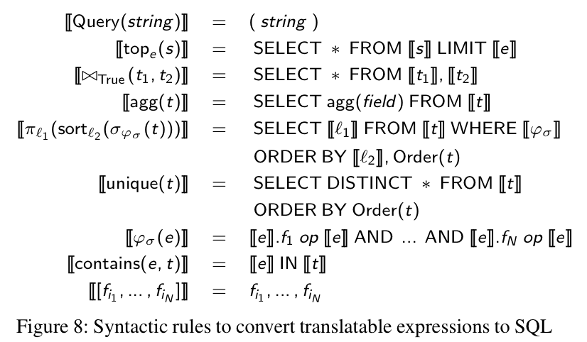
Translation to SQL
SQL Translation
listStudents =
db.executeQuery(
"SELECT s" +
"FROM students s" +
"WHERE s.sid IN (" +
" SELECT sid" +
" FROM enrollments" +
" WHERE cid = 101" +
")" +
"ORDER BY s.sid"
);

Slide 40
QUERY BATCHING

Slide 41
Example : Inventory Application
categories = [ 1, 4, 7, ..., 2156]
For category in categories:
query = "SELECT count(partkey) " +
"FROM part " +
"WHERE p_category=" + category
count = db.execute(query)
sum += count
print sum
Repeated invocation of a query
Inventory application : compute aggregate total of part_keys for all categories in categories
Notes:
User would write the query

Slide 42
Step 1 : Split Loop
categories = [ 1, 4, 7, ..., 2156]
stmt = dbridge.prepareStatement(
"SELECT count(partkey) " +
"FROM part " +
"WHERE p_category=?");
LoopContextTable lct = new LCT();
For category in categories:
LoopContext ctx=lct.createContext();
stmt.set(1, category);
ctx.setInt("category", category);
stmt.addBatch(ctx);
stmt.executeBatch();
for (LoopContext ctx : lct) {
category = ctx.getInt("category");
count = stmt.getResultSet(ctx);
sum += count;
}
print sum
categories = [ 1, 4, 7, ..., 2156]
For category in categories:
query = "SELECT count(partkey) " +
"FROM part " +
"WHERE p_category=" + category
count = db.execute(query)
sum += count
print sum
Notes:
Bold face important aspect of the

Slide 43
Available Options
Alvin Cheung’s Query Synthesis
Sudarshan’s DBridge (Query Batching)
Torsten Gurst’s FERRY LINQ (Query Embedding)

