Slide 1
Static analysis & FOrward
Jules Testard & Ben Cosman, PL Lunch November 18th

Slide 2
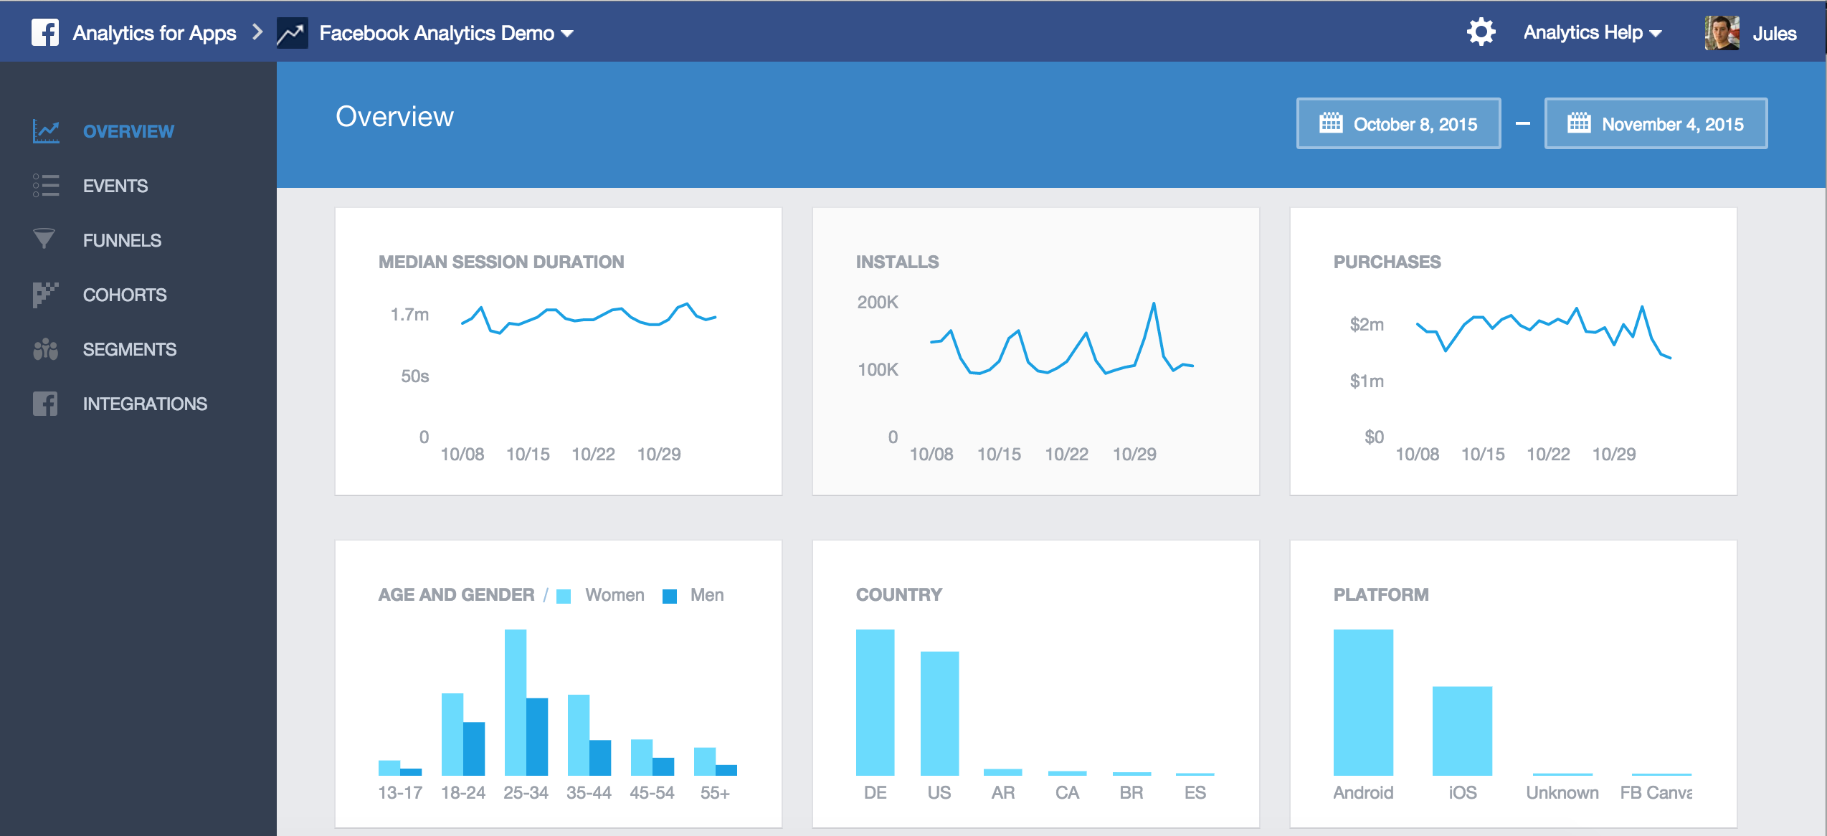
Analytics Web Applications
Notes:
Analytics web applications are very complex applications which includes rich visuals obtained by issuing complex queries over large databases.

Slide 3
Performance matters for analytics applications
Web applications require short latency
Web applications require complex, time-consuming queries
Notes:
Analytics web applications are very complex applications which includes rich visuals obtained by issuing complex queries over large databases.

Slide 4
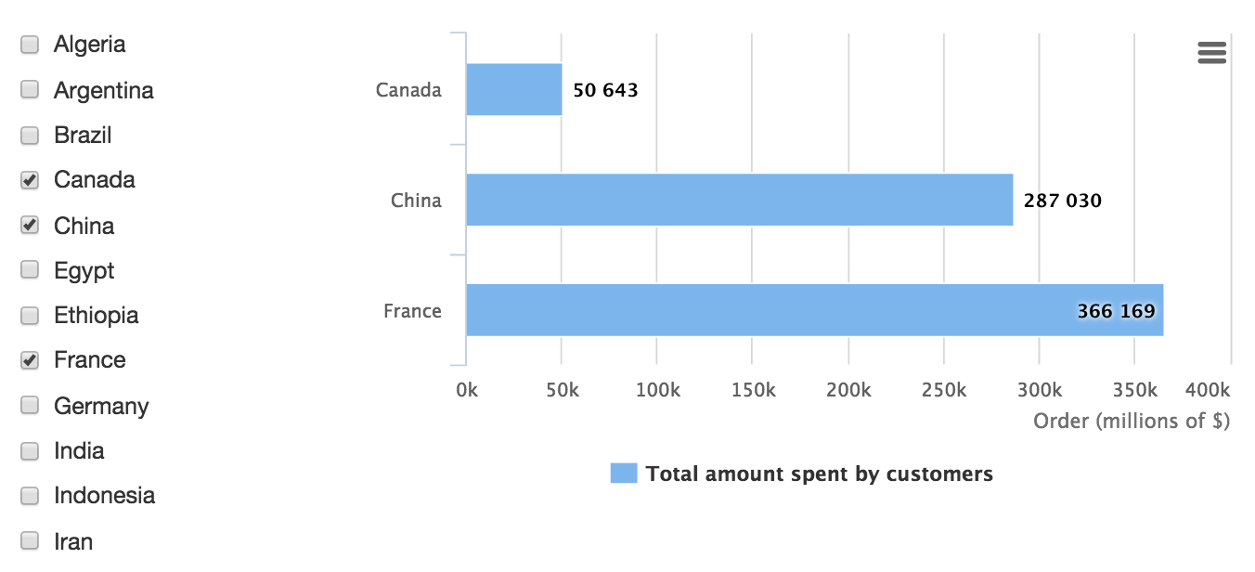
Analytics Web Application
Example 1 : Monitor amount spent by customers from selected countries
Nations
nation_key | name
Schema
Customers
cust_key | nation_ref | address
Orders
Order_key | Cust_ref | order_year | Total_price
Notes:
Describe how the left column selection gives you the selected nations
The right tables will return the total amount spent by customers of each nation

Slide 5
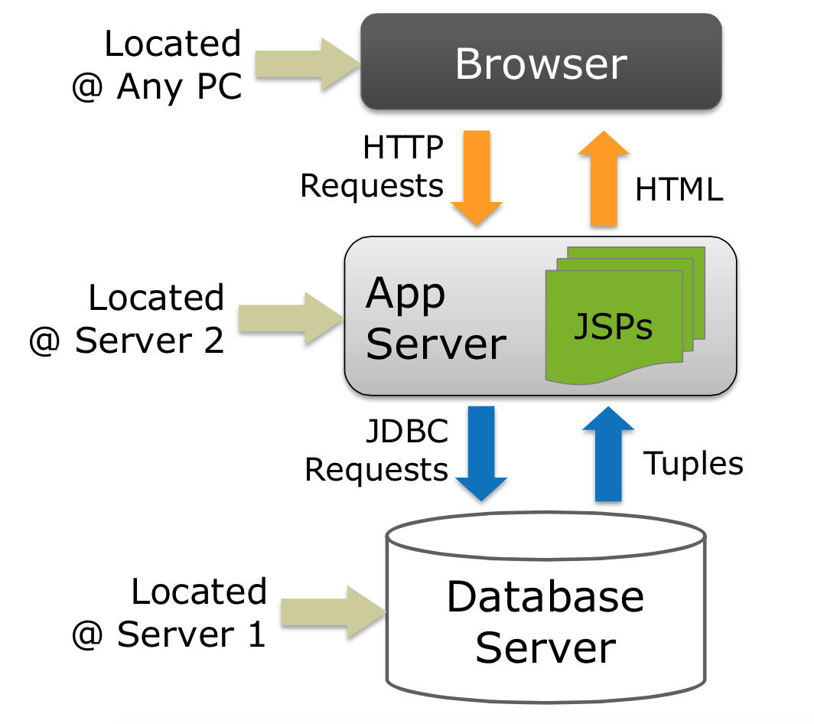
Three Tier Architecture (for Java)
1
5
2
4
3
Notes:
Maybe keep application server around to make sure people are not lost

Slide 6
Java Program for Example 1
01 public List<SumForNation> getSumTotalsImperative(List<Integer> selectedKeys) {
02 List<SumForNation> sumTotals = new ArrayList<>();
03 List<Nation> nations = NationDao.getAllNations();
04 for (Nation nation : nations) {
05 if (selectedKeys.contains(nation.getNationKey())) {
06 int key = nation.getNationKey();
07 long result = 0;
08 List<Customer> customers = CustomerDao.getAllCustomers();
09 List<Order> orderItems = OrderDao.getAllOrderItems();
10 for (Customer c : customers)
11 for (OrderItem o : orderItems)
12 if (c.getCustomerKey() == o.getCustomerRef()
13 && c.getNationRef() == key)
14 result += o.getTotalPrice();
15 sumTotals.add(new SumForNation(nation.getName(),result));
16 }
17 }
18 return sumTotals;
19 }
materializing entire relation
materializing entire relation
Application side
join algorithm
Example uses the Hibernate ORM for data access
Notes:
Query 1 corresponds to the amount spent by customers from Country given by Query 1.

Slide 7
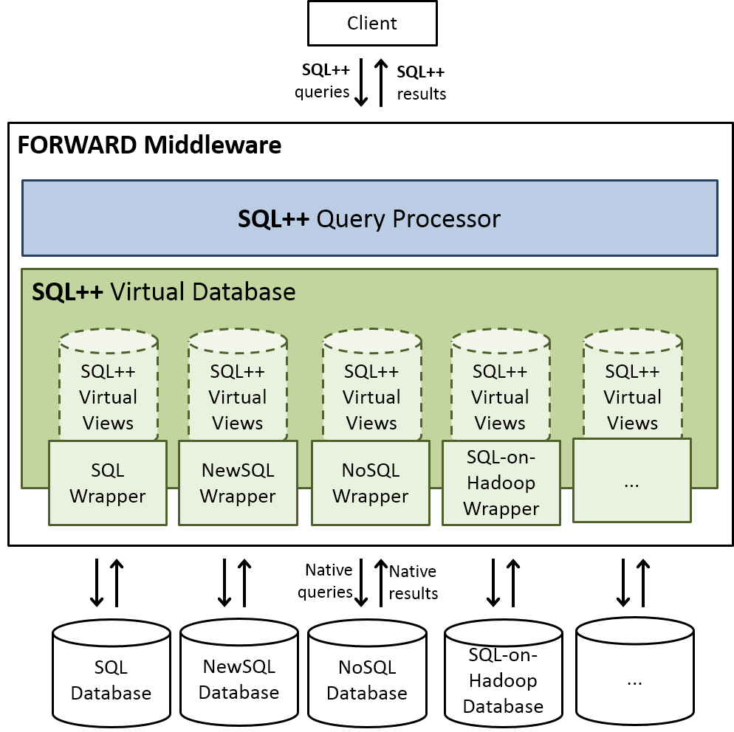
FORWARD Approach
Approach
Web application framework
Single language: SQL++
Benefit
Web application development is entirely declarative
Database-style query optimization is available on the client
Can interact with SQL and NoSQL data sources

Slide 8
FORWARD Approach
SQL++ Code for example 1
<fstmt:with target=“shown_nations”>
SELECT n.name, (
SELECT sum(o.total_price)
FROM db.Orders o, db.Customers c
WHERE o.cust_ref = c.cust_key
AND c.nation_ref = n.nation_key
) as sumTotal
FROM Nations as n
WHERE n.nation_key IN session.SelectedKeys
</fstmt:with>
<funit:bar_chart>
<fstmt:for source=“shown_nations”>
<column>
<label> {sn.name} </label>
<value> {sumTotal} </value>
</column>
</fstmt:for>
</funit:bar_chart>
Data comes from SQL database
Data comes from browser session

Slide 9
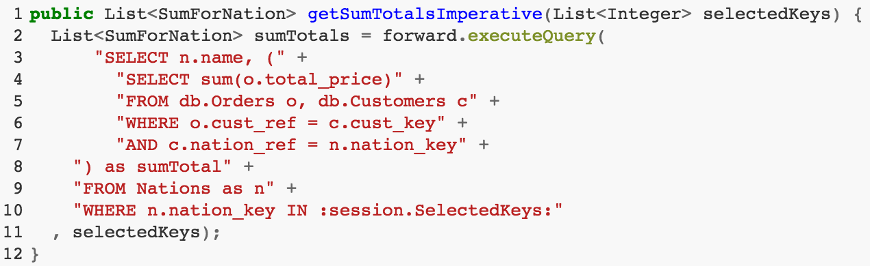
Goal : rewrite java program
Rewritten Java program
Complex Subquery
Parameter relation to the query

Slide 10
Existing work : Query Synthesis
Code fragment
getSumTotalForAlgeria() {
List customers = customerDao.getAllCustomers();
List orders = orderDao.getAllOrders();
int result = 0;
for (Customer c : customers)
for (Order o : orders)
if (c.getCustKey() == o.getCustRef()
&& c.getNationRef() == 1)
// key of Algeria is 1
result += o.getTotalPrice();
return result;
}
Theory of ordered relations
synthesis
translation
getSumTotalForAlgeria() {
return db.executeQuery(
"SELECT sum(ototal_price) as sumTotal " +
"FROM Orders o, Customers c " +
"WHERE o.cust_ref = c.cust_key " +
"AND c.nation_ref = 1"
);
}
Rewritten Code

Slide 11
Translation Process
Identify code fragment, convert to kernel code
Code fragment expressed in kernel code
01 getSumTotalForAlgeria() {
02 List customers = query("SELECT * FROM Customers");
03 List orders = query("SELECT * FROM Orders");
04 int result = 0; int i,j = 0;
05 while (i < size(customers)) { j=0;
06 while (j < size(orders)) {
07 if (customers[i].cust_key
08 == orders[j].cust_ref
09 && customers[i].nation_ref == 1)
10 result += o.total_price;
11 j++;
12 }
13 i++;
14 }
15 return result;
16 }

Slide 12
Translation Process
Code fragment expressed in kernel code
01 getSumTotalForAlgeria() {
02 List customers = query("SELECT * FROM Customers");
03 List orders = query("SELECT * FROM Orders");
04 int result = 0; int i,j = 0;
05 while (i < size(customers)) { j=0;
06 while (j < size(orders)) {
07 if (customers[i].cust_key
08 == orders[j].cust_ref
09 && customers[i].nation_ref == 1)
10 result += o.total_price;
11 j++;
12 }
13 i++;
14 }
15 return result;
16 }
Identify code fragment, convert to kernel code
Compute verification conditions
Outer loop exit condition
Inner loop exit condition
“hole” in verification conditions

Slide 13
Translation Process
Constraint-based synthesis
Each invariant is assumed to be
a conjunction of predicates
Identify code fragment, convert to kernel code
Templates
Compute verification conditions
Produce loop invariants and post-condition candidates
Outer loop exit condition
Inner loop exit condition

Slide 14
Translation Process
Constraint-based synthesis
Each invariant is assumed to be
a conjunction of predicates
Identify code fragment, convert to kernel code
Compute verification conditions
Produce loop invariants and post-condition candidates
Choose a valid set of candidates using Z3
Convert post-condition to SQL

Slide 15
Translation Process
Identify code fragment, convert to kernel code
Compute verification conditions
Exponential time algorithm. May take minutes for some code fragments
Produce loop invariants and post-condition candidates
Choose a valid set of candidates using Z3
Convert post-condition to SQL

Slide 16
Query synthesis in our example
01 public List<SumForNation> getSumTotalsImperative(List<Integer> selectedKeys) {
02 List<SumForNation> sumTotals = new ArrayList<>();
03 List<Nation> nations = NationDao.getAllNations();
04 for (Nation nation : nations) {
05 if (selectedKeys.contains(nation.getNationKey())) {
06 int key = nation.getNationKey();
07 long result = 0;
08 List<Customer> customers = CustomerDao.getAllCustomers();
09 List<OrderItem> orderItems = OrderItemDao.getAllOrderItems();
10 for (Customer c : customers)
11 for (OrderItem o : orderItems)
12 if (c.getCustomerKey() == o.getCustomerRef()
13 && c.getNationRef() == key)
14 result += o.getTotalPrice();
15 sumTotals.add(new SumForNation(nation,result));
16 }
17 }
18 return sumTotals;
19 }
Variable comes from application, not database
Variable comes from application, not database
Alvin Cheung only considers variables coming from the database
Notes:
The previous example was synthetic and unlikely in a real application, which would more likely use a parameterized function.

Slide 17
Our Idea
01 public List<SumForNation> getSumTotalsImperative(List<Integer> selectedKeys) {
02 List<SumForNation> sumTotals = new ArrayList<>();
03 List<Nation> nations = NationDao.getAllNations();
04 for (Nation nation : nations) {
05 if (selectedKeys.contains(nation.getNationKey())) {
06 int key = nation.getNationKey();
07 long result = 0;
08 List<Customer> customers = CustomerDao.getAllCustomers();
09 List<OrderItem> orderItems = OrderItemDao.getAllOrderItems();
10 for (Customer c : customers)
11 for (OrderItem o : orderItems)
12 if (c.getCustomerKey() == o.getCustomerRef()
13 && c.getNationRef() == key)
14 result += o.getTotalPrice();
15 sumTotals.add(new SumForNation(nation,result));
16 }
17 }
18 return sumTotals;
19 }
Allow query synthesis to consider data generated by the application program
Break down fragments into smaller pieces on which query synthesis can be applied
Notes:
The previous example was synthetic and unlikely in a real application, which would more likely use a parameterized function.

Slide 18
Our ideas

Slide 19
Inner loop fragment
06 int key = nation.getNationKey();
07 long result = 0;
08 List<Customer> customers = CustomerDao.getAllCustomers();
09 List<OrderItem> orderItems = OrderItemDao.getAllOrderItems();
10 for (Customer c : customers)
11 for (OrderItem o : orderItems)
12 if (c.getCustomerKey() == o.getCustomerRef()
13 && c.getNationRef() == key)
14 result += o.getTotalPrice();
synthesis
Inner Fragment
Post Condition
Treat as constant

Slide 20
Intermediate fragment
01 public List<SumForNation> getSumTotalsImperative(List<Integer> selectedKeys) {
02 List<SumForNation> sumTotals = new ArrayList<>();
03 List<Nation> nations = NationDao.getAllNations();
04 for (Nation nation : nations) {
05 if (selectedKeys.contains(nation.getNationKey())) {
07 long result = subQuery(“…”, nation.getNationKey());
15 sumTotals.add(new SumForNation(nation,result));
16 }
17 }
18 return sumTotals;
19 }
New judgement for projection axiom
Outer Fragment Post condition
Notes:
The previous example was synthetic and unlikely in a real application, which would more likely use a parameterized function.

Slide 21
Translate to SQL++
Outer Fragment Post Condition
Inner Fragment Post Condition
translation
SELECT n.name, (
SELECT sum(o.total_price)
FROM db.Orders o, db.Customers c
WHERE o.cust_ref = c.cust_key
AND c.nation_ref = n.nation_key
) as sumTotal
FROM Nations as n
WHERE n.nation_key
IN session.SelectedKeys
Generated SQL++ code

Slide 22
Summary
Approach
We made two extensions to the TOR
Add one new type of constant
Add one new judgement for the projection axiom
Extension should not impact run-time significantly because search space is only increased by variables added to scope
Unknowns
How to identify new fragments
How to decompose fragments into “inner” and “outer” fragments
How to minimize the number of variables added to scope for the analysis to work out

Slide 23
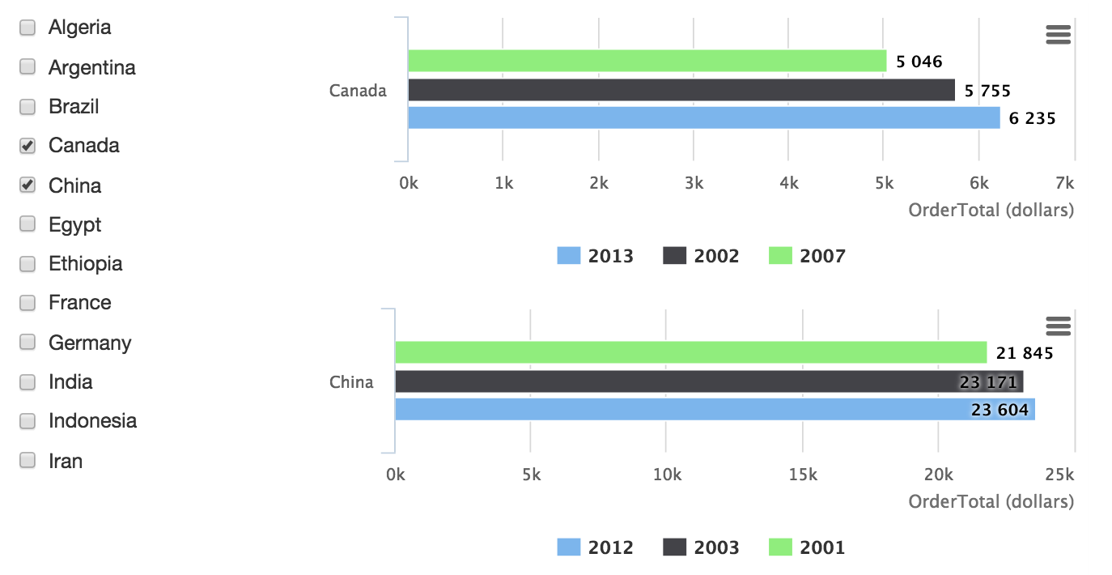
Beyond SQL : Complex Analytics Web Applications
Example 2 : Monitor top 3 years in terms of amount spent by customers from selected countries
Notes:
Describe how the left column selection gives you the selected nations
The right tables will return the total amount spent by customers of each nation

Slide 24
Complex Example
01 public List<SumForNationTopYears> getSumTotal3Years(
02 List<Nation> selectedNations) throws Exception {
03 List<SumForNationTopYears> sumTotalsTopY = new ArrayList<>();
04 for (Nation nation : selectedNations) {
05 List<YearData> yearsData = NationDao.doComplexQuery(nation);
06 sumTotalsTopY.add(
new SumForNationTopYears(nation, yearsData));
07 }
08 return sumTotalsTopY;
09 }
Data is a list, fragment is not valid SQL but valid SQL++
synthesis
Post condition
SQL++ Code
translation
SELECT n.name, (…) as data
FROM Nations as n
WHERE n.nation_key
IN session.SelectedKeys

Slide 25
Backup

Slide 26
Performance Comparison

