Slide 1
My Git WorkFlow
The GitHub Patterns
Rui Carvalho
@rhwy
Notes:
This Talk is about common git workflows that most people use and targets people still using standard VCS (cvs, svn, tfs…) in their company.

Slide 2

How code lives
The origin of the problem

Slide 3

lifecycle
Troubles !
New Features
New Features
Projects and code evolve with time
Bug Fix
In Production
Testing Next Version
Notes:
Code is living and at every moment, depending on the project size, the team size, the project age and many other factors, you need to have different “versions” of you code available

Slide 4

How people code
Solutions ?

Slide 5
Classic VCS Habits
Do a project “Long running” branch
Continue that ugly coding
Pray to be the first to merge
Deploy monthly to avoid conflicts
Iterate for X years (average 5?)
Big bang the project and create a new VCS root

Slide 6

Sounds good ?

Slide 7

Source Code
Should I care ?

Slide 8
Code Matters!
Your code and your VCS are your only valid documentation
Your code is living and your VCS is the open book of that History

Slide 9

Rules
Keep calm and code

Slide 10
Objectives ?
Always be able to build a production version
Always be able to build a stable version
Easily integrate new features
Avoid long term “out of space” code (aka project branches)
Produce Value on each commit

Slide 11

git branch
Simple model

Slide 12
Small branches
Very small branches
Keep central repository clean
Work localy then push your branch
Someone else review & merge
Update your master

Slide 13
Small branches
No learning curve
Near classic VCS patterns
But, better isolation
Easier, due to no-cost branching
Work remotely
No side effects

Slide 14
Distant
Project A
master
Project A
Small_work
merge
4
1
clone
pull
5
push
3
6
rebase
Project A
master
Project A
Small_work
2
branch
Local

Slide 15
//2 step branching
$> git branch “create_login_box”
$> git checkout create_login_box
//1 command branching
$> git checkout –b create_login_box
Create Branch, then Checkout

Slide 16
$> //add files, do some code
$> git add loginViewModel.cs
$> git commit –m “created view model for login”
$> //more core, finish
$> git commit –m “created html login UI”
//then push your branch with that commits
$> git push origin create_login_box
Code, Add to index, Commit, push branch

Slide 17
$> //on the remote repo
$> git checkout master
$> git create_login_box
$> //on your box, sync the master from remote
$> git pull origin master
Someone merge,
then you can update your local master

Slide 18
$> //if you need to continue on the repo, sync it with the updated master
$> git checkout create_login_box
$> git rebase master
$> //if not delete it
$> git branch –d create_login_box
Then continue your work,
Or simply delete your branch

Slide 19

git fork
A better model

Slide 20
Fork what?
Protect your central repository
Restrict rights, accept external work
Your branches, your mess
Your own builds, easier team work
Not git, but quite all online services support it
= clone on server side

Slide 21
Other benefits
Easier remote work
YOU, sure to always have a clean master
Easier code review across teams
It opens a discussion

Slide 22
Distant
Team Account
1
Fork
My Account
ProjectA repository
ProjectA repository
6
pull
Request
branch1
master
branch1
master
branch1
merge
5
Upstream
Origin
2
8
4
clone
Push origin
master
Push
Origin
branch1
7
My Account
pull
Upstream
master
ProjectA repository
master
3
branch1
branch
Local
9
Rebase / delete

Slide 23
$> //remotely:
$> //fork it/clone it on the server side from company/projectA to myaccount/projectA
$> //locally:
$> git clone myrepo/projectA
$> git checkout –b my_feature
1. Fork, clone & branch

Slide 24
$> git add myfile
$> git commit –m “I added some value”
$> git push origin my_feature
2. Work, add, commit, push origin

Slide 25
$> //remotely:
$> //pull request : ask to push your branch my_feature from myaccount/projectA to company/projectA
$> //then merge on company/projectA account(probably someone else)
$> //locally:
$> //update your master with the merged one
$> git pull upstream master
3.Pull request, merge, re-sync

Slide 26
$> //locally
$> //to be sure to always have a clean master available everywher, you need to update it
$> git push origin master
$> //continue to work
$> git checkout my_feature
$> //sync your branch from updated master
$> git rebase master
$> //if not delete it
$> git branch –d create_login_box
Then, update your remote fork,
And continue your work,
Or simply delete your branch

Slide 27

Github workflow style
Better code, more fun

Slide 28

Want to be a Ninja?
Practice, practice, practice

Slide 29
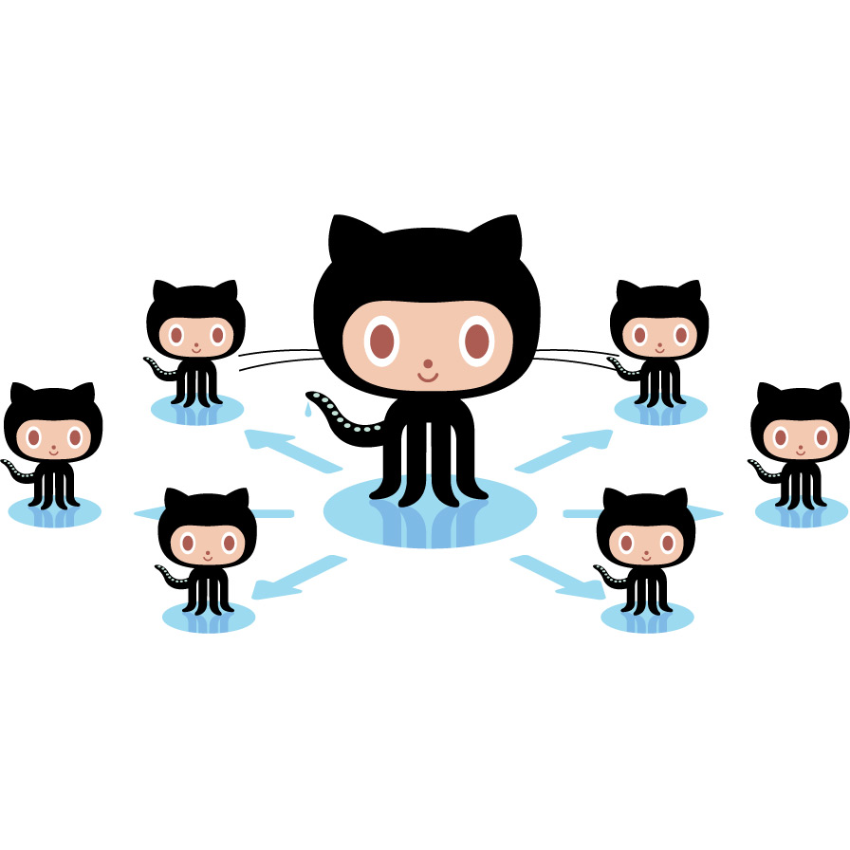
Keep
In touch
Octocats:
http://octodex.github.com/
@rhwy
Codedistillers.com
A references:
http://nvie.com/posts/a-successful-git-branching-model/
https://github.com/NancyFx/Nancy/blob/master/CONTRIBUTING.md
rui.fr
github.com/rhwy

