Slide 1
Git : Part3 Branch Management
These slides were largely cut-and-pasted from http://excess.org/article/2008/07/ogre-git-tutorial/ , with some additions from other sources. I have deleted a lot from the cited tutorial, and recommend that you listen to the entire tutorial on line, if you can.

Slide 2
Branch Management
Review
Branch creation
Merging
Rebasing
Putting it all together

Slide 3
Review
Core git concepts

Slide 4
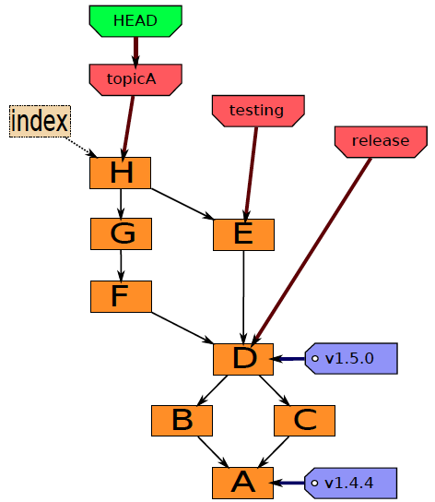
Git components
Index
“staging area”
what is to be committed
http://edgyu.excess.org/git-tutorial/2008-07-09/intro-to-git.pdf

Slide 5
Local Operations
Repository (.git directory)
Index (staging area)
Working directory
checkout the project
add (stage) files
commit

Slide 6
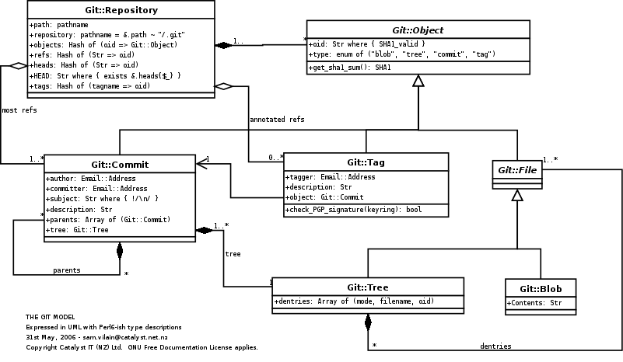
Git object model
http://utsl.gen.nz/talks/git-svn/git-model.png
Notes:
The component clases of the Git object model, as a UML class diagram.

Slide 7
Branches
“alternate universes”

Slide 8
Creating branches
git branch <name> <commit>
HEAD
new
B
A
git branch new HEAD

Slide 9
Local branches
To list them: git branch –l
branch1
branch2
* master
Or look at files in .git/refs/heads/

Slide 10
Remote branches
To see them: git branch –r
origin/HEAD -> origin/master
origin/master
origin/update
Or look at files in .git/refs/remotes/

Slide 11
Merging branches
when alternate universes collide

Slide 12
Merging
HEAD
new
git merge <branch> …
joins branches
creates commit with 2+ parents
can cause conflicts
requiring user intervention
B
C
A
HEAD
new
D
B
C
git merge new HEAD
A

Slide 13
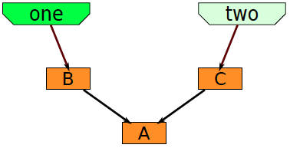
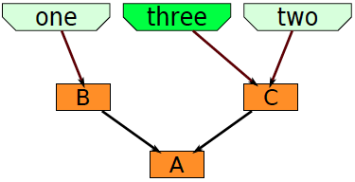
Merge examples
git checkout –b three two
“checkout –b” creates a new branch and checks it out
http://edgyu.excess.org/git-tutorial/2008-07-09/intro-to-git.pdf

Slide 14
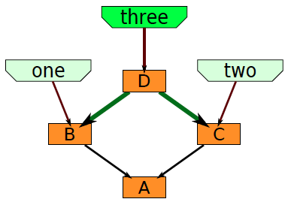
2-way merge
git checkout –b three two
git merge one
http://edgyu.excess.org/git-tutorial/2008-07-09/intro-to-git.pdf

Slide 15
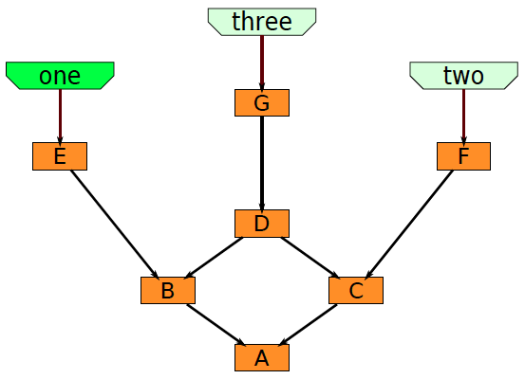
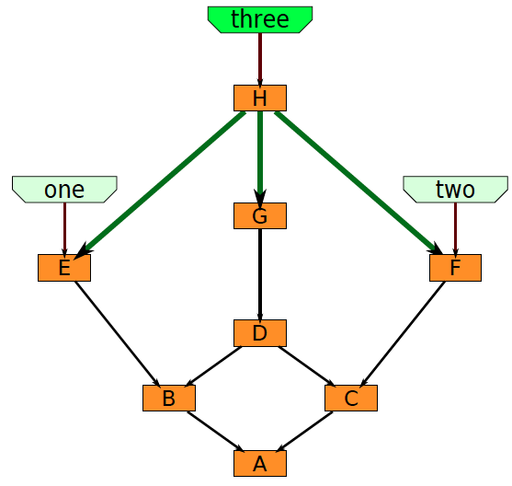
3-way merge
git checkout three
git merge one two
http://edgyu.excess.org/git-tutorial/2008-07-09/intro-to-git.pdf

Slide 16
Fast-forward merge
new
HEAD
C
Current head of the branch to which you are merging is an ancestor of the branch you are merging to it.
The branch head is just moved to the newer commit.
No merge commit object is created unless “-- no-ff” is specified
B
A
HEAD
new
C
B
git merge new HEAD
A

Slide 17
True merge
HEAD
new
Not fast-forward
New commit object must be created for new head
2 cases:
No overlapping changes are detected
Merge proceeds normally
Overlapping changes are detected Manual intervention is required
B
C
A
HEAD
new
D
B
C
A

Slide 18
Beware of false security!
Just because there are no overlapping changes does not mean the changes are semantically compatible.
It only means they do not modify the same region of the same file.
So, unless the merge is a fast-forward, there is a good chance that your merge will break the software.
This is the reason for following a discipline that forces all merges to be fast-forward.

Slide 19
Merge with conflicts
HEAD pointer is unchanged
MERGE_HEAD points to the other branch head
Files that merged cleanly are updated in the index file and working tree
3 versions recorded for conflicting files:
Stage 1: common ancestor version
Stage 2: MERGE_HEAD version
Working tree: marked-up files (with <<< === >>>)
No other changes are made
You can start over with git reset --merge

Slide 20
How merge marks conflicts
Here are lines that are either unchanged from the common ancestor, or cleanly resolved because only one side changed. <<<<<<< yours:sample.txt Conflict resolution is hard; let's go shopping. ======= Git makes conflict resolution easy. >>>>>>> theirs:sample.txt And here is another line that is cleanly resolved or unmodified.
There is an alternate, 3-way, output option that also shows the common ancestor text.

Slide 21
Resolving merge conflicts
Only two choices
Decide not to merge: git-reset --hard
Resolve the conflicts
Resolution tools
Use a mergetool: git mergetool
kdiff3,tkdiff, meld, xxdiff, emerge, vimdiff, gvimdiff, ecmerge, diffuse, tortoisemerge, opendiff, p4merge, araxis
Look at the diffs, and edit: git diff
…
Notes:
Merging conflicts is hard work. It is a good practice to try to avoid doing it at merge time, by rebasing frequently during branch development. When you discover a conflict, it is probably better back out of the merge, rebase,

Slide 22
Rebasing
key to reducing the difficulty of merging

Slide 23
Rebase
Contrasts to merge
Merge joins two branches
Rebase preserves branches
Rolls changes from one branch into the other
Changes now are now relative to newer baseline
Allows tracking changes to baseline while developing new branch
Prevents surprises later
Avoids conflicts with eventual merges
Rebase frequently to avoid merge conflicts

Slide 24
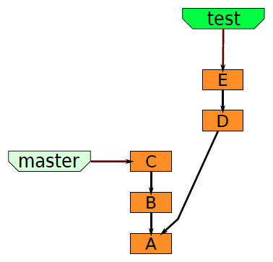
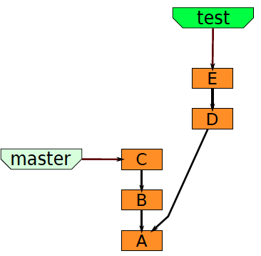
Merging vs. Rebasing
http://edgyu.excess.org/git-tutorial/2008-07-09/intro-to-git.pdf

Slide 25
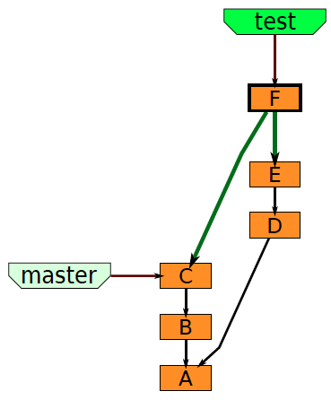
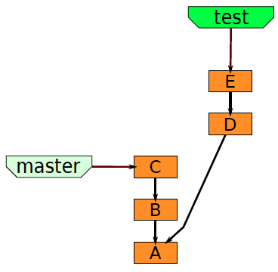
Merging vs. Rebasing
git merge master
http://edgyu.excess.org/git-tutorial/2008-07-09/intro-to-git.pdf

Slide 26
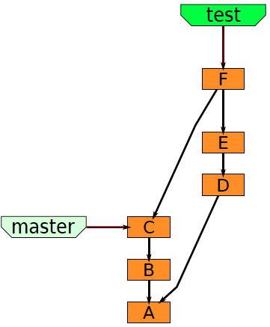
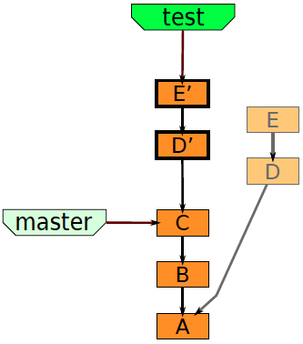
Merging vs. Rebasing
git rebase master
http://edgyu.excess.org/git-tutorial/2008-07-09/intro-to-git.pdf

Slide 27
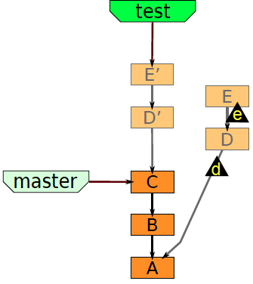
Merging vs. Rebasing
git rebase master
http://edgyu.excess.org/git-tutorial/2008-07-09/intro-to-git.pdf

Slide 28
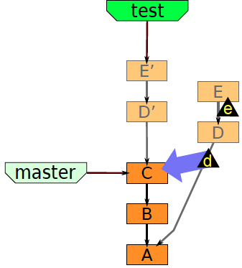
Merging vs. Rebasing
git rebase master
http://edgyu.excess.org/git-tutorial/2008-07-09/intro-to-git.pdf

Slide 29
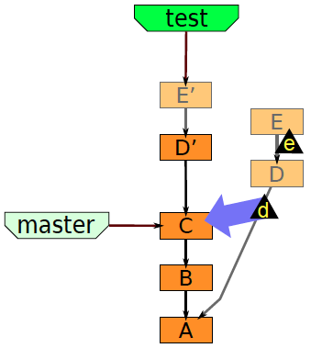
Merging vs. Rebasing
git rebase master
http://edgyu.excess.org/git-tutorial/2008-07-09/intro-to-git.pdf

Slide 30
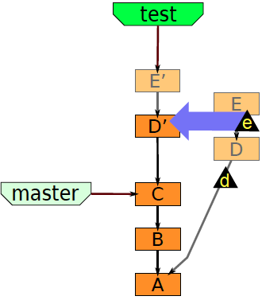
git rebase master
http://edgyu.excess.org/git-tutorial/2008-07-09/intro-to-git.pdf

Slide 31
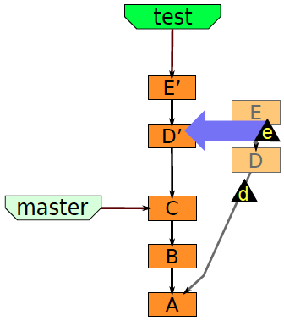
Merging vs. Rebasing
git rebase master
http://edgyu.excess.org/git-tutorial/2008-07-09/intro-to-git.pdf

Slide 32
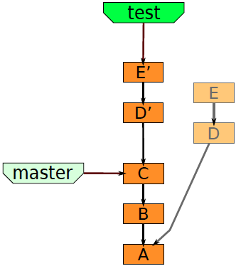
Merging vs. Rebasing
git rebase master
http://edgyu.excess.org/git-tutorial/2008-07-09/intro-to-git.pdf

Slide 33
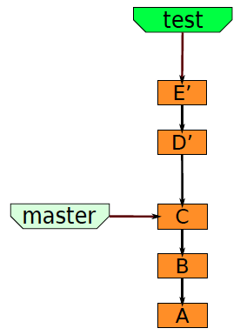
Merging vs. Rebasing
git rebase master
http://edgyu.excess.org/git-tutorial/2008-07-09/intro-to-git.pdf

Slide 34
Putting it all together
A user story showing how rebase is used with branch and merge, to reduce pain of merging.

Slide 35

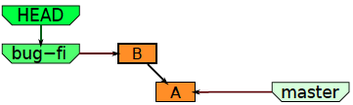
Starting out to fix a bug
git checkout –b bug-fix
git commit –a –m”B”
http://edgyu.excess.org/git-tutorial/2008-07-09/intro-to-git.pdf

Slide 36
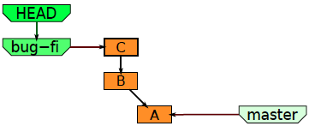
Continue making changes
git commit –a –m”C” –b
http://edgyu.excess.org/git-tutorial/2008-07-09/intro-to-git.pdf

Slide 37
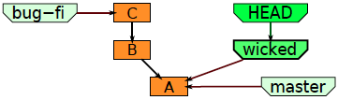
Decide to try out a “wicked” idea.
git checkout –b wicked master
http://edgyu.excess.org/git-tutorial/2008-07-09/intro-to-git.pdf

Slide 38
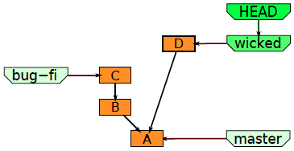
Work on the wicked branch
git commit –a –m”D”
http://edgyu.excess.org/git-tutorial/2008-07-09/intro-to-git.pdf

Slide 39
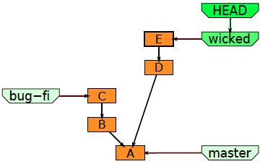
And some more
git commit –a –m”E”
http://edgyu.excess.org/git-tutorial/2008-07-09/intro-to-git.pdf

Slide 40
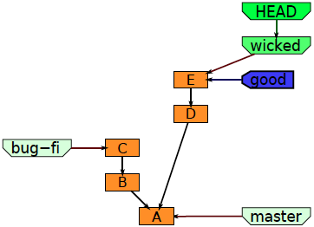
Tag a good point
git tag –a –m”got somewhere” good
http://edgyu.excess.org/git-tutorial/2008-07-09/intro-to-git.pdf

Slide 41
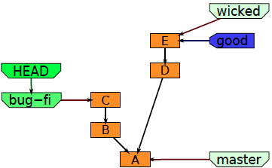
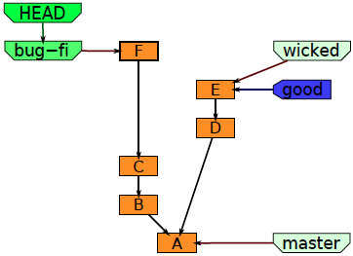
Manager asks about the bug
git checkout bug-fix
git commit –a –m “F”
So you go back to work on it some more
http://edgyu.excess.org/git-tutorial/2008-07-09/intro-to-git.pdf

Slide 42
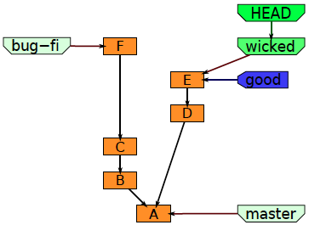
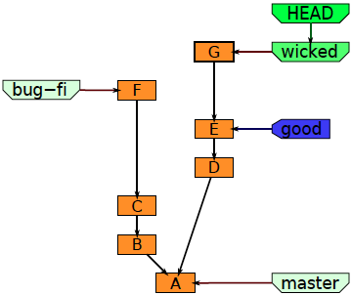
But your mind is elsewhere
git checkout wicked
so you finish off the wicked feature
git commit –a –m”G”
http://edgyu.excess.org/git-tutorial/2008-07-09/intro-to-git.pdf

Slide 43
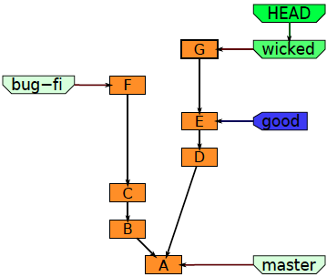
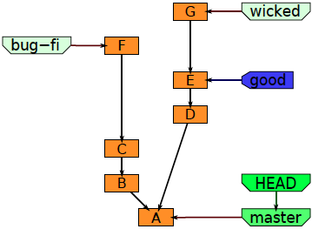
Bug fix and wicked new feature are both done, so it’s time to merge
git checkout master
http://edgyu.excess.org/git-tutorial/2008-07-09/intro-to-git.pdf

Slide 44
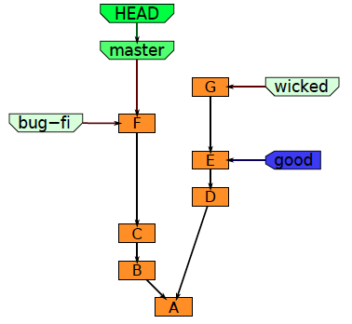
Advance the the master to include the bug fix
git reset --hard bug-fix

Slide 45
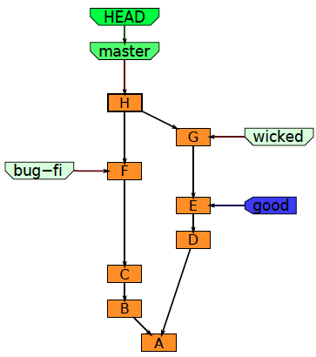
Merge it into the master branch
git merge wicked
http://edgyu.excess.org/git-tutorial/2008-07-09/intro-to-git.pdf

Slide 46
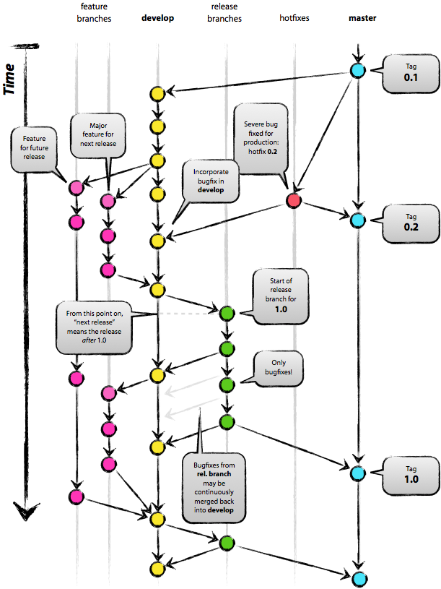
For a more complete description of branch management and the the commit-rebase-merge cycle, see the separate notes at the website linked below.
http://nvie.com/wp-content/uploads/2009/12/Screen-shot-2009-12-24-at-11.32.03.png

