Slide 1
NoSQL Data Integration Survey

Slide 2
Papers surveyed
Materializing SQL Queries in Key-Value Stores [Unknown]. SIGMOD 2014
A. Dey, A. Fekete, U. Rohm [U of Sydney]. Scalable Transactions across Heterogeneous NoSQL Key-Value Data Stores : VLDB 2013
Karthik Ramachandra, S. Sudarshan [IIT Mumbai]. Holistic Optimization by Prefetching results: SIGMOD 2012
V. Srinivasan, Brian Bulkowski [CitrusLeaf Inc.]. Citrusleaf : Real-time NoSQL DB which pre- serves ACID : VLDB 2011
Tilmann Rabl, Mohammad Sadoghi, Hans- Arno Jacobsen, Sergio-Gomez Villamor, Victor Muntes-Mulero, Serge Mankovskii [University Of Toronto, CA Labs]. Solving Big Data Chal- lenges for Enterprise Application Performance Management. VLDB 2012
Avrilia Floratou, Nikhil Teletia, David J. De- Witt, Jignesh M. Patel, Donghui Zhang [Mi- crosoft, U. of Wisconsin, Madison]. Can the Elephants Handle the NosQL Onslaught. VLDB 2012

Slide 3
Survey Methodology
Describe the paper’s content.
Go over relevant characteristics of papers in the context of NoSQL Data Integration
Solutions describes by the article differ substantially, making it hard to compare them.

Slide 4
Materializing SQL Queries in Key-Value Stores
Key-Value stores are tailored for key-based reads/writes.
Not very practical if we want a global view of the system.
How to get an online (up to date) view of the entire data efficiently (not just for a few keys)?
How do we do complex query processing in key-value stores?

Slide 5
Materializing SQL Queries in Key-Value Stores
Solution :
implement SQL-like materialized views in key-value stores and maintain them efficiently.
Extend the Cassandra Store to support materialized views. Provide multiple implementation and compare their performance.
Provide overview of consistency guarantees (of the views, not the store).

Slide 6
Materializing SQL Queries in Key-Value Stores
What is the required functionality (class of queries) for a key-value store to be compatible with the solution?
How does this solution differ from existing view implementations in key-value stores?

Slide 7
Materializing SQL Queries in Key-Value Stores
Materialized Views are analogous to SQL operators :
Projection View
Index View
Selection View
Aggregation View
Join View
Hierarchical View : this type of view allows to compose the previous views.
Whenever a change is made to an original table in the key-value store, it is reflected on the views. Views cannot be updated directly (only through the base tables). The changes are propagated across views in the case of the hierarchical view.

Slide 8
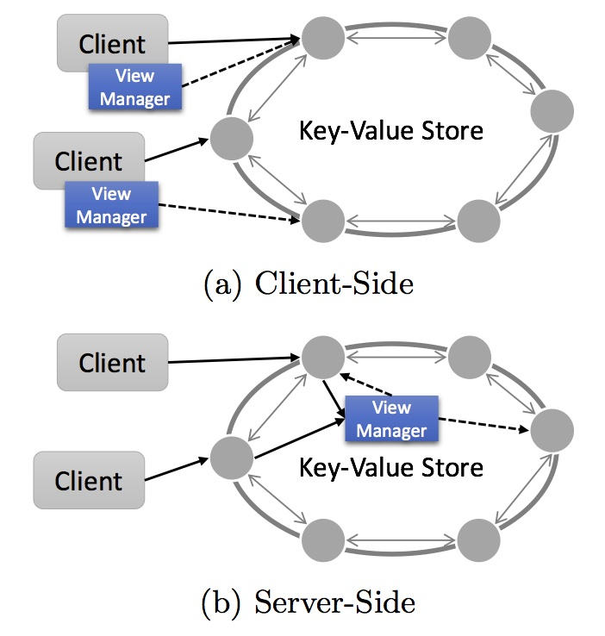
Materializing SQL Queries in Key-Value Stores
Architecture could be either client-side or server-side.
Current architecture is server-side.
Article does not specify on which server node view managers are implemented

Slide 9
Materializing SQL Queries in Key-Value Stores
Weak Consistency : state of view and base table converge eventually.
Hierarchical Views
Strong Consistency : on top of weak consistency ordering of the base table states is preserved in the view.
All other views
Complete Consistency : on top of strong consistency, all base table states are reflected in view table states.

Slide 10
Scalable Transactions across Heterogeneous NoSQL Key-Value Data Stores [A. Dey, A. Fekete, U. Rohm (U of Sydney)]

